Slide 1

Idiom of the Day crystal clear = completely clear and understood example: - Was my question clear? - Yes, crystal clear!

Slide 2



Phrase of the Day = really great very high in quality examples: - It's a top-notch hotel. - The food in this restaurant is top-notch. - I'm feeling top notch today!

Slide 3

not my cup of tea
= used to describe something you don't like, something you can't do, or something you are not interested in.
examples:
- Thanks for inviting me, but shopping isn't really my cup of tea.
- Football isn't my cup of tea. I prefer basketball.

Slide 4


in a nutshell = in a few words; in the simplest way possible; in summary example: - I woke up late. Then, my car broke down, so I had to walk to work. It was raining, and I got wet. In a nutshell, I had a bad morning.

Slide 5

Idiom of the Day
When pigs fly = will never happen
examples:
- I will skydive when pigs fly.
- My parents will let me… when pigs fly.
- I will wake up early tomorrow to clean my room. – Yeah, when pigs fly.
- I will eat… when pigs fly.

Slide 6

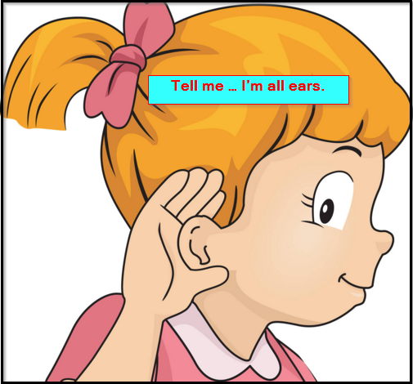
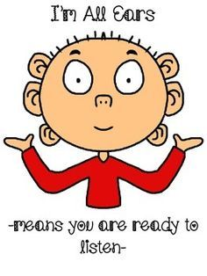
Idiom of the Day
all ears
= ready to listen
examples:
The kids were all ears when I was telling them the story.
- Okay, tell me what the problem is. I’m all ears.

Slide 7

Idiom of the Day
= Good luck!
examples:
- I know you can do it! Break a leg !
- I hope you break a leg at the match tomorrow!
- I'm nervous about singing on stage.
You'll be fine! Go break a leg
out there!

Slide 8

Idiom of the Day not rocket science
= easy, not as difficult as you may think
examples:
- Grammar is not rocket science. Just keep practicing.
- I should be able to do this. It's not rocket science!

Slide 9

out of this world = extremely good examples: - Your apple pie is out of this world! - Your ideas are always out of this world!

Slide 10
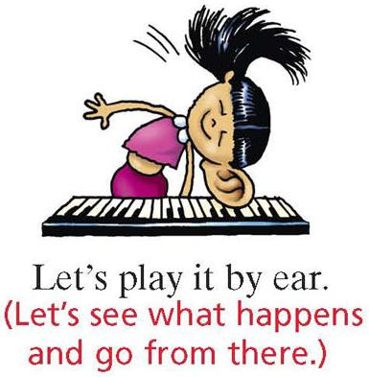
play it by ear = to decide what to do depending on the situation without planning ahead examples: - We’ll see what’s the weather like and play it by ear. - I decided to play it by ear when I went to the interview. - I don't know exactly what I'm going to do this weekend; I'm going to play it by ear.

Slide 11

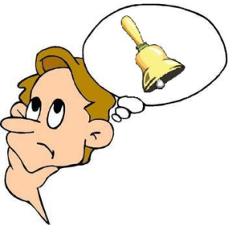
Idiom of the Day
When something "rings a bell", it reminds you of something you have heard before. You don't remember many details but you know it sounds familiar.
examples:
-Her name rings a bell, but I can't remember her face.
- Her name is Anne. Does that ring a bell?
- Do you remember Steve from second grade? Hmm the name doesn't ring a bell with me.

Slide 12

Idiom of the Day
out of the blue
If something happens "out of the blue", it happens suddenly and unexpectedly; without warning; very surprising
examples:
- It was sunny, and the sky was clear for most of the day, but it started raining out of the blue in the evening.
- I was driving at night when out of the blue, a deer jumped in front of my car.

Slide 13
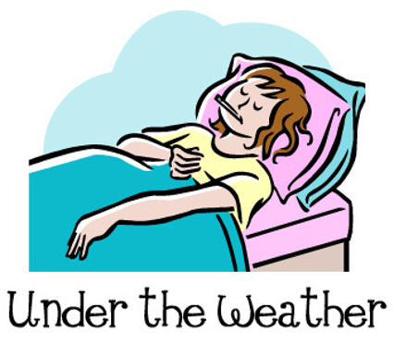
Idiom of the Day
If you say that you are "under the weather", you mean that you feel sick; you don't feel well. A person can be under the weather or feel under the weather.
examples:
- Yeah, I was under the weather last week, but I'm feeling much better now.
- I feel a little under the weather, so I don't think I will go out tonight.

Slide 14
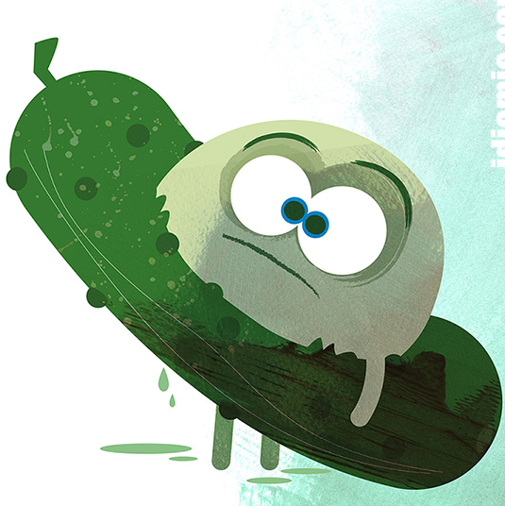
Idiom of the Day
in a pickle
= in a bad situation; in trouble; has a big problem
examples:
I’m in a pickle again. I need your help.
- I lost my wallet! I don’t have money to get a bus ticket, and now I’m in a pickle.

Slide 15

Idiom of the Day
hit the books = to study hard
example:
- The exam is next week. I really have to hit the books this weekend. I want to get an A+!

Slide 16
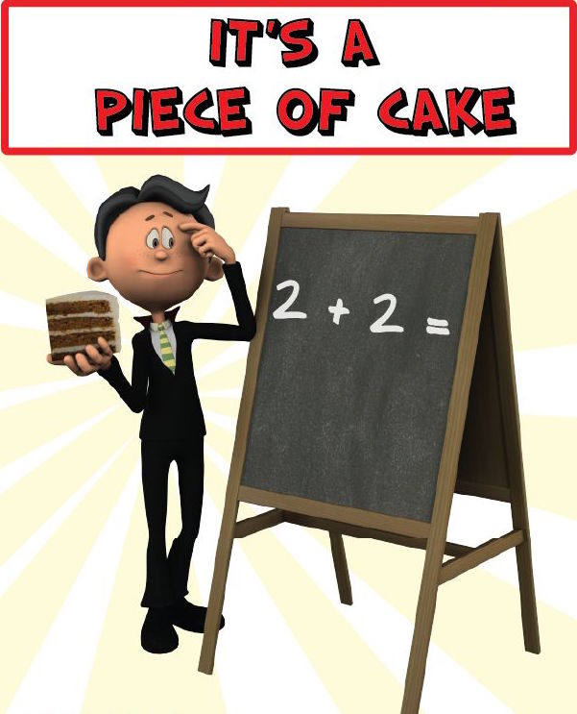
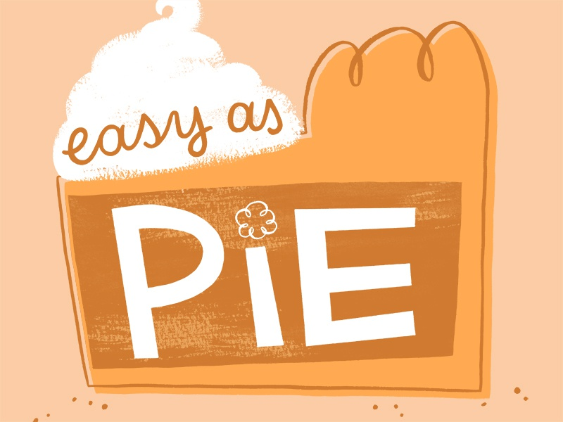
Idioms of the Day piece of cake / easy as pie
= very easy
examples:
Wow, that exam was a piece of cake! I'm sure I'll get a good grade.
I'm sure the test next week will be easy as pie for me. I've been studying for weeks!
I've already finished my homework. It was a piece of cake for me!
- I was expecting the task to be hard, but it was as easy as pie!

Slide 17
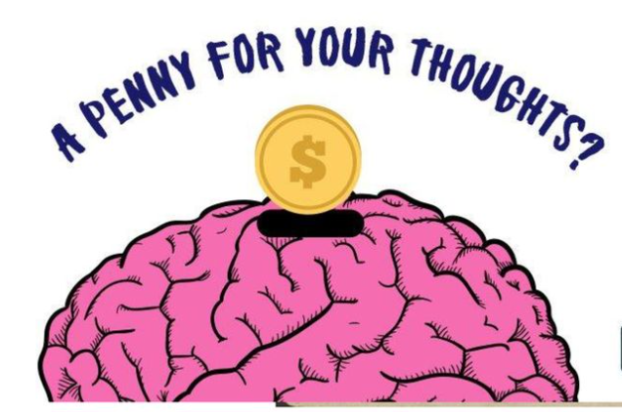
Idiom of the Day A penny for your thoughts = Tell me what you're thinking about.
examples:
- You've been sitting quietly for over an hour. A penny for your thoughts, Adam.
- You look sad. A penny for your thoughts?
-

Slide 18
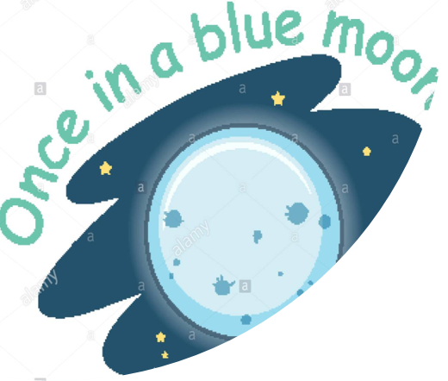
Idiom of the Day
once in a blue moon
If something happens once in a blue moon, it happens very rarely; doesn’t happen often.​
examples:
​
-This kind of chance comes once in a blue moon.
​-My aunt lives in Canada, so I only get to see her once in a blue moon.
-I don't know why I bought that dress. I wear it once in a blue moon.

Slide 19
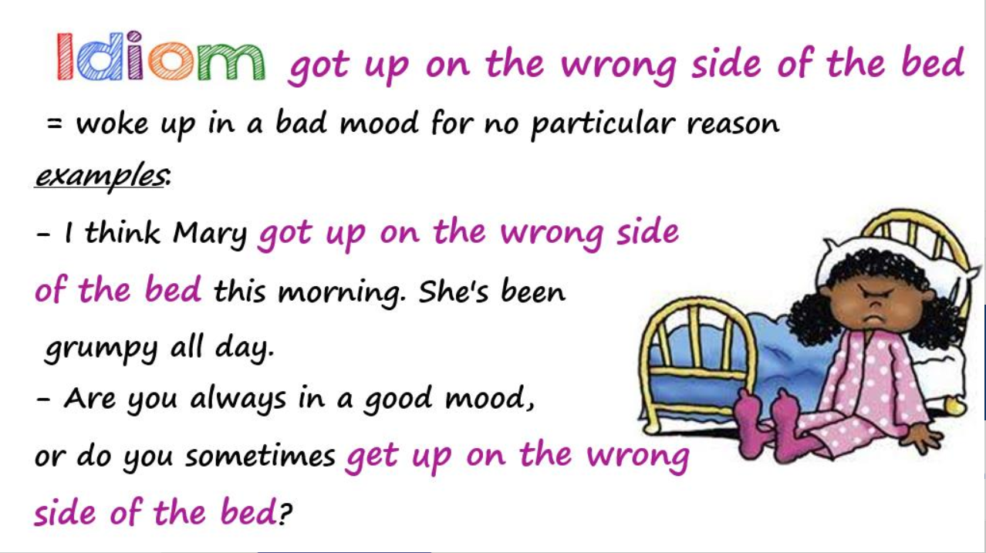

Slide 20

up to (my) neck in something = very busy with something; have too much work to do example: My dad is always up to his neck in work.
Idiom of the Day

Slide 21
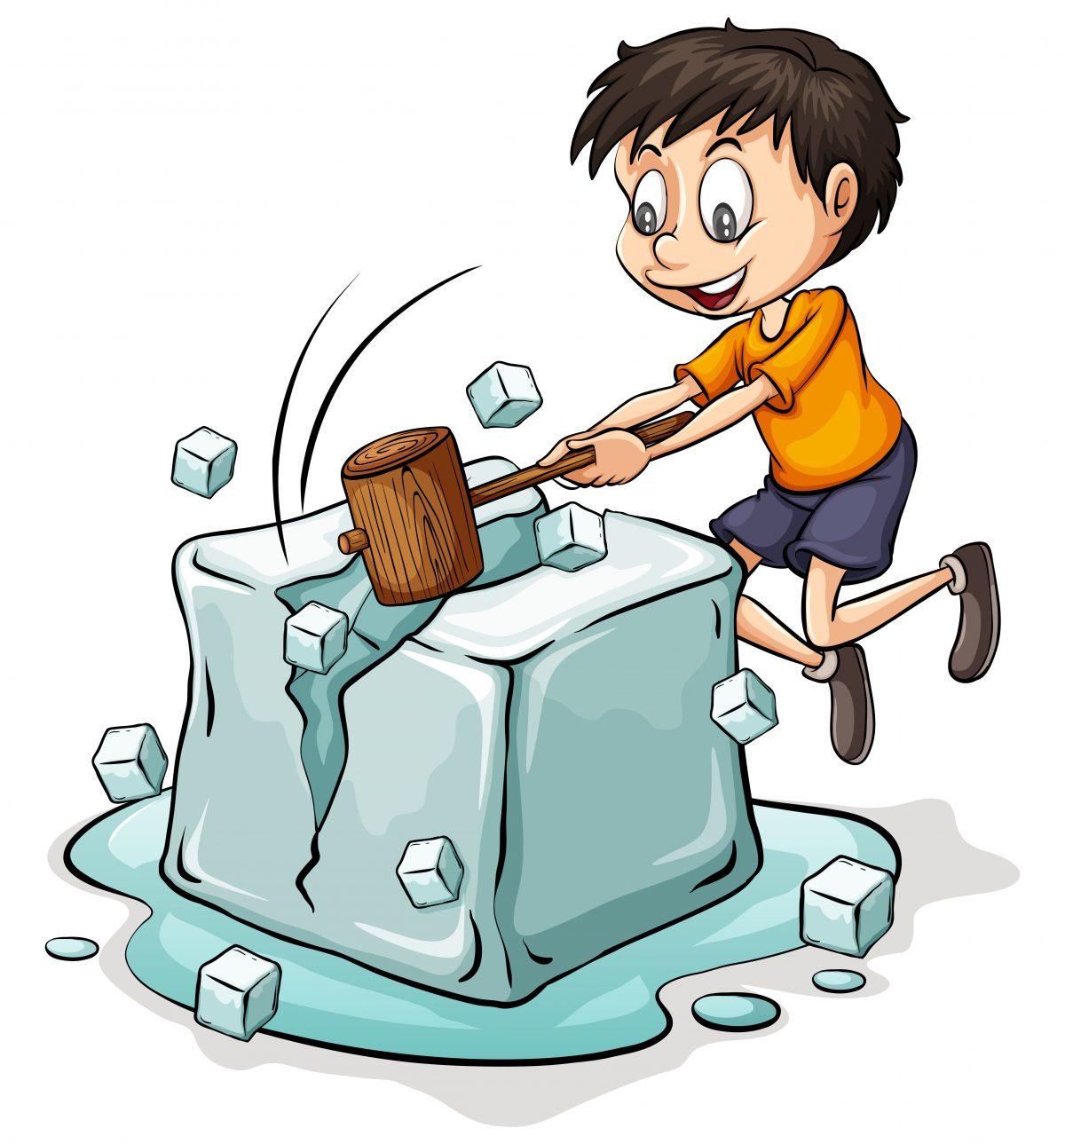

Idiom of the Day break the ice = to say or do something that makes people more relaxed and friendly towards each other
examples:
- Dad always knows how to break the ice and get everyone feeling relaxed.
- Sam started his speech with a joke to break the ice.
- I was nervous on the first day of school, but the teacher broke the ice with a fun activity.
Note: A game, a joke, an activity, or a story that breaks the ice is called an "icebreaker".

Slide 22

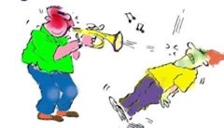
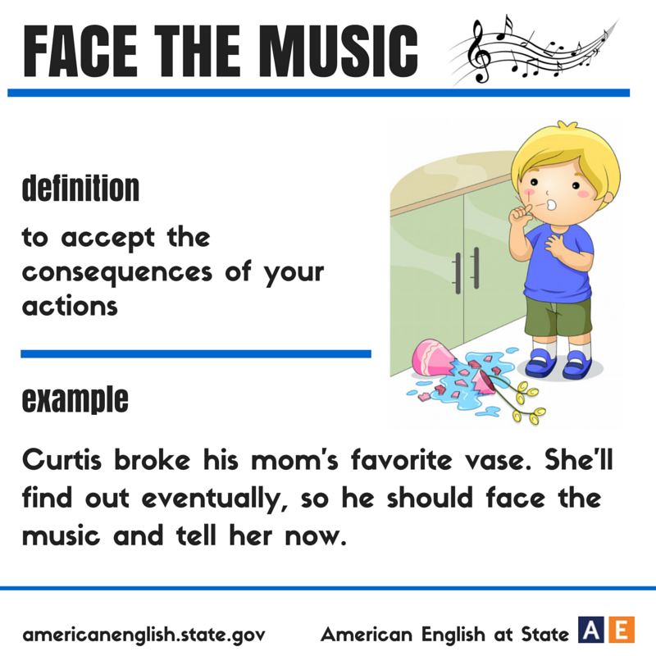
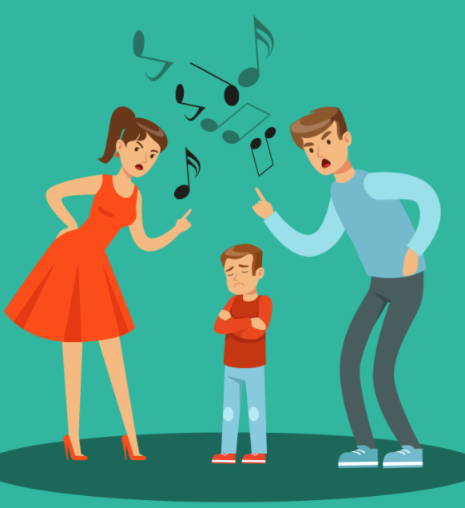
If someone has to face the music, they have to accept the responsibility (or punishment) for something wrong they have done.
examples:
- Chris broke his mom's favorite vase and had to face the music when his mom got home.
- After failing a Math test, Adam had to go home and face the music.
- I have to face the music and tell my parents the truth.
- The teacher caught Elena cheating, and now she must face the music.

Slide 23


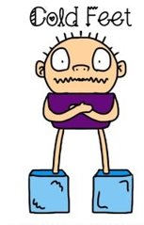
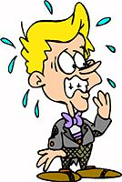
get cold feet = to suddenly become too afraid or nervous to do something
examples:
- I was going to try skydiving, but I got cold feet.
- I heard that many people are attending my presentation tomorrow. I hope I don't get cold feet.
- The thief got cold feet when the dog started barking.
- She got cold feet before her wedding.

Slide 24
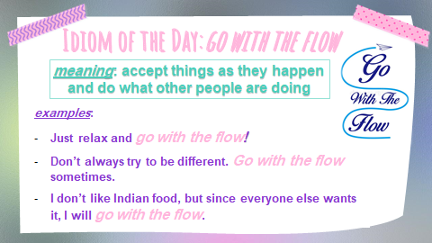

Slide 25
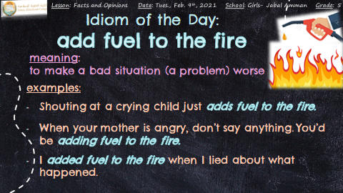

Slide 26
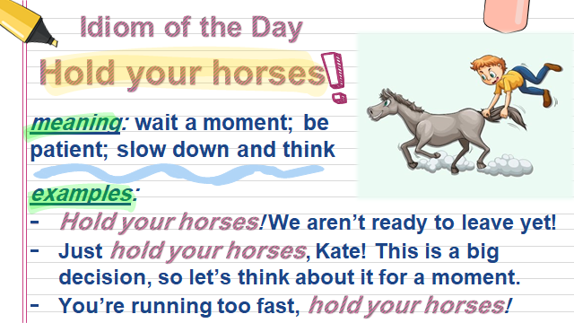

Slide 27
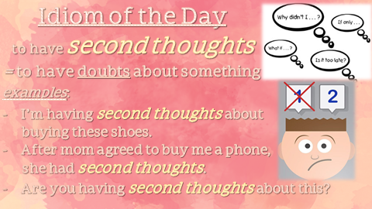

Slide 28
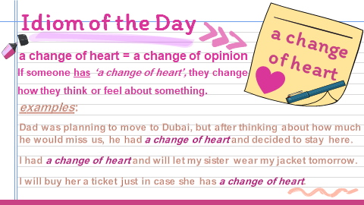

Slide 29
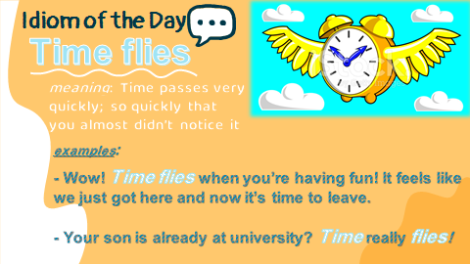

Slide 30
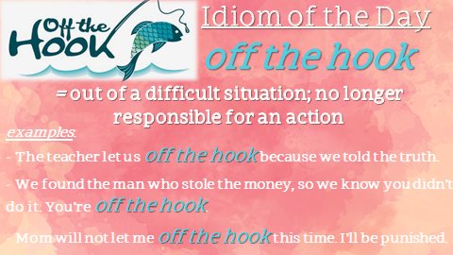

Slide 31
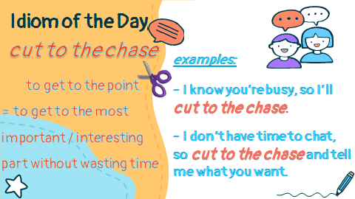

Slide 32
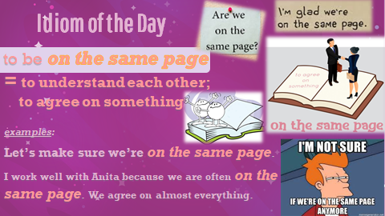

Slide 33
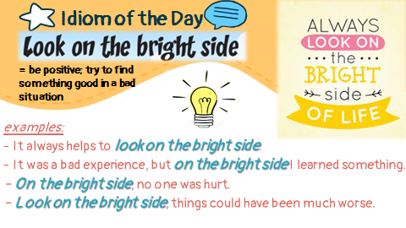

Slide 34
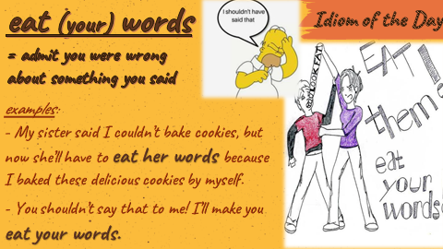

Slide 35
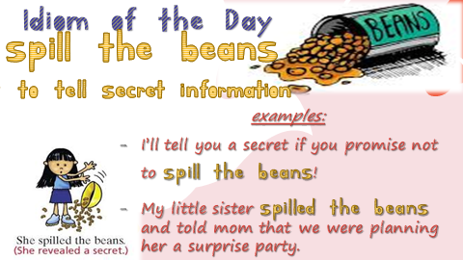

Slide 36


Slide 37
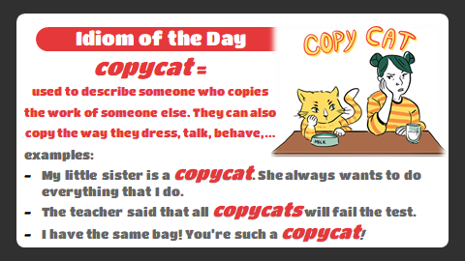

Slide 38
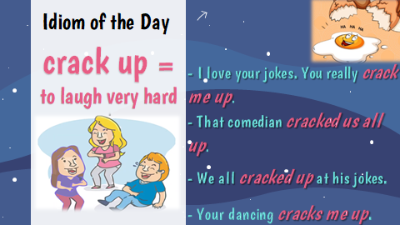

Slide 39
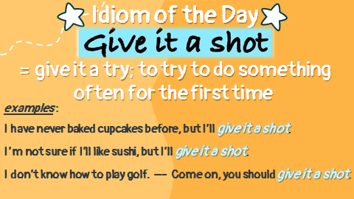

Slide 40
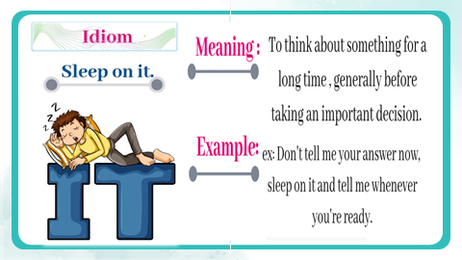

Slide 41
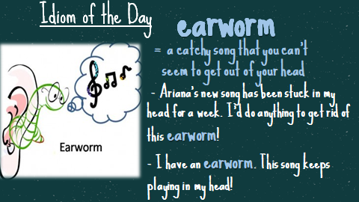

Slide 42
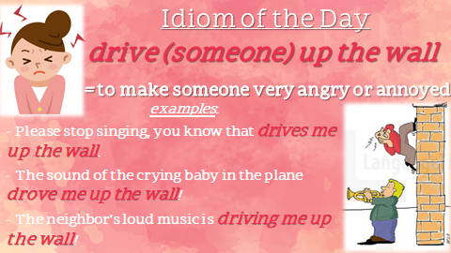

Slide 43
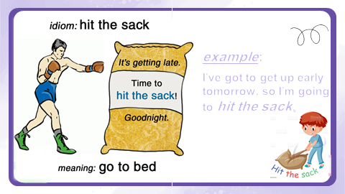

Slide 44
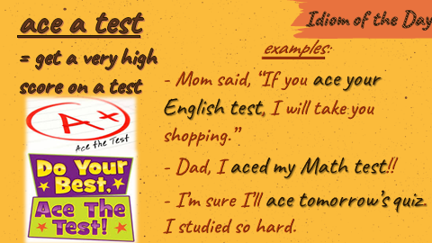

Slide 45
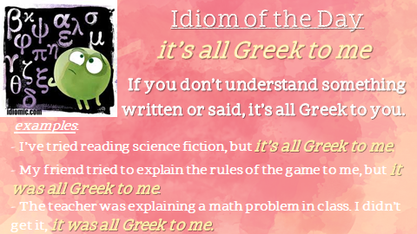

Slide 46
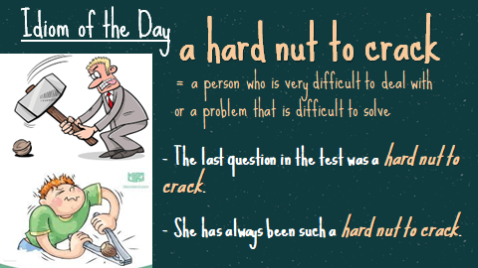

Slide 47
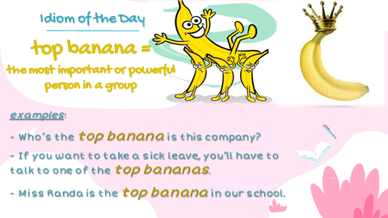

Slide 48
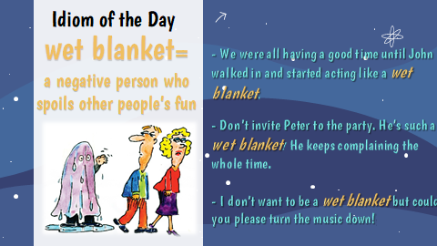

Slide 49


Idiom of the Day over the moon = very happy about something
examples:
- I got my dream job! I’m over the moon right now.
- My parents will be over the moon when they read my report card.
My sister and I were over the moon when we got our new puppy.

Slide 50
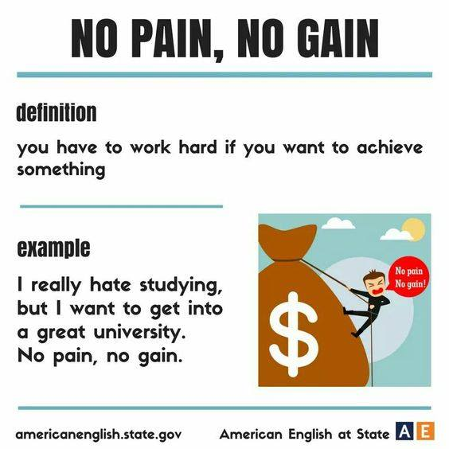
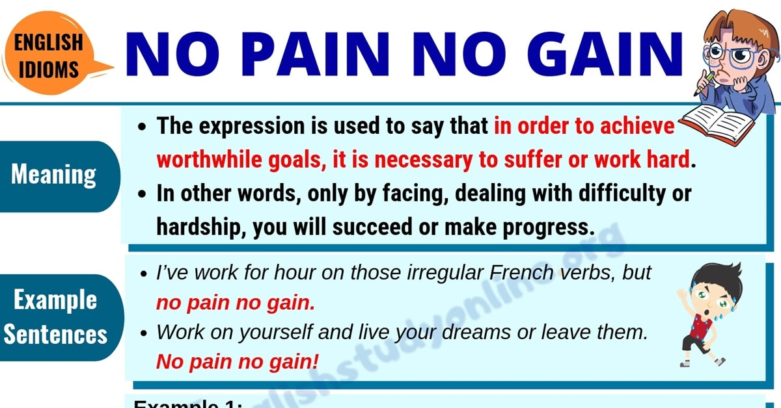
Idiom of the Day No pain, no gain = You have to work hard to get what you want.
examples:
- Studying is really difficult, but I want to get into a great university. No pain, no gain.
I’ve been working for hours on those English idioms…but no pain, no gain!
After a hard practice, our coach reminded us, “No pain, no gain!”
-

