Slide 1
Writing a proposal
3.7

Slide 2
Lesson’s Objectives
To understand the purpose and features of a proposal.
To use linking words and persuasive language.
To work collaboratively to create a group proposal.
To review and give feedback on another group’s proposal.

Slide 3
Task 1
Listen to people talking about their cities.
What changes or improvements do the people suggest for each city? Write the correct letter.
1 e 2 f 3 d 4 c 5 b 6 a

Slide 4
1. What is the main purpose of a proposal? A) To entertain the reader with a story B) To suggest a plan or solution to a problem C) To describe historical events

Slide 5
2. Which part of a proposal explains the current situation and why change is needed? A) Introduction B) Current Situation C) Recommendations

Slide 6
3. Which of the following is an example of formal language suitable for a proposal? A) “I think this is a cool idea.” B) “It is recommended that the school introduces weekly life skills classes.” C) “Maybe students will like it.”

Slide 7
5. What should the conclusion of a proposal do? A) Summarize benefits and persuade the reader to act B) Introduce new recommendations C) List random facts

Slide 8


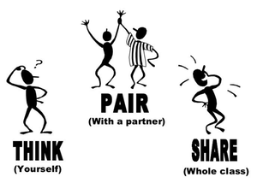

What is proposal writing?
Have you ever tried to suggest a change at school, at home, or with your friends? How did you do it?

Slide 9



Features of a proposal
Task:
use your phones/the board to search for:
The meaning of “proposal writing.”
The purpose of writing a proposal.
Sharing (Kagan – Rally Robin):
Each member in the group shares one idea at a time:

Slide 10


A proposal is a formal piece of writing in which you identify a problem or situation, explain why it is important, and suggest possible solutions or actions. Its main purpose is to persuade the reader to accept your ideas or recommendations.

Slide 11



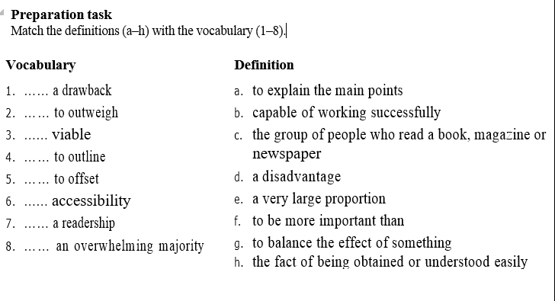
Round Robin

Slide 12
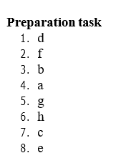
Check your answers

Slide 13
Task : Read the proposal carefully. Then check if the sentences are true or false :
Group Work
1. You should say what the aim of the proposal is in the introduction. | True | False
2. Subheadings should make it easy for the reader to follow the proposal. | True | False
3. It is better not to mention the drawbacks of your proposed solution. | True | False
4. A proposal should be written in a persuasive and personal style. | True | False
5. The passive is a useful structure for writing a proposal. | True | False
6. Your proposal should make clear what you are recommending and why. | True | False

Slide 14
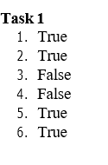
Great job! Show me a thumbs up, high five your partner, or do a happy dance if you got more than 3 correct.

Slide 15
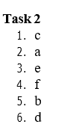
Phrases | Functions
…… It is proposed that … …… This proposal intends to outline … …… One issue is … …… A change to a digital format is therefore recommended … …… It draws on the views of 3,000 students surveyed in May. …… The key benefits would be … | Stating the aim of the report Saying what information the report is based on Proposing a solution Justifying a solution Recognizing the disadvantages Concluding

Slide 16
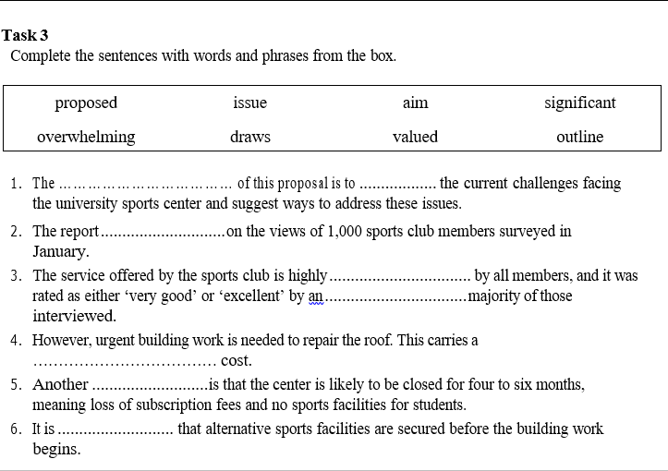

Slide 17
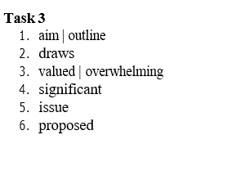

Slide 18
Features of a Proposal
Title – a short, neutral heading that clearly shows what the proposal is about.
Introduction – explains the issue and why it is important.
Aim – states what the proposal hopes to achieve.
Current Situation – describes what is happening now and why change is needed.
Recommendations – gives clear suggestions for improvement with reasons.
Conclusion – summarizes the benefits of the recommendations and persuades the reader to act.
Formal Language – uses polite, formal, and persuasive expressions.
Linking Words – connects ideas (e.g., as a result, the result of this is that, resulting in, leading to improved outcomes).

Slide 19

Linking Words Revision
Classify the following linking words into their categories

Slide 21

Differentiation /Real Life Application
Task: Proposal on Junk Food in the Canteen
Question for the whole class: Our school canteen sells a lot of junk food. How can we solve this problem and encourage healthier eating?
Each student completes one differentiated task. At the end, the group puts all parts together into a full proposal.

Slide 22
Member 1 : Write 2–3 sentences to introduce the issue.
Guiding question: “Why is junk food in the canteen a problem? What is the aim of this proposal?”
Sentence starter: “This proposal aims to show that junk food in the canteen is a problem because …”
Member 2 Task: Describe the situation now.
Guiding question: “What do students usually eat from the canteen? Why is it not healthy?”
Sentence starter: “At present, many students … which leads to …”
Member 3 Task: Suggest at least two clear solutions.
Guiding question: “What should the school do instead of selling junk food?”
Challenge: Use linking words (as a result, the result of this is that, leading to improved health).
Example: “I would recommend that the canteen should … Another suggestion would be to …”
Member 4 Task: Summarize the proposal and persuade the reader.
Guiding question: “What are the benefits if we follow these recommendations?”
Sentence starter: “In conclusion, these suggestions would … resulting in … and leading to …”

Slide 23
Final Step (Collaboration)
Each group puts all 4 parts together → one complete proposal.
They check: Does it have Title, Introduction, Current Situation, Recommendations, Conclusion?
Share proposals with the class (each member reads their section).

Slide 24
Now it’s time to share your work! Each group will switch proposals with another group. Read the other group’s proposal carefully and use the peer review checklist to give them feedback.
✅ Check if they have all the parts (introduction, current situation, recommendations, conclusion). ✅ Look at the language – did they use linking words like as a result or leading to? ✅ Give one positive comment (‘What we liked…’) and one suggestion (‘What could be better…’).

Slide 25
Peer Review Criteria for Proposal Writing
When you receive another group’s proposal, read it carefully and check the following:
Introduction – Does the proposal clearly introduce the problem of junk food in the canteen?
Current Situation – Is the present problem described in detail (what students eat, why it is unhealthy)?
Recommendations – Are there at least two clear and realistic suggestions for solving the problem?
Conclusion – Does the conclusion summarize and persuade the reader about the importance of the recommendations?
Organization – Is the proposal structured in order (introduction, current situation, recommendations, conclusion)?
Language – Are linking words, persuasive phrases, and correct grammar used?
How to Assess
If the criterion is met → put a ✅ If it needs improvement → put a ❌ and write a short comment or suggestion.

Slide 26
Sample
Title Improving Student Engagement in Classroom Learning
Introduction Student engagement plays a crucial role in achieving better learning outcomes. When students are actively involved in lessons, they develop stronger skills, perform better academically, and stay motivated. The aim of this proposal is to recommend practical strategies to enhance student engagement in the classroom.
Current Situation At present, many students show low levels of participation during lessons. Some are hesitant to contribute, while others become distracted easily. Although teachers use various methods, these strategies are not always effective in maintaining student interest. This situation highlights the need for changes that can make lessons more interactive and meaningful.

Slide 27
Recommendations I would recommend that teachers integrate more collaborative learning activities, such as group discussions and peer-to-peer teaching. This would enable students to share ideas, learn from one another, and develop their communication skills. It would also mean that students could feel more confident expressing their opinions in a supportive environment.
Another suggestion would be to make greater use of digital tools and interactive resources, such as quizzes, polls, and educational apps. This would encourage active participation and make learning more enjoyable. It would also mean that lessons could cater to different learning styles and keep students engaged throughout the class.
Conclusion By adopting these recommendations, teachers can create a more dynamic and engaging learning environment. Collaborative activities and digital tools will not only improve student motivation but also enhance their academic performance and confidence. It is therefore strongly recommended that these strategies be implemented to support both teachers and students in achieving greater success.

Slide 28

Exit Ticket: Proposal Writing
Instructions: Answer the following questions in 2–3 sentences.
What is the purpose of a proposal?
Name one feature of a good proposal.
Write one phrase or linking word you can use in your recommendations (e.g., as a result, leading to…).
What is one thing you did well today in writing your proposal?

