Slide 1
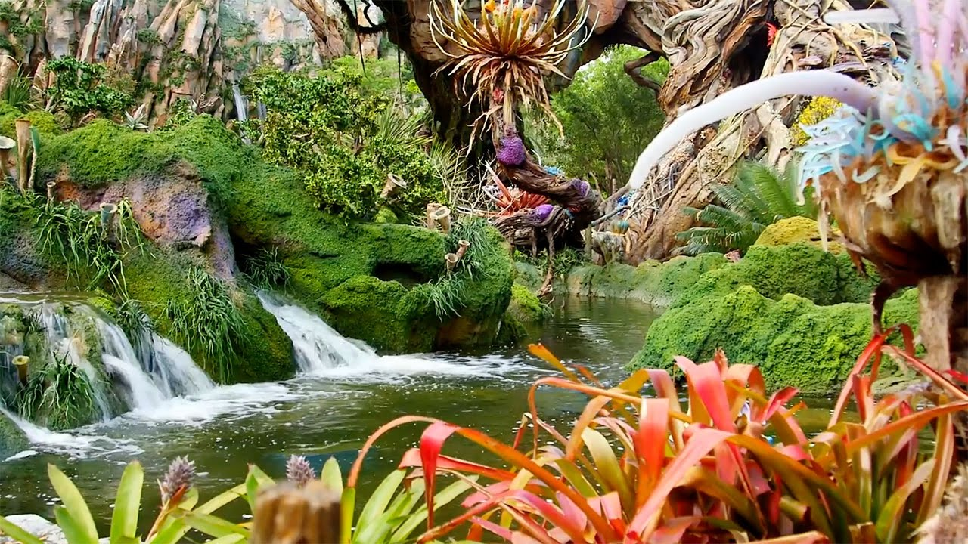
How does the natural world affect us?

Slide 2
Title: How Does the Natural World Affect Us?
Outcomes:
Answer the big question and relate ideas to what the students already know.
Recognize the meanings of the new words

Slide 3
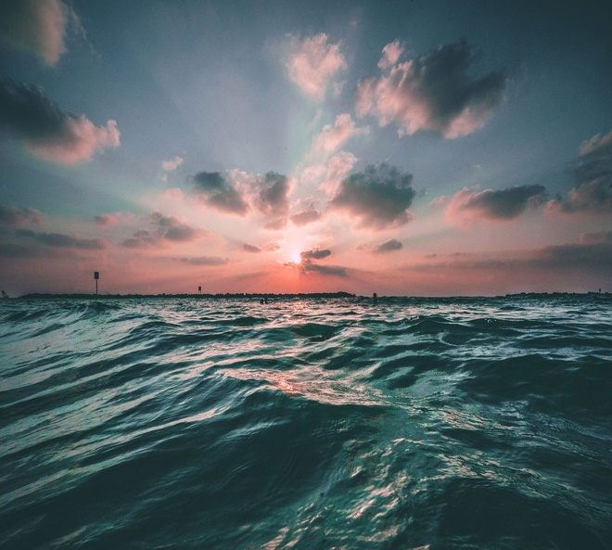
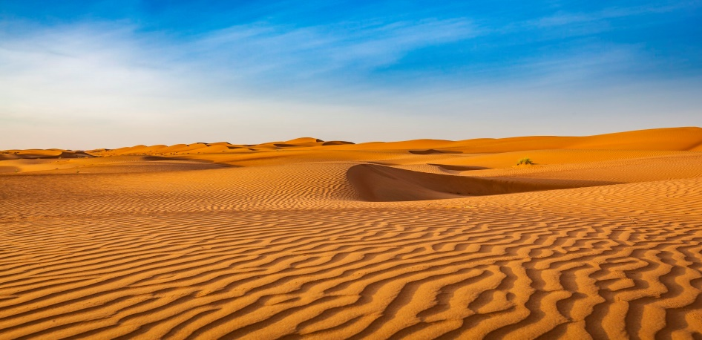
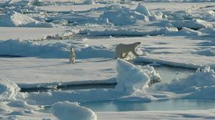
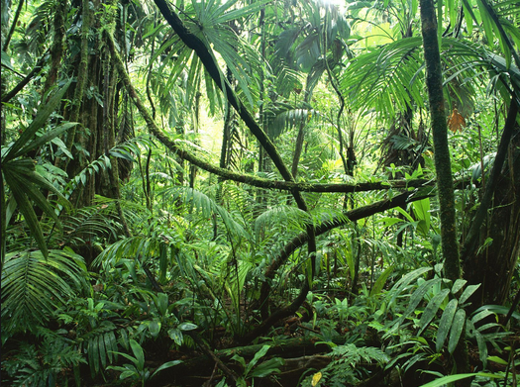
What are these?

Slide 4
Circle the correct answer.
1. A science article is a piece of -- work.
a. fiction b. nonfiction c. poem
2. Ecosystem consists of -------------things.
a. living b. nonliving c. living and nonliving

Slide 5
Have you ever been to a forest? A beach? What living and nonliving things did you see there?

Slide 6
What do you already know about each place?
Forest | Desert | Beach

Slide 7
What is an ecosystem?
Ecosystem is a group of living things and nonliving things in the environment they live in.
An informational text is a piece of nonfiction writing that might appear in a magazine, in an academic journal, or on the internet. Science articles concerned with facts that can be observed or proved. In this article, you will learn some basic facts about ecosystems and how they work.

Slide 8
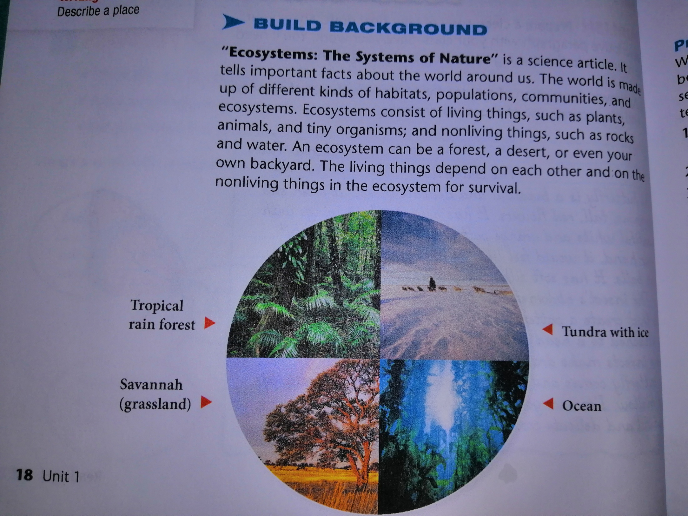

Slide 9
Watch the video about a mountainous area in Scotland( Cairngorm) and answer the questions.
Why do hundreds of hikers and climbers get lost ?
2. What are some of threatening situations?
3. What do they do to be safe in that area? Why?
4. How can the natural world affect us positively and negatively?

Slide 10
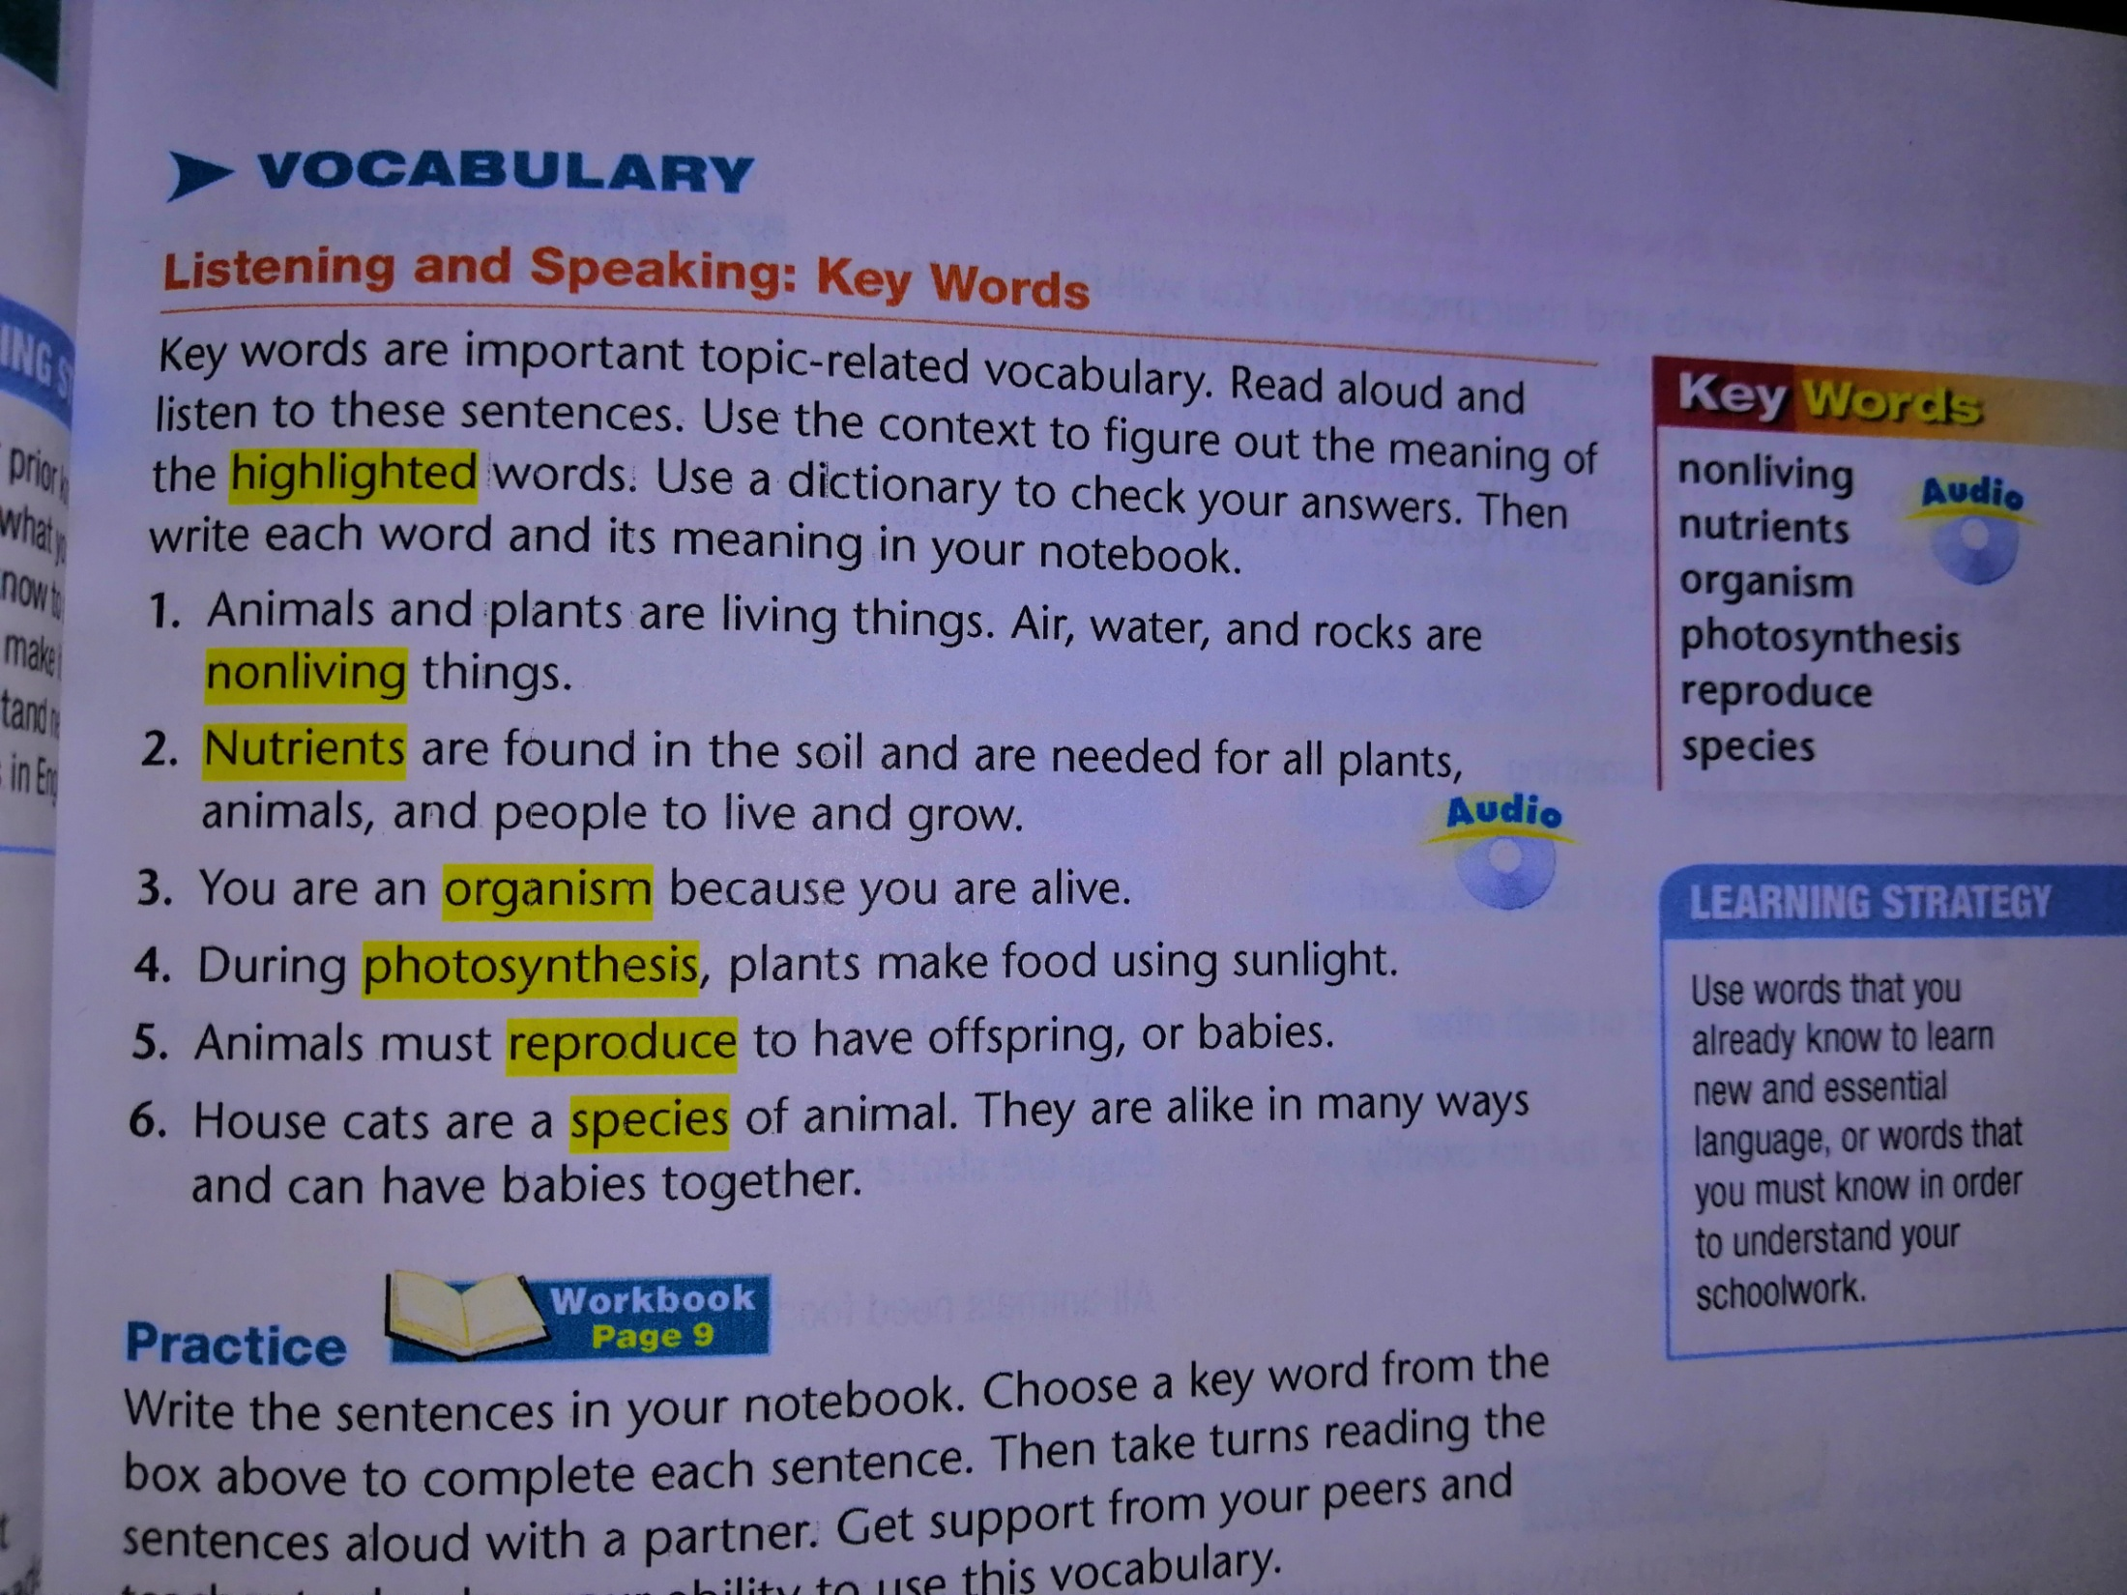

Slide 11
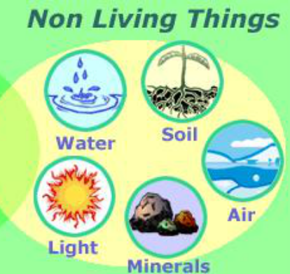
Nonliving:(adj) not alive.
Nonliving things don’t breathe.

Slide 12

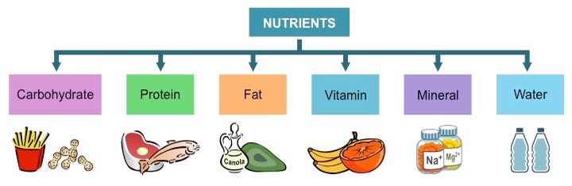
Nutrients:(n.) vitamins and minerals that help an organism stay healthy.
Nutrients:(n.) If you want to know the nutrients in a box of food, look on the side of the box.

Slide 13
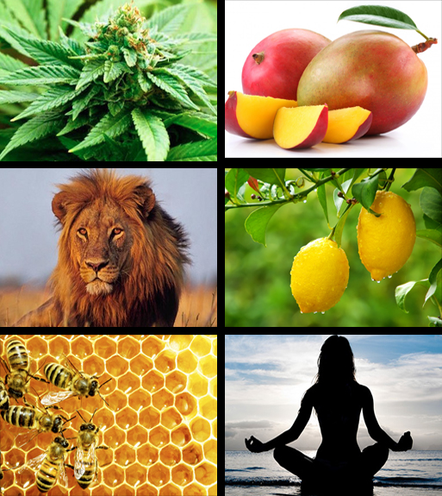
Organism:(n.) a living thing.
Plants and animals are organisms.

Slide 14
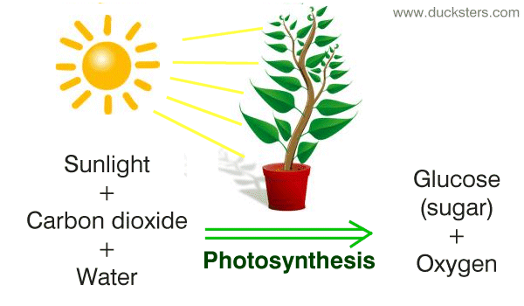
Grade: 7
Page279
photosynthesis: (n.) process which plants make food from water, light, and carbon dioxide.
Plants need sunlight for photosynthesis.

Slide 15
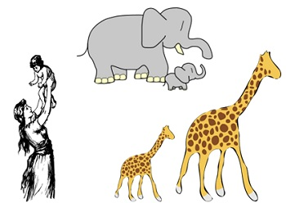
reproduce: (v) to produce new individuals.
reproduce: (v) Some animals reproduce by having babies.

Slide 16
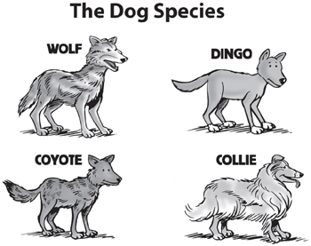
Species: (n) a category of living things that can reproduce with each other.
Species: (n) All dogs are in the same species.

Slide 17
Practice: S.B.P. 19
Choose the correct word from the box to complete each sentence.
( nonliving, nutrients, organism, photosynthesis, reproduce, species)
1. Dogs can have puppies together because they are the same -----------.
2. The natural world is made up of both living and --------------------- things.
3. A whale, like an ant, is an ---------------, or living thing.
4. The -------------- in the soil help plants grow.
5. Plants make food by a process called ---------------.
6. Rabbits and squirrels cannot -------------- because they belong to different species.

Slide 18
A collocation: is two or more words that often go together.
Radio force glass file labor sauce station computer
door school have ready
force tomato high make
get meal noise

Slide 19
Words in Bold are NOT English. Find Synonyms of the words in bold.
1. You need to gft food to stay healthy.
2. We can protect the wkuyre by recycling.
3. In the classroom, the teacher retads with students.
4. Camels can kjdjhh long period of time without water.

Slide 20
Academic Words
S. B. P. 20
Listen and repeat the words.
consume
environment
interact
survive

Slide 21
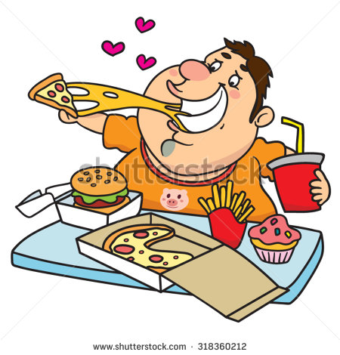
consume:( v) eat or use something.
Sanad likes to consume healthy food.

Slide 22
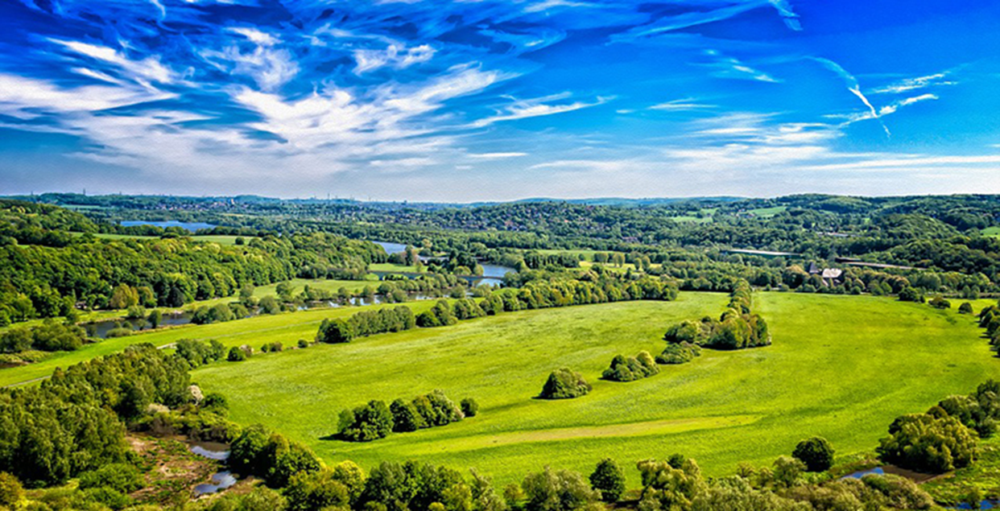
environment: ( n) the world of land, sea, and air that we live in.
Can you describe your school environment?

Slide 23
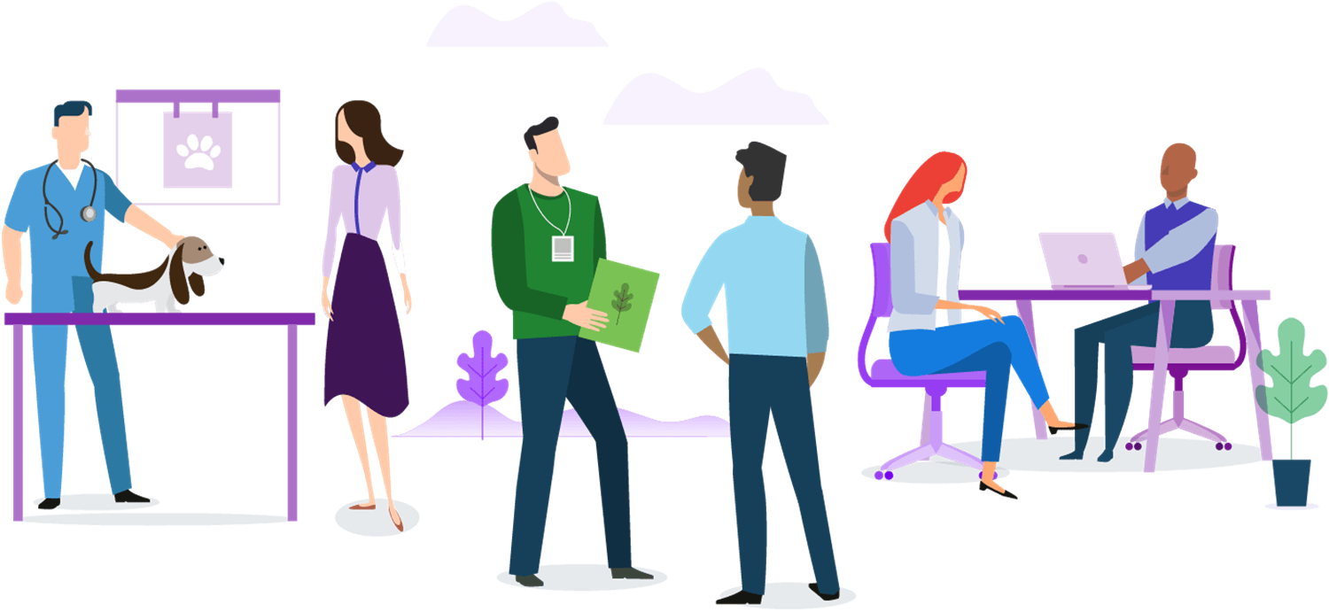
interact:( v) have an effect on each other.
students interact in the classroom .

Slide 24
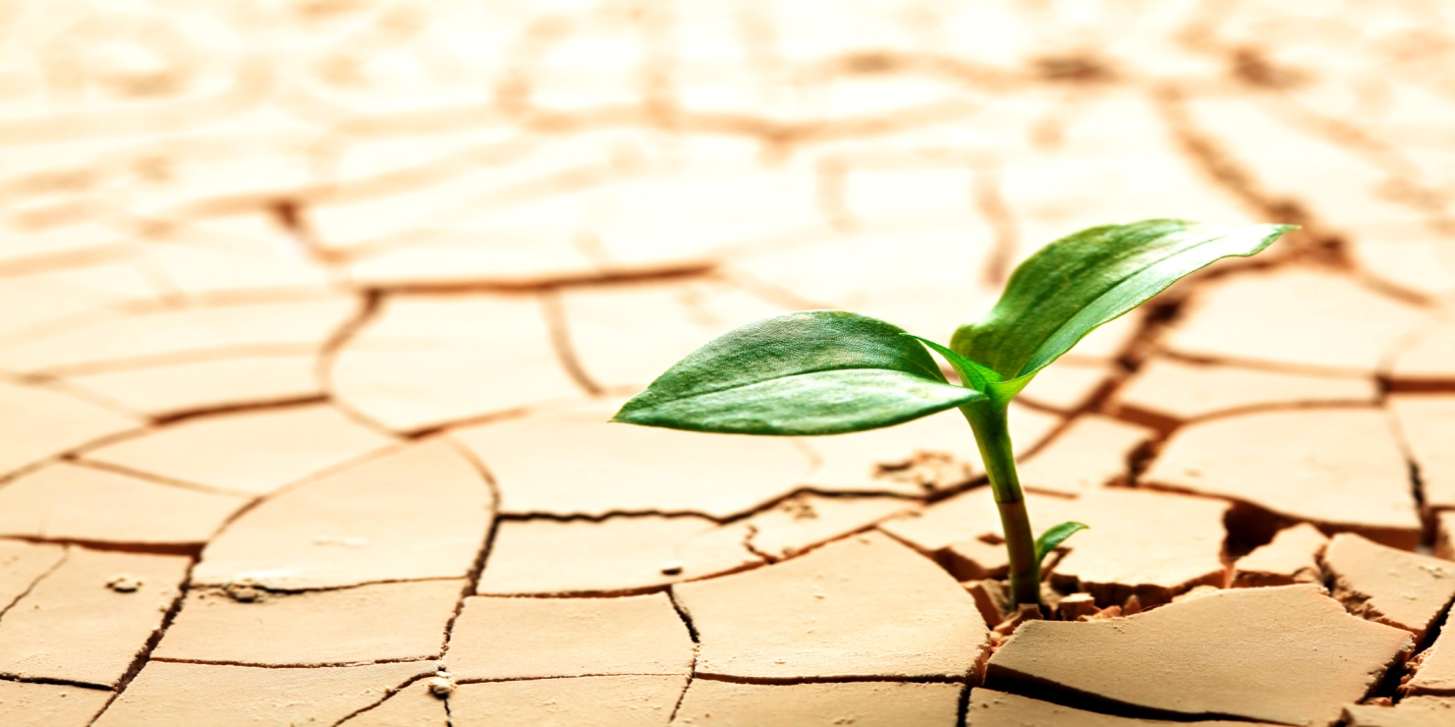
survive:( v) continue to live.
People need food to survive.

Slide 25
Practice: S.B. P. 20
Answer the following questions. Try to include the bolded words in your answers.

Slide 26
1. What kind of food does a bird consume? 2. What can people do to protect the environment? 3. How do dogs interact with humans? 4. What does a plant or animal need to survive in the desert?

Slide 27
Here are some suggested answers.
A bird consumes seeds.
People can protect the environment by recycling.
Pet dogs interact with people by playing with them.
Plants and animals that live in the desert need some way of retaining water and need to have skin that isn’t harmed by the sun.

Slide 28
1. Write complete sentences using the following words.
1. interact (v.): ________________________________________________________
2. species: (n.) ______________________________________________________
2. Write a synonym of the underlined phrases below.
My food contains lots of vitamins and minerals that help me remain healthy.
My food contains ____________________that help me remain healthy.
2. Camels eat cacti and other desert vegetation.
Camels _________________ cacti and other desert vegetation.
**********************************************************
3. Circle the suitable form of the word.
1. My students can easily (interact / interaction) with different types of people.
2. Omar’s (interaction /interact) with people of different ages makes him sociable.
3. We can help save the (environment /environmental) by keeping it clean.
4. Mohammad and Talal want to participate in many (environment / environmental) activities that will be held in school.
********************************************************************
4. Write the antonym of:
1. nonliving ≠ ________________ 2. survive ≠ __________________

Slide 29
/9 Title: Reading comprehension
Outcomes:
1. Read for specific information.
2. Recognize the meanings of the new words.
3. Answer reading and critical thinking questions.

Slide 30
Reading Summary
The reading selection is about ecosystem. It focuses in animal habitat and communities and on the role each living thing plays in an ecosystem.

Slide 31
Ecosystem The systems of Nature
Purpose for reading:
To recognize how do living things depend on their natural environment to survive.
2. What is the genre?

Slide 32
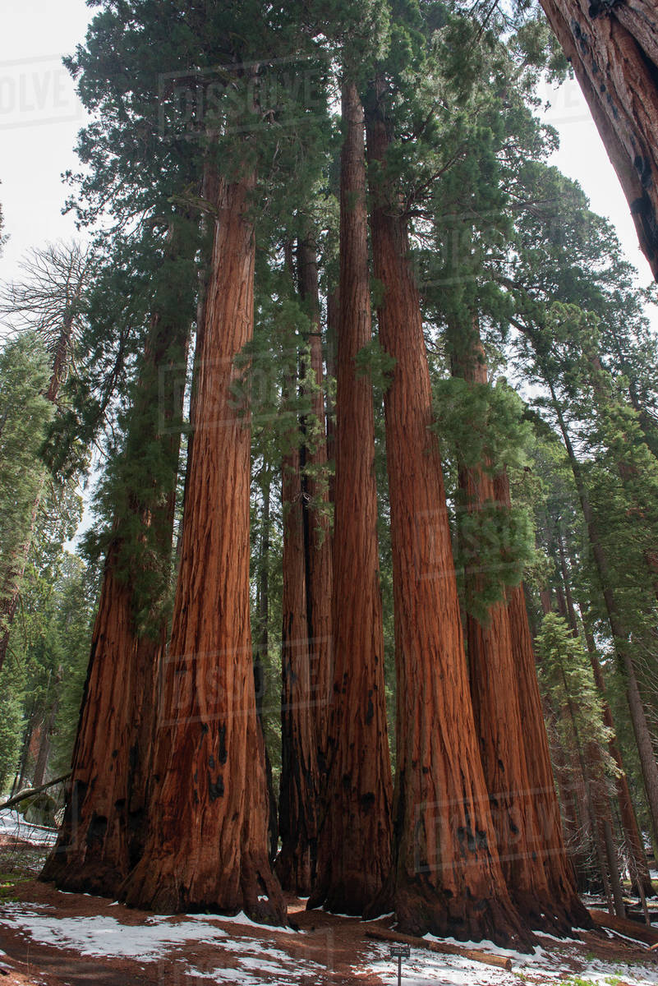
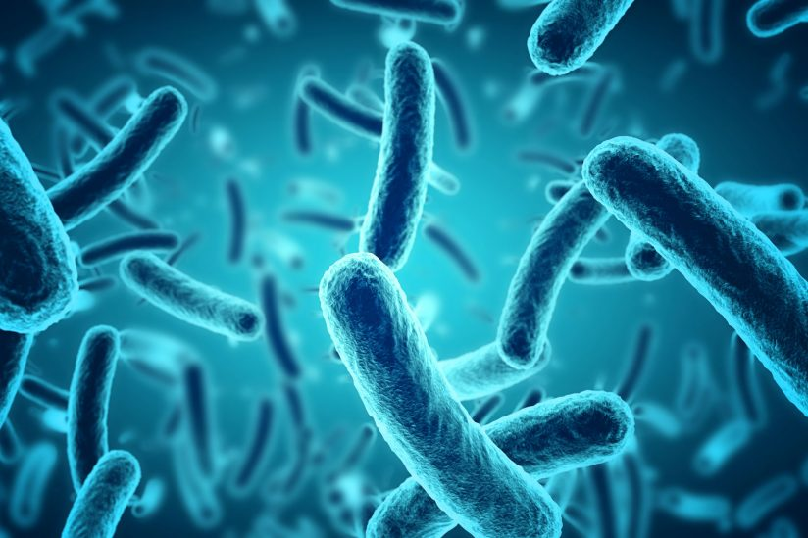
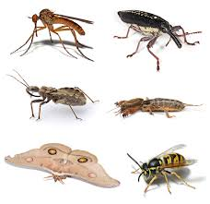
P. 22 Organisms and Species
Give examples of organisms?

Slide 33
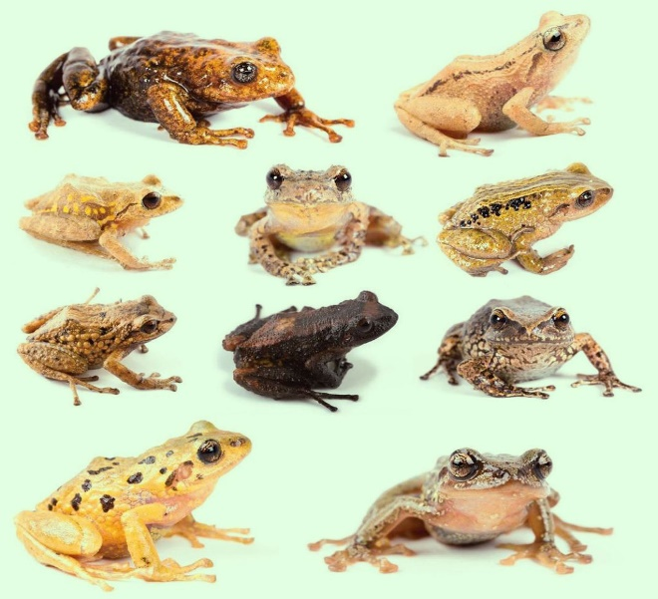
2. What is a species? 2. What are the features of species? 3. Can cows and horses have offspring? Why? Critical Thinking 4. What would happen if a species can’t have offspring?
P. 22

Slide 34
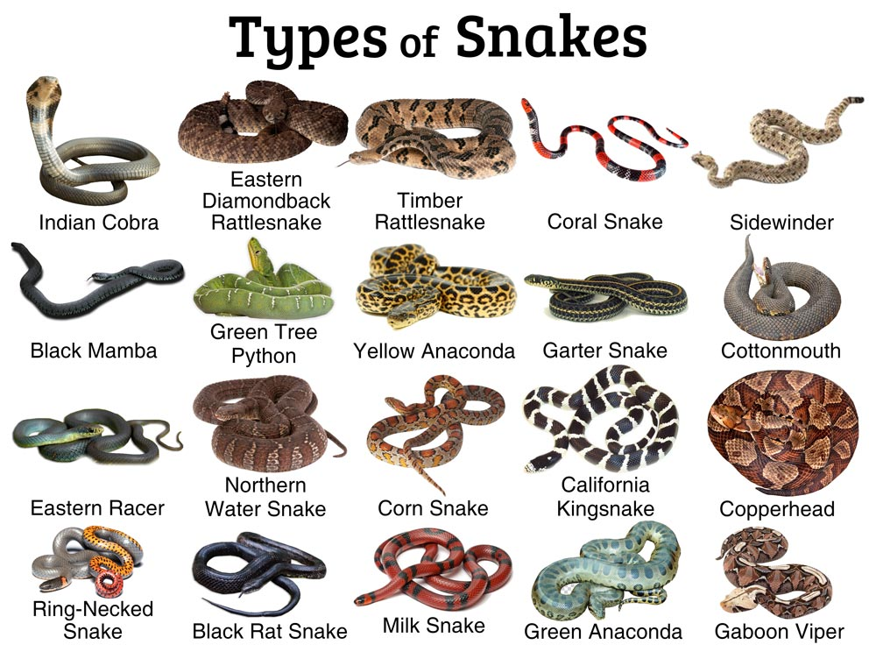
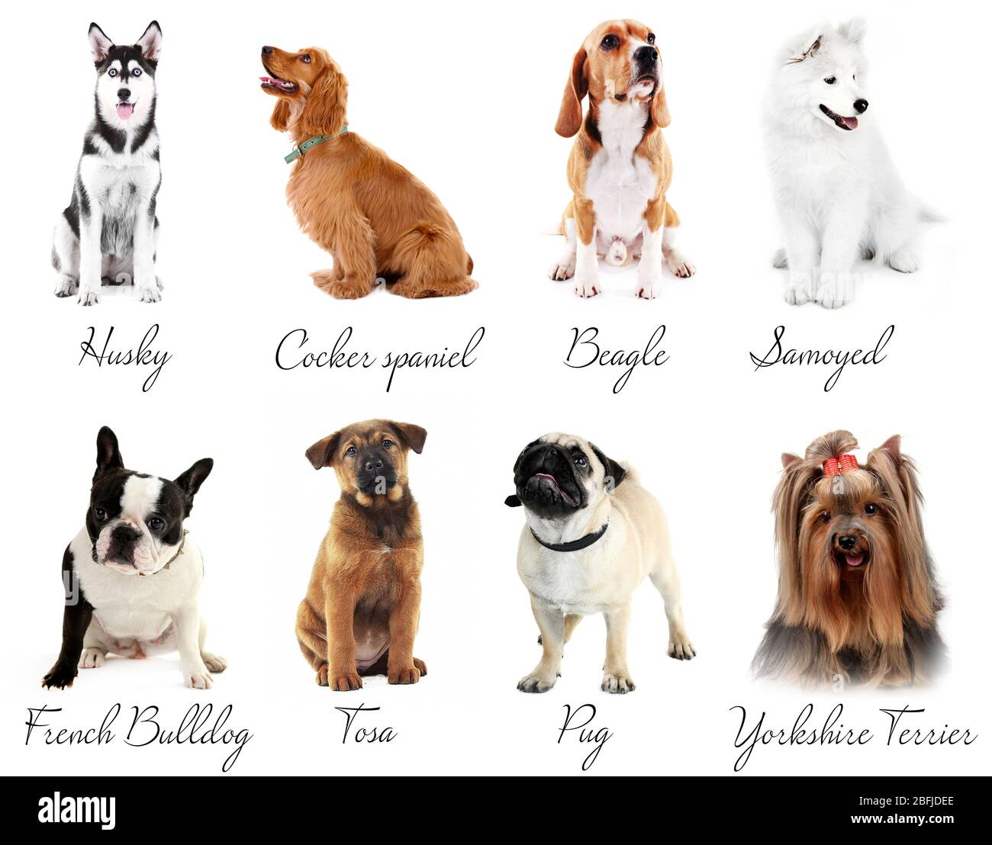
Species

Slide 35
P. 23 Habitats
Where do ( camels/ fish/ lions) live? What do they need to live in their places?
What is a habitat?
2. Why do you think a habitat is important for all organisms?
3. Give an example of a big & small habitat?

Slide 36
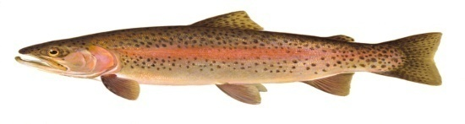
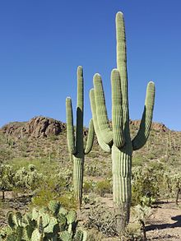
4. Why do different organisms live in different habitats? 5. What is the habitat of 6. Give an example of an organism that lives in different habitat.

Slide 37

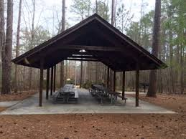

Slide 38
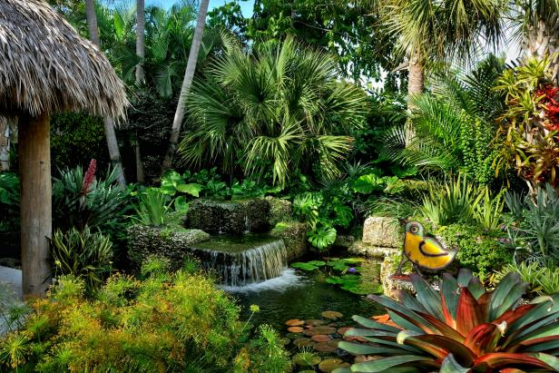
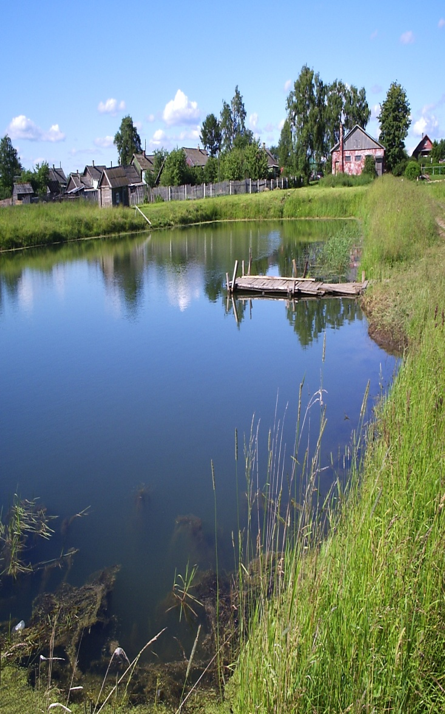

Slide 39
Challenge Words and Terms P. 23
Find a word from the text that means
1. give--------------
2. Suitable to live:-----------------------------
3. Water that is not salty:-----------------------------------

Slide 40
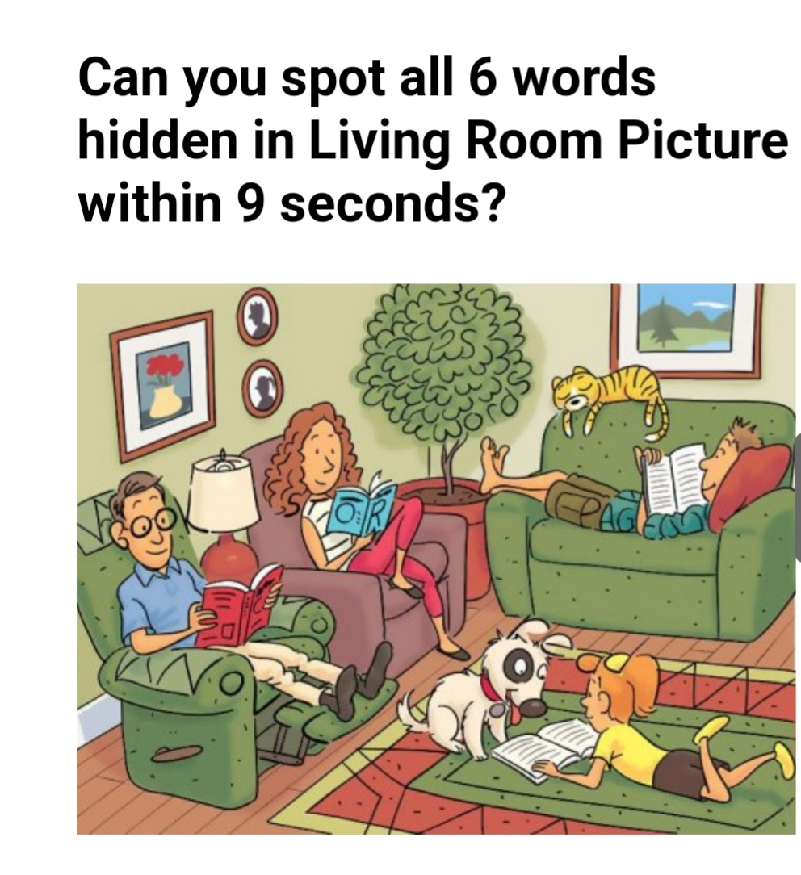

Slide 41
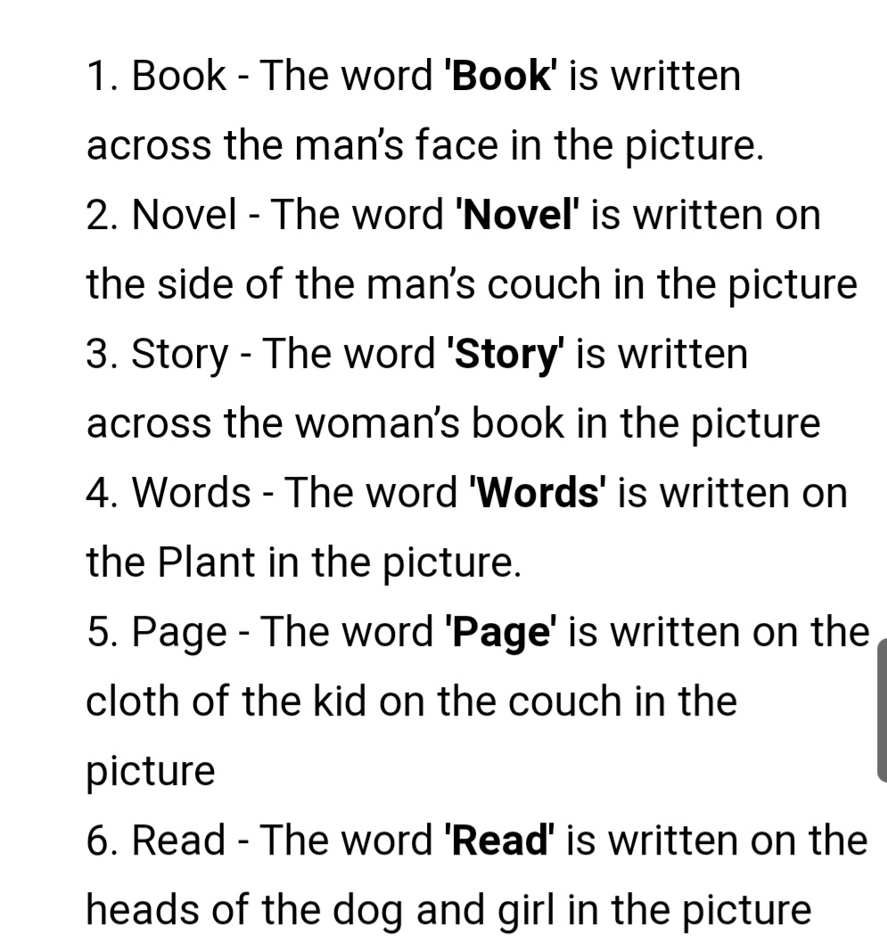

Slide 42
Before You Go on S. B. P. 23
An organism is a living thing. One example is a bird.
2. A species is a group of animals that are alike in many ways and can reproduce together.

Slide 43
On Your Own P. 23 What is your habitat?

Slide 44
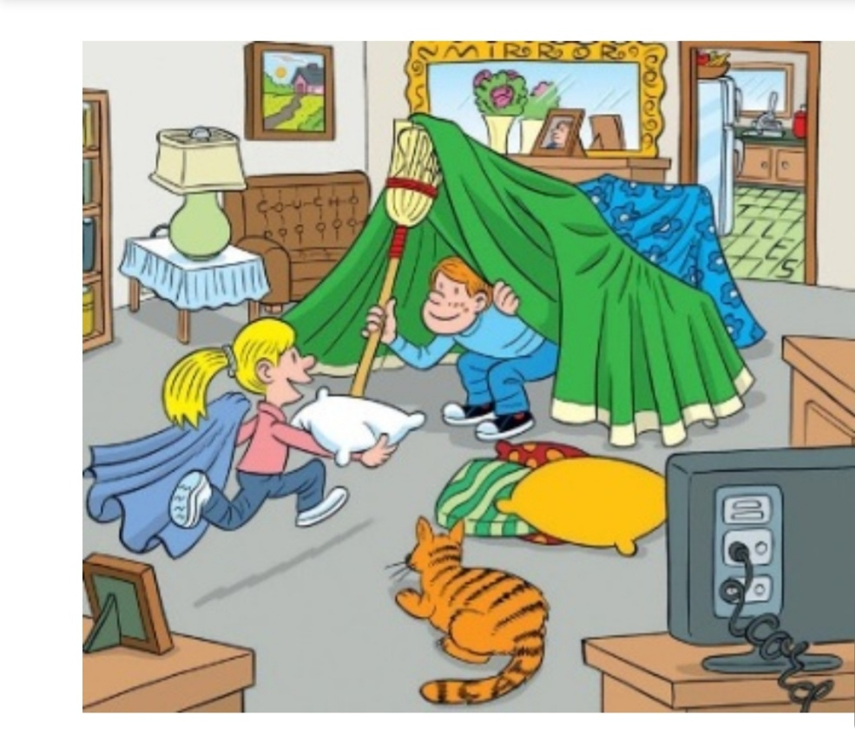

Slide 45
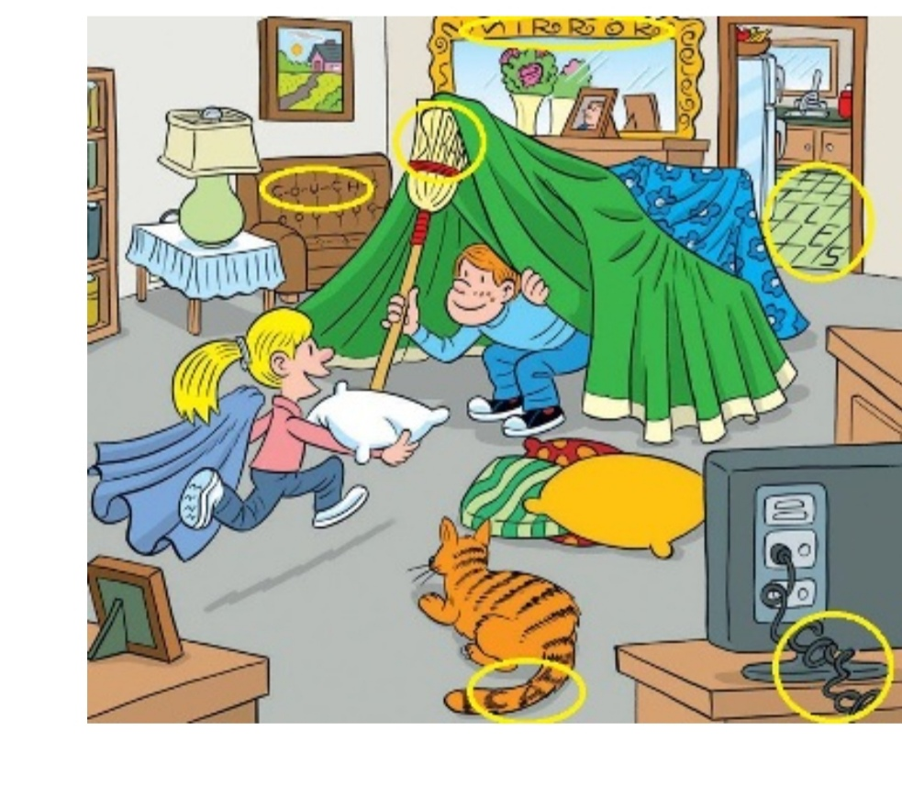

Slide 46
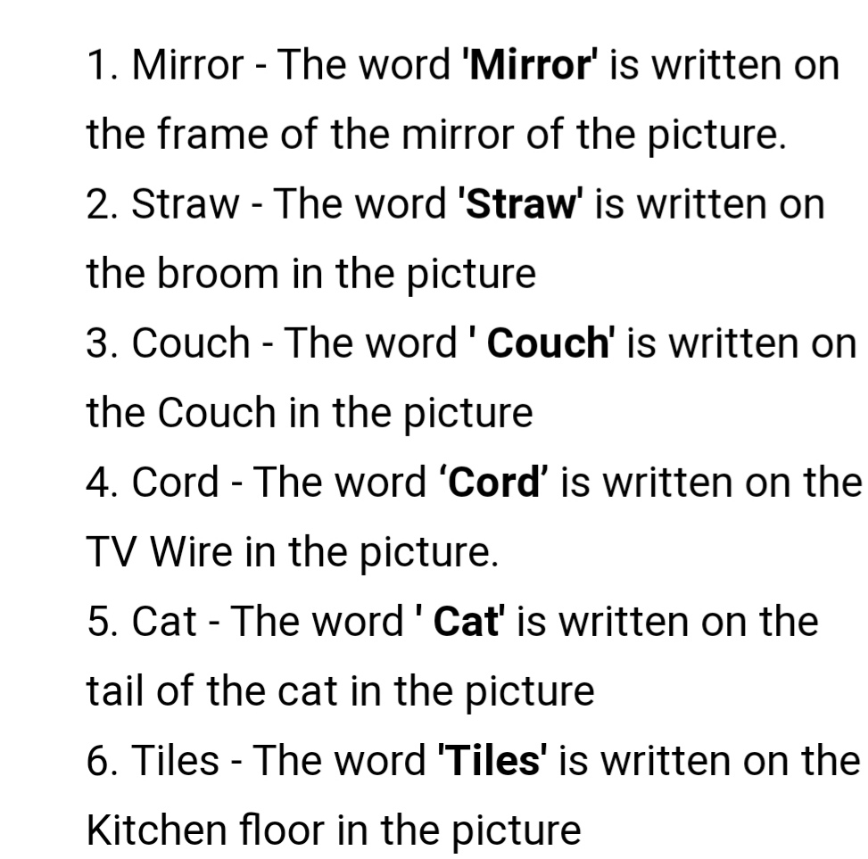

Slide 47
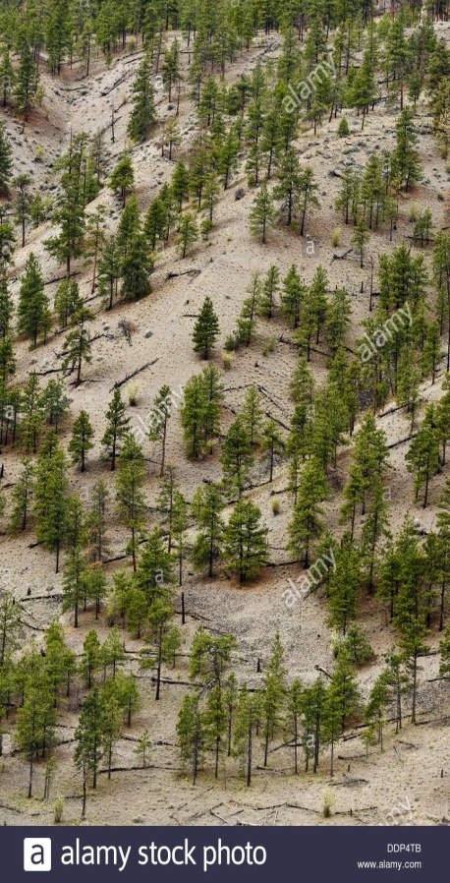
P. 24 Populations and Communities
How many people are there in Jordan?
What is a population? Do they stay in one place?
2. Give examples of different populations.

Slide 48
3. What is a community? 4. How do populations in any community interact? Give example. Critical Thinking How can any population protect the community they live in?

Slide 49
P. 24 Challenging Words and Terms 1. Give the antonym of different--------------- 2. Give the synonym of near, not far away-------- 3. Give 3 verbs----------------- 4. The pronoun their in the last paragraph refer to------------- 5. Give an example of 2 prepositions----- 6. Find the meaning of (to have an effect to each other)---------------------- 7. Find the meaning of( A place that protects you from danger or weather)-------------------------

Slide 50
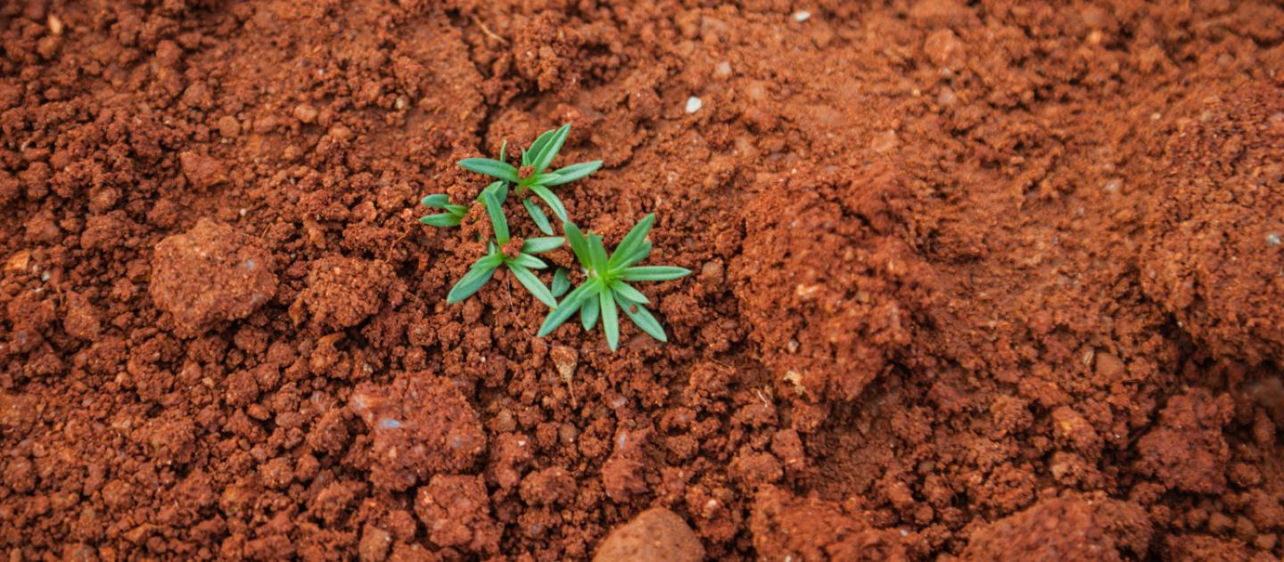
P. 25 Parts of the Ecosystem
What is an ecosystem?
2. Give en example of interaction between living and nonliving thing in ecosystem?

Slide 51
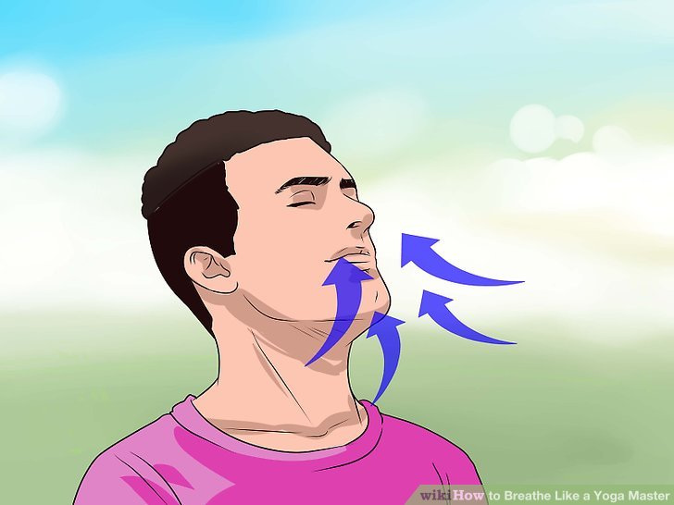
Breathe( v. )

Slide 52
Before You Go On P. 25
1. A population is made up of all the members of one species in the same area.
2. An ecosystem is made up of both the living and nonliving things in an area.

Slide 53
On Your Own
Why do you think taking care of ecosystem is important? Explain.

Slide 54
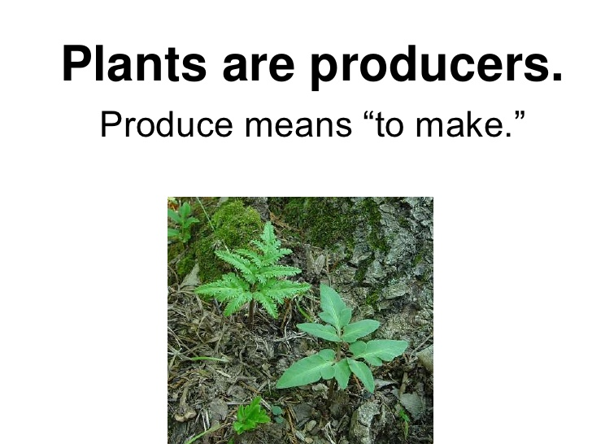
P. 26 Three Kinds Of Organisms
1. What are the three parts of organisms?
2. What are producers? What do producers use to make their own food?

Slide 55
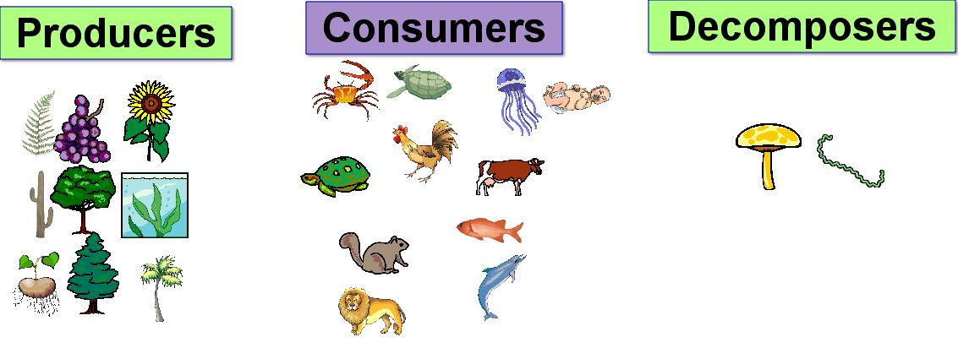

Slide 56
Photosynthesis

Slide 57


Slide 58
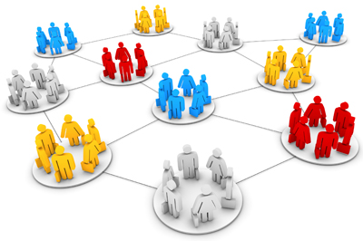
3. What is the difference between producers and consumers? 4. How are consumers put into groups?

Slide 59
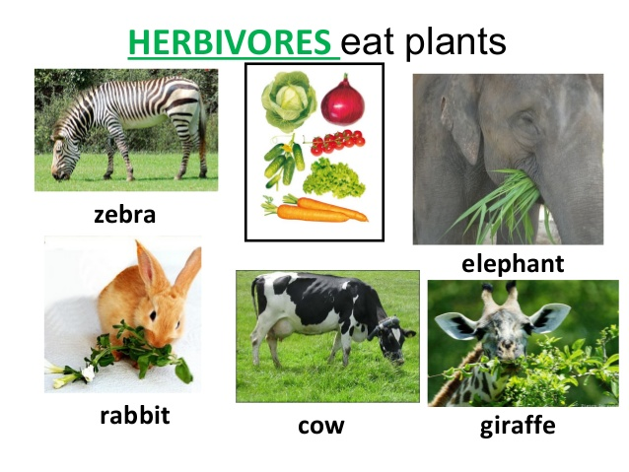
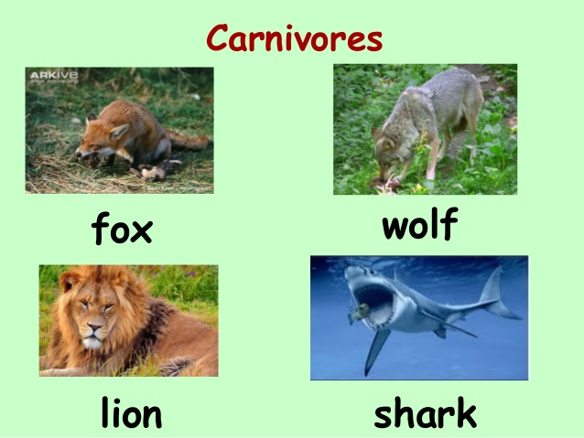
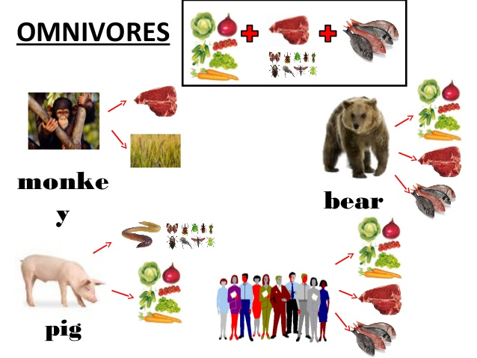

Slide 60
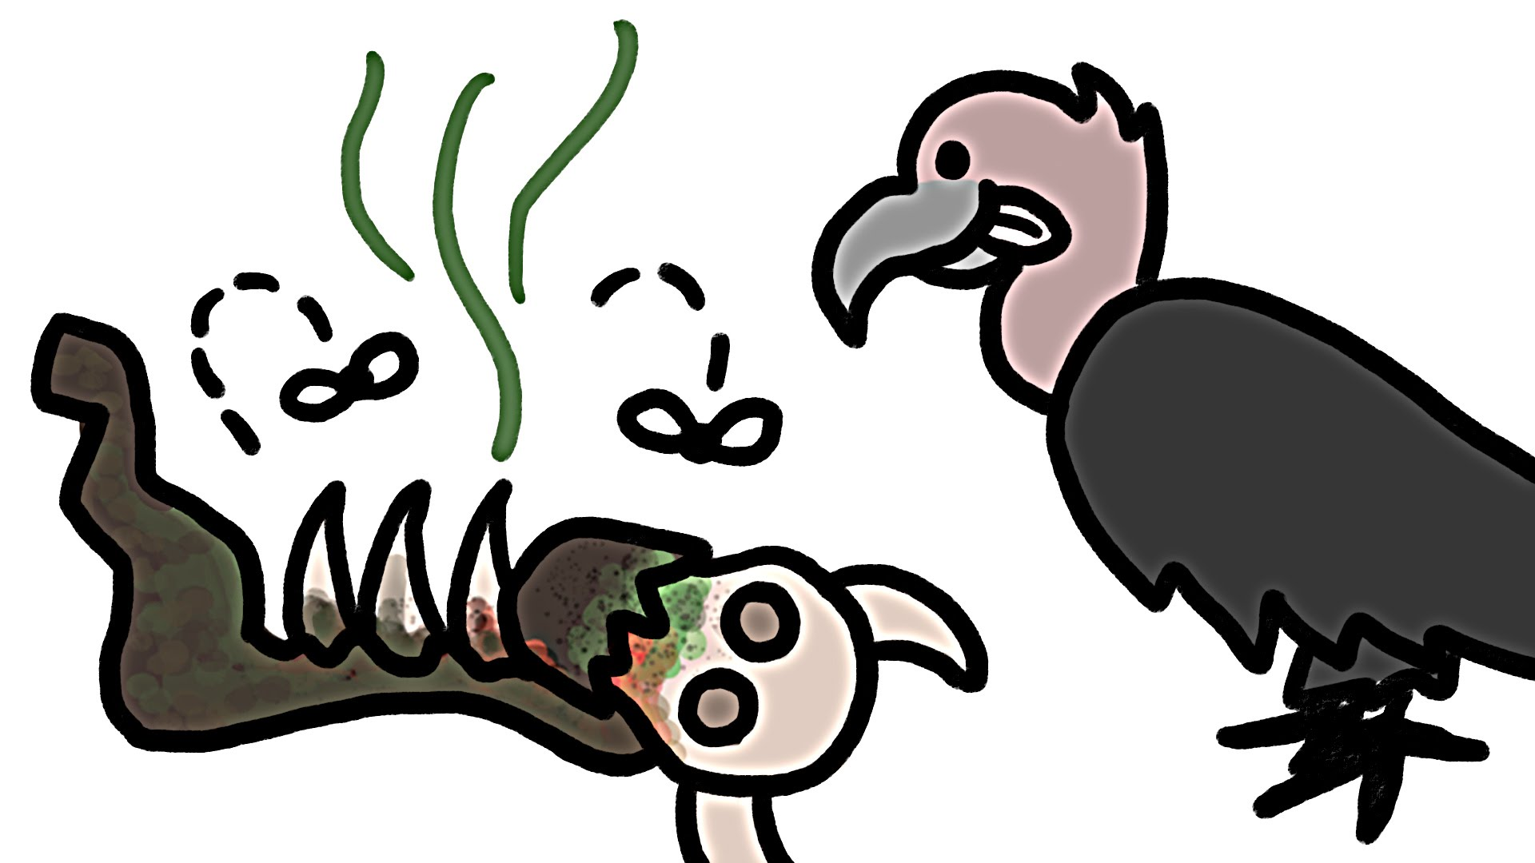
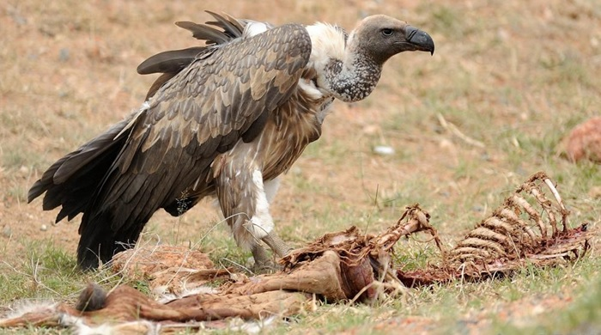

Slide 61
5. What is the role of decomposers?
6. Why are decomposers important?
7. Give examples of decomposers.

Slide 62
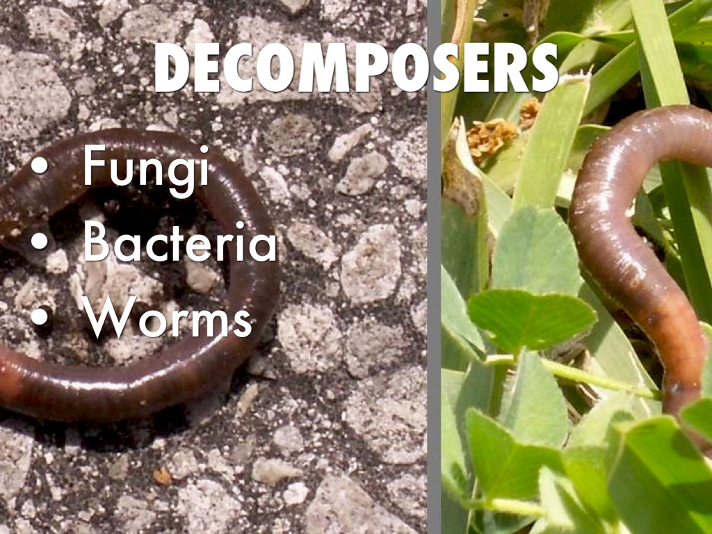
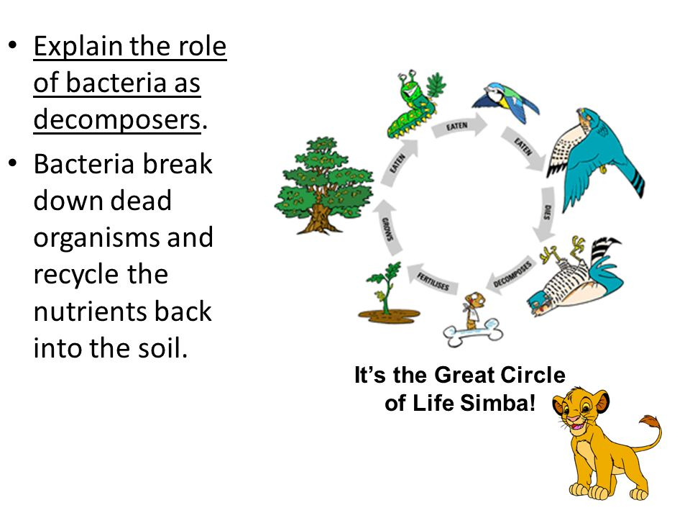

Slide 63
18/9 Outcomes
Students should be able to:
Discuss the value of the lesson.
Answer critical/ and reading questions.
Practice the words of the lesson

Slide 64
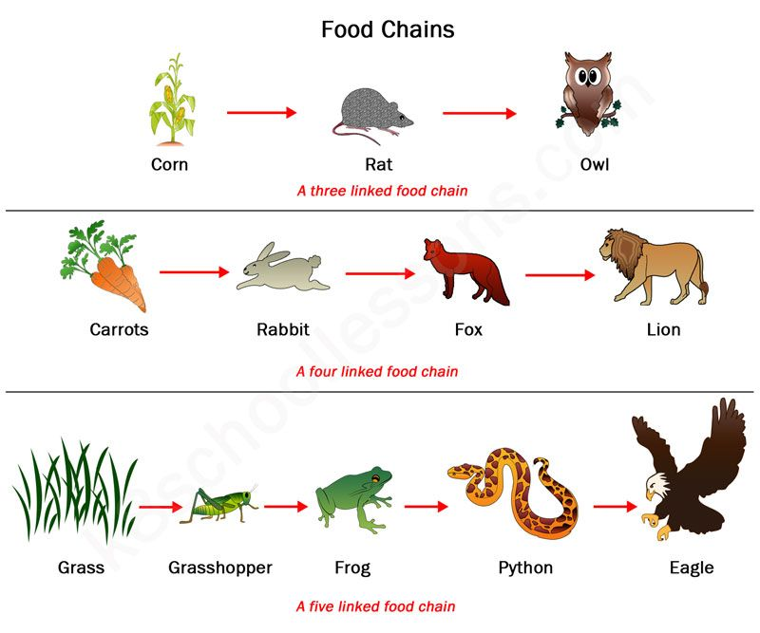
P. 27 What is food Chain?

Slide 65
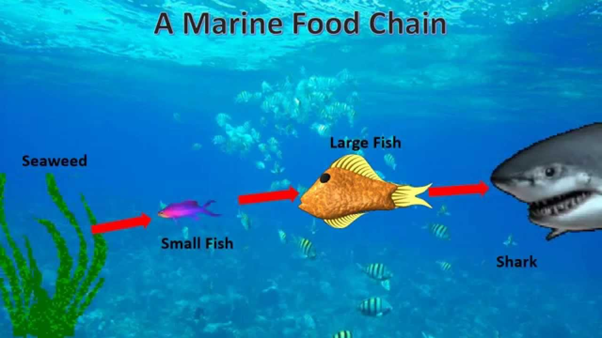

Slide 66
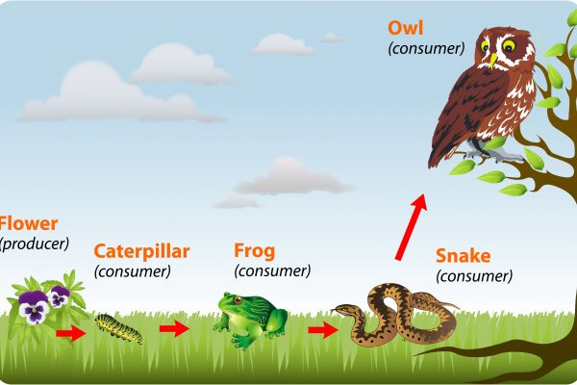

Slide 67
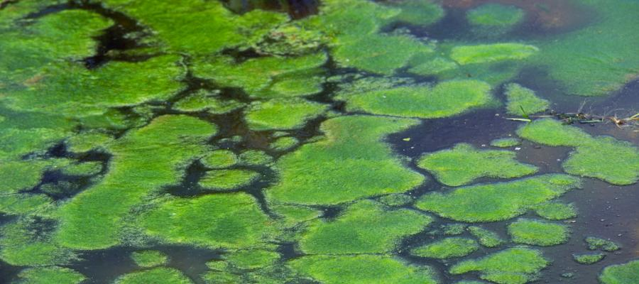


Slide 68
Before You Go On P. 27
Name three kinds of organisms in an ecosystem?
Producers, consumers, decomposers.
2. What are three kinds of consumers?
herbivores, carnivores and omnivores.

Slide 69
Discussion
If you could choose, what type of habitat would you prefer to live? Why?

Slide 70
Discussion
What would happen to a forest ecosystem if someone cuts down all trees.

Slide 71
Comprehension P. 28
What does a habitat provide for living things?
A habitat provides shelter and food for living things.
2. Name two kinds of decomposers?
Two kinds of decomposers are bacteria and fungi.

Slide 72
3. Compare and contrast a community and an ecosystem?
A community is made up of only living things, and an ecosystem is made up of living and nonliving things. Both contain more than one kind of thing.

Slide 73
4. Describe how the different organisms interact in a food chain?
Different organisms, such as producers, consumers, and decomposers, play different roles in a food chain. Some producers help to make oxygen. They produce their own food, using nutrients from the soil and light. Some consumers use producers for food, and some consumers are also decomposers. They give back nutrients to the soil.

Slide 74
5. Why should people learn about ecosystem?
People will understand how to take care of ecosystems if they learn about them.

Slide 75
6. Do you think the author would agree with this statement: "All living things depend on nonliving things”? Why?
Yes, the author would agree with the statement. The author’s main message is that there is interdependence in nature.

Slide 76
7. Why do you think humans can survive in many different environments?
Humans can live in many different kinds of places because they are adaptable and can solve problems.

Slide 77
8. Do you think it is important for humans to protect nature? Why?
Yes, it’s important for humans to protect nature because humans are part of nature and we all rely on each other.

Slide 78




Slide 89
The End

