Slide 1

OBJECTIVES
WARM UP
Unit: Two
Lesson: 4
Subject: Reading: Providing Light in The darkness
Grade: Nine
PREASSESSMENT
PRESENTATION
FORMATIVE ASSESSMENT
FEEDBACK
DIFFERENTIATION
REAL LIFE APPLICATION
CRITICAL THINKING
EXIT TICKET

Slide 2

ISLAMIC EDUCATIONAL COLLEGE DATE:
SUBJECT: English
GRADE:9
UNIT:1
LESSON:2
Objectives
01:00 minutes
Lesson Objectives:
Students should be able to:
1. Read for specific information
2. Recognize the meanings of the new words.

Slide 3

ISLAMIC EDUCATIONAL COLLEGE DATE:
SUBJECT: English
GRADE:9
UNIT:1
LESSON :2
WARM UP
03:00 minutes
Think—pair--share
1. Why do you think inventions are important to society? 2. How do you think Edison’s inventions changed everyday life for people at the time?

Slide 4

ISLAMIC EDUCATIONAL COLLEGE DATE:
SUBJECT: English
GRADE:9
UNIT:1
LESSON:2
PREASSESSMENT
3:00 minutes
1. What kind of _________would you need to ice skate?
a. patent
b. significance
c. injury
d. equipment

Slide 5
ISLAMIC EDUCATIONAL COLLEGE DATE:
SUBJECT: English
GRADE:9
UNIT:1
LESSON:2
PREASSESSMENT
3:00 minutes
2. What do you think has made significant_________to society?
a. investor
b. tenacity
c. contribution
d. injury

Slide 6
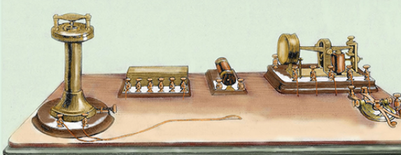

ISLAMIC EDUCATIONAL COLLEGE DATE:
SUBJECT: English
GRADE: 9
UNIT:1
LESSON:2
PRESENTATION
Telegraph
03:00 minutes
What is a telegraph ?
When was it invented ?
1:30

Slide 7
Presentation Task 1 P.54/55
1- What did people use to light their homes before the invention of the light bulb?
2- What was the aim of Edison?
3. Mention the qualities of Edison.
4. Quote a sentence shows Edison’s contribution to the previous efforts of light bulb.

Slide 8
Challenging words.
Ingenuity :
Devoted :
Incandescent:
Strides:
cleverness
dedicated
shining
footsteps

Slide 9
ISLAMIC EDUCATIONAL COLLEGE DATE:
SUBJECT: English
GRADE: 9
UNIT:1
LESSON:2
PRESENTATION
Telegraph
03:00 minutes
What is a telegraph ?
When was it invented ?
1:30

Slide 10
ISLAMIC EDUCATIONAL COLLEGE DATE:
SUBJECT: English
GRADE:9
UNIT:1
LESSON:2
Objectives
01:00 minutes
Lesson Objectives:
Students should be able to:
1. Read for specific information
2. Recognize the meanings of the new words.

Slide 11
ISLAMIC EDUCATIONAL COLLEGE DATE:
SUBJECT
GR ADE
UNIT
5:00 minutes
LESSON
PreAssessment
OUTCOMES
Edison was the only one who contributed to light the world we live in.
True
False
WARM UP
PREASSESSMENT
PRESENTATION
FORMATIVE ASSESSMENT
FEEDBACK
DIFFERENTIATION
REAL LIFE APPLICATION
CRITICAL THINKING
EXIT TICKET

Slide 12

ISLAMIC EDUCATIONAL COLLEGE DATE: / 5/ 2025
SUBJECT: Grammar
GRADE: 9
UNIT:4
Lesson: 1
OUTCOMES
Which word am I thinking of….
device
05:00 minutes
WARM UP
1. Industry
2. Inventors
3. Patent
4. Tenacity
5.Contribution
6. Reject
7. Injury
8. Significant
REAL LIFE APPLICATION
Situation 1 : Sarah recently bought a new item that helps her monitor her daily steps. The small, wearable gadget tracks her activity and even syncs with her phone to provide health insights.
CRITICAL THINKING
PREASSESSMENT
PRESENTATION
DIFFERENTIATION
FORMATIVE ASSESSMENT
FEEDBACK
EXIT TICKET

Slide 13
ISLAMIC EDUCATIONAL COLLEGE DATE: / 5/ 2025
SUBJECT: Grammar
GRADE: 9
UNIT:4
Lesson: 1
OUTCOMES
Which word am I thinking of….
Contribution
05:00 minutes
WARM UP
Situation 2:During the class project, everyone worked together. John brought the supplies, Maria wrote the report, and Ahmed created the presentation. Each person helped in their own way to complete the project.
1. Industry
2. Inventors
3. Patent
4. Tenacity
5.Contribution
6. Reject
7. Injury
8. Significant
REAL LIFE APPLICATION
CRITICAL THINKING
PREASSESSMENT
PRESENTATION
DIFFERENTIATION
FORMATIVE ASSESSMENT
FEEDBACK
EXIT TICKET

Slide 14
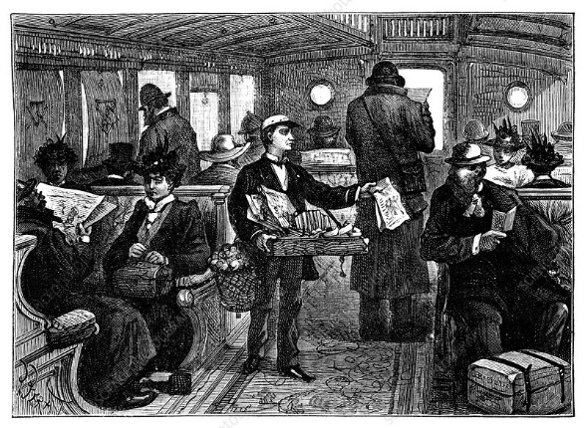
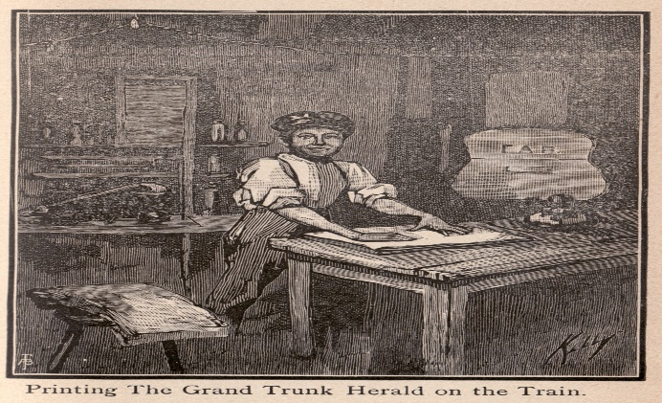
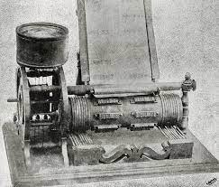
1847
15 years old
16 years old
21 years old
12 years old
Telegraph operator
Invented the first patented electrical vote recorder
Time when he was born
newspaper boy on a train
Publisher of his newspaper(The Weekly Herald)

Slide 15
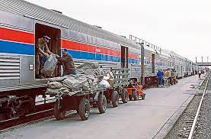
Task 2 55/56
Which sentence from the text shows that Thomas Edison was a curious and energetic boy.
What was special about The Weekly Herald?
Where did he try his new experiments at the beginning?
Why did he start selling newspapers outside trains?
Find a word from the text means 1. strong sharp smell 2. enter somewhere rudely
What gave him a chance to travel?
6. How old was Edison when he came up with his first patented invention? What was it? Where was it used?
7. Why didn’t the Congress use Edison’s new invention?

Slide 16
ISLAMIC EDUCATIONAL COLLEGE DATE:
SUBJECT
GR ADE
UNIT
5:00 minutes
LESSON
Differentiation
OUTCOMES
1+3 Write Two Facts ( from the text)about Thomas Edison
2+4 give a summary of What’s taken so far.
WARM UP
PREASSESSMENT
PRESENTATION
FORMATIVE ASSESSMENT
FEEDBACK
DIFFERENTIATION
REAL LIFE APPLICATION
CRITICAL THINKING
EXIT TICKET

Slide 17
ISLAMIC EDUCATIONAL COLLEGE DATE:
SUBJECT
GR ADE
UNIT
LESSON
Real Life Application:
OUTCOMES
01:00 minutes
WARM UP
PREASSESSMENT
In Gaza, doctors now are having little or no electricity. What do they use to do surgeries? What does this show about them?
PRESENTATION
FORMATIVE ASSESSMENT
FEEDBACK
DIFFERENTIATION
REAL LIFE APPLICATION
CRITICAL THINKING
EXIT TICKET

Slide 18
ISLAMIC EDUCATIONAL COLLEGE DATE:
SUBJECT
GR ADE
UNIT
LESSON
Critical Thinking:
OUTCOMES
01:00 minutes
WARM UP
PREASSESSMENT
If Edison had given up after many failures, what might have happened to the progress of lighting technology?
PRESENTATION
FORMATIVE ASSESSMENT
FEEDBACK
DIFFERENTIATION
REAL LIFE APPLICATION
CRITICAL THINKING
EXIT TICKET

Slide 19
ISLAMIC EDUCATIONAL COLLEGE DATE:
SUBJECT: English
GRADE :9
UNIT:1
LESSON:2
EXIT TICKET
03:00 minutes
Write 3 things you’ve learned today.

Slide 20
ISLAMIC EDUCATIONAL COLLEGE DATE:
SUBJECT: English
GRADE:9
UNIT:1
LESSON:2
PREASSESSMENT
3:00 minutes
1. The first patented invention by Edison was the --------- when he was -------years old?
a. Phonograph /23
b. Light bulb 20
c. Electrical vote recorder / 21
d. Telegraph /25

Slide 21
ISLAMIC EDUCATIONAL COLLEGE DATE: / 5/ 2025
SUBJECT: Grammar
GRADE: 9
UNIT:4
Lesson: 1
OUTCOMES
Which word am I thinking of….
significant
05:00 minutes
WARM UP
Situation:The teacher told the students that the upcoming exam would be very important. It would count for 50% of their final grade, which means doing well on it would have a big impact on their overall result.
1. Industry
2. Inventors
3. Patent
4. Tenacity
5.Contribution
6. Reject
7. Injury
8. Significant
REAL LIFE APPLICATION
CRITICAL THINKING
PREASSESSMENT
PRESENTATION
DIFFERENTIATION
FORMATIVE ASSESSMENT
FEEDBACK
EXIT TICKET

Slide 22
ISLAMIC EDUCATIONAL COLLEGE DATE: / 5/ 2025
SUBJECT: Grammar
GRADE: 9
UNIT:4
Lesson: 1
OUTCOMES
Which word am I thinking of….
investors
05:00 minutes
WARM UP
Situation : Mia had a great idea for a new app, but she didn’t have the money to build it. She gave a presentation to a group of people who were willing to give her money to start her business, hoping it would become successful so they could earn some of the profits later.
1. Industry
2. Inventors
3. Patent
4. Tenacity
5.Contribution
6. Reject
7. Injury
8. Significant
REAL LIFE APPLICATION
CRITICAL THINKING
PREASSESSMENT
PRESENTATION
DIFFERENTIATION
FORMATIVE ASSESSMENT
FEEDBACK
EXIT TICKET

Slide 23
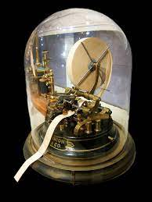
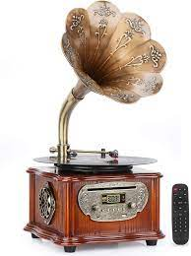
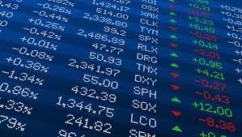
Task 2 56
Describe the invention of stock ticker .
How did he contribute to Graham Bell’s invention?
What led to the recording industry?
Edison’s aim was to light up a single home?(T/F) justify.
Find a sentence that shows Edison with his team made many researches before inventing the light bulb.

Slide 24
Worksheet
Critical Thinking
1. What challenges do you think Edison faced when trying to convince people to invest in his ideas?
2. Why do you think Edison and his team tried so many different theories before perfecting the light bulb?

Slide 25
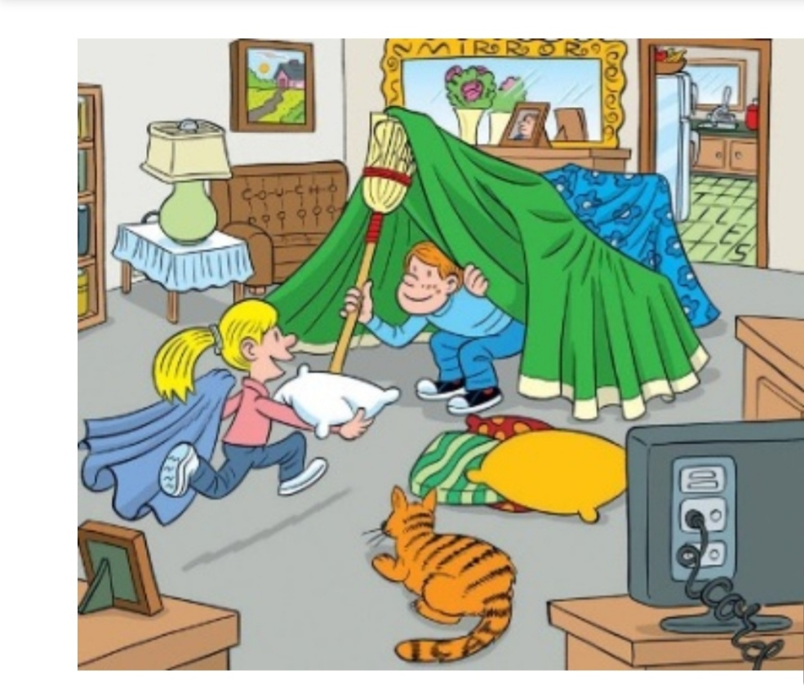

Slide 26
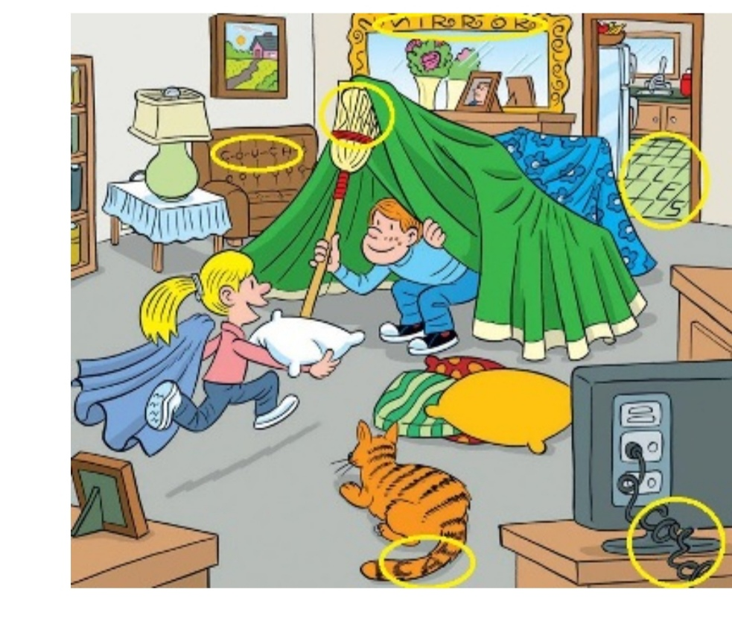

Slide 27
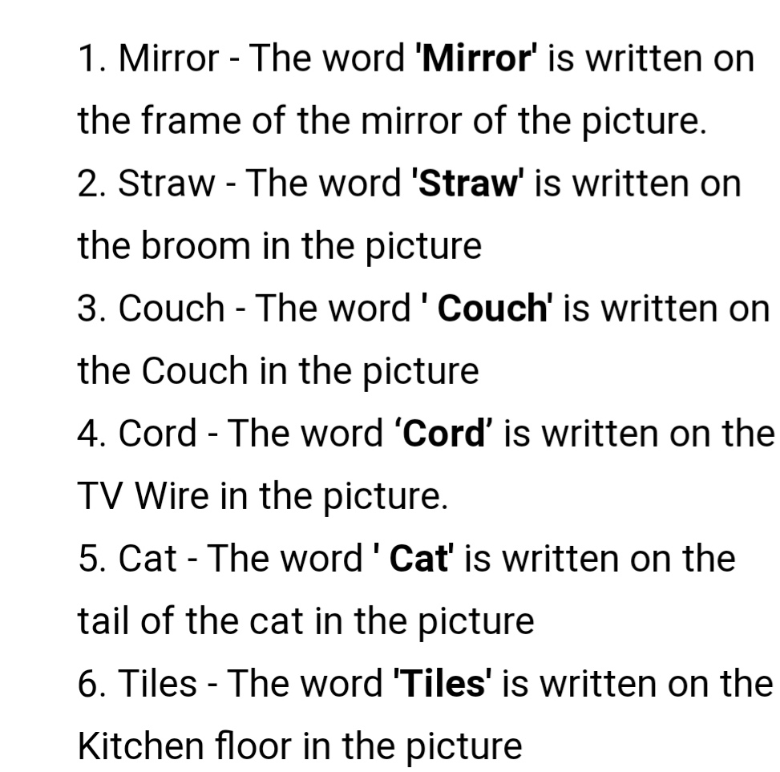

Slide 28
ISLAMIC EDUCATIONAL COLLEGE DATE:
SUBJECT: English
GRADE:9
UNIT:1
LESSON:2
PREASSESSMENT
1. . What was Edison’s second invention, and why was it useful?
A. The light bulb, because it helped people see at night
B. The stock ticker, because it sent stock prices quickly over wires
C. The phonograph, because it played music
D. The telephone, because it helped people talk long-distance

Slide 29
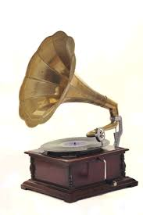
ISLAMIC EDUCATIONAL COLLEGE DATE:
SUBJECT: English
GRADE:9
UNIT:1
LESSON:2
PREASSESSMENT
2. What new industry did Edison’s work on the phonograph help create?
Film industry
Telephone industry
Recording industry
Publishing industry

Slide 30
ISLAMIC EDUCATIONAL COLLEGE DATE:
SUBJECT: English
GRADE:9
UNIT:1
LESSON:2
PREASSESSMENT
3. What larger vision did Edison have beyond inventing the light bulb?
A. Creating colorful lights for holidays
B. Building a space station
C. Distributing electricity across an entire city
D. Making lamps for trains

Slide 31
ISLAMIC EDUCATIONAL COLLEGE DATE:
SUBJECT: English
GRADE:9
UNIT:1
LESSON:2
PREASSESSMENT
4. What improvements did Edison make to the telephone?
A. He made it wireless
B. He improved it so people started installing it in offices and homes
C. He turned it into a music player
D. He made it portable

Slide 32
ISLAMIC EDUCATIONAL COLLEGE DATE:
SUBJECT: English
GRADE:9
UNIT:1
LESSON:2
PREASSESSMENT
P. 56+ Worksheet
Quote a sentence that shows the way people used to get stock prices before the invention of the the stock ticker?
Quote a sentence that shows light was the reason the great inventor became well-known
Quote a sentence that shows Edison’s larger vision beyond inventing the light bulb?
Quote a sentence that shows role investors play in Edison’s success with electric lighting?

Slide 33
Task 3 56
Why do you think Edison announced his inventions before he had them ready?
He probably wanted to get people excited about his inventions he was working on and be positive.
2. What was the biggest challenge for Edison's team in creating the light bulb? How was it solved?
Finding the appropriate element that wouldn’t burn up. After experimenting with over 6000 materials, the team found bamboo worked best.
3. What qualities do you think the people on Edison's team had?
Edison’s team had hard work, patience, determination, and teamwork. They kept experimenting even after failing many times, which shows they were persistent and dedicated.
4. Find a word that means stimulate or encourage someone to take action
spurred.
5. Quote a sentence that shows Edison’s persistence and determination produced successful results.
Edison's tenacity had paid off

Slide 34
ISLAMIC EDUCATIONAL COLLEGE DATE:
SUBJECT
GR ADE
UNIT
5:00 minutes
LESSON
Differentiation
OUTCOMES
1+3 Write Two Facts ( from the text)about Thomas Edison
2+4 give a summary of What’s taken so far.
WARM UP
PREASSESSMENT
PRESENTATION
FORMATIVE ASSESSMENT
FEEDBACK
DIFFERENTIATION
REAL LIFE APPLICATION
CRITICAL THINKING
EXIT TICKET

Slide 35
ISLAMIC EDUCATIONAL COLLEGE DATE:
SUBJECT: English
GRADE :9
UNIT:1
LESSON:2
EXIT TICKET
03:00 minutes
Write 3 things you’ve learned today.

Slide 36
ISLAMIC EDUCATIONAL COLLEGE DATE:
SUBJECT
GR ADE
UNIT
5:00 minutes
LESSON
Preassessment
OUTCOMES
1. What was the most difficult part for Edison and his team to create?
A. The outer glass bulb B. The wire that connected to electricity C. The element inside the bulb that lights up D. The switch to turn the light on and off
WARM UP
PREASSESSMENT
PRESENTATION
FORMATIVE ASSESSMENT
FEEDBACK
DIFFERENTIATION
REAL LIFE APPLICATION
CRITICAL THINKING
EXIT TICKET

Slide 37
ISLAMIC EDUCATIONAL COLLEGE DATE:
SUBJECT
GR ADE
UNIT
5:00 minutes
LESSON
Preassessment
OUTCOMES
2. Edison announced his inventions before he had them ready?
A. True B. False
WARM UP
PREASSESSMENT
PRESENTATION
FORMATIVE ASSESSMENT
FEEDBACK
DIFFERENTIATION
REAL LIFE APPLICATION
CRITICAL THINKING
EXIT TICKET

Slide 38
ISLAMIC EDUCATIONAL COLLEGE DATE:
SUBJECT
GR ADE
UNIT
5:00 minutes
LESSON
Preassessment
OUTCOMES
What invention made Edison famous according to the passage?
A. The telephone B. The light bulb C. The phonograph D. The electric fan
WARM UP
PREASSESSMENT
PRESENTATION
FORMATIVE ASSESSMENT
FEEDBACK
DIFFERENTIATION
REAL LIFE APPLICATION
CRITICAL THINKING
EXIT TICKET

Slide 39
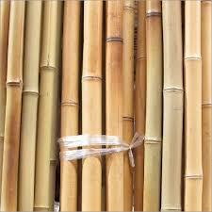
ISLAMIC EDUCATIONAL COLLEGE DATE:
SUBJECT
GR ADE
UNIT
5:00 minutes
LESSON
Preassessment
OUTCOMES
4. What material did Edison and his team finally use for the element inside the bulb?
A. Metal wire B. Treated bamboo C. Iron D. Silver
WARM UP
PREASSESSMENT
PRESENTATION
FORMATIVE ASSESSMENT
FEEDBACK
DIFFERENTIATION
REAL LIFE APPLICATION
CRITICAL THINKING
EXIT TICKET

Slide 40
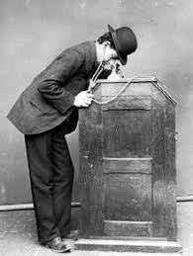
Task 4 P. 59
1- Which of Edison's inventions were not very successful?
One of Edison’s less successful inventions was the kinetophone
2. Describe the function of Kinetophone.
The Kinetophone combined film and sound, allowing people to watch a motion picture through a peephole while listening to sound played on a phonograph.
3- What kind of things did Edison make lists of?
He made lists of things that he thought people needed and would buy.
4. What was Edison’s attitude toward failure?
Edison had a positive attitude toward failure. He said, “I have not failed 10,000 times—I’ve successfully found 10,000 ways that will not work,” showing that he saw failures as learning opportunities rather than setbacks.

Slide 41
Critical Thinking Task 4 P. 59
3- What do you think is most remarkable about Edison? Explain.
The most remarkable thing about Edison is his persistence and creativity. Even though many of his inventions, like the Kinetophone and concrete products, failed, he never gave up. He kept trying new ideas, which allowed him to secure over 1,000 patents and create inventions, like the electric light bulb, that changed the world.
4- “If you learn from defeat, you haven’t really lost.” Explain how this quote reflects Edison’s attitude towards failure.
It reflects Edison’s attitude toward failure because he saw mistakes as opportunities to learn rather than true losses. As the text says, he did not consider his 10,000 failed attempts as failures; instead, he viewed them as ways to discover what did not work, which eventually helped him succeed.

Slide 42
ISLAMIC EDUCATIONAL COLLEGE DATE:
SUBJECT
GR ADE
UNIT
5:00 minutes
LESSON
Differentiation
OUTCOMES
1+3 Write Two Facts ( from the text)about Thomas Edison
2+4 give a summary of What’s taken so far.
WARM UP
PREASSESSMENT
PRESENTATION
FORMATIVE ASSESSMENT
FEEDBACK
DIFFERENTIATION
REAL LIFE APPLICATION
CRITICAL THINKING
EXIT TICKET

Slide 43
ISLAMIC EDUCATIONAL COLLEGE DATE:
SUBJECT: English
GRADE :9
UNIT:1
LESSON:2
EXIT TICKET
03:00 minutes
Write 3 things you’ve learned today.

Slide 44
1. How did Edison’s work with electricity change industries like schools, factories, or homes?
2. How do wars affect electricity and street lights in cities, and what problems does this cause for people?

Slide 45
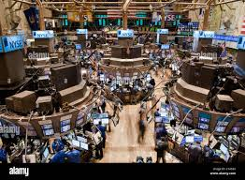

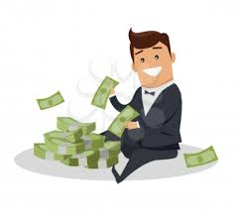
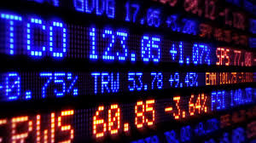
ISLAMIC EDUCATIONAL COLLEGE DATE:
SUBJECT: English
GRADE: 9
UNIT:1
LESSON:2
10m
PRESENTATION
Stock Exchange
Investors

Slide 46
ISLAMIC EDUCATIONAL COLLEGE DATE:
SUBJECT: English
GRADE: 9
UNIT:1
LESSON:2
FORMATIVE ASSESSMENT:
04:00 minutes
Problem : obtaining real-time stock prices from the New York Stock Exchange was a slow and inefficient process. "Runners" were tasked with physically carrying the latest prices from the exchange floor to brokers and investors. This often led to delays and inaccuracies.
Work with your partner and try to think of a solution to deliver the information from the stock exchange to the investors directly to save time.

Slide 47
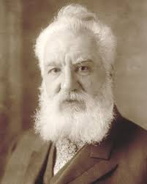
ISLAMIC EDUCATIONAL COLLEGE DATE:
SUBJECT: English
GRADE: 9
UNIT:1
LESSON:2
FORMATIVE ASSESSMENT:
04:00 minutes
Alexander Graham Bell
What is Edison’s contribution to Alexander Graham Bell’s invention?

Slide 48
ISLAMIC EDUCATIONAL COLLEGE DATE:
SUBJECT: English
GRADE:9
UNIT:2
LESSON:3
DIFFERENTIATION
05:00 minutes
Differentiation
Students 3 and 4
Students 1 and 2
Write a timeline showing the major inventions Edison worked on, in the correct order.
Include at least 4 key inventions from the passage.
For each invention, write 1–2 sentences explaining:
What the invention did
How it changed life for people at the time
Match each invention to its use:
Stock Ticker → 📈
Telephone → 📞
Phonograph → 🎵
Light Bulb → 💡
Draw a picture of your favorite invention from the list.
Group work should be done quietly.

Slide 49
ISLAMIC EDUCATIONAL COLLEGE DATE:
SUBJECT: English
GRADE :9
UNIT:1
LESSON:2
EXIT TICKET
03:00 minutes
Write 3 things you’ve learned today.

