Slide 1

Unit: Two
Lesson: One
Subject: Providing Light
Grade: 9

Slide 2



ISLAMIC EDUCATIONAL COLLEGE DATE:
SUBJECT
GR ADE
UNIT
LESSON
OBJECTIVES
01:00 minutes
OBJECTIVES :
Discuss the big Question.
Recognize the meanings of the new words.
WARM UP
PREASSESSMENT
PRESENTATION
FORMATIVE ASSESSMENT
FEEDBACK
DIFFERENTIATION
REAL LIFE APPLICATION
CRITICAL THINKING
EXIT TICKET

Slide 3

ISLAMIC EDUCATIONAL COLLEGE DATE:
SUBJECT
GR ADE
UNIT
LESSON
Warm Up
OUTCOMES
03:00 minutes
WARM UP
PREASSESSMENT
PRESENTATION
FORMATIVE ASSESSMENT
FEEDBACK
DIFFERENTIATION
REAL LIFE APPLICATION
CRITICAL THINKING
EXIT TICKET

Slide 4
ISLAMIC EDUCATIONAL COLLEGE DATE:
SUBJECT
GR ADE
UNIT
LESSON
Pre-assessment
1. A written account of a person’s life written by someone else is --------------------------.
a. myth
autobiography
biography
science article
OUTCOMES
02:00 minutes
WARM UP
PREASSESSMENT
PRESENTATION
FORMATIVE ASSESSMENT
FEEDBACK
DIFFERENTIATION
REAL LIFE APPLICATION
CRITICAL THINKING
EXIT TICKET

Slide 5
ISLAMIC EDUCATIONAL COLLEGE DATE:
SUBJECT
GR ADE
UNIT
LESSON
Presentation: Words in bold are not English. Try
to figure out these words and give as many synonyms as you can
1. The doctor used a small goekkr to check the patient’s heartbeat.
2. The workers wore safety mdwt at the construction site.
3. The fashion nmve changes styles every year.
Many aole put money into the new company.
She applied for a dkelp to protect her invention, so she will have the right to sell her new product.
With great lrew, the athlete finished the race despite his injury.
OUTCOMES
02:00 minutes
WARM UP
PREASSESSMENT
PRESENTATION
FORMATIVE ASSESSMENT
FEEDBACK
DIFFERENTIATION
REAL LIFE APPLICATION
CRITICAL THINKING
EXIT TICKET

Slide 6

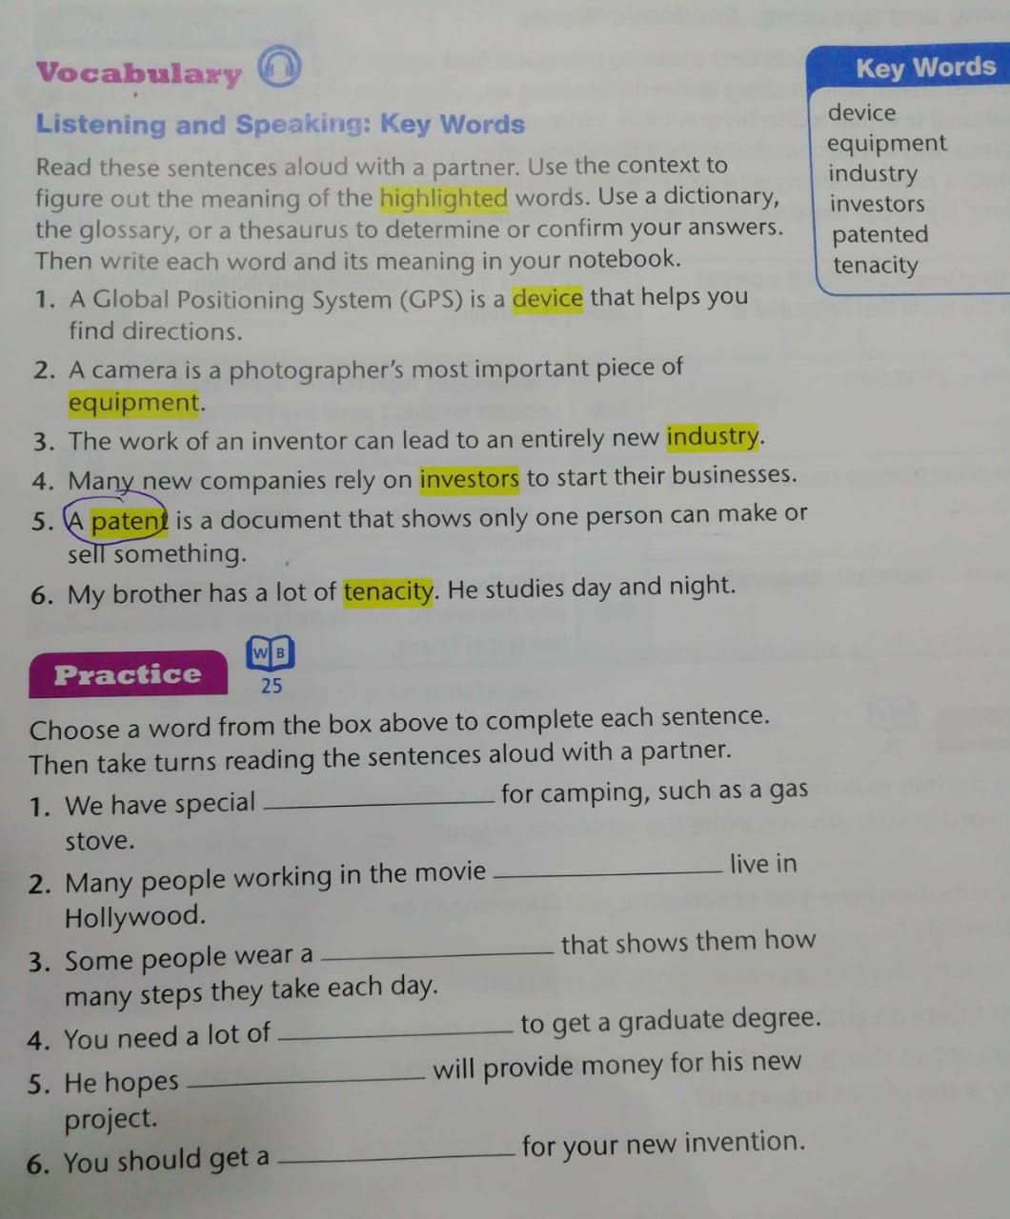
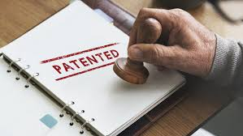

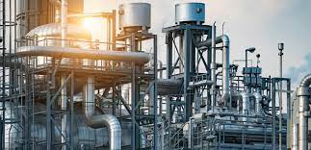
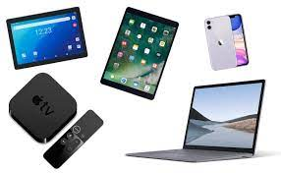

Key Words St. Page 51

Slide 7
Device, equipment, patent, industry, inventors, tenacity.

Slide 8
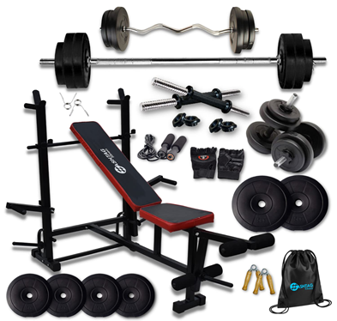
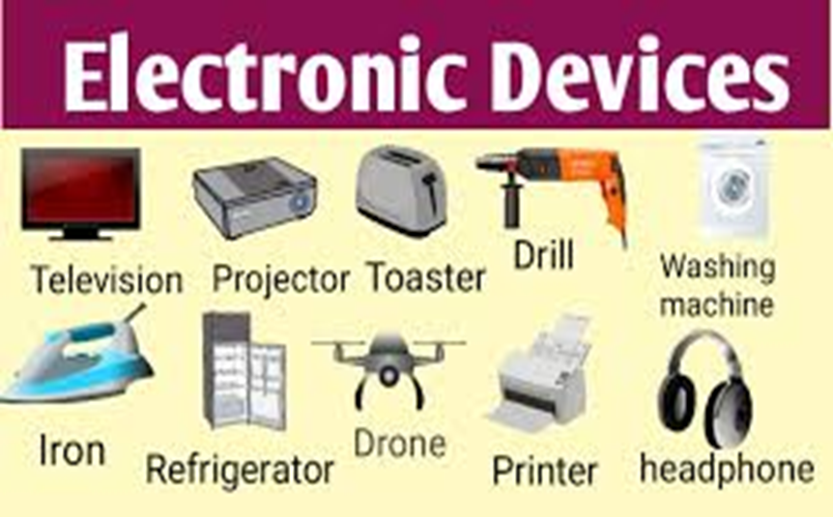



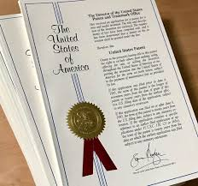
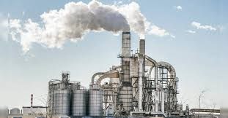

ISLAMIC EDUCATIONAL COLLEGE DATE:
SUBJECT
GR ADE
UNIT
5:00 minutes
LESSON
OUTCOMES
WARM UP
PREASSESSMENT
PRESENTATION
FORMATIVE ASSESSMENT
FEEDBACK
DIFFERENTIATION
REAL LIFE APPLICATION
CRITICAL THINKING
EXIT TICKET

Slide 9

ISLAMIC EDUCATIONAL COLLEGE DATE: 19 / 2/ 2025
SUBJECT: Grammar
GRADE: 9
UNIT: 4
Lesson: 1
OUTCOMES
Equipment Vs Device
01:30 minutes
WARM UP
REAL LIFE APPLICATION
CRITICAL THINKING
PREASSESSMENT
PRESENTATION
DIFFERENTIATION
FEEDBACK
FORMATIVE ASSESSMENT
EXIT TICKET

Slide 10
ISLAMIC EDUCATIONAL COLLEGE DATE: 19 / 2/ 2025
SUBJECT: Grammar
GRADE: 9
UNIT: 4
Lesson: 1
OUTCOMES
02:30 minutes
WARM UP
REAL LIFE APPLICATION
Device: Typically refers to a tool or machine designed for a specific purpose. It often implies something more technical or electronic. Examples include a smartphone, a calculator, or a medical device.
Equipment: Refers to the necessary items or tools used for a particular task or job. This can include a wide range of items, from simple tools to complex machinery. Equipment is usually more general and may encompass several devices. For example, gym equipment can include weights, treadmills, and resistance bands.
CRITICAL THINKING
PREASSESSMENT
PRESENTATION
DIFFERENTIATION
FEEDBACK
FORMATIVE ASSESSMENT
EXIT TICKET

Slide 11


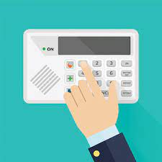

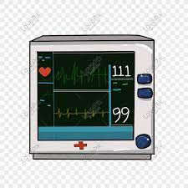

ISLAMIC EDUCATIONAL COLLEGE DATE: / / 2025
SUBJECT: Grammar
GRADE: 9
UNIT: 4
Lesson: 1
OUTCOMES
WARM UP
equipment
1- The laboratory has specialized________________ for conducting experiments and analyzing data.
2- The company developed a new security ________ to protect their data .
3- The photographer packed his _____________ for the photo shoot.
4- The doctor used a medical _________ to monitor the patient’s heart rate.
5- The hearing aid is a _________ that helps people with hearing loss hear better.
PREASSESSMENT
device
PRESENTATION
FORMATIVE ASSESSMENT
equipment
FEEDBACK
DIFFERENTIATION
device
REAL LIFE APPLICATION
CRITICAL THINKING
device
EXIT TICKET

Slide 12
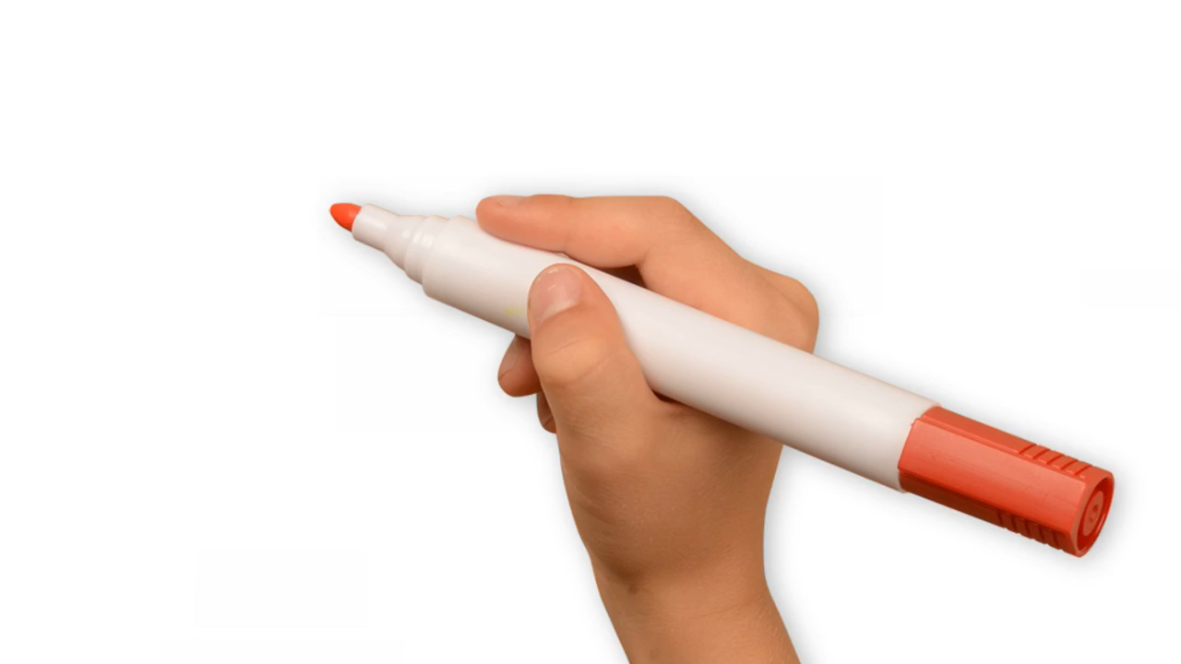
Which key word is a synonym to the word mentioned in the video

Slide 13
Device, equipment, patent, industry, inventors, tenacity.

Slide 14
ISLAMIC EDUCATIONAL COLLEGE DATE: / 5/ 2025
SUBJECT: Grammar
GRADE: 9
UNIT: 4
Lesson: 1
OUTCOMES
04:00 minutes
Differentiation
WARM UP
PREASSESSMENT
Students 1+3
Students 2+4
PRESENTATION
FORMATIVE ASSESSMENT
FEEDBACK
Put the following words in sentences and write them on your notebook.
Tenacity
Industry
Device
Write a short paragraph using the words
patent
significance
Tenacity
Device
DIFFERENTIATION
REAL LIFE APPLICATION
CRITICAL THINKING
EXIT TICKET

Slide 15
What is Light?
What were people’s lives like before the invention of electric light?

Slide 16

ISLAMIC EDUCATIONAL COLLEGE DATE: /2/ 2025
SUBJECT: Grammar
GRADE: 9
Unit: 4
Lesson: 1
OUTCOMES
CRITICAL THINKING
WARM UP
REAL LIFE APPLICATION
Imagine that you just invented a device that helps students stay focused while studying. In 60 seconds, decide:
What does the device do?
What problem does it solve?
Who would invest in it?
CRITICAL THINKING
PREASSESSMENT
FEEDBACK
FORMATIVE ASSESSMENT
PRESENTATION
DIFFERENTIATION
BUZZ IN
EXIT TICKET

Slide 17
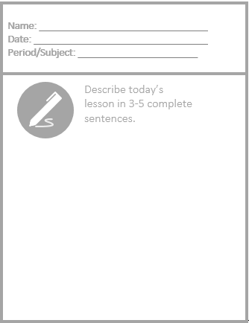
Exit Ticket

Slide 18

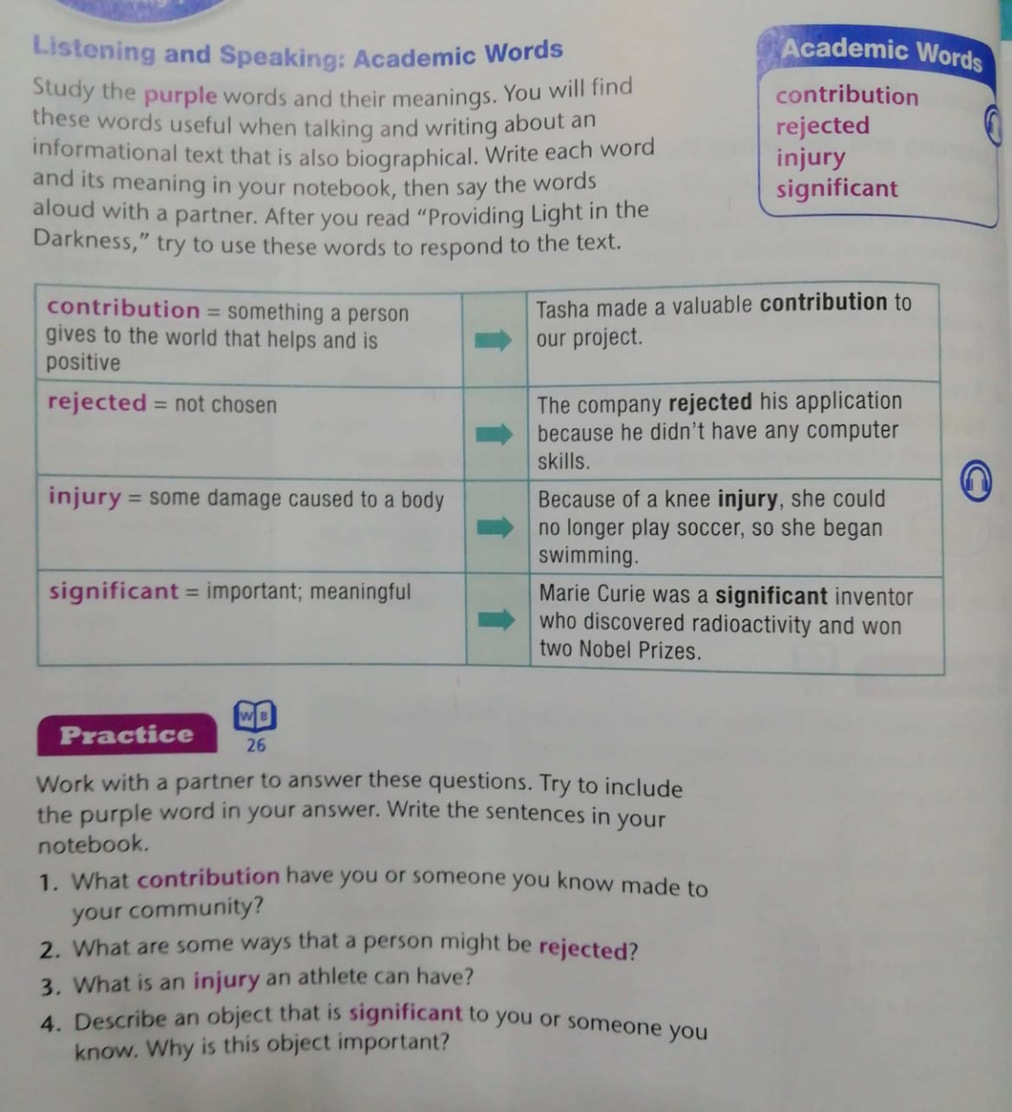
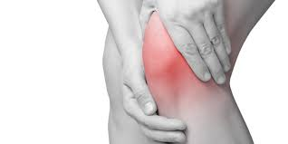


Academic words
S.B page 52

Slide 19
Academic words
S.B page 52

Slide 20
ISLAMIC EDUCATIONAL COLLEGE DATE:
SUBJECT
GR ADE
UNIT
LESSON
Real Life Application:
OUTCOMES
01:00 minutes
WARM UP
PREASSESSMENT
What are some of Jordan’s contributions to helping people in neighboring countries?
PRESENTATION
FORMATIVE ASSESSMENT
FEEDBACK
DIFFERENTIATION
REAL LIFE APPLICATION
CRITICAL THINKING
EXIT TICKET

Slide 21
ISLAMIC EDUCATIONAL COLLEGE DATE:
SUBJECT
GR ADE
UNIT
LESSON
Exit Ticket:
OUTCOMES
02:00 minutes
WARM UP
PREASSESSMENT
PRESENTATION
Tell about one thing you have learned------------------------
Tell about one thing you still need to know----------------------
FORMATIVE ASSESSMENT
FEEDBACK
DIFFERENTIATION
REAL LIFE APPLICATION
CRITICAL THINKING
EXIT TICKET

