Slide 1

Unit: Money.
Lesson: Life without Money.
Grade :8

Slide 2


Islamic Educational College Date : / To /
Major:
Grade:
Unit:
Lesson:
Outcomes
01:00 minutes
Warm-Up
Pre-assessment
Students will be able to describe life without money.
Presentation
Formative assessment
Feedback
Differentiation
Linking to life
Critical Thinking
Closure

Slide 3
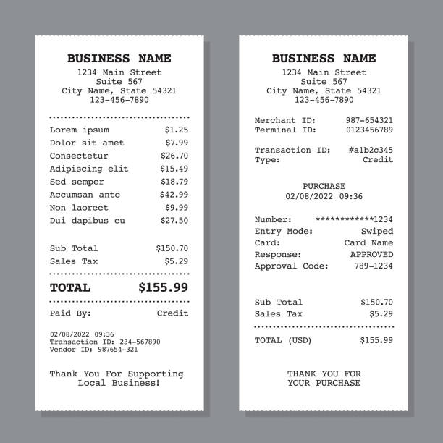
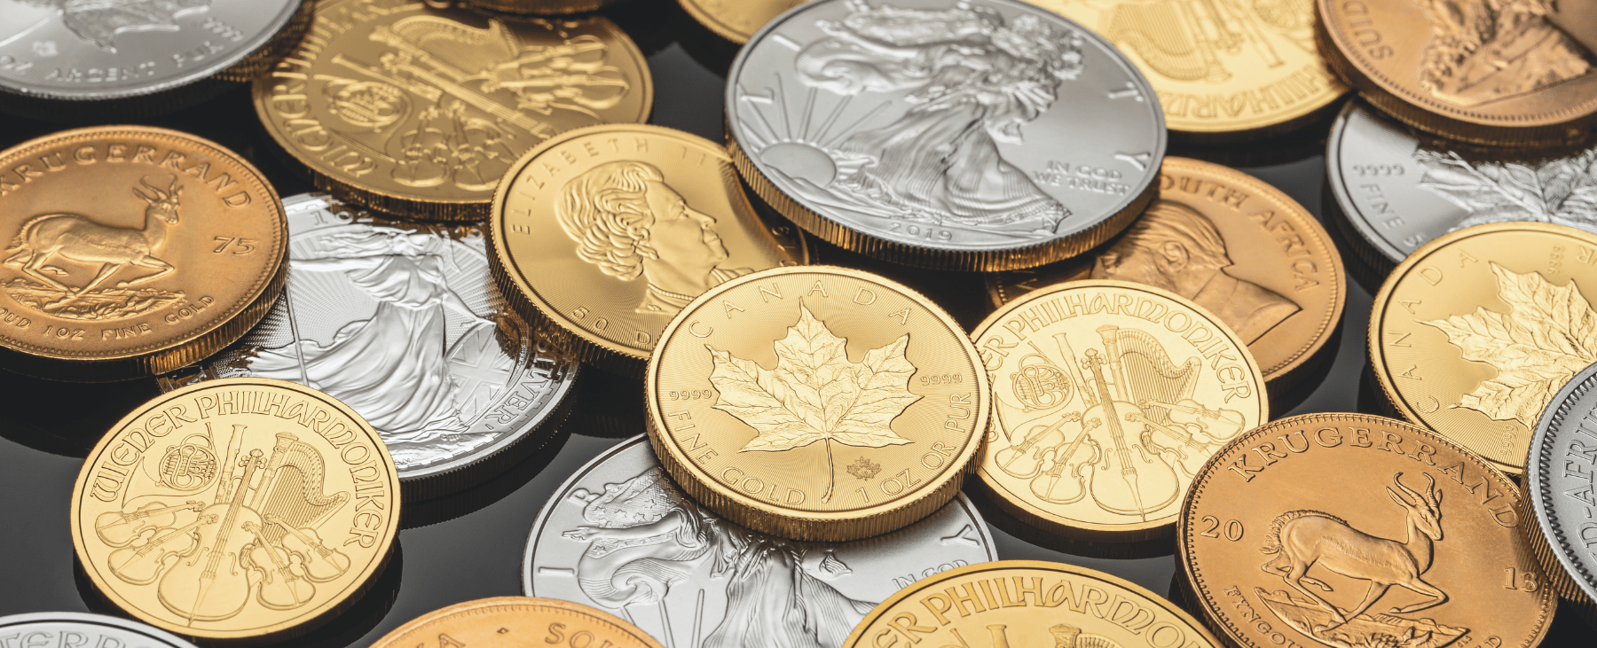

Islamic Educational College Date : / To /
Major:
Grade:
Unit:
Lesson:
Outcomes
03:00 minutes
Hot seat…
Warm-Up
Pre-assessment
Bill
Presentation
Formative assessment
Feedback
Differentiation
Linking to life
coins
Critical Thinking
Closure

Slide 4
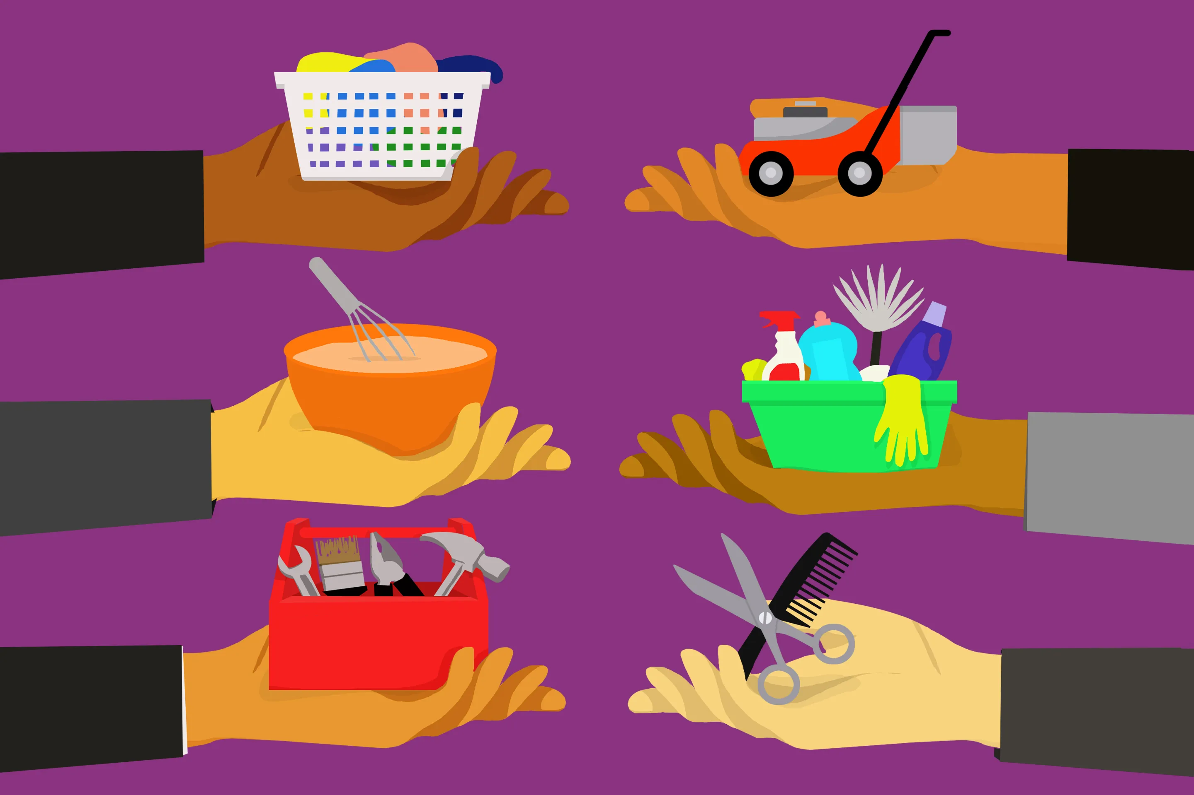

Islamic Educational College Date : / To /
Major:
Grade:
Unit:
Lesson:
Outcomes
04:00 minutes
Warm-Up
Imagine you couldn’t use money for one day. How would you get food, clothes, or things you need?
Pre-assessment
Presentation
Formative assessment
Feedback
Differentiation
Linking to life
Critical Thinking
Closure

Slide 5
Islamic Educational College Date : / To /
Major:
Grade:
Unit:
Lesson:
Outcomes
05:00 minutes
Warm-Up
Watch the following video!
Then, discuss it with your partner the following questions:
1- How did people buy their things in the past?
2-Do you think this system is fair? Why/ Why not?
Pre-assessment
Presentation
Formative assessment
Feedback
Differentiation
Linking to life
Critical Thinking
Closure

Slide 6
1-How did people in the past buy the things they need?
2-Do you think that this system is fair? Why/ Why not?
3-What are some possible challenges of bartering?

Slide 7
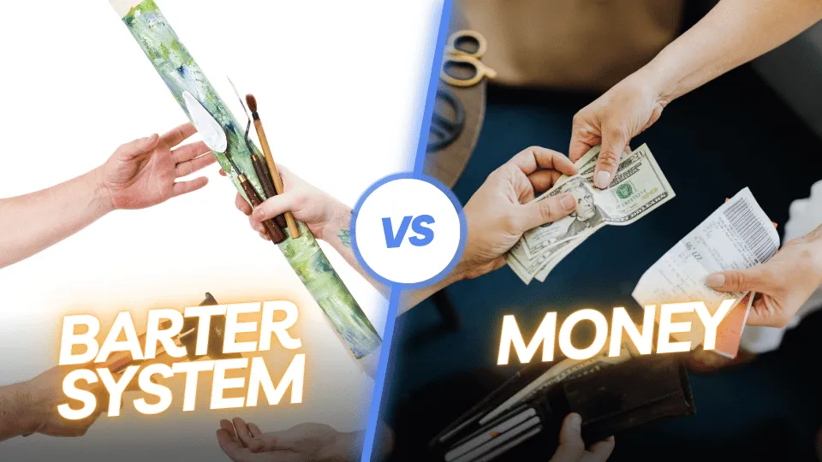

Islamic Educational College Date : / To /
Major:
Grade:
Unit:
Lesson:
Outcomes
05:00 minutes
Warm-Up
Some people say money is unfair, but others say trade is unfair. Which do you agree with, and why?
Pre-assessment
Presentation
Formative assessment
Feedback
Differentiation
Linking to life
Critical Thinking
Closure

Slide 8
Islamic Educational College Date : / To /
Major:
Grade:
Unit:
Lesson:
Outcomes
06:00 minutes
Warm-Up
. 1👉 imagine a small village that runs without money. How would people meet their needs and make sure everyone is treated fairly?
. 2👉 If two families needed different things, how could they solve the problem of sharing what they have in a way that works for both?
. 3👉Some people say life without money would bring people closer, while others say it would create conflicts. Which side do you agree with, and why?
4👉 Imagine a town where no one uses money. How would people get the things they need each day?
Pre-assessment
Presentation
Formative assessment
Feedback
Differentiation
Linking to life
Critical Thinking
Closure

Slide 9
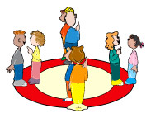
Islamic Educational College Date : / To /
Major:
Grade:
Unit:
Lesson:
Outcomes
8:00 minutes
Warm-Up
Inside- outside circle
Pre-assessment
Presentation
Formative assessment
Feedback
Differentiation
Linking to life
Critical Thinking
Closure

Slide 10
Islamic Educational College Date : / To /
Major:
Grade:
Unit:
Lesson:
Outcomes
06:00 minutes
Warm-Up
Imagine you live in a world without money. Explain how people would get the things they need and how they would trade fairly, .
Pre-assessment
Presentation
Formative assessment
Feedback
Summative assessment
Linking to life
Critical Thinking
Closure
Random Pick

Slide 11

Islamic Educational College Date : / To /
Major:
Grade:
Unit:
Lesson:
Outcomes
02:00 minutes
Warm-Up
Pre-assessment
Presentation
What have you learned today?
Formative assessment
Feedback
Differentiation
Linking to life
Critical Thinking
Closure

