Slide 1


Unit 1
Personality Adjectives

Slide 2
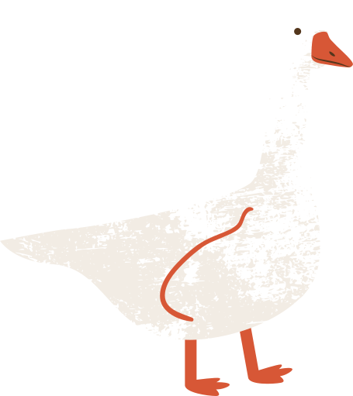
The Lesson’s Objectives
01
1- Recognize the meanings of the new words” personality adjectives” and use them correctly .

Slide 3
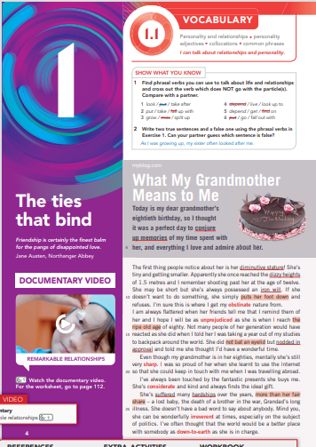
Obstinate
Unprejudiced
Sharp
Considerate
Irreverent
Down to earth
Faithful
The Bold Words

Slide 4

Pre- assessment
Mark the following words according to the attached rubric:
1- Never seen this word before
2- Seen the word, but not sure what it means
3- Used the words, but not sure if correctly
4- Used the word confidently in spelling or writing
5- Used the words confidently in both speaking and writing
2 minutes

Slide 5
Guess the meanings from the context :
1- The teacher was unprejudiced, treating all students equally regardless of their backgrounds.
2- John is always considerate of others' feelings, making sure not to hurt anyone with his words.
3- Her sharp mind allowed her to solve complex problems quickly.
4- The dog was faithful to its owner, always staying by his side.
Loyal .
B) Tolerant .
C) Quick- witted
( clever) .
D) Thoughtful (caring about others )

Slide 6

Formative Assessment
Performance
Pair Work
Task 2
With your partner, read the situations and guess which word I am thinking of. Write your answer on the white Board.
2 minutes

Slide 7
Which word am I thinking of….
Sharp
Situation 1: During a math class, the teacher presents a challenging problem to the students. One student, who is known for quickly understanding complex concepts, raises their hand almost immediately with the correct solution.
:

Slide 8
Which word am I thinking of….
Unprejudiced
Situation 2: A diverse group of people is interviewing for a job at a company. The interviewer, noticing the different backgrounds of the candidates, ensures that each one is evaluated based on their qualifications and skills alone.

Slide 9
Which word am I thinking of….
Considerate
Situation 3: During a busy morning at a café, a customer accidentally spills their coffee. Another customer, noticing this, quickly offers to help clean up and even buys them another cup

Slide 10
Which word am I thinking of….
Adviser
Situation4 : A pet dog waits by the door every evening, knowing that their owner will return home from work at the same time. Despite the long hours alone, the dog never fails to greet their owner with enthusiasm.

Slide 11
{unprejudiced – sharp – faithful – considerate }
The _______________neighbor helped carry the groceries for the elderly lady.
2. Her _______________view allowed her to make fair decisions without any bias.
3. The detective had a ____________ eye for details, noticing things others missed.
4. She remained ___________ to her friends, supporting them through difficult times
Summative Assessment
Time 2.5

Slide 12

Think of someone who is :
Unprejudiced
Sharp
Considerate
Faithful

Slide 13
Guess the meanings from the context :
1- His irreverent jokes about serious topics made some people uncomfortable, as they felt he was not showing the respect expected in such situations.
2- Despite his wealth, he was a down-to-earth person who never flaunted his success.
3- Despite the advice, he remained obstinate and refused to change his decision.
A)Stubborn .
B)Practical .
C)Disrespectful .

Slide 14
Formative Assessment
Performance
Pair Work
Task 2
With your partner, read the situations and guess which word I am thinking of. Write your answer on the white Board.
2 minutes

Slide 15
Which word am I thinking of….
obstinate
Situation 1 : At a family gathering, a relative refuses to acknowledge any dietary preferences or restrictions expressed by others, insisting on serving only their own favorite dishes..

Slide 16
Which word am I thinking of….
Irreverent
Situation 2: During a serious meeting, one team member uses humor to make light of a strict policy that others are afraid to question.

Slide 17
Which word am I thinking of….
Down to earth
Situation 3: A high school teacher addresses the class about study habits. Instead of offering theoretical advice, the teacher gives straightforward, practical suggestions like setting up a dedicated study space and breaking tasks into smaller, manageable steps.

Slide 18
2 minutes
{ irreverent – down to earth-obstinate }
Her _______________attitude made her approachable and easy to talk to.
The child was _____________, insisting on having his way no matter what.
The comedian's _____________ style of humor challenged traditional norms and often pushed the boundaries of what was considered acceptable.
Summative Assessment

Slide 19
Think of someone who is :
Irreverent.
Obstinate.
Down to earth.

Slide 20
Differentiation
* Students 1+ 2 :
Write a text using the words we have learned today .
Students 3+4 :
3 : Explain each picture orally to your partner .
4 : Guess the picture and write the concept the picture shows and write it down.

Slide 21
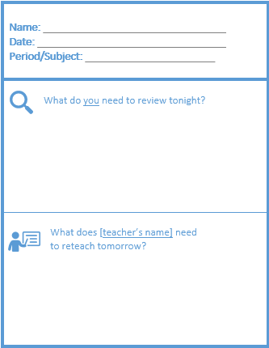
Exit Ticket

Slide 22
Lesson’s Objectives :
02
Recognize what “a collocation” is.
* Realize the meanings of the new” “collocations” and use them correctly .

Slide 23
Warming Up Activity
* Performance : Group Work
* Task : Guess Disney Characters from the Emoji's .
* Time : 2 minutes .

Slide 24
Pre- assessment
2 minutes

Slide 25
What is a collocation ?
A collocation is two or more words that often go together. These combinations just sound "right" to native English speakers, who use them all the time. On the other hand, other combinations may be unnatural and just sound "wrong". Look at these examples:
Natural English... | Unnatural English...
The fast train Fast food | The quick train Quick food
A quick shower A quick meal | a fast shower a fast meal

Slide 26
Make a decision
Make a mistake
Make an effort
- Do homework
- Do the dishes
- Do business

Slide 27
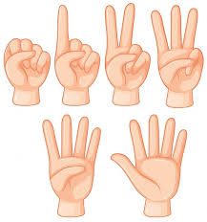
1- Diminutive stature .
2- Dizzy heights.
3-Iron Will
4- Suffer hardships .
5- Nod in approval .
6- Home baked treats .
7- Unassuming manner.
8- Conjure up with memories.

Slide 28
Suffer hardships : to endure or experience difficult or challenging situations, often involving pain, struggle, or discomfort. It refers to going through tough circumstances or adversity.
During the long winter, the villagers had to suffer hardships like scarce food and freezing temperatures.
Many pioneers suffered hardships as they traveled across the rugged terrain to reach their new homes.
Despite suffering hardships throughout his journey, he remained determined to achieve his dreams.
Diminutive stature: refers to a person or object being notably small or short in height. It describes someone or something with a physically small or petite build.
Despite her diminutive stature, she commanded the room with her powerful voice and confidence.
The diminutive stature of the statue made it easy to overlook in the crowded gallery.
His diminutive stature didn’t stop him from excelling in sports, proving that size isn’t everything.

Slide 29
Dizzy heights : metaphorically refers to achieving a very high level of success, power, or status, often to a point where it feels overwhelming or difficult to handle. It suggests reaching the peak of one's potential or career, where the position is both impressive and possibly intimidating.
After years of hard work, she finally reached the dizzy heights of the corporate world as CEO.
His new album took him to the dizzy heights of fame, with millions of fans around the world.
The team rose to the dizzy heights of success after winning the championship for the third year in a row.
Conjure up with memories: to bring memories or images to mind, often vividly or unexpectedly. It suggests the act of recalling or evoking past experiences, feelings, or thoughts as if summoning them from the past
The old photograph conjured up memories of our childhood summers spent at the lake.
Hearing that song always conjures up memories of my first school dance.
The scent of fresh-baked bread conjured up memories of visiting my grandmother’s house as a child.

Slide 30

We are going to read different situations to guess which collocation am I thinking of..
Task 2
2 minutes

Slide 31
Which word am I thinking of….
Suffer hardships
Situation 1: Imagine a family who lost everything in a natural disaster. They had no home, no money, and had to sleep in temporary shelters. Despite this, they never gave up and eventually rebuilt their lives.

Slide 32
Which word am I thinking of….
Diminutive Stature
Situation 3: Imagine a woman who always gets mistaken for a teenager because she is very small and looks younger than her age. Despite her size, she commands respect wherever she goes..

Slide 33
Which word am I thinking of….
Dizzy heights
Situation 3 : Think of a man who started working as a waiter in a small café. Over the years, through hard work and perseverance, he became the CEO of a large restaurant chain. His rapid rise in position took him to unexpected levels of success.

Slide 34
Which word am I thinking of….
Conjure up memories
Situation 5:
Imagine you're cleaning out your attic with your family. As you're sorting through old boxes, you come across an old, dusty photo album that hasn't been opened in years. You flip through the pages and see pictures from your childhood—birthday parties, family vacations, and moments spent with loved ones who are no longer around.

Slide 35
Formative Assessment
diminutive stature suffered hardships conjures up memories dizzy heights
conjures up memories
1- Every time I hear that song, it________ of the road trip we took last year.
2- Reaching the ___________of fame, she had to learn how to navigate the pressure and attention that came with her success.
3- Though he had a ____________, his leadership and intelligence made him stand out in every group.
4- During the war, many families ______________, losing loved ones and struggling to find food and shelter.
dizzy heights
diminutive stature
suffered hardships

Slide 36
Home baked treats : refers to delicious baked goods, such as cookies, cakes, pies, or bread, made at home rather than purchased from a store.
The smell of home-baked treats filled the kitchen, making everyone eager to try the fresh cookies.
She brought a basket of home-baked treats to the party, and they were a big hit with the guests.
Nothing beats the comfort of enjoying home-baked treats with a cup of tea on a rainy day.
Iron will : refers to a strong and unyielding determination or resolve. It describes a person’s ability to remain steadfast and persistent in the face of challenges or difficulties.
Her iron will enabled her to overcome numerous obstacles and achieve her dream of becoming a doctor.
The athlete's iron will was evident as he pushed through the pain to finish the marathon.
Leading the company through a crisis required an iron will and unwavering commitment to success.

Slide 37
Nod in approval : to signal agreement, consent, or satisfaction by moving the head up and down slightly. It is a non-verbal way of expressing approval or agreement..
When the manager presented the new project plan, the team members nodded in approval, indicating they were on board with the ideas.
She gave a nod in approval after reviewing the final draft of the report, pleased with the improvements.
The teacher nodded in approval as the student answered the question correctly and confidently.
Unassuming manner refers to a way of behaving that is modest, humble, and without any showiness or arrogance. It describes someone who does not seek attention or praise but instead presents themselves in a simple and unpretentious way.
Despite his vast experience and knowledge, he approached the meeting with an unassuming manner that won everyone’s respect.
Her unassuming manner made her approachable and easy to talk to, even though she was a top executive at the

Slide 38
Which collocation am I thinking of….
Home-baked treats
Situation 1 :Visualize walking into a kitchen filled with the smell of fresh cookies and cakes. Your friend tells you their grandmother made everything from scratch just for you.

Slide 39
Which word am I thinking of….
Iron will
Situation 2: Consider a person who trained for a marathon despite having a serious injury. Everyone told them to quit, but they kept going and finished the race. Their determination was unbreakable.

Slide 40
Which word am I thinking of….
Nod in approval:
Situation 3: Picture a student who presents a well-prepared project to their teacher. The teacher listens carefully, then silently acknowledges the effort by tilting their head slightly, signaling their satisfaction.

Slide 41
Which word am I thinking of….
Unassuming manner
Situation 4: Think of a person who dresses simply and speaks softly. Despite their modest appearance, everyone is surprised to learn that they are actually a renowned artist with multiple awards.

Slide 42
Formative Assessment
home baked treats unassuming manner nod in a approval iron will
1- The director gave a quick _____________after reviewing the final scene, signaling that the filming was complete
2- .Her ______________was evident as she continued working tirelessly to support her family, no matter how difficult things became.
3- Her _____________made it easy for people to overlook her, but those who knew her admired her quiet strength and wisdom.
4- The smell of ______________ filled the kitchen, making it impossible to resist grabbing a cookie fresh from the oven.
nod in approval
iron will
Unassuming manner
home baked treats

Slide 43
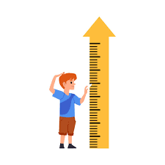
Real Life Application
. Diminutive Stature
Task: Think of someone you know
(a friend, family member, or public figure) who has a diminutive stature but makes a big impact in life.
1 minute
1 minute
. Share what you have in mind with your partner .

Slide 44
Real Life Application
. Dizzy height
Task: Can you describe a time when you or someone close to you achieved great success? What were the challenges of reaching that 'dizzy height'?"
1 minute
1 minute
. Share what you have in mind with your partner .

Slide 45
Real Life Application
Round Table
. Conjure up memories
Task: Write one thing that conjures up memories for you. Pass it to your partner.
Add what you have written once you receive your partner’s response. Repeat till you receive your paper .
1 minute think
2 minutes

Slide 46
Homework
Task: Analyze a character from a book or movie who has an "unassuming manner." Describe their traits and how these traits affect their interactions with others.

Slide 47

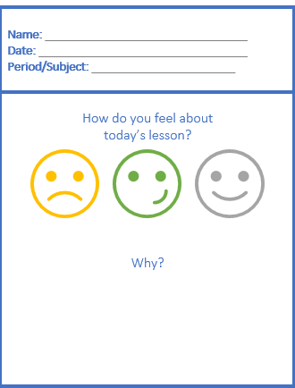
Exit Ticket

