Slide 1


Being Friends
Unit 1

Slide 2
Lesson’s Objectives
1-Understand the Key Traits of Friendship.
2- Draw Parallels Between Fiction and Real-Life Friendships .

Slide 3
Warming up
https://learnenglish.britishcouncil.org/skills/listening/b1-listening/meeting-old-friend

Slide 4




ISLAMIC EDUCATIONAL COLLEGE DATE: / / 2025
SUBJECT: Reading
GRADE: 10
UNIT:1
Lesson: 1
OUTCOMES
1:30 minute
Pre assessment
WARM UP
REAL LIFE APPLICATION
CRITICAL THINKING
What does the phrase “ties that bind” most likely mean?
Shoes and clothes
Relationships and connections
Knots in a rope
Rules and laws
Which of these is an example of a strong friendship?
Ignoring someone when they need help
Sharing secrets and supporting each other
Only talking to someone when you need something
Competing to see who is better
PREASSESSMENT
PRESENTATION
DIFFERENTIATION
FORMATIVE ASSESSMENT
FEEDBACK
EXIT TICKET

Slide 5
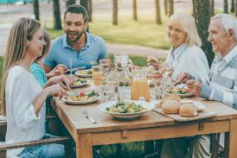
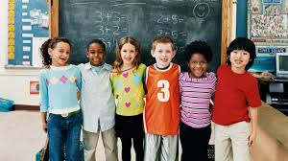


SUBJECT: Reading
GRADE: 10
UNIT: 1
Lesson: 1
OUTCOMES
02:00
minute
Real Life Application
WARM UP
Real Life Application
How do these pictures relate to our lesson title?
CRITICAL THINKING
FORMATIVE ASSESSMENT
FEEDBACK
DIFFERENTIATION
REAL LIFE APPLICATION
PRESENTATION
EXIT TICKET

Slide 6
1- What qualities do you look for in a friend, and why?
2- How do you think trust is built in a friendship?
3- Can you describe a situation where a friend helped you overcome a challenge?
4- How do you handle disagreements with your friends?
5- What are the most important aspects of maintaining a long-lasting friendship?

Slide 7

Speaking:
Read the short text with quotes from famous people about friendship. Which quote do you like the most?
The Ancient Greek philosopher Aristotle wrote that “ friendship takes time: 'Wishing to be friends is quick work, but friendship is a slow ripening fruit.
Fast forward to the 1900's, and the American car manufacturer Henry Ford said: 'My best friend is the one who brings out the best in me.
'Now, social media allows us to 'friend' - or 'unfriend' - people online. We can easily compare how many friends we have on our social media profiles. However, as writer Malorie Blackman says: 'Life isn't about quantity, it's about quality.'

Slide 8

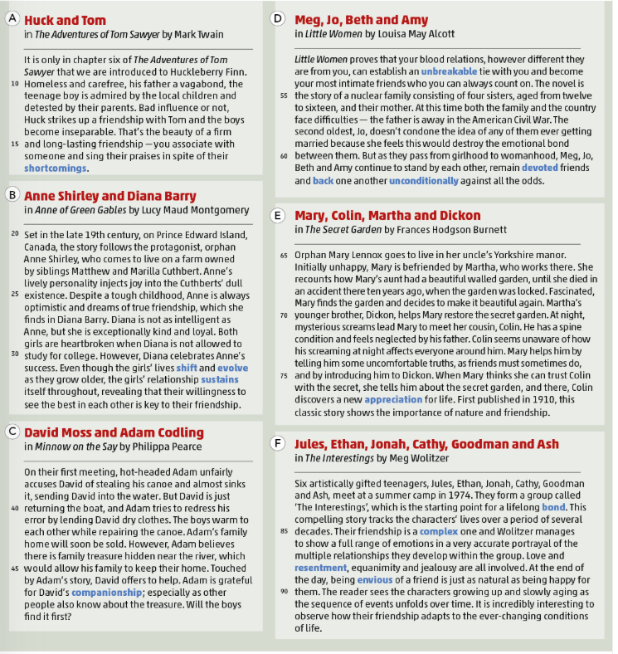
ISLAMIC EDUCATIONAL COLLEGE DATE: / / 2025
SUBJECT: Reading
GRADE: 10
UNIT: 1
Lesson: 1
OUTCOMES
3:00 minutes
WARM UP
REAL LIFE APPLICATION
CRITICAL THINKING
PREASSESSMENT
PRESENTATION
DIFFERENTIATION
FEEDBACK
FORMATIVE ASSESSMENT
EXIT TICKET

Slide 9
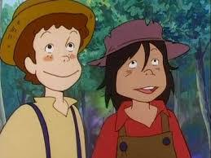

01
Huck and Tom in The Adventures of Tom Sawyer by Mark Twain. It is only in chapter six of The Adventures of Tom Sawyer that we are introduced to Huckleberry Finn. Homeless and carefree, his father a vagabond, the teenage boy is admired by the local children and detested by their parents.
Homeless : without a home
Carefree : free from anxiety
The Adventure of Tom Sawyer . By “ Mark Twain”
Vagabond : a person who wanders from place to place without a home or job.
Detested : hated

Slide 10
01
Huck and Tom
Bad influence or not, Huck strikes up a friendship with Tom and the boys become inseparable. That's the beauty of a firm 15 and long-lasting friendship -you associate with someone and sing their praises in spite of their shortcomings.
Strikes up : began .
The Adventure of Tom Sawyer . By “ Mark Twain”
Inseparable :unable to be separated .
Associate with : connect with
Sing their praises : to say good things about someone often in a very enthusiastic way
Shortcomings :
Flaws or faults

Slide 11
1. Based on The Adventures of Tom Sawyer, Huck was detested by the children’s parents. Illustrate Huck’s personality.
Huck is homeless and carefree, a boy admired by other children for his free spirit but disliked by adults because of his bad influence.
Pair Work
1:30 minute

Slide 12

Students 1+2
Students 3+4
Differentiation
Performance : Pair work
Task : answer the questions given .
Time : 4 minutes

Slide 13
Real Life Application
Pair work
Time : 1:30
Huck has a reputation in the town as an outcast, yet Tom chooses to be friends with him. Do you think it’s important to look beyond someone’s reputation when forming friendships? Why or why not?

Slide 14
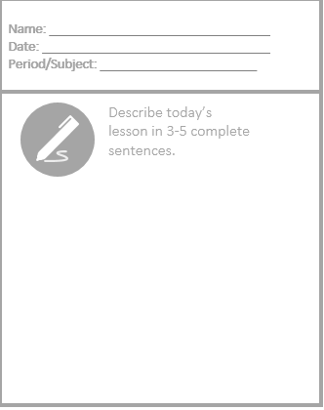
Exit Ticket

Slide 15
Lesson’s Objectives :
Make connections between the themes of the story and their own personal experiences, reflecting on how they handle conflicts, work together with friends, and offer support.
Engage in reflective discussions about how they can apply lessons learned from the story to improve their own relationships and teamwork skills.

Slide 16
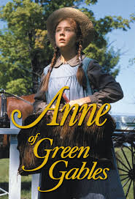
02
Anne Shirley and Diana Barryin Anne of Green Gables by Lucy Maud Montgomery Set in the late 19th century, on Prince Edward Island, Canada, the story follows the protagonist, orphan Anne Shirley, who comes to live on a farm owned by siblings Matthew and Marilla Cuthbert. Anne's lively personality injects joy into the Cuthberts' dull existence. Despite a tough childhood, Anne is always optimistic and dreams of true friendship, which she finds in Diana Barry.
Protagonist : the leading character or one of the major characters in a novel, film …etc
Protagonist : the leading character or one of the major characters in a novel, film …etc
By Lucy Maud
Lively : energetic
Injects joy : brings happiness
Optimistic : cheerful

Slide 17
02
Diana is not as intelligent as Anne, but she is exceptionally kind and loyal. Both girls are heartbroken when Diana is not allowed to study for college. However, Diana celebrates Anne's success. Even though the girls' lives shift and evolve as they grow older, the girls' relationship sustains itself throughout, revealing that their willingness to see the best in each other is key to their friendship.
Evolve : develop
Sustains throughout : means that their relationship endures and remains stable over time, regardless of any changes or challenges they may face.
By Lucy Maud
Willingness : readiness

Slide 18
2. Quote the sentence that indicates that Anne overcame her circumstances and pursued her dream.
“Despite a tough childhood, Anne is always optimistic and dreams of true friendship”
Pair Work
1:30 minute

Slide 19
3. Shirley and Diana have a key to their friendships. Justify.
Their friendship is based on seeing the best in each other. Even when separated by life changes, their bond stays strong because they remain supportive and understanding.
Pair Work
1:30 minute

Slide 20
Students 1+2
Students 3+4
Differentiation
* Performance : Pair work
* Task : answer the questions given .
Time : 5 minutes

Slide 21
Real Life Application
Performance : individual
Time :5 minutes
1. Reflective Writing
Task:
Write a journal entry about a time when you supported a friend through a difficult situation. Describe the situation, your actions, and how your support helped your friend, drawing parallels to how Anne and Diana support each other.

Slide 22
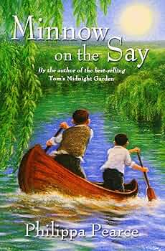
03
David Moss and Adam Codling in Minnow on the Say by Philippa Pearce
On their first meeting, hot-headed Adam unfairly accuses David of stealing his canoe and almost sinks it, sending David into the water. But David is just returning the boat, and Adam tries to redress his error by lending David dry clothes. The boys warm to each other while repairing the canoe. Adam's family home will soon be sold.
Hot headed :easily angered
Accuse :charge with .
Redress : correct
Warm :become more friendly and develop a positive connection
canoe
Repairing : fixing

Slide 23
03
However, Adam believes there is family treasure hidden near the river, which would allow his family to keep their home. Touched by Adam's story, David offers to help. Adam is grateful for David's companionship; especially as other people also know about the treasure. Will the boys find it first?

Slide 24
4. How was the first meeting between David and Adam?
Their first meeting was not pleasant — Adam accused David of stealing his canoe, and David almost drowned while returning it.
Pair Work
1:30 minute

Slide 25

Selection / Story | Main Characters | Background / Situation | How They Become Friends | Actions Showing Friendship | Qualities of Friendship
Huck and Tom (The Adventures of Tom Sawyer)
Anne Shirley and Diana Barry (Anne of Green Gables)
David Moss and Adam Codling (Minnow on the Say)

Slide 26
Selection / Story | Main Characters | Background / Situation | How They Become Friends | Actions Showing Friendship | Qualities of Friendship
Huck and Tom (The Adventures of Tom Sawyer) | Huck Finn, Tom Sawyer | Huck: homeless, carefree, disliked by adults; Tom: local boy | Huck strikes up friendship with Tom; they become inseparable | Spend time together, go on adventures, stick with each other despite flaws | Loyalty, acceptance of shortcomings
Anne Shirley and Diana Barry (Anne of Green Gables) | Anne Shirley, Diana Barry | Anne: orphan, lively, optimistic; Diana: kind, loyal | Meet as young girls; bond through kindness and support | Celebrate each other’s successes, support emotionally, long-lasting friendship | Loyalty, kindness, support, seeing the best in each other
David Moss and Adam Codling (Minnow on the Say) | David Moss, Adam Codling | David: honest, helpful; Adam: hot-headed, family home at risk | Meet after Adam accuses David of stealing canoe; bond while repairing it | Adam lends clothes; David helps find treasure; trust and companionship | Trust, forgiveness, support, shared adventures

Slide 27
Real life Application
First Impressions and Forgiveness:
Adam and David start their friendship with a misunderstanding, but they quickly become friends. Have you ever had a bad first impression of someone that later turned into a friendship? How did you resolve the initial misunderstanding?

Slide 28
Exit Ticket

Slide 29
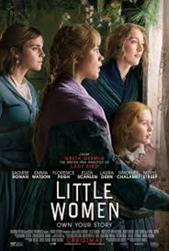
04
Little Women proves that your blood relations, however different they are from you, can establish an unbreakable tie with you and become your most intimate friends who you can always count on .The novel is the story of a nuclear family consisting of four sisters, aged from twelve to sixteen, and their mother .At this time both the family and the country face difficulties – the father is away in the American Civil War.
Intimate : close
Count on : rely on .
Nuclear family : a family structure that consists of two parents living with their children, also known as an immediate family

Slide 30
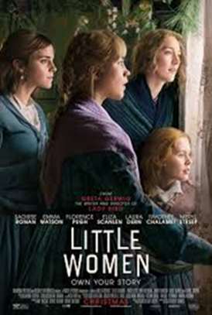
04
The second oldest, Jo , doesn’t condone the idea of any of them ever getting married because she feels this would destroy the emotional bond between them .But as they pass from girlhood to womanhood ,Meg, Jo, Beth and Amy continue to stand by each other , remain devoted friends and back one another unconditionally against all the odds.
Condone : excuse

Slide 31
5. Little Women gives a portrayal of the relationship and of the bond between the members of a family. Give evidence according to the text.
The novel shows how Meg, Jo, Beth, and Amy continue to stand by each other, remaining devoted friends and sisters who love one another unconditionally despite hardships.
Pair Work
1:30 minute

Slide 32
Task 1: Personal Reflection Discuss with your partner whether you agree or disagree with Jo’s belief that marriage would damage the bond between sisters. Use examples from your own experiences or real-life situations to support your opinion.
Pair work
2 minutes

Slide 33

Discuss as a class how the bond between siblings or close family members in Little Women reflects the bonds we share in our own families. What lessons can we apply to our relationships with siblings or close friends?To talk about events in the future that have already been planned.

Slide 34
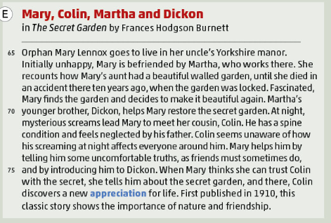
Orphan (line 65): A child whose parents are dead.
Manor (line 65): A large country house with lands; an estate.
Reaccounts (line 67): Relates or tells a story or series of events.
Spine condition (line 71): A medical problem or disease affecting the backbone.
Appreciation (line 76): Recognition and enjoyment of the good qualities of something.

Slide 35
6. The Secret Garden is considered a good example that highlights the importance of nature and friendship. Justify.
Mary’s friendship with Colin and Dickon helps her heal emotionally and brings new life to the neglected garden, showing how nature and companionship can restore both health and happiness.
Pair Work
1:30 minute

Slide 36
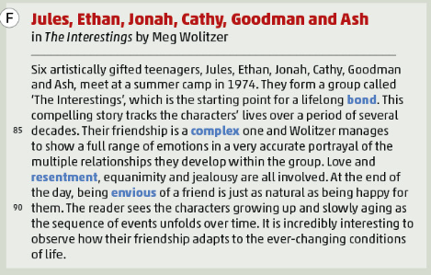
Artistically gifted (line 79): Having a natural talent for creative arts like painting, music, or writing.
Bond (line 82): A strong feeling of connection or friendship between people.
Complex (line 85): Made up of many interrelated parts; complicated.
Resentment (line 87): Bitter indignation or ill will at having been treated unfairly.
Equanimity (line 87): Mental calmness, composure, and evenness of temper, especially in a difficult situation.
Jealousy (line 87): A feeling of envy toward someone else's achievements, possessions, or advantages.
Envious (line 89): Feeling or showing a desire to have what someone else has.

Slide 37
7. In The Interestings, a friendship endures despite contradictory feelings among the individuals. Explain.
Their friendship lasts through love, envy, ambition, and jealousy, proving that even though they experience conflicting emotions, their long-term bond remains strong over the years
Pair Work
1:30 minute

Slide 38
Selection / Story | Main Characters | Background / Situation | How They Become Friends | Actions Showing Friendship | Qualities of Friendship
Meg, Jo, Beth, and Amy (Little Women)
Mary, Colin, Martha, and Dickon (The Secret Garden)
Jules, Ethan, Jonah, Cathy, Goodman, Ash (The Interestings)

Slide 39
Selection / Story | Main Characters | Background / Situation | How They Become Friends | Actions Showing Friendship | Qualities of Friendship
Meg, Jo, Beth, and Amy (Little Women) | Meg, Jo, Beth, Amy March | Sisters aged 12–16; father away in Civil War; face family and societal challenges | Friendship grows naturally as sisters | Stand by each other, remain devoted, support unconditionally | Loyalty, devotion, unconditional support
Mary, Colin, Martha, and Dickon (The Secret Garden) | Mary Lennox, Colin Craven, Martha, Dickon | Mary: orphan; Colin: sick, neglected; Martha: maid; Dickon: helpful brother | Mary and Colin(she hers his screams at night) became friends after meeting through Martha and Dickon while working on the secret garden | Help each other, restore garden, build trust, encourage growth | Trust, support, honesty, encouragement
Jules, Ethan, Jonah, Cathy, Goodman, Ash (The Interestings) | Jules, Ethan, Jonah, Cathy, Goodman, Ash | Artistically gifted teenagers; meet at summer camp 1974 | Form group “The Interestings,” lifelong bond | Maintain connection, support each other, navigate complex emotions | Loyalty, patience, adaptability, understanding

Slide 40
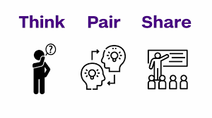

ISLAMIC EDUCATIONAL COLLEGE DATE: / / 2025
SUBJECT: Reading
GRADE: 10
Unit: 1
Lesson: 1
OUTCOMES
CRITICAL THINKING
2:00 minutes
WARM UP
REAL LIFE APPLICATION
Which story’s friendship do you think would be hardest to keep in real life? Why?
CRITICAL THINKING
PREASSESSMENT
FEEDBACK
FORMATIVE ASSESSMENT
PRESENTATION
DIFFERENTIATION
EXIT TICKET

Slide 41
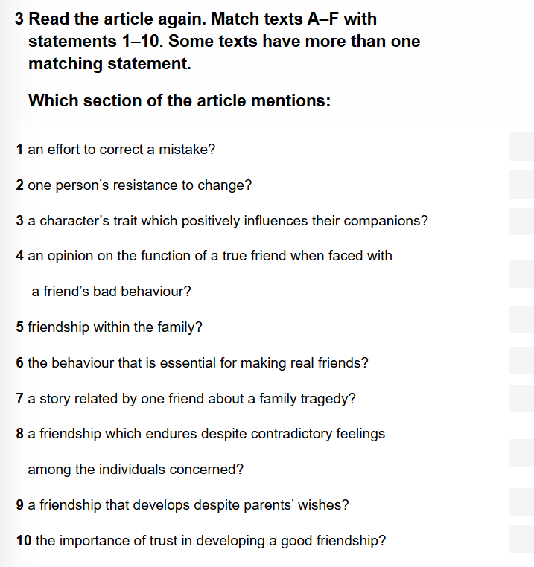
ISLAMIC EDUCATIONAL COLLEGE DATE: / / 2025
SUBJECT: Reading
GRADE: 10
UNIT: 1
Lesson: 1
OUTCOMES
3:00 minutes
WARM UP
REAL LIFE APPLICATION
CRITICAL THINKING
PREASSESSMENT
PRESENTATION
DIFFERENTIATION
FEEDBACK
FORMATIVE ASSESSMENT
EXIT TICKET

Slide 42
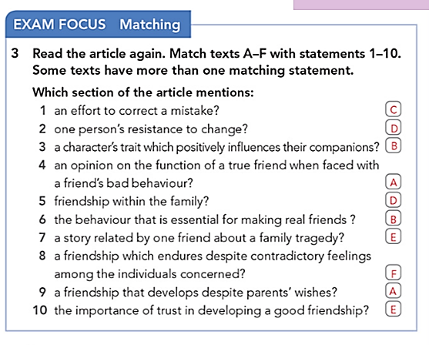
ISLAMIC EDUCATIONAL COLLEGE DATE: / / 2025
SUBJECT: Reading
GRADE: 10
UNIT: 1
Lesson: 1
OUTCOMES
1:00 minutes
WARM UP
REAL LIFE APPLICATION
CRITICAL THINKING
PREASSESSMENT
PRESENTATION
DIFFERENTIATION
FEEDBACK
FORMATIVE ASSESSMENT
EXIT TICKET

Slide 43
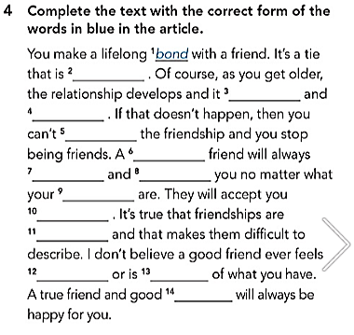
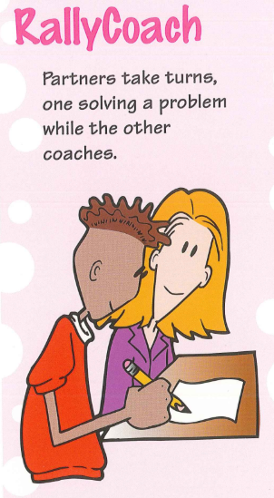
ISLAMIC EDUCATIONAL COLLEGE DATE: / / 2025
SUBJECT: Reading
GRADE: 10
UNIT: 1
Lesson: 1
OUTCOMES
5:00 minutes
WARM UP
REAL LIFE APPLICATION
CRITICAL THINKING
PREASSESSMENT
PRESENTATION
DIFFERENTIATION
FEEDBACK
FORMATIVE ASSESSMENT
EXIT TICKET

Slide 44
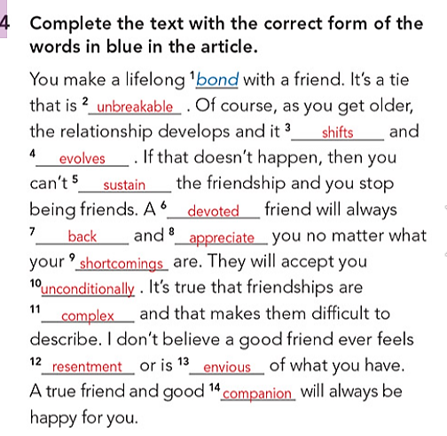
ISLAMIC EDUCATIONAL COLLEGE DATE: / / 2025
SUBJECT: Reading
GRADE: 10
UNIT: 1
Lesson: 1
OUTCOMES
1:00 minutes
WARM UP
REAL LIFE APPLICATION
CRITICAL THINKING
PREASSESSMENT
PRESENTATION
DIFFERENTIATION
FEEDBACK
FORMATIVE ASSESSMENT
EXIT TICKET

Slide 45
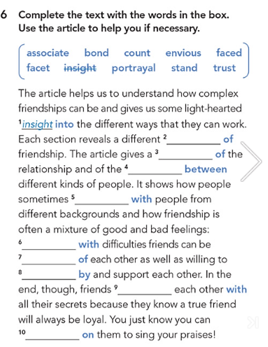
ISLAMIC EDUCATIONAL COLLEGE DATE: / / 2025
SUBJECT: Reading
GRADE: 10
UNIT: 1
Lesson: 1
OUTCOMES
Formative assessment
5:00 minute
WARM UP
Performance : Pair Work .
Time : 5 Minutes.
PREASSESSMENT
PRESENTATION
FORMATIVE ASSESSMENT
FEEDBACK
DIFFERENTIATION
REAL LIFE APPLICATION
CRITICAL THINKING
EXIT TICKET

Slide 46
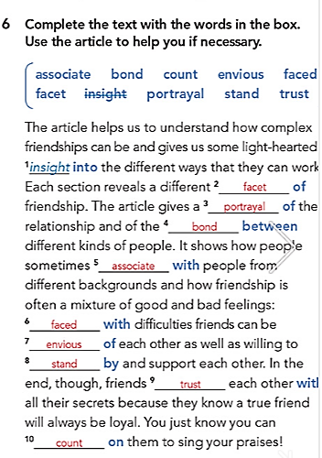
ISLAMIC EDUCATIONAL COLLEGE DATE: 19 / 2/ 2025
SUBJECT: Reading
GRADE: 10
UNIT: 1
Lesson: 1
OUTCOMES
1:00 minutes
WARM UP
REAL LIFE APPLICATION
CRITICAL THINKING
PREASSESSMENT
PRESENTATION
DIFFERENTIATION
FEEDBACK
FORMATIVE ASSESSMENT
EXIT TICKET

