Slide 1
Unit : two
Grammar : verb to be
Grade :5
Part 1

Slide 3
Outcomes:
Identify the forms of to be (am, is, are, was, were).
Use (to be )correctly in sentences.
Make positive, negative, and question forms.
Describe people and things using to be.

Slide 4

Warm up
If I were invisible for a day, I would ……………….

Slide 5
Can You Answer These Questions?
pre-assessment
Are your friends in this class?
Is there a computer in your classroom?
Are you going on a trip this year?
Is your teacher tall or short?
Are the lights in the classroom on?

Slide 6
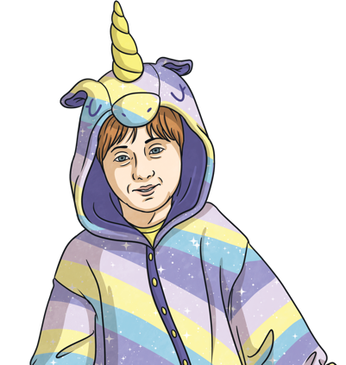

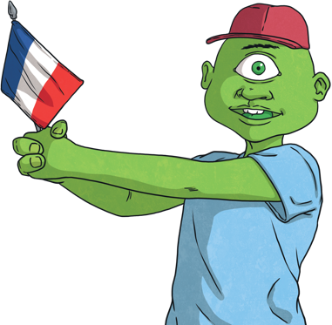
Using ‘am’
Introduction
We use am when the subject is ‘I’, when we are talking about me.
I am clever.
I am learning French.
I am not doing my homework.

Slide 7
Using ‘am’
Formative assessment
Fill in ‘am’ to complete the sentences
I am a teenager this year.
I a teenager this year.
I am at the ski resort.
I at the ski resort.
My brother is short, but I am tall.
My brother is short, but I tall.

Slide 8
Using ‘am’
Fill in ‘am’ to complete the sentences
Gabby, I am angry with you.
Gabby, I angry with you.
I am not in Australia, I am in India.
I not in Australia, I in India.
Am I sick?
I sick?

Slide 9
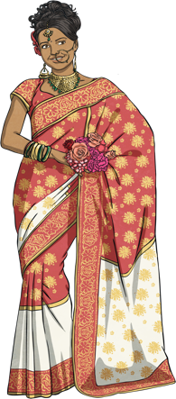
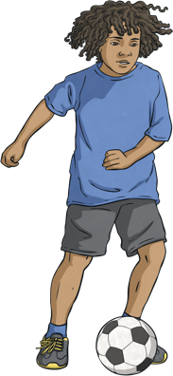
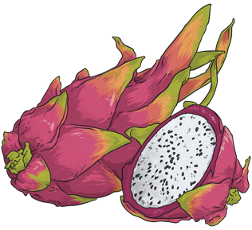
Using ‘is’
We use is when the subject is ‘he’, ‘she’ or ‘it’.
When the subject is singular = one thing.
She is married.
The fruit is tasty.
Is he swimming?

Slide 10

Using ‘is’
Fill in ‘is’ to complete the sentences
The nurse working hard.
The nurse is working hard.
She is nervous for the exam.
She nervous for the exam.
Peru is a country in South America.
Peru a country in South America.

Slide 11
Using ‘is’
Fill in ‘is’ to complete the sentences
Is he listening to the news?
he listening to the news?
The hat yellow, but the scarf green.
The hat is yellow, but the scarf is green.
It is raining today, bring your umbrella.
It raining today, bring your umbrella.

Slide 12

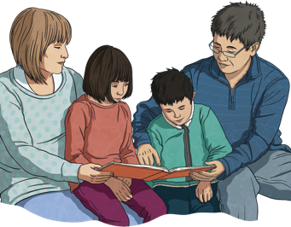
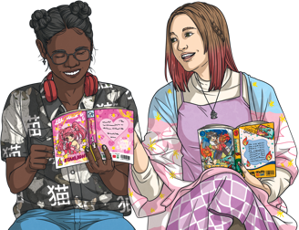
Using ‘are’
We use are when the subject is ‘you’, ‘we’, ‘they’ ‘many’.
When the subject is plural = 2 things + .
They are reading.
We are best friends.
Are the butterflies a family?

Slide 13
Using ‘are’
Fill in ‘are’ to complete the sentences
English lessons are not difficult.
English lessons not difficult.
they dating?
Are they dating?
The boxes are square.
The boxes square.

Slide 14
Using ‘are’
Fill in ‘are’ to complete the sentences
We coming to your birthday party.
We are coming to your birthday party.
Why you fishing here?
Why are you fishing here?
Those students are getting good results.
Those students getting good results.

Slide 15
Differentiation
1:Fill in the blank:I ___ a student. (am / is / are)
2. Choose the correct form and explain why it’s correct: The children ___ in the playground. a) is b) are c) am
3. Rewrite the sentence in the negative form: They are happy. ______________________
4. Write two sentences using to be: – one in the present tense, – one in the question form.

Slide 16

Choose the correct answer
am = I | is = One thing | are = Many things
(Am / Is / Are) I on the right road?
Am I on the right road?
You (am / is / are) brave and strong.
You are brave and strong.
She (am / is / are) not reading a good book.
She is not reading a good book.
I (am / is / are) in the ocean.
I am in the ocean.

Slide 17
Choose the correct answer
am = I | is = One thing | are = Many things
(Am / Is / Are) they selling their house?
Are they selling their house?
Why (am / is / are) the train stopping here?
Why is the train stopping here?
Mom (am / is / are) in the middle, I (am / is / are) on the left and my brothers (am / is / are) next to me.
Mom is in the middle, I am on the left and my brothers are next to me.

Slide 18

Sort the Sentences
Press the sentences below to reveal the answers.
Am
Is
Are
Am I making dinner?
The umbrella is in the car.
Are the bicycles new?
The umbrella in the car.
the bicycles new?
I making dinner?

Slide 19

Sort the Sentences
Press the sentences below to reveal the answers.
Am
Is
Are
Am I making dinner?
The umbrella is in the car.
Are the bicycles new?
I am on my skateboard.
The guitar is not there.
We are moving to Doha.
I on my skateboard.
We moving to Doha.
The guitar not there.

Slide 20

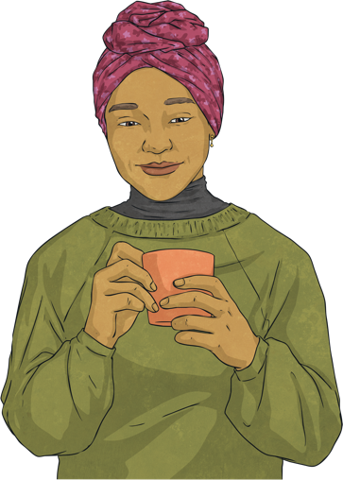
Create your own sentence
Remember to add ‘am’, ‘is’, or ‘are’.
The woman is drinking coffee.
coffee
+
click to reveal

Slide 21
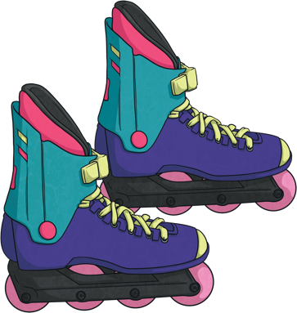
Create your own sentence
Remember to add ‘am’, ‘is’, or ‘are’.
rollerblades
The rollerblades are colourful.
+
click to reveal

Slide 22
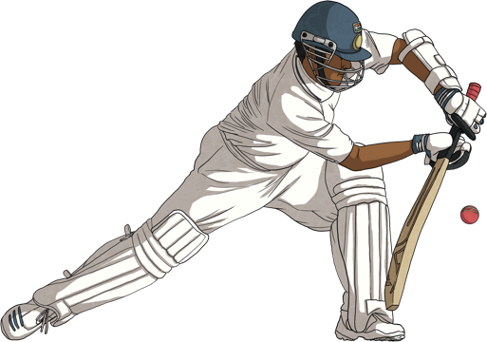
Create your own sentence
Remember to add ‘am’, ‘is’, or ‘are’.
I am not a tennis player, I am a cricket player.
+
I + not
click to reveal

Slide 23
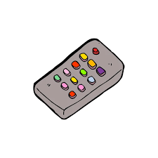
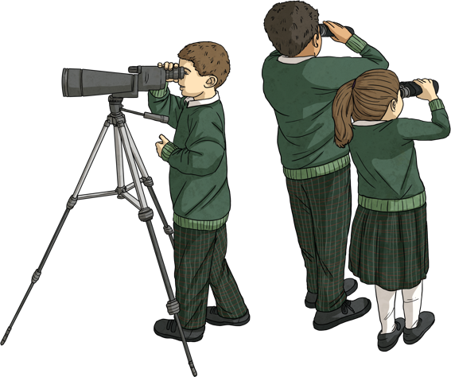
Choose the correct ‘be’ verb
Click on the answer you think is correct.
They am bird-watching.
They are bird-watching.
They are bird-watching.
Are they bird-watching?
They is bird-watching.
Can you change the answer to a question?
click to reveal

Slide 24
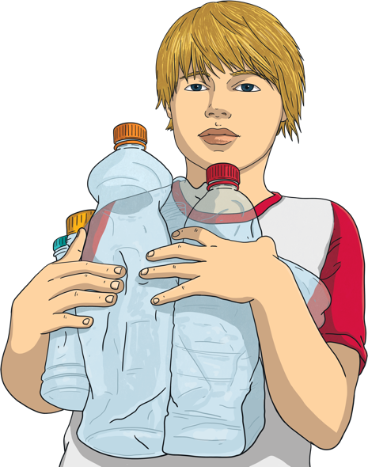
Choose the correct ‘be’ verb
Click on the answer you think is correct.
He am collecting bottles.
He is collecting bottles.
He are collecting bottles.
He is not collecting bottles.
He is collecting bottles.
Can you change the answer to the negative form?
click to reveal

Slide 25

Use the Spinners to Make a Sentence
Summative
The hamburguer
I
feeling
hairy
The socks
The girl
at the bakery
baking
He
We
thinking
funny
They
buying

Slide 26
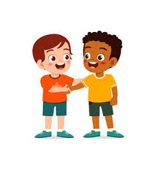
Real life situation
introduce yourself and a friend using the verb to be (am / is / are).

Slide 27


Critical thinking
Think about your school or neighborhood. What is the best thing about it, and what are the problems? Use “is” or “are” in 5–6 sentences and explain your opinion.

Slide 28

Exit ticket

