Slide 1


What Is Informative Writing?

Slide 2
Learning Outcomes
Understand Writing
Identify Structure
Write Examples
Students will learn the definition of informative writing and recognize its purpose in conveying clear and factual information to the audience.
They will explore the key components of an informative text, including the introduction, body, and conclusion, which help organize their ideas effectively.
Finally, students will practice their skills by writing a short example, applying the structure they learned and using relevant facts to support their writing.
2

Slide 3

Warm-Up Activity: Rally Robin
Tongue Twister Race:
Who can say it fastest without mistakes?
Fuzzy Wuzzy was a bear. Fuzzy Wuzzy had no hair.
Fuzzy Wuzzy wasn’t very fuzzy, was he?
Buzz in

Slide 4


Pre-Assessment
Which one of the following is a fact ?
1. My dad loves reading
2. Reading is important
3. My favorite story is Alice in the Wonderland
IRS

Slide 5
Pre-Assessment
Which one of the following is a fact ?
1. My dad loves reading
2. Reading is important
3. My favorite story is Alice in the Wonderland
IRS

Slide 6
Pre-Assessment
Which one of the following is an opinion?
1. Water freezes at 0°C
2. Summer is the best season.🌞
3. There are 7 days in a week. 📅
IRS

Slide 7
Pre-Assessment
Which one of the following is an opinion?
1. Water freezes at 0°C
2. Summer is the best season.🌞
3. There are 7 days in a week. 📅
IRS

Slide 8
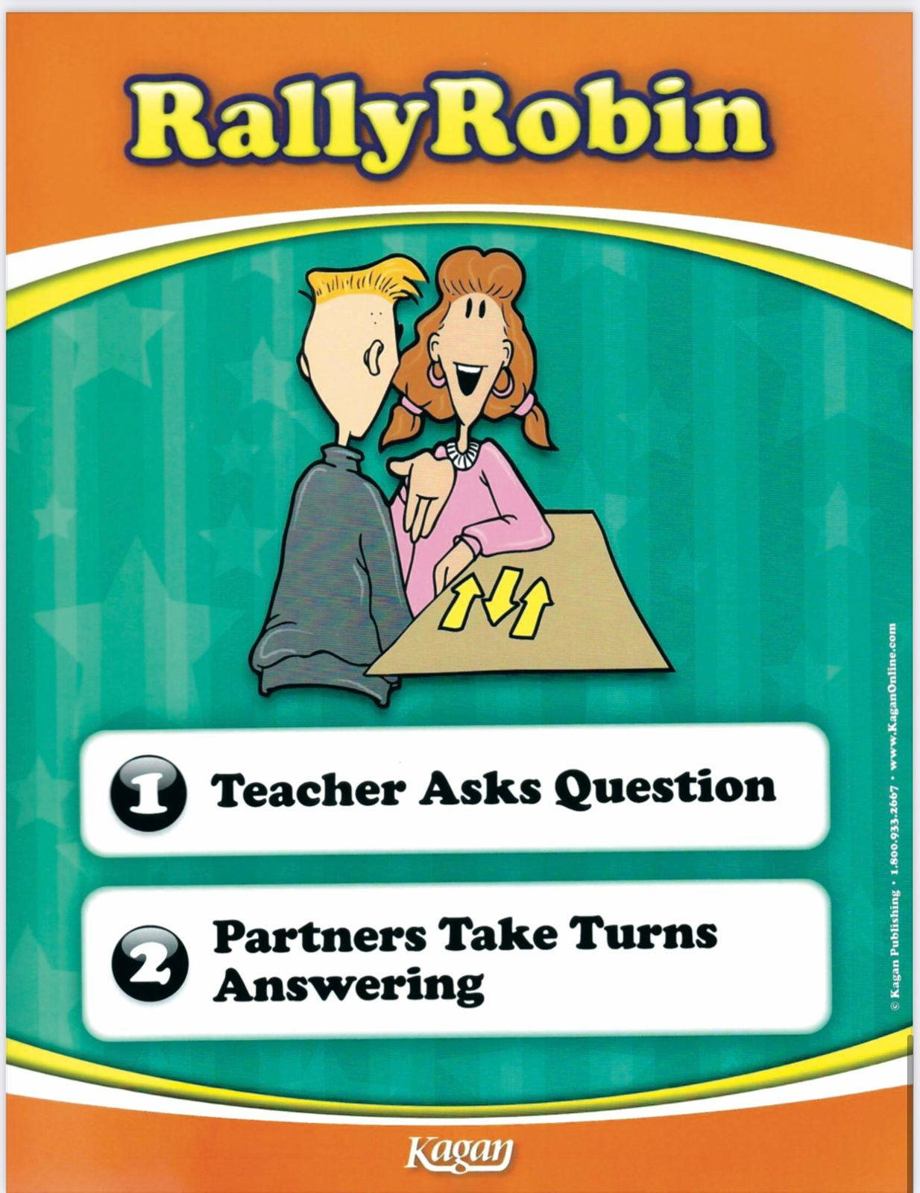
Which paragraph gives facts.
Give evidence .
My Mother
My mother is a kind and loving person who takes care of our family every day. She has warm, gentle eyes that make everyone feel welcome and a bright smile that can cheer anyone up. Her hair is long and soft, and she usually ties it neatly when she works at home. She is always busy cooking delicious meals, helping me with my homework, and keeping the house tidy. I love how she tells stories and shares advice that helps me learn new things. My mother is not only hardworking but also patient and caring. She always listens to my problems and gives me the best guidance. I admire her because she makes our home happy and full of love.
My Mother
My mother is a very important person in my family. She is caring and hardworking, and she helps take care of everyone at home. Every morning, she makes breakfast for us and helps me get ready for school. She is also very good at cooking, and she likes to try new recipes. In her free time, she enjoys reading books and gardening. My mother teaches me many things, such as how to be responsible, kind, and organized. I admire her because she always works hard and supports our family.
5

Slide 9
Which paragraph gives facts.
Give evidence .
My Mother
My mother is a kind and loving person who takes care of our family every day. She has warm, gentle eyes that make everyone feel welcome and a bright smile that can cheer anyone up. Her hair is long and soft, and she usually ties it neatly when she works at home. She is always busy cooking delicious meals, helping me with my homework, and keeping the house tidy. I love how she tells stories and shares advice that helps me learn new things. My mother is not only hardworking but also patient and caring. She always listens to my problems and gives me the best guidance. I admire her because she makes our home happy and full of love.
My Mother
My mother is a very important person in my family. She is caring and hardworking, and she helps take care of everyone at home. Every morning, she makes breakfast for us and helps me get ready for school. She is also very good at cooking, and she likes to try new recipes. In her free time, she enjoys reading books and gardening. My mother teaches me many things, such as how to be responsible, kind, and organized. I admire her because she always works hard and supports our family.
facts
5

Slide 10
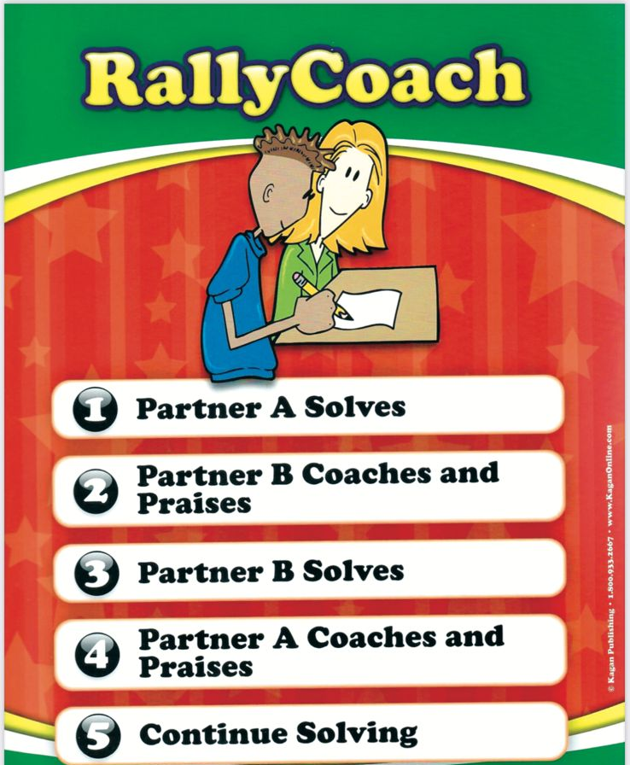
Why do we need informative writing?
Buzz in

Slide 11
Why do we need informative writing?
-To share knowledge: Informative writing gives readers facts about a topic, like animals, countries.
To explain clearly: It helps people understand things step by step, like instructions or how something works.
To help make decisions: Reading factual information can help someone choose the best option, like what to eat or how to solve a problem.
To record important information: Informative writing keeps facts organized so we can look back at them, like in textbooks, reports, or articles.
To teach and guide others: It allows writers to share what they know and help readers learn new things.
5

Slide 12
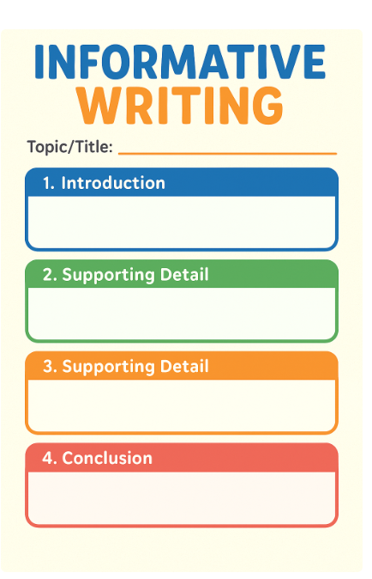


Informative Paragraph
Parts

Slide 13
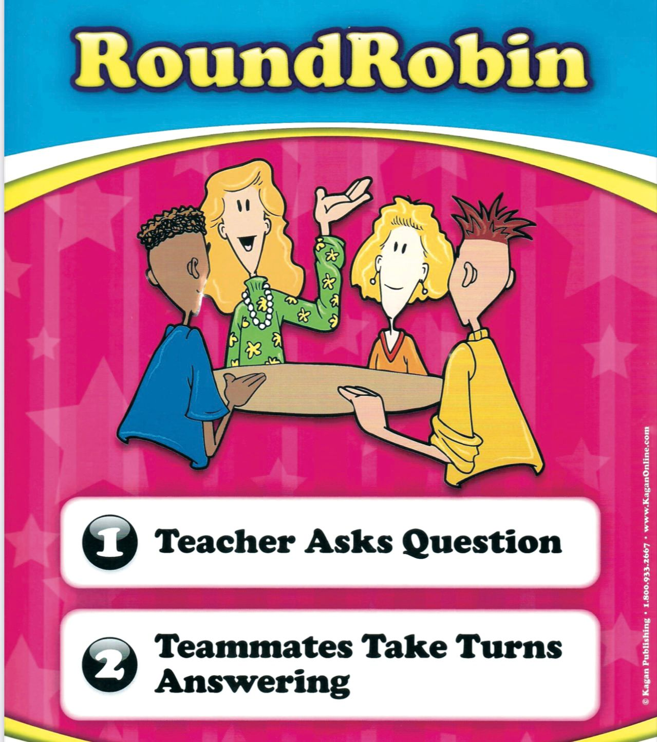
Dogs need food, water, exercise, and love to stay healthy and happy.
Put the sentences in the correct order to make a clear and informative paragraph.
They are loyal, friendly, and can be trained to do many tasks.
Dogs are one of the most popular pets in the world.
Why Dogs Make Great Pets
Buzz in
2 min.

Slide 14
Why Dogs Make Great Pets
Feedback
Dogs are one of the most popular pets in the world.
They are loyal, friendly, and can be trained to do many tasks.
Dogs need food, water, exercise, and love to stay healthy and happy.
Buzz in
2 min.

Slide 15

Critical Thinking:
Linking to Life
-Why is it important to share true and clear information about our school with others (like new students, parents, or visitors)?
Buzz in

Slide 16
Differentiation
Differentiation
1- Circle the correct title for an informative paragraph about our school. IEC school IEC School IEC School. | 2. Rearrange the following words to write an informative title about our school. Fun –IEC- School at- Learning
3. Write an informative and creative title ________________________________________ ________________________________________ _______________________________________ ________________________________________ | 4. Use the word bank to write an informative paragraph. Word Bank: learn • grow • together • future • students • success • community • school • goals ________________________________________ _______________________________________ ________________________________________

Slide 17
Summative Assessment
Informative writing is a type of writing that
tries to convince the reader to agree with the writer’s opinion.
tells a story from the writer’s imagination.
gives facts and information about a topic to help the reader understand it.
IRS
1 min.

Slide 18
Summative Assessment
Informative writing is a type of writing that
tries to convince the reader to agree with the writer’s opinion.
tells a story from the writer’s imagination.
gives facts and information about a topic to help the reader understand it.
IRS
1 min.

Slide 19
Summative Assessment
The correct order of an informative paragraph
Concluding sentence
Supporting sentences
Topic sentence
2. Supporting sentences
Topic sentence
Concluding sentence
3. Topic sentence
Supporting sentences
Concluding sentence
IRS
1 min.

Slide 20
Summative Assessment
The correct order of an informative paragraph
Concluding sentence
Supporting sentences
Topic sentence
2. Supporting sentences
Topic sentence
Concluding sentence
3. Topic sentence
Supporting sentences
Concluding sentence
IRS
1 min.

Slide 21

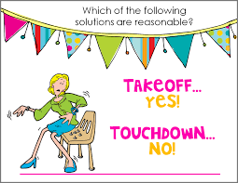
Please indicate your understanding of today’s learning outcomes by take off – touch down strategy .
What an informative writing is.
The parts of an informative paragraph.
Why we write an informative paragraph is.

