Slide 1
Doctors Without Borders pp.90-95
5th grade

Slide 2

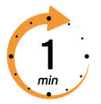
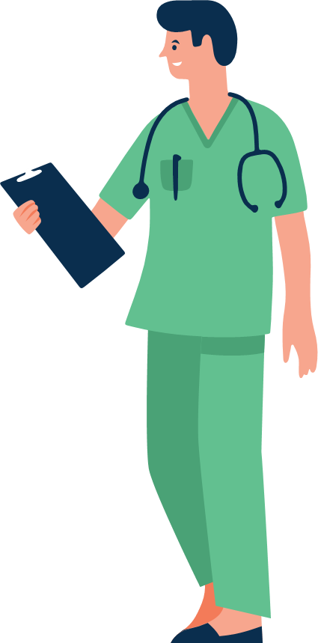
Discuss in pairs.
1. What do you do when you feel sick or get hurt?
2. What do you think happens in places where there are not enough doctors?
3. Can you think of people whose job is to help others in need around the world?

Slide 3
Warm up
I’ll show some medical supplies, and I want you to think about what kind of emergency that item could help with.

Slide 4
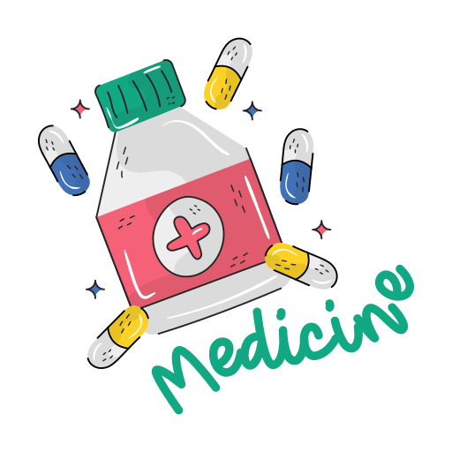

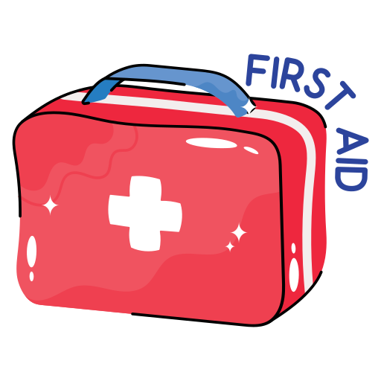

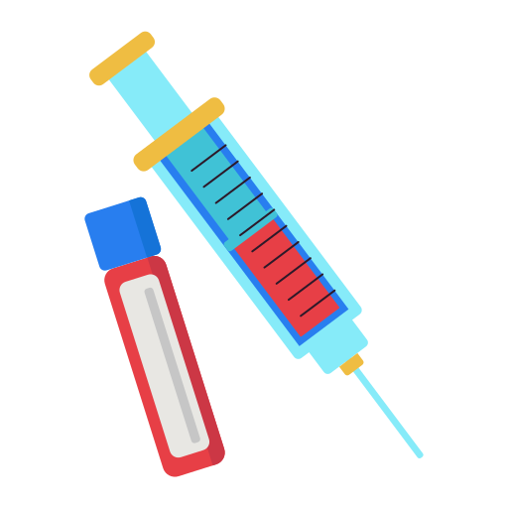

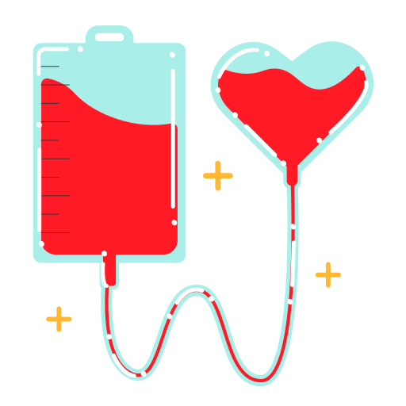

Warm up

Slide 5
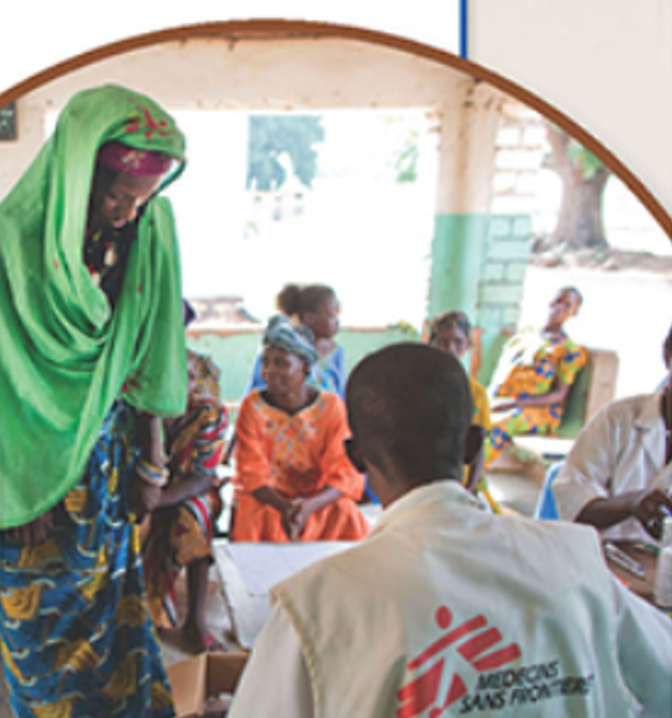
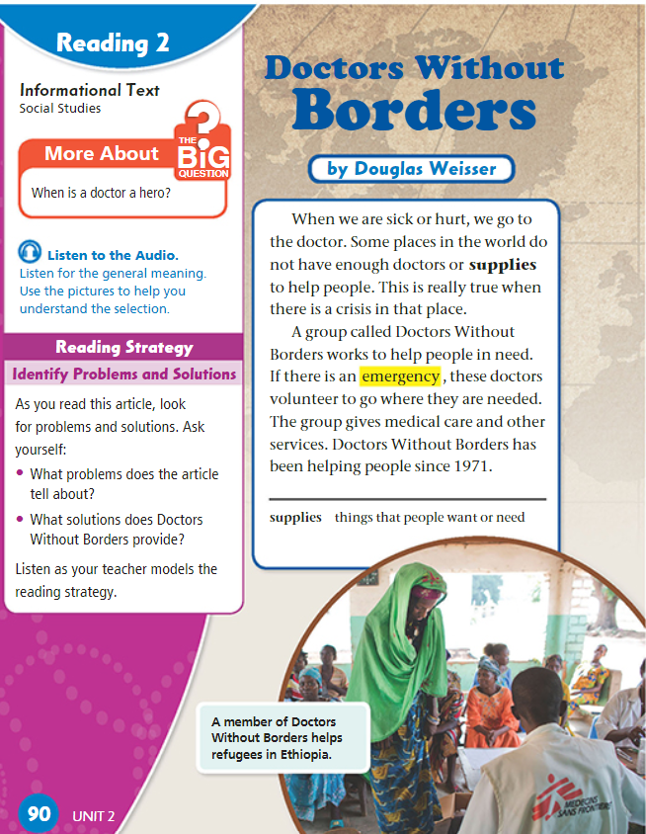

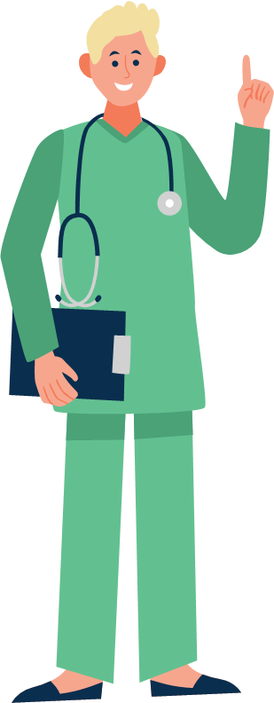
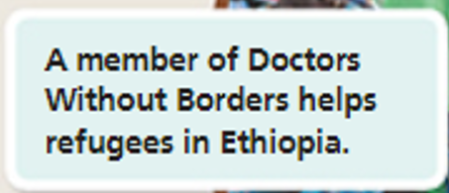
p.90

Slide 6
Discussion Questions on p.90
Where do we usually go when we are sick or hurt?
What problem do some places in the world face?
When is the need for doctors and supplies important?
What is the name of the group that helps people in need?
What do the doctors from Doctors Without Borders do in an emergency?
When did Doctors Without Borders start helping people?
What does the word ‘supplies’ mean?
Use it in a sentence of your own.

Slide 7
Feedback
Where do we usually go when we are sick or hurt?
What problem do some places in the world face?
When is the need for doctors and supplies important?
What is the name of the group that helps people in need?
What do the doctors from Doctors Without Borders do in an emergency?
When did Doctors Without Borders start helping people?
What does the word ‘supplies’ mean?
Use it in a sentence of your own.
Doctors need medical supplies such as bandages and gloves.

Slide 8
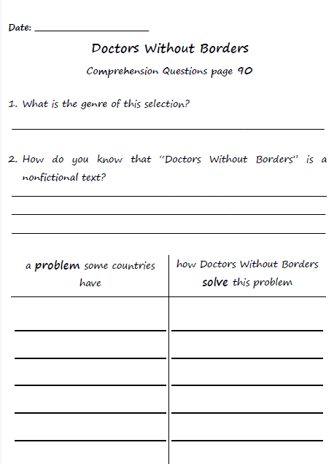
Comprehension Questions p.90

Slide 9
Feedback
It’s an informational text – social studies.
“Doctors Without Borders” is a nonfictional text because it gives information and has captions, headings, and real photos.
Some countries don’t have enough doctors or medical supplies when there is an emergency.
Doctors Without Borders volunteers to go to these countries to help people and give medical care.

Slide 10
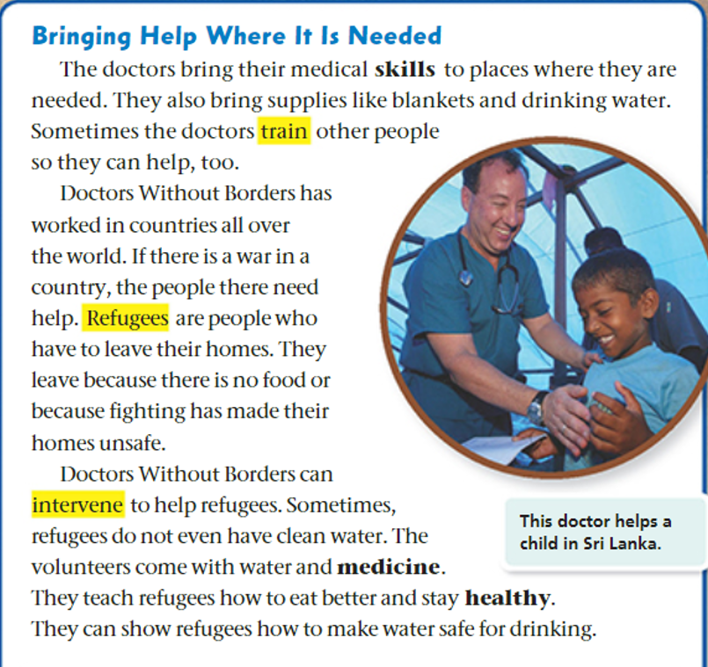
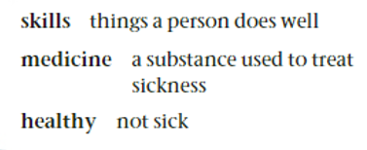

p.91

Slide 11
Discussion Questions on p.91
Circle the heading of the text. How does the heading
help you understand what the text is about?
2. What do the doctors bring to places where help is needed?
3. Who do the doctors sometimes train to help with their work?
4. Who are refugees?
5. Why do refugees have to leave their homes?
6. How does Doctors Without Borders help refugees?
7. What do the doctors teach refugees?
8. Highlight the caption. How does it help you understand what’s happening in the picture?

Slide 12
Feedback
heading
Circle the heading of the text. How does the heading
help you understand what the text is about?
2. What do the doctors bring to places where help is needed?
3. Who do the doctors sometimes train to help with their work?
4. Who are refugees?
5. Why do refugees have to leave their homes?
6. How does Doctors Without Borders help refugees?
7. What do the doctors teach refugees?
8. Highlight the caption. How does it help you understand what’s happening in the picture?
caption

Slide 13
p.91
What do the circled pronouns refer to?

Slide 14
p.91
What do the circled pronouns refer to?

Slide 15
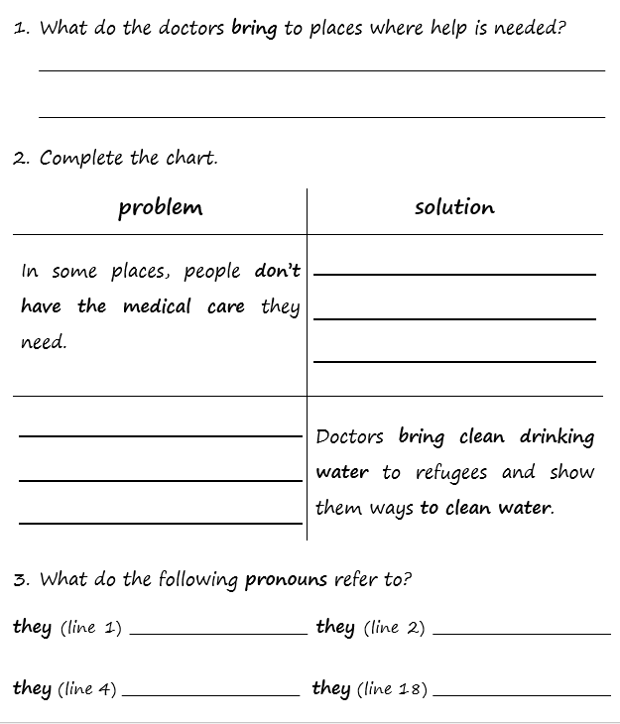
Comprehension Questions p.91

Slide 16
Feedback
Doctors bring their medical skills, supplies, and drinking water.
Doctors travel to these places and bring medical help and supplies.
Refugees don’t have safe drinking water.
medical skills
the doctors
other people
the volunteers

Slide 17
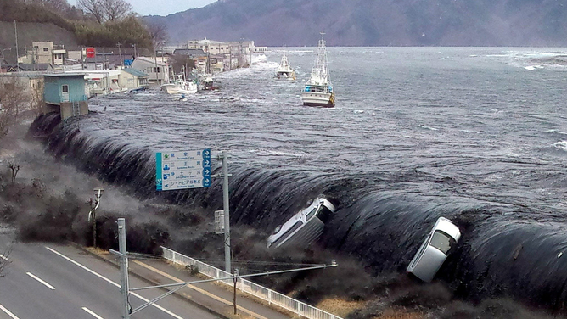
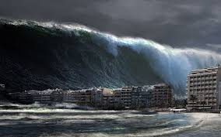
What is a Tsunami?

Slide 18
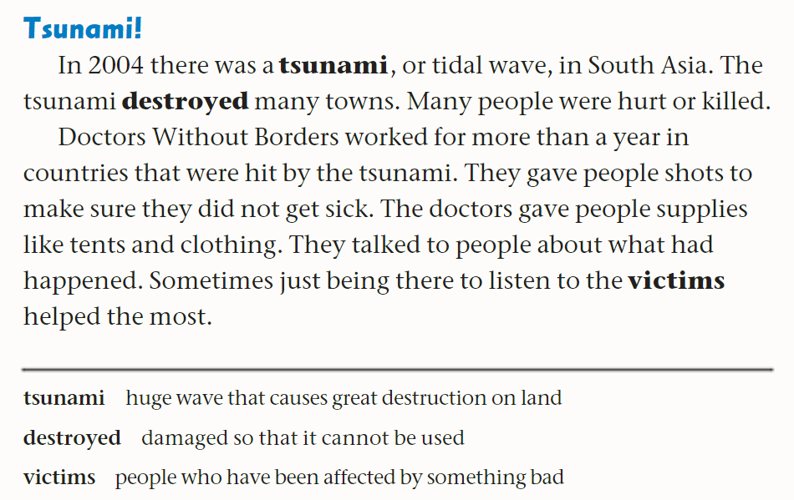

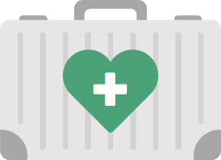
p.92

Slide 19
p.92
when
where
1
2
What did the tsunami do?
1
How did Doctors Without Borders help?
2
3

Slide 20
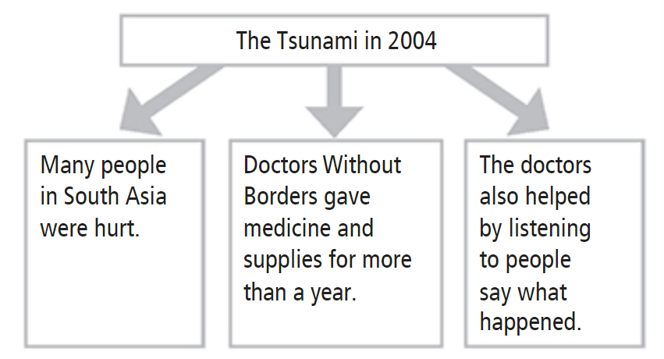

p.92

Slide 21
p.92

Slide 22
Read how Doctors Without Borders helped people in South Asia after the tsunami in 2004. The, complete the chart.
Problem | Solution
People could get sick easily.
 | The doctors gave people tents and other supplies.
People were upset.

Slide 23
Read how Doctors Without Borders helped people in South Asia after the tsunami in 2004. The, complete the chart.
Problem | Solution
People could get sick easily. | The doctors gave people shots.
People lost their homes and didn’t have sufficient supplies. | The doctors gave people tents and other supplies.
People were upset. | The doctors talked to the victims and listened to them.

Slide 24
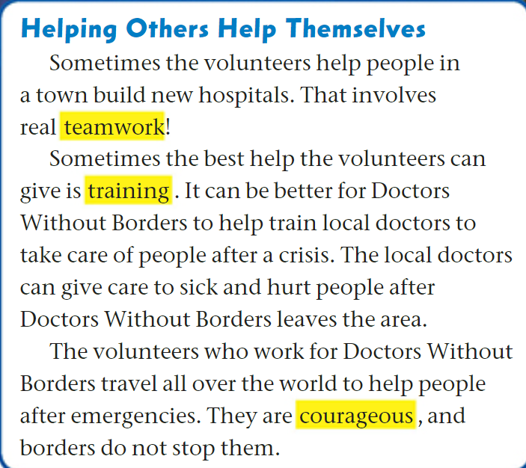
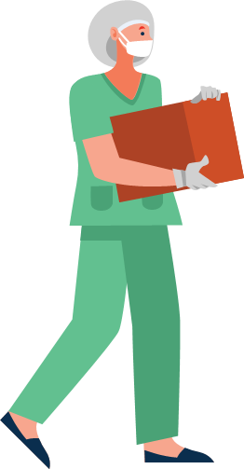

p.93

Slide 25
Discussion Questions on p.93
What do volunteers help build in towns?
How do volunteers help local people?
Why is training helpful for local doctors?
Find a word that means “major problem”.
What do local doctors do after volunteers leave?
Where do volunteers go to help people?
What quality do the volunteers have?
Do borders stop Doctors Without Borders volunteers from helping others?

Slide 26
Feedback
What do volunteers help build in towns?
How do volunteers help local people?
Why is training helpful for local doctors?
Find a word that means “major problem”.
What do local doctors do after volunteers leave?
Where do volunteers go to help people?
What quality do the volunteers have?
Do borders stop Doctors Without Borders volunteers from helping others?
crisis

Slide 27
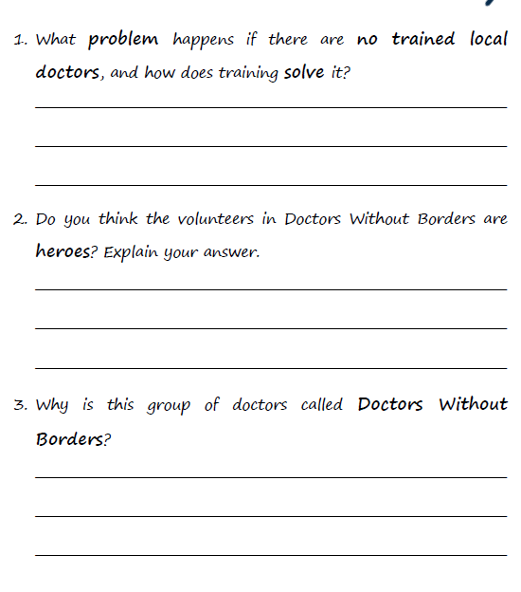
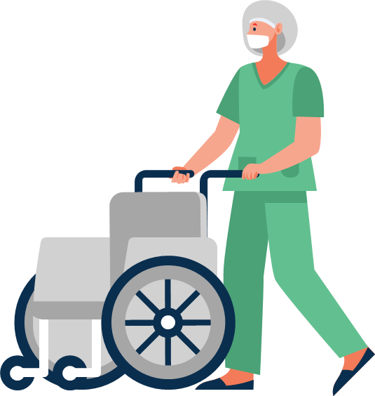
Comprehension Questions p.93

Slide 28
Feedback
Without trained doctors, sick and hurt people will not get help after volunteers leave. Training solves this by teaching local doctors to take care of them.
Yes, I think the volunteers are heroes because they are courageous, they help people in need, and they save lives.
The doctors travel anywhere in the world to help people, and borders do not stop them.

