Slide 1
Adjectives

Slide 2
Outcomes:
Identify the meaning of adjectives and the types of it.
Use adjectives in sentences.
Value: Appreciate the act of keeping themselves clean.

Slide 3


Warm up
https://www.youtube.com/watch?v=Ryfs_csiWAc

Slide 4
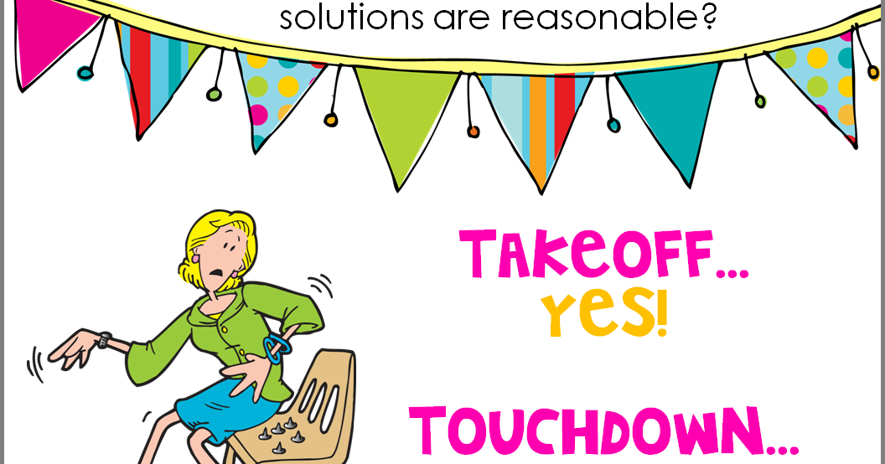
Pre-assessment.
A dad is a pesron
A lion is a place.
A school is a place.
A baclpack is an animal.

Slide 5
Presentation

Slide 6
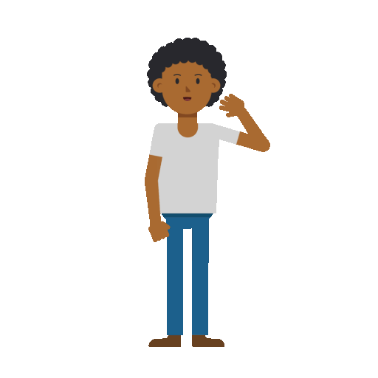


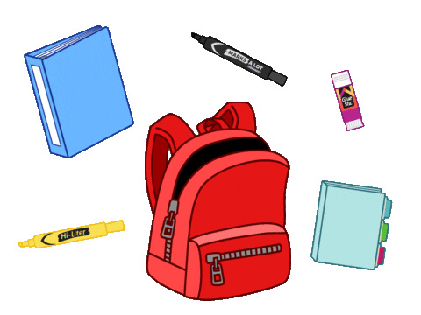
A noun is a names of a:
Person
animal
place
thing

Slide 7
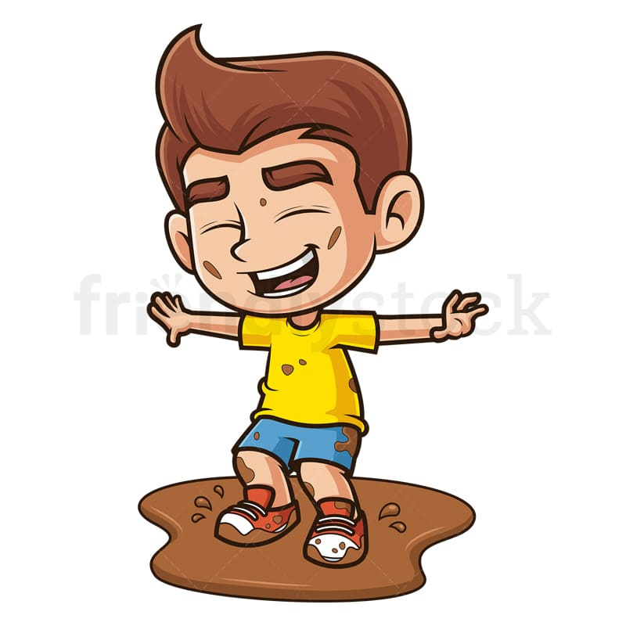
Adjectives tell us more about a noun.
Let’s describe the.

Slide 8
Let’s listen to a song
3:00 mins/
https://www.youtube.com/watch?v=QxoDGlPUmyU

Slide 9

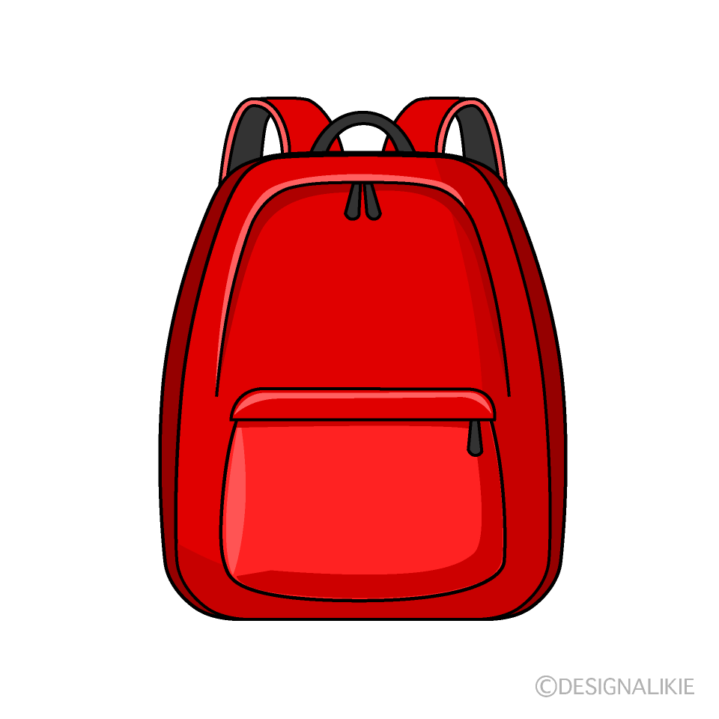
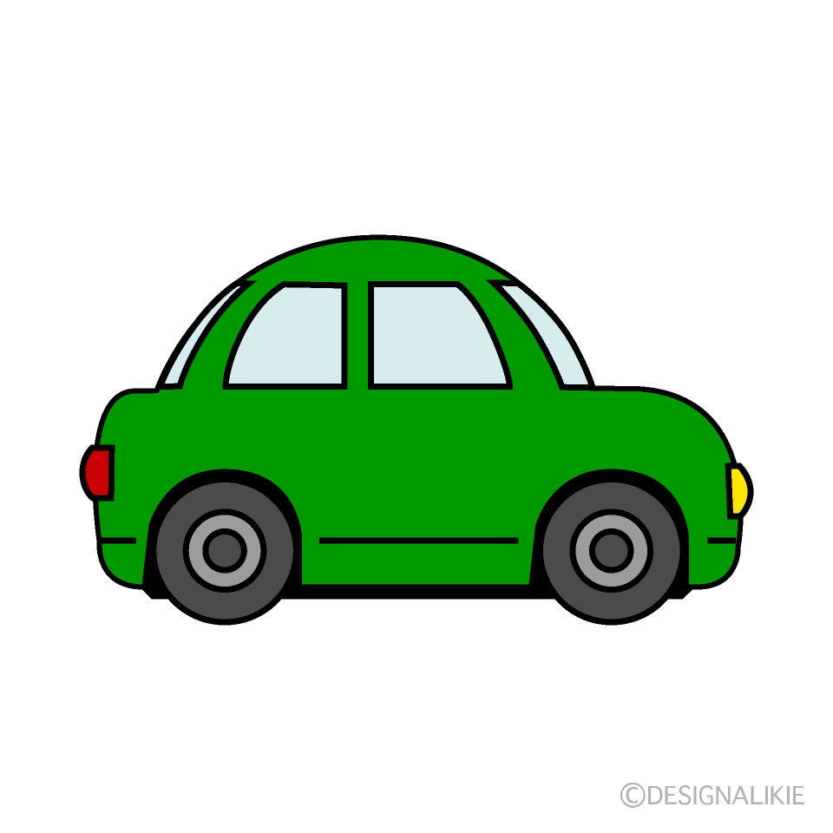
Adjectives can be colors.
1. I like my red backpack.
2. I have a green car.

Slide 10

Can you think of more colors?
2:00 mins
Random pick

Slide 11
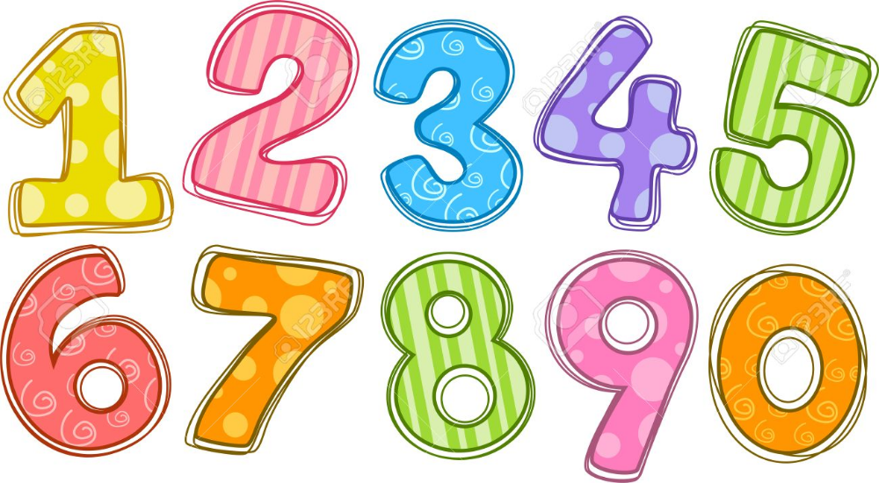


Adjectives can be numbers .
1. He has three books..
2. I have two brothers.

Slide 12

How many pencils do you have?
2:00 mins
Random pick

Slide 13
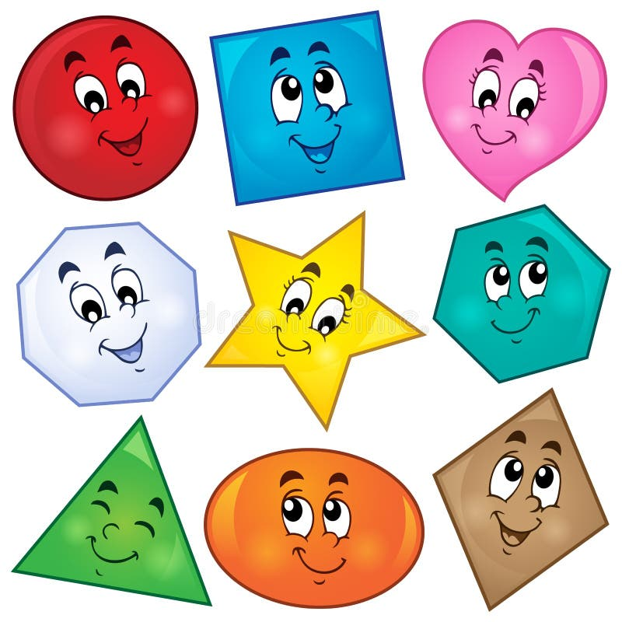


Adjectives can be shapes .
1. The photo frame is square.
2. The clock has a circle shape.

Slide 14
Look around you. Can you find any shapes?
2:00 mins
Random pick

Slide 15
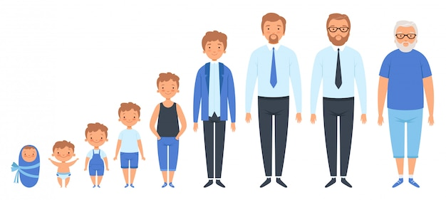

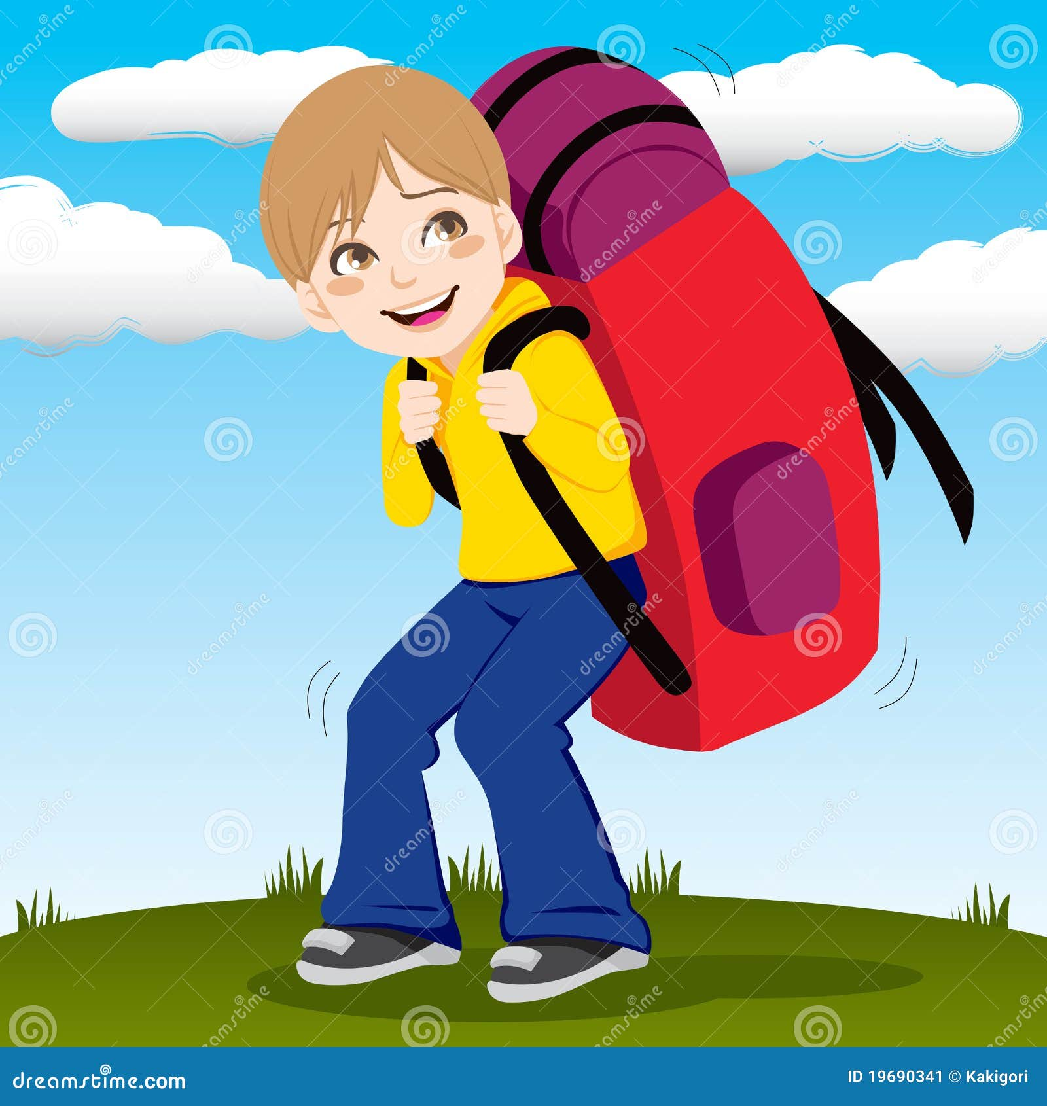
Adjective can be size.
1. My pen is small.
2. I have a big backpack.

Slide 16

Real life application
Let’s describe our favorite toy to our friends.

Slide 17

Match each picture with its correct adjective.
Group work

Slide 18
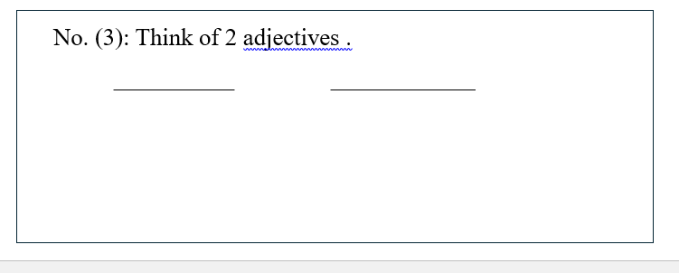
Differentiation no. 3

Slide 19
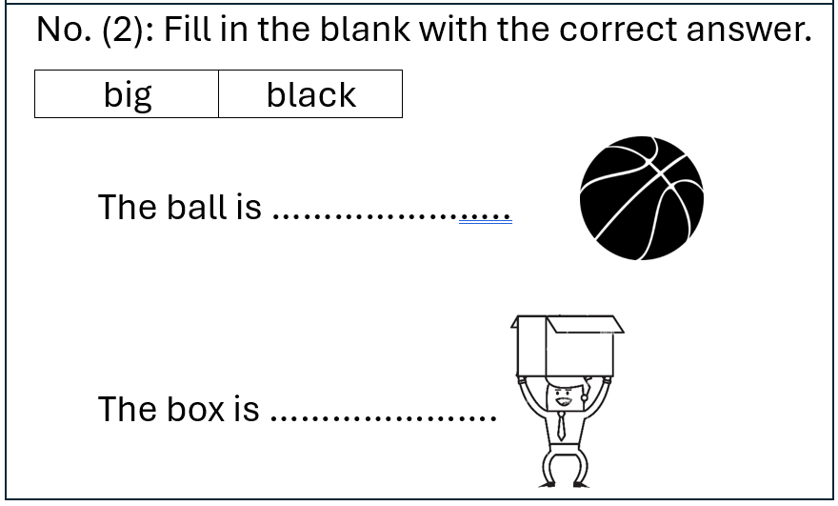
Differentiation no. 2

Slide 20
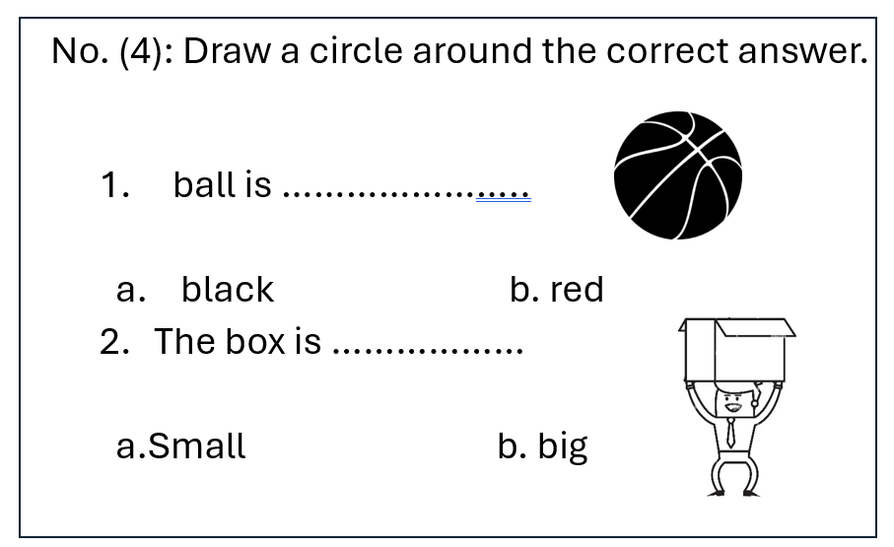
Differentiation no. 4

Slide 21
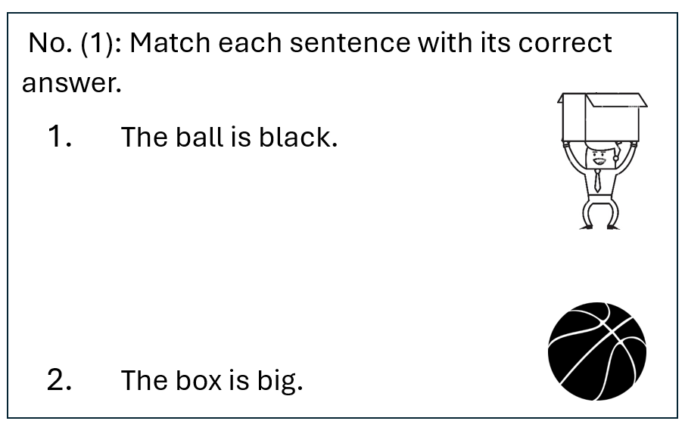
Differentiation no. 1

Slide 22
Critical thinking/ Buzz in
If you could use only 2 adjectives to describe your parents. What would they be and why?

Slide 23
let’s play a game.
https://create.kahoot.it/details/babf7d14-0388-46c4-af71-2f0f64c0b604

Slide 24
Summative assessment.
Red is an adjective.
1. True
2. False
A teacher is an adjective.
1. True
2. False

Slide 25
