Slide 1

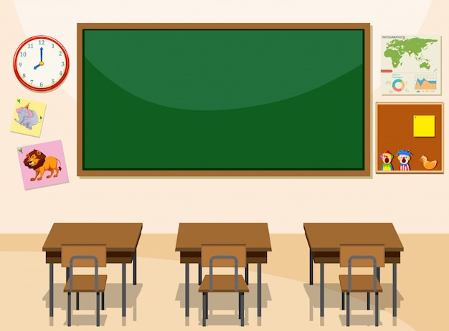

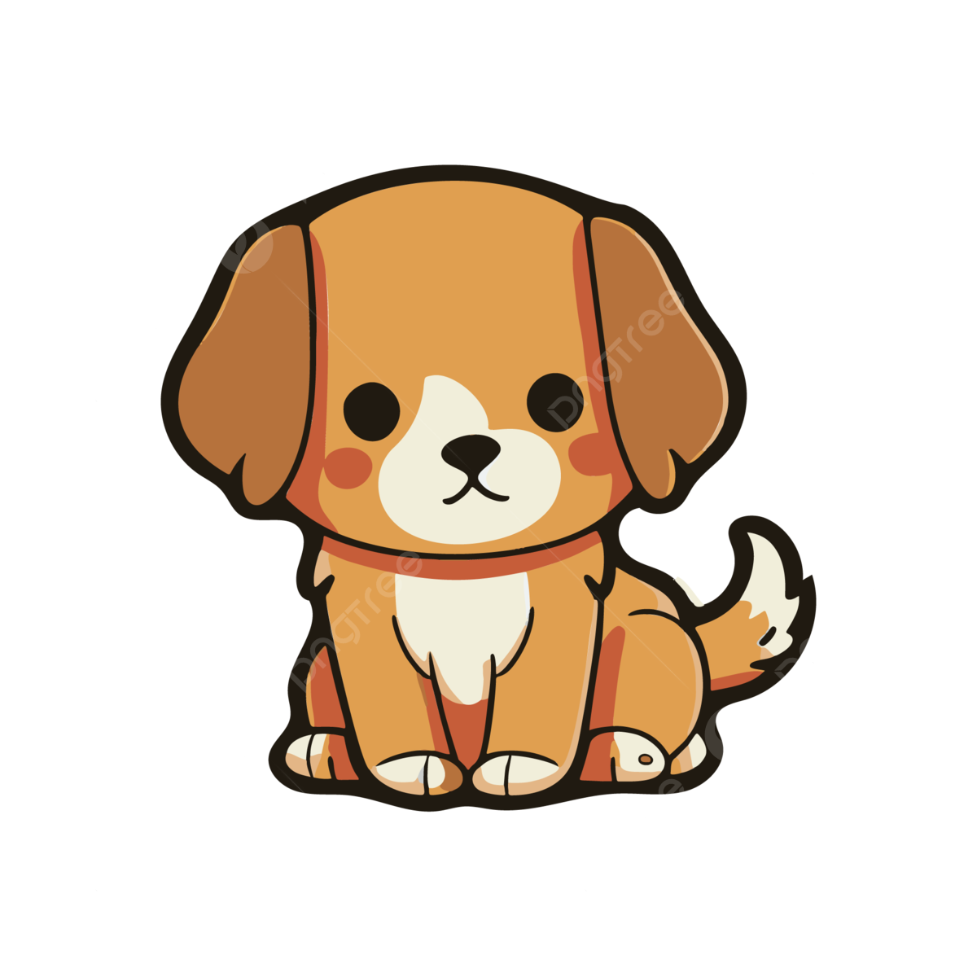
Nouns
→

Slide 2
Warm up
Value: Respecting others
2:00 mins
https://www.youtube.com/watch?v=YNOnFsnjYhY

Slide 3
Outcomes:
1:00 mins
By the end of this lesson students should be able to:
Identify the meaning of nouns.
identify the types of nouns.
Value: Appreciate the act of respecting others

Slide 4

Pre-assessment
2:00 mins
Mini board/IRS
Take off- Touch Down n
Take off if you think the shown picture is a thing

Slide 5
A noun is a naming word
A noun is a name of a person, animal, place or thing.

Slide 6

Let’s listen to a song.
5:00 mins
https://www.youtube.com/watch?v=9cu7C07pNbA&list=RD9cu7C07pNbA&start_radio=1

Slide 7
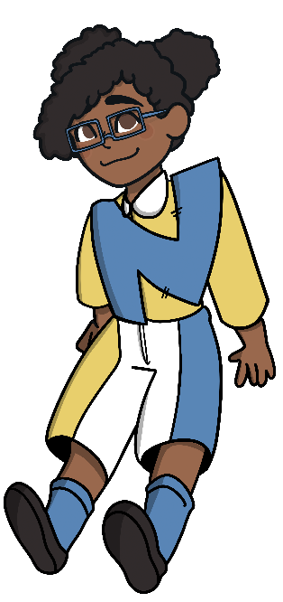
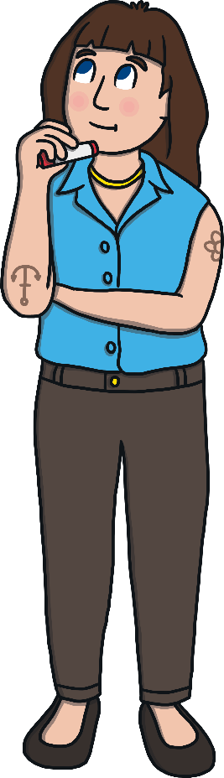
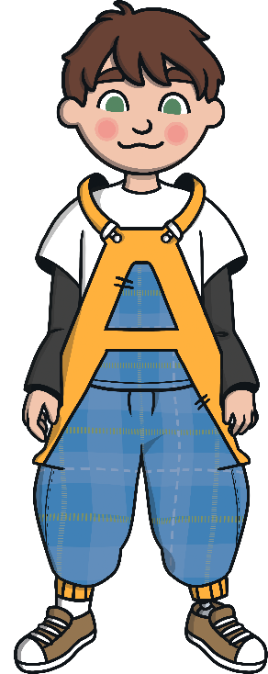


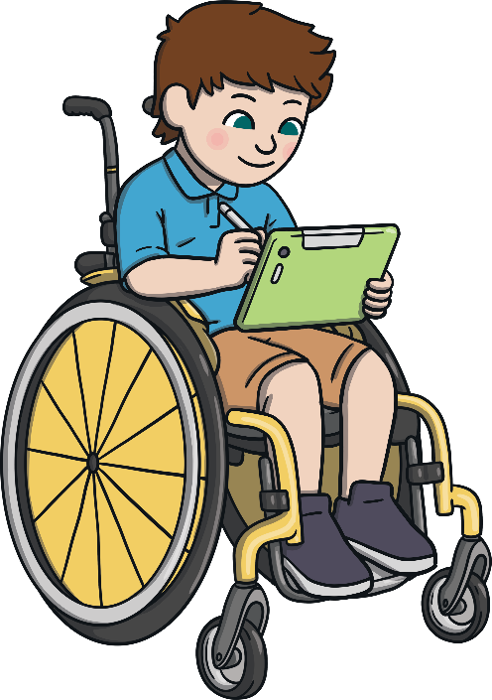
A noun can be a name of a person.
teacher
Nouns can be used to name people.
Adam
doctor
Tamara

Slide 8
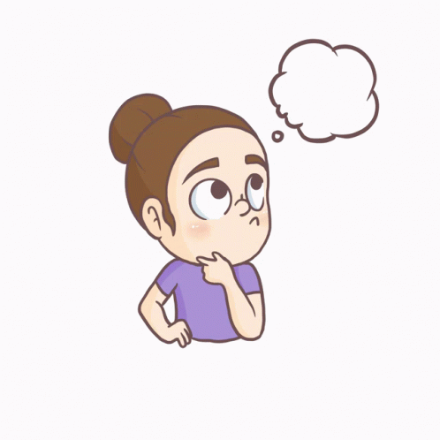
If you could give yourself a name, what would it be and why?
1:30 mins
Buzz in
Critical thinking

Slide 9
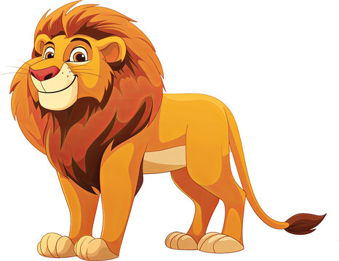
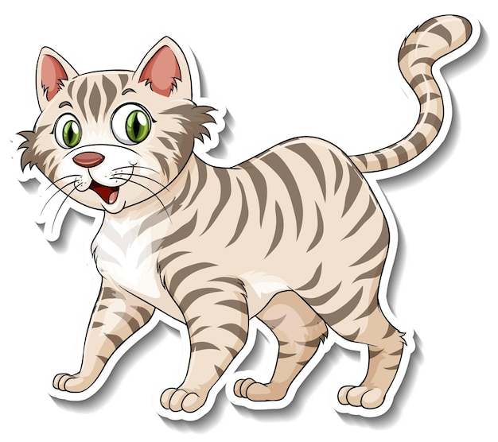
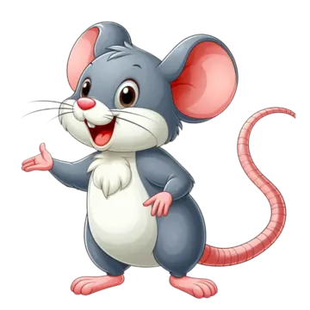
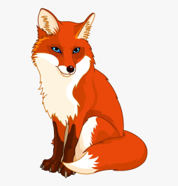

Nouns can also be used to name animals.
cat
lion
rat
shark
fox

Slide 10

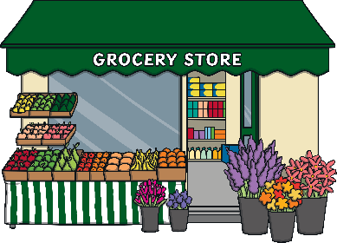

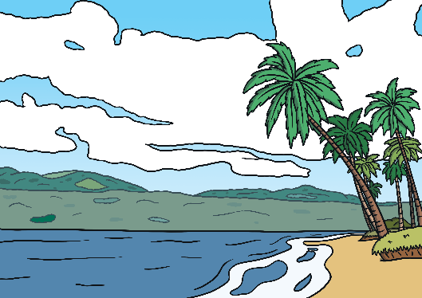
Nouns can also be used to name places.
kitchen
school
shop
Jordan
beach

Slide 11




pumpkin
And nouns can be used to name things.
computer
balloon
pencil
backpack
book

Slide 12

Group work
3:00 mins
Random pick
Sort the following pictures into types of nouns.

Slide 13

Real life application
3:00 mins
Rally Robin
“Look around the classroom. Can you find one person, one place, and one thing that you can name? Say them out loud!”

Slide 14
Let’s find the nouns in the sentences.
3:00 mins
Rally Robin
1. I have a red backpack and a green pen.
2. Tala and Ali are nice.
3. He has a big cat in his home.

Slide 15
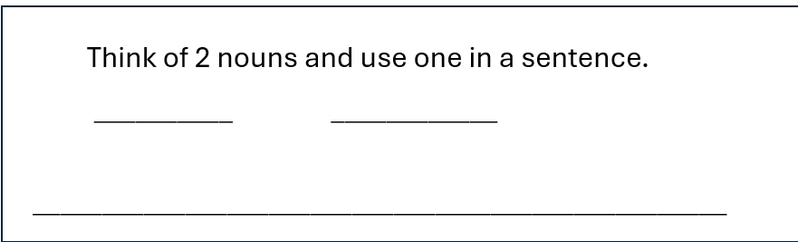
Differentiation no.
3:00 mins
Random pick

Slide 16
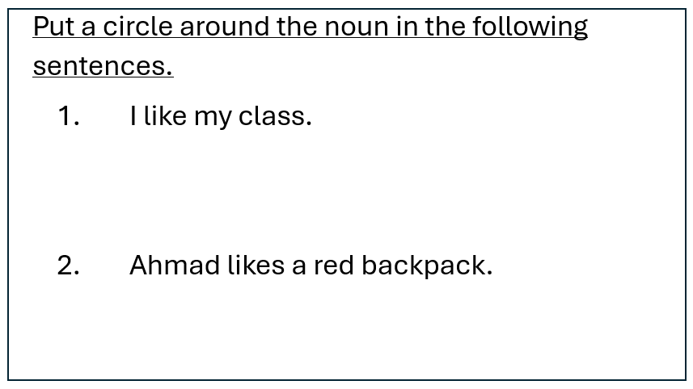
Differentiation no. 2
3:00 mins
Random pick

Slide 17
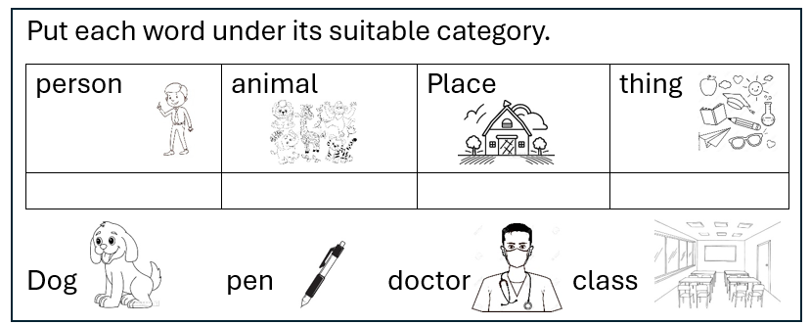
Differentiation No. 3
3:00 mins
Random pick

Slide 18
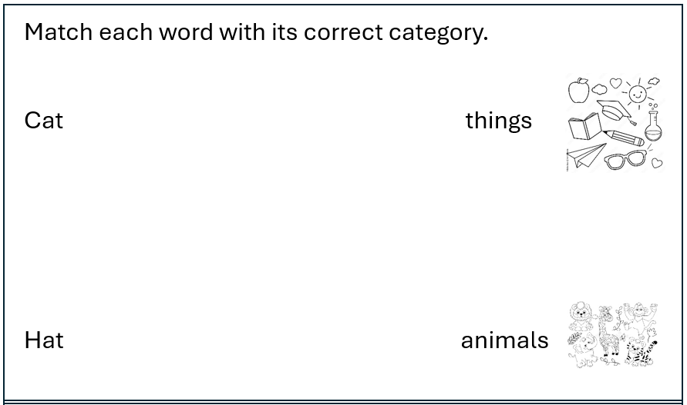
Differentiation no. 4
3:00 mins
Random pick

Slide 19

Mystery box

Slide 20
https://create.kahoot.it/details/93b67dbb-7ded-41d9-afd1-4e49b621e4ee
Let’s play a game

Slide 21
Let’s play a game
5:00 mins
Random pick
https://wordwall.net/resource/15182787/english/noun-sort

Slide 22
Summative Assessment/IRS
Which word is a noun.
2-table
1- run

Slide 23
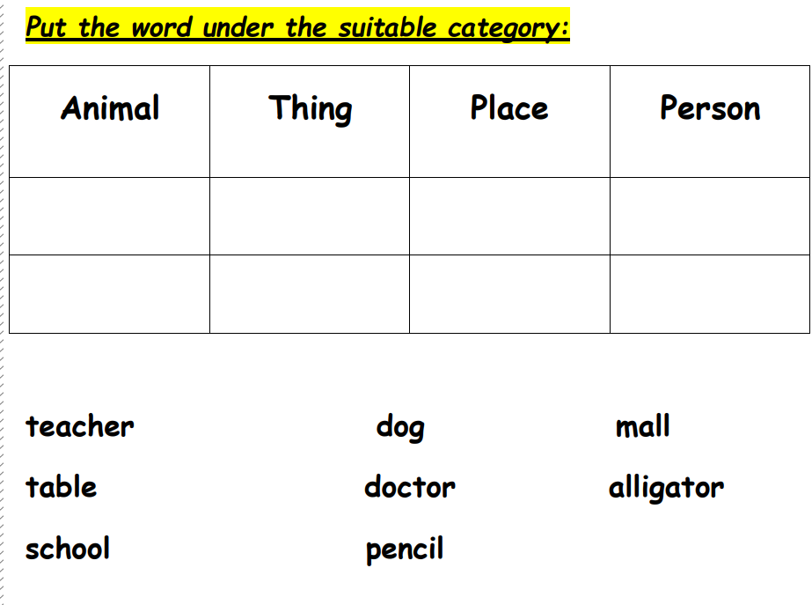

Slide 24
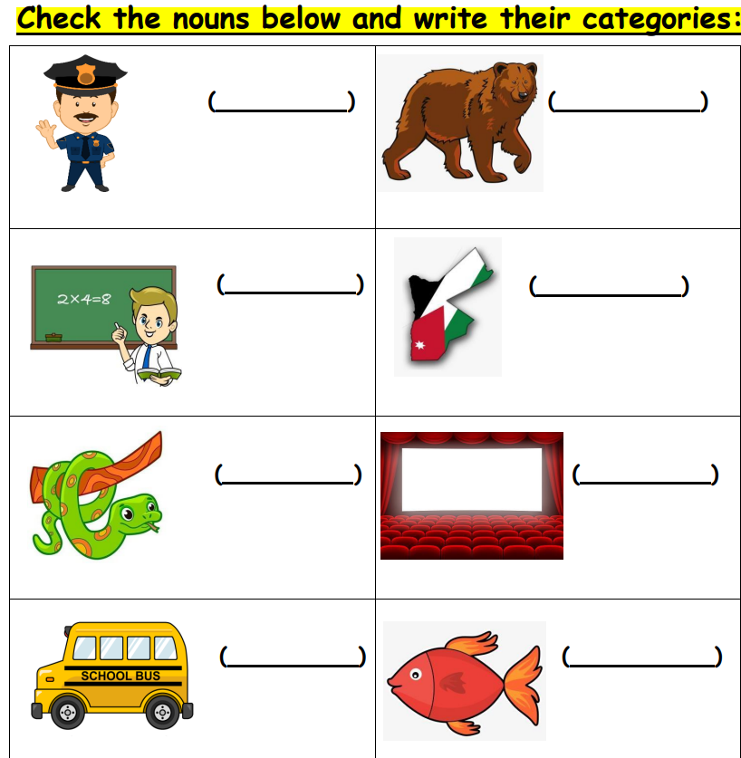

Slide 25
If you could only use 2 nouns today, which would you use and why?
Exit Ticket

