Slide 1

Unit8C: Breathing and respiration
Lesson title:
8Ce:Anaerobic respiration
(pg. 50+51)

Slide 2


Date:
الكلية العلمية الإسلامية
Lesson: Anaerobic respiration
Unit 8C
Grade 10th
Subject: Science
outcomes
0:30minutes
Outcomes
Introduction
Define reactants, product of an anaerobic respiration.
Formative evaluation
Essential activity
Constructive evaluation
Feedback
Differentiation learning
Linked to real-life
Critical thinking
Pg. 50+51
Summative evaluation

Slide 3
Date:
الكلية العلمية الإسلامية
Lesson: Anaerobic respiration
Unit: 8C
Grade 10th
Subject: Science
Formative evaluation
Outcomes
01:00 minutes
Introduction
1. Aerobic respiration needs _____________.
a. glucose. b. oxygen c. both of them
2. The kind of respiration is called------------- respiration.
a. aerobic b. anaerobic c. both of them are correct
Formative evaluation
Essential activity
Constructive evaluation
Feedback
Differentiation learning
Linked to real-life
Critical thinking
Summative evaluation
IRS
IRS

Slide 4
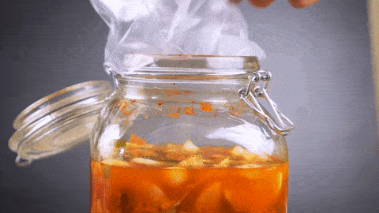
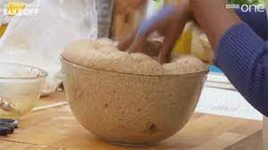

Date:
الكلية العلمية الإسلامية
Lesson: ANAerobic respiration
Unit 8c
Grade 10th
Subject: Science
Introduction
01:30 minutes
Outcomes
Introduction
What are the organisms used to make these products?
Are these processes used oxygen to perform their product?
What is the name of this kind of respiration
Formative evaluation
PRESENTATION
Constructive evaluation
Feedback
Differentiation learning
Linked to real-life
Critical thinking
Summative evaluation

Slide 5
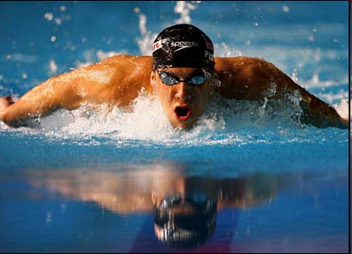
Date:
الكلية العلمية الإسلامية
Lesson: Anaerobic respiration
Unit 8C
Grade 10th
Subject: Science
PRESENTATION
Outcomes
03:00 minutes
Can anaerobic respiration happen in your body?in which case? Where does it happen ?
In cytoplasm of muscle cells during rapid and vigorous exercise, muscle cells may be depleted of oxygen. They then switch from aerobic respiration to…………???????.
Introduction
Formative evaluation
PRESENTATION
Constructive evaluation
Feedback
Use anaerobic bacteria to make sour pickles .
Use anaerobic yeast to raise the dough.
Differentiation learning
Linked to real-life
Critical thinking
Summative evaluation

Slide 6
Date:
الكلية العلمية الإسلامية
Lesson: Anaerobic respiration
Unit 8C
Grade 10th
Subject: Science
PRESENTATION
Outcomes
03:00 minutes
Can anaerobic respiration happen in your body?in which case? Where does it happen ?
In cytoplasm of muscle cells during rapid and vigorous exercise, muscle cells may be depleted of oxygen. They then switch from aerobic respiration to…………???????.
Introduction
Formative evaluation
PRESENTATION
Constructive evaluation
Feedback
Differentiation learning
Linked to real-life
Critical thinking
Summative evaluation

Slide 7
Date:
الكلية العلمية الإسلامية
Lesson: Anaerobic respiration
Unit:8C
Grade 10th
Subject: Science
Constructive evaluation
03:00 minutes
Outcomes
Introduction
Write the chemical equation of anaerobic respiration ?
Formative evaluation
Essential activity
Constructive evaluation
Feedback
Differentiation learning
Linked to real-life
Random pick
Critical thinking
Summative evaluation

Slide 8
Date:
الكلية العلمية الإسلامية
Lesson: ANAerobic respiration
Unit 8c
Grade 10th
Subject: Science
Differentiated learning
Outcomes
What is the difference between aerobic respiration and anaerobic respiration?( reactants, products)
03:00 minutes
1
Introduction
Which kind or respiration do we use during strenuous exercises?
Formative evaluation
2
Essential activity
Constructive evaluation
What does anaerobic respiration mean?
Feedback
3
Differentiation learning
Linked to real-life
What are the two kinds of respirations?
4
Critical thinking
Summative evaluation

Slide 9
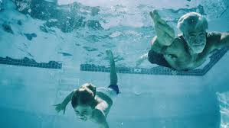
Date:
الكلية العلمية الإسلامية
Lesson: Aerobic respiration
Unit 3
Grade 10th
Subject: Science
Critical thinking
01:00 minutes
Outcomes
Introduction
Which kind of respiration do they use?
Formative evaluation
Essential activity
Constructive evaluation
Feedback
Differentiation learning
Linked to real-life
Critical thinking
Summative evaluation
BUZZ IN

Slide 10
Date:
الكلية العلمية الإسلامية
Lesson: Anaerobic respiration
Unit 8C
Grade 10th
Subject: Science
Summative evaluation
01:00 minutes
Outcomes
Introduction
1-The reactants of anaerobic respiration _____________.
a. glucose. b. vitamin C c. calcium
2. The importance of anaerobic respiration
a. move suddenly b. quick motion c. both of them are correct
Formative evaluation
Essential activity
Constructive evaluation
Feedback
Differentiation learning
Linked to real-life
Critical thinking
Summative evaluation
IRS

Slide 11
Date:
الكلية العلمية الإسلامية
Lesson: Anaerobic respiration
Unit 8C
Grade 10th
Subject: Science
outcomes
00:30 minutes
Outcomes
Introduction
Compare between aerobic and anaerobic respiration?
Formative evaluation
Essential activity
Constructive evaluation
Feedback
Differentiation learning
Linked to real-life
Critical thinking
Pg. 50+51
Summative evaluation

Slide 12

Date:
الكلية العلمية الإسلامية
Lesson: ANAerobic respiration
Unit 8c
Grade 10th
Subject: Science
Introduction
01:00 minutes
Outcomes
Introduction
Which picture shows aerobic respiration?
Which picture shows aerobic respiration?
a
b
Formative evaluation
PRESENTATION
Constructive evaluation
Feedback
Differentiation learning
Linked to real-life
Critical thinking
Summative evaluation

Slide 13
Date:
الكلية العلمية الإسلامية
Lesson: Anaerobic respiration
Unit: 8C
Grade 10th
Subject: Science
Formative evaluation
Outcomes
01:00 minutes
Introduction
1. The importance of respiration is_____________.
a. glucose. b. oxygen c. energy
2. The kind of respiration if we make fermentation of dough is called------------- respiration.
a. aerobic b. anaerobic c. both of them are correct
Formative evaluation
Essential activity
Constructive evaluation
Feedback
Differentiation learning
Linked to real-life
Critical thinking
Summative evaluation
IRS
IRS

Slide 14

Date:
الكلية العلمية الإسلامية
Lesson: Anaerobic respiration
Unit 8C
Grade 10th
Subject: Science
presentation
Outcomes
03:00 minutes
Introduction
Formative evaluation
Essential activity
Constructive evaluation
Feedback
Differentiation learning
Linked to real-life
Critical thinking
Summative evaluation

Slide 15
Date:
الكلية العلمية الإسلامية
Lesson: Anaerobic respiration
Unit 8C
Grade 10th
Subject: Science
Feedback
01:00 minutes
Outcomes
Introduction
Formative evaluation
Essential activity
Constructive evaluation
Feedback
Differentiation learning
Linked to real-life
Critical thinking
Summative evaluation

Slide 16
Date:
الكلية العلمية الإسلامية
Lesson: Anaerobic respiration
Unit 8C
Grade 10th
Subject: Science
Constructive evaluation
02:00 minutes
Outcomes
Introduction
Formative evaluation
At your notebook
define anaerobic respiration.
Essential activity
Constructive evaluation
Feedback
Differentiation learning
Linked to real-life
Critical thinking
Summative evaluation

Slide 17
Date:
الكلية العلمية الإسلامية
Lesson: Anaerobic respiration
Unit 8C
Grade 10th
Subject: Science
Differentiation learning
05:00 minutes
Outcomes
Task 1: Answer the following questions / notebook / cooperative learning
Introduction
 | Aerobic respiration | Anaerobic respiration
Reactants
Products
The amount of energy
Occurs in
Formative evaluation
Essential activity
Constructive evaluation
Feedback
Differentiation learning
Linked to real-life
Critical thinking
Summative evaluation
Task 1 : using rounding robin .

Slide 18
Date:
الكلية العلمية الإسلامية
Lesson: Anaerobic respiration
Unit 8C
Grade 10th
Subject: Science
Essential activity
05:00 minutes
Outcomes
 | Aerobic respiration | Anaerobic respiration
Reactants | Glucose +oxygen( enough amount) | Glucose ( may oxygen =not enough)
Products | Carbon dioxide +water + 38 ATP | Lactic acid+2ATP
The amount of energy | 38 | 2
Occurs in | All kinds of living cells | Some Bacteria, fungi(yeast) ,muscles
Introduction
Formative evaluation
Essential activity
Constructive evaluation
Feedback
Differentiation learning
Linked to real-life
Critical thinking
Summative evaluation

Slide 19
Date:
الكلية العلمية الإسلامية
Lesson: Anaerobic respiration
Unit 8C
Grade 10th
Subject: Science
Critical thinking
02:00 minutes
Outcomes
Which one of the two kinds of respiration is more important?
Introduction
Formative evaluation
Essential activity
Constructive evaluation
Buzz in
Feedback
Differentiation learning
Linked to real-life
Critical thinking
Summative evaluation

Slide 20
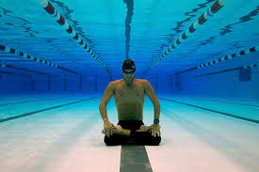
Date:
الكلية العلمية الإسلامية
Lesson: Aerobic respiration
Unit 3
Grade 10th
Subject: Science
Linking ………….. To real life
01:00 minutes
Outcomes
Introduction
How many minutes can we hold our breath? can we increase it? Photo A
Formative evaluation
Essential activity
Constructive evaluation
Feedback
Differentiation learning
Linked to real-life
Critical thinking
Summative evaluation

Slide 21
Date:
الكلية العلمية الإسلامية
Lesson: Anaerobic respiration
Unit 8C
Grade 10th
Subject: Science
Summative evaluation
05:00 minutes
Outcomes
Task 1: Answer the following questions / notebook / cooperative learning
Introduction
 | Aerobic respiration | Anaerobic respiration
Reactants
Products
The amount of energy
Occurs in
Formative evaluation
Essential activity
Constructive evaluation
Feedback
Differentiation learning
Linked to real-life
Critical thinking
Random pick
Summative evaluation

Slide 22
Date:
الكلية العلمية الإسلامية
Lesson: Anaerobic respiration
Unit 8C
Grade 10th
Subject: Science
outcomes
00:30 minutes
Outcomes
Introduction
Label the parts of the respiratory system .
Formative evaluation
Essential activity
Constructive evaluation
Feedback
Differentiation learning
Linked to real-life
Critical thinking
Pg. 50+51
Summative evaluation

Slide 23
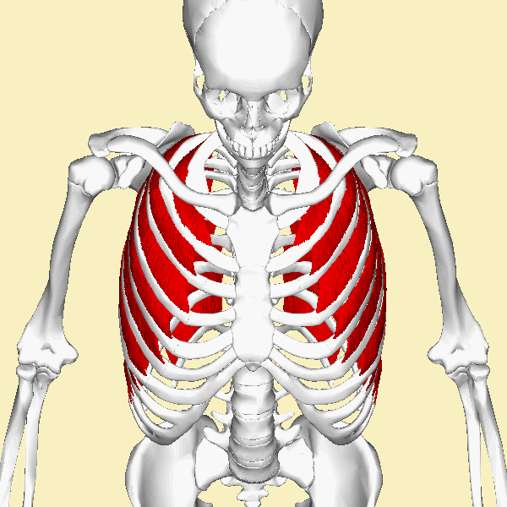
Date:
الكلية العلمية الإسلامية
Lesson: ANAerobic respiration
Unit 8c
Grade 10th
Subject: Science
Introduction
01:00 minutes
Outcomes
Introduction
What can you see in this picture ?
Formative evaluation
PRESENTATION
Constructive evaluation
Feedback
Differentiation learning
Linked to real-life
Critical thinking
Summative evaluation

Slide 24
Date:
الكلية العلمية الإسلامية
Lesson: Anaerobic respiration
Unit: 8C
Grade 10th
Subject: Science
Formative evaluation
Outcomes
01:00 minutes
Introduction
1. The importance of respiratory system is _____________.
a. pass the air. b. pass the food c. making reaction
2. The location of your respiratory system is in the ------------- .
a. abdomen b. chest c. lower part
Formative evaluation
Essential activity
Constructive evaluation
Feedback
Differentiation learning
Linked to real-life
Critical thinking
Summative evaluation
IRS
IRS

Slide 25
Date:
الكلية العلمية الإسلامية
Lesson: Anaerobic respiration
Unit 8C
Grade 10th
Subject: Science
presentation
Outcomes
03:00 minutes
Introduction
Formative evaluation
Essential activity
Constructive evaluation
Feedback
Differentiation learning
Linked to real-life
Critical thinking
Summative evaluation

Slide 26
Date:
الكلية العلمية الإسلامية
Lesson: Anaerobic respiration
Unit 8C
Grade 10th
Subject: Science
Tasks:
Outcomes
03:00 minutes
Introduction
Label the parts of respiratory system?
Sources( go to the lab, anatomy, model, class work sheet)
Formative evaluation
Essential activity
Constructive evaluation
Feedback
Differentiation learning
Linked to real-life
Critical thinking
Summative evaluation

Slide 27
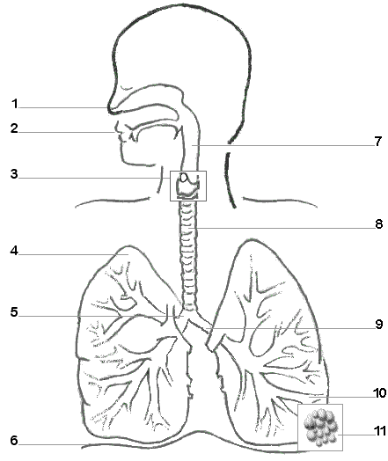
Label the parts of respiratory system:

Slide 28
Respiratory system is located in your chest.

