Slide 1



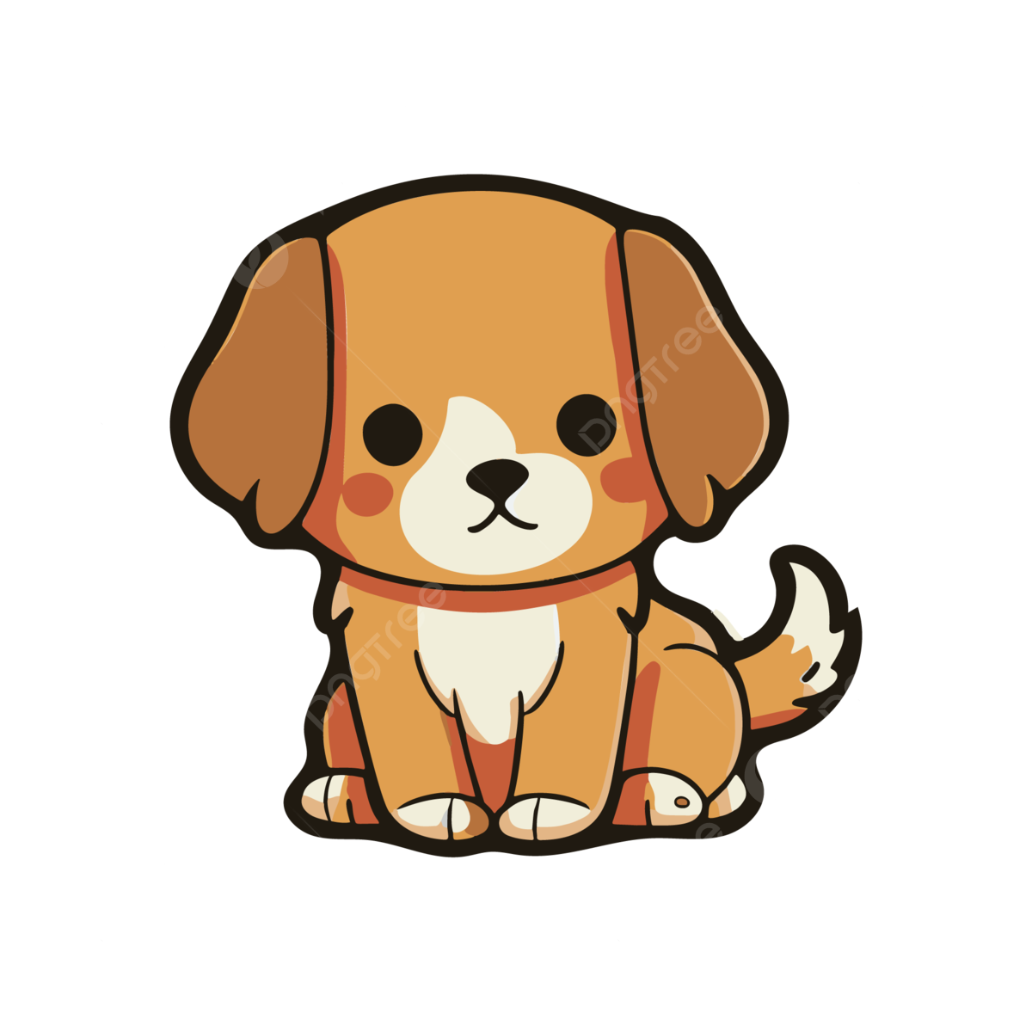
Nouns
→

Slide 2
Warm up
Value: Respecting others
2:00 mins
https://www.youtube.com/watch?v=YNOnFsnjYhY

Slide 3
Outcomes:
1:00 mins
By the end of this lesson students should be able to:
Identify the meaning of nouns.
identify the types of nouns.
Value: Appreciate the act of respecting others

Slide 4

Pre-assessment
2:00 mins
Mini board/IRS
Take off- Touch Down n
Take off if you think the shown picture is a thing

Slide 5
A noun is a naming word
A noun is a name of a person, animal, place or thing.

Slide 6

Let’s listen to a song.
5:00 mins
https://www.youtube.com/watch?v=9cu7C07pNbA&list=RD9cu7C07pNbA&start_radio=1

Slide 7
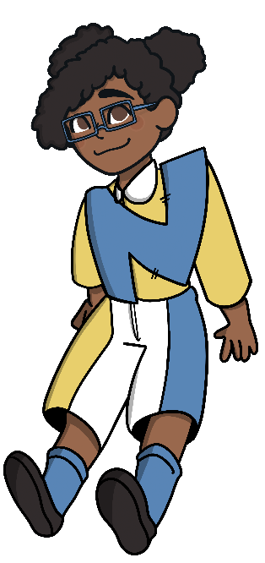
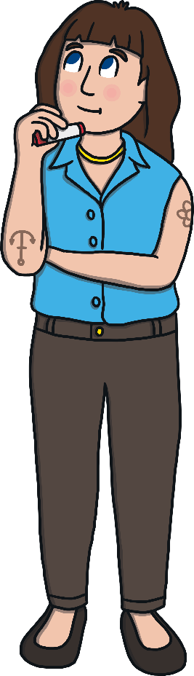
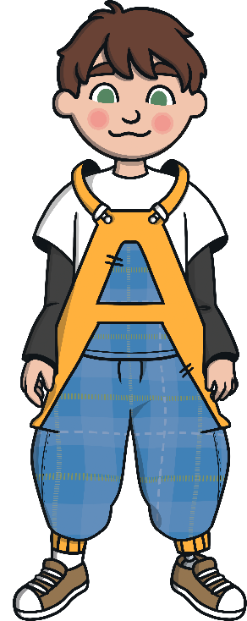


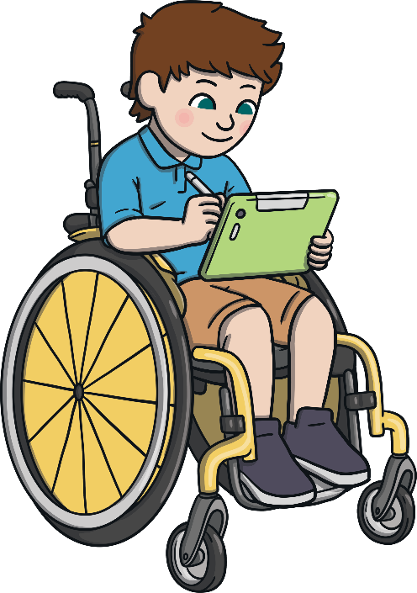
A noun can be a name of a person.
teacher
Nouns can be used to name people.
Adam
doctor
Tamara

Slide 8
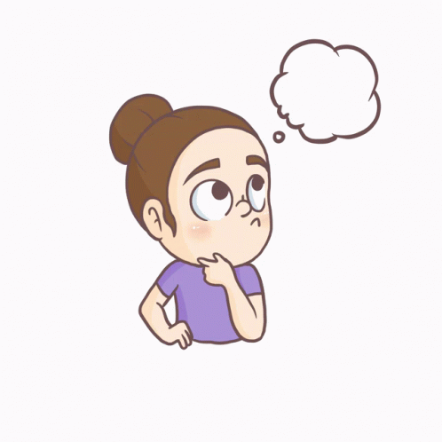
If you could give yourself a name, what would it be and why?
1:30 mins
Buzz in

Slide 9

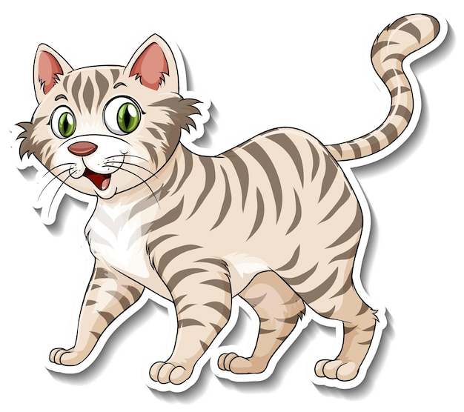
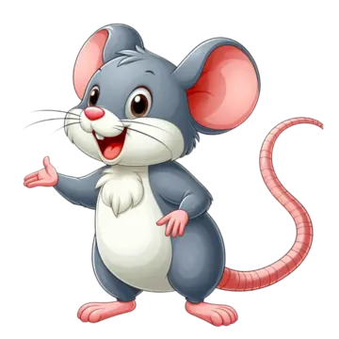
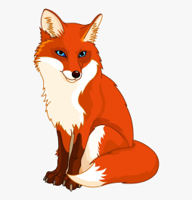

Nouns can also be used to name animals.
cat
lion
rat
shark
fox

Slide 10

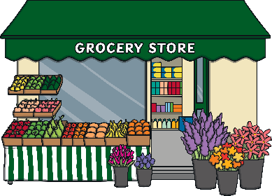


Nouns can also be used to name places.
kitchen
school
shop
Jordan
beach

Slide 11




pumpkin
And nouns can be used to name things.
computer
balloon
pencil
backpack
book

Slide 12
Circle the nouns in the sentences.
3:00 mins
Round Table
1. I have a red backpack .
2. Tala and Ali are nice.
3. He has a big cat .

Slide 13

Group work
3:00 mins
Random pick
Sort the following pictures into types of nouns.

Slide 14
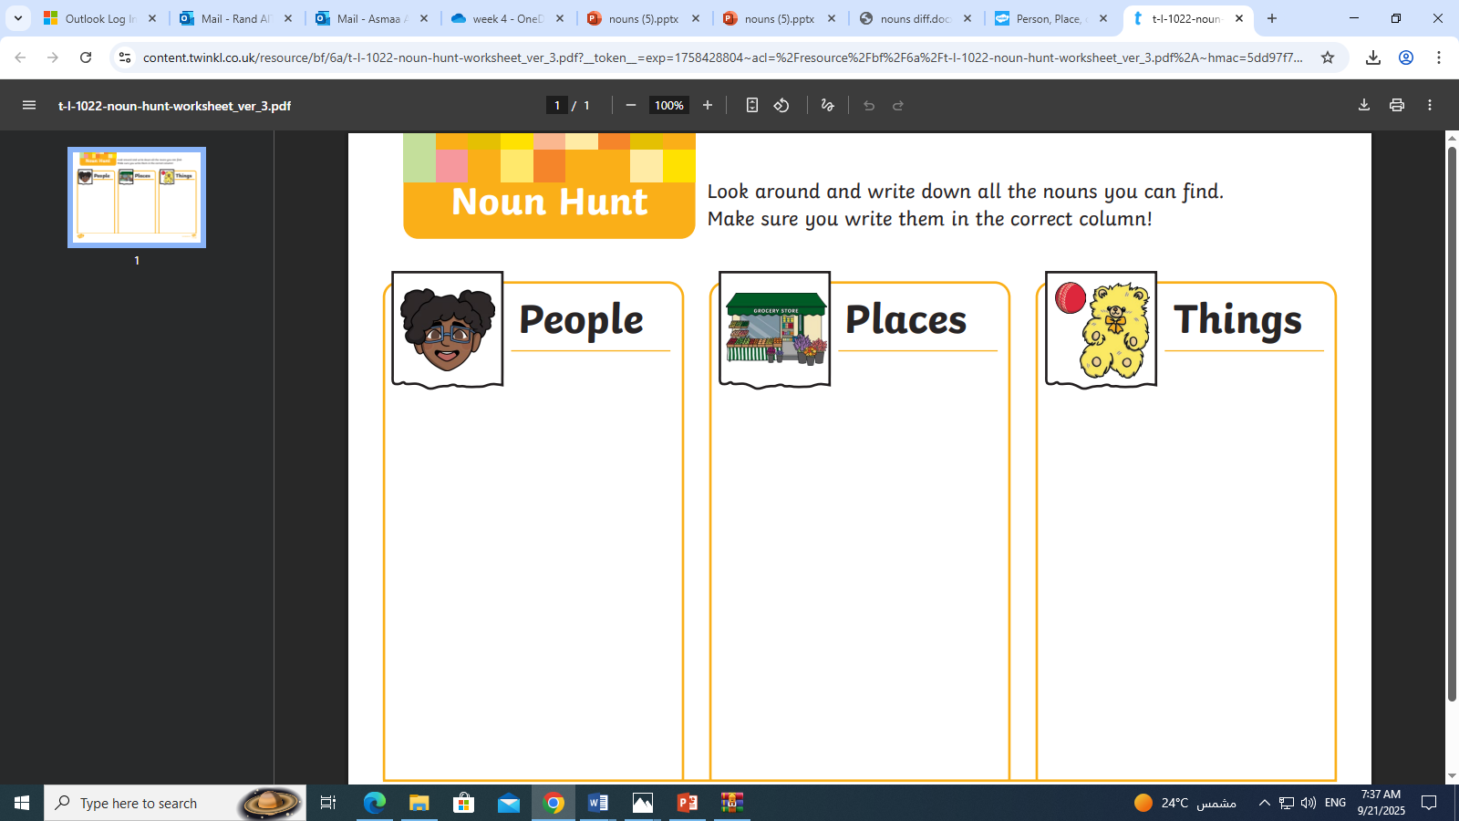
Feedback
Chef
Artist
coach
Beach
City
mountain
Bicycle
Lamp
phone

Slide 15

Real life application
3:00 mins
Round Robin
“Look around the classroom. Can you find one person, one place, and one thing that you can name? Say them out loud!”

Slide 16
Differentiation no. 1
3:00 mins
Random pick
Think of a noun that is an animal

Slide 17
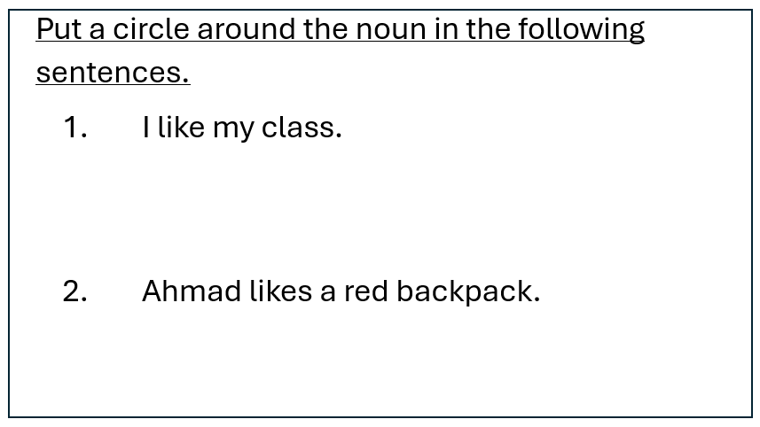
Differentiation no. 2
3:00 mins
Random pick

Slide 18
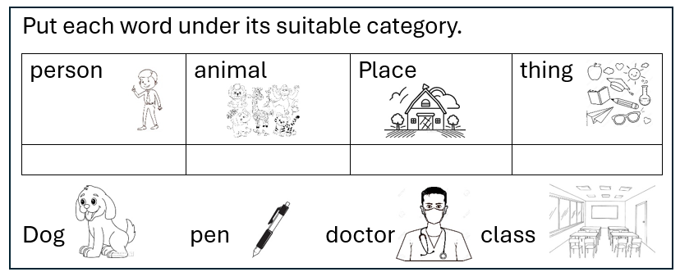
Differentiation No. 3
3:00 mins
Random pick

Slide 19
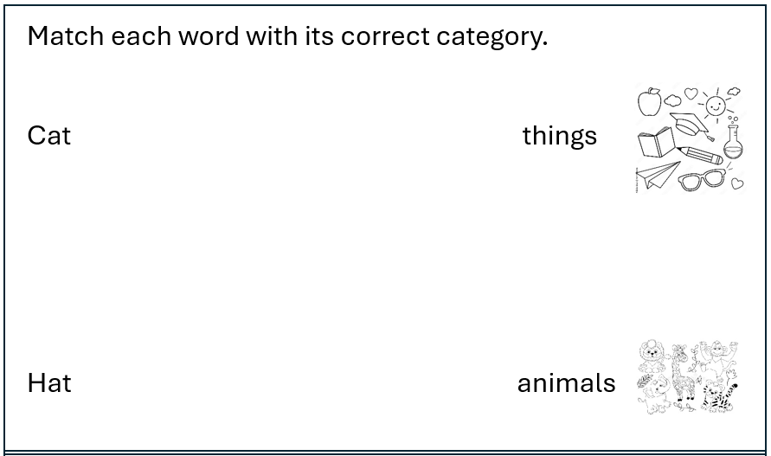
Differentiation no. 4
3:00 mins
Random pick

Slide 20
Let’s play a game
5:00 mins
Random pick
https://wordwall.net/resource/15182787/english/noun-sort

Slide 21
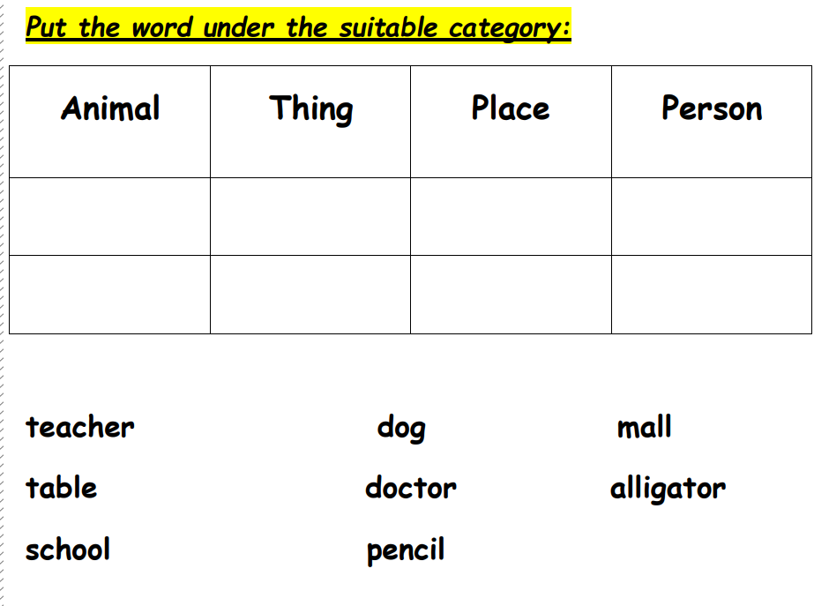

Slide 22
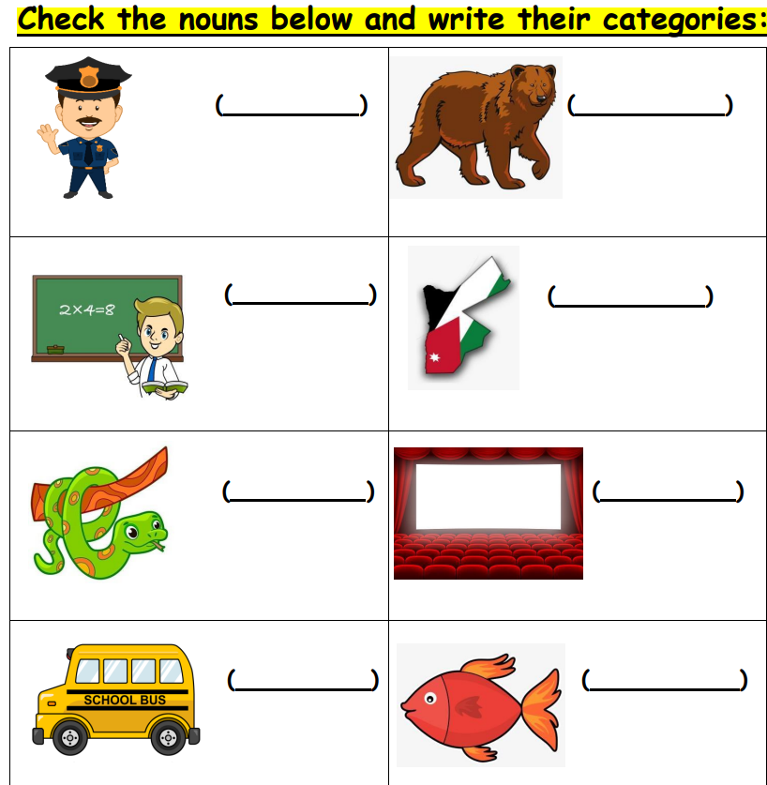

Slide 23
Summative Assessment/IRS
Which word is a noun.
2-table
1- run

Slide 24
If you could only use 2 nouns today, which would you use and why?
Exit Ticket

