Slide 1
Phonics
Ff

Slide 2
Warm up
https://www.youtube.com/watch?v=ET4B3UfWrYY

Slide 3
outcomes
1. Identify the sound of letter Ff. and read words with the letter
2. Write the letter correctly in between the lines.
Value: appreciate the act of being kind to others.

Slide 4
Pre-assessment/ IRS
Are you familiar with the following letter (Ff)?
1
Yes
2
No

Slide 5
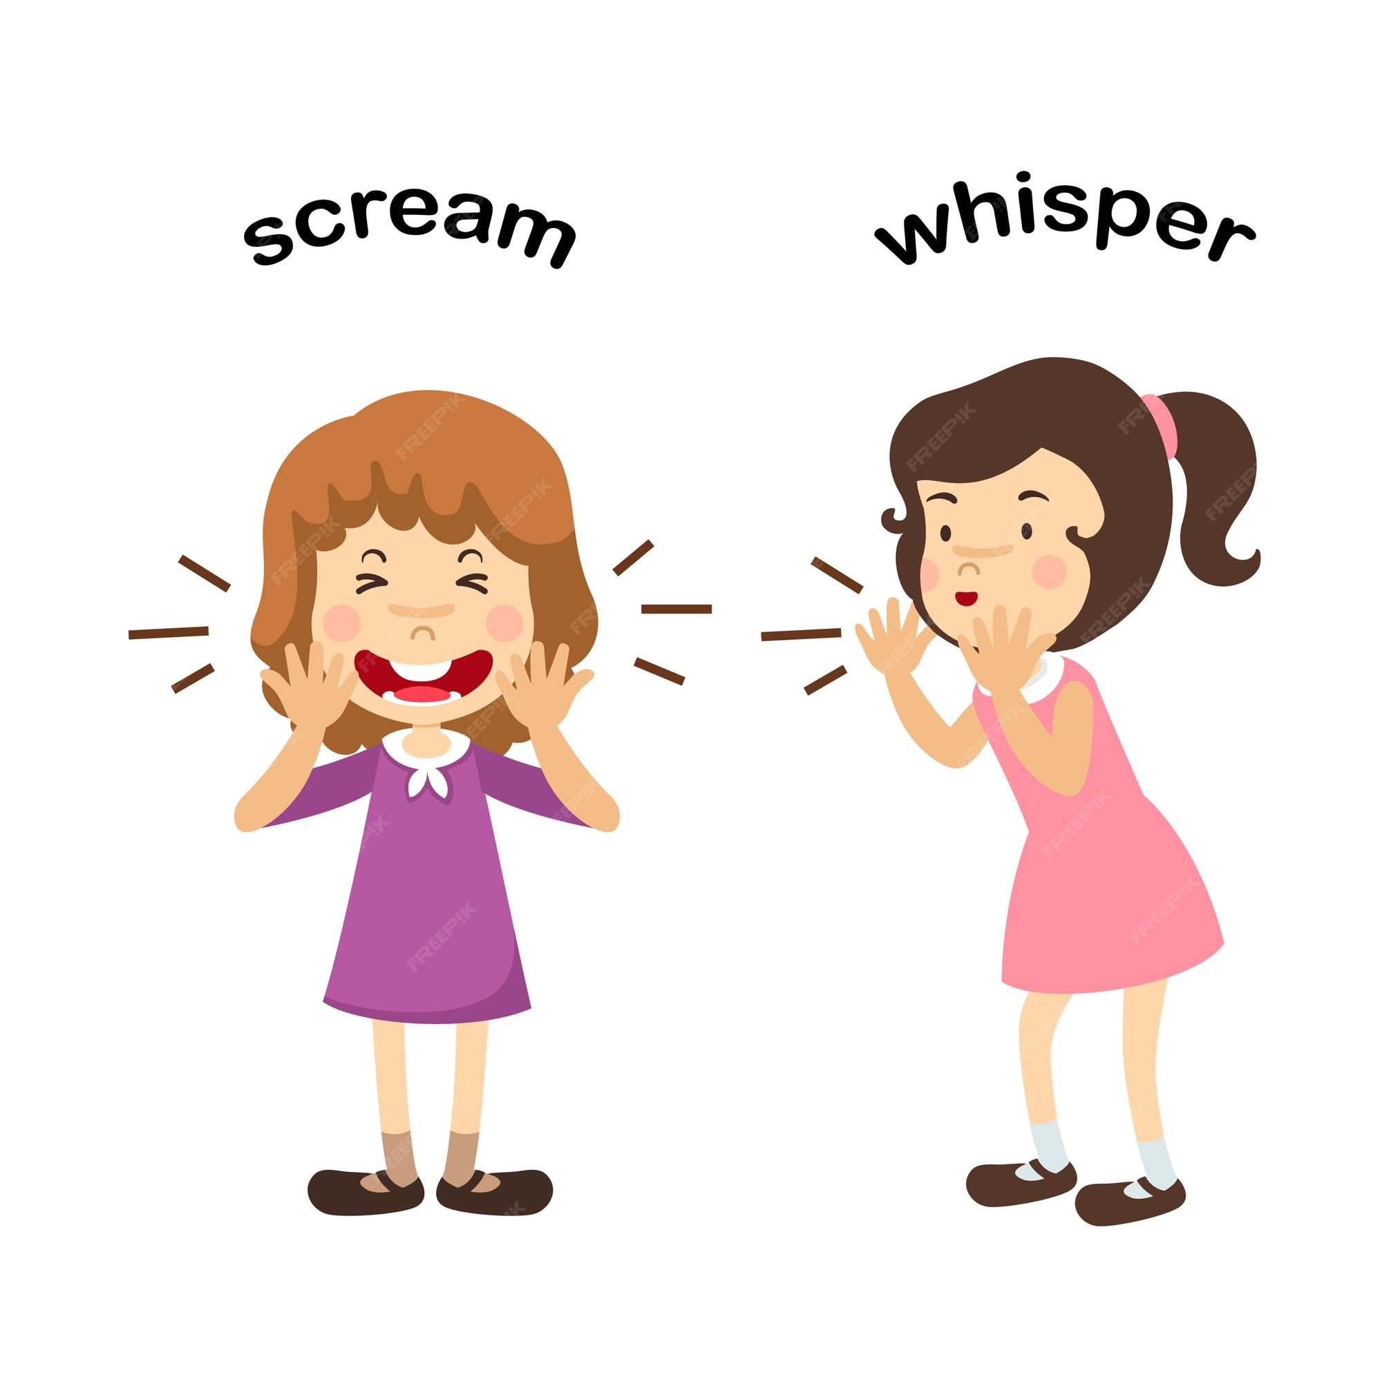
Ff

Slide 6
Let’s sing together
https://www.youtube.com/watch?v=iKuZGsW6aWQ

Slide 7


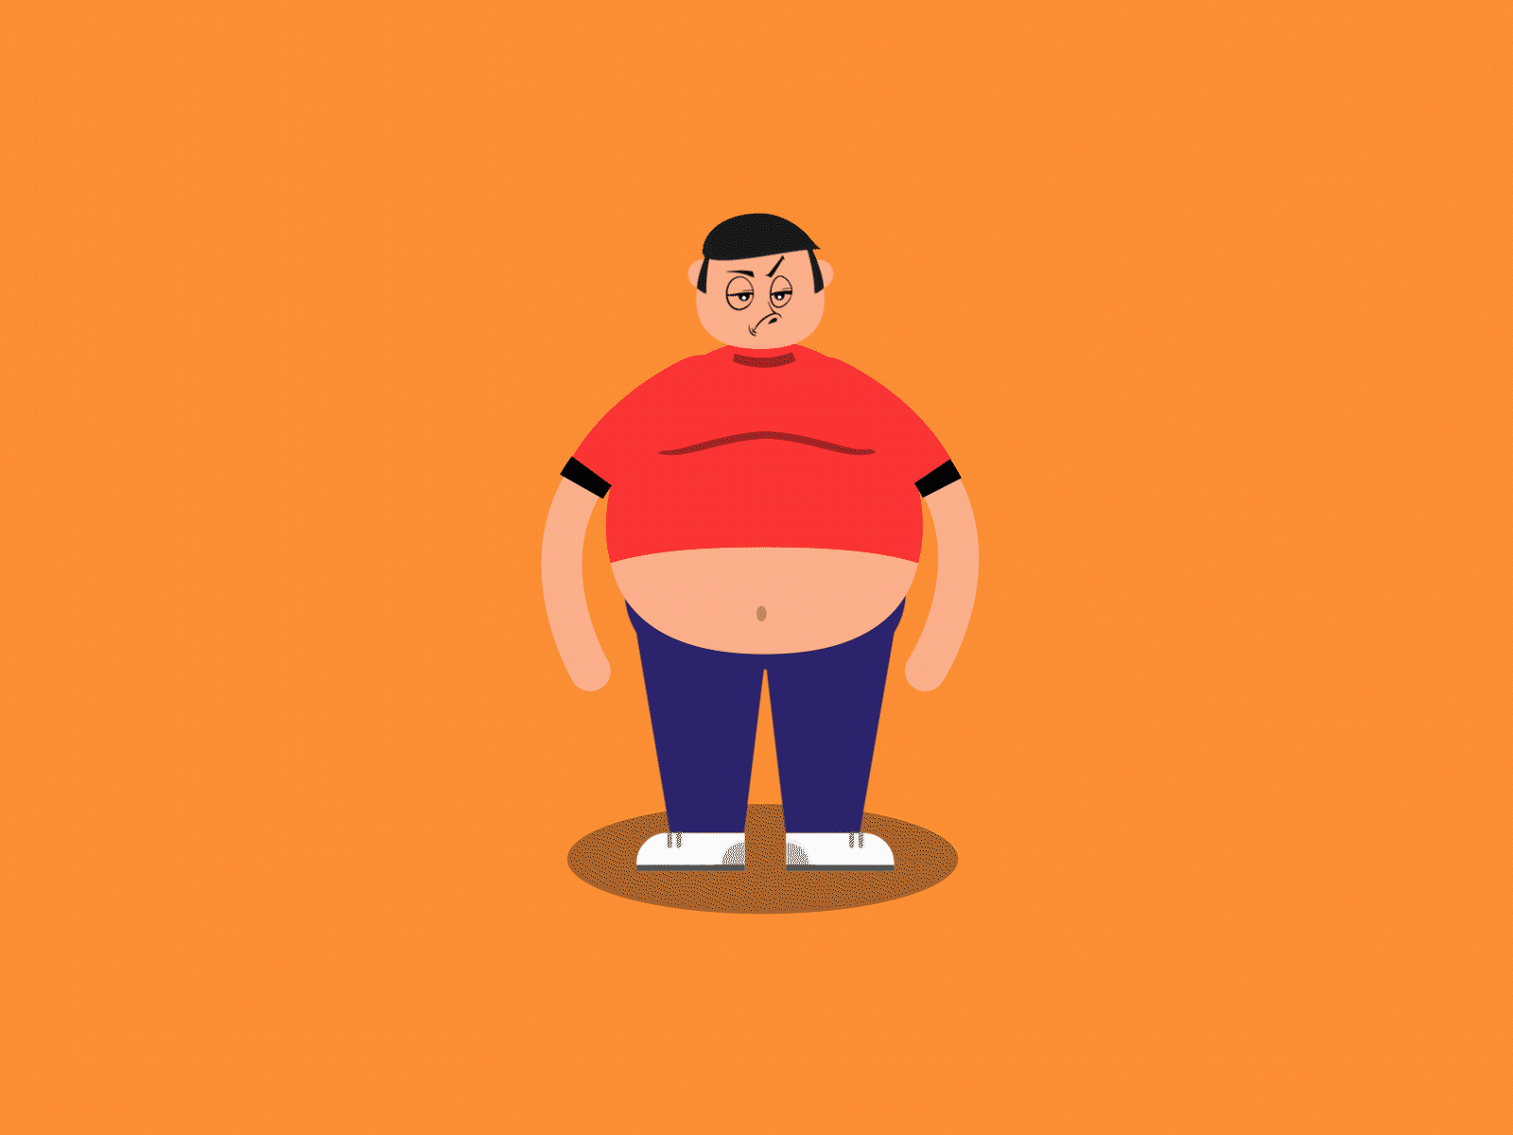


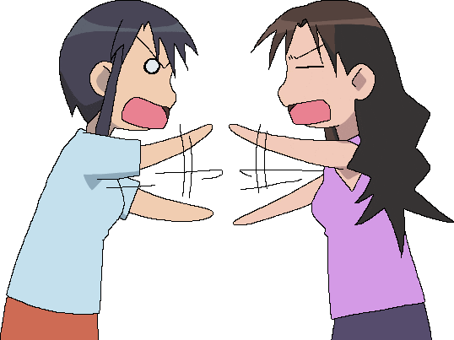
fish
fat
fan
leaf
infant
fight

Slide 8

Think of more words with letter Ff and tell them to your partner.
Real life application/ Random pick

Slide 9
Group work
Match each picture with its correct word.

Slide 10
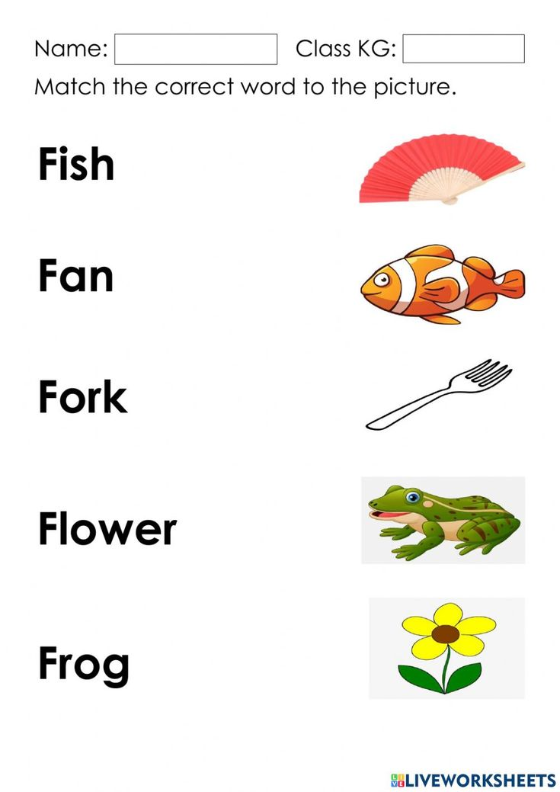

Slide 11
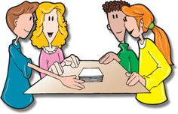
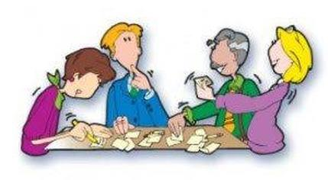
Critical thinking question/ Buzz in
If you change the first letter of “fen” what new words do you get?

Slide 12
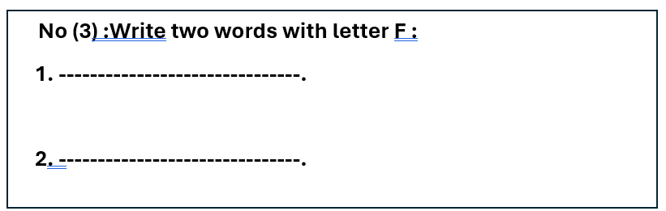
Differentiation no.3.

Slide 13
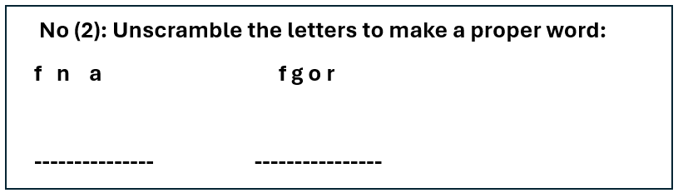
Differentiation no. 2.

Slide 14
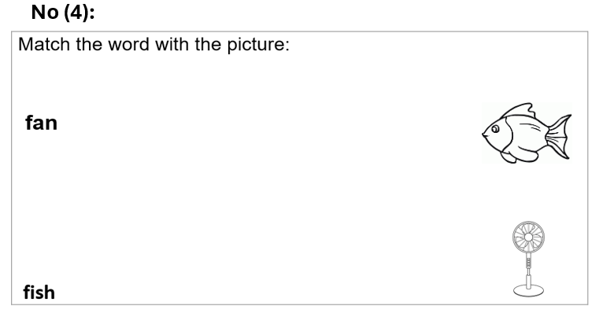
Differentiation no.4.

Slide 15
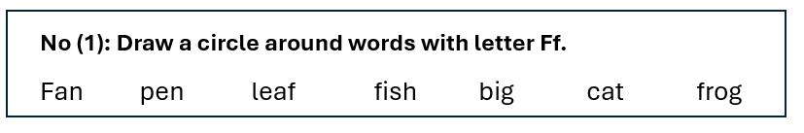
Differentiation no.1.

Slide 16
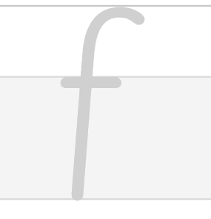
How to write lowercase f
1
2
3

Slide 17

How to write uppercase F
1
2
3

Slide 18
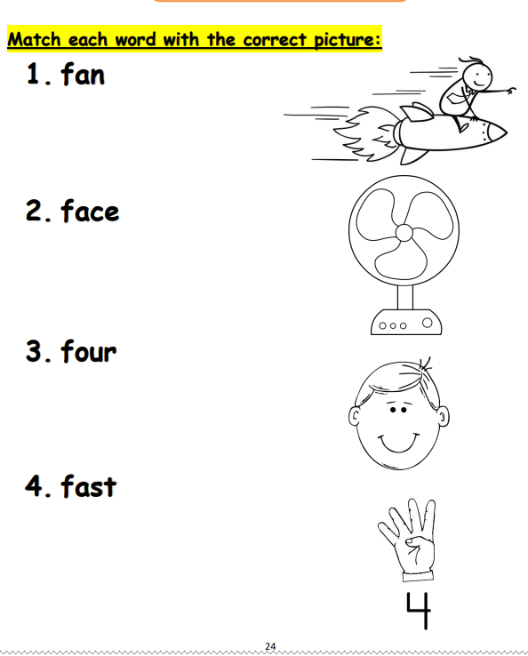

Slide 19
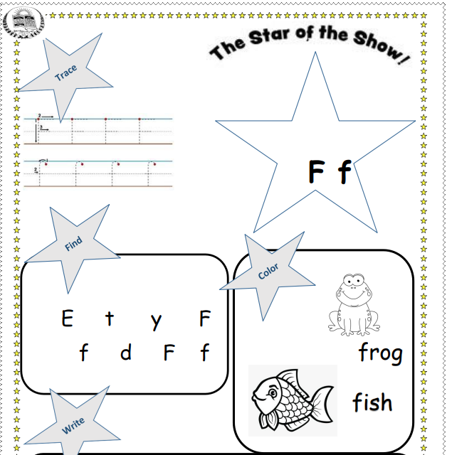

Slide 20
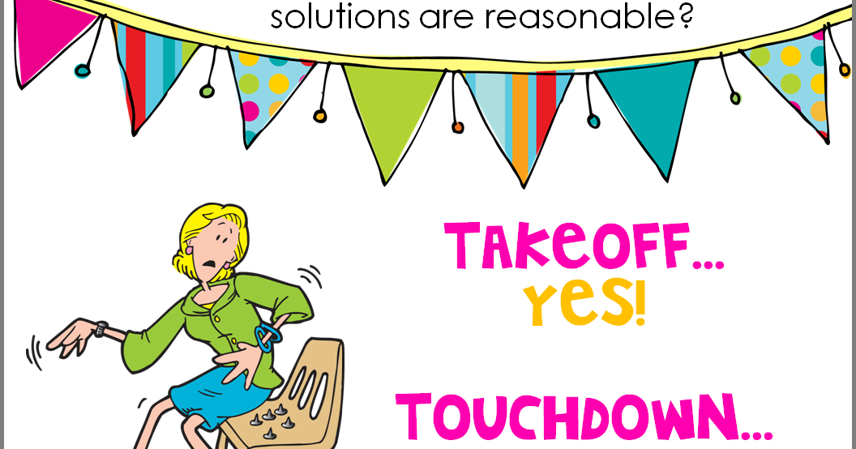
Take-off touch down
Take-off if you hear a word with /f/, touch down if you don’t.

Slide 21
Let’s play a game
https://wordwall.net/resource/10642710/letter-f

Slide 22
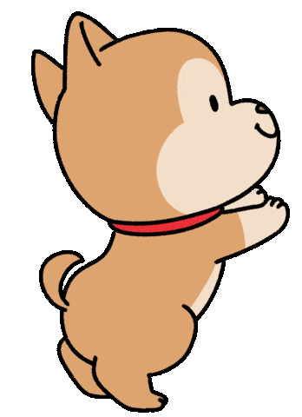
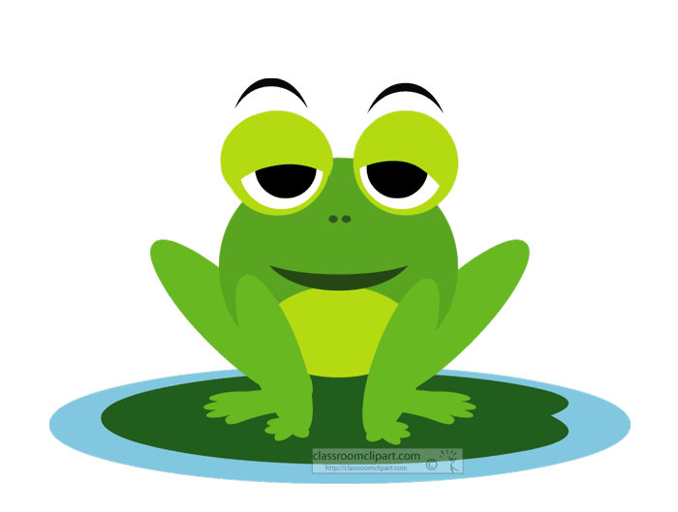
Summative assessment/ IRS
Which word has the letter Ff?
1
2

Slide 23
02
Phonics
Ll

Slide 24
Warm up
https://www.youtube.com/watch?v=J6apq9b3kak

Slide 25
outcomes
1. Identify the sound of letter Ll. and read words with the letter
2. Write the letter correctly in between the lines.
Value: appreciate the act of being honest.

Slide 26
Pre-assessment/ IRS
Are you familiar with the following letter (Ll)?
1
Yes
2
No

Slide 27
Ll

Slide 28
Let’s sing together
https://www.youtube.com/watch?v=fR2GGuIM2is

Slide 29

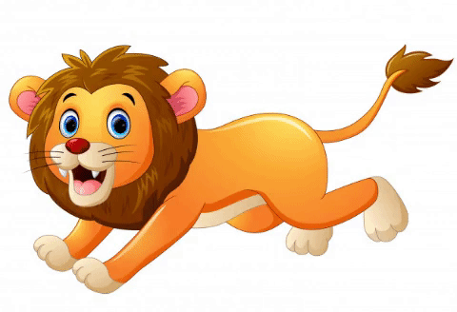
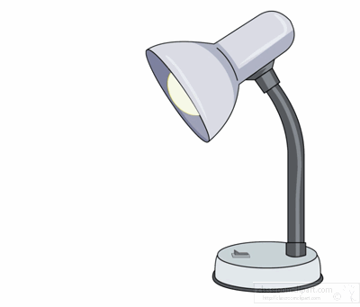
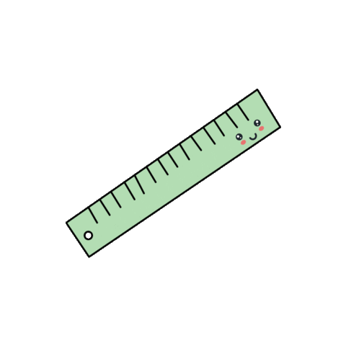
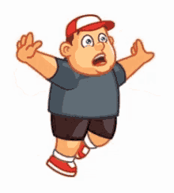
lollipop
lion
lamp
leaf
ruler
fall

Slide 30
Think of more words with letter Ll and tell them to your partner.
Real life application/ Random pick

Slide 31
Group work
Match each picture with its correct word.

Slide 32
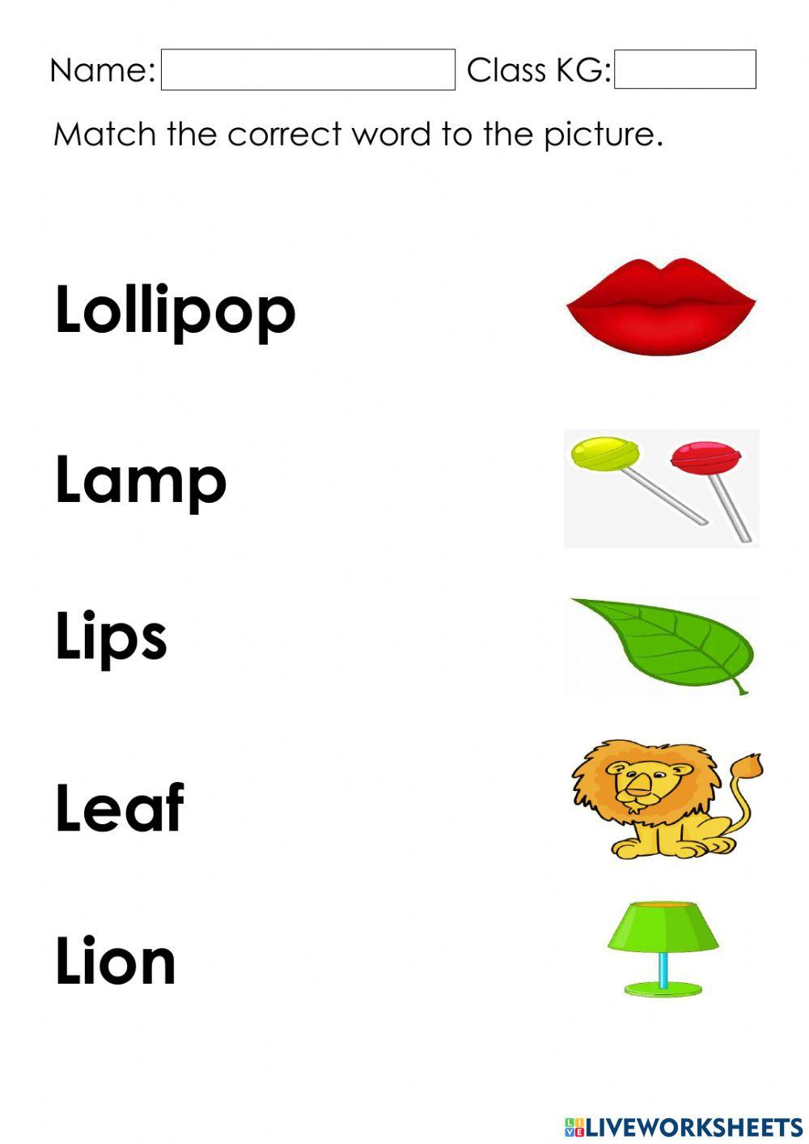

Slide 33
Critical thinking question/ Buzz in
If you change the first letter of “led” what new words do you get?

Slide 34

Differentiation no.3.

Slide 35
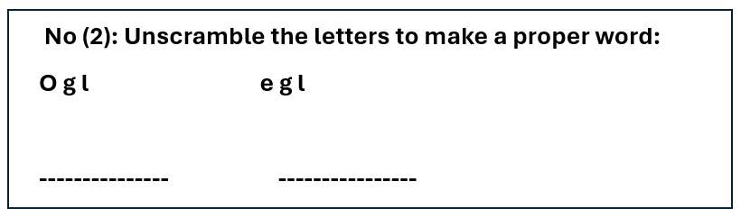
Differentiation no. 2.

Slide 36
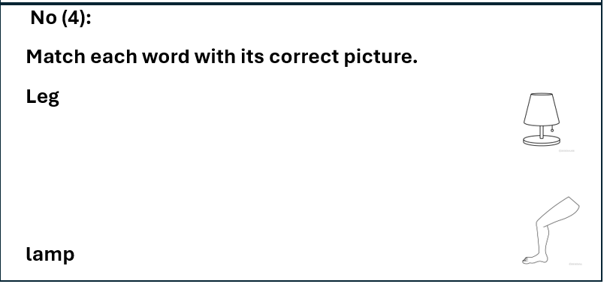
Differentiation no.4.

Slide 37
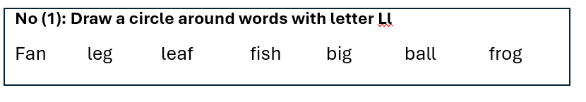
Differentiation no.1.

Slide 38

How to write lowercase l
1
2
3

Slide 39

How to write uppercase L
1
2
3

Slide 40
Take-off touch down
Take-off if you hear a word with /l/, touch down if you don’t.

Slide 41
Let’s play a game
https://wordwall.net/resource/31231293/reading/letter-l

Slide 42
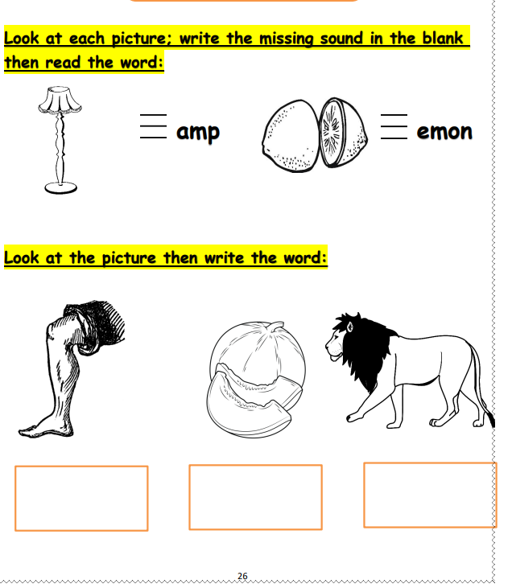

Slide 43
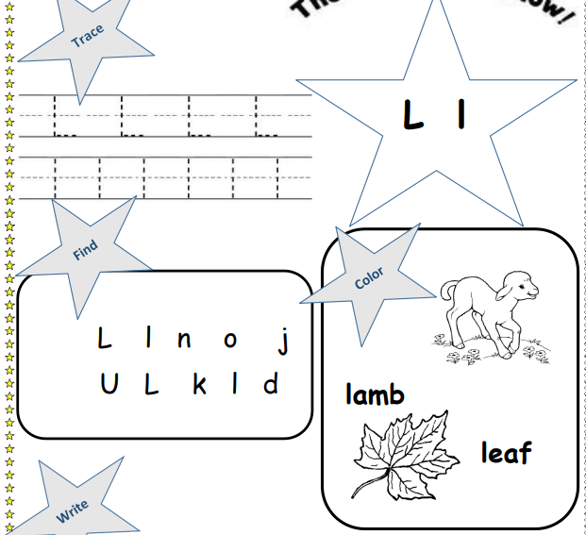

Slide 44

Summative assessment/ IRS
Which word has the letter Ll?
1
2

Slide 45
02
Phonics
Tt

Slide 46
Warm up
https://www.youtube.com/watch?v=Dkt0xe_n0h0

Slide 47
outcomes
1. Identify the sound of letter Tt. and read words with the letter
2. Write the letter correctly in between the lines.
Value: appreciate the act of not stealing.

Slide 48
Pre-assessment/ IRS
Are you familiar with the following letter (Tt)?
1
Yes
2
No

Slide 49
T t

Slide 50
Let’s sing together
https://www.youtube.com/watch?v=Dkt0xe_n0h0

Slide 51

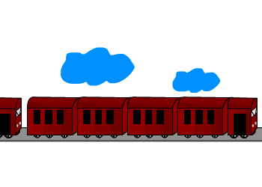

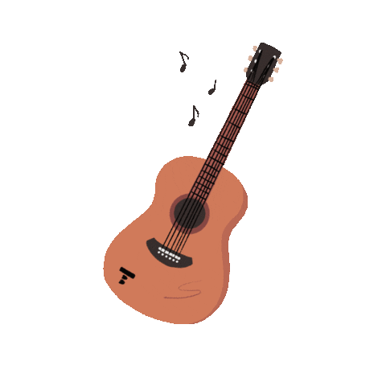

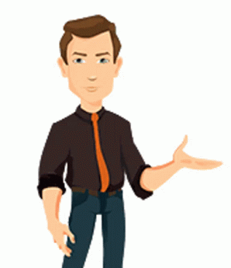
tiger
train
pot
guitar
tasty
talk

Slide 52
Think of more words with letter Tt and tell them to your partner.
Real life application/ Random pick

Slide 53
Group work
Match each picture with its correct word.

Slide 54
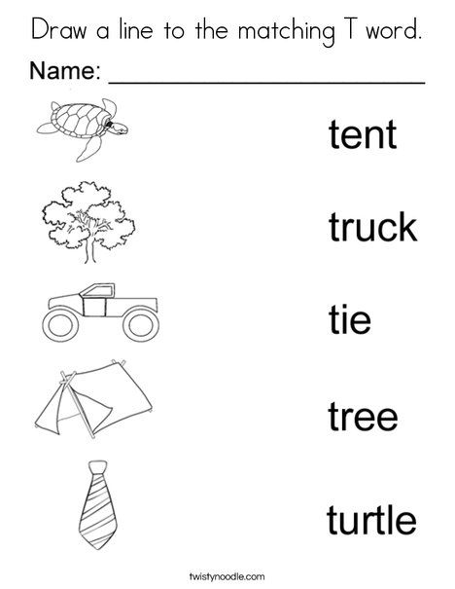

Slide 55
Critical thinking question/ Buzz in
If you change the first letter of “ten” what new words do you get?

Slide 56
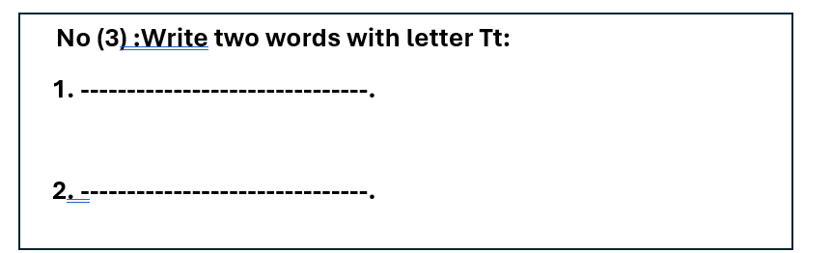
Differentiation no.3.

Slide 57
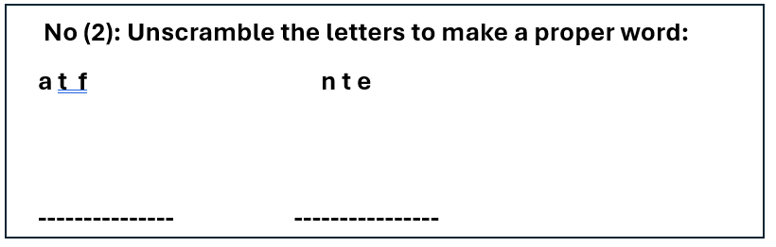
Differentiation no. 2.

Slide 58
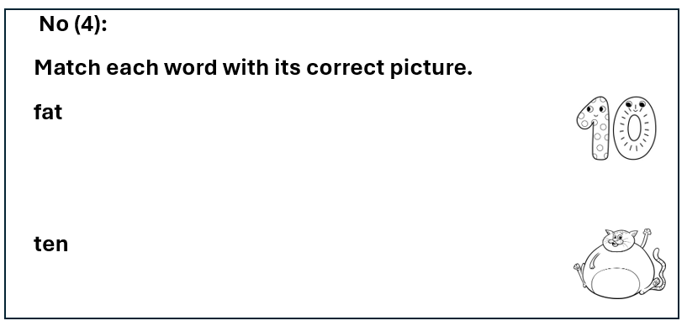
Differentiation no.4.

Slide 59
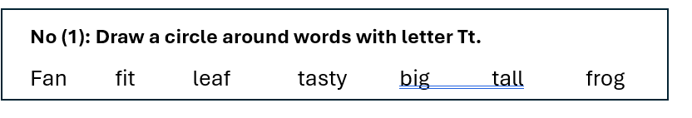
Differentiation no.1.

Slide 60
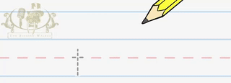
How to write lowercase t

Slide 61

How to write uppercase T
1
2
3

Slide 62
Take-off touch down
Take-off if you hear a word with /t/, touch down if you don’t.

Slide 63
Let’s play a game
https://wordwall.net/resource/32342650/letter-t

Slide 64

Summative assessment/ IRS
Which word has the letter Tt?
1
2

Slide 65
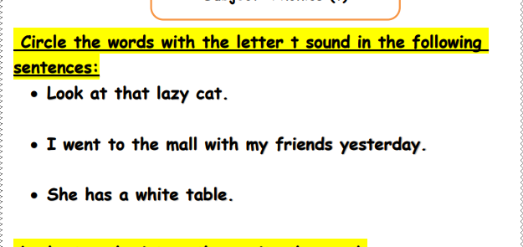

Slide 66
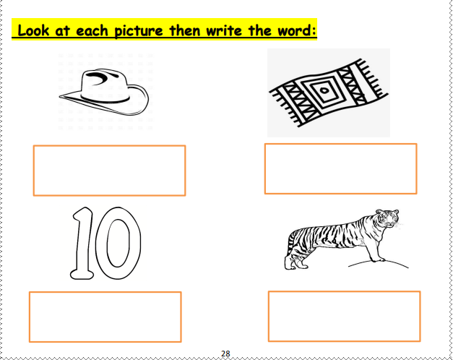

Slide 67
