Slide 1
Graphical method of solving simultaneous linear equations
10th grade
Unit: simultaneous linear equations

Slide 2


Learning Objectives
The Islamic Scientific College
Lesson: Graphical method
Unit : 5
Grade: 10
Subject: Math
Outcomes
Introduction
Pre-assessment
Solve simultaneous equations by graphing linear equations and finding their intersection.
Essential activity
Constructive evaluation
Feedback
Differentiation learning
Real-life situation
Critical thinking
Summative evaluation
Exit ticket

Slide 3
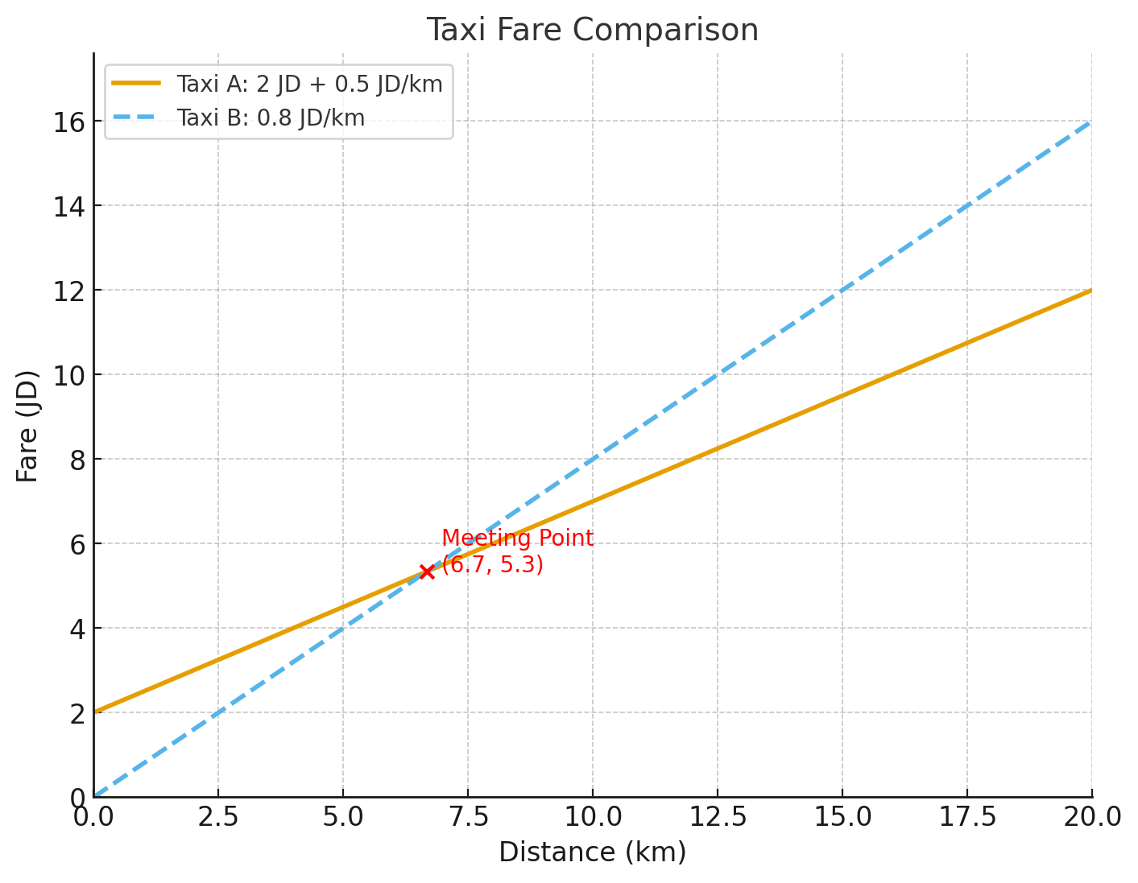
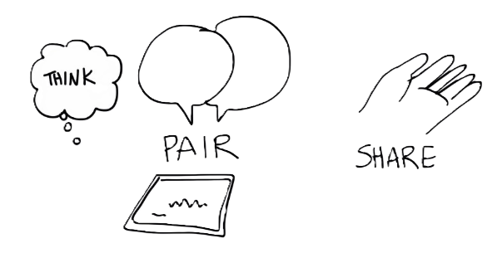
The Islamic Scientific College
Lesson: Graphical method
Unit : 5
Grade: 10
Subject: Math
🚖 Two taxi fare (one with a flat starting fee + lower rate, the other with no starting fee but higher per km rate). At what distance do both taxis cost the same?
Outcomes
Introduction
Pre-assessment
Essential activity
Constructive evaluation
Feedback
Differentiation learning
Real-life situation
Critical thinking
Summative evaluation
Exit ticket

Slide 4
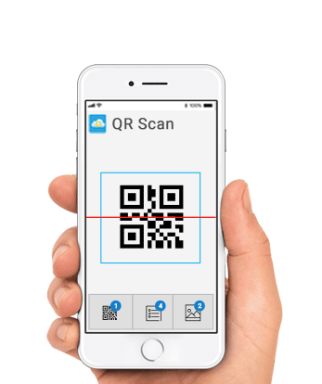

The Islamic Scientific College
Lesson: Graphical method
Unit : 5
Grade: 10
Subject: Math
Outcomes
Pre-learning
Introduction
Pre-assessment
Essential activity
Constructive evaluation
Feedback
Differentiation learning
Real-life situation
Critical thinking
Summative evaluation
Round table
Exit ticket

Slide 5

The Islamic Scientific College
Lesson: Graphical method
Unit : 5
Grade: 10
Subject: Math
Use the following equation to fill the table of values below:
Outcomes
Introduction
$$y = −2x +1$$
Pre-assessment
Essential activity
X | -1 | 0 | 1 | 2
y
Constructive evaluation
Feedback
Differentiation learning
Real-life situation
Critical thinking
Summative evaluation
Rally coach
Exit ticket

Slide 6
The Islamic Scientific College
Lesson: Graphical method
Unit : 5
Grade: 10
Subject: Math
Outcomes
The Graphical Method: Basic Steps
Introduction
Pre-assessment
Create a table of values for each equation
Plot points on the coordinate plane
Draw lines through the points
Find the point of intersection
Verify the solution algebraically
Presentation
Constructive evaluation
Feedback
Differentiation learning
Real-life situation
Critical thinking
Summative evaluation
Exit ticket

Slide 7


The Islamic Scientific College
Lesson: Graphical method
Unit : 5
Grade: 10
Subject: Math
Solve the following pair of simultaneous equations using the graphical method.
Outcomes
Introduction
$$2x+y=−1$$
X | -2 | 0 | 2
y
Eq 1
Pre-assessment
$$3x−4y=4$$
Presentation
Eq 2
X | -2 | 0 | 2
y
Constructive evaluation
Feedback
Differentiation learning
Real-life situation
Critical thinking
Summative evaluation
Exit ticket

Slide 8
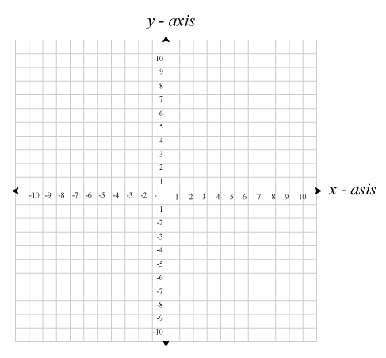




The Islamic Scientific College
Lesson: Graphical method
Unit : 5
Grade: 10
Subject: Math
Eq 1
X | -2 | 0 | 2
y | 3 | -1 | -5
Outcomes
Introduction
$$2x+y=−1$$
Pre-assessment
Eq 2
X | -2 | 0 | 2
y | -2.5 | -1 | 0.5
$$3x−4y=4$$
Presentation
Constructive evaluation
$$2x+y=−1$$
Feedback
$$3x−4y=4$$
Differentiation learning
Real-life situation
Critical thinking
Summative evaluation
Exit ticket

Slide 9
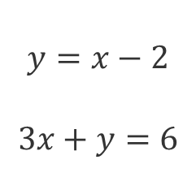
Rally Coach
The Islamic Scientific College
Lesson: Graphical method
Unit : 5
Grade: 10
Subject: Math
Find the solutions to the following pairs of simultaneous linear equations by drawing their graphs.
Outcomes
Introduction
$$y=x−2$$
$$3x+y=6$$
Pre-assessment
Essential activity
Constructive evaluation
Feedback
Differentiation learning
Real-life situation
Critical thinking
Summative evaluation
Exit ticket
Check results using Desmos

Slide 10



The Islamic Scientific College
Lesson: Graphical method
Unit : 5
Grade: 10
Subject: Math
Outcomes
Introduction
Pre-assessment
Essential activity
Constructive evaluation
Feedback

Slide 11
The Islamic Scientific College
Lesson: Graphical method
Unit : 5
Grade: 10
Subject: Math
Please open your book to page 162 and complete the question according to your seat number.
Outcomes
Introduction
Pre-assessment
1&2
3&4
Essential activity
Constructive evaluation
2.g
1.6
Feedback
Differentiation learning
Real-life situation
Critical thinking
Summative evaluation
Exit ticket

Slide 12
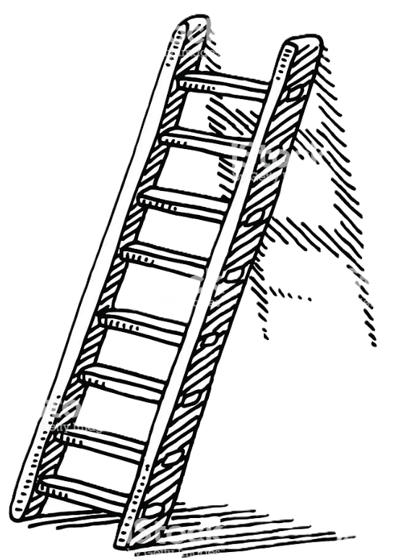
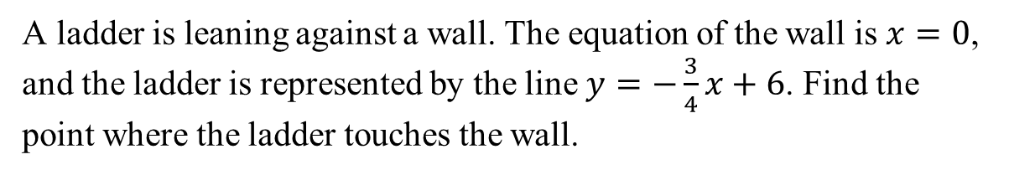
The Islamic Scientific College
Lesson: Graphical method
Unit : 5
Grade: 10
Subject: Math
A ladder is leaning against a wall. The equation of the wall is $x=0$, and the ladder is represented by the line $y=−\frac{3}{4}x+6$. Find the point where the ladder touches the wall.
Outcomes
Introduction
Pre-assessment
Essential activity
Constructive evaluation
Feedback
Differentiation learning
Real-life situation
Critical thinking
Summative evaluation
Exit ticket
👉 Think-Pair-Share

Slide 13


The Islamic Scientific College
Lesson: Graphical method
Unit : 5
Grade: 10
Subject: Math
Outcomes
What would happen if the two lines were parallel? What if they overlapped completely?
Introduction
Pre-assessment
Essential activity
Constructive evaluation
Feedback
Differentiation learning
Real-life situation
Critical thinking
Summative evaluation
Exit ticket

Slide 14
The Islamic Scientific College
Lesson: Graphical method
Unit : 5
Grade: 10
Subject: Math
Outcomes
Why do we say the point of intersection is the solution?
Introduction
Pre-assessment
Essential activity
Constructive evaluation
Feedback
Differentiation learning
Real-life situation
Critical thinking
Summative evaluation
Exit ticket

Slide 15

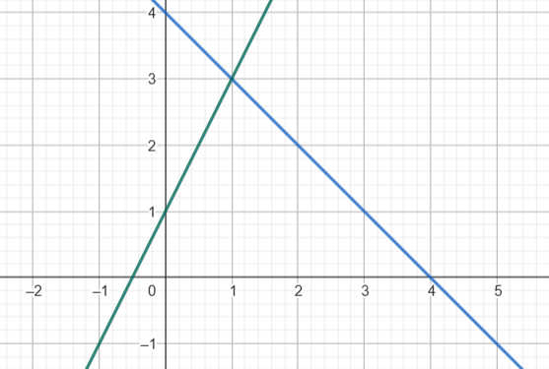
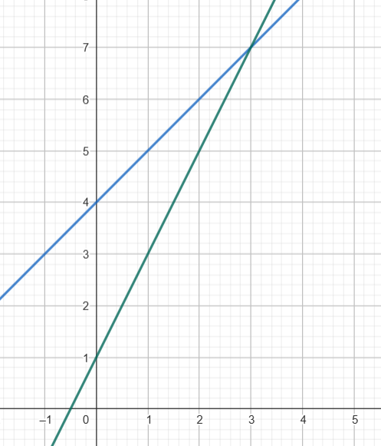
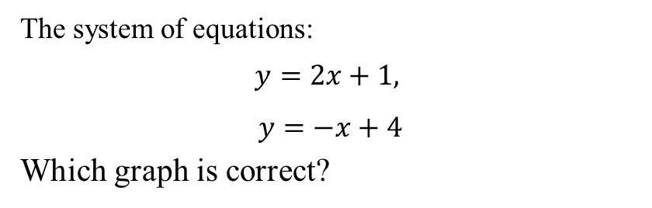
The Islamic Scientific College
Lesson: Graphical method
Unit : 5
Grade: 10
Subject: Math
The system of equations:
$$y=2x+1,$$
$$y=−x+4$$
Which graph is correct?
Outcomes
Introduction
Pre-assessment
Essential activity
IRS
1)
2)
Constructive evaluation
Feedback
Differentiation learning
Real-life situation
Critical thinking
Summative evaluation
Exit ticket

Slide 16
👉 Which method do you find easier—graphical or algebraic (elimination/substitution)? Why? 👉 What part of today’s lesson was most challenging for you, and how will you work to overcome it?
The Islamic Scientific College
Lesson: Graphical method
Unit : 5
Grade: 10
Subject: Math
Exit ticket
Outcomes
Introduction
Pre-assessment
Essential activity
Constructive evaluation
Feedback
Differentiation learning
Real-life situation
Critical thinking
Summative evaluation
Exit ticket

Slide 17

Homework
The Islamic Scientific College
Lesson: Graphical method
Unit : 5
Grade: 10
Subject: Math
Outcomes
Introduction
Pre-assessment
Essential activity
I
Constructive evaluation
Feedback
Differentiation learning
Real-life situation
Critical thinking
Summative evaluation
Exit ticket

