Slide 1
Simple Present
U1 / R2

Slide 2
Specific Outcomes
By the end of this lesson, students are expected to:
Revise the verbs.
Use simple present to talk about things people always do.
Make negative statements using the simple present form.
Form a question using the simple present form.
Consider spelling rules.

Slide 3
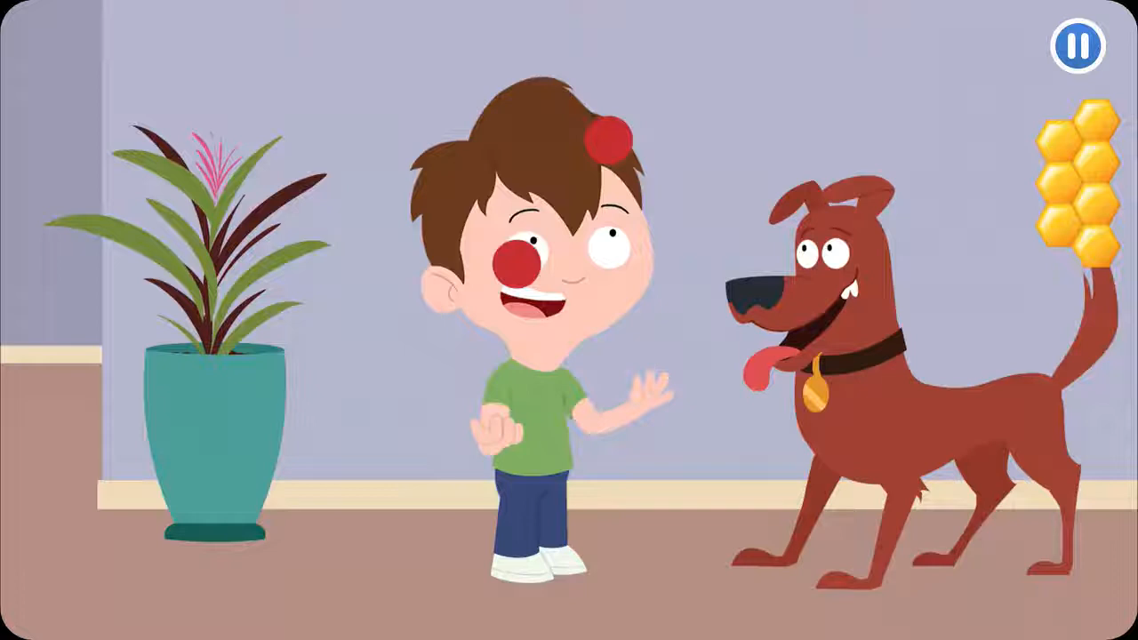
Warm up:
RP
https://www.youtube.com/watch?v=mdA2sByFX1I&ab_channel=BetterWorldiansFoundation

Slide 4
Pre-assessment: Take Off – Touch Down
Take off if you hear a verb and touch down if you hear a noun:
car – book – mom – drive – hump – school - give

Slide 5
presentation

Slide 6

Remember!
A verb is a word that shows an action!
What is a VERB?

Slide 7
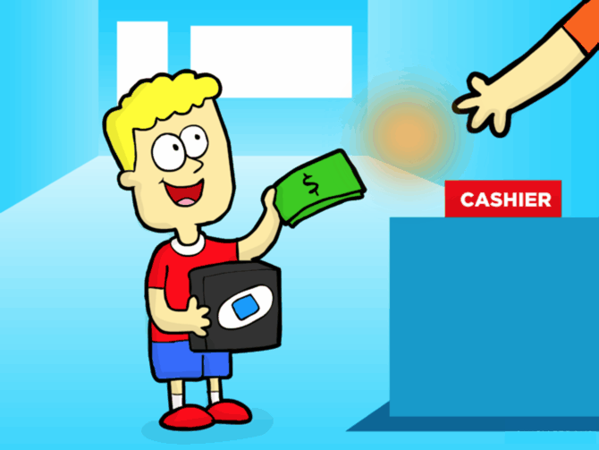
Examples of Verbs:
buy

Slide 8

Examples of Verbs:
learn

Slide 9
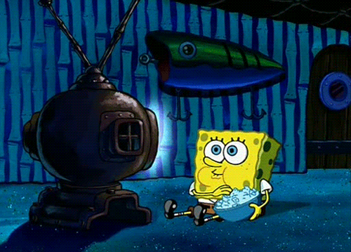
Examples of Verbs:
watch

Slide 10
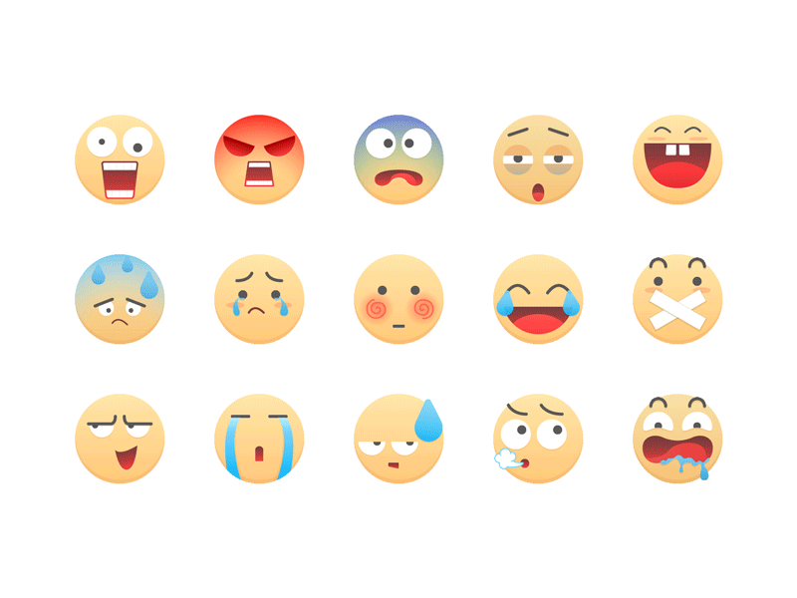
Examples of Verbs:
feel

Slide 11
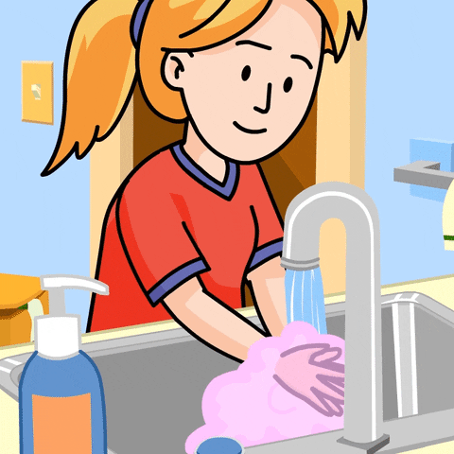
Examples of Verbs:
wash

Slide 12

Examples of Verbs:
hit

Slide 13
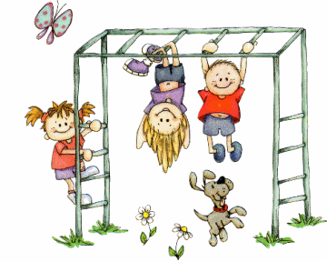
Examples of Verbs:
play

Slide 14

Examples of Verbs:
like

Slide 15

Real life application: in groups - Find Someone Who:
likes to sing: | knows how to ride a bike: | Buys groceries with mom/dad:
feels happy on Sundays: | cooks: | helps with the chores:

Slide 16





She
plays
cries
likes
swims

Slide 17
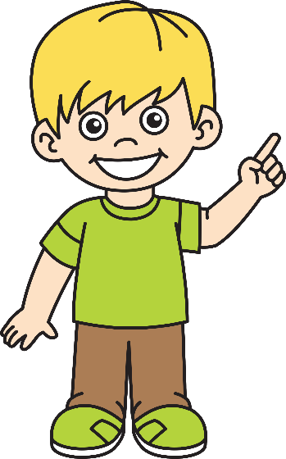
He
rides
drinks
eats
makes

Slide 18

It
jumps
stops
sleeps
runs

Slide 19
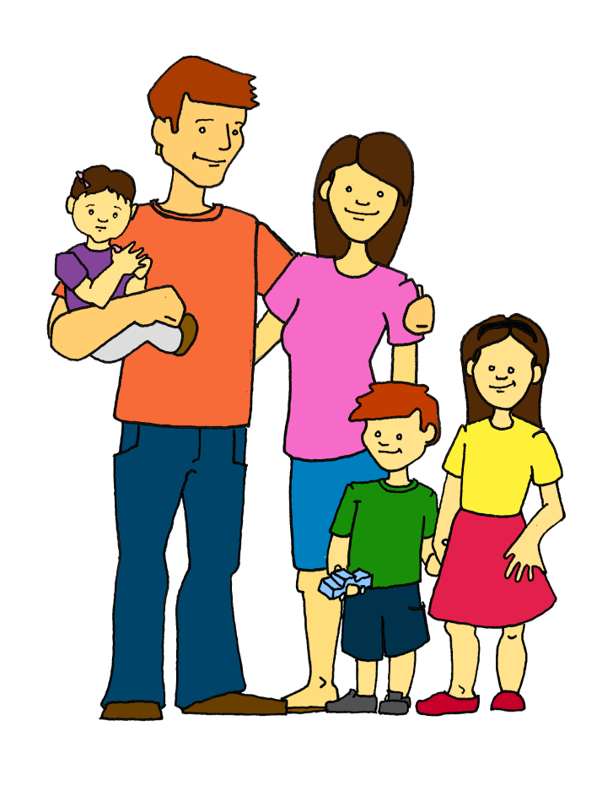
We
You
They

Slide 20
Spelling Rules:
Superman (s) is very friendly with most of the letters but he is not a friend with letters:
(s, z, x, sh, ch)
So he asks the (e) sound to come and sit next to those letters.
For example:
Rami fixes the big TV.
She watches this funny show.

Slide 21
Add the correct ending ( -s / -es / verbs that do not add-s) :
Formative assessment ( Round Table):
RP
She ____________ the cake. (mix)
Ali ____________ his hair every day. (brush)
Salma ____________ the ball. (kick)
They ____________ tennis. (play)
mixes
brushes
kicks
play

Slide 22
Critical Thinking:
Buzz in
If I want to add s or es to the verb (study) how will the spelling of the verb be?
-------------------------------

Slide 23
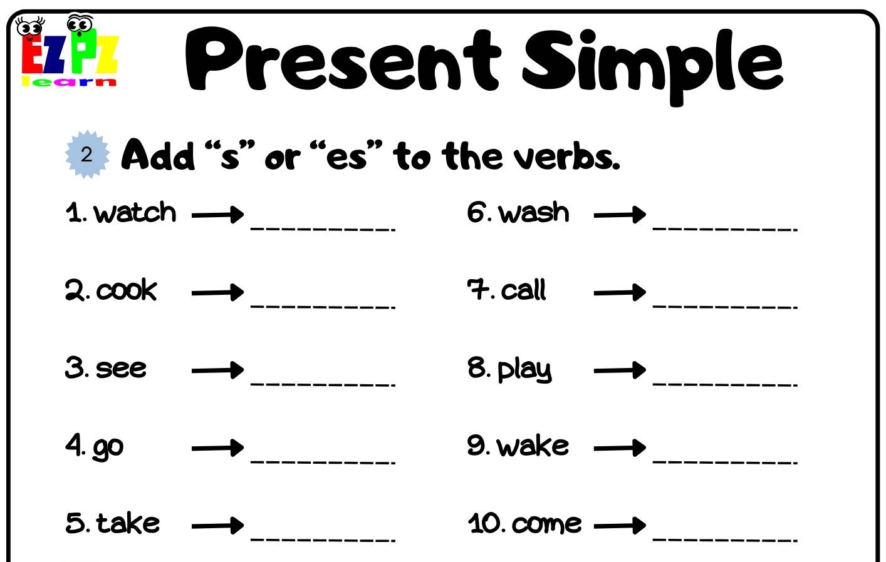
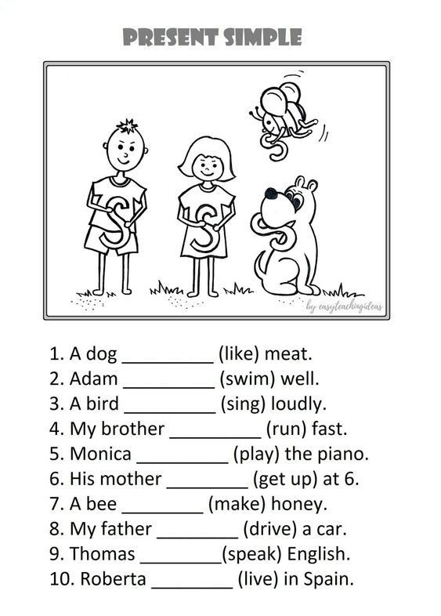
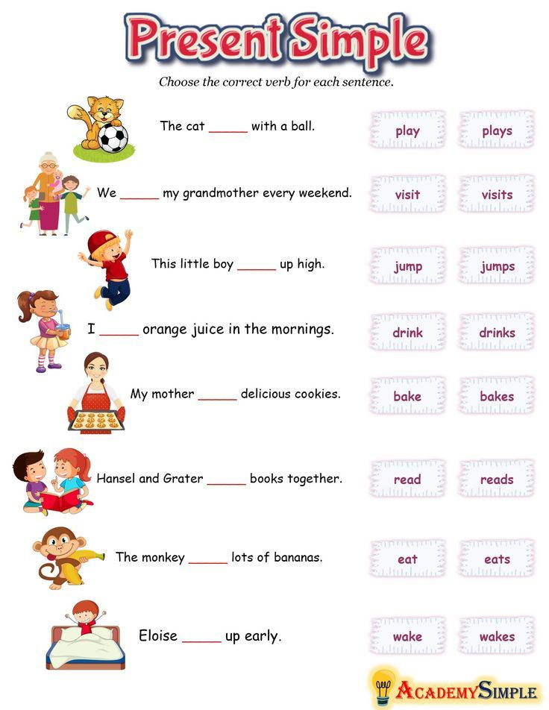
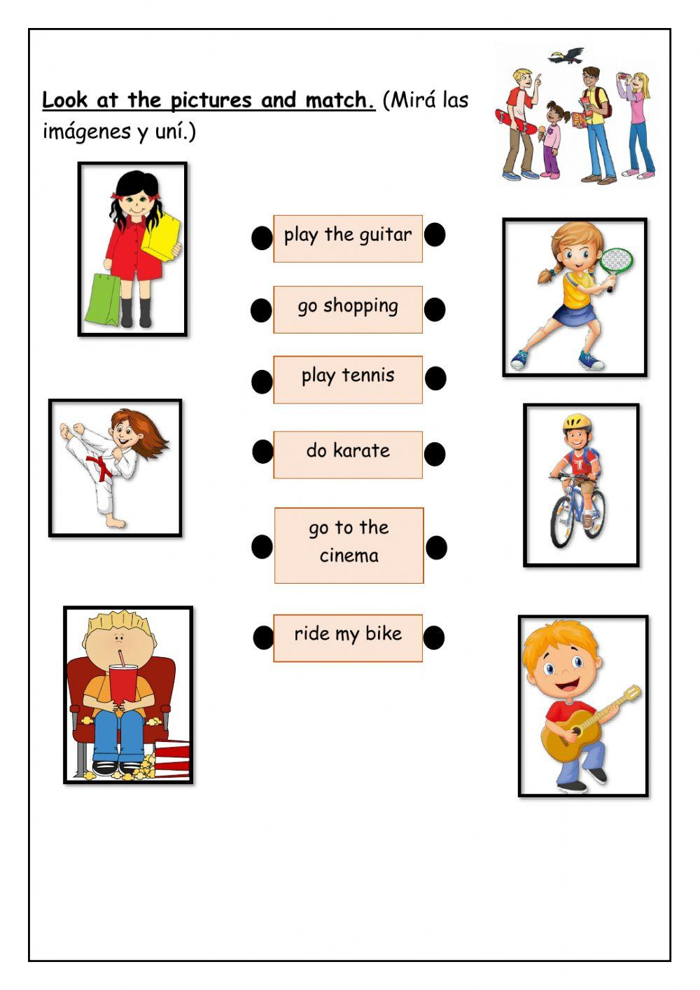
Differentiation:
3
IRS
2
4
1

Slide 24
Summative Assessment:
Choose the correct verb to complete the sentence: She ---------- every day. 1. sings 2. sing

Slide 25
Closure:
Rally Coach:
Tell your friend your daily routine:

Slide 26
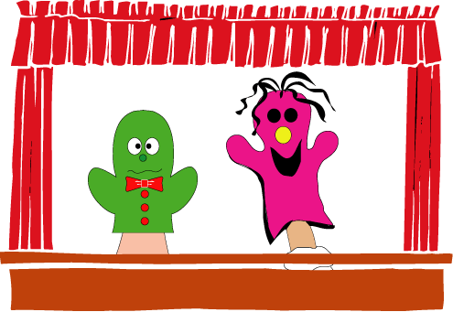
Puppet Show (Negative Form)

Slide 27
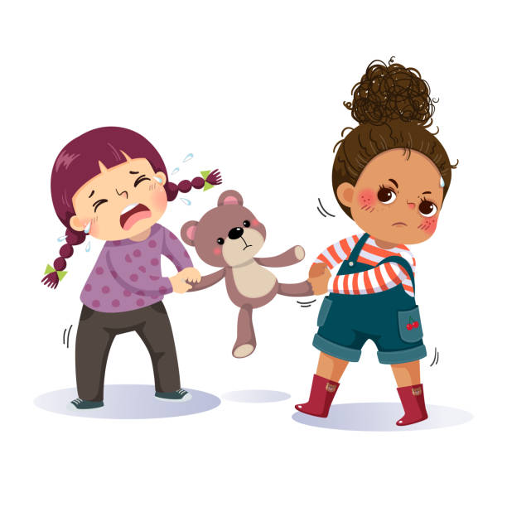

Negatives in simple present tense
He / she / it
Singular subject + does not (doesn’t) + verb (no –s)
She doesn’t want to share her toys.
The TV doesn’t work.

Slide 28
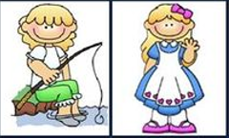

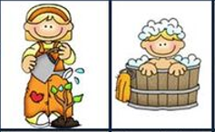
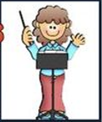


Work in pairs, ask and answer about these pictures:
For example: 1. Does she go fishing every day?
1
2
4
5
6
3
8
10
7
9

Slide 29
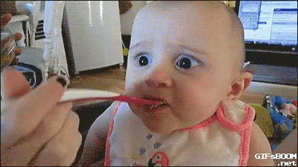
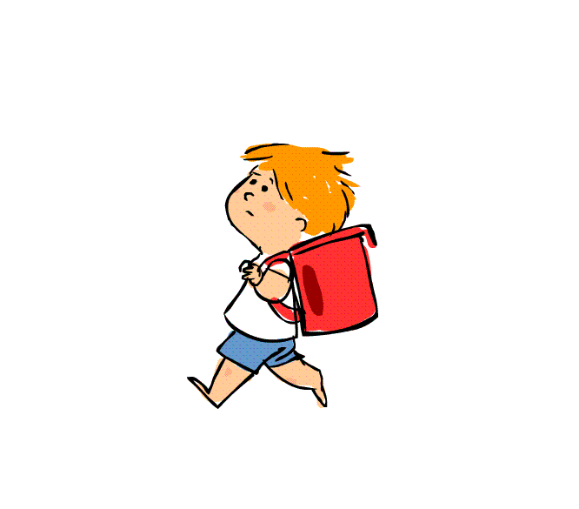
Questions in simple present tense
He / she / it
Does + subject + verb
Does he go to school?
Yes, he does.
Does he like it?
No, he doesn’t.

Slide 30
play | write | read | draw
listen | wear | cry | run
clap | call | hug | drink
dance | brush hair | brush teeth | kick
climb | jump | clean | open

Slide 31
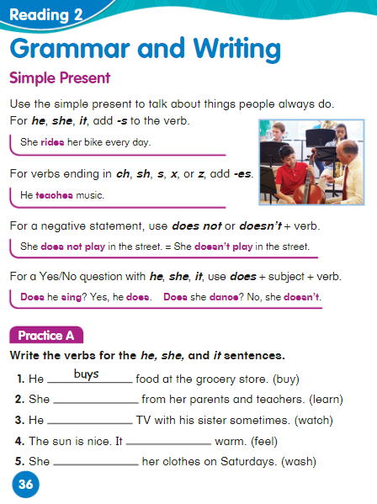

Slide 32
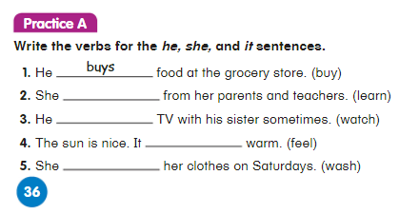
learns
watches
feels
washes

Slide 33
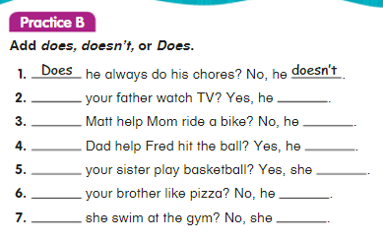
Does
does
Does
doesn’t
Does
does
Does
does
Does
doesn’t
Does
doesn’t

Slide 34
Charades Time
Wrap-up:

