Slide 1


Patterns in the Park
Lesson 1
Chapter 1 / Lesson 12 & / page 3 & 5

Slide 2
1:00
min
Outcomes
Identify repeating patterns.
Create repeating patterns.

Slide 3
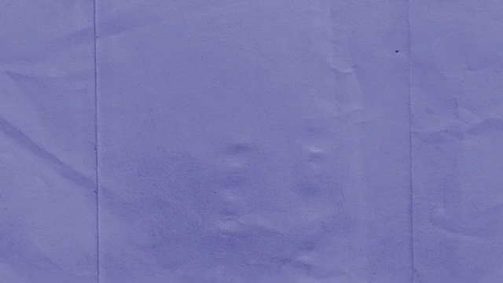
2:00
mins
Warm Up

Slide 4


Pre-Assessment
2:00
mins
What comes next?
Random Pick

Slide 5
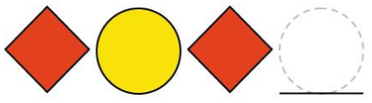
Pre-Assessment
2:00
mins
What comes next?
Random Pick

Slide 6
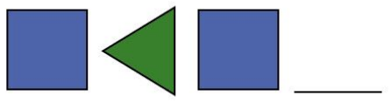
Pre-Assessment
2:00
mins
What comes next?
Random Pick

Slide 7

Pre-Assessment
2:00
mins
What comes next?
Random Pick

Slide 8

What is a Pattern?
A pattern shows something that happens over and over again.
Random Pick

Slide 9
What is a Pattern Core?
The Pattern Core is the part of a pattern that keeps repeating.
Random Pick

Slide 10
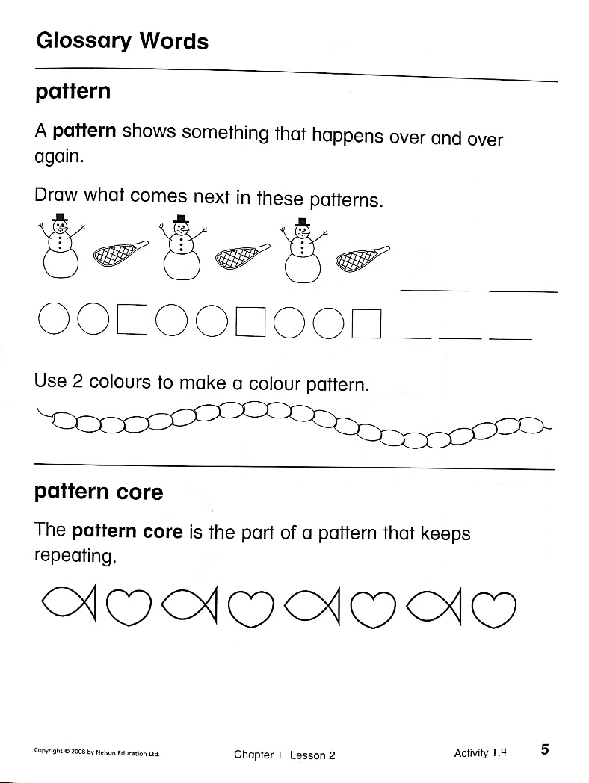

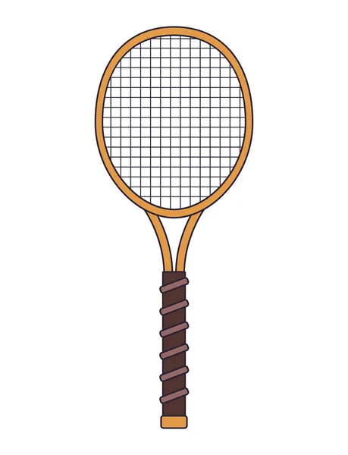
Open your book page 5
Random Pick

Slide 11
Open your book page 5
Random Pick

Slide 12
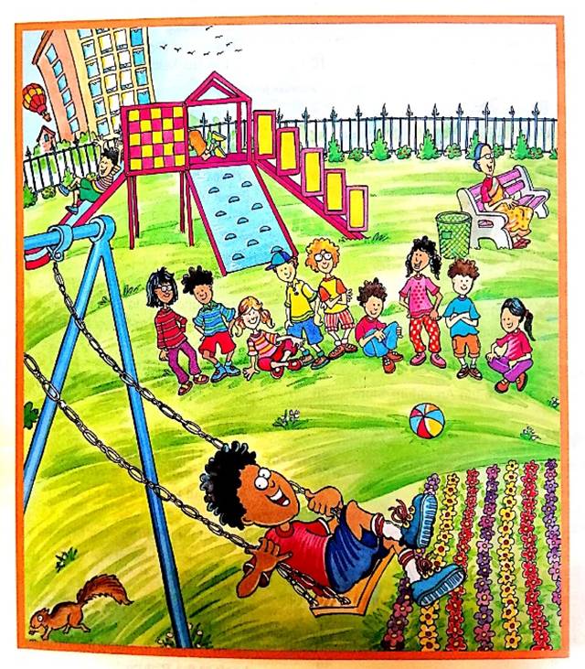
Look at the picture.
What patterns can you see?
Random Pick

Slide 13
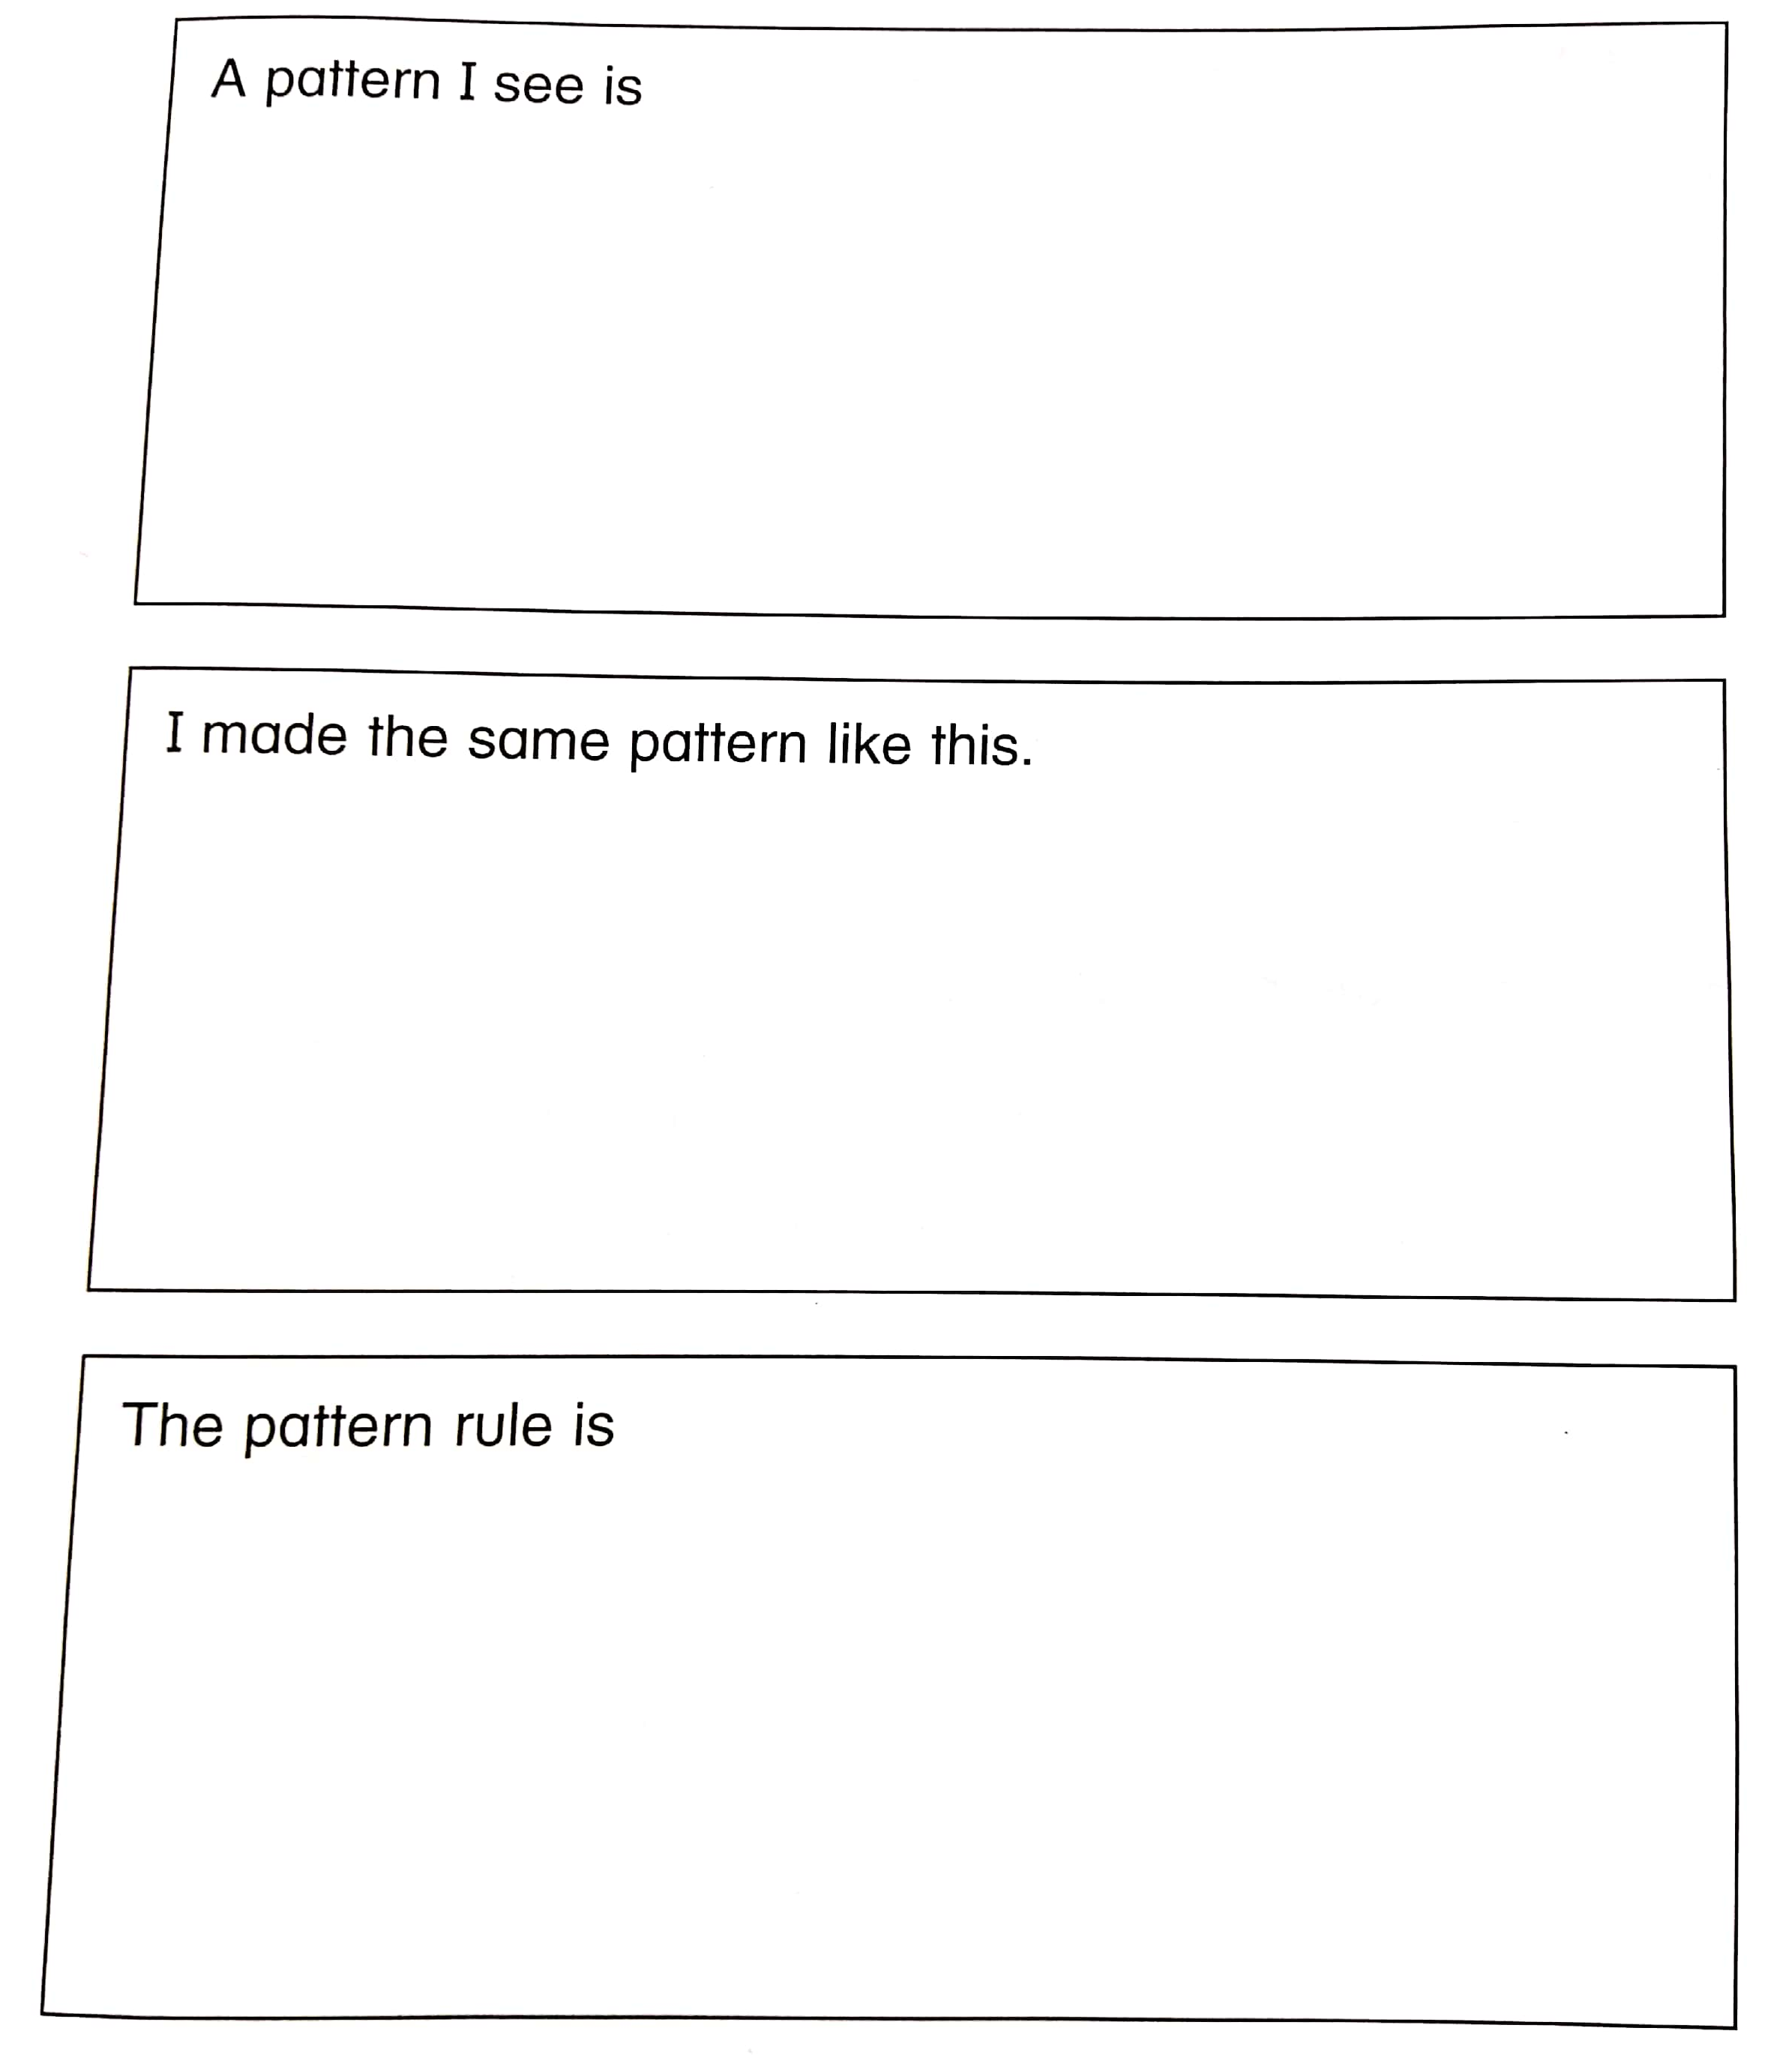


Random Pick

Slide 14

1:00
min
Critical Thinking / Relate to Real Life
What patterns can you see inside the classroom?
Buzz In

Slide 15

3:00
mins
Group work
Open your Math Booklet page
Random Pick

Slide 16

Summative Assessment
2:00
mins
In pairs
Student A draws a pattern.
Student B draws a circle around the pattern core.
Rally Coach

Slide 17
Let’s Play!
https://wordwall.net/resource/27288737/patterns-game
Random Pick

