Slide 1
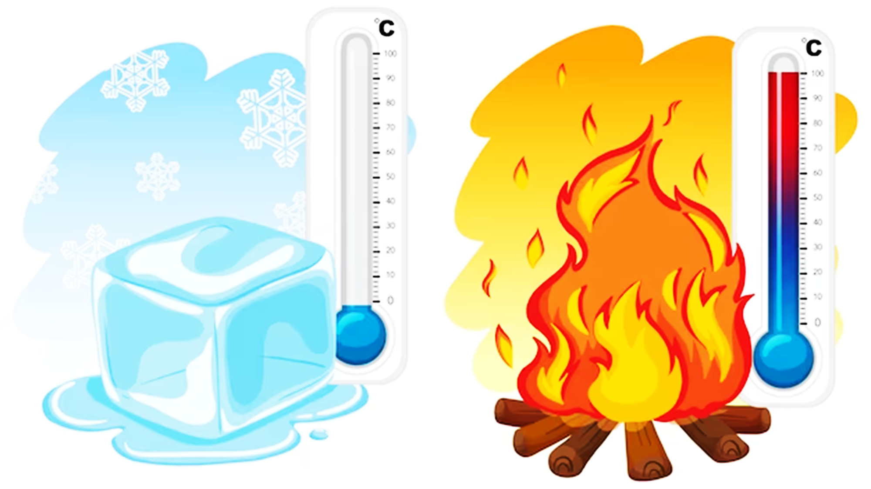
What is hot and what is cold?
Chapter 2 Lesson 2 p. 20

Slide 2
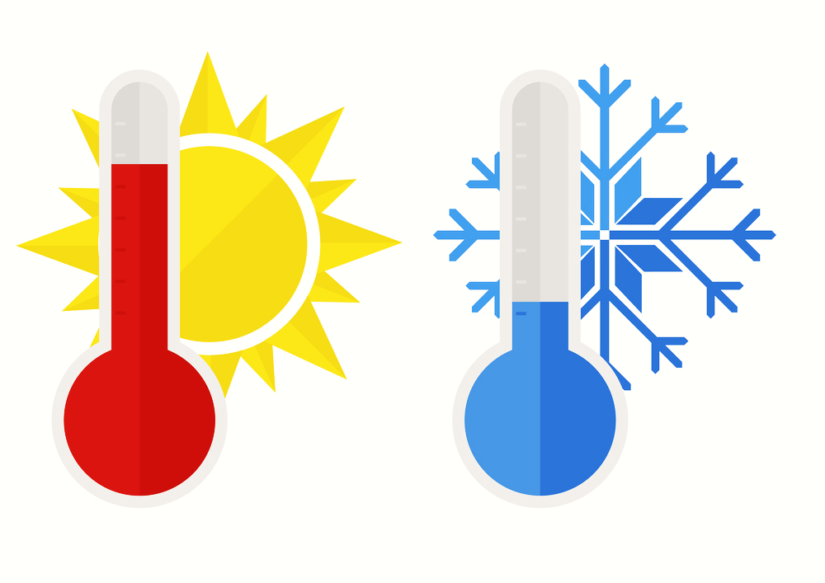
Outcomes
1. Identify and differentiate between hot and cold objects.
2. Apply their understanding of hot and cold to real-life situations.
3. Perceive the importance of protecting ourselves from extreme hot or cold.

Slide 3

Warm up

Slide 4
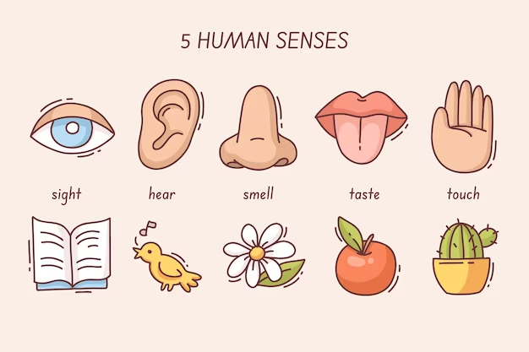
Pre – assessment
Which sense helps us know how hot or cold something is?

Slide 5
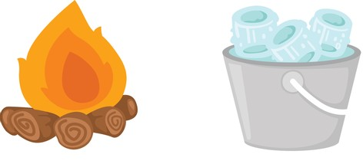
Temperature
how does something feels
hot cold

Slide 6

Hot or Cold

Slide 7

Hot or Cold

Slide 8
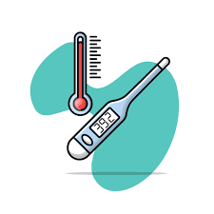
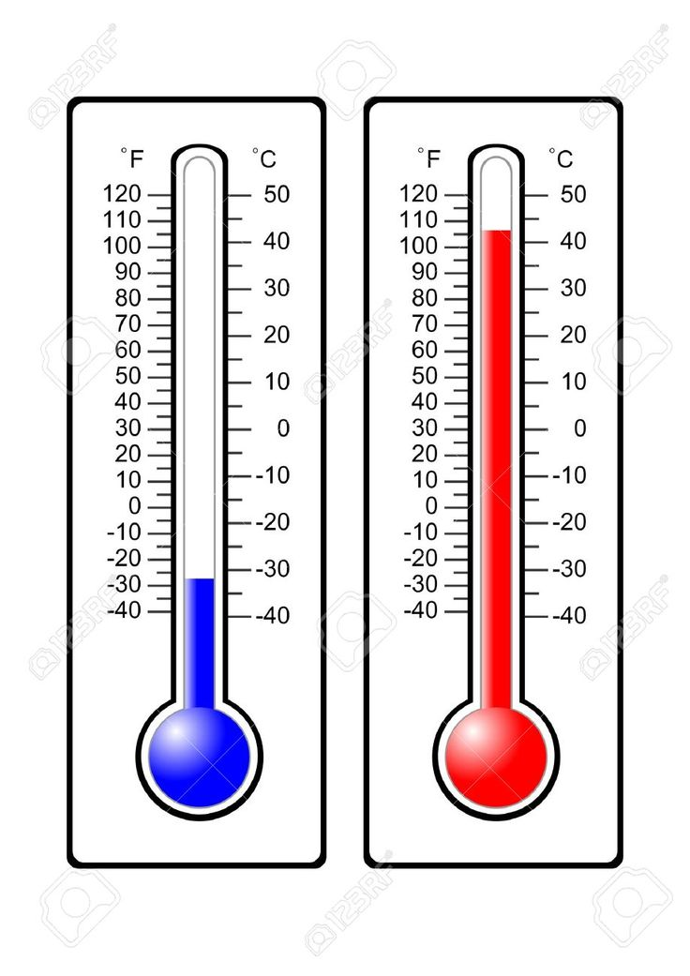
Thermometer
measures the temperature.
We read the thermometer to know if it is hot or cold.

Slide 9
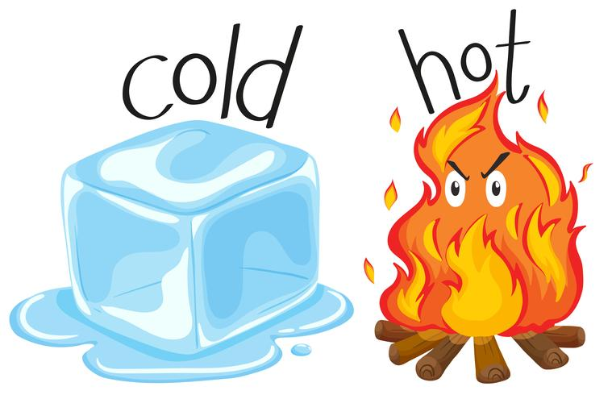
Formative Assessment
https://www.liveworksheets.com/w/en/life-experience-subject/1853563

Slide 10
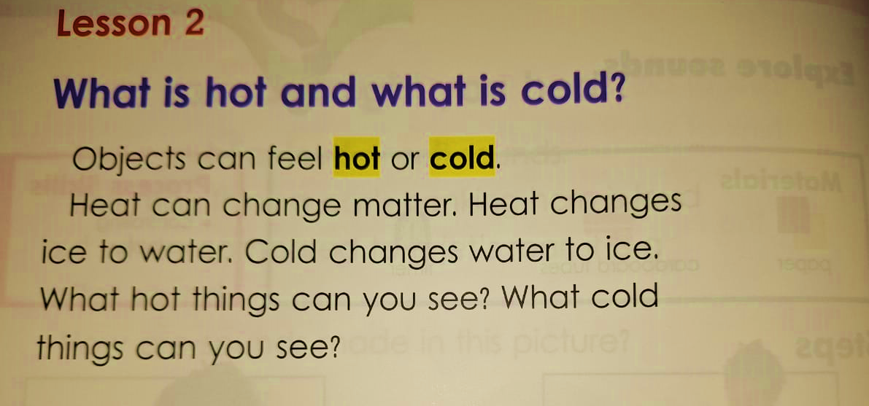
p. 20

Slide 11
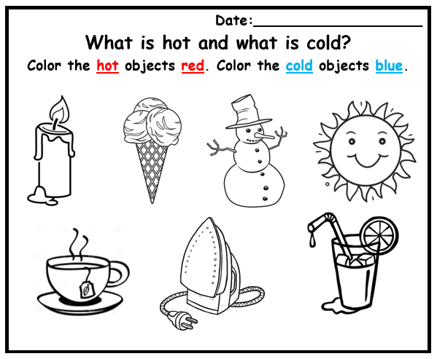
Summative Assessment

Slide 12
Wrap up
https://www.tinytap.com/activities/g3t2d/play/hot-or-cold
https://www.iknowit.com/lessons/k-temperature-hot-cold.html

