Slide 1
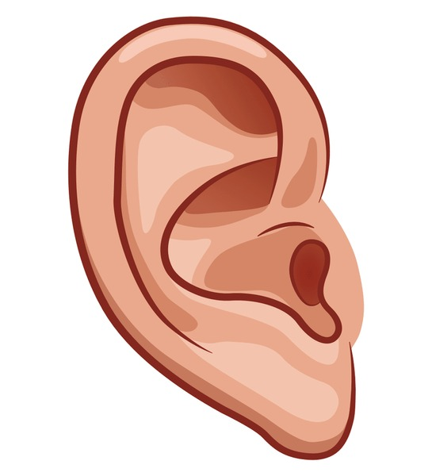
What sounds might you hear?
Unit 3 / Chapter 2 / Lesson 1 / pages 18 & 19

Slide 2
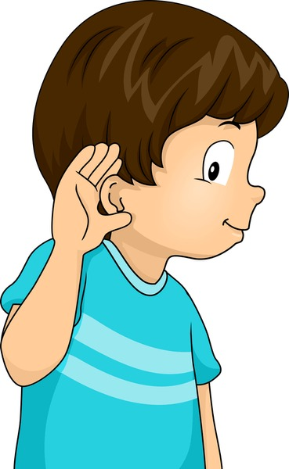
Outcomes
1:00
min
1. Identify sounds we hear every day.
2. Classify sounds as loud and soft.
3. Perceive the importance of respecting others; avoid making noise.

Slide 3
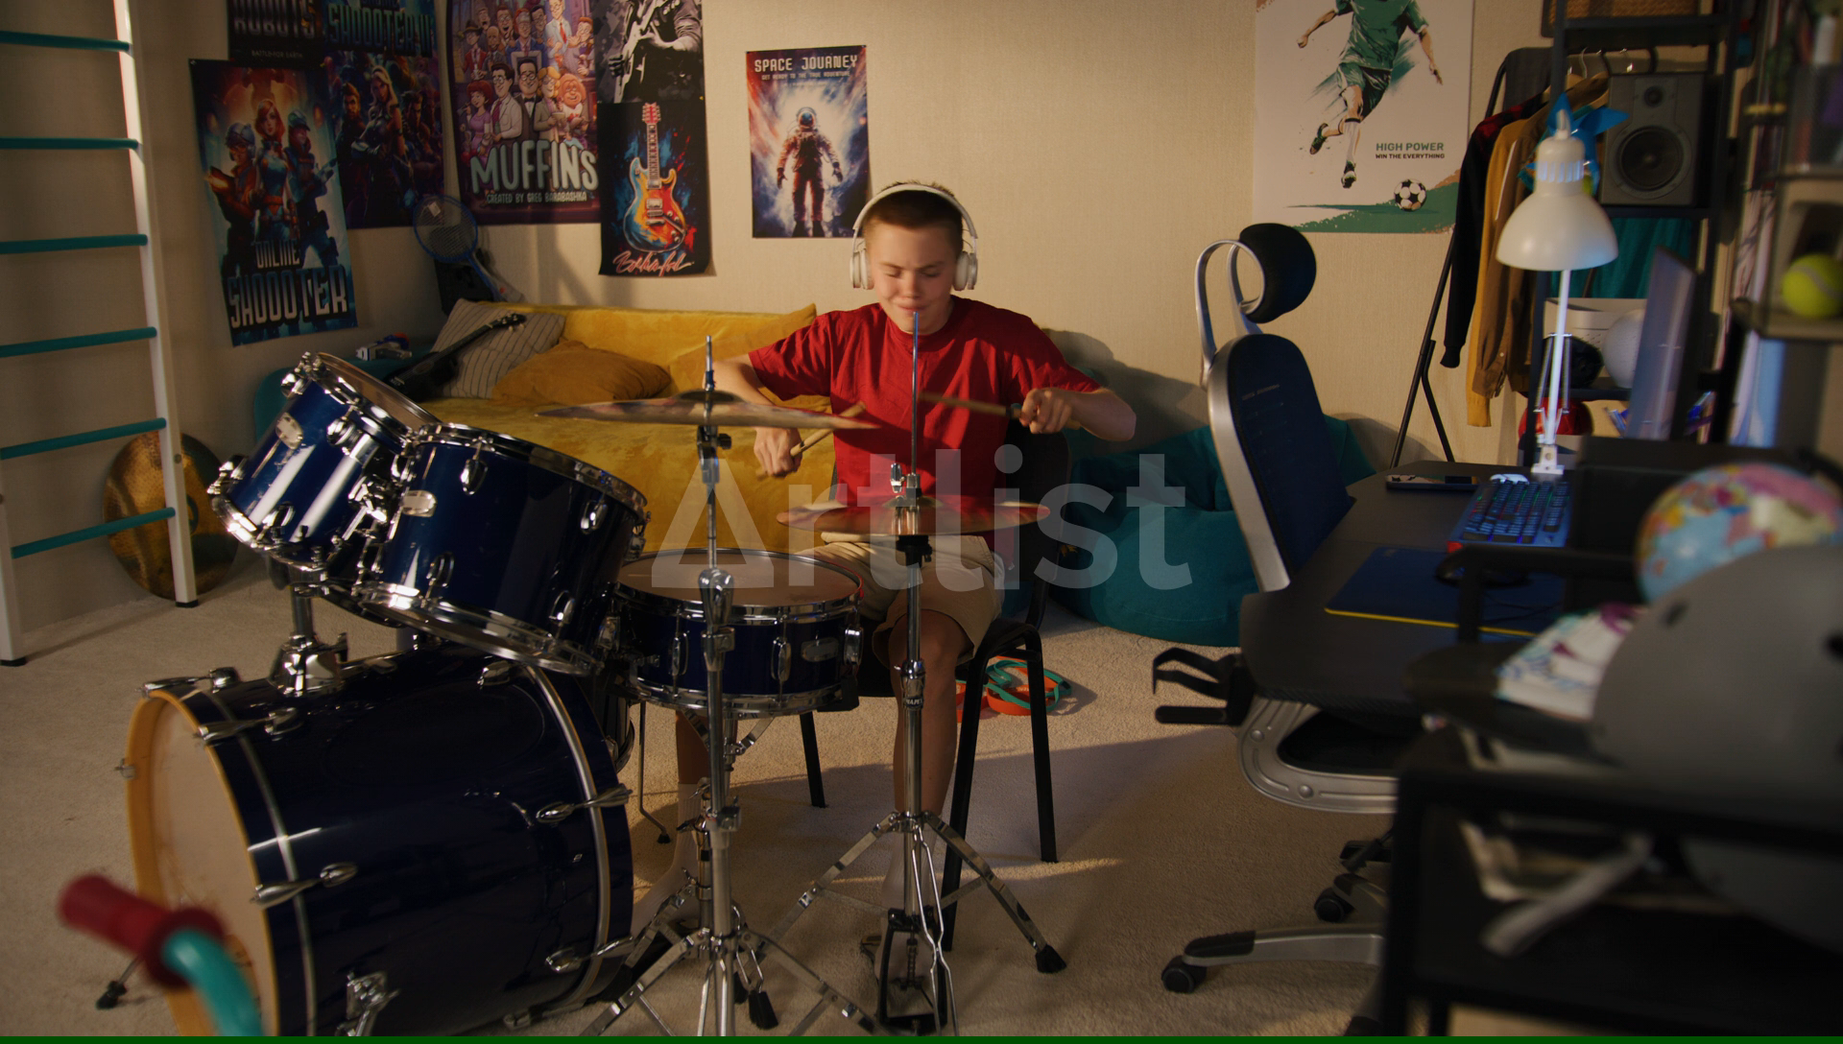
Warm up
2:00
mins

Slide 4
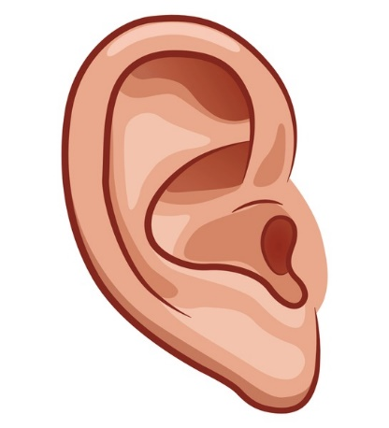
Pre-assessment
2:00
mins
Which part of your body do you use to hear sounds?

Slide 5

Listen and tell whether the sound you hear is loud or soft
1)
Loud
2)
Soft
3)
Soft
4)
Loud
Random Pick

Slide 6


How would be the sounds in these places?
Random Pick

Slide 7
Formative Assessment
3:00
mins
https://www.liveworksheets.com/w/en/science/1938070
Random Pick

Slide 8
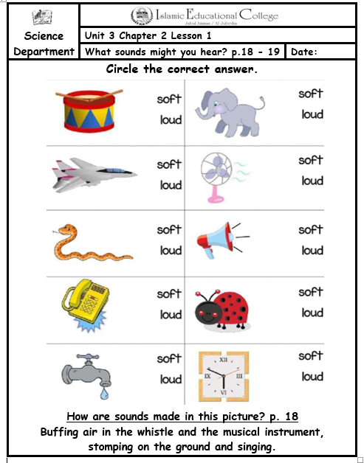
2:00
mins
Summative Assessment
Rally Coach
Puffing

Slide 9
Wrap up
2:00
mins
https://www.baamboozle.com/game/190984

