Slide 1
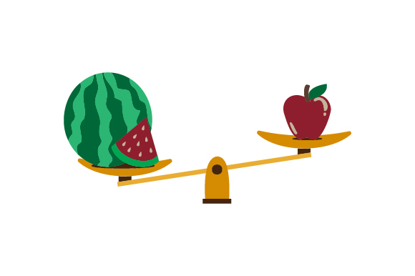
What is light and what is heavy
Using a balance p. 8 & 9
Unit 3/ chapter 1/ Lesson 2/ pages 10 & 11

Slide 2
Outcomes
1:00
min
Define the concept of light and heavy.
Identify objects that are light and heavy.

Slide 3

Warm up
2:00
mins

Slide 4
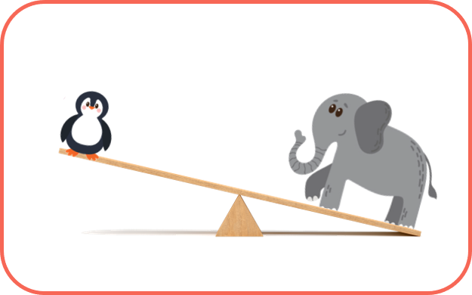
Pre Assessment
2:00
mins
IRS
Which one is heavy?

Slide 5
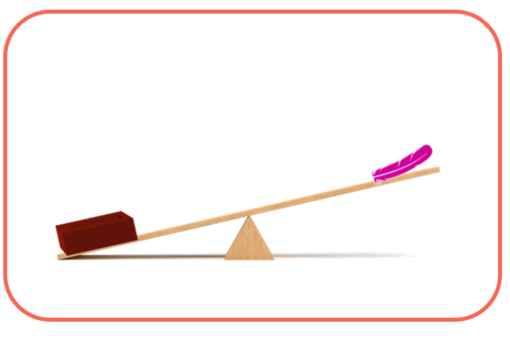
Pre assessment
2:00
mins
Which one is heavy?
IRS

Slide 6
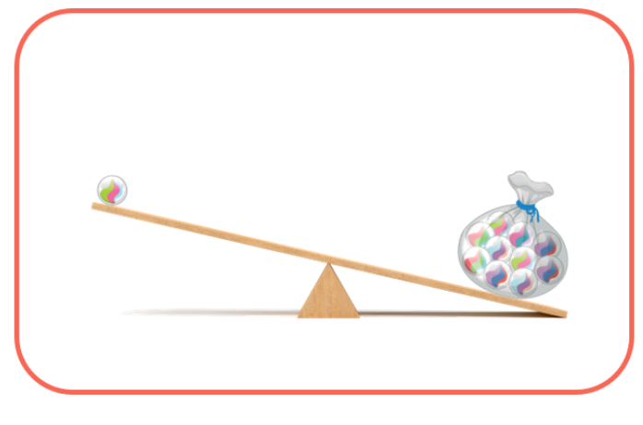
Pre assessment
2:00
mins
Which one is light?
IRS

Slide 7
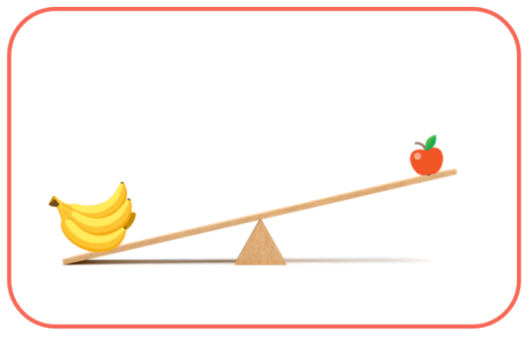
Pre assessment
2:00
mins
Which one is light?
IRS

Slide 8
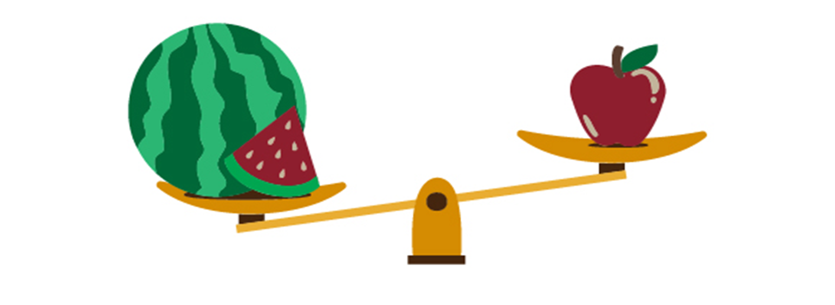
What is heavy and what is light?
https://www.turtlediary.com/game/heavy-and-light.html
RANDDOM PICK

Slide 9
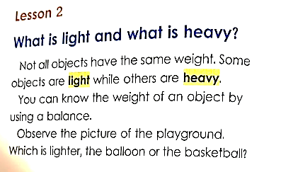
PRESENTATION
5:00
mins
RANDDOM PICK

Slide 10
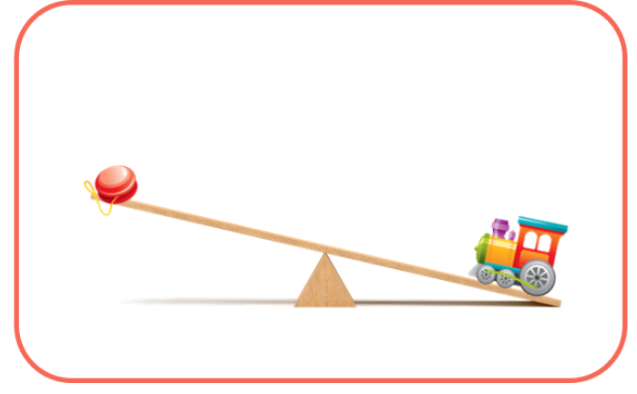
PRESENTATION
Both objects have different weights.
When you compare objects based on their weights, you get heavy and light objects.
RANDDOM PICK

Slide 11
Group work
3:00
mins
https://www.liveworksheets.com/w/en/math/133598
RANDDOM PICK

Slide 12

Relate to real life
2:00
mins
Think of something that is heavier than your lunchbox?
RANDDOM PICK

Slide 13
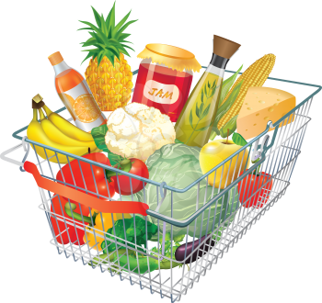
Critical thinking
1:00
mins
Imagine you are carrying a heavy bag of groceries. What could you do to make it feel lighter?
BUZZ IN

Slide 14
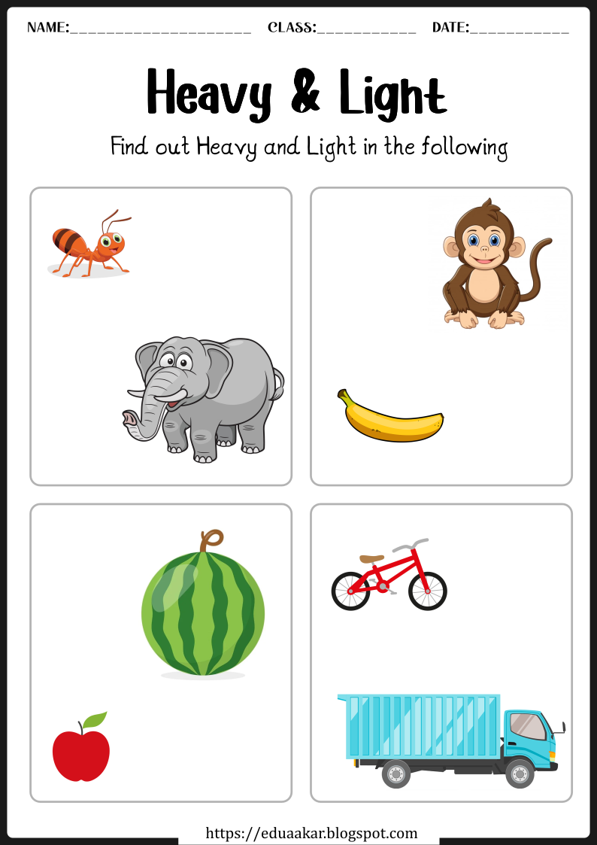

Summative Assessment
2:00
mins
light
heavy
heavy
light
heavy
light
heavy
light

Slide 15
Let’s play!
https://www.liveworksheets.com/w/en/math/253149
RANDDOM PICK

