Slide 1
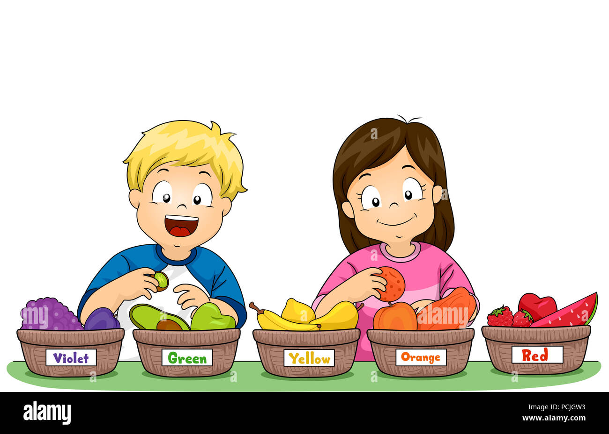
How do you group objects?
Unit 3 Chapter 1 Lesson 1 p. 6 & 7

Slide 2
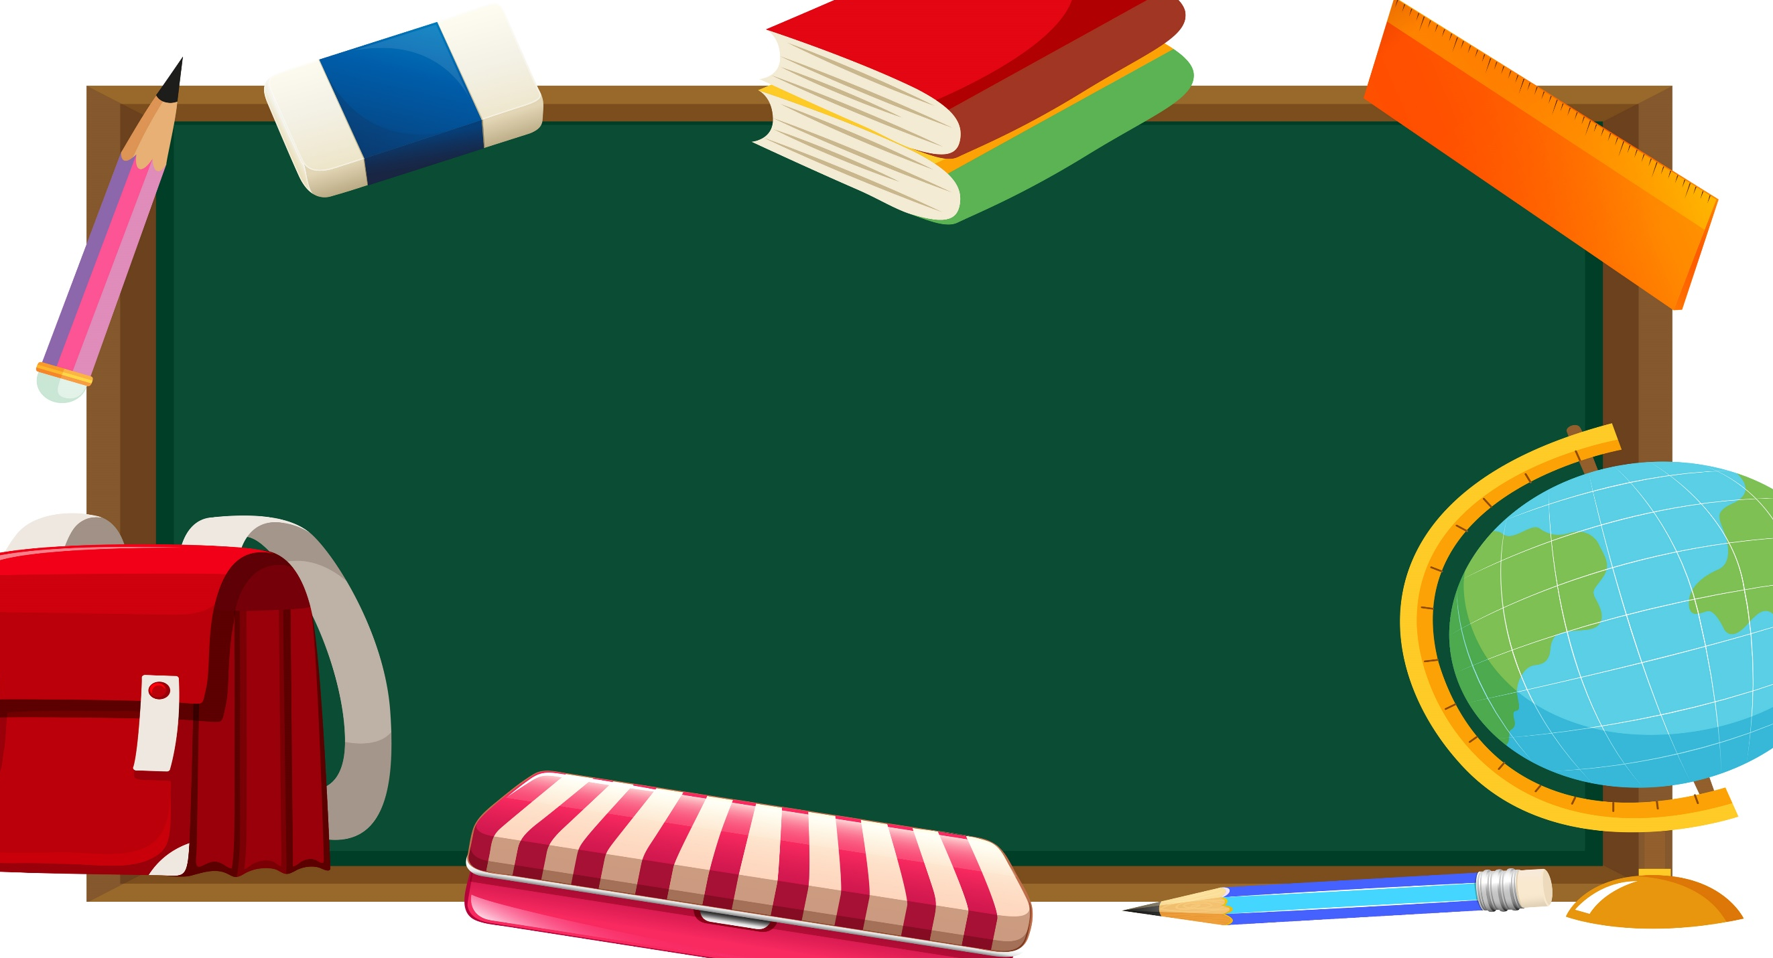
1:00 min
Outcomes
Identify different attributes of objects (color, shape, size, and hardness).
Group set of objects based on shared attributes.

Slide 3

Warm up
2:00 mins

Slide 4
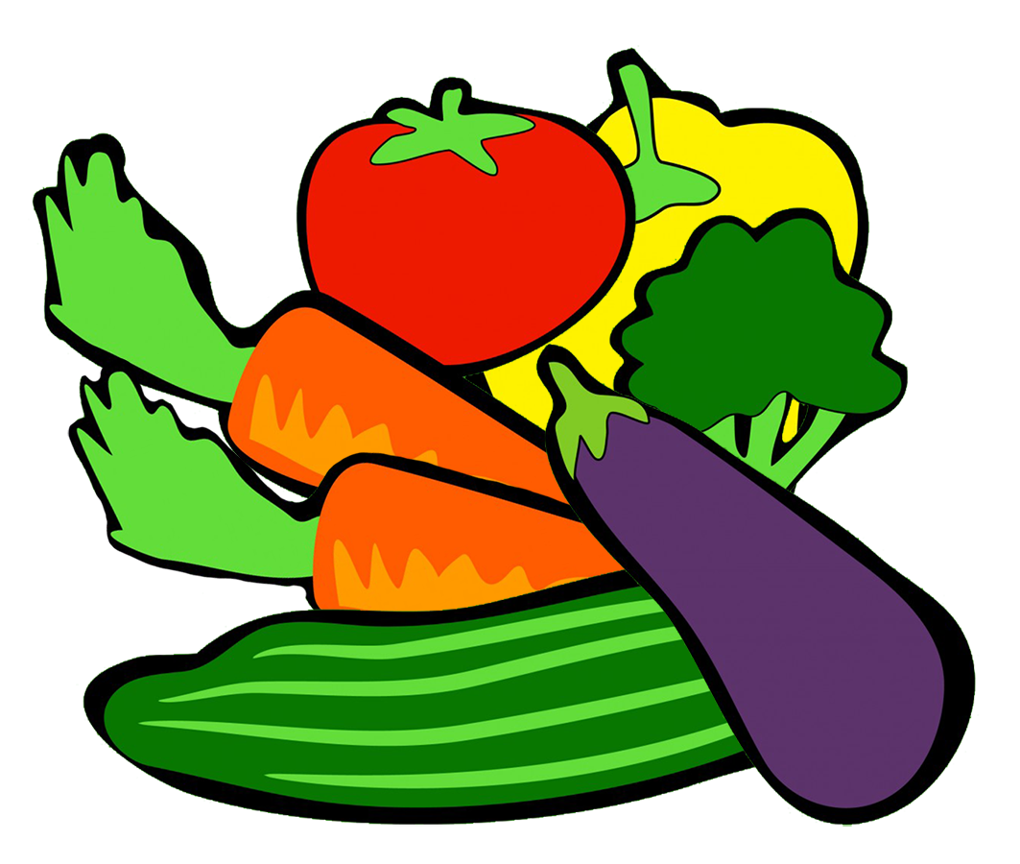
2:00 mins
Pre – assessment
Name the group you see !
Vegetables
Random Pick

Slide 5
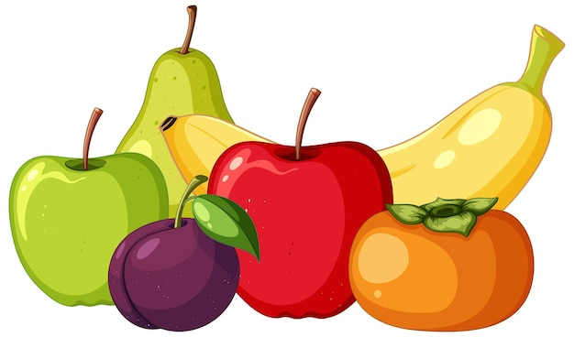
Name the group you see !
Fruits
Random Pick

Slide 6
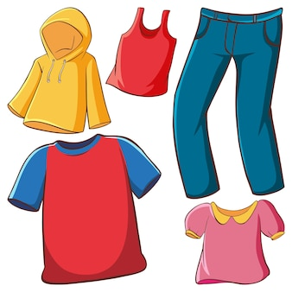
Name the group you see !
Clothes
Random Pick

Slide 7
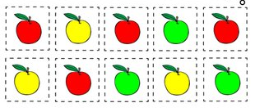
Presentation
How can you group the apples in the picture?
Color
Random Pick

Slide 8







Presentation
How can you group the strawberries in the picture?
Size
Random Pick

Slide 9

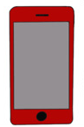




Presentation
How can you group the objects in the picture?
Shape
Random Pick

Slide 10

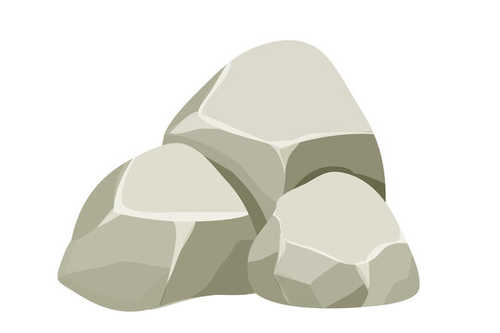


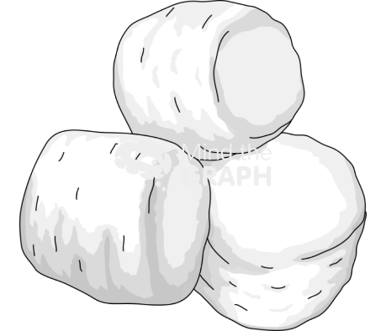
Presentation
How can you group the objects in the picture?
Hardness
Random Pick

Slide 11
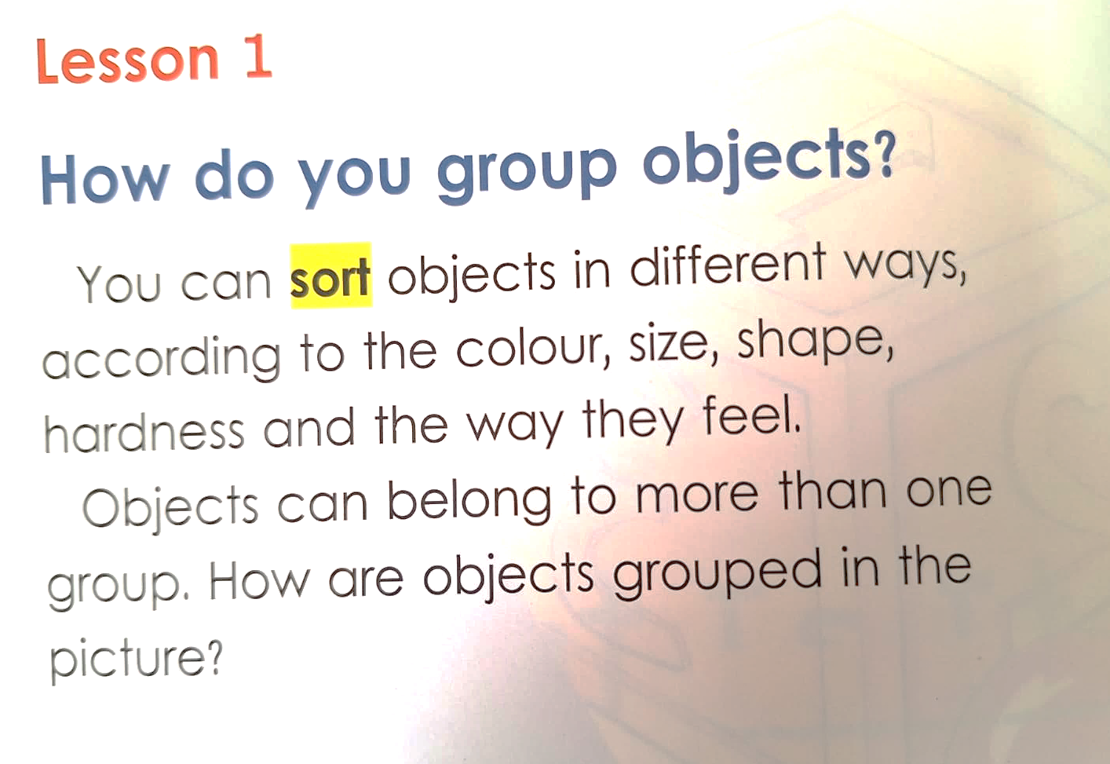
Open your book page 6

Slide 12
3:00 mins
Formative Assessment
Let’s Play !
https://www.liveworksheets.com/node/6491970
https://wordwall.net/resource/58922883/whats-the-category
https://www.abcya.com/games/counting_sorting_comparing
Random Pick

Slide 13
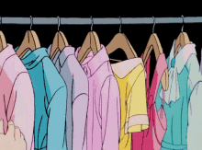
1:00 min
Relate to Real Life
How do you sort your things in your closet?
by color or size?
Random Pick

Slide 14
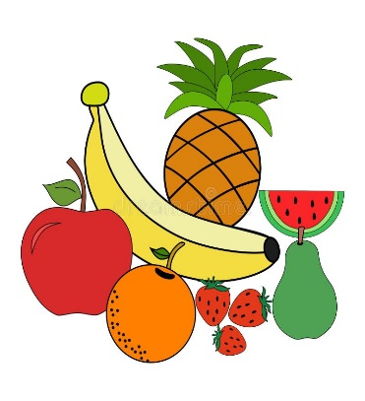
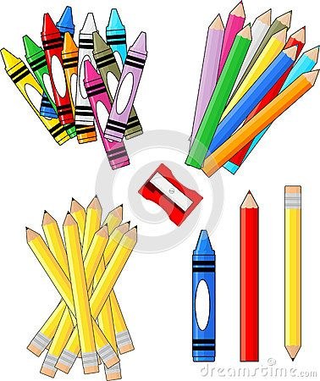
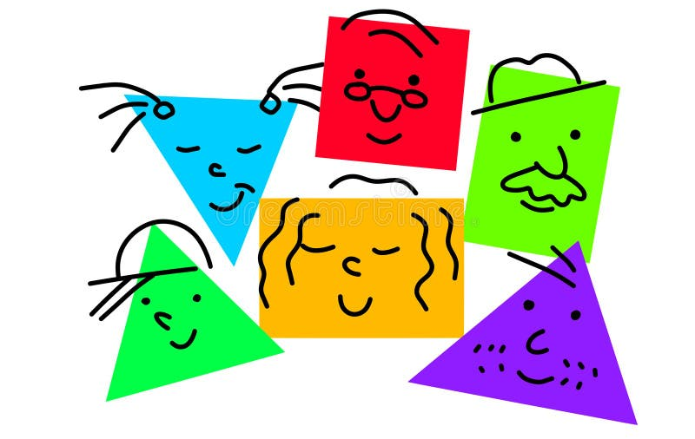
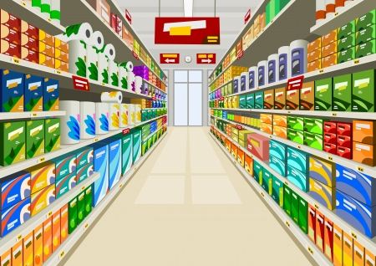
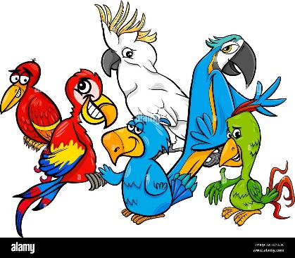
1:00 min
Critical Thinking
Why is it important to group objects?
Buzz In

Slide 15
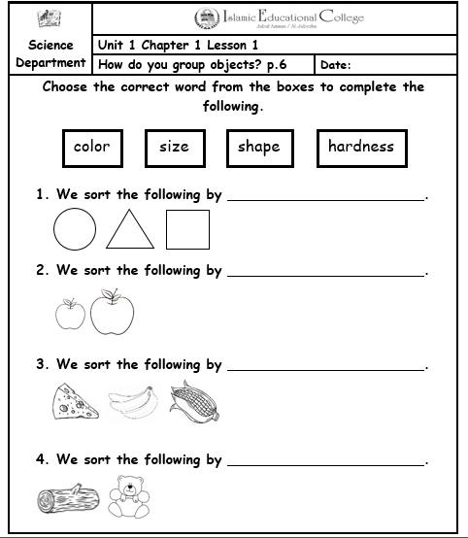

2:00 mins
Summative Assessment
shape
size
color
hardness
Rally Coach

