Slide 1
Grammar passive
Simple present present continuous Present Perfect
good!
8th grade
Hello!

Slide 2




Outcomes
01
02
03
Distinguish
between active and passive voice in sentences
Recognize
why passive voice is appropriate to use in certain contexts
create
sentences in the passive voice

Slide 3
Warm up
Read the sentences 1-10 and discuss the following questions.
-Where do you see these sentences?
-Who do you think did the action in each sentence?
-Why do you think the doer is not mentioned?
-What is the tense used in each sentence?
-How is the structure of these sentences different from the normal structure?
1.Smoking is not allowed.
2.Books are returned here.
3.The building is locked on Fridays.
4.The reading list has been updated.
5.Books are organized by genre.
6.Tests are being graded.
7.The rules have been explained.
8.Payment is accepted by card or cash.
9.The thief has been arrested.
10.All tickets are sold out.

Slide 4
Warm up
Read the sentences 1-10 and discuss the following questions.
-Where do you see these sentences?
-Who do you think did the action in each sentence?
-Why do you think the doer is not mentioned?
-What is the tense used in each sentence?
-How is the structure of these sentences different from the normal structure?
1.Smoking is not allowed.
2.Books are returned here.
3.The building is locked on Fridays.
4.The reading list has been updated.
5.Books are organized by genre.
6.Tests are being graded.
7.The rules have been explained.
8.Payment is accepted by card or cash.
9.The thief has been arrested.
10.All tickets are sold out.

Slide 5
Who does the action?
Traffic wakes me every day.
Most South Americans speak Spanish.
Sally is cleaning the house.
The dog is chasing the ball.
The students have learned new words.

Slide 6
Who does the action?
Traffic wakes me every day.
Most South Americans speak Spanish.
Sally is cleaning the house.
The dog is chasing the ball.
The students have learned new words.
Active – Form
Subject + verb + object

Slide 7
Who does the action?
She is known for her art.
Cash has been stolen from the register.
My room is being painted.

Slide 8
Who does the action?
She is known for her art.
Cash has been stolen from the register.
My room is being painted.
Passive – Form
object + verb to be + past participle

Slide 9

When do we use the passive voice?

Slide 10



When do we use the passive voice?
when we don’t know who does the action
when we want to give more importance to the action rather than the subject.
John’s car was stolen yesterday.
More and more computers are sold every day.
when we want to sound formal
when the subject is obvious
Plastic bags are produced in China.
Smoking is not allowed.
The thief was arrested two hours ago.
when it’s not important who does the action
!
My room is being painted.

Slide 11
PASSIVE
1. They play football.
2. They are playing football.
3. They have played football.

Slide 12
PASSIVE
simple present
1. They play football.
2. They are playing football.
3. They have played football.
present continuous
present perfect

Slide 13
PASSIVE
1. They play football.
Football
2. They are playing football.
Football
3. They have played football.
Football
simple present
present continuous
present perfect

Slide 14
PASSIVE
1. They play football.
Football ____ played.
2. They are playing football.
Football ___________ played.
3. They have played football.
Football ____ played.
simple present
present continuous
present perfect

Slide 15
PASSIVE
1. They play football.
Football is played.
2. They are playing football.
Football is being played.
3. They have played football.
Football has been played.
simple present
present continuous
present perfect

Slide 16
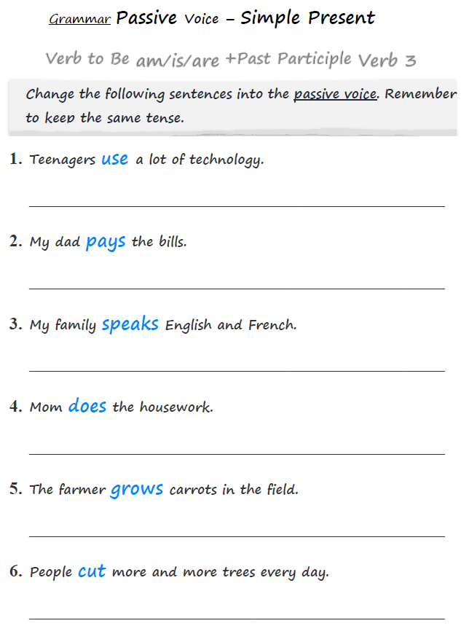
Passive in the Simple Present
Verb to BE
(is, are, am) + Verb 3

Slide 17
Passive in the Simple Present
Verb to BE
(is, are, am) + Verb 3
A lot of technology is used by teenagers.
The bills are paid by my dad.
English and Spanish are spoken by my family.
The housework is done by Mom.
Carrots are grown in the field by the farmer.
More and more trees are cut every day.

Slide 18
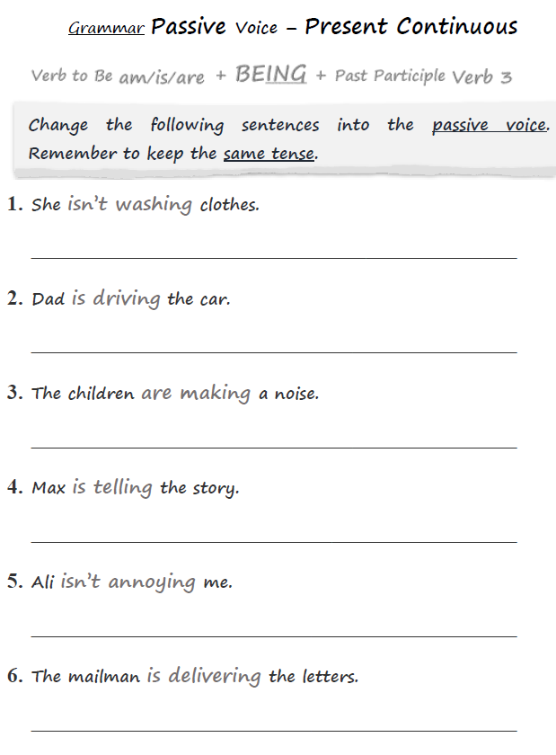
Passive in the Present Continuous
Verb to BE
(is, are, am) + BEING + Verb 3

Slide 19
Passive in the Present Continuous
Verb to BE
(is, are, am) + BEING + Verb 3
Clothes are not being washed.
The car is being driven by Dad.
A noise is being made by the children.
The story is being told by Max.
I am not being annoyed by Ali.
The letters are being delivered.

Slide 20
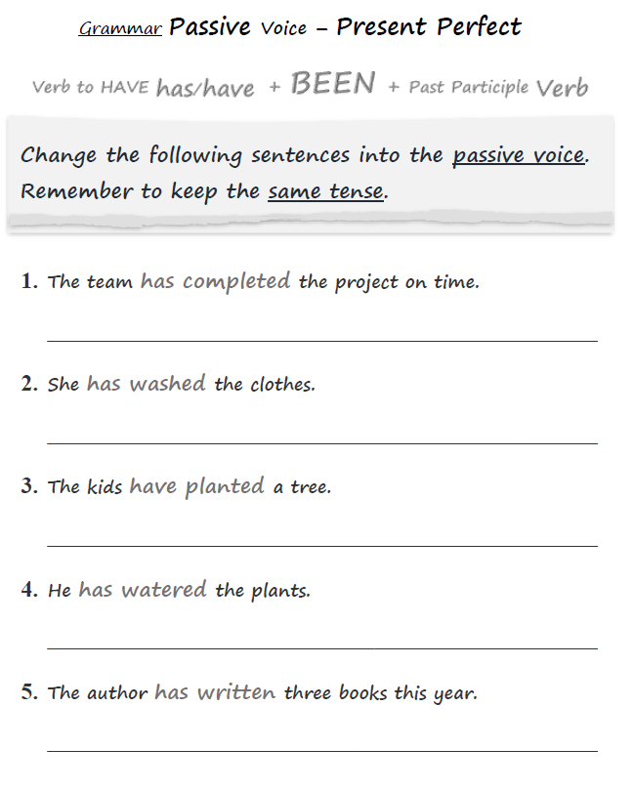
Passive in the Present Perfect
Verb to HAVE
(HAVE, HAS) + BEEN + Verb 3

Slide 21
Passive in the Present Perfect
Verb to HAVE
(HAVE, HAS) + BEEN + Verb 3
The project has been completed on time.
The clothes have been washed.
A tree has been planted by the kids.
The plants have been watered.
Three books have been written this year.

Slide 22
Verb to be and verb to have should agree with the object.
I – am / have
he, she, it – is / has
you, we, they – are / have

Slide 23
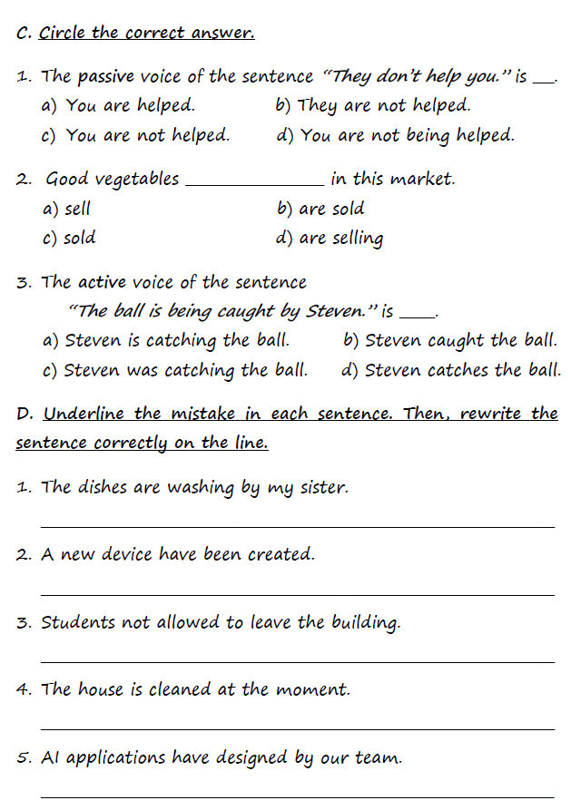
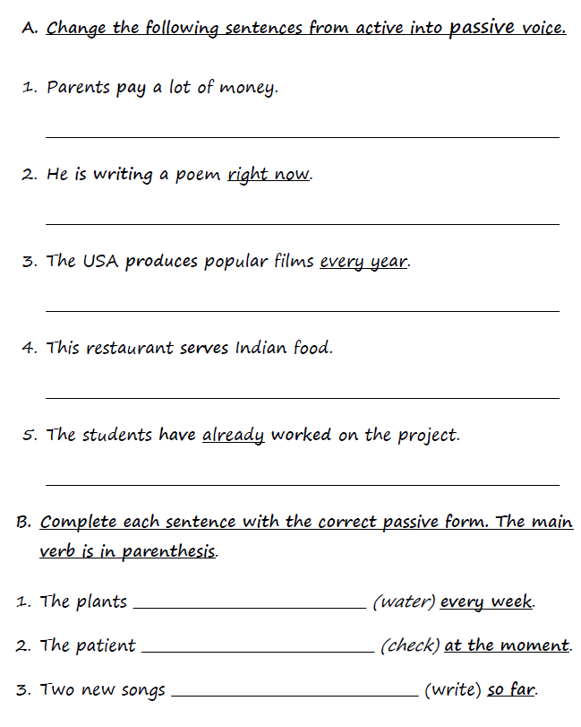
Practice in the Notebook

Slide 24
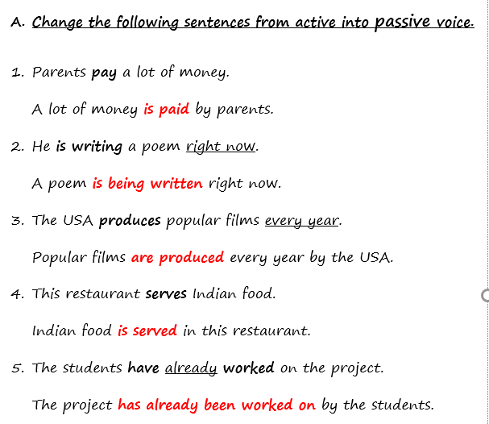
simple present
present continuous
simple present
simple present
present perfect

Slide 25
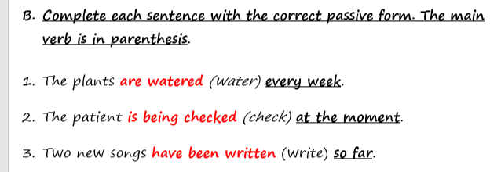
simple present
present
continuous
present perfect

Slide 26
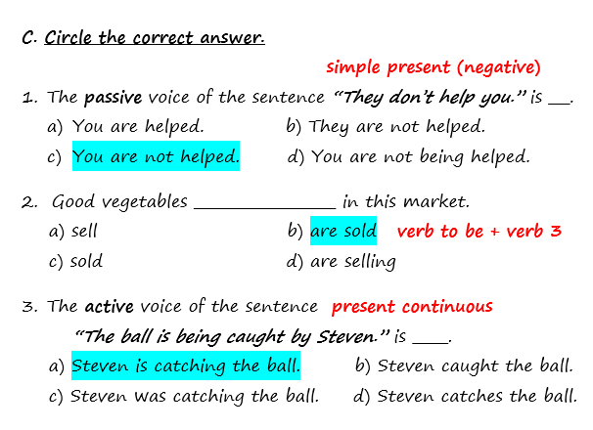

Slide 27
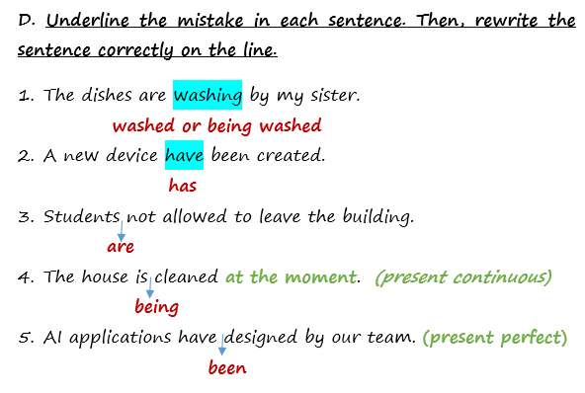

Slide 28
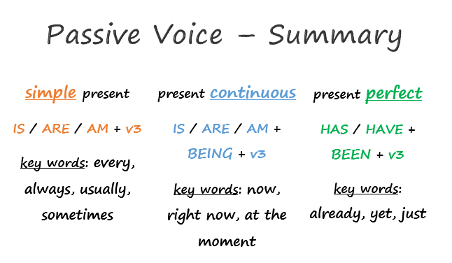
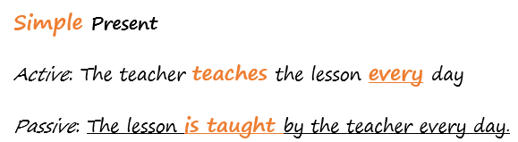
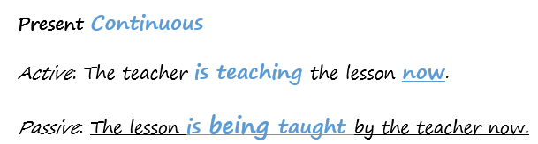
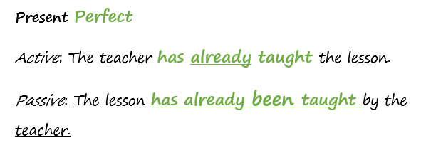
for, since

Slide 29
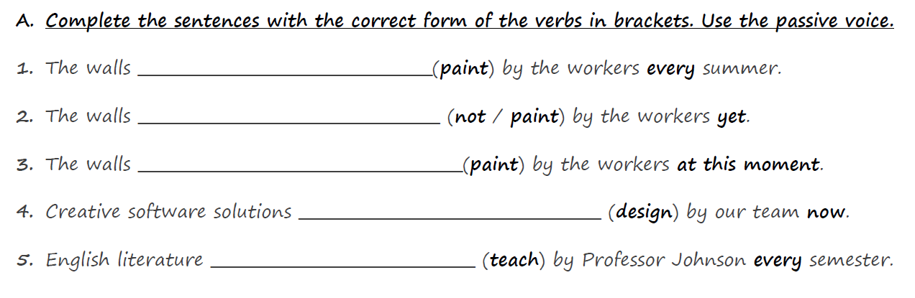
Worksheet

Slide 30
Worksheet
are painted
have not been painted
are being painted
are being designed
is taught

Slide 31
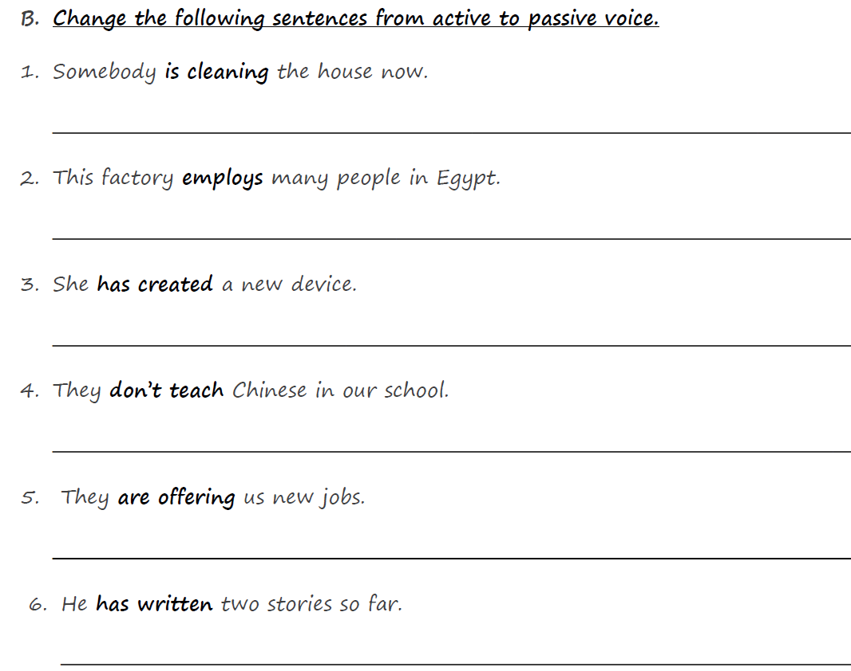
Worksheet

Slide 32
Worksheet
The house is being cleaned now.
Many people in Egypt are employed by this factory.
A new device has been created.
Chinese is not taught in our school.
We are being offered new jobs.
Two stories have been written so far.

Slide 33
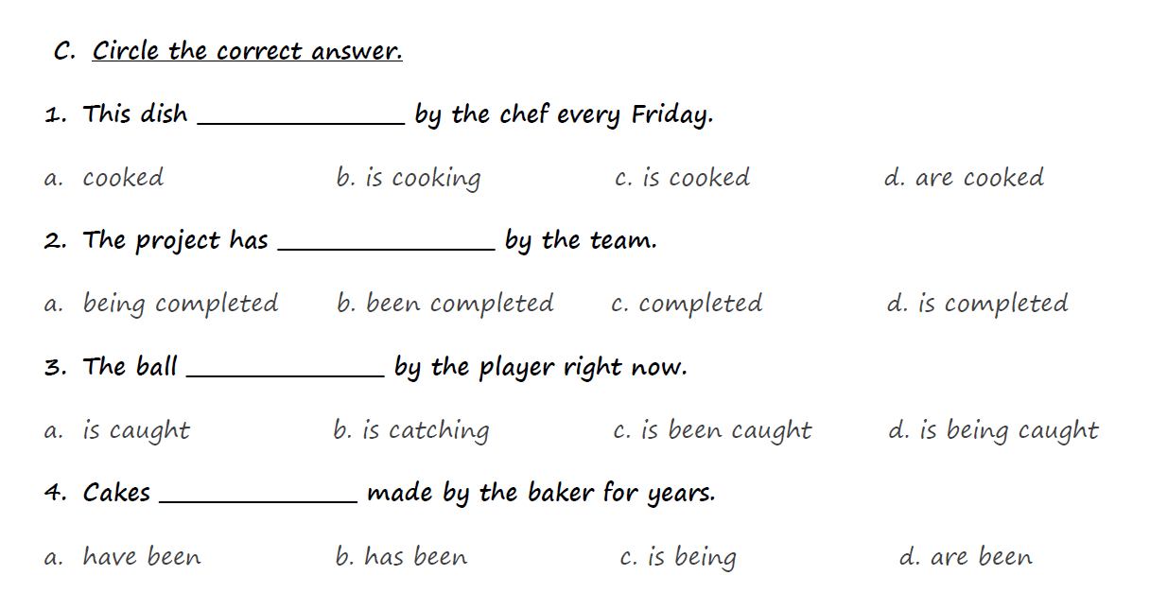
Worksheet

Slide 34
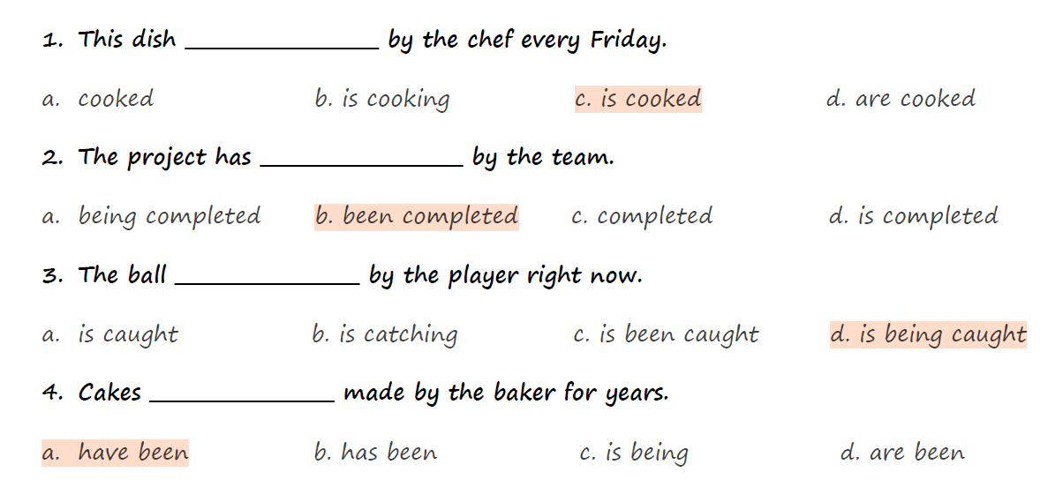
Worksheet

Slide 35

Open the links for more practice.
Simple present
https://www.liveworksheets.com/cz1348744gd
Present Continuous
https://www.liveworksheets.com/as1203603pd
https://www.liveworksheets.com/mo2573444zg
https://www.liveworksheets.com/pe1343539jr
Present Perfect
https://www.liveworksheets.com/w/en/english-second-language-esl/1037717

