Slide 1
Doctors Without Borders pp.90-95
5th grade

Slide 2

Outcomes By the end of this lesson, students are expected to
Main Idea
Genre
Heroes
explain what Doctors Without Borders does and why their work is important
identify the genre and describe its special elements
describe how people can be heroes by helping others in times of need

Slide 3

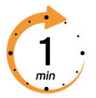
Discuss in pairs.
1. What do you do when you feel sick or get hurt?
2. What do you think happens in places where there are not enough doctors?

Slide 4

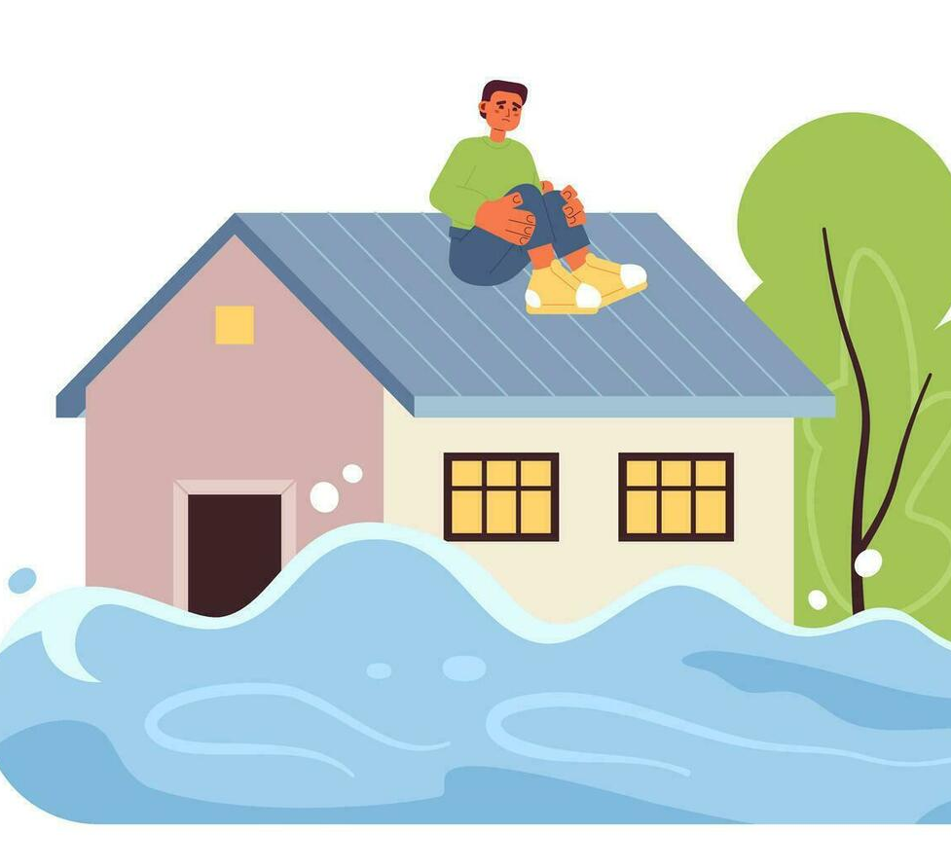
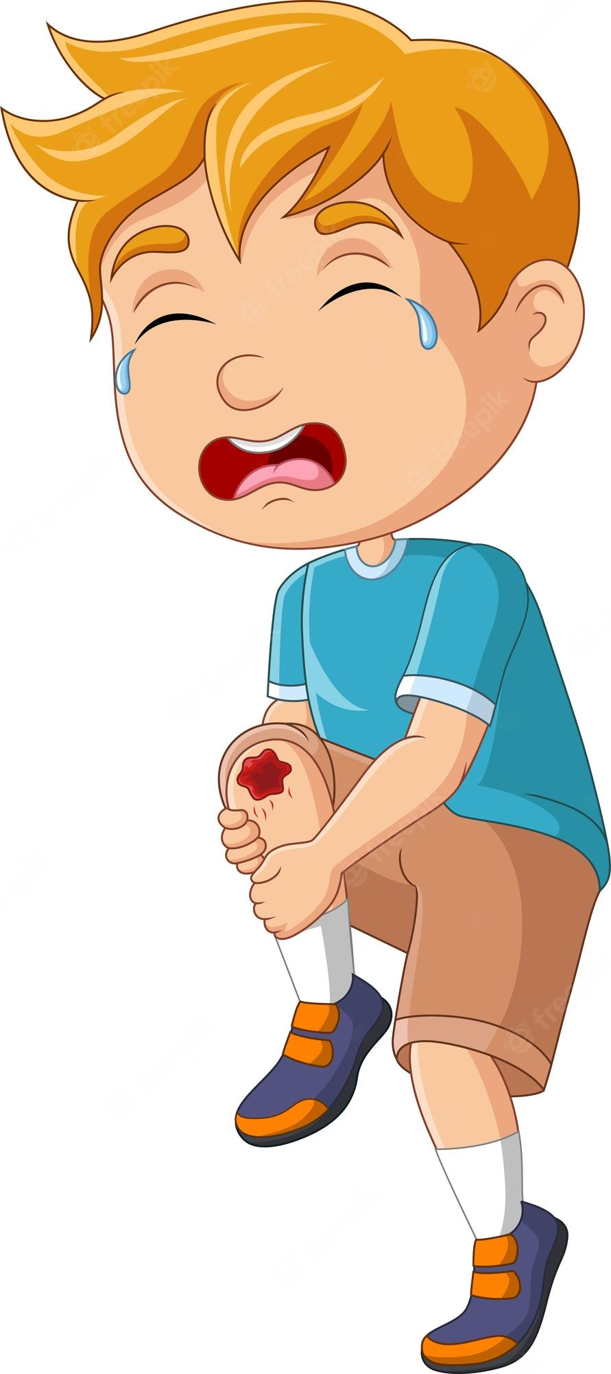

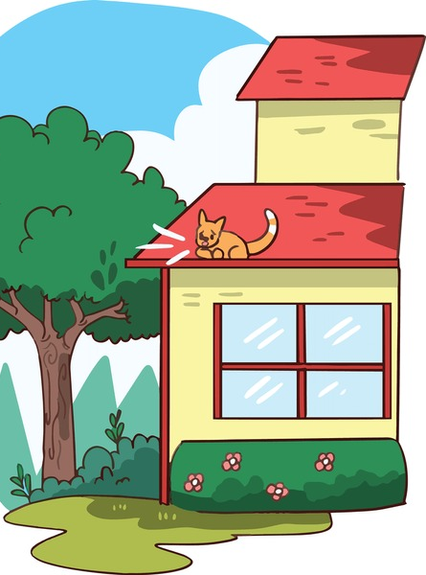
Warm up
Who could help in these situations?
What would you do to help?

Slide 5

IRS
Pre-Assessment

Slide 6
IRS
What is one quality that most heroes share?
1. They want to be famous.
2. They help others in emergencies.
3. They work only for money.
4. They don’t intervene when there is a problem.

Slide 7

IRS
What is one quality that most heroes share?
2. Heroes help others in emergencies.

Slide 8
IRS
What is the genre of “Doctors Without Borders”?
1. folktale
2. short story
3. informational text
4. fable

Slide 9

IRS
What is the genre of “Doctors Without Borders”?
3. informational text

Slide 10
IRS
What do you think “Doctors Without Borders” is?
1. a name of a group of teachers who help refugees
2. a name of a hospital
3. a name of a company that sells medicine
4. a name of a group of doctors who travel to help

Slide 11
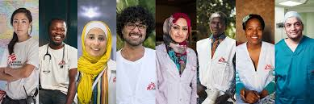
IRS
What do you think “Doctors Without Borders” is?
4. a name of a group of doctors who travel to help

Slide 12
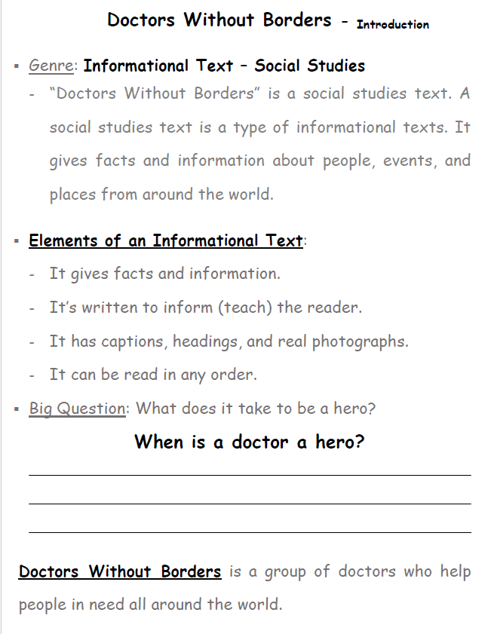
A heading is the title of a section or page. It tells what the text below is about. A caption is a short sentence under a picture that explains what the picture shows.
Doctors are heroes when they volunteer to help others and save lives

Slide 13
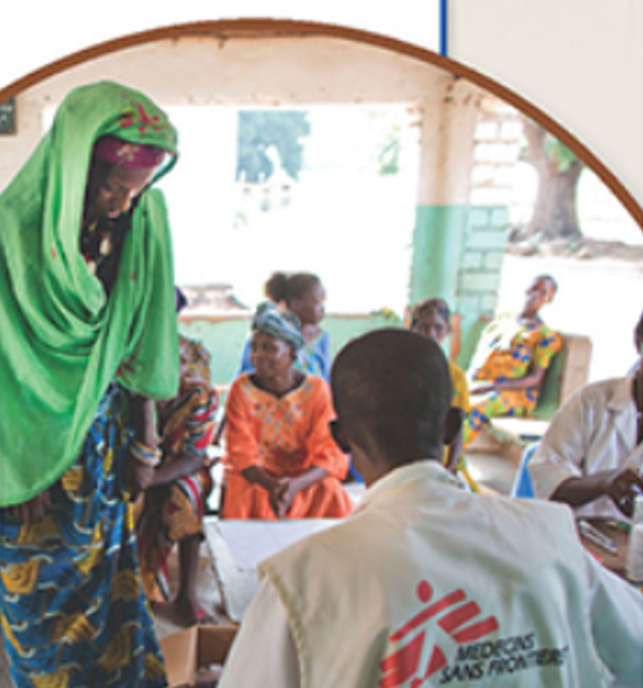
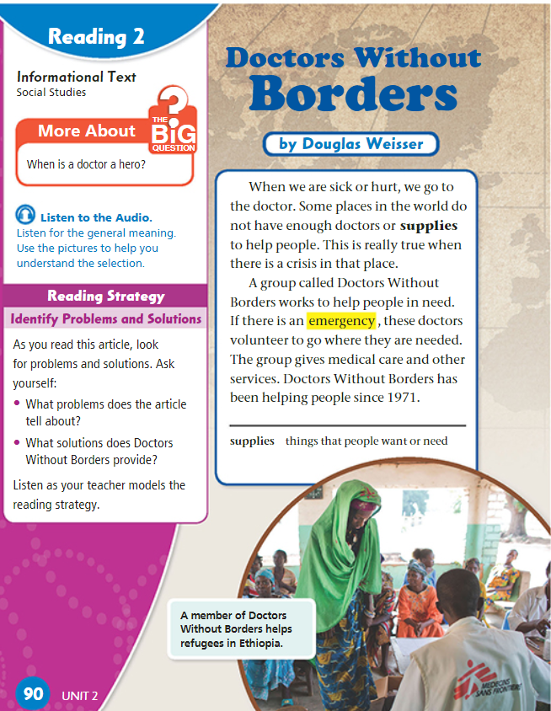

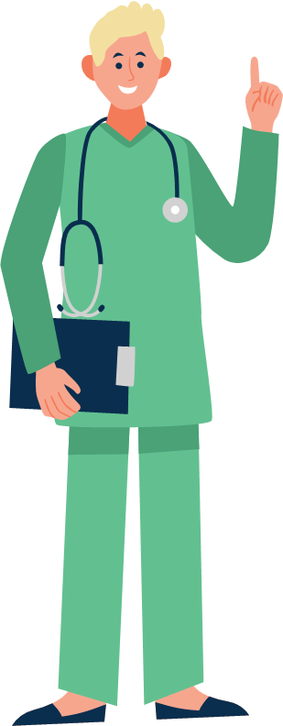
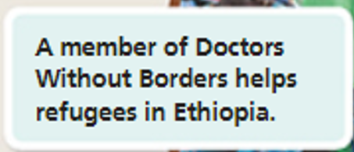
p.90

Slide 14
Discussion Questions on p.90
Where do we usually go when we are sick or hurt?
What problem do some places in the world face?
When is the need for doctors and supplies important?
What is the name of the group that helps people in need?
What do the doctors from Doctors Without Borders do in an emergency?
When did Doctors Without Borders start helping people?

Slide 15
Discussion Questions on p.90
Where do we usually go when we are sick or hurt?
What problem do some places in the world face?
When is the need for doctors and supplies important?
What is the name of the group that helps people in need?
What do the doctors from Doctors Without Borders do in an emergency?
When did Doctors Without Borders start helping people?

Slide 16

Linking to Life
Have you ever helped someone who really needed it, even in a small way?
How did it make you feel?

Slide 17


Buzz in!
Critical Thinking:
If you were a doctor, would you risk your own safety and travel to a dangerous place to help people during an emergency? Why or why not?

Slide 18

Differentiation
Student’s Number | Task
1+4 | Write 4–6 sentences explaining what you learned about Doctors Without Borders. Who they are - What they do - Why their work is important
2+3 | Imagine you are part of Doctors Without Borders. Write a short diary entry (6–8 sentences) describing a day of helping people in another country. Where you are - What happened - How you helped - How you felt when you made a difference

Slide 19
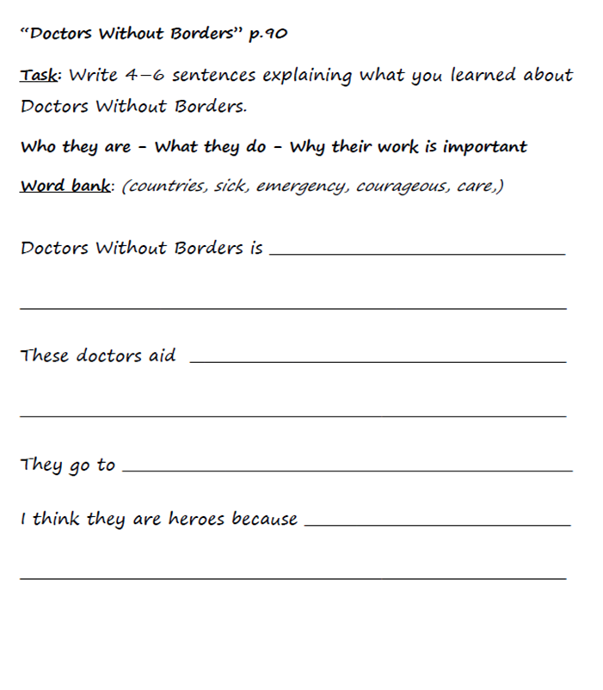

3
4
2
1
4
1

Slide 20
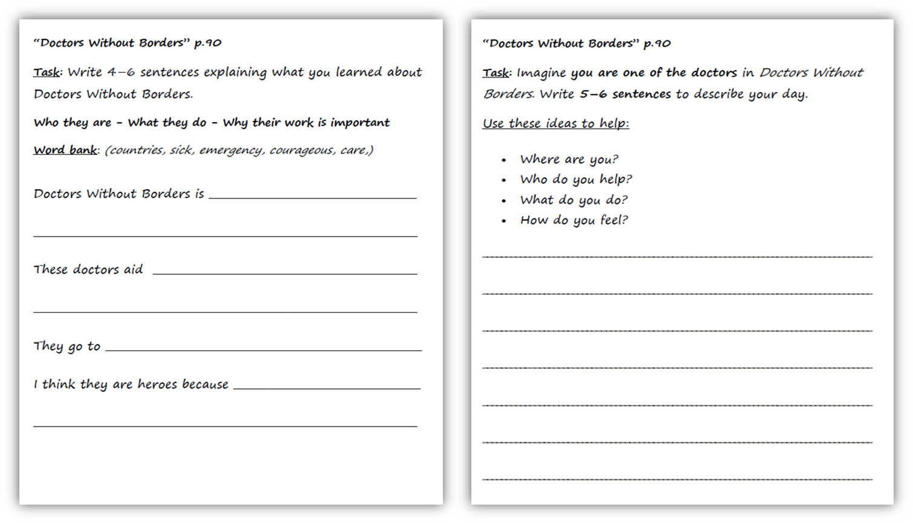
Feedback
a group of doctors
who help sick people.
people after war or
Today I worked in a small village in Africa where there are no hospitals. Many children were sick, so we gave them medicine and food. People thanked us and children smiled when they felt better. I felt happy and proud because I helped people who needed care.
natural disasters.
countries that have emergencies
because they are
courageous, and they care about others

Slide 21


https://kahoot.it/solo/?quizId=6a7b21b0-18c8-4aca-a6bd-71fabe70255b

Slide 22
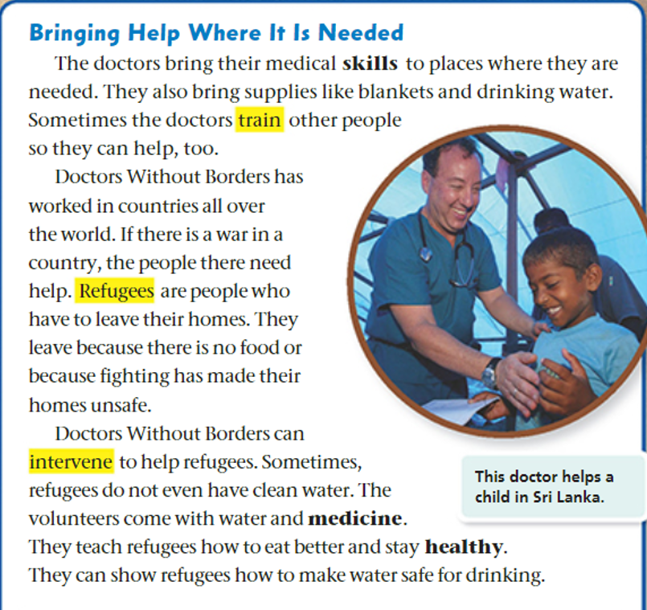
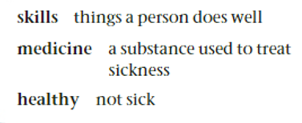

p.91

Slide 23
Discussion Questions on p.91
Circle the heading of the text. How does the heading
help you understand what the text is about?
2. What do the doctors bring to places where help is needed?
3. Who do the doctors sometimes train to help with their work?
4. Who are refugees?
5. Why do refugees have to leave their homes?
6. How does Doctors Without Borders help refugees?
7. What do the doctors teach refugees?
8. Highlight the caption. How does it help you understand what’s happening in the picture?

Slide 24
Feedback
heading
Circle the heading of the text. How does the heading
help you understand what the text is about?
2. What do the doctors bring to places where help is needed?
3. Who do the doctors sometimes train to help with their work?
4. Who are refugees?
5. Why do refugees have to leave their homes?
6. How does Doctors Without Borders help refugees?
7. What do the doctors teach refugees?
8. Highlight the caption. How does it help you understand what’s happening in the picture?
caption

Slide 25
p.91
What do the circled pronouns refer to?

Slide 26
p.91
What do the circled pronouns refer to?

Slide 27
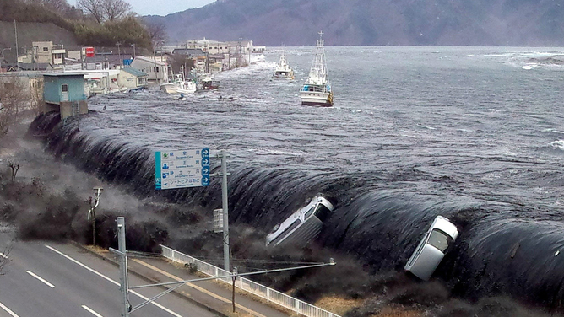
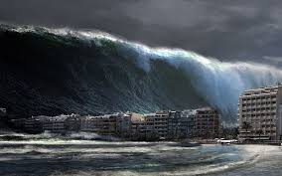
What is a Tsunami?

Slide 28
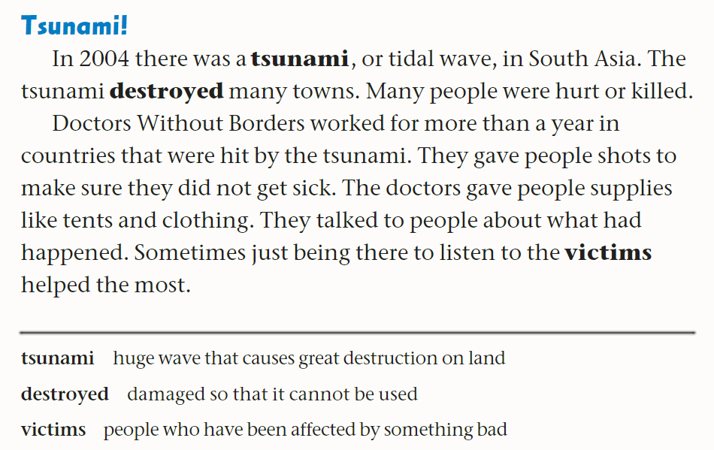


p.92

Slide 29
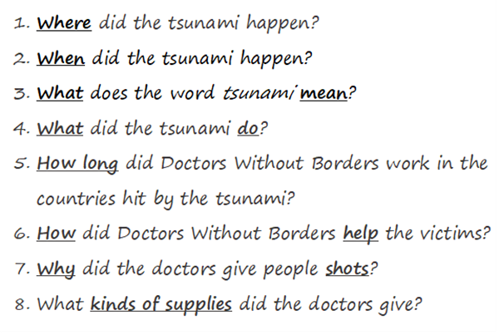
p.92

Slide 30
p.92

Slide 31
Read how Doctors Without Borders helped people in South Asia after the tsunami in 2004. The, complete the chart.
Problem | Solution
People could get sick easily.
 | The doctors gave people tents and other supplies.
People were upset.

Slide 32
Read how Doctors Without Borders helped people in South Asia after the tsunami in 2004. The, complete the chart.
Problem | Solution
People could get sick easily. | The doctors gave people shots.
People lost their homes and didn’t have sufficient supplies. | The doctors gave people tents and other supplies.
People were upset. | The doctors talked to the victims and listened to them.

Slide 33
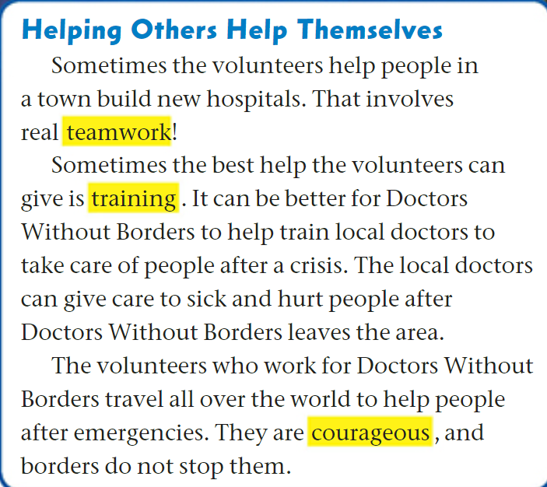


p.93

Slide 34
Discussion Questions on p.93
What do volunteers help build in towns?
How do volunteers help local people?
Why is training helpful for local doctors?
Find a word that means “major problem”.
What do local doctors do after volunteers leave?
Where do volunteers go to help people?
What quality do the volunteers have?
Do borders stop Doctors Without Borders volunteers from helping others?

Slide 35
Feedback
What do volunteers help build in towns?
How do volunteers help local people?
Why is training helpful for local doctors?
Find a word that means “major problem”.
What do local doctors do after volunteers leave?
Where do volunteers go to help people?
What quality do the volunteers have?
Do borders stop Doctors Without Borders volunteers from helping others?
crisis

