Slide 1
Doctors Without Borders pp.90-95
5th grade

Slide 2

Outcomes
By the end of this lesson, students are expected to
Main Idea
Genre
Heroes
explain what Doctors Without Borders does and why their work is important
identify the genre and describe its special elements
describe how people can be heroes by helping others in times of need

Slide 3


Discuss in pairs.
1. What do you do when you feel sick or get hurt?
2. What do you think happens in places where there are not enough doctors?

Slide 4

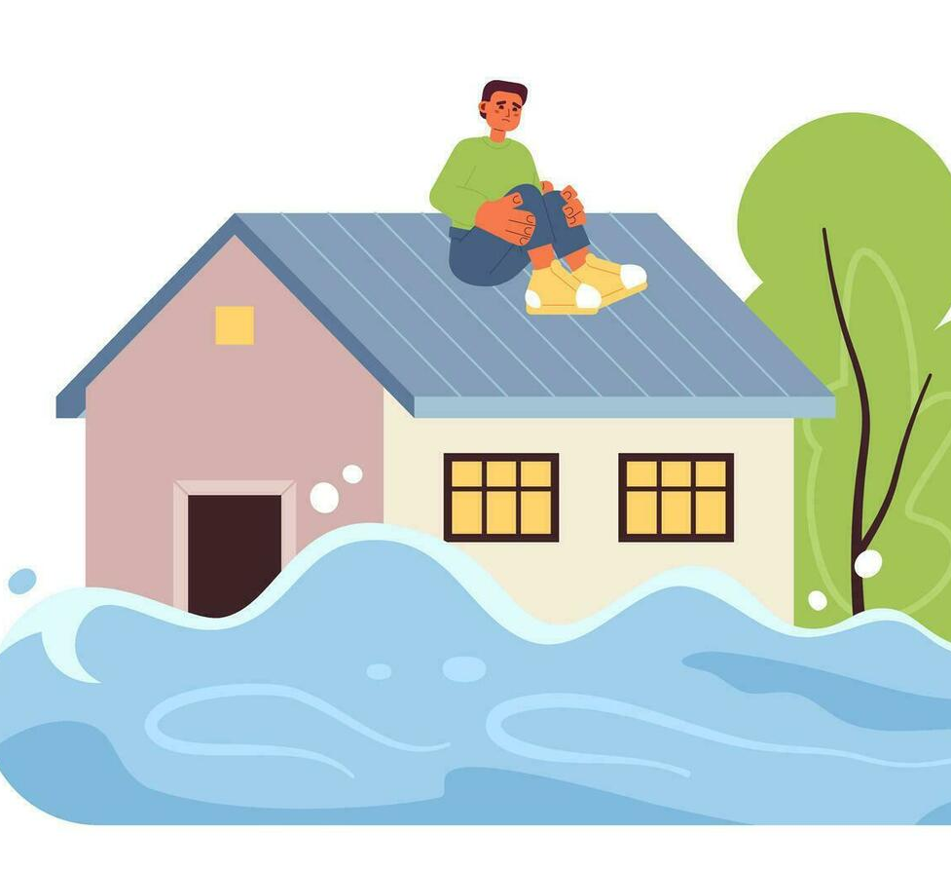
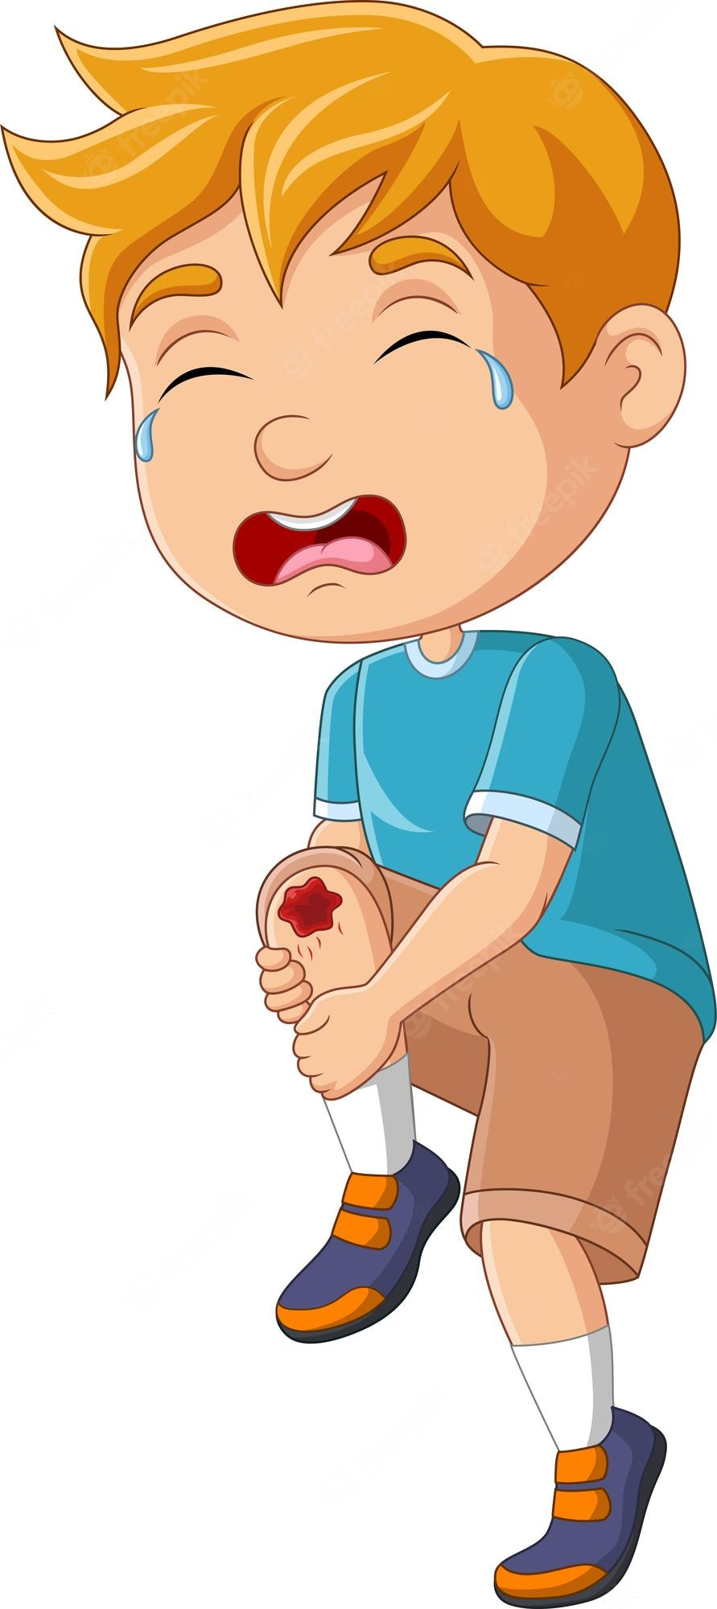

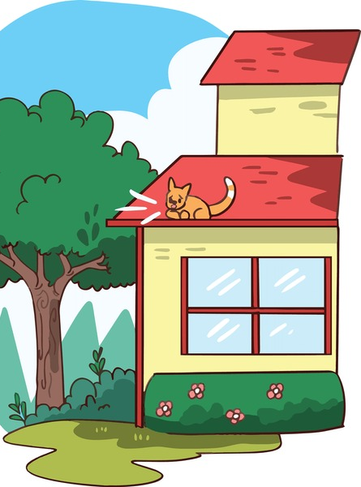
Warm up
Who could help in these situations?
What would you do to help?

Slide 5

IRS
Pre-Assessment

Slide 6
IRS
What is one quality that most heroes share?
1. They want to be famous.
2. They help others in emergencies.
3. They work only for money.
4. They don’t intervene when there is a problem.

Slide 7

IRS
What is one quality that most heroes share?
2. Heroes help others in emergencies.

Slide 8
IRS
What is the genre of “Doctors Without Borders”?
1. folktale
2. short story
3. informational text
4. fable

Slide 9

IRS
What is the genre of “Doctors Without Borders”?
3. informational text

Slide 10
IRS
What do you think “Doctors Without Borders” is?
1. a name of a group of teachers who help refugees
2. a name of a hospital
3. a name of a company that sells medicine
4. a name of a group of doctors who travel to help

Slide 11
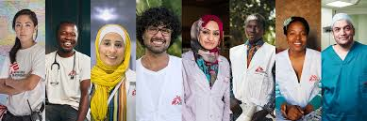
IRS
What do you think “Doctors Without Borders” is?
4. a name of a group of doctors who travel to help

Slide 12
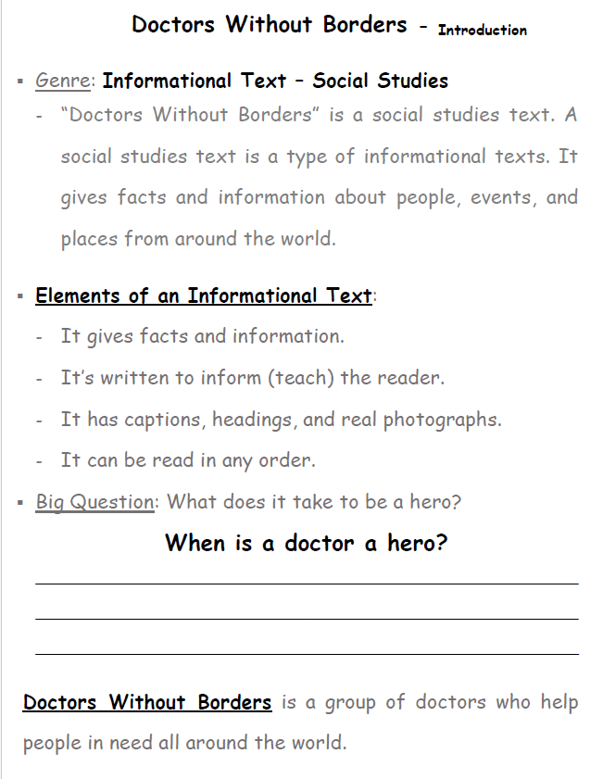

Slide 13
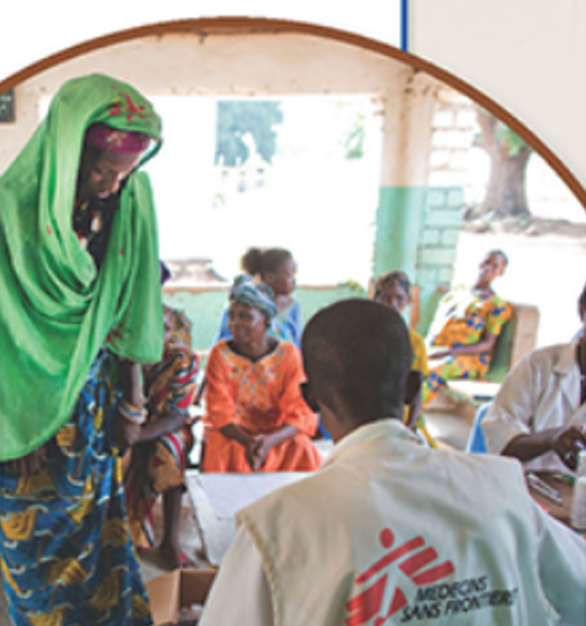
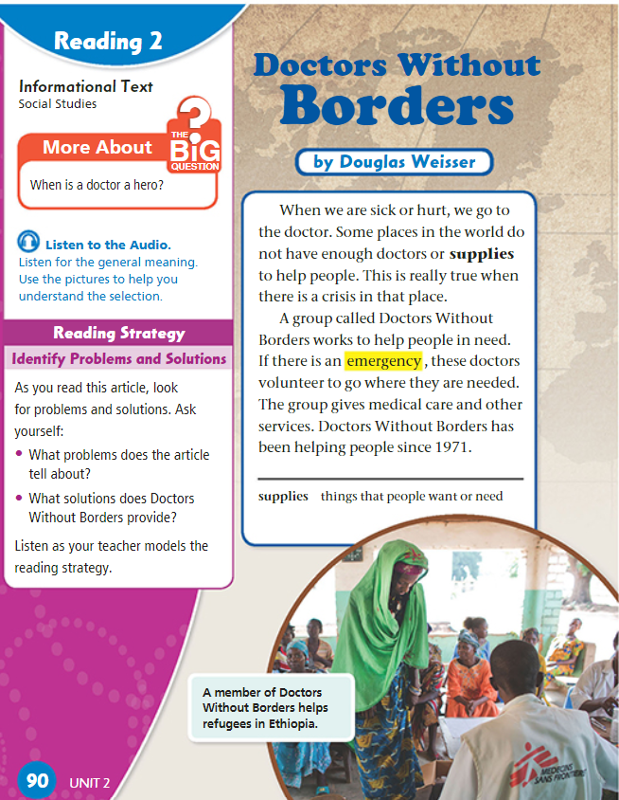

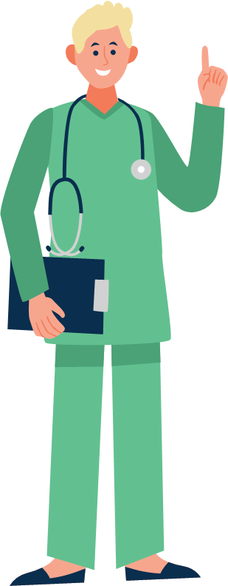
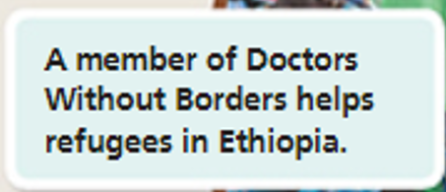
p.90

Slide 14
Discussion Questions on p.90
Where do we usually go when we are sick or hurt?
What problem do some places in the world face?
When is the need for doctors and supplies important?
What is the name of the group that helps people in need?
What do the doctors from Doctors Without Borders do in an emergency?
When did Doctors Without Borders start helping people?

Slide 15
Discussion Questions on p.90
Where do we usually go when we are sick or hurt?
What problem do some places in the world face?
When is the need for doctors and supplies important?
What is the name of the group that helps people in need?
What do the doctors from Doctors Without Borders do in an emergency?
When did Doctors Without Borders start helping people?

Slide 16

Linking to Life
Have you ever helped someone who really needed it, even in a small way?
How did it make you feel?

Slide 17


Buzz in!
Critical Thinking:
If you were a doctor, would you risk your own safety and travel to a dangerous place to help people during an emergency? Why or why not?

Slide 18

Differentiation
Student’s Number | Task
1+4 | Write 4–6 sentences explaining what you learned about Doctors Without Borders. Who they are - What they do - Why their work is important
2+3 | Imagine you are part of Doctors Without Borders. Write a short diary entry (6–8 sentences) describing a day of helping people in another country. Where you are - What happened - How you helped - How you felt when you made a difference

Slide 19
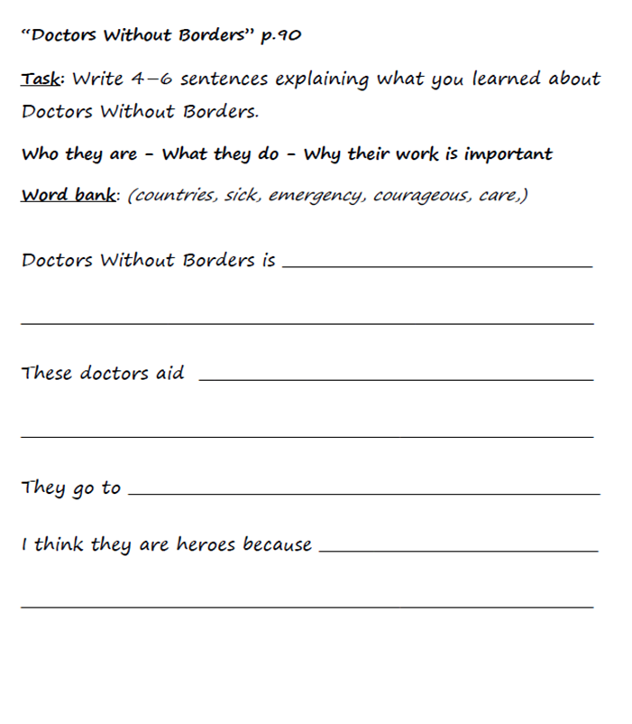

3
4
2
1
4
1

Slide 20
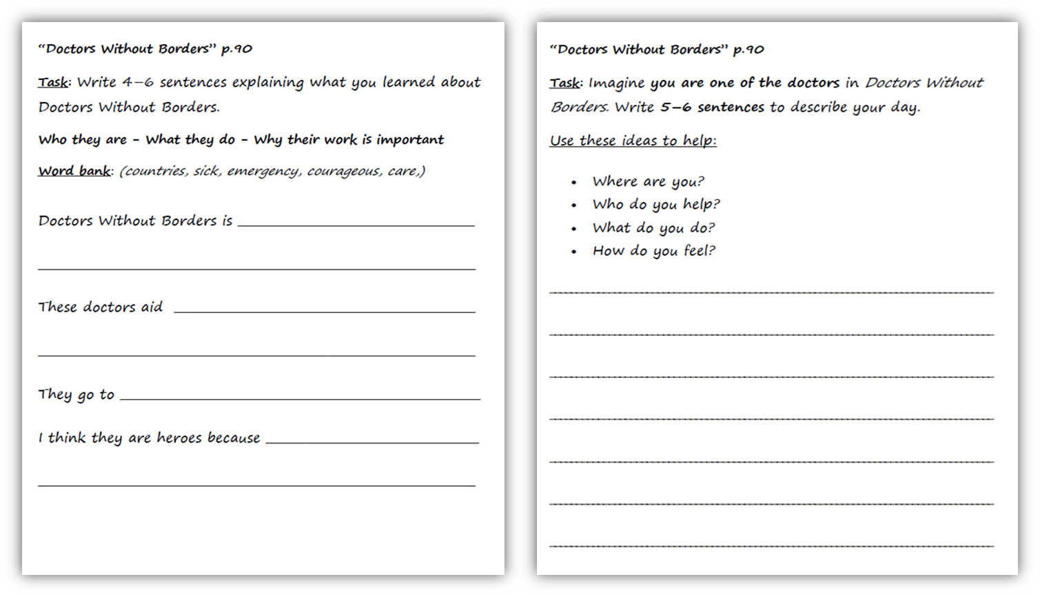
Feedback
a group of doctors
who help sick people.
people after war or
Today I worked in a small village in Africa where there are no hospitals. Many children were sick, so we gave them medicine and food. People thanked us and children smiled when they felt better. I felt happy and proud because I helped people who needed care.
natural disasters.
countries that have emergencies
because they are
courageous, and they care about others

Slide 21


https://kahoot.it/solo/?quizId=6a7b21b0-18c8-4aca-a6bd-71fabe70255b

