Slide 2
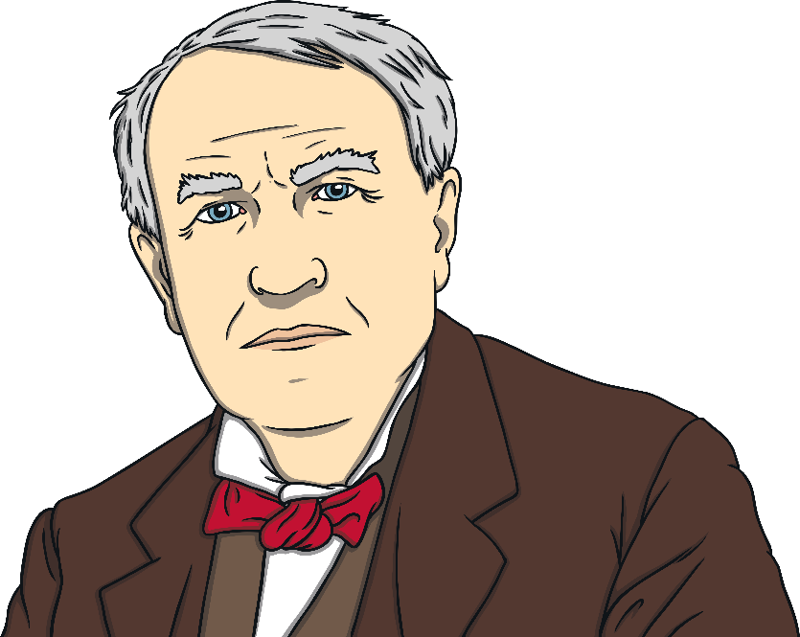
Providing LIGHT in the DARKNESS
Unit 2 page 51

Slide 3
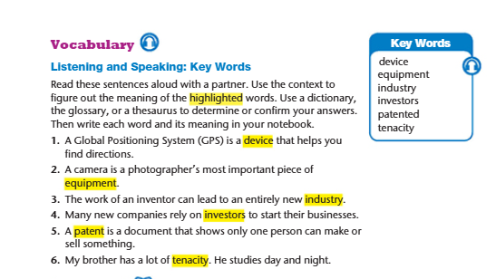
https://forms.office.com/Pages/DesignPageV2.aspx?origin=NeoPortalPage&subpage=design&id=sP71scJ1uk-unvS8MA9V-LmNFnXseUpHkXwjbJf2hBVUQ1lEMTdBMlRSQ0IzWFJXM1RGUERGUkhGTC4u

Slide 4
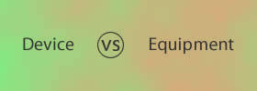


Slide 5
🔹 Device
A device is usually a single tool or machine made for a special purpose.
It’s often small, electronic, or mechanical.
You can carry it or use it individually.
Examples:
A phone is a device for communication.
A thermometer is a device for measuring temperature.
A USB stick is a device for storing data.
🔹 Equipment
Equipment means all the tools, or materials you need for a certain job or activity.
You can’t count it (it’s uncountable).
Examples:
A photographer’s equipment includes a camera, tripod, and lights.
The hospital bought new equipment for the surgery room.
The lab has modern equipment for experiments.

Slide 6
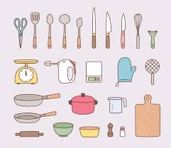
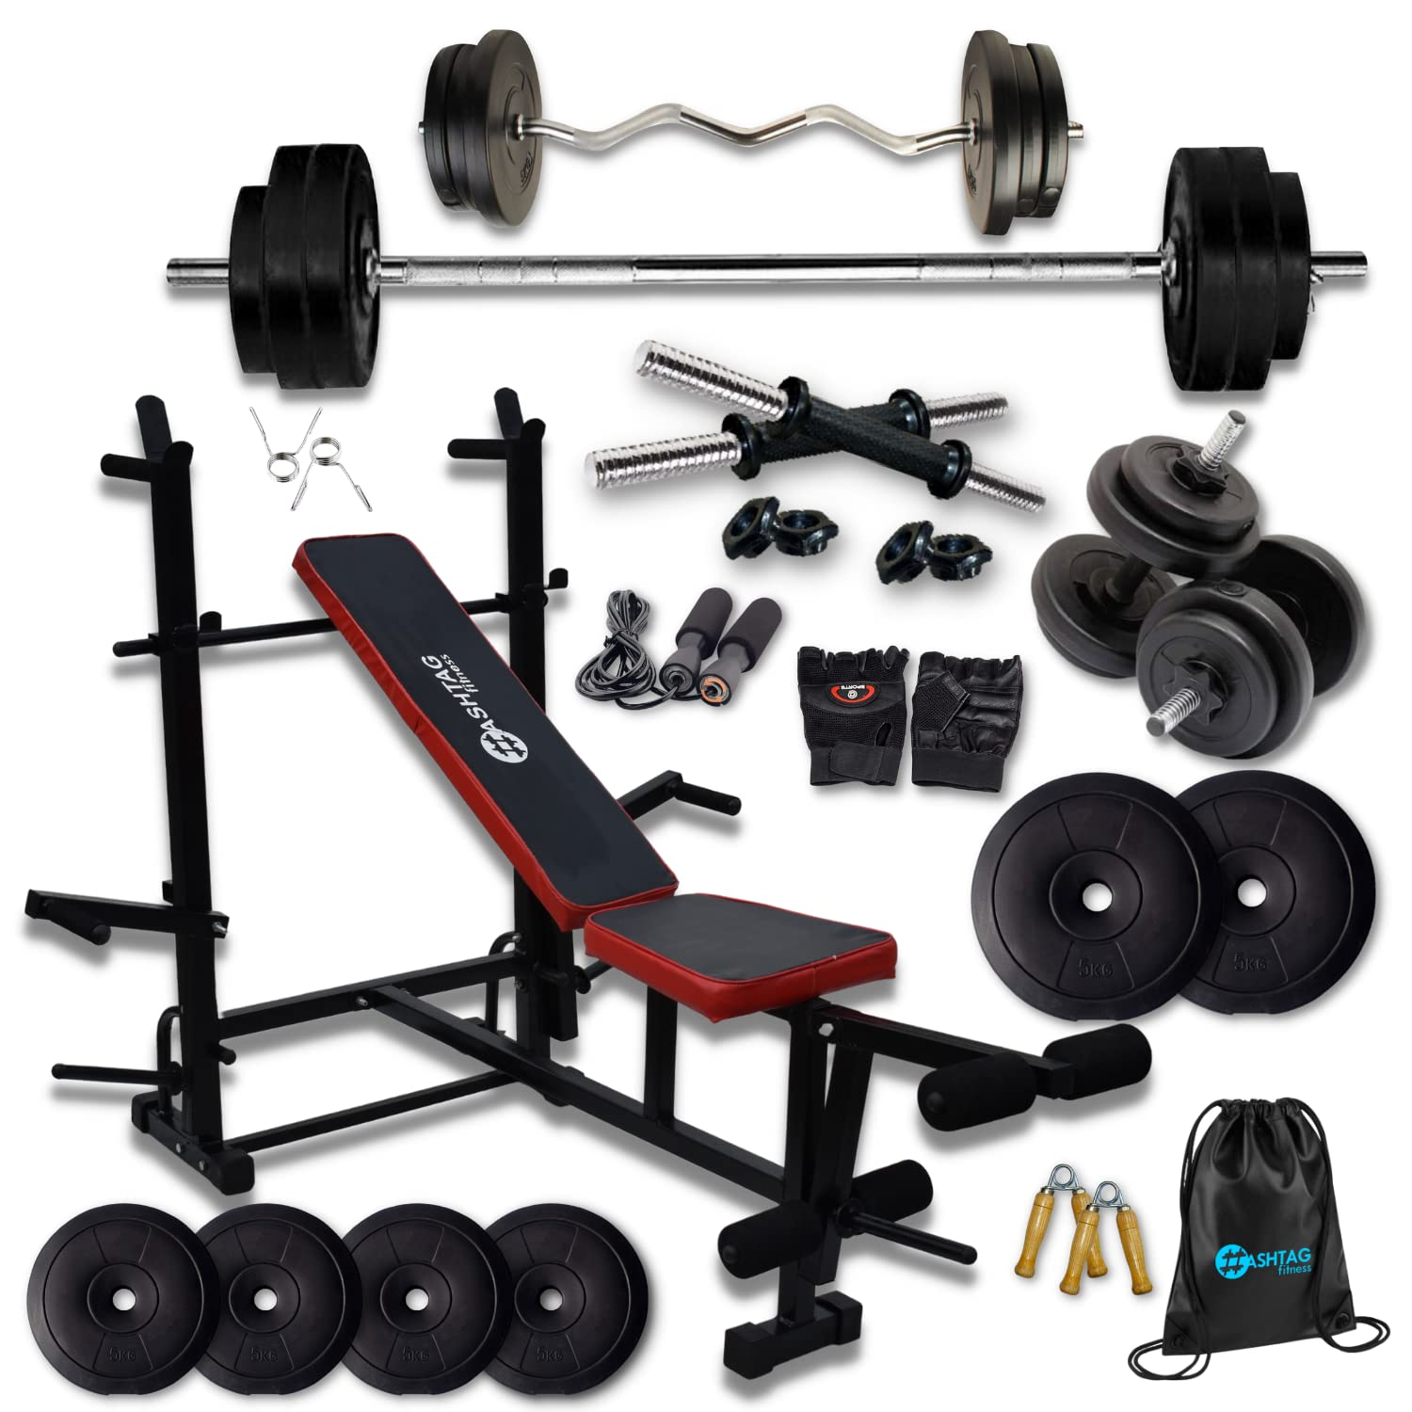
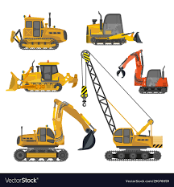


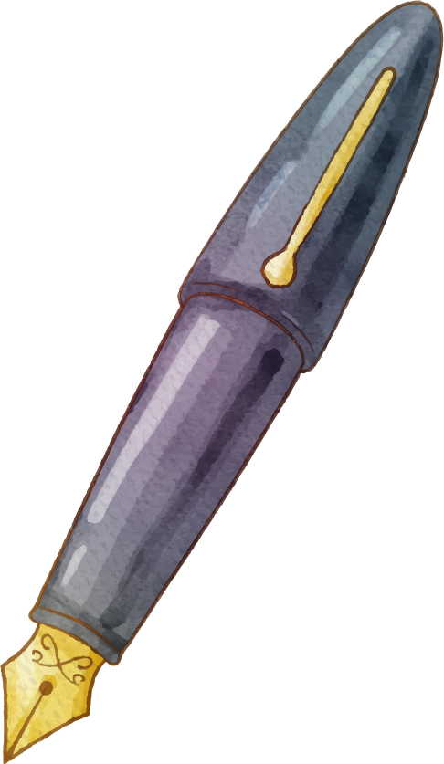


Here are examples of equipment
Kitchen
Gym
Constructions

Slide 7
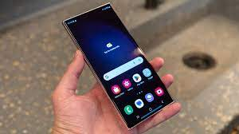
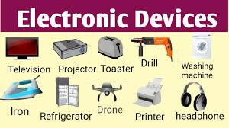
Our poetry experts
You can speak a bit about this person here

Slide 8
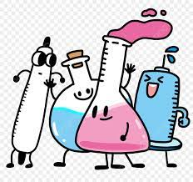
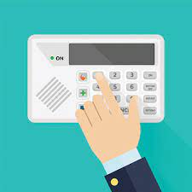
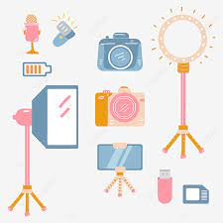
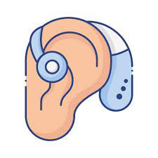
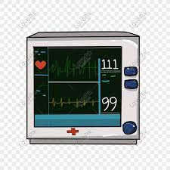
1- The laboratory has specialized________________ for conducting experiments and analyzing data.
2- The company developed a new security ________ to protect their data .
3- The photographer packed his _____________ for the photo shoot.
4- The doctor used a medical _________ to monitor the patient’s heart rate.
5- The hearing aid is a _________ that helps people with hearing loss hear better.
equipment
device
equipment
device
device

Slide 9

1. I know the difference between equipment and device.
Feedback

Slide 10
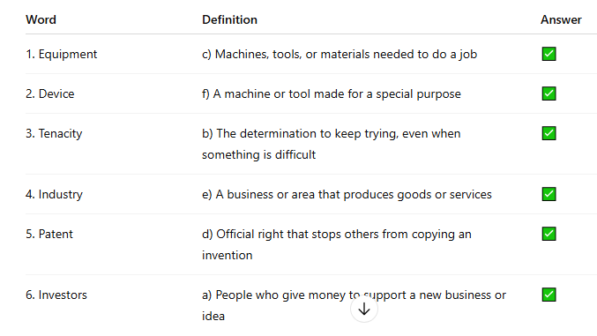

Slide 11


Revision
Task 2
Read the situations and guess which word I am thinking of. Write your answer on the white Board.
2 minutes

Slide 12
Which word am I thinking of….
Device
Situation 1 : Sarah recently bought a new item that helps her monitor her daily steps. The small, wearable gadget tracks her activity and even syncs with her phone to provide health insights.

Slide 13
Which word am I thinking of….
Equipment
Situation 2: The construction team needed to check all the safety items before starting work. Helmets, harnesses, and gloves were essential to ensure that the workers remained safe while operating heavy machinery..

Slide 14
Which word am I thinking of….
Industry
Situation 3:The fashion field has been rapidly changing with the rise of eco-friendly materials. Designers and brands are now focusing on sustainability, creating clothes that are both stylish and good for the environment.

Slide 15
Which word am I thinking of….
Patent
A young engineer invented a new kind of solar-powered backpack that can charge phones and laptops. Before showing it to companies, she applied for a patent so that no one could copy her idea without her permission.

Slide 16
Which word am I thinking of….
tenacity
A student wanted to win a national robotics competition. His first robot didn’t work, and the second one broke. Still, he kept trying, improving his design each time. His tenacity helped him finally win first place.

Slide 17
Which word am I thinking of….
Investors
A group of university students started a small company that made water bottles from recycled plastic. They needed money to grow their business, so they met with investors who believed in their idea and decided to support them financially.

Slide 18
Which word am I thinking of….
Device
Situation 1 : Sarah recently bought a new item that helps her monitor her daily steps. The small, wearable gadget tracks her activity and even syncs with her phone to provide health insights.

Slide 19
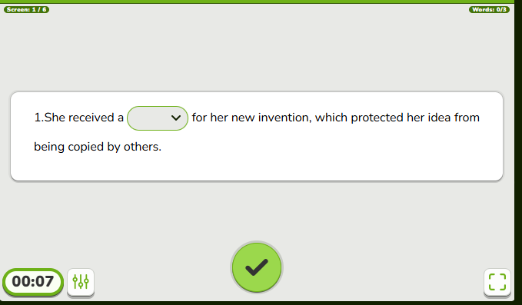
Formative Assessment

Slide 20
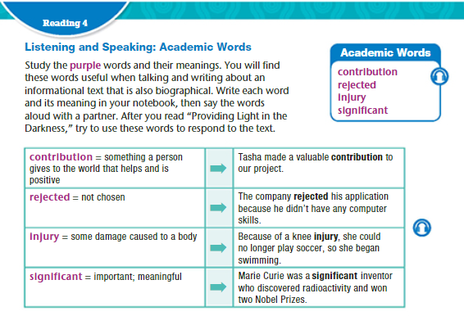

Slide 21
Guess the Meaning from the context
Read the segment with your partner. Try to guess the meaning of each bolded word using the context. Then, match each word with its correct definition.
Task 2
2 minutes

Slide 23
Revision
Task 2
Read the situations and guess which word I am thinking of. Write your answer on the white Board.
2 minutes

Slide 24
Which word am I thinking of….
rejected
Situation 1 : Sarah recently bought a new item that helps her monitor her daily steps. The small, wearable gadget tracks her activity and even syncs with her phone to provide health insights.

Slide 25
Which word am I thinking of….
Contribution
Situation 2:During the class project, everyone worked together. John brought the supplies, Maria wrote the report, and Ahmed created the presentation. Each person helped in their own way to complete the project.

Slide 26
Which word am I thinking of….
Injury
Situation 3:During the soccer game, James fell and twisted his ankle. He had to sit on the bench for the rest of the game, and the coach said he would need to visit the doctor. The doctor told him he might need a week to recover before he can play again.

Slide 27
Which word am I thinking of….
significant
Situation 2:The teacher told the students that the upcoming exam would be very important. It would count for 50% of their final grade, which means doing well on it would have a big impact on their overall result.

Slide 28



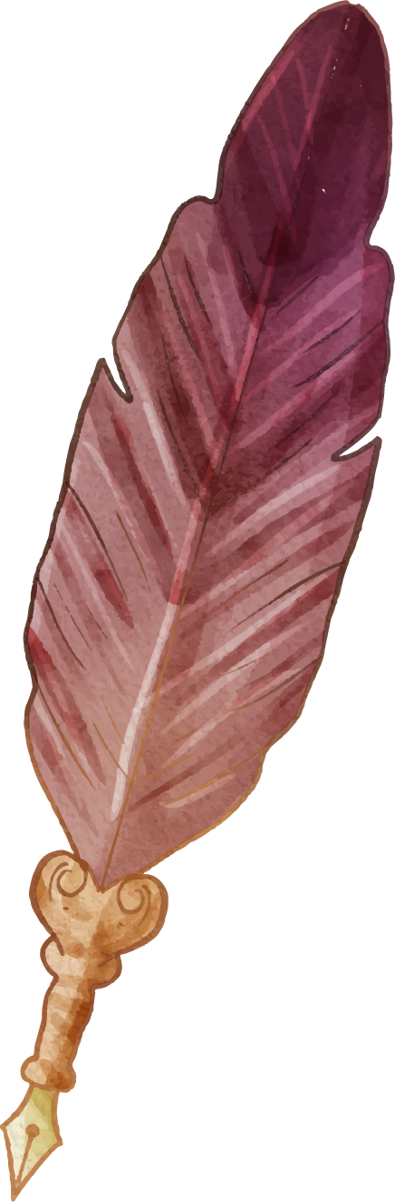
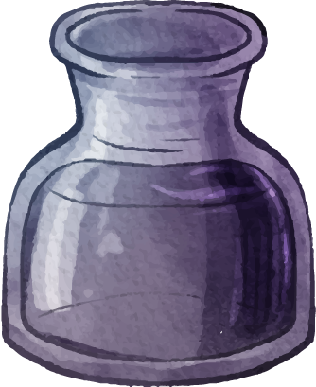

Industry : the companies and activities involved in the process of producing goods for sale, especially in a factory or special area:
1. The fashion industry is known for its ever-changing trends and styles.
2. The technology industry has seen rapid advancements in recent years.
3. The hospitality industry includes hotels, restaurants, and tourism services.
5. The film industry in Hollywood is famous worldwide.
The music industry is highly competitive, with many aspiring artists trying to make a name for themselves.

Slide 29






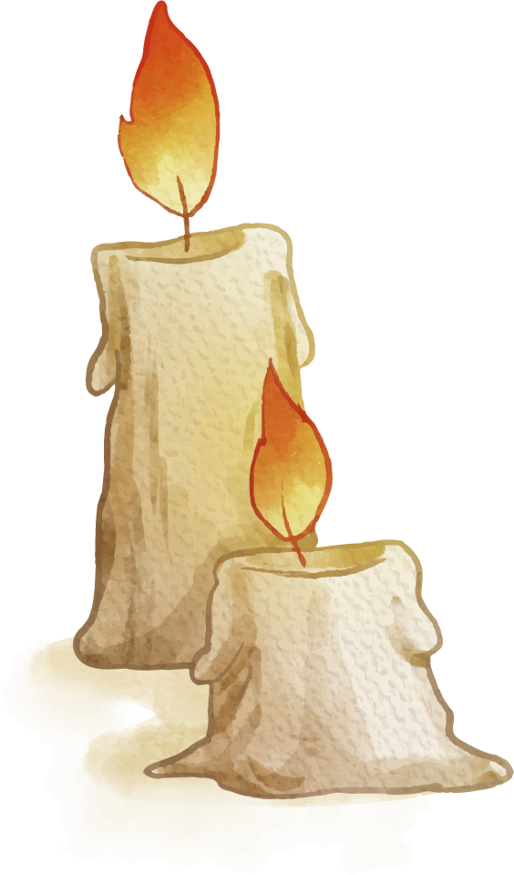
Investors :People or organization that put money into financial schemes, property, etc. with the expectation of achieving a profit.
The investors decided to put their money into a promising tech startup.
The company attracted a group of angel investors to fund its expansion.
Many investors were cautious in the face of economic uncertainty.
Real estate investors often look for properties with strong growth potential.
The investors were pleased to see a significant return on their investment.

Slide 30
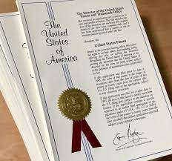
Patent

Slide 31
Tenacity : determination
His tenacity in pursuing a cure for the disease inspired many.
The athlete's tenacity during training paid off with a gold medal.
The project's success was largely due to the team's tenacity in overcoming obstacles.

Slide 33

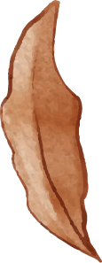
1. Every little bit helps; even a small ____________________ can make a difference in a charity's mission
2. She felt disappointed when her job application was _____________by the company.
3. She made a _______________ impact on her community by organizing charity events.
4. He suffered a severe ____________ to his leg in a car accident and had to undergo surgery.
5. Playing contact sports without proper protective gear can lead to serious ____________ .
6. The storm caused _____________damage to the coastal town, with many homes flooded
7. The manuscript was ____________by several publishers before finding the right one.
8. His financial _____________ helped fund the local youth soccer team's new uniforms.
contribution
rejected
significant
Injury
Injury
significant
rejected
Contribution

