Slide 1
Unit 2-Reading 2
Five New Words at a Time and Quilt pages 84-87
8th grade

Slide 2
Benefits of Facing and Overcoming Challenges
advantages / good results
difficulties

Slide 3
Oral Discussion
We all have challenges in life. What are some
examples of challenges people face?
2. What are the benefits of facing and overcoming
those challenges?
3. Do you know anyone who has overcome a big challenge?
4. Have you ever overcome a big challenge?
5. How can family members be helpful when someone in
the family is facing a challenge?
6. What challenges does our country face?

Slide 4
Outcomes
01
02
Big Question
Genre
03
04
Literary Words
Comprehension
connect the story to the concept of facing and overcoming challenges and relate to the main character
identify the special elements of the genre personal narrative
identify the characters and point of view
analyze and summarize the main events and respond to comprehension questions effectively

Slide 5
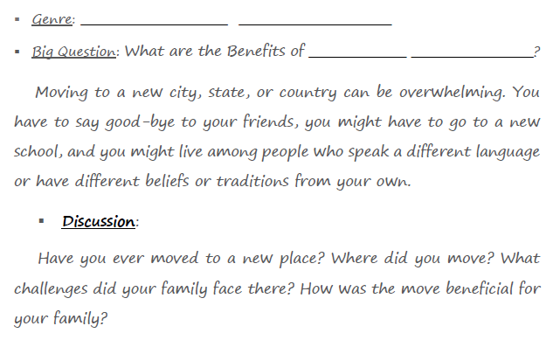
Genre and Big Question
Personal Narrative
Overcoming Challenges

Slide 6
Genre
What is a Personal Narrative?
A personal narrative is a story based on real-life personal experiences. It’s usually told in first person point of view.

Slide 7
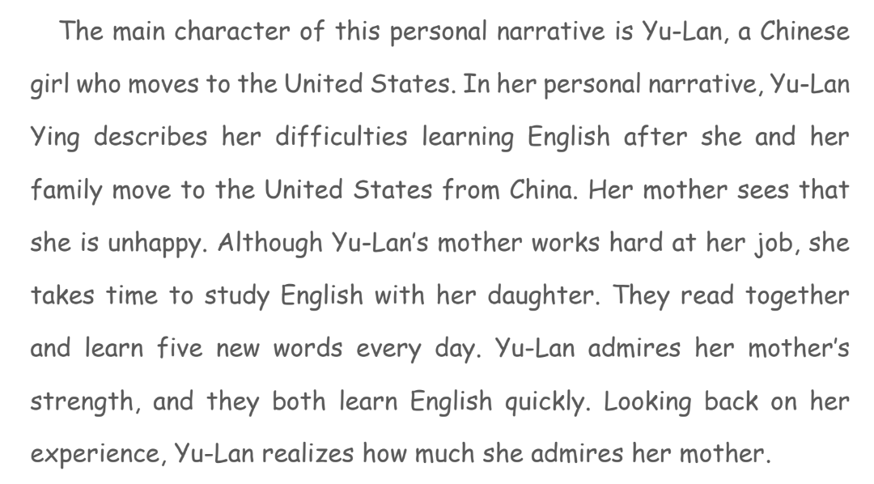
Introduction

Slide 8
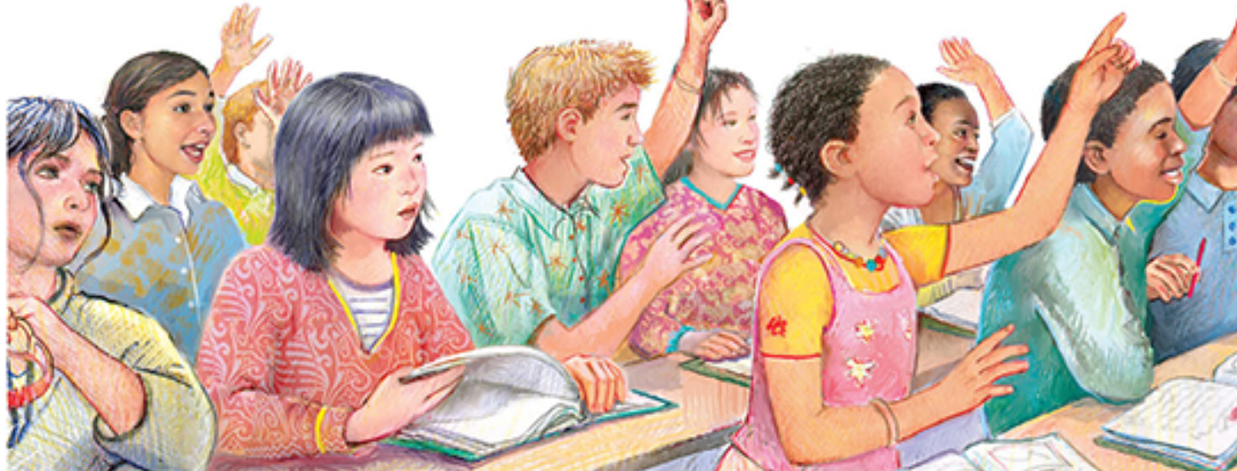
Illustration p.84

Slide 9
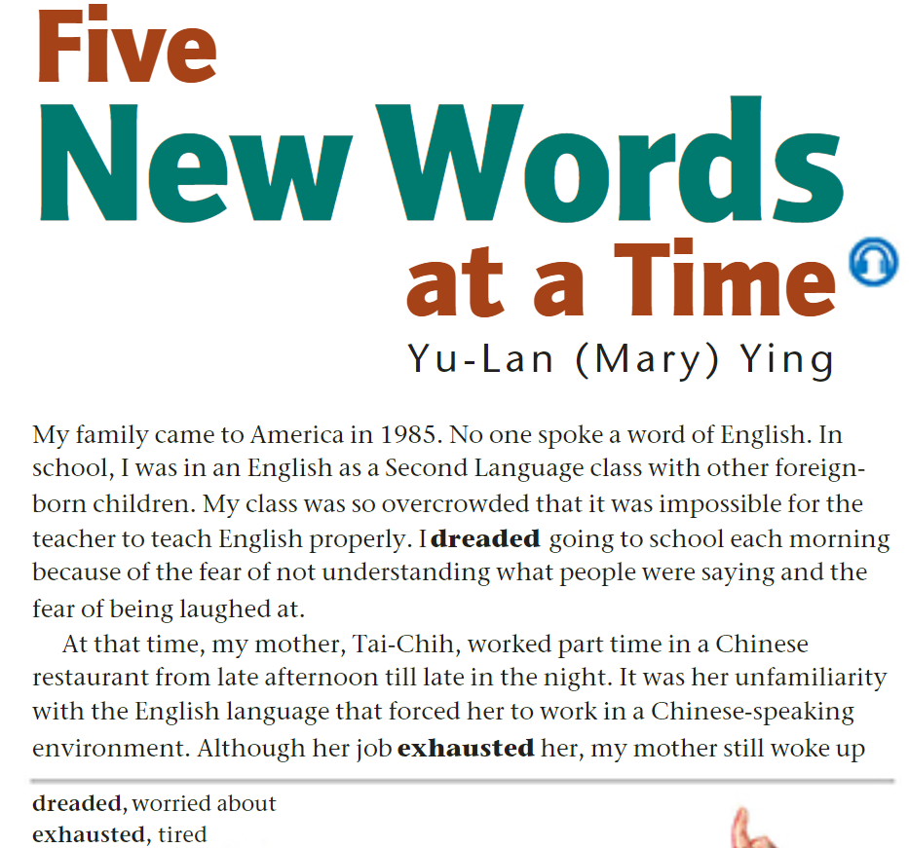

Page 84

Slide 10
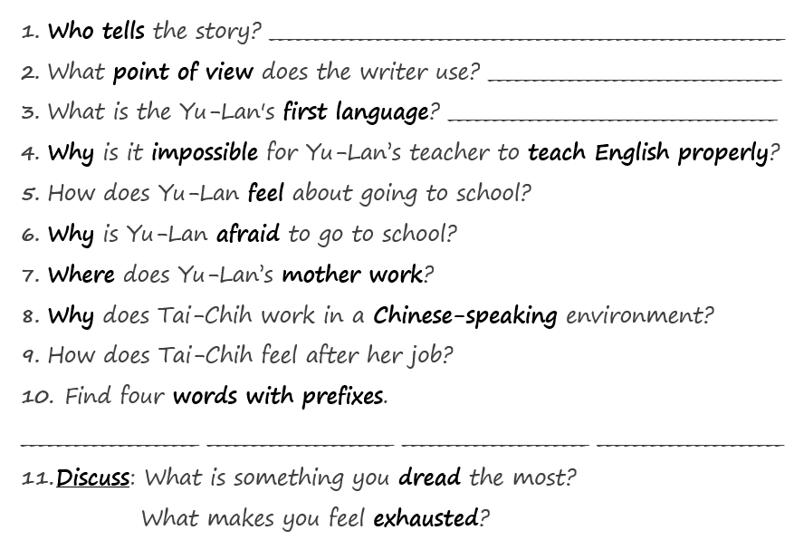
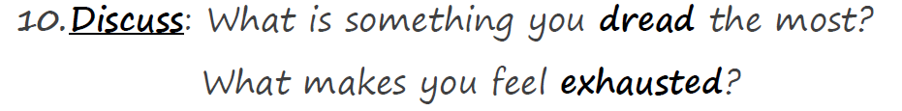
Page 84
the main character, Yu-Lan
first person
Chinese

Slide 11
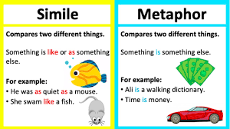
What is the difference between simile and metaphor?

Slide 12
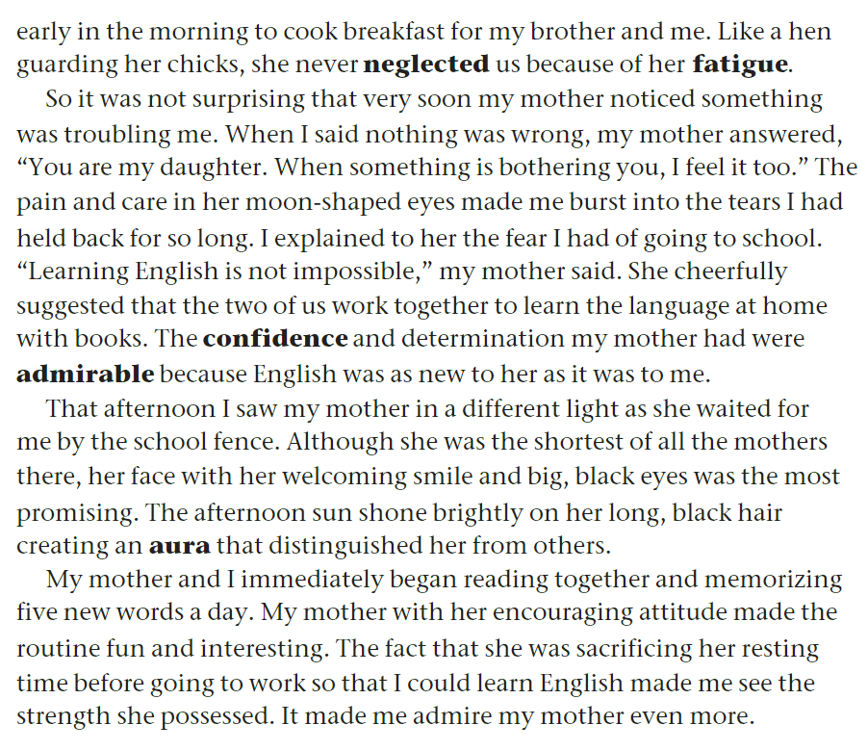
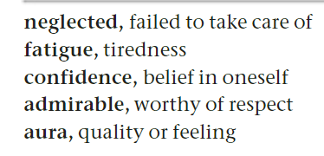
Page 85

Slide 13
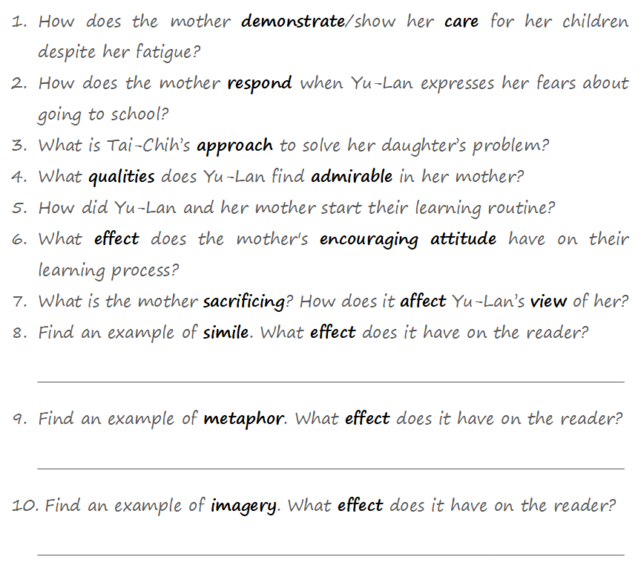
Page 85
simile
metaphor
imagery
It shows the protective nature of the mother.
It shows the beauty and comforting quality of the mother’s eyes.
It shows the mother’s warmth and positive energy.

Slide 14

Use the following words in complete and meaningful sentences.
neglected
fatigue
confidence
admirable
aura

Slide 15

Feedback
neglected: The plants died because the garden was neglected.
fatigue: Fatigue showed on my face after the long journey.
confidence: Good grades give me more confidence.
admirable: She’s an admirable person; everyone likes and respects her.
aura: She has an aura of confidence that makes her attractive.

Slide 16

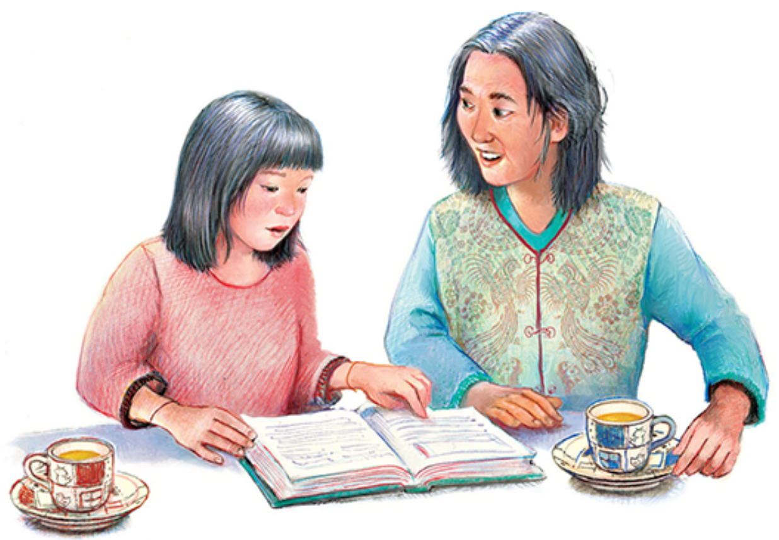
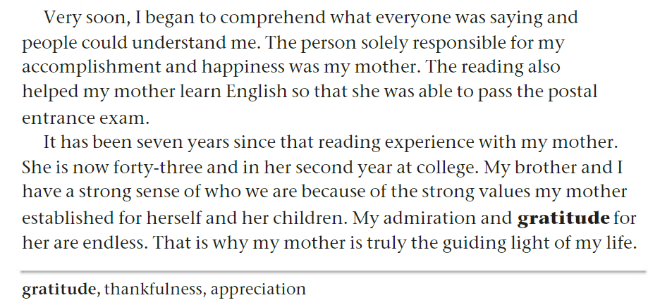
Page 86

Slide 17
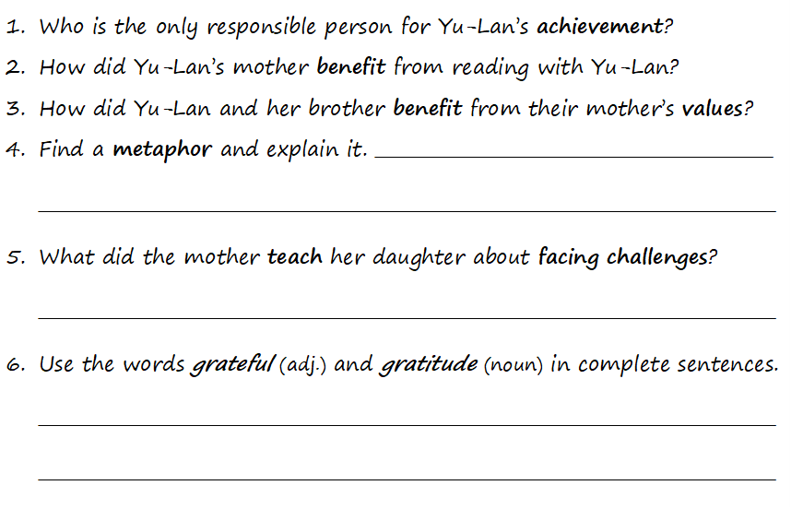
Page 86
She compares her mother
to a "guiding light" because she provides direction and support in her life
A person can overcome a challenge in small steps.
metaphor
I’m grateful to you for being so kind to me.
I made her a card to express my deep gratitude.

Slide 18
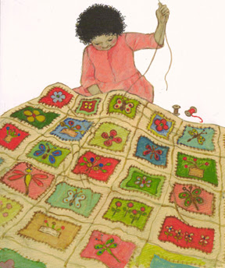
Quilt p.87
A quilt is a heavy blanket that is made of different pieces of fabric (patches) sewed together.

Slide 19
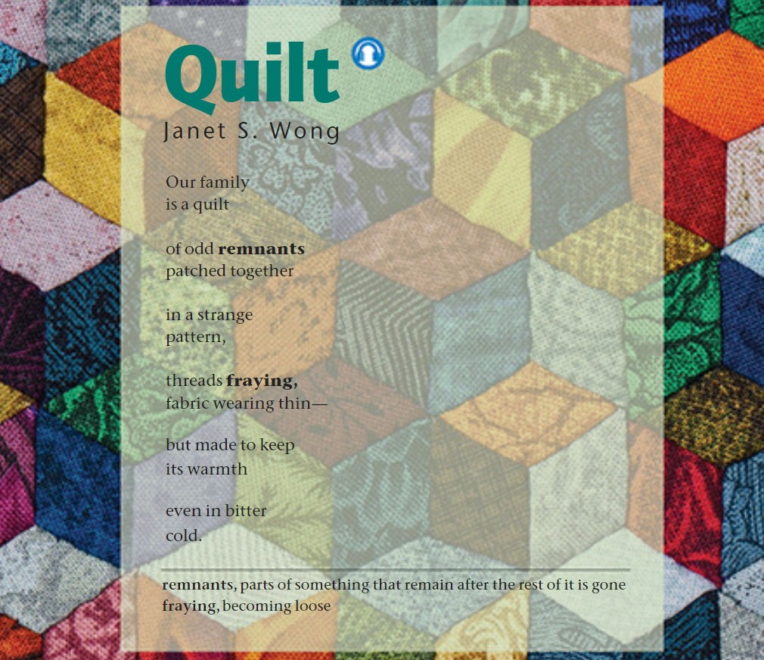
Genre: Poem

Slide 20
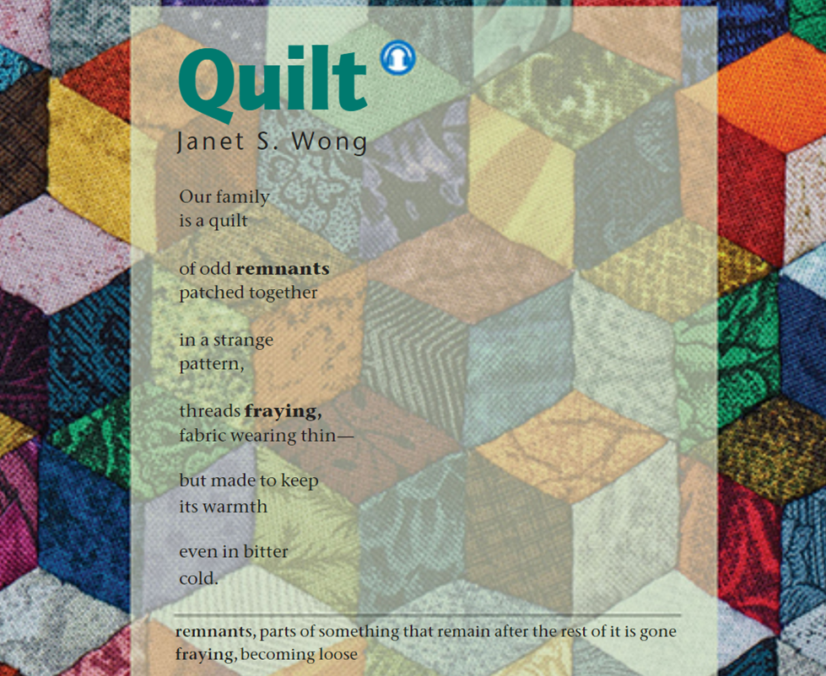
Questions on p.87
1. Explain the metaphor
“Our family is a quilt of odd remnants patched together”
2. “but made to keep its warmth even in bitter cold.”
What does this say about the strength of family bonds?
3. What is the significance of the phrase "threads fraying" ?
4. What theme is the poet conveying about family through the metaphor of a quilt?
5. How would you compare the family relationships described in “Quilt” with the relationship between Yu-Lan and her mother?

Slide 21
Feedback
1. The speaker compares her family to a quilt. A family is made up of different people, each unique, like different pieces of fabric in a quilt. These pieces are "patched together" to create something strong and warm.
2. Like a quilt, the family provides warmth and comfort by caring for one another, even during challenging times.
3. The bonds within the family may weaken over time, but won’t break.
4. Family, like a quilt, is made up of different, imperfect pieces that come together to create warmth, strength, and support, especially during difficult times.
5. The poem talks about building strong and positive family relationships, especially during difficult times. Yu-lan’s mother sacrificed to support and help her daughter overcome a difficulty.

Slide 22
Connect – Critical Thinking Questions
1. Have you ever had to learn another language?
If so, what was your approach?
What resources did you use?
2. Would you recommend Yu-Lan’s mother’s approach of learning five new words a day?
3. Have you ever helped someone face a challenge? What did you do? How did the experience make you feel?
4. Think of a recent challenge you’ve had to face. Compare your experience to Yu-Lan’s in terms of feelings, approach, and outcome.

