Slide 1

Unit: 3
Lesson: Let’s Eat
Subject: Simple, Compound and Complex Sentences
Grade: 10

Slide 2


ISLAMIC EDUCATIONAL COLLEGE DATE: / / 2025 :
SUBJECT: Grammar
GRADE: 8
UNIT: 4
Lesson: 2
LESSON
OBJECTIVES
OBJECTIVES:
To distinguish between simple, compound and complex sentences
To complete the different related tasks, practices and activities successfully
01:00 minute
WARM UP
PREASSESSMENT
PRESENTATION
FORMATIVE ASSESSMENT
FEEDBACK
DIFFERENTIATION
REAL LIFE APPLICATION
CRITICAL THINKING
EXIT TICKET

Slide 3

ISLAMIC EDUCATIONAL COLLEGE DATE: / / 2025
SUBJECT: Grammar
GRADE: 8
UNIT: 4
LESSON: 2
OUTCOMES
WARM UP:
Solve the riddle.
Riddle:
I am not alive, but I grow; I don’t have lungs, but I can blow. I don’t have a mouth, but water kills me. What am I?
Is it 1. candle or 2. fire?
Answer: Fire
01:00 minute
WARM UP
PREASSESSMENT
PRESENTATION
FORMATIVE ASSESSMENT
FEEDBACK
DIFFERENTIATION
REAL LIFE APPLICATION
CRITICAL THINKING
EXIT TICKET
IRS

Slide 4
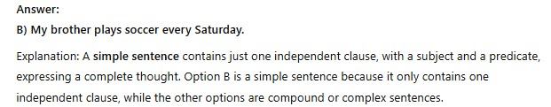

ISLAMIC EDUCATIONAL COLLEGE DATE: / / 2025
SUBJECT: Grammar
GRADE: 8
UNIT: 4
LESSON: 2
PREASSESSMENT:
Question:
Which of the following is a simple sentence?
A) Even though I was tired, I stayed up late to finish my project. B) My brother plays soccer every Saturday. C) When I finish my homework, I will watch TV. D) I wanted to go to the park, but it started raining.
OUTCOMES
01:00 minute
WARM UP
PREASSESSMENT
PRESENTATION
FORMATIVE ASSESSMENT
FEEDBACK
DIFFERENTIATION
REAL LIFE APPLICATION
CRITICAL THINKING
EXIT TICKET
BUZZ IN

Slide 5
Sentence Structure: Sentence Types

Slide 6
Sentence Types
Simple
Compound
Complex
Compound-Complex

Slide 7
Basic Elements
SUBJECT
PREDICATE
Mary
plays tennis.

Slide 8
Simple Sentence

Slide 9

Simple Sentence
A simple sentence has one subject and one
predicate.

Slide 10
Simple Sentence
Observe how a simple sentence is constructed:
We went to San Juan yesterday.

Slide 11
Simple Sentence
Pronoun
Verb
Prepositional phrase
We went to San Juan .
Simple subject
Complete predicate

Slide 12


Simple Sentence
Tom and Mary
play tennis and swim.
Compound Subject
Compound Predicate
&
&

Slide 13
Compound Sentence

Slide 14
Compound Sentence
A compound sentence has more than one
part that can stand alone (independent clauses).
Independent clauses are connected by coordinating conjunctions, conjunctive adverbs or a semi-colon.

Slide 15
Compound Sentence
We went to San Juan, and
most of us played all night.

Slide 16
Compound Sentence
Subject
Verb
Prepositional phrase
We went to San Juan,
Predicate
Coordinating Conjunction
and most of us played all night .
Subject
Verb
Modifying phrase

Slide 17

Compound Sentence
Use of Coordinating Conjunctions
SUBJECT
PREDICATE
SUBJECT
PREDICATE

Slide 18
Compound Sentence
Tom
swims,
and
Mary
plays tennis.

Slide 19
COMPOUND SENTENCE:
COORDINATING CONJUNCTIONS
FOR AND NOR BUT OR YET SO
FANBOYS

Slide 20
COMPOUND SENTENCE:
COORDINATING CONJUNCTIONS
Tom swims, and Mary plays tennis.
Clause 1 Independent
Clause 2 Independent

Slide 21
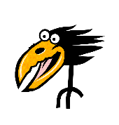
COMPOUND SENTENCE:
COORDINATING CONJUNCTIONS
Tom swims, and Mary plays tennis.
Comma before “and”
in compound sentences!

Slide 22
COMPOUND SENTENCE:
CONJUNCTIVE ADVERBS
MOREOVER
HOWEVER OTHERWISE THEREFORE

Slide 23
COMPOUND SENTENCE:
CONJUNCTIVE ADVERBS
Bob is handsome; moreover, he is rich.
Clause 1 Independent
Clause 2 Independent

Slide 24
COMPOUND SENTENCE:
CONJUNCTIVE ADVERBS
Bob is handsome; moreover, he is rich.
Note: Semicolon before conjunctive adverb and comma
after conjunctive adverb!

Slide 25
CONJUNCTIVE ADVERB:
AT THE BEGINNING, IN THE MIDDLE,AT THE END
Bob is handsome; moreover, he is rich. Bob is handsome; he is, moreover, rich. Bob is handsome; he is rich, moreover.

Slide 26
COMPOUND SENTENCE:
SEMICOLON
Tom has benefited from his exercise program; he is slim and energetic.

Slide 27
Complex Sentence

Slide 28
Complex Sentence
least two alone and
A complex sentence has at
parts: one that can stand another one that cannot
The part that cannot stand alone is linked to the rest of the sentence by a subordinating conjunction

Slide 29
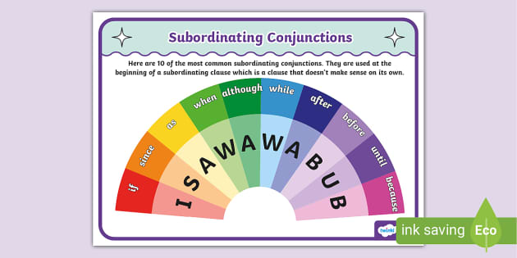

Slide 30
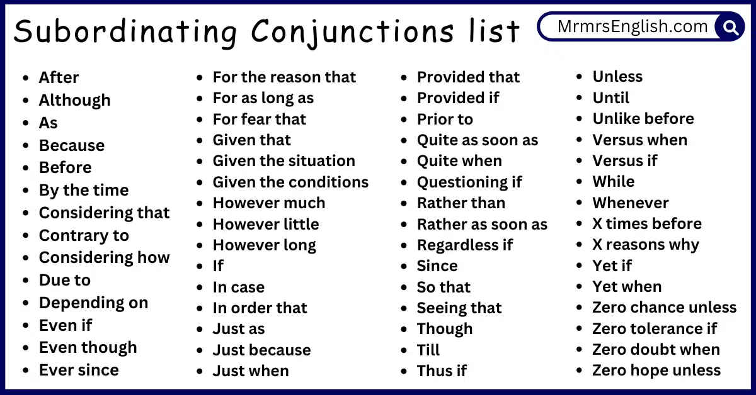

Slide 31
Complex Sentence
Since my friend and I wanted to have fun,
we went to San Juan yesterday.

Slide 32
Complex Sentence
Since we wanted to have fun,
Subordinating
Conjunction
Part that cannot stand alone
Subject
Predicate
we went to San Juan yesterday.

Slide 33
Complex Sentence
SUBJECT
PREDICATE
even though
SUBJECT
PREDICATE

Slide 34
Complex Sentence
Bob
is popular
even though
he
is ugly.

Slide 35
COMPLEX SENTENCE:
SUBORDINATING CONJUNCTIONS
The most common subordinating conjunctions are "after," "although," "as," "because," "before," "how,"
"if," "once," "since," "than,"
"that," though," "till," "until,"
"when," "where," "whether,” and
while."

Slide 36
COMPLEX SENTENCE:
SUBORDINATING CONJUNCTIONS
Bob is popular even though he is ugly.
Clause 1 Independent
Clause 2 Dependent

Slide 37
COMPLEX SENTENCE:
SUBORDINATING CONJUNCTIONS
Even though Bob is ugly, he is popular.
Clause 1 Dependent
Clause 2 Independent

Slide 38

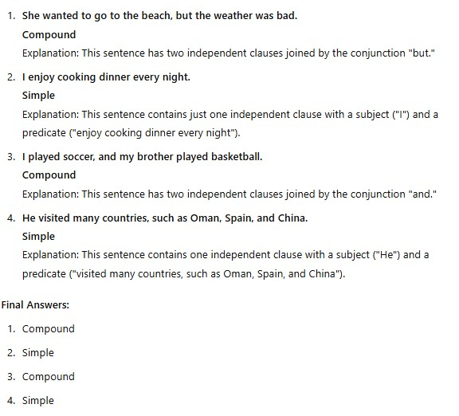
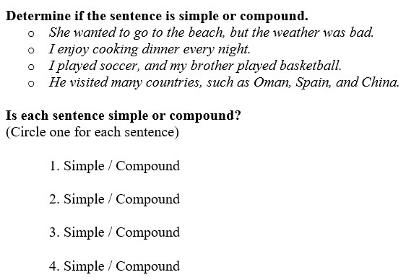
ISLAMIC EDUCATIONAL COLLEGE DATE: / / 2025
SUBJECT: Grammar
GRADE: 8
UNIT: 4
LESSON : 3
LESSON: 2
FORMATIVE ASSESSMENT:
OUTCOMES
WARM UP
PREASSESSMENT
PRESENTATION
FORMATIVE ASSESSMENT
FEEDBACK
DIFFERENTIATION
REAL LIFE APPLICATION
CRITICAL THINKING
EXIT TICKET
BUZZ IN

Slide 39
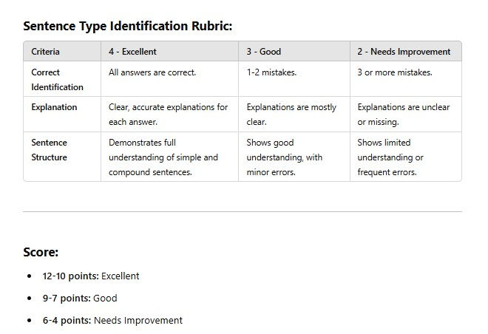

Slide 40


ISLAMIC EDUCATIONAL COLLEGE DATE: / / 2025 :
SUBJECT: Grammar
GRADE: 8
UNIT: 4
LESSON: 2
OUTCOMES
DIFFERENTIATION:
Based on your number, do the task assigned to you by the teacher. (Handout) ☺
1 & 3: Do question 1.
2 & 4: Do question 2.
01:00 minute
WARM UP
PREASSESSMENT
1
PRESENTATION
FORMATIVE ASSESSMENT
2
FEEDBACK
DIFFERENTIATION
3
REAL LIFE APPLICATION
CRITICAL THINKING
EXIT TICKET
4

Slide 41
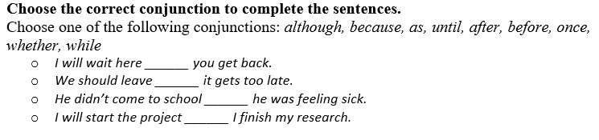
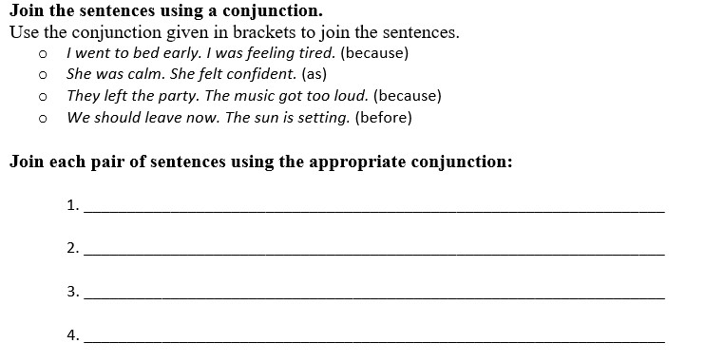
1 & 3:
2 & 4:

Slide 42
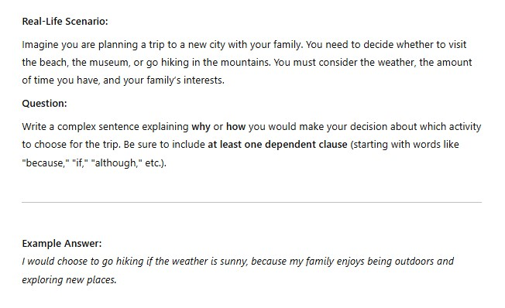
ISLAMIC EDUCATIONAL COLLEGE DATE: / / 2025 :
SUBJECT: Grammar
GRADE: 8
UNIT: 4
LESSON: 2
OUTCOMES
REAL LIFE APPLICATION:
01:00 minute
WARM UP
PREASSESSMENT
PRESENTATION
FORMATIVE ASSESSMENT
FEEDBACK
DIFFERENTIATION
REAL LIFE APPLICATION
CRITICAL THINKING
EXIT TICKET
BUZZ IN

Slide 43
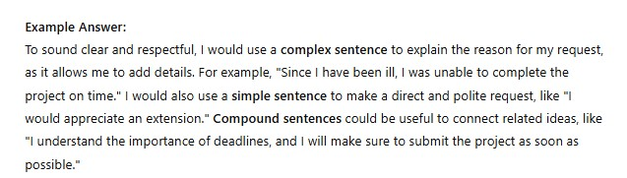

ISLAMIC EDUCATIONAL COLLEGE DATE: / / 2025 :
SUBJECT: Grammar
GRADE: 8
UNIT: 4
LESSON: 2
OUTCOMES
CRITICAL THINKING:
Critical Thinking Question:
You are writing a letter to your principal to request an extension on a school project. You want to express your reasons clearly, but you also want to sound respectful and professional.
Question: What types of sentences would be most effective to use in your letter? Explain why you would choose simple, compound, or complex sentences in different parts of the letter. Provide at least two examples: one for expressing a reason, and one for making a polite request.
01:00 minute
WARM UP
PREASSESSMENT
PRESENTATION
FORMATIVE ASSESSMENT
FEEDBACK
DIFFERENTIATION
REAL LIFE APPLICATION
CRITICAL THINKING
EXIT TICKET
BUZZ IN

Slide 44

ISLAMIC EDUCATIONAL COLLEGE DATE: / / 2025 :
SUBJECT: Grammar
GRADE: 8
UNIT: 4
LESSON: 2
OUTCOMES
EXIT TICKET:
Open the box then decide if the sentence is simple, compound or complex.
https://wordwall.net/resource/14281793/english/simple-compound-and-complex-sentences
02:00 minutes
WARM UP
PREASSESSMENT
PRESENTATION
FORMATIVE ASSESSMENT
FEEDBACK
DIFFERENTIATION
REAL LIFE APPLICATION
CRITICAL THINKING
EXIT TICKET
IRS

