Slide 1

OBJECTIVES
WARM UP
Unit: 3 - Let’s Eat
Lesson: Grammar
Subject: Relative Pronouns
Grade: 10
PREASSESSMENT
PRESENTATION
FORMATIVE ASSESSMENT
FEEDBACK
DIFFERENTIATION
REAL LIFE APPLICATION
CRITICAL THINKING
EXIT TICKET

Slide 2


SUBJECT
GRADE
UNIT
LESSON
01:00 minutes
Objective
Identify relative pronouns (who, whom, whose, which, that) and relative adverbs (where, when, why).
Understand what relative clauses are and their function in a sentence.

Slide 3
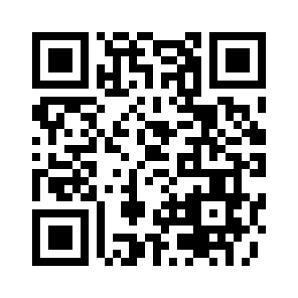

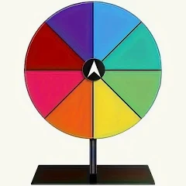
SUBJECT
GRADE
UNIT
LESSON
Knowing each other!
02:00 minutes
Warm-Up
https://wordwall.net/play/86770/102/364

Slide 4
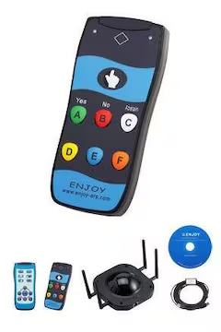
SUBJECT
GRADE
UNIT
LESSON
03:00 minutes
PRE-ASSESSMENT
1- Which relative pronoun is used for things or animals?
1) who 2) which 3) which
2- Choose the correct relative pronoun to complete the sentence:
The girl ______ book was lost is looking for it.
1) whose 2) which 3) that
IRS

Slide 5
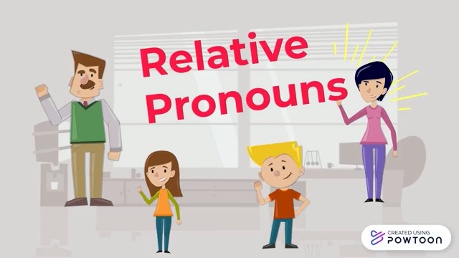
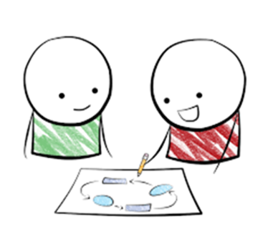
SUBJECT
GRADE
UNIT
LESSON
PRESENTATION
07:00 minutes
Take notes
while
watching☺

Slide 6
SUBJECT
GRADE
UNIT
LESSON
PRESENTATION
07:00 minutes
What are Relative Pronouns?
Relative pronouns are words that help connect a sentence by giving more information about a person, place, or thing. Some common relative pronouns are:
who → for people (e.g., The boy who is running is my friend.)
whom → for people (used less often) (e.g., The teacher whom we respect is kind.)
which → for animals and things (e.g., The book which I read was amazing.)
that → for people, animals, or things (e.g., The cake that she made was delicious.)
whose → shows possession (e.g., The girl whose dog is lost is sad.)
where → for places (e.g., This is the park where we play.)

Slide 7
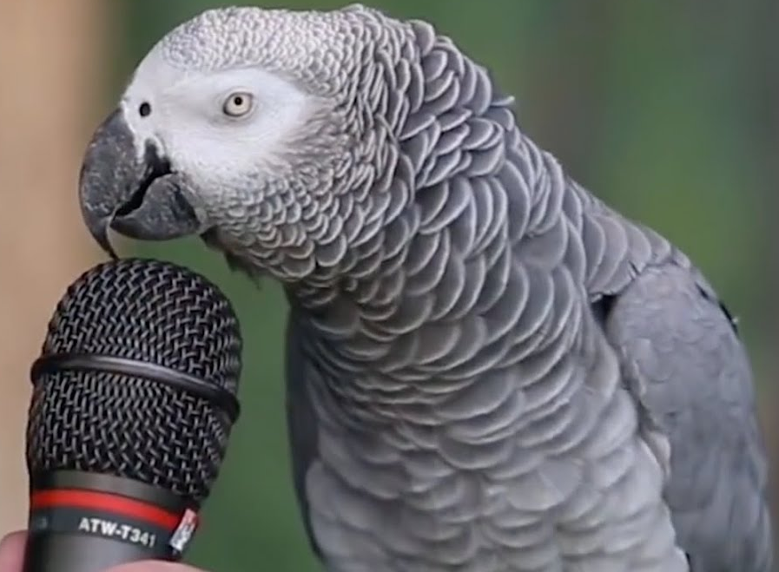


SUBJECT
GRADE
UNIT
LESSON
01:00 minutes
Critical Thinking
"Imagine you are writing a story about a magical island. You want to describe a talking parrot that helps lost travelers. Which relative pronoun would you use to describe the parrot, and why? Would you choose 'who' or 'which'? Explain your choice."

Slide 8

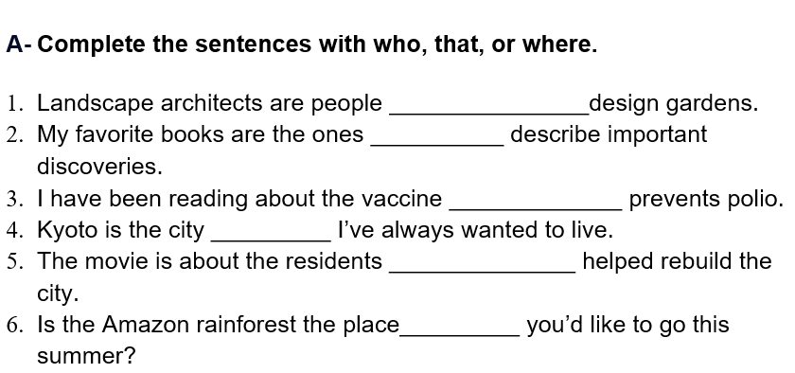

SUBJECT
GRADE
UNIT
LESSON
05:00 minutes
Formative Assessment
In 4 minutes:
Open your booklet.
Fill in the blanks with the suitable pronouns.
1
2
3
4

Slide 9

SUBJECT
GRADE
UNIT
LESSON
01:00 minutes
REAL LIFE APPLICATION
Give us an information about your favorite teacher/friend using some relative pronouns.

Slide 10

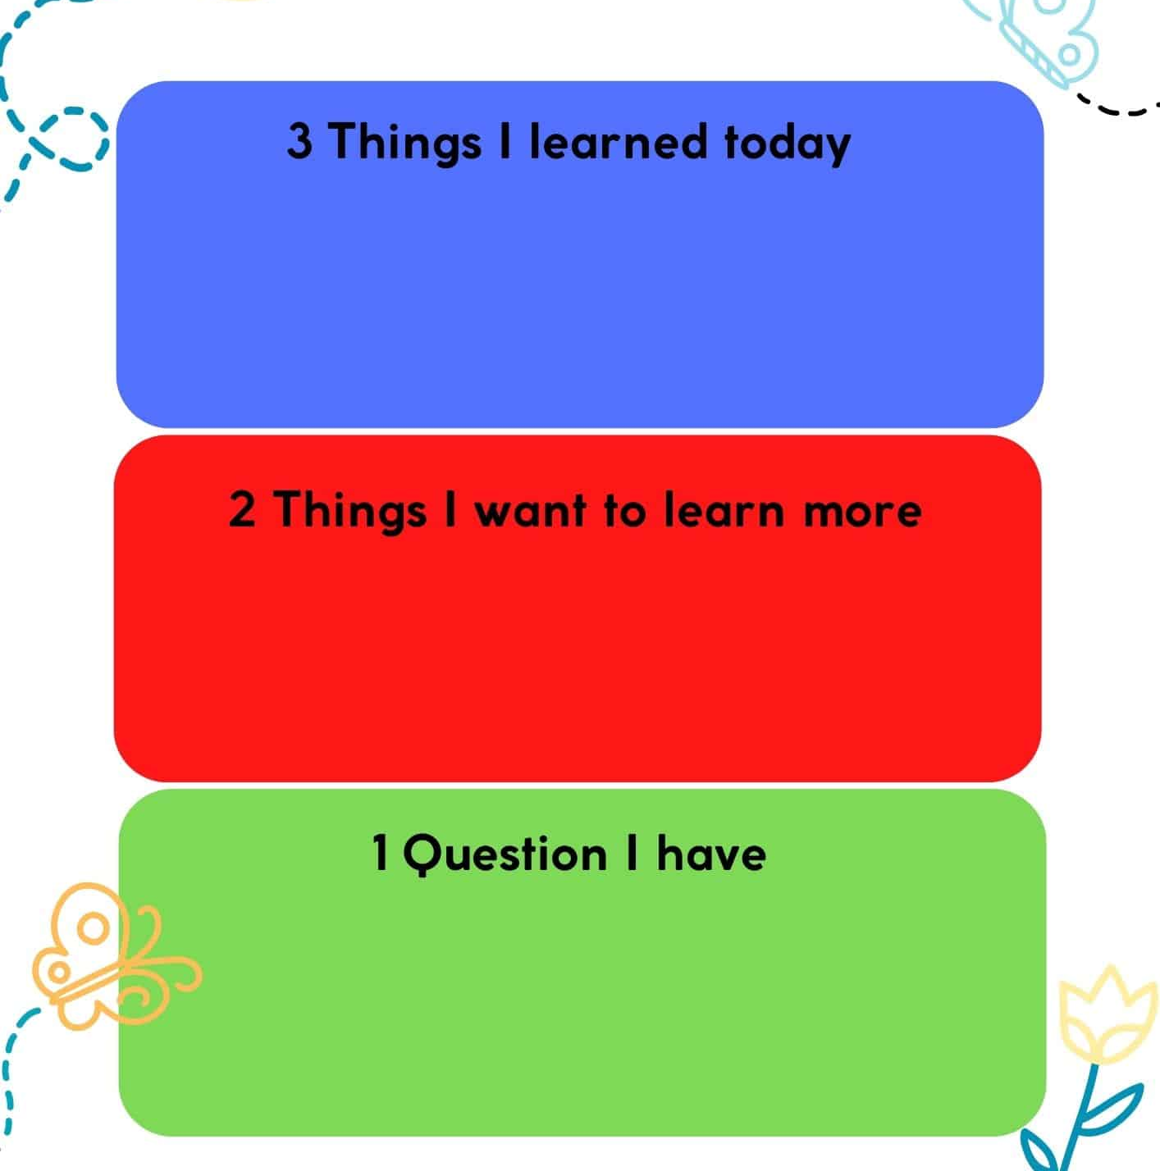
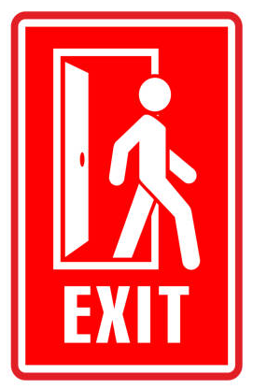
SUBJECT
GR ADE
UNIT
LESSON
OUTCOMES
Summative Assessment
01:00 minutes
WARM UP
PREASSESSMENT
PRESENTATION
FORMATIVE ASSESSMENT
FEEDBACK
DIFFERENTIATION
REAL LIFE APPLICATION
CRITICAL THINKING
EXIT TICKET

Slide 11
SUBJECT
GRADE
UNIT
LESSON
01:00 minutes
Objective
Recognize the difference between defining and non-defining relative clauses.

Slide 12
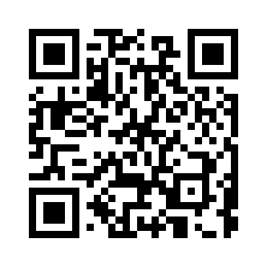


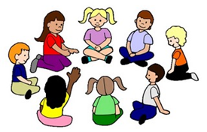
SUBJECT
GRADE
UNIT
LESSON
02:00 minutes
PRE-ASSESSMENT
Speaking Cards!
https://wordwall.net/play/86770/761/501

Slide 13
SUBJECT
GRADE
UNIT
LESSON
02:00 minutes
PRE-ASSESSMENT
IRS
1- Which sentence is wrong?
1- Frida Kahlo was the artist where painted many self-portraits.
2- Frida Kahlo was the artist who painted many self-portraits.
2- Which of the words below IS NOT a relative pronoun?
1- who
2- they

Slide 14


SUBJECT
GRADE
UNIT
LESSON
PRESENTATION
04:00 minutes
What are Relative Pronouns?
Relative pronouns are words that help connect a sentence by giving more information about a person, place, or thing. Some common relative pronouns are:
who → for people (e.g., The boy who is running is my friend.)
whom → for people (used less often) (e.g., The teacher whom we respect is kind.)
which → for animals and things (e.g., The book which I read was amazing.)
that → for people, animals, or things (e.g., The cake that she made was delicious.)
whose → shows possession (e.g., The girl whose dog is lost is sad.)
where → for places (e.g., This is the park where we play.)

Slide 15
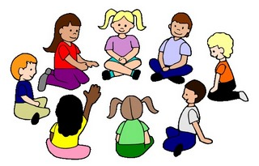
SUBJECT
GRADE
UNIT
LESSON
PRESENTATION
04:00 minutes
- describe a noun
- begin with a relative pronoun
(who – that – where)
- restrictive adjectival clauses
are essential to the meaning
and DO NOT require commas.
adjectival clauses
The book that I borrowed from the library is very
interesting.
("that I borrowed from the library" specifies which book.)
2. Students who study hard usually get good grades.
("who study hard" tells us which students.)
3.The car that has a flat tire belongs to my neighbor.
("that has a flat tire" identifies which car.)

Slide 16
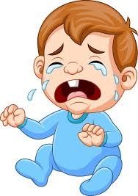
SUBJECT
GRADE
UNIT
LESSON
02:00 minutes
Critical Thinking
Think then add an adjectival clause to the sentence below.
I saw a baby.
I saw a baby ……………

Slide 17
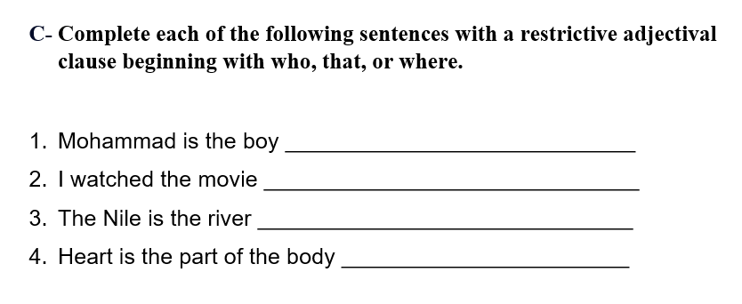
SUBJECT
GRADE
UNIT
LESSON
03:00 minutes
Formative Assessment

Slide 18

SUBJECT
GRADE
UNIT
LESSON
02:00 minutes
REAL LIFE APPLICATION
Mia took on the responsibility of protecting the heart of her village. This can be tied to leadership roles in real life, where individuals step up to protect their communities, the environment, or important values.
What responsibilities can young people take on
to make a difference in their community?
Think then give us
a sentence that has an adjectival clause.

Slide 19
ISLAMIC EDUCATIONAL COLLEGE DATE:
SUBJECT
GR ADE
UNIT
LESSON
OUTCOMES
Summative Assessment
01:00 minutes
WARM UP
PREASSESSMENT
PRESENTATION
FORMATIVE ASSESSMENT
FEEDBACK
DIFFERENTIATION
REAL LIFE APPLICATION
CRITICAL THINKING
EXIT TICKET

Slide 20


SUBJECT
GRADE
UNIT
LESSON
01:00 minutes
HOMEWORK

