Slide 1

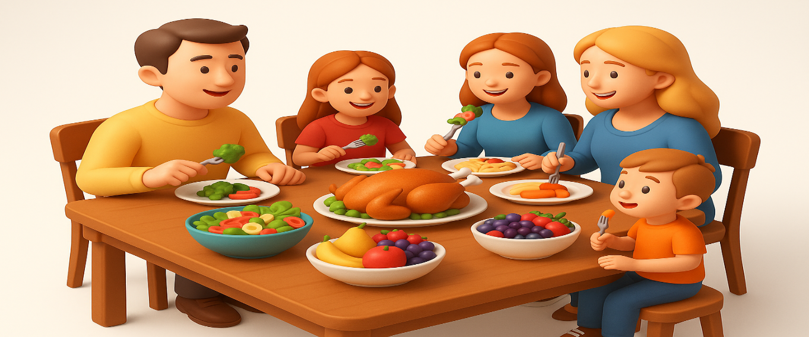
OBJECTIVES
WARM UP
Unit: Three
Lesson: Reading Comprehension
“CAN YOU EAT YOURSELF HAPPY”
Subject: Let’s eat
Grade: 10
PREASSESSMENT
PRESENTATION
FORMATIVE ASSESSMENT
FEEDBACK
DIFFERENTIATION
REAL LIFE APPLICATION
CRITICAL THINKING
EXIT TICKET

Slide 2


ISLAMIC EDUCATIONAL COLLEGE DATE:
SUBJECT Let’s eat
GRADE 10
UNIT 3
LESSON
Objectives
Identify key information and details in the article.
Understand how food affects physical and emotional health.
Practice reading strategies: skimming, scanning, and inference.

Slide 3
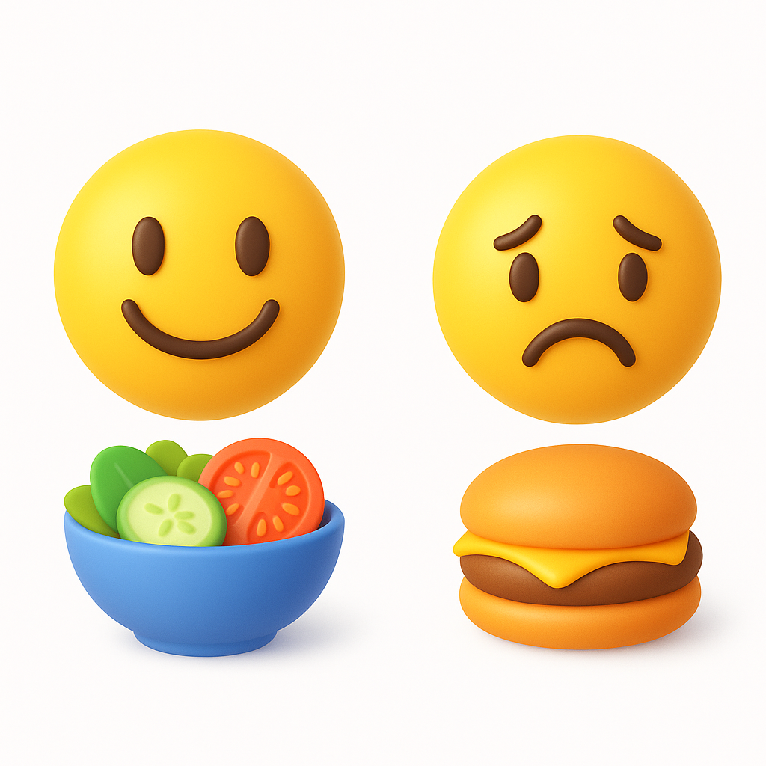
ISLAMIC EDUCATIONAL COLLEGE DATE:
SUBJECT
GRADE
UNIT
LESSON
WARM UP
03:00 minutes
(Think–Pair–Share)
Question: Do you think the food we eat can influence our mood? How?
Instructions: Students think individually, then share with a partner, then share with class.

Slide 4
ISLAMIC EDUCATIONAL COLLEGE DATE:
SUBJECT
GRADE
UNIT
LESSON
preassessment
02:00 minutes
What’s the difference between fruit and vegetable?
Which food group does garlic belong to?
What is a “knob of butter”?
Buzz In

Slide 5
Word formation
The General Rule
Many adjectives ending in -al describe a quality or characteristic of something.
To find the noun form, we often remove the *-al* suffix.
The Pattern:
Noun + al → Adjective
Example: Logic (noun) + al = Logical (adjective)
Therefore, to go backwards:
Logical (adjective) - al = Logic (noun)

Slide 6
Watch Out for Exceptions & Spelling!
The rule is great, but English always has a few twists! Pay close attention to spelling changes.
Psychological → Psychology
The ending changes from -ical to -y. This is a common change for many words (e.g., biology, geology).
Essential → Essence
The -tial ending changes to -nce. the spelling is different.
Key Takeaway: Always double-check the spelling of the root word when you remove the suffix.

Slide 7
Let's Practice! Choose the Correct Word.
Select the correct word (the Adjective or the Noun) to complete each sentence.
Her work was so ________ (influence / influential) that it changed the entire field.
He couldn't hide his ________ (emotion / emotional) when he won the award.
The theme of love is ________ (universal / universe) in storytelling across all cultures.
The ________ (essence / essential) of good communication is clarity.
Firefighting is a dangerous ________ (occupation / occupational).
Oxygen is a basic ________ (element / elemental) necessary for life.
t's important to read the label to understand the (nutrition / nutritional) value of your food.
She decided to major in ________ (psychology / psychological) to understand the human mind better.

Slide 8
Feedback
Select the correct word (the Adjective or the Noun) to complete each sentence.
1. Her work was so **influential** (adjective) that it changed the entire field.
2. He couldn't hide his **emotion** (noun) when he won the award.
3. The theme of love is **universal** (adjective) in storytelling across all cultures.
4. The **essence** (noun) of good communication is clarity.
5. Firefighting is a dangerous **occupation** (noun).
6. Oxygen is a basic **element** (noun) necessary for life.
7. It's important to read the label to understand the nutritional (adjective) value of your food.
8. She decided to major in **psychology** (noun) to understand the human mind better.

Slide 9
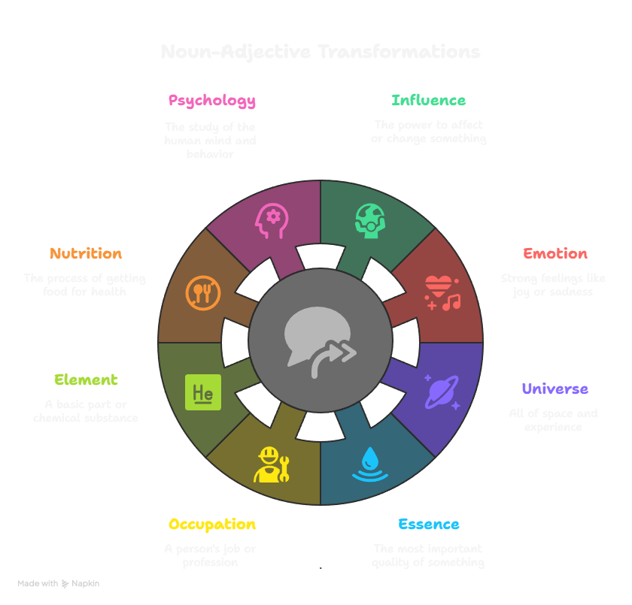

Slide 10
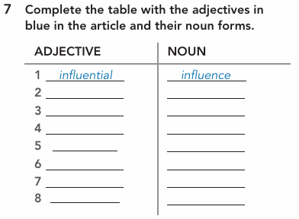

ISLAMIC EDUCATIONAL COLLEGE DATE:
SUBJECT
GRADE
UNIT
LESSON
PRESENTATION
03:00 minutes

Slide 11
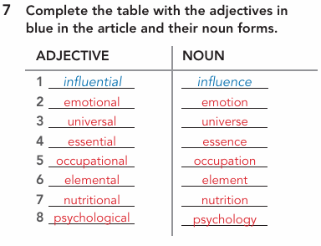

ISLAMIC EDUCATIONAL COLLEGE DATE:
SUBJECT
GRADE
UNIT
LESSON
PRESENTATION
02:00 minutes

Slide 12
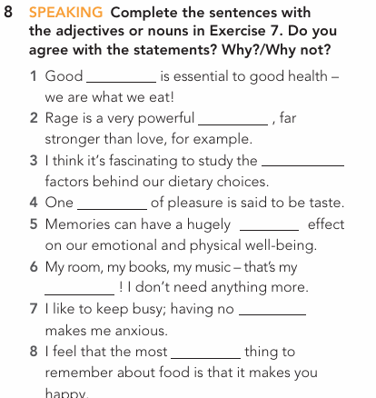
ISLAMIC EDUCATIONAL COLLEGE DATE:
SUBJECT
GRADE
UNIT
LESSON
PRESENTATION
03:00 minutes

Slide 13
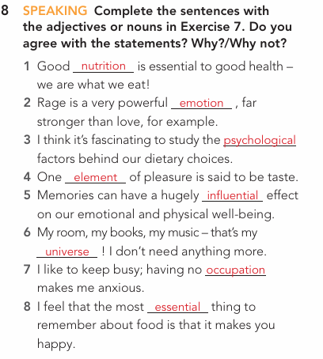

ISLAMIC EDUCATIONAL COLLEGE DATE:
SUBJECT
GRADE
UNIT
LESSON
PRESENTATION
02:00 minutes

Slide 14

Think–Pair–Share

Slide 15
ISLAMIC EDUCATIONAL COLLEGE DATE:
SUBJECT
GRADE
UNIT
LESSON
PRESENTATION
02:00 minutes
(Skimming Q):
Q: What is the main idea of Paragraph 1?

Slide 16

ISLAMIC EDUCATIONAL COLLEGE DATE:
SUBJECT
GRADE
UNIT
LESSON
05:00 minutes
PRESENTATION
1. It seems that food is an unavoidable topic of conversation these days. Whether you’re browsing online, flicking through a magazine, zoning out in front of the TV or chatting away to friends, someone will almost certainly be discussing food in one form or another. Favorite talking points include whether we are over- or underweight because of the type of food we eat; whether we eat too much junk and processed food; whether we ought to eat meat or not; and exactly which superfood or diet is going to save our lives and give us the body we want. These are all burning questions for those of us fortunate enough to be able to choose what we eat, and while diet-related issues are undoubtedly serious and potentially life-threatening, the effects of eating are not only physical. Recent research has been looking at how food affects our moods as well as our bodies.
(While Reading):
Q1: What diet-related issues are mentioned?
Q2: What do recent studies explore about food?
Buzz In

Slide 17
Term | Meaning
unavoidable | Impossible to avoid or escape.
flicking through | To look quickly at the pages of a magazine, book, or website.
zoning out | To stop paying attention and just stare without thinking.
chatting away | To talk in a friendly, casual manner for a period of time.
talking points | Subjects or topics that people discuss or argue about.
processed food | Food that has been changed from its natural state.
superfood | A food believed to be very good for your health.
burning questions | Very important and urgent questions.
diet-related issues | Health problems caused by the food a person consumes.
undoubtedly | Without a doubt; certainly.
potentially life-threatening | Could possibly cause death.
moods | A person's emotional state.

Slide 18
What role does the food we eat play in affecting both our physical health and our moods?

Slide 19

1. Food affects not only our bodies but also our moods; Physically, we become over- or underweight, and emotionally, it produces hormones.

Slide 20
ISLAMIC EDUCATIONAL COLLEGE DATE:
SUBJECT
GRADE
UNIT
LESSON
PRESENTATION
02:00 minutes
(Skimming Q):
Q: What is the main idea of Paragraph 2?

Slide 21
ISLAMIC EDUCATIONAL COLLEGE DATE:
SUBJECT
GRADE
UNIT
LESSON
06:00 minutes
PRESENTATION
2. First and foremost, flavour is a powerful conductor of memories and emotions. Strawberries may evoke a very special summer, a birthday cake may conjure a childlike wonder. In Proust’s Remembrance of Things Past, for example, the narrator depicts the ‘powerful joy’ that a tea-soaked madeleine awakes in him. When he is ‘dispirited after a dreary day, with the prospect of a depressing morrow’. It isn’t so much that the sweet cake tastes lovely, but that it transports him to his innocent youth, when his aunt in the country would feed him the very same treat on Sunday mornings. But the single most influential sense in flavour appreciation is the sense of smell. Unlike the other senses, smell is processed in a part of the brain that deals with strong emotional responses and memory. A particular smell can trigger both a memory of the time we first experienced it and a repetition of the feelings we had then. So for each of us, particular memories and feelings become associated with certain smells. These are just some of the many ways in which food can make us happy.
(While Reading):
Q1: How can taste and smell trigger emotions?
Q2: What example does Proust give?
Buzz In

Slide 22

2. In what ways does this statement ‘flavor can be a powerful conductor of memories and emotions’ deepen our understanding of the connection between sensory experiences and human memory? Provide examples to support your explanation.
3. “Smell is considered to be the most influential sense in flavor appreciation” Justify this statement using evidence from daily life or research.

Slide 23
2. The text states that “flavour is a powerful conductor of memories and emotions.” For example, strawberries may remind someone of “a very special summer,” and a birthday cake may “conjure a childlike wonder.” Proust’s madeleine shows how a taste can “transport him to his innocent youth.”
3. The passage says that “the single most influential sense in flavour appreciation is the sense of smell,” because it is processed in the brain area that deals with “strong emotional responses and memory.” A particular smell can trigger both a memory and “a repetition of the feelings we had then.”

Slide 24
foremost | adverb | most importantly; first.
conductor | noun | Something that transmits or carries something else. Here, it means a trigger or carrier of memories.
evoke | verb | To bring a memory, feeling, or image into your mind.
conjure | verb | To make something appear or seem to appear, as if by magic.
depicts | verb | Shows or describes something in a picture or story.
dispirited | adjective | Feeling sad, discouraged, and having lost hope.
dreary | adjective | Dull, boring, and depressing; causing sadness.
prospect | noun | The possibility or likelihood that something will happen.
morrow | noun | (Old-fashioned word) The next day; tomorrow.
transport | verb | To cause someone to imagine they are in a different place or time.
influential | adjective | Having a lot of power to change or affect something or someone.
appreciation | noun | The recognition and enjoyment of the good qualities of something.
trigger | verb | To cause something to start or happen.
associated | verb | Connected in your mind.

Slide 25
ISLAMIC EDUCATIONAL COLLEGE DATE:
SUBJECT
GRADE
UNIT
LESSON
PRESENTATION
02:00 minutes
(Skimming Q):
Q: What is the main idea of Paragraph 3?

Slide 26
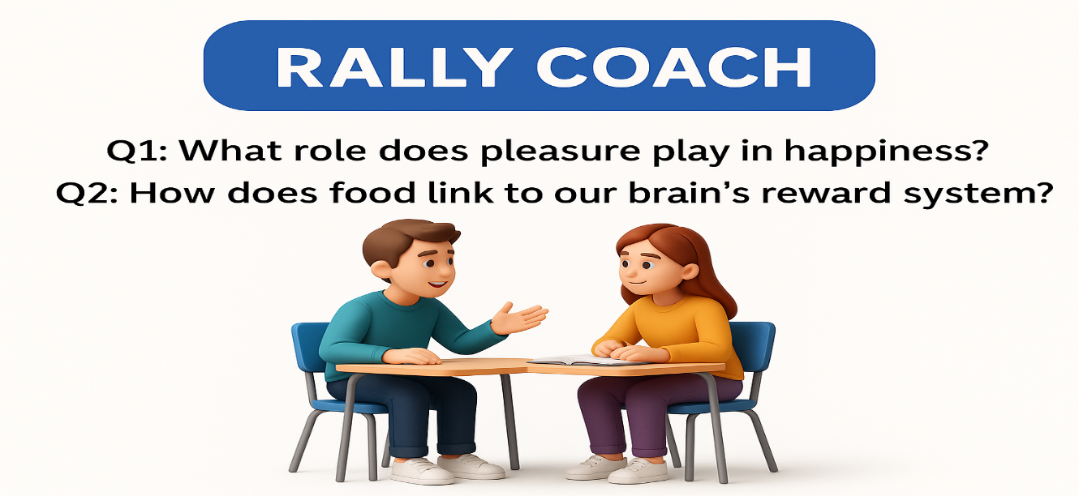
ISLAMIC EDUCATIONAL COLLEGE DATE:
SUBJECT
GRADE
UNIT
LESSON
08:00 minutes
PRESENTATION
3. Of course, it does help if these foods are toothsome, delectable or in other words delicious. ‘Tasty food is one of the most universal routes to pleasure,’ reads an academic paper by the Oxford psychiatrist Morten Kringelbach on our understanding, so far, of the neuroscience of happiness. This is why eating forms the basis of much scientific experimentation into the mechanics behind that elusive, warm, fuzzy sense of well-being. Pleasure is widely viewed as an essential component of happiness. Food excites the reward system in the brain, stimulating desire and anticipation, and when we eat something we enjoy, it releases hormones which produce the sensation of pleasure.
Work with your partner.
Partner A reads the question aloud and answers it.
Partner B listens carefully, checks, and coaches (helps if needed).
Switch roles: Partner B answers the next question, and Partner A coaches.
Continue until both partners have answered both questions.

Slide 27
toothsome | adjective | (Formal) Delicious and pleasing to eat.
delectable | adjective | Extremely tasty and enjoyable.
universal | adjective | Done, experienced, or understood by everyone.
routes | noun | Ways or paths to achieve something.
psychiatrist | noun | A medical doctor who specializes in treating mental health conditions.
neuroscience | noun | The scientific study of the brain and nervous system.
elusive | adjective | Difficult to find, catch, describe, or achieve.
well-being | noun | The state of being comfortable, healthy, or happy.
essential component | phrase | A necessary and basic part that something must have.
reward system | phrase | A network in the brain that makes you feel pleasure to encourage certain behaviors.
stimulating | verb | Encouraging or triggering activity or a response.
anticipation | noun | The feeling of excitement about something that is going to happen.
hormones | noun | Chemical messengers in the body that control many functions, including mood.
sensation | noun | A physical feeling or experience.

Slide 28
4. There are some ways in which food can make us happy. Explain referring to the passage?
5. “Tasty food is considered one of the most universal routes to pleasure”. In two sentences, comment on the previous sentence providing real-life examples .
6. What does the author mean by "the neuroscience of happiness"?
“Hormones play an important role in the sensation of pleasure when eating” What role do they play?

Slide 29
4. Food can make us happy in many ways: through memories and emotions, by stimulating the reward system in the brain, and by releasing hormones that create pleasure.
5. Tasty food gives pleasure because it excites our senses—like enjoying chocolate after a long day or eating a favorite family dish during celebrations. These experiences create joy and comfort.
6. “The neuroscience of happiness” refers to the scientific study of how the brain creates feelings of pleasure, satisfaction, and happiness, particularly when stimulated by eating.
7. Hormones released during eating stimulate the brain’s reward system, creating sensations of pleasure, desire, and well-being.

Slide 30
ISLAMIC EDUCATIONAL COLLEGE DATE:
SUBJECT
GRADE
UNIT
LESSON
PRESENTATION
02:00 minutes
(Skimming Q):
Q: What is the main idea of Paragraph 4?
Buzz In

Slide 31
ISLAMIC EDUCATIONAL COLLEGE DATE:
05:00 minutes
SUBJECT
GRADE
UNIT
LESSON
PRESENTATION
4. However, such pleasures are fleeting, and overconsumption of tasty but unhealthy foods may interfere with your reward system. You may also feel different. Psychologist Andrew Smith of Cardiff University suspects that our attitudes and beliefs about these foods cause us to feel low after consuming them. In a study he carried out, one group were given crisps and chocolate (foods we tend to consider unhealthy and only to be consumed occasionally as special treats) for their teatime snack over the course of ten days, while another group ate fruit. The results associated chocolate with greater depression, and those who ate chocolate and crisps reported greater cognitive difficulties and fatigue, whereas the fruit group had lower anxiety, depression and distress
(While Reading):
Q1: What did Andrew Smith discover about chocolate?
Q2: What do nutritionists suggest to regulate mood?
Buzz In

Slide 32
8. According to the text, what negative effects can overconsumption of unhealthy foods have on our bodies?
9. In the study mentioned in the text, what were the two groups of participants given as their teatime snacks?
What were the results of the study in terms of the participants' mental well-being?

Slide 33
8. Overconsumption of unhealthy foods can disrupt the brain’s reward system, cause uncontrollable cravings, lead to binges, and increase feelings of guilt, depression, fatigue, and cognitive difficulties.
9. One group was given crisps and chocolate, while the other group ate fruit for their teatime snacks.
10. The chocolate-and-crisps group experienced more depression, fatigue, and cognitive difficulties, while the fruit group had less anxiety, depression, and distress.

Slide 34
fleeting | adjective | Lasting for a very short time; temporary.
overconsumption | noun | The act of having too much of something; eating or drinking more than is needed or good for you.
interfere with | phrasal verb | To disrupt or prevent something from working properly.
attitudes | noun | A person's way of thinking or feeling about something; an opinion.
suspects | verb | Believes something to be true or likely, but without certain proof.
tend to | verb phrase | To usually do a particular thing; to be likely to behave in a certain way.
occasionally | adverb | Sometimes, but not very often; once in a while.
over the course of | phrase | During a period of time; throughout the length of.
depression | noun | (In this context) A state of feeling very sad and without hope.
cognitive difficulties | phrase | Problems with mental processes like thinking, learning, remembering, and concentrating.
fatigue | noun | Extreme tiredness or exhaustion.
anxiety | noun | A feeling of worry, nervousness, or unease.
distress | noun | Extreme sadness, pain, or suffering.

Slide 35
ISLAMIC EDUCATIONAL COLLEGE DATE:
SUBJECT
GRADE
UNIT
LESSON
PRESENTATION
02:00 minutes
(Skimming Q):
Q: What is the main idea of Paragraph 5?

Slide 36
ISLAMIC EDUCATIONAL COLLEGE DATE:
SUBJECT
GRADE
UNIT
LESSON
07:00 minutes
PRESENTATION
5. Alongside pleasure, another contributor to happiness and well-being is a sense of meaningfulness – and this is where cooking, as opposed to eating food, comes in. Cooking is in fact an established occupational therapy for depression. According to Mark Salter, a consultant psychiatrist in Hackney, London, “The preparing, sharing and consuming of food is so precious,” he says, “because it lies slap at the heart of what it means to be human – to love, to relate, to plan, to feed, to enjoy and to share. It isn’t only a pleasure, but a life skill.” It’s elemental, caring for yourself and others. When choosing ingredients, combining flavours and creating a dish, you are imagining the health-giving or pleasurable impact it will have on those who will consume it. Cooking takes the focus away from yourself.
(While Reading ):
  Q1: How is cooking more than just preparing food?
  Q2: What does Mark Salter say about food and meaning?

Slide 37
11. Clarify how cooking differs from simply eating food, and justify why this distinction is important according to the text.
According to Mark Salter, why is the preparing, sharing, and consuming of food so precious? What is your own opinion concerning that?

Slide 38
11. Cooking differs from eating because it involves planning, preparing, and sharing food, which gives a sense of purpose and care for others. This distinction is important because cooking provides meaningfulness and promotes mental well-being
12. According to Mark Salter, preparing, sharing, and consuming food is precious because it represents love, care, planning, and the human ability to connect with others. In my opinion, it is precious because it strengthens family bonds and creates joyful memories.

Slide 39
alongside | preposition | Together with; in addition to.
contributor | noun | Something that helps to cause or provide something.
meaningfulness | noun | The quality of having a purpose or being important.
as opposed to | phrase | In contrast with; rather than.
established | adjective | Recognized and accepted because it has been used for a long time.
occupational therapy | noun | A type of treatment that uses everyday activities to help people with physical or mental health problems.
consultant | noun | A senior expert in a professional field.
precious | adjective | Extremely valuable and important.
slap at the heart of | idiom | Right in the center of; the most important part of.
elemental | adjective | Basic, fundamental, and essential.
caring for | verb phrase | Looking after; providing for the needs of someone or something.
ingredients | noun | The different foods that you use to make a particular meal.
combining | verb | Mixing or putting different things together.
impact | noun | The effect or influence that something has.
takes the focus away | phrase | Stops you from thinking so much about yourself.

Slide 40
ISLAMIC EDUCATIONAL COLLEGE DATE:
SUBJECT
GRADE
UNIT
LESSON
PRESENTATION
02:00 minutes
(Skimming Q):
Q: What is the main idea of Paragraph 6?

Slide 41
ISLAMIC EDUCATIONAL COLLEGE DATE:
07:00 minutes
SUBJECT
GRADE
UNIT
LESSON
PRESENTATION
6. Combine the power of cooking to make us happy with the tendency for home-cooked food to be healthier, and you have a nutritional and psychological jackpot. Apart from being healthy, eating home-prepared food is also followed by more intense, positive emotions and less anxiety than consuming food away from home. If you go one step further and grow some food of your own, then you do even better. What with the established positive health effects of being active rather than sedentary, be outside and working with nature rather than cooped up inside all day, together with the satisfaction of growing food and the deliciousness of freshly harvested produce, the happy-making potential of eating is enormous.
(While Reading ):
Q1: What are two emotional benefits of home cooking?
Q2: How can eating together affect happiness?
Buzz In

Slide 42
tendency | noun | A likelihood to behave or happen in a particular way.
nutritional | adjective | Related to the health value of food.
psychological | adjective | Related to the mind and emotions.
jackpot | noun | (Here) A huge success or winning situation where you get all the benefits at once.
intense | adjective | Very strong or extreme.
sedentary | adjective | Involving a lot of sitting and not much physical activity.
cooped up | adjective (phrase) | Confined or trapped in a small space.
satisfaction | noun | A feeling of pleasure you get from fulfilling a need or desire.
harvested | verb | Gathered a ripe crop from the field.
produce | noun | (Here) Fresh fruits and vegetables.
potential | noun | The possibility for something to happen or develop in the future.
enormous | adjective | Very large in size or amount; huge.

Slide 43
13. How does cooking take the focus away from yourself, according to the text?
What are some positive health effects of being active and working with nature? Support your answer with daily-life incidents from your own experience.

Slide 44
13. Cooking takes the focus away from yourself by shifting attention to how the food will benefit and please those who eat it, rather than focusing on your own problems.
14. Being active and working with nature improves physical health, reduces stress, and creates satisfaction. For example, gardening or playing outdoor sports makes people feel more energetic, relaxed, and proud of their achievements.

Slide 45

ISLAMIC EDUCATIONAL COLLEGE DATE:
SUBJECT
GRADE
UNIT
LESSON
04:00 minutes
FORMATIVE ASSESSMENT
Activity: Match headings to paragraphs (from book p.30 ex.2).
Strategy: Round Table – group members take turns writing answers.

Slide 46
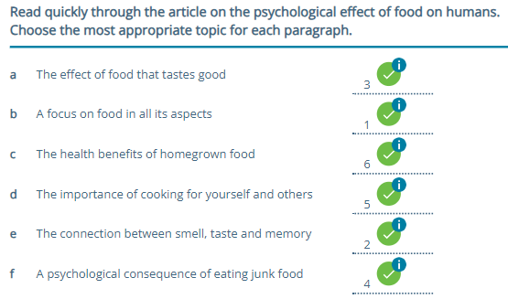
ISLAMIC EDUCATIONAL COLLEGE DATE:
SUBJECT
GRADE
UNIT
LESSON
FEEDBACK
01:00 minutes

Slide 47
ISLAMIC EDUCATIONAL COLLEGE DATE:
SUBJECT
GRADE
UNIT
LESSON
03:00 minutes
DIFFERENTIATION
* Multiple choice (from book ex.3).
** Write a short paragraph( three sentences) on how food affects your mood.

Slide 48
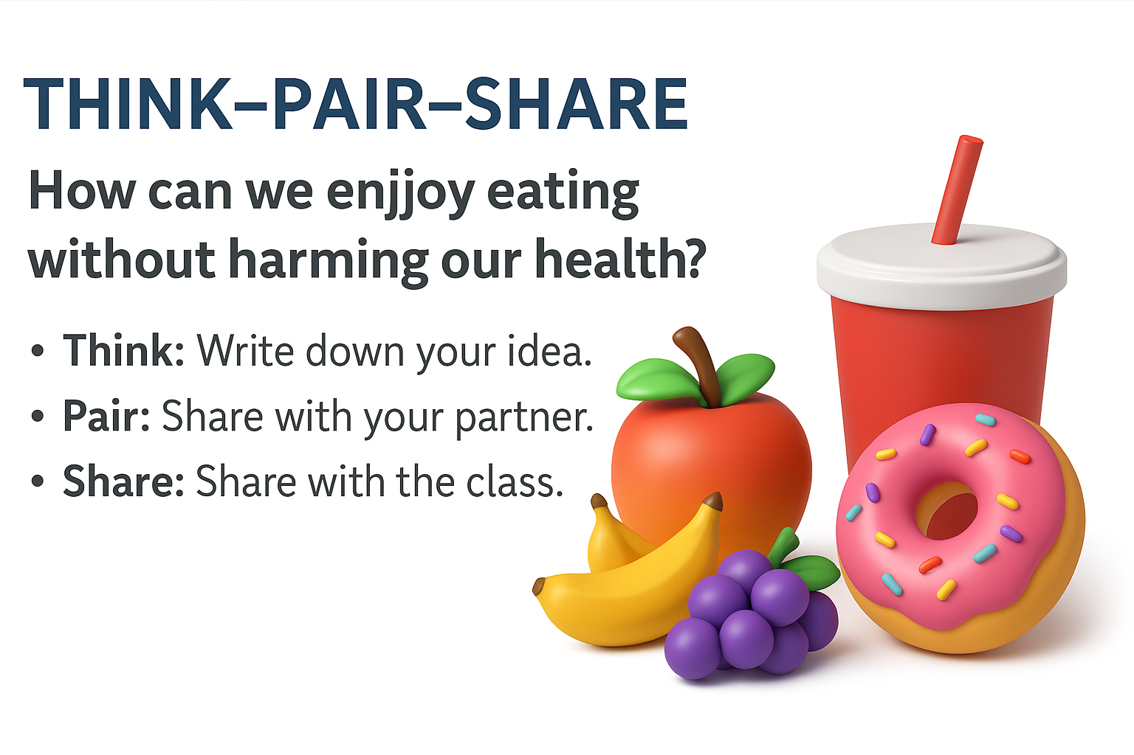
ISLAMIC EDUCATIONAL COLLEGE DATE:
SUBJECT
GRADE
UNIT
LESSON
REAL LIFE APPLICATION
05:00 minutes
Think–Pair–Share

Slide 49
ISLAMIC EDUCATIONAL COLLEGE DATE:
SUBJECT
GRADE
UNIT
LESSON
CRITICAL THINKING
Timed Pair Share
05:00 minutes
1. To what extent do you agree that food preparation and sharing go beyond survival and represent love, culture, and human connection? Defend your view with at least two points, whether it’s for or against.
2. Evaluate the benefits of eating home-prepared food in terms of health, cost, and cultural values, and then compare and contrast that with eating junk or unhealthy food.

Slide 50

I agree a lot with this idea. When someone cooks for you, it shows love and care, not just survival. For example, my mom always cooks special food on holidays, and it makes me feel connected to my family and culture. Also, sharing food with friends or relatives brings people closer and creates memories. So food is not only about eating to live, but also about love and human connection.
Home-prepared food is much healthier because you know the ingredients, and it usually has less fat and sugar. It also costs less since one meal at home can feed many people, while fast food is expensive. Culturally, home cooking keeps traditions alive, like family recipes that are passed down. On the other hand, junk food is fast and tasty but not healthy. The passage says it can even make people feel more depressed or tired. Junk food also doesn’t bring the same cultural or family meaning as eating together at home.

Slide 51
ISLAMIC EDUCATIONAL COLLEGE DATE:
SUBJECT
GRADE
UNIT
LESSON
EXIT TICKET
01:00 minutes
Task: One-minute paper – What new idea did you learn today about food and happiness?
Open your books P. 30. EX: 4,7,8.

