Slide 1

OBJECTIVES
Unit: 3
Lesson: Vocabulary
Subject: Vocabulary-pages ( 28-29)
Grade: 10
WARM UP
PREASSESSMENT
PRESENTATION
FORMATIVE ASSESSMENT
FEEDBACK
DIFFERENTIATION
REAL LIFE APPLICATION
CRITICAL THINKING
EXIT TICKET

Slide 2

ISLAMIC EDUCATIONAL COLLEGE DATE:12/11/2024
SUBJECT Vocabulary
GRADE 10
UNIT 3
LESSON 1
Objectives
01:00 minutes
Students will be able to:
Learn and practice new food-related vocabulary.
Use collocations and adjectives in context.
Apply vocabulary in real-life speaking tasks.
Reflect on their learning.

Slide 3
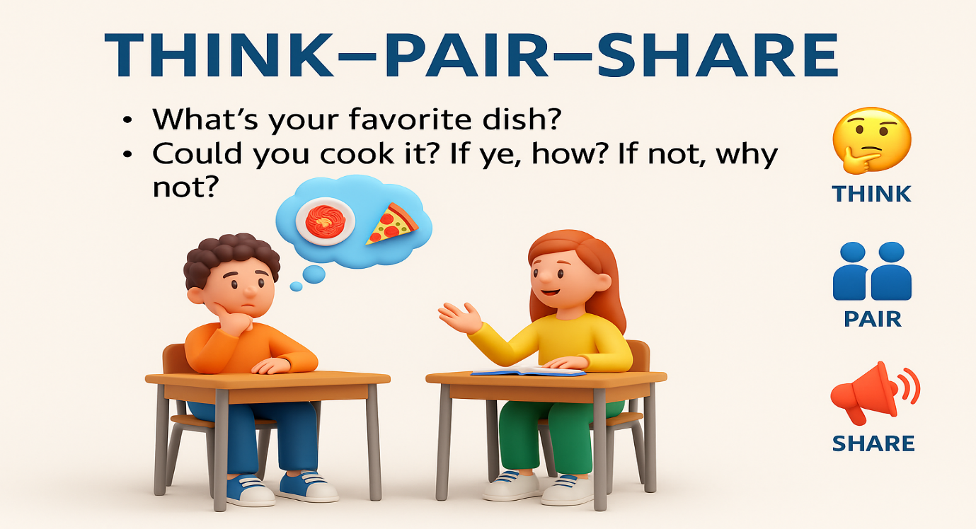

ISLAMIC EDUCATIONAL COLLEGE DATE:12/11/2024
SUBJECT Vocabulary
GRADE 10
UNIT 3
LESSON 1
05:00 minutes
Instructions
Think – Answer the question alone.
Pair – Share your answer with your partner.
Share – Tell your ideas to the class.
WARM UP
Think–Pair–Share
https://wordwall.net/resource/3401493

Slide 4
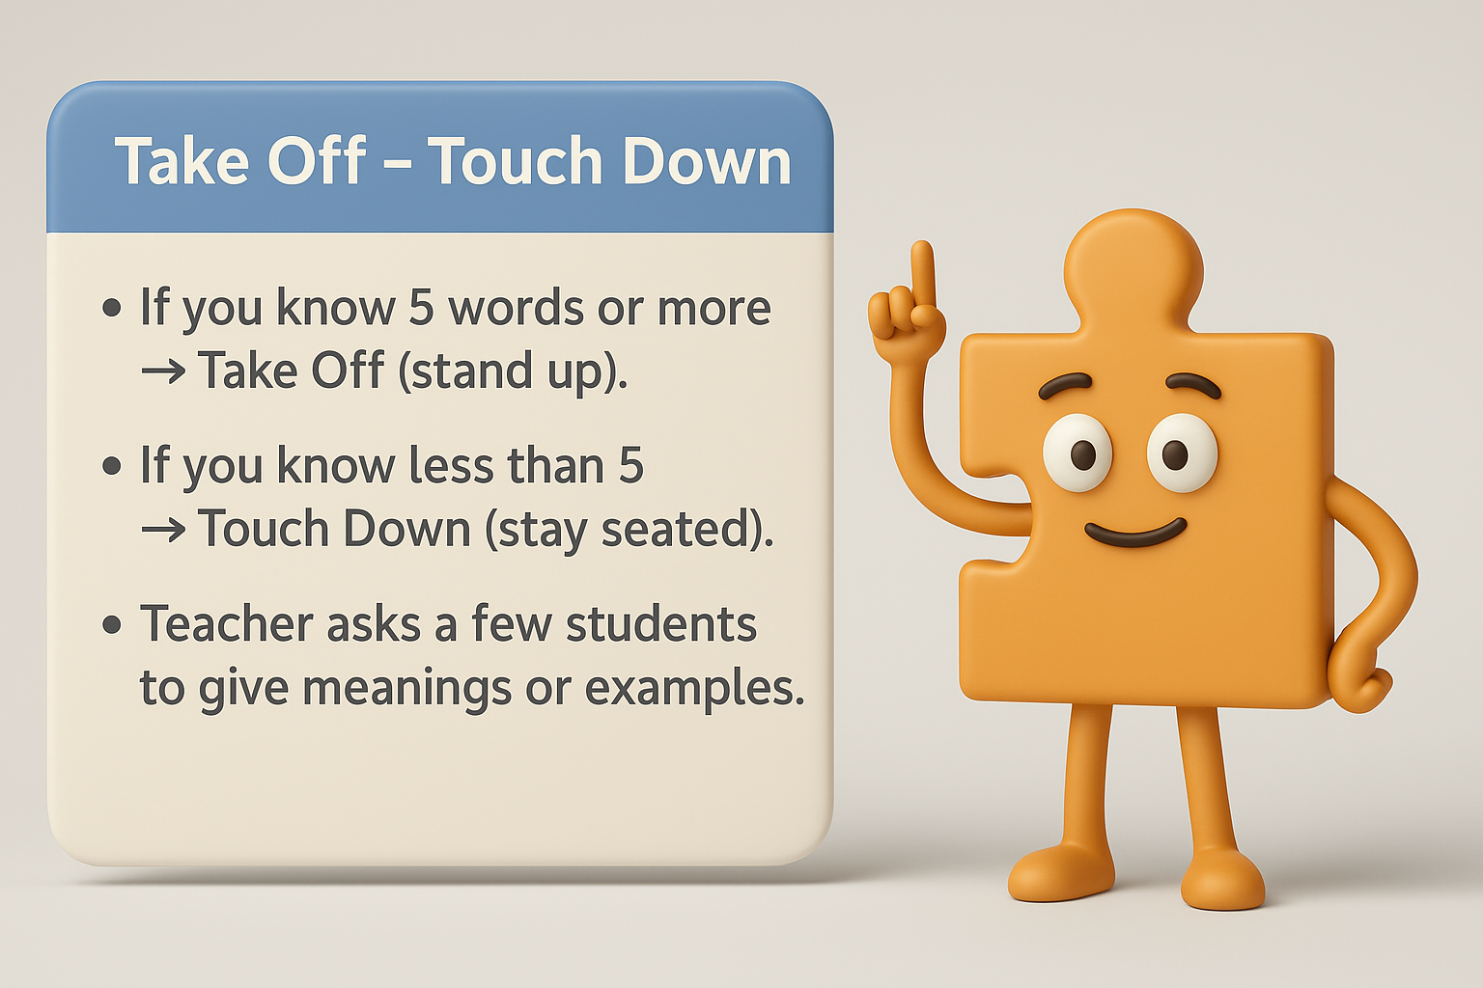
ISLAMIC EDUCATIONAL COLLEGE DATE:12/11/2024
SUBJECT Vocabulary
GRADE 10
UNIT 3
LESSON 1
PREASSESSMENT
05:00 minutes
fruit, vegetable, herb, fish, meat, flavour, taste
sizzling, clinking, buzzing, crunching, bubbling, rattling
fine dining, junk food, home-cooked meal, street food, fast food, soft voice / quiet tone
Soundsnap: https://www.soundsnap.com/search/audio?query=rattling

Slide 5

ISLAMIC EDUCATIONAL COLLEGE DATE:12/11/2024
SUBJECT Vocabulary
GRADE 10
UNIT 3
LESSON 1
Presentation
Student’s Book pages 28
010:00 minutes
Think–Pair–Share for Vocabulary Text
Think (1–2 mins)
Students read the short vocabulary text individually.
They underline / note the main idea of the text (e.g., “it’s about food words.
They quickly guess the meaning of the underlined words/phrases from context.
Pair (3–4 mins)
Students turn to a partner and compare their ideas:
What is the text mainly about?
Do they agree on the meaning of the underlined words?
Share (3–4 mins)
A few pairs share with the whole class.
Teacher confirms meanings, gives pronunciation, or adds examples.
Timing: 8–10 minutes total

Slide 6
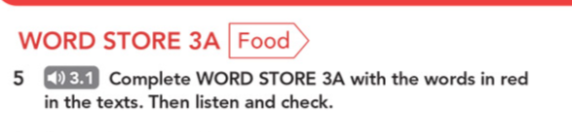
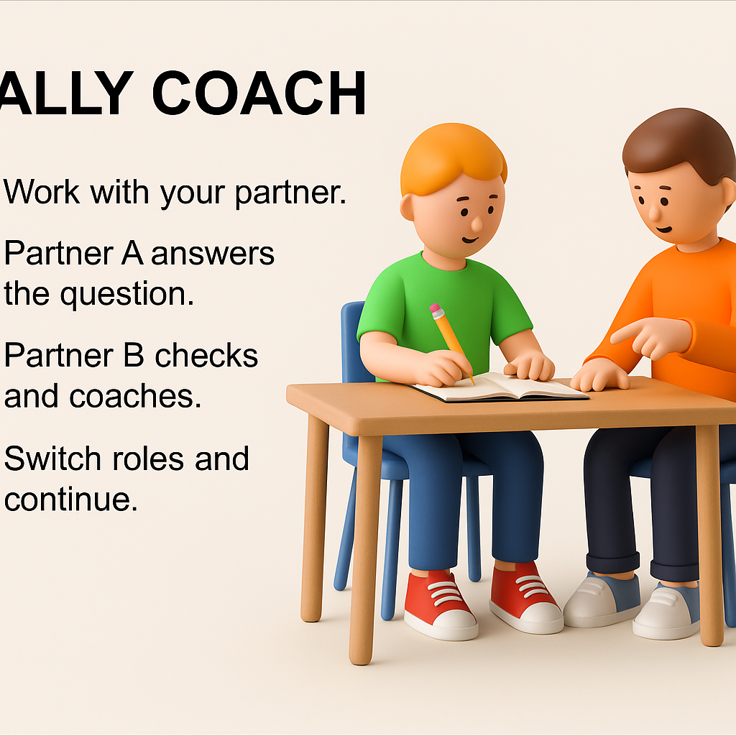
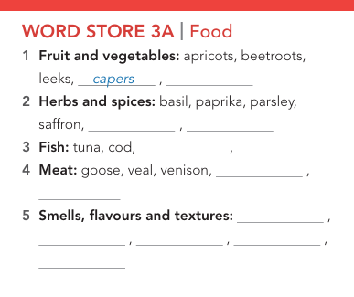
ISLAMIC EDUCATIONAL COLLEGE DATE:12/11/2024
SUBJECT Vocabulary
GRADE 10
UNIT 3
LESSON 1
Presentation
Student’s Book pages 29 Ex.5
06:00 minutes

Slide 7
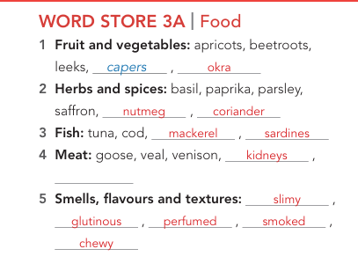
ISLAMIC EDUCATIONAL COLLEGE DATE:12/11/2024
SUBJECT Vocabulary
GRADE10
UNIT3
LESSON1
FEEDBACK
01:00 minutes
Ex5

Slide 8

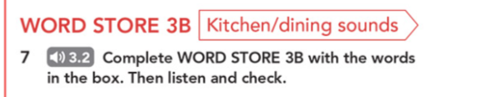
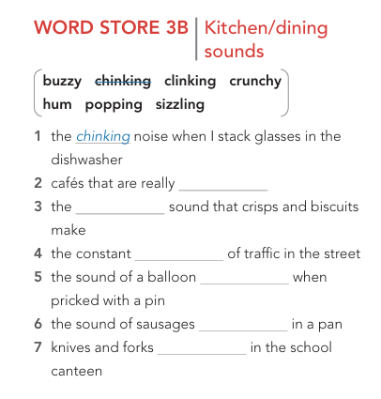
ISLAMIC EDUCATIONAL COLLEGE DATE:13/11/2024
SUBJECT Vocabulary
GRADE 10
UNIT 3
LESSON 1
Presentation
Students Book pages 29 Ex.5
Work individually to complete the exercise then check with your partner (compare answers).
06:00 minutes

Slide 9
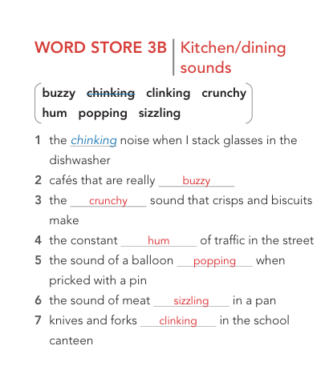
ISLAMIC EDUCATIONAL COLLEGE DATE:13/11/2024
SUBJECT Vocabulary
GRADE10
UNIT3
LESSON1
FEEDBACK
01:00 minutes
Ex 7

Slide 10
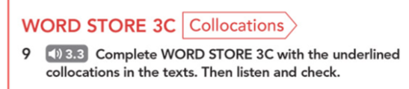
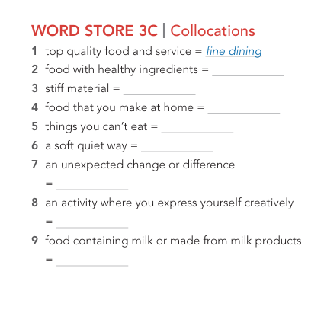
ISLAMIC EDUCATIONAL COLLEGE DATE:14/11/2024
SUBJECT Vocabulary
GRADE 10
UNIT 3
LESSON 1
Presentation
Students Book pages P. 29 Ex.9
Work individually to complete the exercise then check with your partner (compare answers).
06:00 minutes
Buzz In

Slide 11
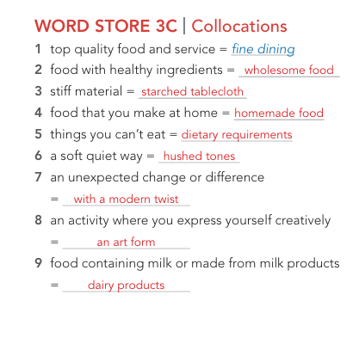
ISLAMIC EDUCATIONAL COLLEGE DATE:14/11/2024
SUBJECT Vocabulary
GRADE10
UNIT3
LESSON1
FEEDBACK
01:00 minutes
Ex9

Slide 12
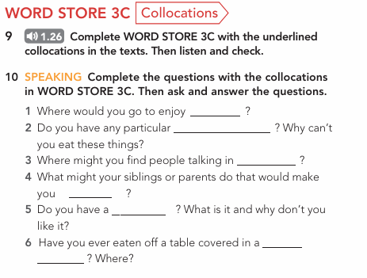
ISLAMIC EDUCATIONAL COLLEGE DATE:14/11/2024
SUBJECT Vocabulary
GRADE 10
UNIT 3
LESSON 1
Presentation
Students Book pages P. 29 Ex.9
Work individually to complete the exercise then check with your partner (compare answers).
06:00 minutes
Buzz In

Slide 13
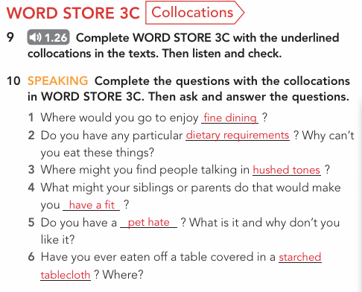
ISLAMIC EDUCATIONAL COLLEGE DATE:14/11/2024
SUBJECT Vocabulary
GRADE 10
UNIT 3
LESSON 1
Feedback
Students Book pages P. 29 Ex.9
Work individually to complete the exercise then check with your partner (compare answers).
06:00 minutes
Buzz In

Slide 14
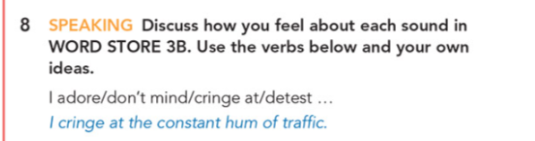
ISLAMIC EDUCATIONAL COLLEGE DATE:13/11/2024
SUBJECT Vocabulary
GRADE 10
UNIT 3
LESSON 1
FORMATIVE ASSESSMENT – Feed back
06:00 minutes
Page 29 Ex. 8
Search the meaning of cringe & detest. Do they express positive or negative feelings?

Slide 15
ISLAMIC EDUCATIONAL COLLEGE DATE: 14/ 11/ 2024 :
SUBJECT: vocabulary
GRADE: 10
UNIT: 3
LESSON: 1
01:00 minutes
“You will watch a short video about food vocabulary. Pay attention to how the words are used in context.”
While watching:
Students note down 3 new words they hear.

Slide 16

ISLAMIC EDUCATIONAL COLLEGE DATE: 14/ 11/ 2024 :
SUBJECT: vocabulary
GRADE: 10
UNIT: 3
LESSON: 1
https://www.youtube.com/watch?v=nh8r9SDmHn4
04:00 minutes

Slide 17
ISLAMIC EDUCATIONAL COLLEGE DATE:12/11/2024 1
SUBJECT Vocabulary
GRADE 10
UNIT 3
LESSON
REAL LIFE APPLICATION
03:00 minutes
Think–Pair–Share
Think – Answer alone.
Pair – Share with your partner.
Share – Tell the group.
Who is your favourite chef ?
Which of his/ her dishes do you like to prepare or to try ?

Slide 18
ISLAMIC EDUCATIONAL COLLEGE DATE: 12/11/2024
SUBJECT Vocabulary
GRADE10
UNIT 3
LESSON
CRITICAL THINKING
05:00 minutes
Timed Pair Share
Partner A speaks (1 min).
Partner B listens.
Switch: Partner B speaks (1 min).
Thank each other & share with class Using Buzz In.
Q: Do you agree that food vocabulary reflects culture? Why/why not?
Buzz In

Slide 19
ISLAMIC EDUCATIONAL COLLEGE DATE: / / 2025
Subject: Vocabulary
Grade: 10
Unit: 2
Lesson: 1
OUTCOMES
Differentiation
03:00 minutes
WARM UP
Students 1+2
Students 3+4
PREASSESSMENT
PRESENTATION
Write a short paragraph using at least five of the new words. Challenge them to incorporate both the vocabulary words and the phrasal verbs.
Write down 3 sentences using the new words
FORMATIVE ASSESSMENT
FEEDBACK
DIFFERENTIATION
REAL LIFE APPLICATION
📌 Share: Each pair presents their product to the class.
CRITICAL THINKING
Criteria | 2 pts (Strong) | 1 pt (Developing)
Engagement | Actively participates & stays on task | Limited participation or off-task
Collaboration | Shares ideas & supports partner | Minimal sharing or uneven work
Communication | Ideas are clear & connected to text | Ideas unclear or weakly linked
EXIT TICKET

Slide 20
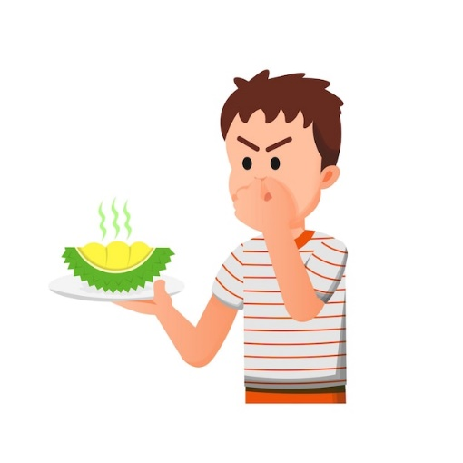
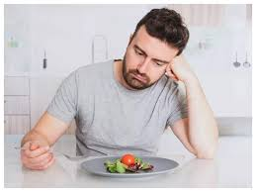
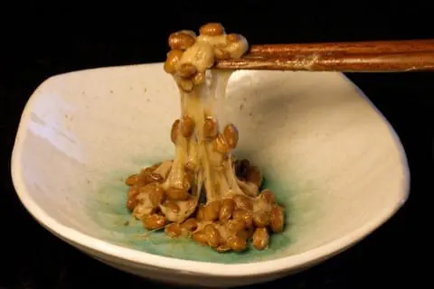
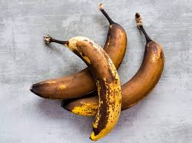
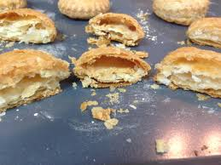
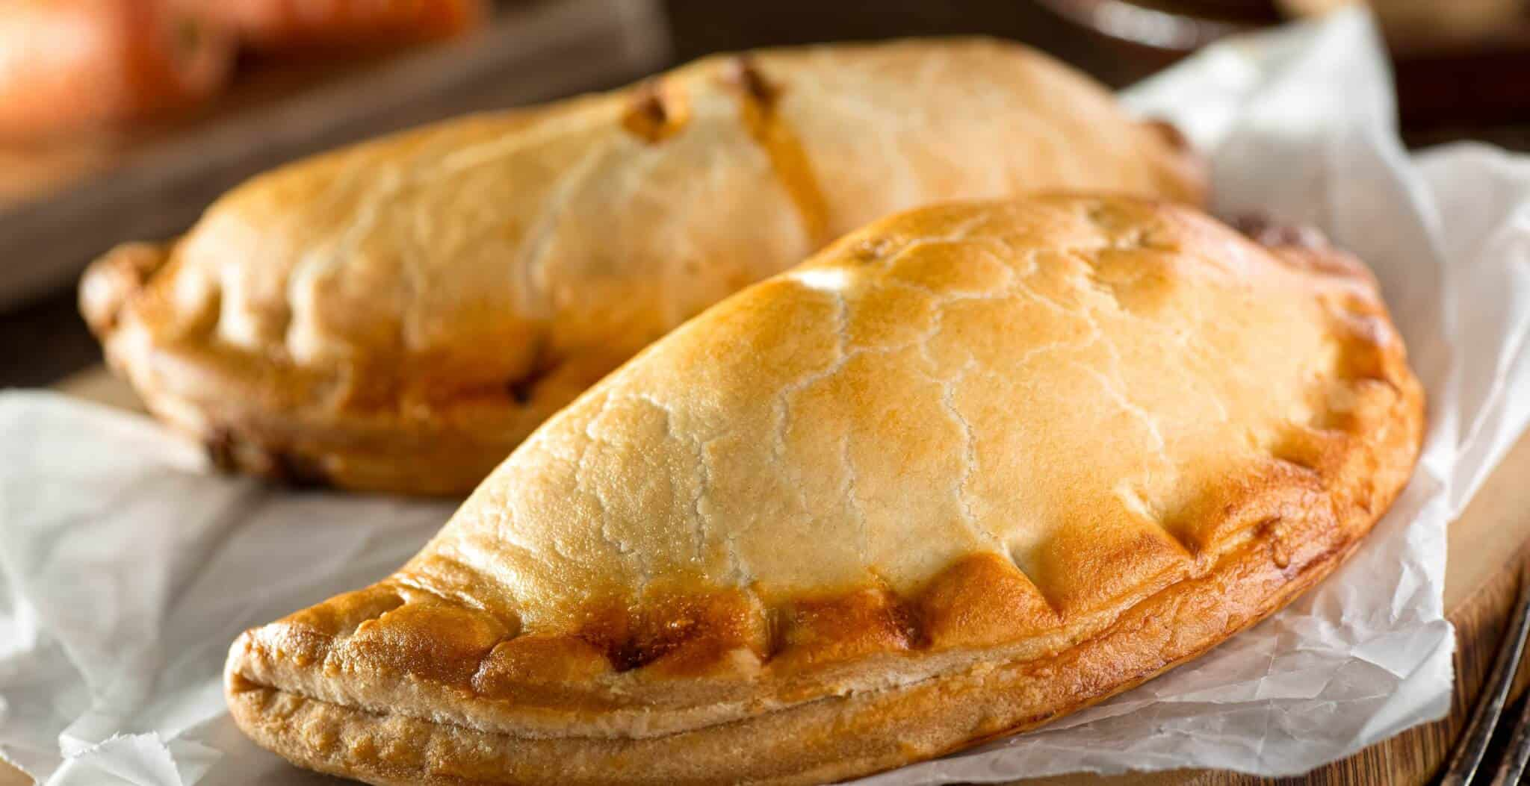
ISLAMIC EDUCATIONAL COLLEGE DATE:12/11/2024
SUBJECT Vocabulary
GRADE 10
UNIT 3
LESSON 1
EXIT TICKET
02:00 minutes
Look at the images on the board .Under each image, write down the correct word from the list.
( bland, pungent , pasty , glutinous, flaky , slimy )

Slide 21

ISLAMIC EDUCATIONAL COLLEGE DATE:12/11/2024
SUBJECT Vocabulary
GRADE 10
UNIT 3
LESSON 1
EXIT TICKET
01:00 minutes
bland
pungent
slimy
pasty
flaky
glutinous

Slide 22

ISLAMIC EDUCATIONAL COLLEGE DATE:12/11/2024
SUBJECT Vocabulary
GRADE 10
UNIT 3
LESSON 1
EXIT TICKET
02:00 minutes

