Slide 1
Pronouns ( I +You)

Slide 2
Intended Outcomes:
01
02
03
Identify the pronouns (I, You) and their be verbs.
Use the pronouns in sentences.
Value: Appreciate the act of not wasting time.

Slide 3
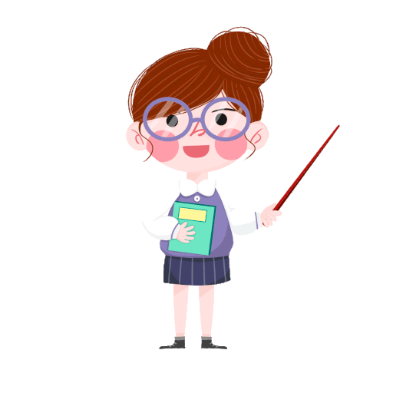
Warm Up:
https://www.youtube.com/watch?v=5v_2658ey3c

Slide 4
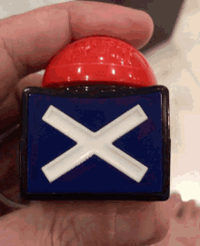
Pre assessment ( IRS):
Which one is the noun ?
1
2
door
yellow

Slide 5
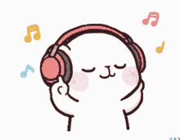
Let’s listen to a song.
https://www.youtube.com/watch?v=IXjfcEmqAHc&list=RDIXjfcEmqAHc&start_radio=1

Slide 6


I
We use the pronoun (I) when we talk about ourselves.
I am noun

Slide 7
I
We use the pronoun (I) when we talk about ourselves.
I am adjective

Slide 8

adjective
I am happy.
Your Turn now to give examples

Slide 9
noun
I am a teacher.
Your Turn now to give examples

Slide 10
You
You are adjective

Slide 11
You
You are noun

Slide 12
noun
You are students.
Your Turn now to give examples

Slide 13
adjective
You are beautiful.
Your Turn now to give examples

Slide 14
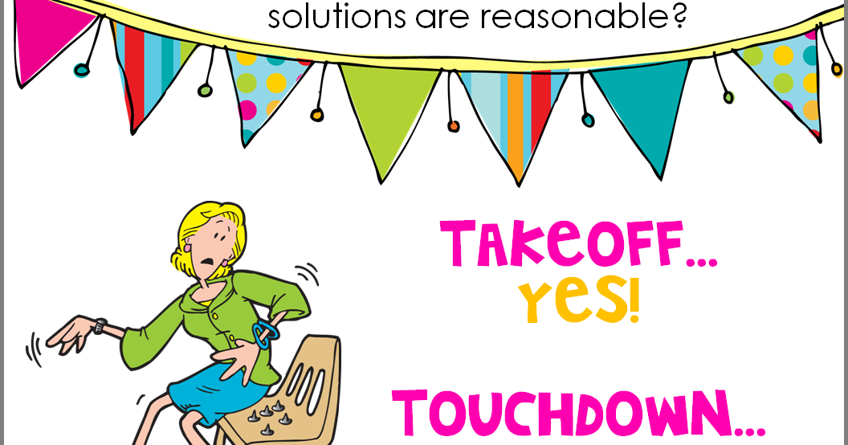
Take off – Touch down
1.you are a boy 2. you are a girl 3. you are 7 years old. 4. you are smart. 5. you love Mlokhey. 6. you love Shawerma. 7. you like to play football

Slide 15

Real life application
Use I am and you are to talk about your self and your friend.

Slide 16
Group work
Unscramble the words to make a sentence

Slide 17
Critical thinking
What be verbs we use with the following pronouns: he/we
Buzz in

Slide 18
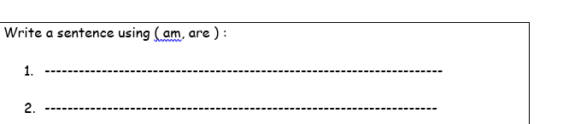
Differentiation 3

Slide 19
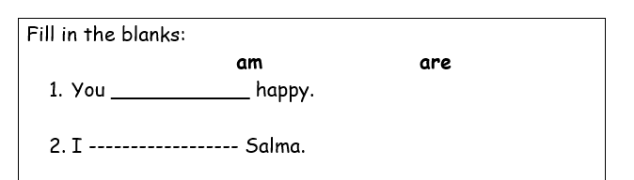
Differentiation 2

Slide 20
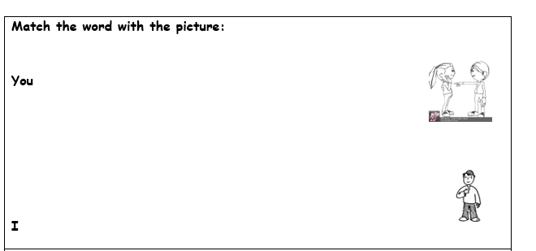
Differentiation 4

Slide 21
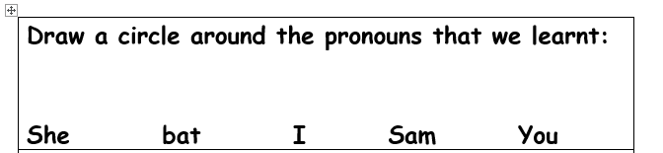
Differentiation 1

Slide 22
Let’s play a game.
https://create.kahoot.it/details/9a8cfe95-4af6-4e88-9778-757d05f9914e

Slide 23
Summative assessment. IRS
I _____ 6 years old.
1 2
am you

Slide 24


Contraction
You are
You’re
I am
I’m

Slide 25

Negative
I
you
am
are
not

Slide 26

Examples
I’m not sad
You’re not hungry.

Slide 27

Questions
Are you hungry? Yes, I am.
Are you mad? No, I’m not.

Slide 28
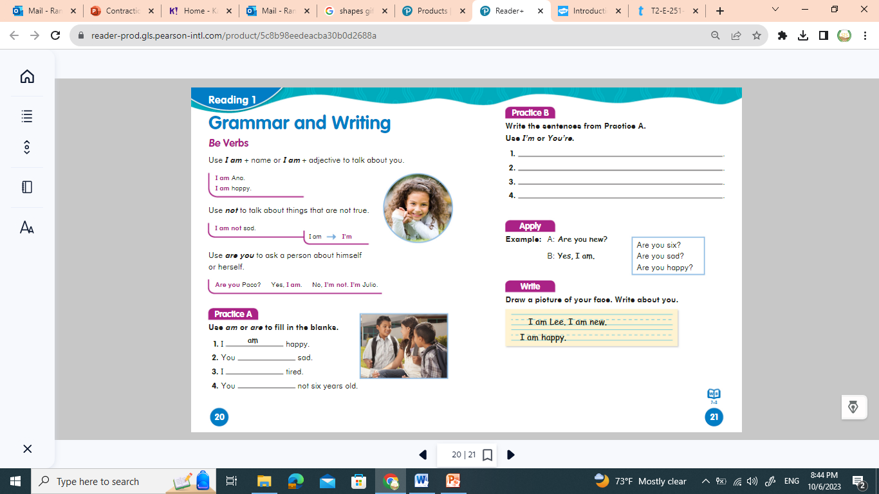
Formative Assessment
are
am
are

Slide 29
Rally Robin
Think of two sentences one about you and one about your friend.
Share your sentences.

Slide 30
Summative Assessment
You am smart.
True
false

Slide 31


