Slide 1


Grade 9
Unit 1: Collocations
physical appearance

Slide 2


Islamic Educational College
English
Unit 1
Grade 9
Lesson’s Objectives
Identify and categorize descriptive words based on different aspects of appearance, such as facial features, hair and body build.

Slide 3
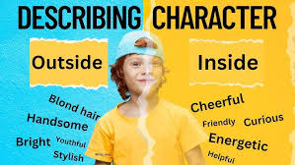

Slide 4

Pre assessment
IRS

Slide 5
1.What is the main purpose of a descriptive essay?
To tell a story
To describe a person, place, or thing in detail.
To argue a point

Slide 6
2.Which of the following is most important in a descriptive essay?
Presenting facts.
Using sensory details (sight, smell, sound, etc.)
Convincing the reader of your opinion.

Slide 7
3.In a descriptive essay, which of these would help the reader imagine the scene better?
Vague language
Dialogue between characters
Detailed descriptions using adjectives and adverbs

Slide 8
4.What should a descriptive essay have in its conclusion?
A new idea that wasn’t mentioned before.
A summary of the descriptions given.
A list of key points.

Slide 9
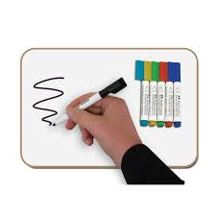
https://www.liveworksheets.com/ny1659372to
Lead

Slide 10

https://www.liveworksheets.com/worksheet/en/english-second-language-esl/1292433
“Work with your partner using one phone. Sort the adjectives that describe appearance into the correct categories (e.g., hair, height, build, face).”

Slide 11
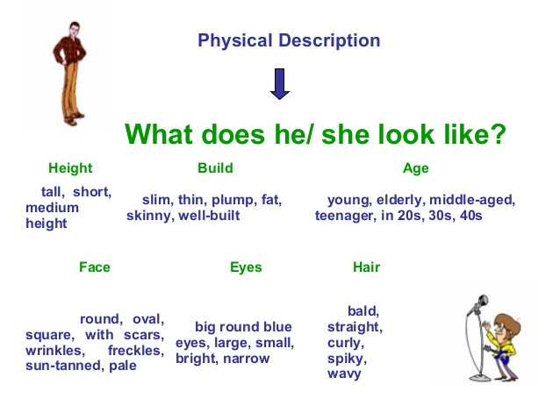

Slide 12
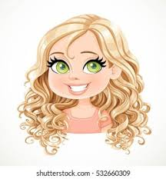
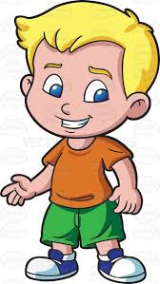
Example: She is a tall, slim young woman with long curly blonde hair, a round face, and blue eyes.
* When describing hair, the order typically follows:
1.Length: long, short, shoulder-length
2. Type: curly, straight, wavy, frizzy
3. Color: blonde, brown, black, red.
Example: She has long curly blonde hair.
* When describing eyes, the order usually follows:
Size: large, small, narrow, wide
Shape: round, almond-shaped, slanted
Color: blue, brown, green, hazel
Example: He has large round blue eyes.

Slide 13
Basic Adjective Order for Appearance
When describing a person, adjectives usually follow this order:
Age → Height → Build/Body/Weight → Hair → Face/Features → Other details
Using your categories:
Age → young, old, middle-aged
Height → tall, short, average height
Weight/Build → slim, chubby, muscular, thin
Hair → long, short, curly, straight, blonde, black
Face/Features → round face, square face, sharp features, freckles

Slide 14
Example Sentences
1. She is a young, tall, slim, beautiful girl with long, curly brown hair and a round face.
2. He is an old, short, muscular, handsome man with short, straight black hair and sharp features.
3. They are middle-aged, average-height, thin, good-looking people with straight blonde hair and friendly faces.

Slide 15
Introduction
✨ Hook: Have you ever met someone whose presence brightens every room they enter? From the way they carry themselves to the kindness they show others, some people leave a lasting impression.
🎯 Thesis statement: In this essay, I will describe my best friend by focusing on her appearance, her personality, and the special qualities that make her unforgettable.

Slide 16
My best friend has a very unique appearance that makes her easy to recognize( topic sentence) . She is of average height and has a slim figure, which gives her an elegant look. Her face is oval-shaped with bright brown eyes that always seem full of energy. She has long, wavy black hair that frames her face beautifully, and she usually ties it in a ponytail when she is busy. Her smile is wide and cheerful, showing her white teeth, and it instantly makes people feel comfortable around her. The way she dresses is simple but stylish, as she prefers casual clothes that reflect her free and easy personality.

Slide 17
Beyond her appearance, what truly makes my best friend special is her personality. She is friendly and considerate, always ready to listen when someone needs to talk. She has a sharp sense of humor that can make even the most serious person laugh, and she knows how to cheer people up when they are feeling down. At the same time, she is hardworking and determined, never giving up when faced with challenges. She treats everyone with respect, whether they are her classmates, teachers, or strangers. Her positive attitude and caring nature make her a person whom others can trust and admire.

Slide 18
In conclusion, my best friend is unforgettable because of her unique appearance and her warm, caring personality. Her bright eyes, cheerful smile, and graceful style make her stand out, while her kindness, determination, and sense of humor make her loved by everyone around her. She is not only beautiful on the outside but also on the inside, which is why she continues to inspire and influence me in so many positive ways.

Slide 19
Is the appearance of a person important ?Why ?Why not?

Slide 20
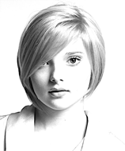
________ face .
Islamic Educational College
English
Unit 1
Grade 9
Round

Slide 21
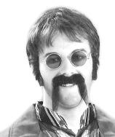
__________ moustache
Droopy

Slide 22
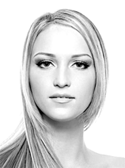
_________face
Oval

Slide 23
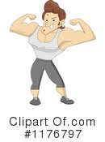
My brother is _________ and handsome .
Well- built

Slide 24
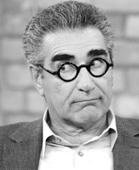
__________eyebrows .
Bushy

Slide 25
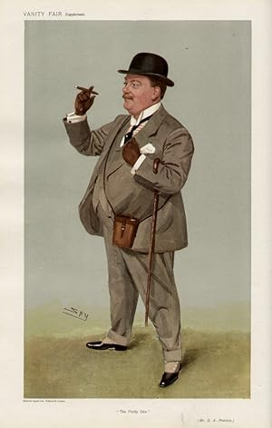
Portly :
having a stout body; somewhat fat (used especially of a man).
"a portly little man with a bowler hat

Slide 26
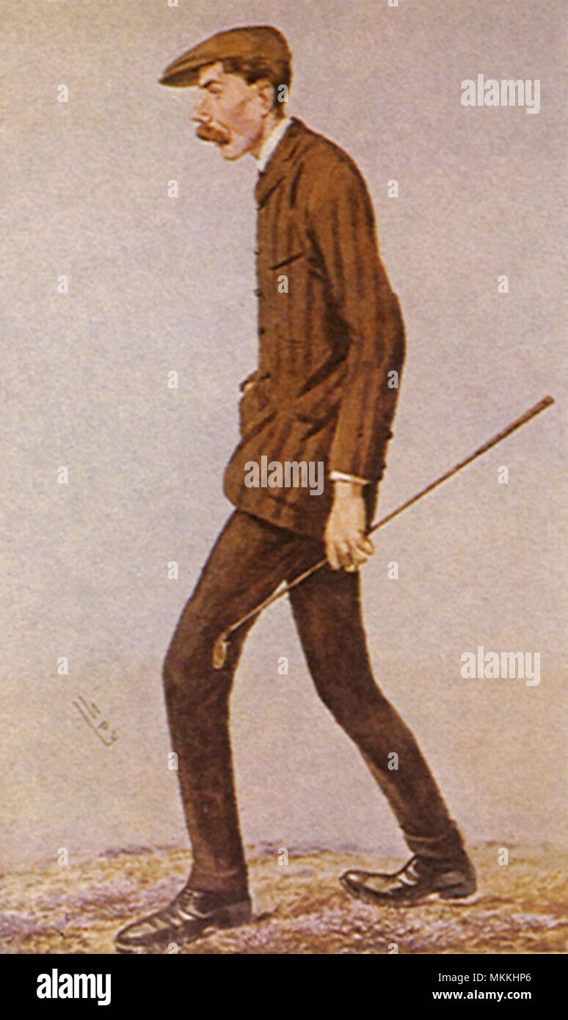
Lanky :
(of a person) ungracefully thin and tall

Slide 27
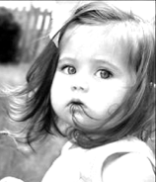
_______ cheeks
Chubby

Slide 28
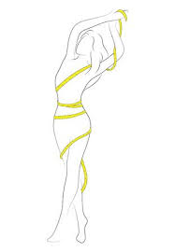
________ figure
Slim

Slide 29
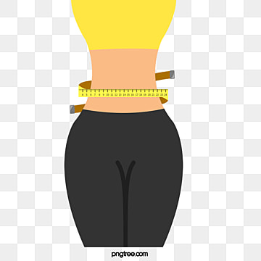
______ waist .
Slender

Slide 30
________ face .
Islamic Educational College
English
Unit 1
Grade 9
Round

Slide 31
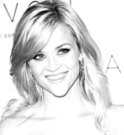
___________ face
Pointed
4.

Slide 32
__________ moustache
Droopy

Slide 33
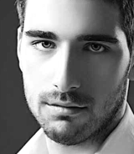
__________nose
Straight

Slide 34
_________face
Oval

Slide 35
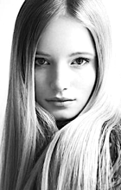
________hair
Sleek

Slide 36
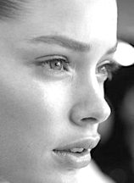
_______ nose .
Upturned

Slide 37
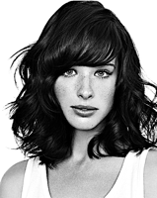
___________ hair .
Shoulder - length

Slide 38
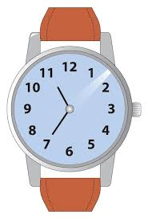
1. My father has a round________ , with chubby____ and a droopy__________ . My mother has a more pointed ______ and a straight_____ . My younger sister is more like my father. She has an oval ______ and an upturned _______ . My older sister is like a model. She has a slim _______ and a slender ______ . She has beautiful sleek, shoulder-length ________. I feel so ordinary next to her , but she always says I look nice.
Formative assessment
face
cheeks
moustache
face
nose
face
nose
figure
waist
hair
1:30

Slide 39
My brother is _________ and handsome .
Well- built

Slide 40
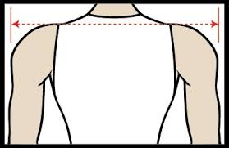
________ shoulders .
Broad

Slide 41
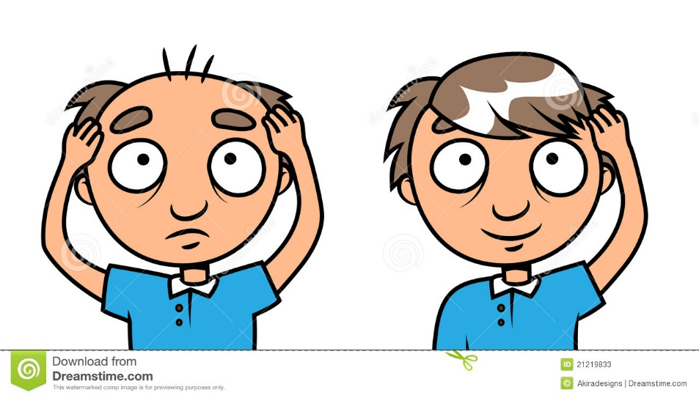
Going _______
bald

Slide 42
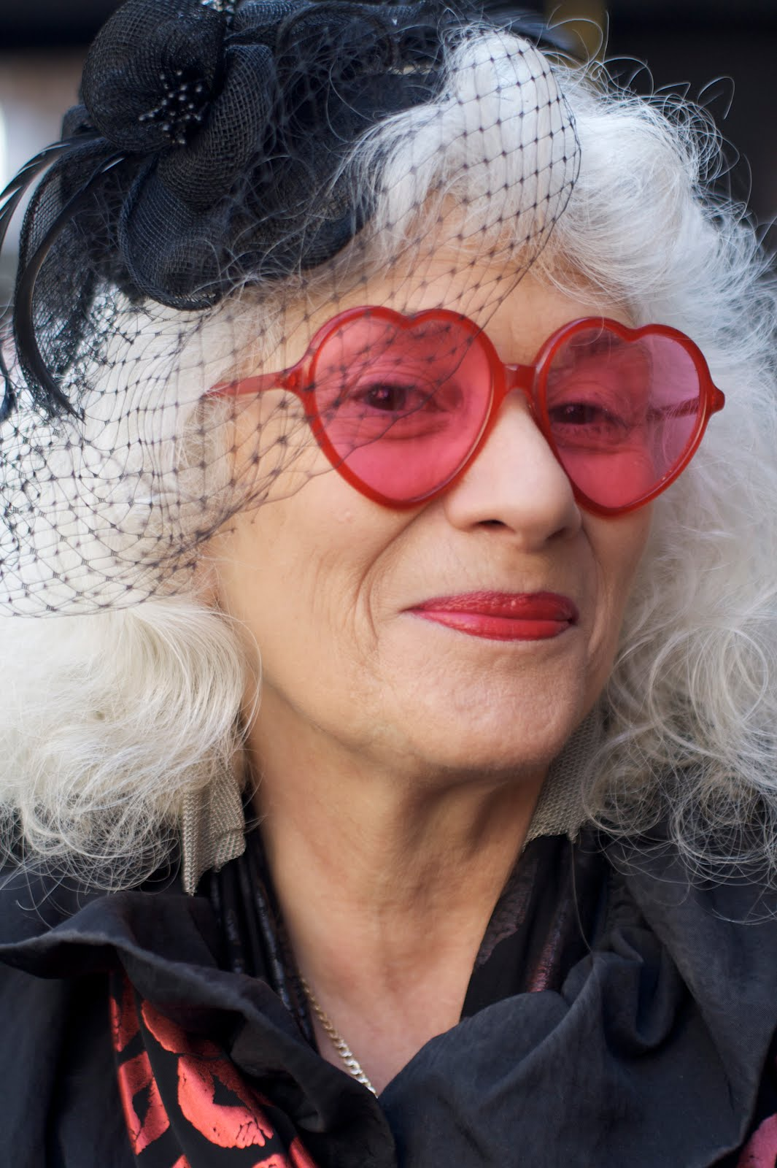
She tries to have a youthful ____________
appearance

Slide 43
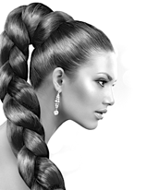
________ hair .
Thick

Slide 44
__________eyebrows .
Bushy

Slide 45
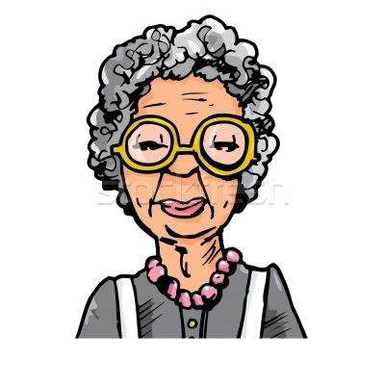
She used to have black hair before it________ grey .
Went

Slide 46
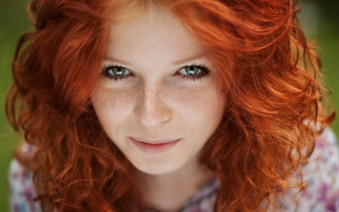
_________hair
Ginger

Slide 47
Formative assessment
Islamic Educational College
English
Unit 1
Grade 9
2. My father and my two older brothers are all well-______ with ______ shoulders. My father is _______ bald but he still has a very youthful ____________ for someone who is forty. My brothers both have thick _____ and _____ eyebrows. My mother’s side of the family mostly have dark _____
in fact my mother had -black ______ when she was younger, before she went ______ — but on my father’s side some have fair hair and some have ginger______ .
built
broad
going
1:30
appearance
hair
bushy
hair
hair
grey
_________ hair

Slide 48
Height
Which word best describes the height of a basketball player?
Short.
b) Medium height.
c) Tall

Slide 49
2. Build
How would you describe the build of a bodybuilder?
Slim.
Muscular.
Overweight

Slide 50
4. Age
Which term best describes someone who is 75 years old?
Young.
Elderly.
Middle-aged

Slide 52
Model 1:
Describing a person (my friend)
Najib has been my intimate friend since we were in primary school. He's a tall and slim young man with pale skin and curly dark hair. He has brown small eyes and an oval shiny face. He always wears casual clothes. Najib is very funny, and he always makes me laugh. Also, he is a very generous and sensitive person. However, sometimes he can be a little tense. Najib is very keen on playing football. During the weekends, he spends hours either training his football team or watching matches on TV. In addition to that, he enjoys singing and dancing, as well, and he is fond of listening to pop music. Everybody likes him for his sense of humour and modesty. All in all, I'm happy to have such a good person as a friend; and I'm sure we'll always be intimate friends

Slide 53
Model 2: Describing a person
My best friend Lara is a quite special person. She is a twenty-year old girl who studies Biology at the University of Fes. She is a slim and tall girl who has got black curly hair and brown eyes. She also has a round face on which the charming smile is usually drawn. Lara wears casual clothes like jeans and t-shirts. Lara loves playing all kinds of sports, such as basketball and tennis, and she is very good at them. Besides, Lara is a friendly, optimistic, and reliable person. All these positive characteristics made people love Lara from the first time they meet her.

Slide 54
1- Have a tendency to exaggerate / lose his/her temper / make snap (quick) decisions
Ex: Peter’s a great guy, but he sometimes has a tendency to exaggerate.

Slide 55
2- Speak your mind – tell what you really think of something.
Ex: I like him because he always speaks his mind.

Slide 56
3- Have a sense of humor .
Ex: His jokes are so funny. He’s got a great sense of humor.

Slide 57
Strong personality – confident and assertive person.
Ex: He became a boss because he has a strong personality.

Slide 58
Outgoing personality – talkative and open person.
Ex: Gregory has an outgoing personality and he enjoys meeting new people.

Slide 59
Have a vivid imagination – the ability to imagine things easily.
Ex: Thanks to her vivid imagination, the novel she wrote won an award.

Slide 60
Good at keeping secrets .
Ex: Laura is good at keeping secrets.

Slide 61
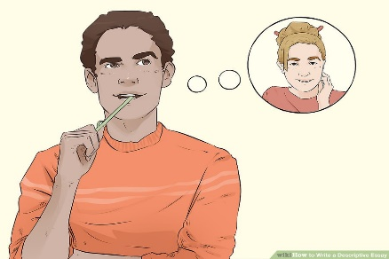
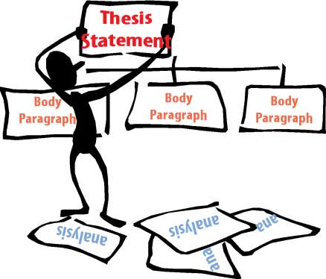
Title: Descriptive Essay / Describe a Character
Brainstorming Ideas for the Essay
Choose a person to describe. One option for a topic is to describe a person that you know well in your life. This could be a family member like your mother or your father. It could also be your best friend .
Outline the essay in sections. Organize the essay by creating a brief outline. Do this in sections: introduction, body, and conclusion:

Slide 62
The introduction
Start with a "Lead sentence" to hook your reader:
The Body
- Physical Traits:
What does he/she look like from outside?
Tall / short / has a round face / has long black wavy hair / has brown eyes ….etc.
B- Personality Traits:
What do you like about this person? Generous / helpful / friendly/ loyal .etc.
Characteristic #1
Examples and details of characteristic #1 (show how )
Characteristic # 2
Examples and details of characteristic # 2 ….etc
Conclusion: Wrap up the essay with a strong conclusion. Your conclusion should tie all the thoughts in your essay together. Restate your thesis statement in the conclusion and end with a strong final sentence. Do not add anything new to your essay in the conclusion.
.

