Slide 1


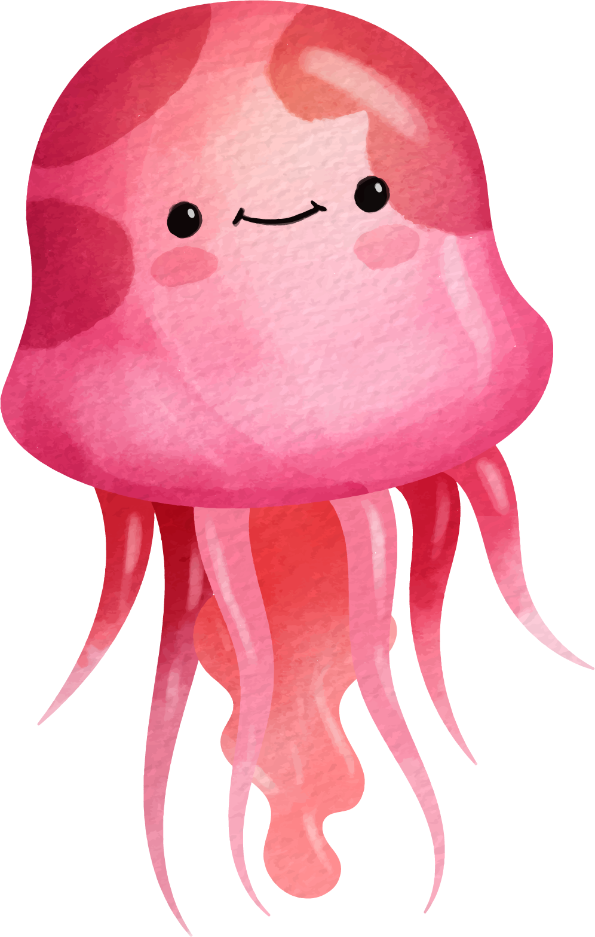


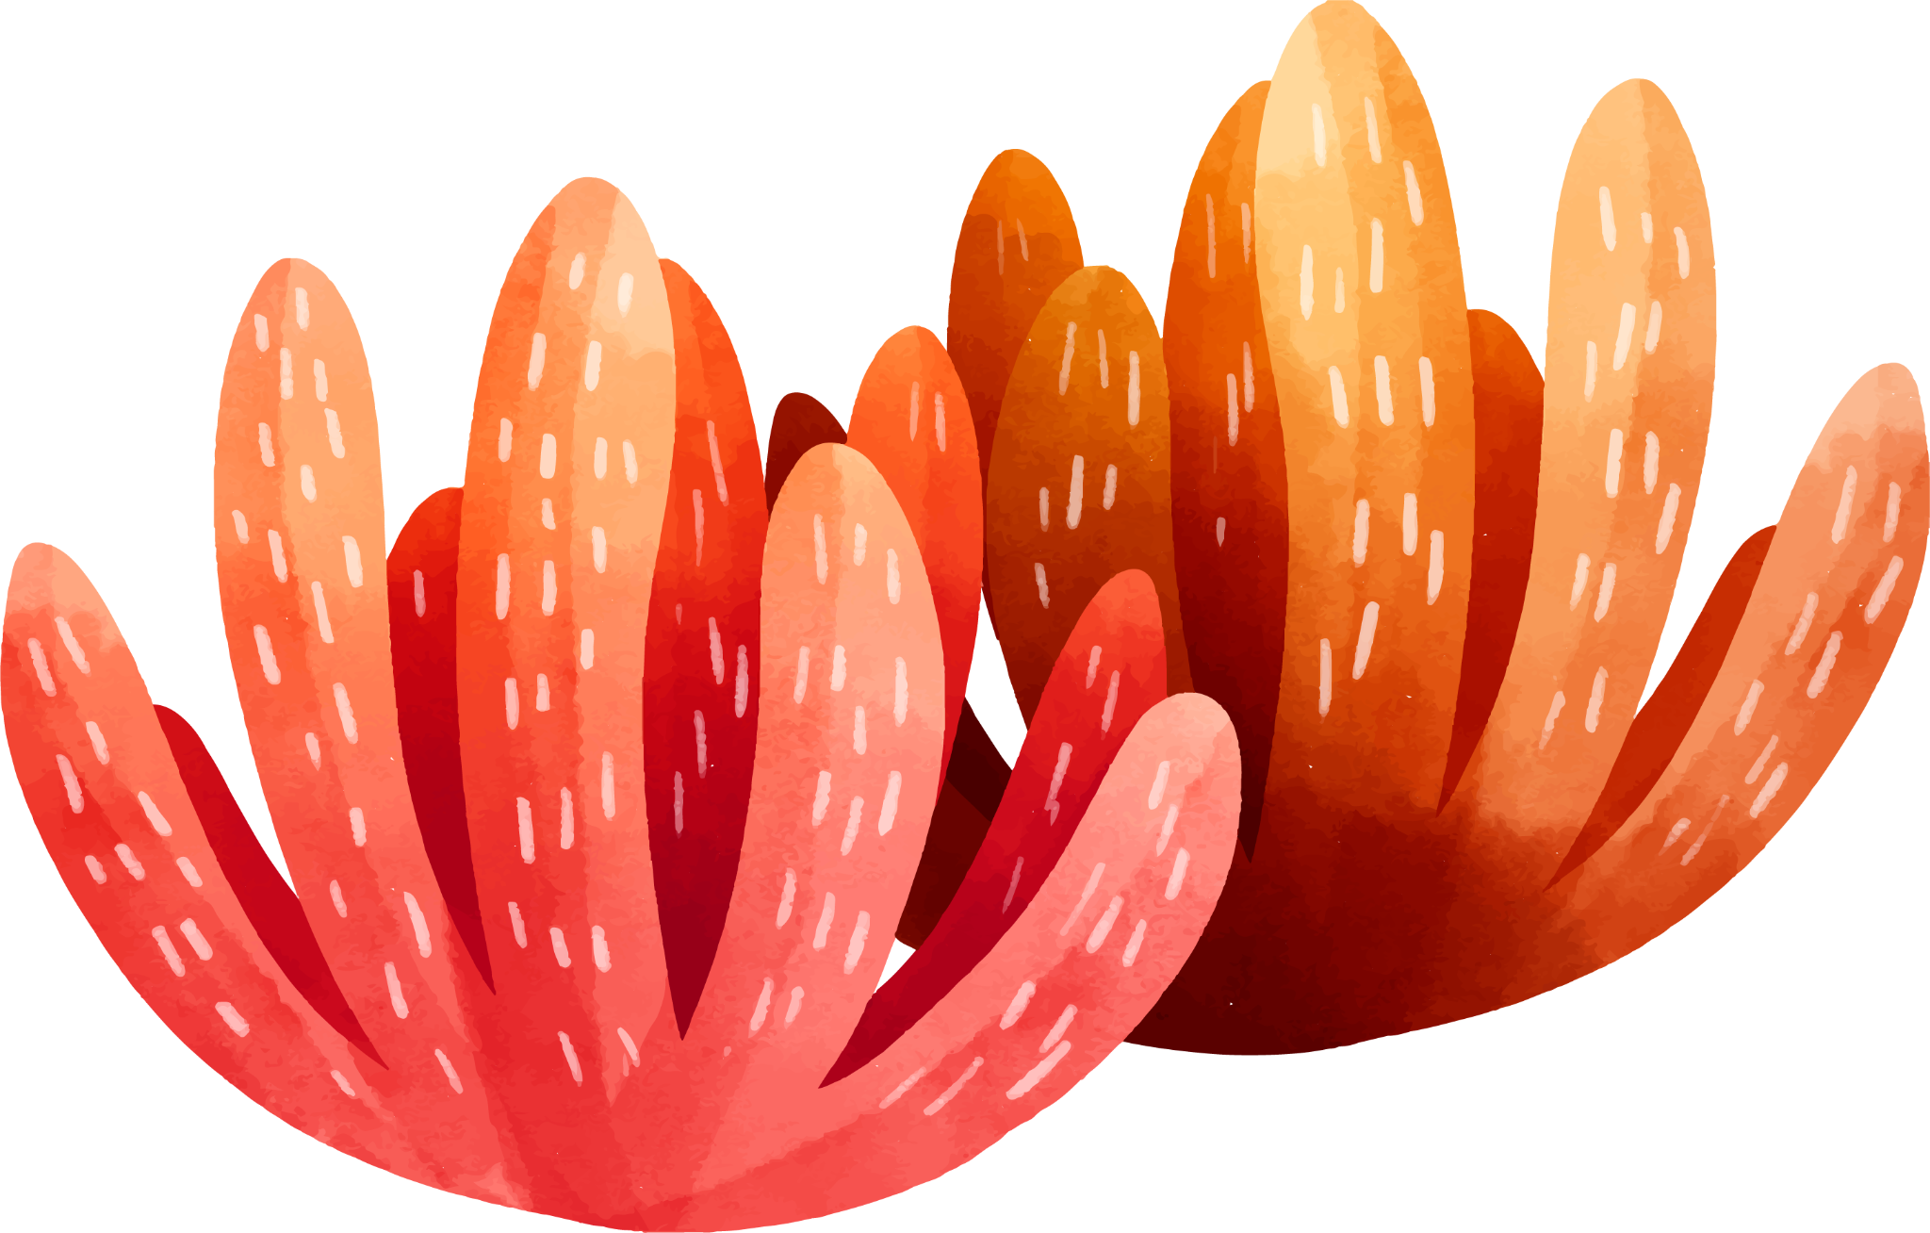




“Stone Soup” Vocabulary
Grade 5

Slide 2



Outcomes
01
02
03
04
By the end of this lesson, students should be able to
recognize and define the new words.
spell the new words correctly.
pronounce the new words correctly.
use the new words in complete and meaningful sentences.

Slide 3
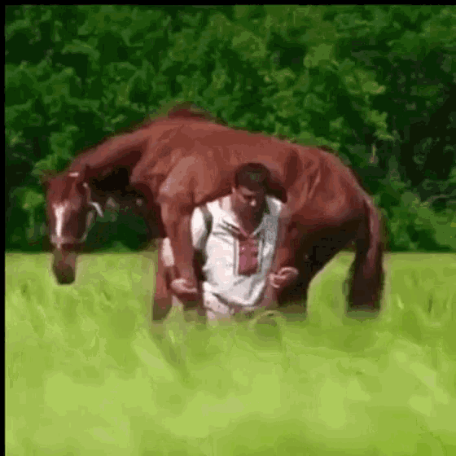
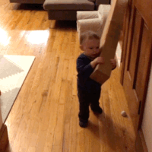


carry – carried (verb)

Slide 4
Word | Part of Speech | Definition
carry carried | verb past form | to hold something or someone with your hands, arms, or on your back.
What did you carry to school today?

Slide 5






peek(verb)

Slide 6
Word | Part of Speech | Definition
peek peeked | verb past form | to look quickly, especially for a short time or while trying not being seen
When have you peeked at someone or something?

Slide 7

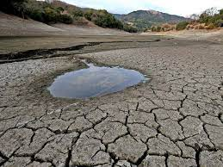
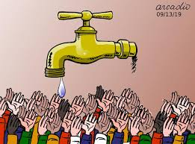
scarce(adjective)

Slide 8
Word | Part of Speech | Definition
scarce (long a sound) | adjective | not easy to find or get; not enough If something is scarce, there’s not much of it.
How can you save water when it’s scarce?

Slide 9

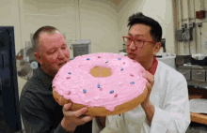

share(verb)

Slide 10
Word | Part of Speech | Definition
share shared | verb past form | to have or use something at the same time as someone else
Why do brothers and sisters share?

Slide 11
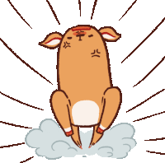
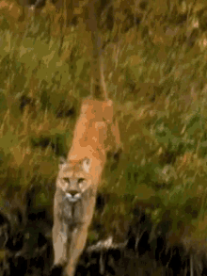

charge (verb)

Slide 12
Word | Part of Speech | Definition
charge charged | verb past form | to run towards someone or something quickly and angrily
Why would an animal charge towards you?

Slide 13
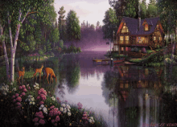
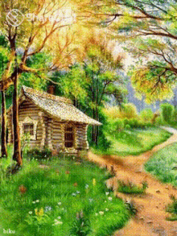
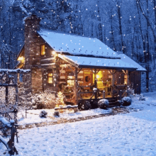

cottage (noun)

Slide 14
Word | Part of Speech | Definition
cottage | noun | a small house, usually in the countryside
Would you like to live in a cottage? Why or why not?

Slide 15
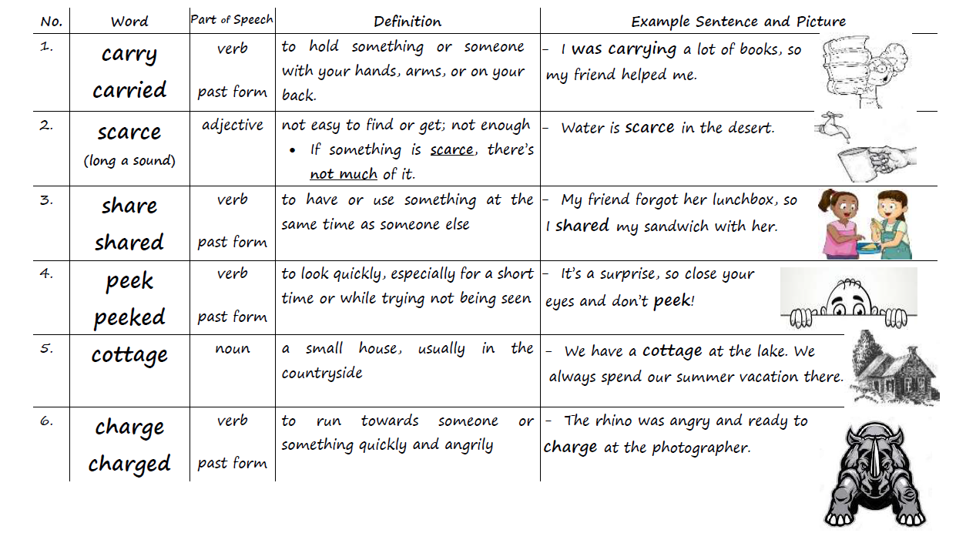
Vocabulary Worksheet p.1

Slide 16
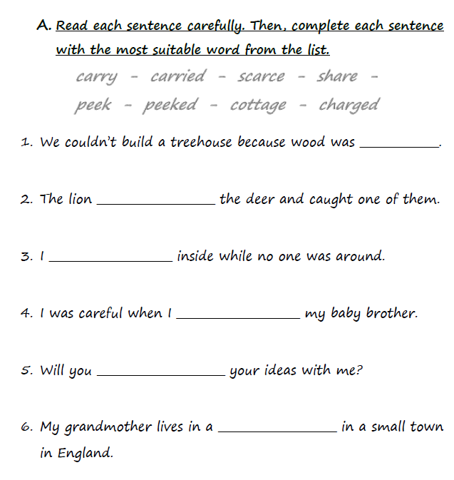
Vocabulary Worksheet p.2 – Practice A

Slide 17
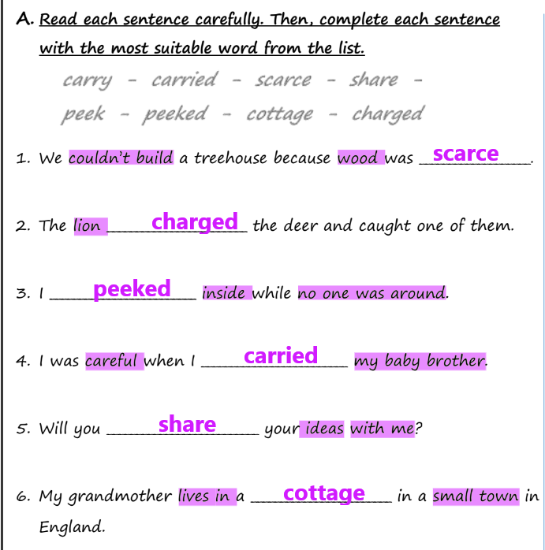
Vocabulary Worksheet p.2 – Practice A

Slide 18
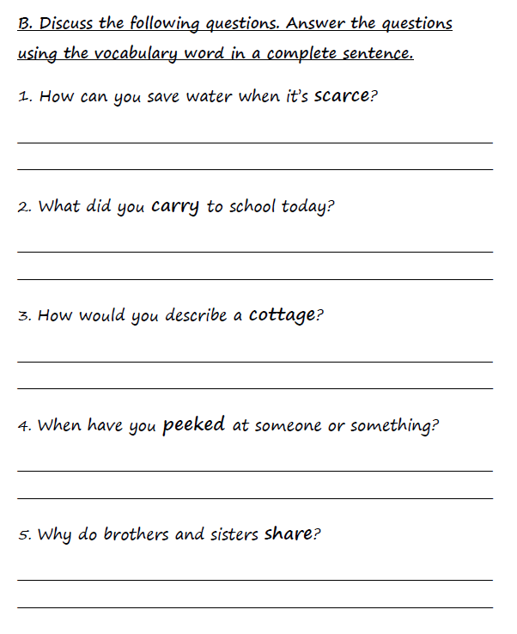
Vocabulary Worksheet p.2 – Practice B

Slide 19
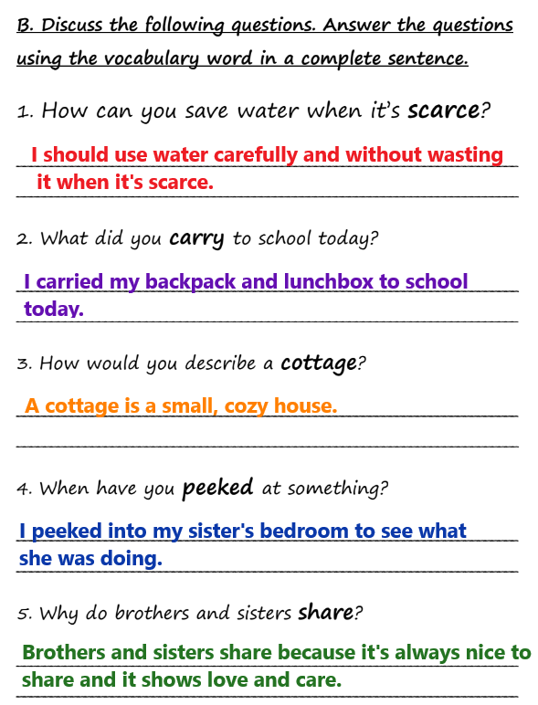
Vocabulary Worksheet p.2 – Practice B

Slide 20


identify (verb)
- Students were able to identify the literary elements in the new story.
- The woman could identify the man who stole her bag.

Slide 21
Word | Part of Speech | Definition
identify identified | verb past form | to recognize, to know, or to find out who someone is or what something is
How many types of flowers can you identify?

Slide 22

occur (verb)
The accident occurred at 10:00 this morning.
Where does this story occur?
Storms may occur at any moment.

Slide 23
Word | Part of Speech | Definition
occur occurred | verb past form | to happen or take place
Why do you think car accidents occur?

Slide 24

major (adjective)
This is a major event in the story.
I have a major role in the school play.
There’s going to be a major storm tomorrow.

Slide 25
Word | Part of Speech | Definition
major | adjective | great; big; important
Tell about one major event that happened in your life.

Slide 26
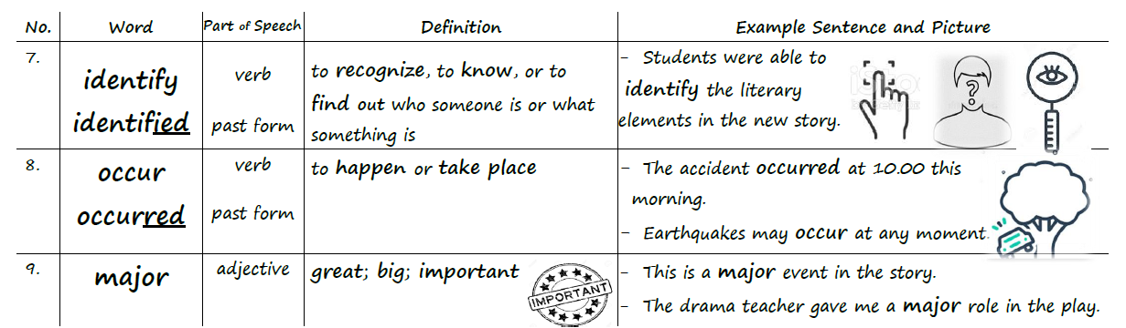
Vocabulary Worksheet p.3

Slide 27
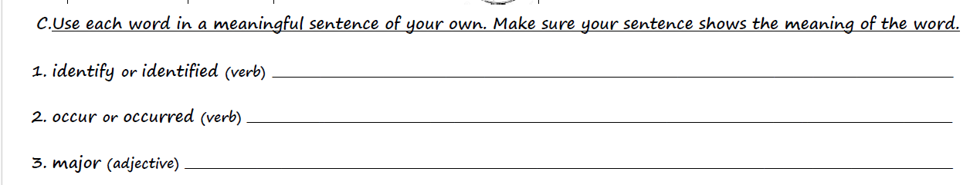
Vocabulary Worksheet p.3 – Practice C

Slide 28
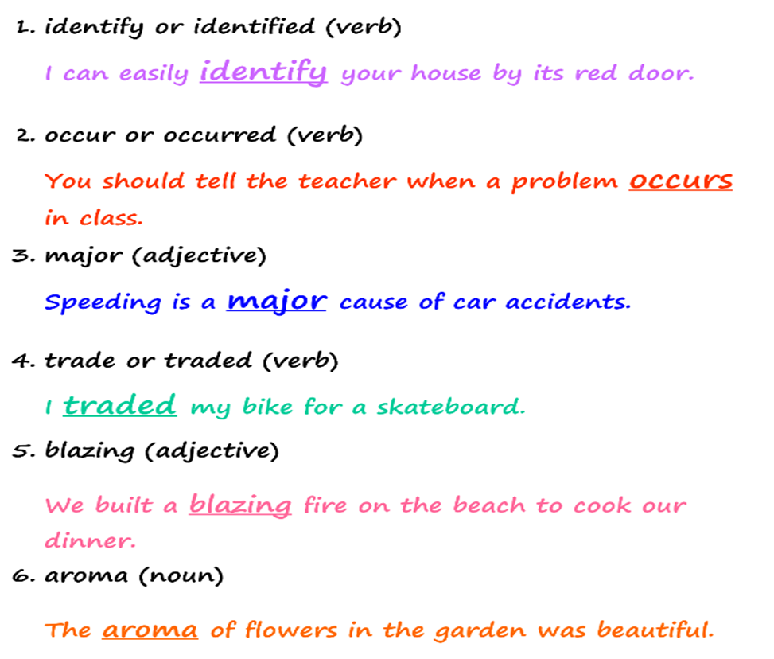
Vocabulary Worksheet p.3 – Practice C

Slide 29
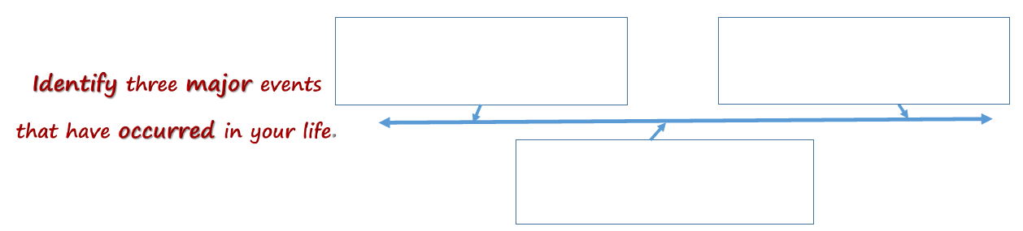

Slide 30
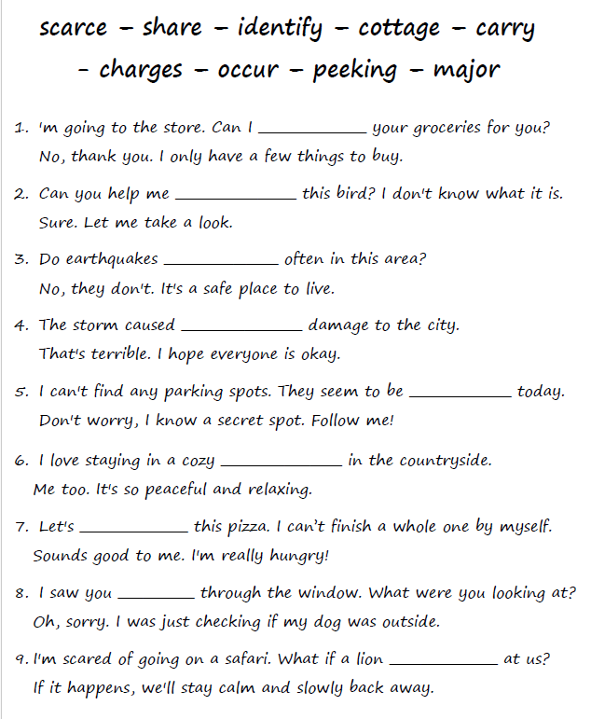
Vocabulary Practice

Slide 31
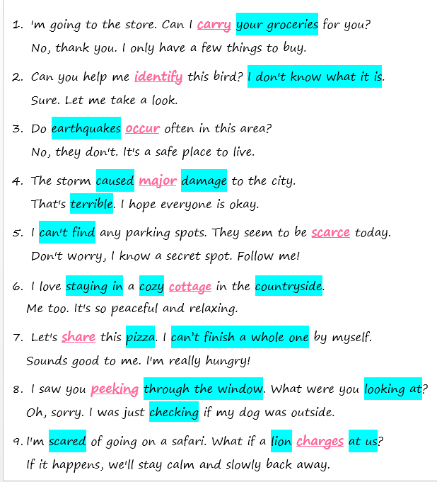
Feedback

Slide 32
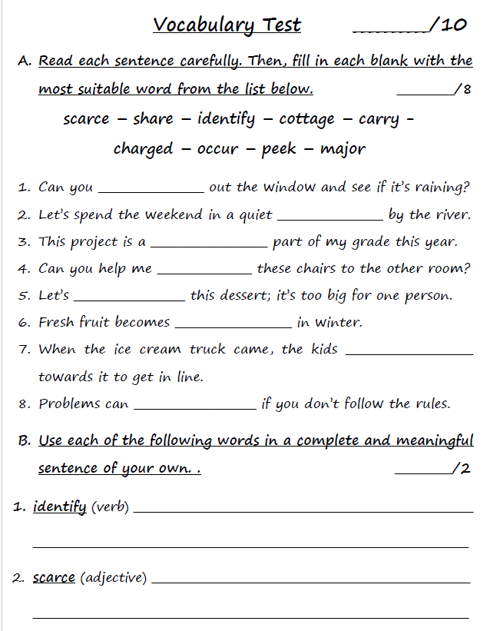
Vocabulary Test

Slide 33
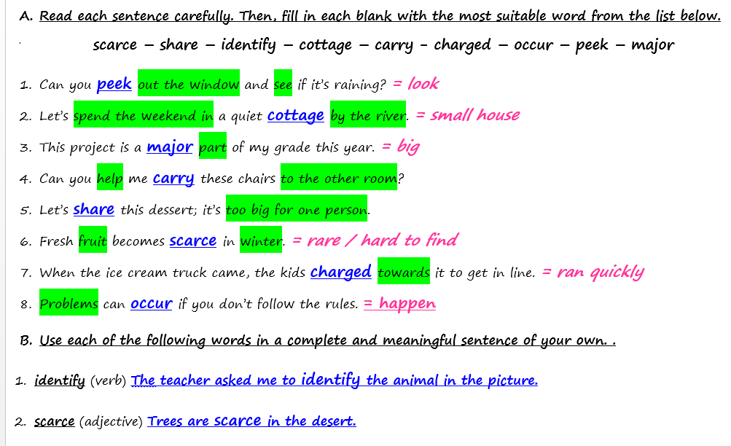
Answers

