Slide 1
can + verb
Part 1
Unit 1 grammar 1
p. 22

Slide 2
Specific Outcomes
By the end of this lesson, students are expected to
1. Use can + verb to talk about things they are able to do.
2. Use can + not + verb to talk about things they are not able to do.
3. Perceive the importance of positive behavior while sharing experiences.

Slide 3
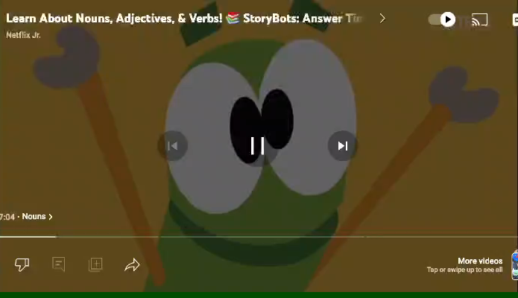
Warm up

Slide 4



Pre assessment
2:00
mins
You have 30 seconds, think of verbs.
Then, write down as many verbs as you know.

Slide 5

What is a verb?
A verb is a word that shows an action.

Slide 6
Look at the pictures and then,
✔ Take off if you can do it !
✘ Touch down if you cannot do it !

Slide 7


play basketball

Slide 8
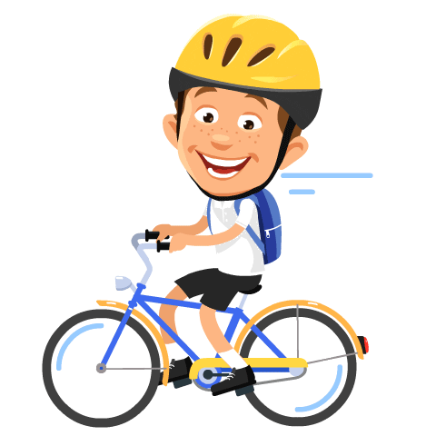
ride a bike

Slide 9

dance

Slide 10

swim

Slide 11

run

Slide 12

fly

Slide 13
Let’s play this game!
Sent on IEC APP
Verbs - True or false (wordwall.net)

Slide 14
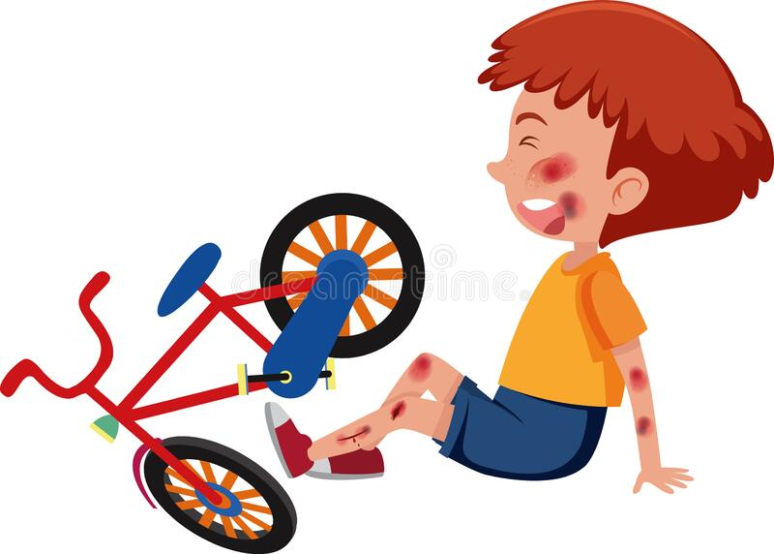

She ___ ride a bike.
Look at the pictures. Who can ride a bike? / Critical Thinking
can
cannot
He _____ ride a bike.
✔
✘

Slide 15
Rule #1
Can + Verb
We use (can + verb)
to talk about things someone is able to do.
can
verb

Slide 16
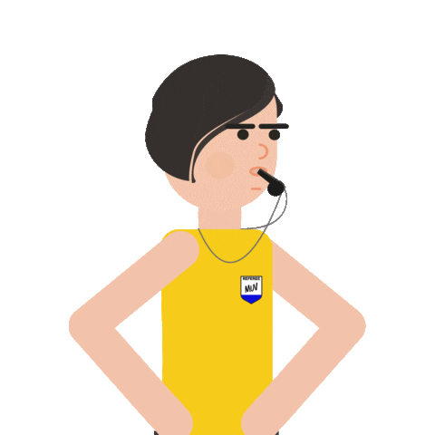
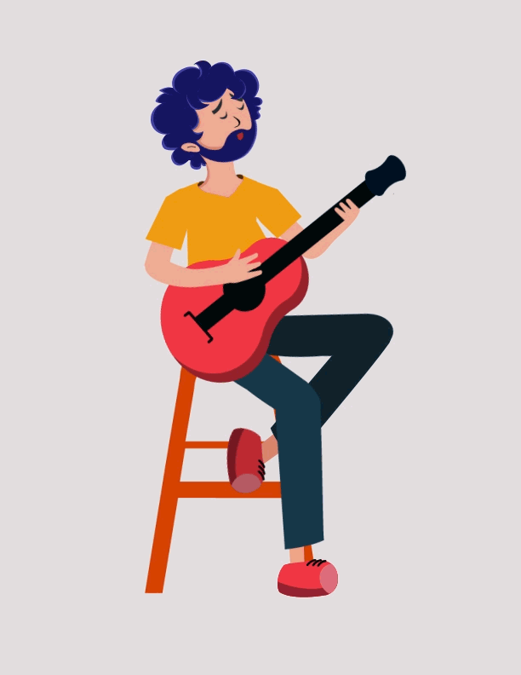
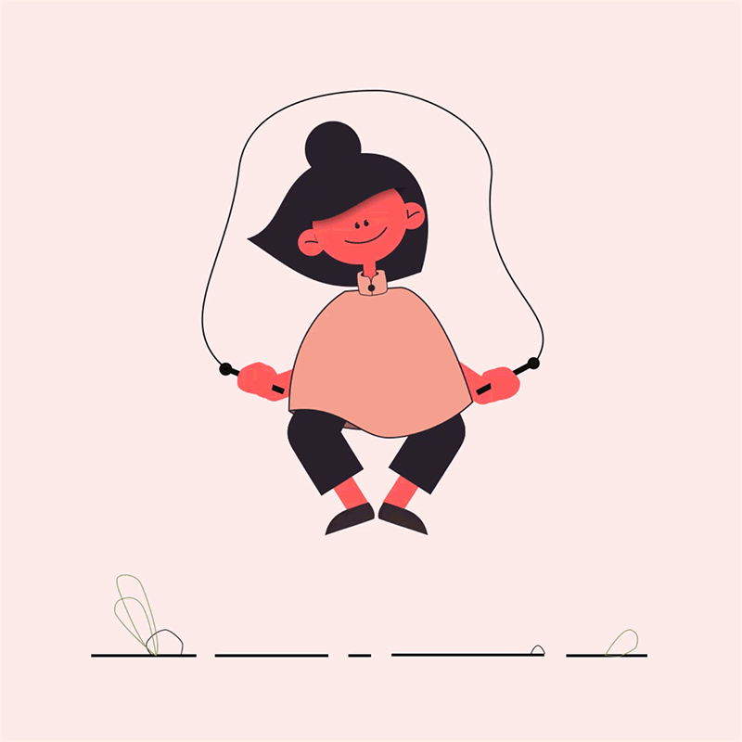
Examples
Suha can wistle.
My uncle can play guitar.
Tina can jump the rope.

Slide 17

Rule #2
Can + Verb
The word can + not is sometimes shortened to (can’t)
We use ( can + not )
to talk about things someone is not able to do.
can
not
verb

Slide 18


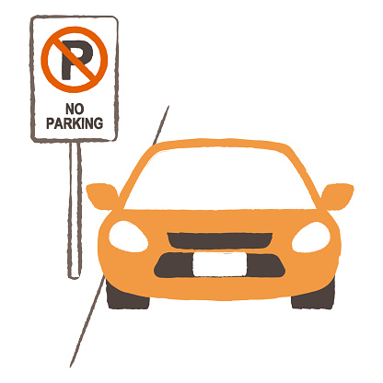
Examples
The dog can’t do push-ups.
I can’t read minds.
You can’t park your car here.

Slide 19

Group work
4:00
mins
In groups, take turns to write one thing you can do and cannot do.
*Student 1 starts then pass it to Student 2 and so on ...

Slide 20
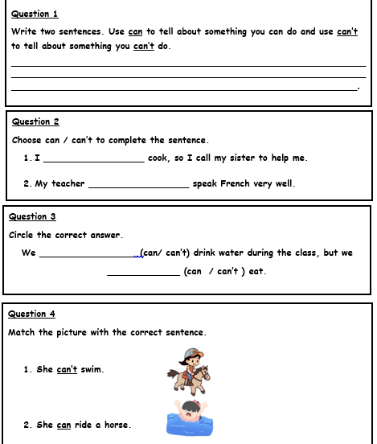
Differentiation
Student 3
3: 00
mins
Student 2
Student 4
Student 1

Slide 21
Feedback
Student 3
3: 00
mins
can’t
Student 2
can
Student 4
can
can’t
Student 1

Slide 22

Relate to real Life
2:00
mins
You have 30 seconds,
think of two things you can’t do inside the classroom.

Slide 23

Summative Assessment
2:00
mins
Look at the picture, then choose the correct sentence.
1. Rashed can read a book.
2. Rashed can not read a book.
IRS

Slide 24

Summative Assessment
2:00
mins
Choose the correct sentence.
1. Adam paint can a picture.
2. Adam can paint a picture.
IRS

Slide 25
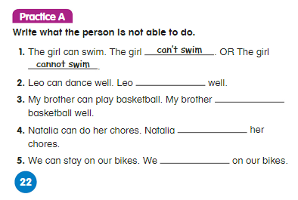

Summative Assessment
2:00
mins
can’t dance
can’t play
can’t do
can’t stay

Slide 26
Spin the wheels to make some silly questions, then try to answer them!
Wrap Up
I can / cannot …..

Slide 27
can + verb
Part 2
Unit 1 grammar 1
p. 23

Slide 28
Specific Outcomes
By the end of this lesson, students are expected to
1. Ask question using can.
2. Perceive the importance of positive behavior while sharing experiences.

Slide 29

Warm up

Slide 30

Pre assessment
2:00
mins
In groups, take turns to answer the questions.

Slide 31
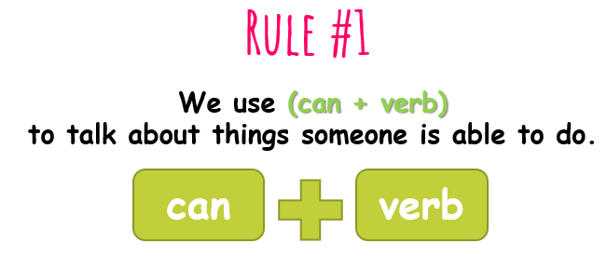
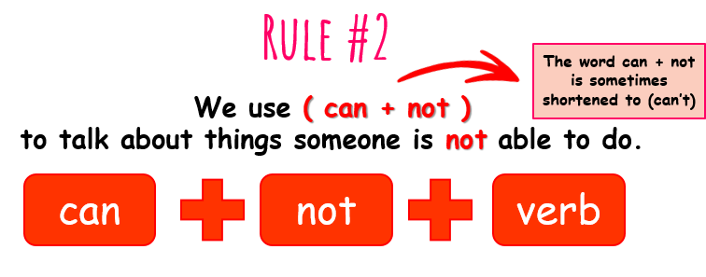
Can + Verb

Slide 32

Rule #3
To ask a question, we use (can + subject + verb?)
Can
subject
verb
Don’t forget to use a question mark at the end of the question.

Slide 33
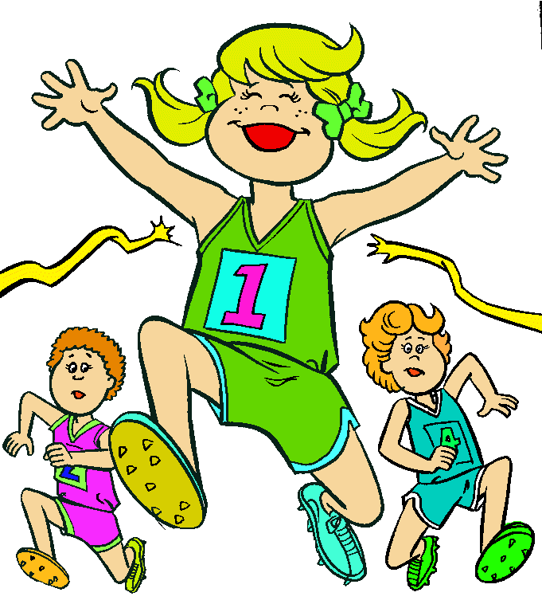

Examples
Can she win the game?
Yes, she can.
Can you spell this word?
No, I can’t.

Slide 34
Group work
4:00
mins
Read the following sentences, and then change them into a question using (can).
1.We can eat ice cream in winter.
2.We can talk with teacher’s permission.
3.I can eat during the break.
4.We can run in the classroom.
5.We can use our phones.

Slide 35
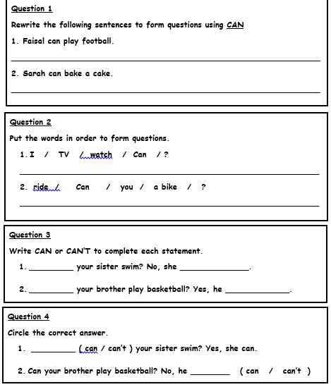
Differentiation
Student 3
3: 00
mins
Student 2
Student 4
Student 1

Slide 36
Feedback
Can Faisal play basketball?
Student 1
3: 00
mins
Can Sarah bake a cake?
Student 2
Can I watch TV?
Can you ride a bike?
Student 3
Can
can’t
Can
can
Student 4

Slide 37
Relate to real Life
2:00
mins
In pairs, take turns to ask your partner if they can do the following activities. Then switch and answer your partner’s question.
ride a bike | sing
swim | use computer
cook | write with your left hand

Slide 38
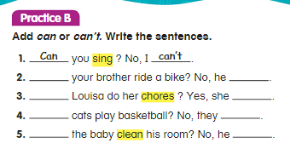
Summative Assessment
2:00
mins
Can
can’t
Can
can
Can
can’t
Can
can’t

Slide 39
Wrap-Up
Sent on iec app
https://wordwall.net/resource/4325083
01

