Slide 1
Vocabulary
Words to Know
Unit 1 Reading 1 p. 11
Part 1

Slide 2
Specific Outcomes
By the end of this lesson, students are expected to:
Recognize the following words:
Sight words
sing
eat
Story words
wash
chore
buy
are
clean

Slide 3
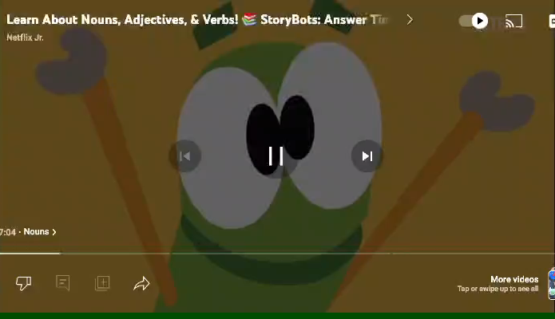
Warm-Up

Slide 4
Pre-assessment:
Touch Down Take Off
Stand up if you know the meaning of the following words;
sing
chore
wash

Slide 5

sing
Is it a verb or a noun?
I like to sing.
We sing the national anthem in the morning.
Use the verb sing in a sentence:
_____________________________

Slide 6

buy
Is it a verb or a noun?
I will buy some clothes from the mall.
Fadi wants to buy a car.
Use the verb buy in a sentence:
_____________________________

Slide 7

eat
Is it a verb or a noun?
I eat an apple every morning.
Mom eats pizza when she’s sad.
Use the verb eat in a sentence:
_____________________________

Slide 8
are
We are smart students.
There are a lot of big bags.
Use the verb are in a sentence:
_____________________________

Slide 9
Group work
buys
sing
eat
are
We ________ a song.
Dad _______ bread everyday.
Who _______ you talking to?
Let’s _______ outside today.

Slide 10
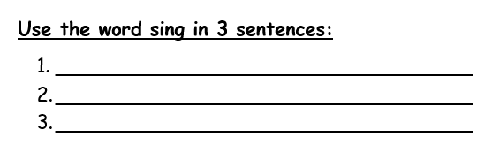
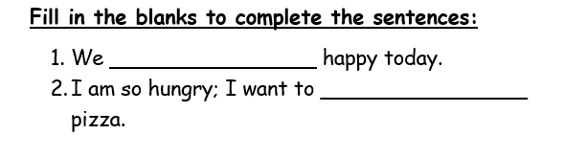
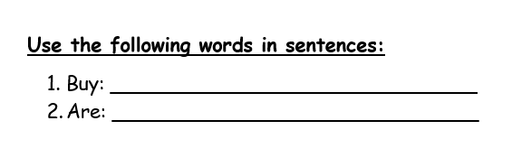
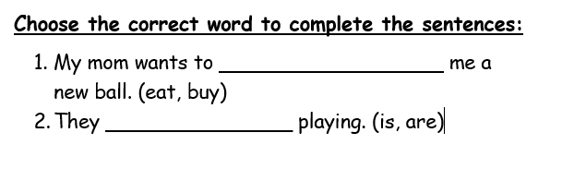
1
Differentiation
3
2
4

Slide 11
Search / Critical Thinking
Use google to look for the past and the future tense from the verb (buy), then use them in sentences.

Slide 12

What about you?
Relate to Real Life
You and your friends go to a restaurant. You want to buy some food to share. After you eat, you talk about which dishes are your favorites.
👉 What foods would you buy, what would you eat, and what dishes are the best for you?

Slide 13
Critical Thinking
Can you make a sentence using the words (buy, eat, are) together?

Slide 14
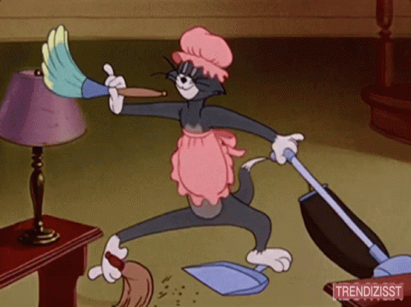
Use the noun “chore” in a sentence:
_____________________________
chore
My chore is to feed the dog.

Slide 15
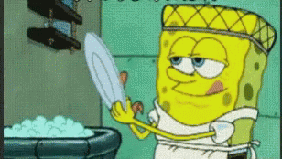
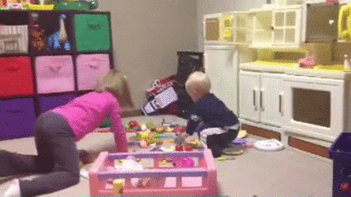
Different household chores:
Wash the dishes.
Tidy up the toys.

Slide 16
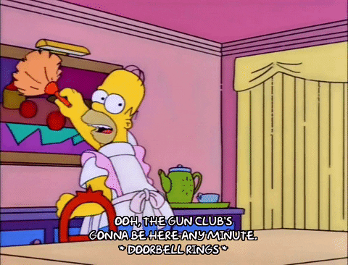

Dry up the dishes
Do some dusting.

Slide 17
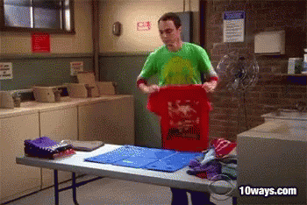
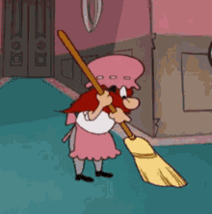
Sweep the floor.
Put the clean washing away.

Slide 18
Search / Critical Thinking
Use google to look for different meaning for the word chore.

Slide 19
What about you?
Relate to Real Life
What are some chores that you do with your family?
Do you think it is important for family members to help each other do chores? Why or why not?

Slide 20

Use the verb “clean” in a sentence:
_____________________________
clean
I enjoy cleaning my room.

Slide 21
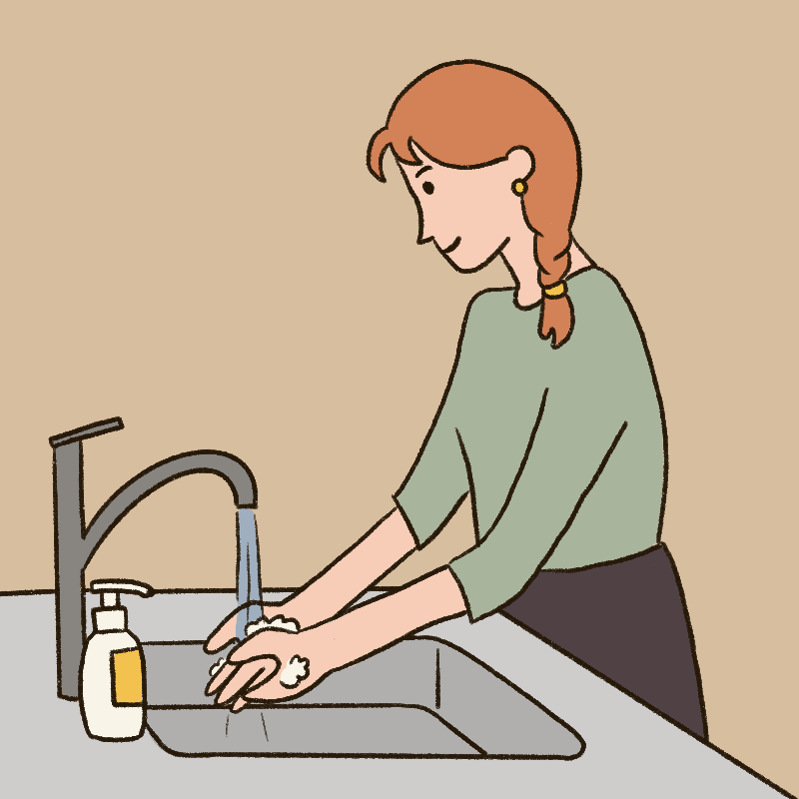
Use the verb “wash” in a sentence:
_____________________________
wash
I wash my face every morning.

Slide 22
Critical Thinking Question: Buzz in
Can you make a sentence using the words (chore, wash, clean) together?

Slide 23
Group work: Formative Assessment
chore
clean
wash
I ________ my room every week.
My brother’s ________ is to _______ the dishes.

Slide 24
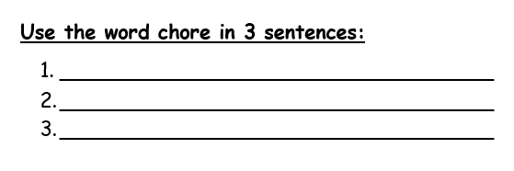
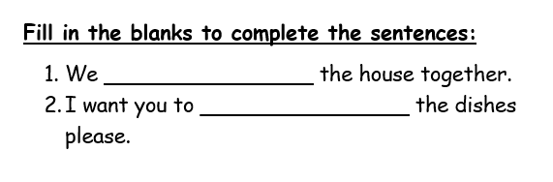
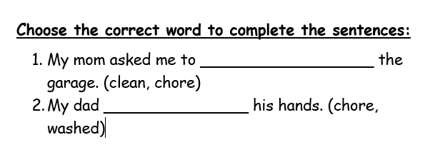
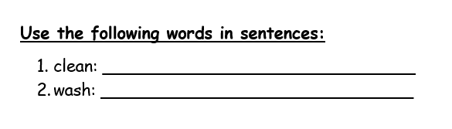
1
Differentiation
3
2
4

Slide 25
Summative Assessment
Listen to the teacher and use the mini board to complete the sentences:
I _________ my hands before and after eating.
We __________ excited today.
My ____________ is to tidy my room.

Slide 26
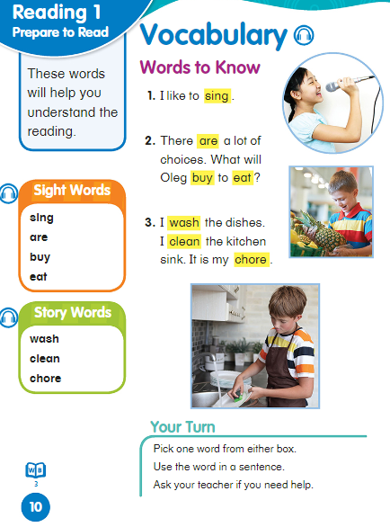


Slide 27

Closure
Game!

