Slide 1

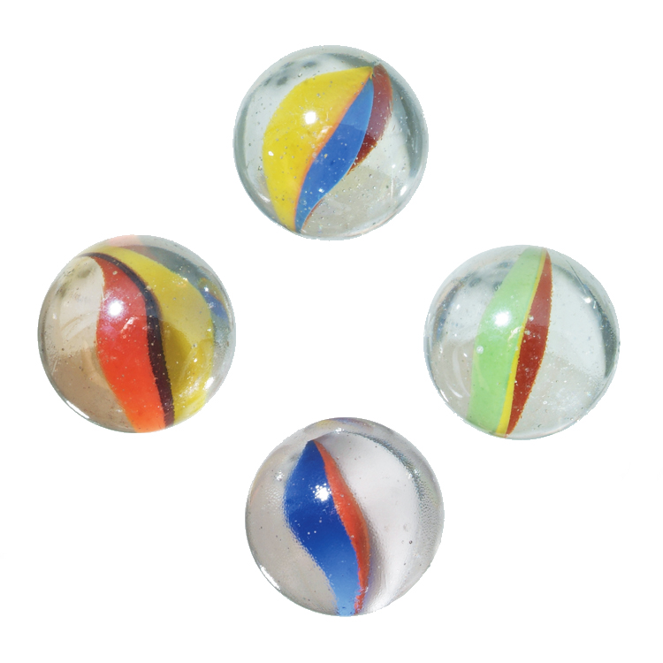
Literature
Short Story
The Marble Champ
Gary Soto
S. B. p. 156-163

Slide 2

What Defines Success?
Outcomes:
Students should be able to
Define the meanings of the new words.
Use the new words in meaningful sentences.

Slide 3
Page: 156 The Marble Champ
Listen and repeat
champion
recital
razor- sharp

Slide 4

Champion:(n) person who has won a competition.
Waleed is a Spelling Bee champion in our school.

Slide 5
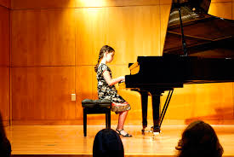
recital: (adj) public performance of music or dance.
I was good at performing my piano recital. Every one in the theatre was truly happy.

Slide 6
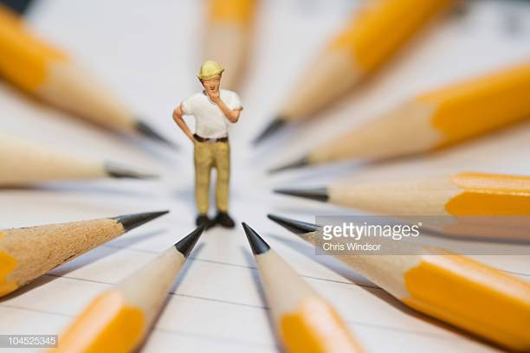
Razor- sharp: (adj) extremely sharp.
Rashed has a razor sharp mind. He is so talented and smart.

Slide 7
Page: 157 The Marble Champ
Listen and repeat
fumed
rummaged
accurate

Slide 8
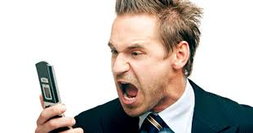
fume: (v) complain angrily.
Karam fumed because his friend Essam didn’t invite him to his birthday Party.

Slide 9

rummage: (v) search for something by moving things around.
Kamal rummaged through the drawer to find the brochure.

Slide 10

Accurate:( adj) correct or exact.
My watch is accurate.

Slide 11
Page: 158 The Marble Champ
Listen and repeat
milky
agate
hypnotic

Slide 12
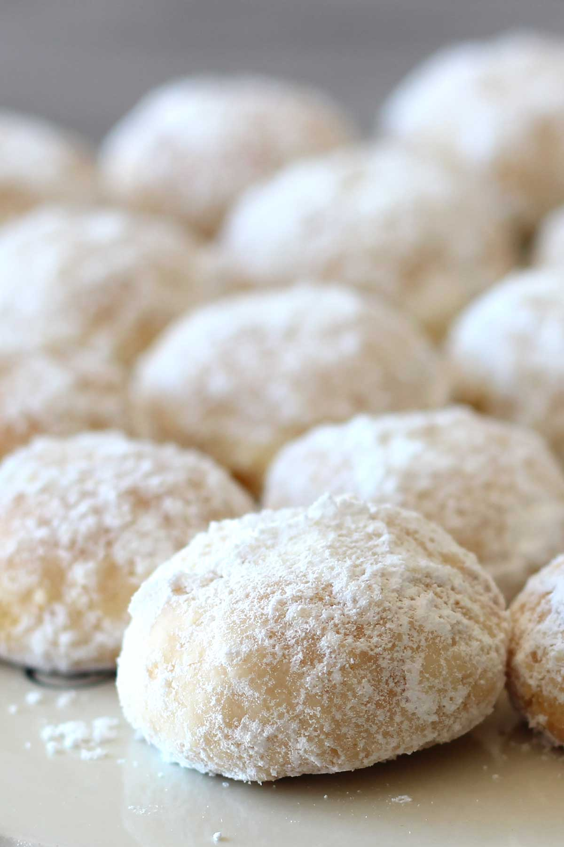
milky: (adj) white, like milk.
Would you like your coffee milky?

Slide 13

agate: (n.) colored playing marble with strips.
I like that red agate stone.

Slide 14

hypnotic: (adj) fascinating.
The beat of the music was hypnotic.

Slide 15
Page: 159, 160 The Marble Champ
Listen and repeat
bad
reluctantly
rigged

Slide 16
“ Wow, she is bad! She can beat the other girls easily.
bad: (adj) slang expression meaning “good”.

Slide 17
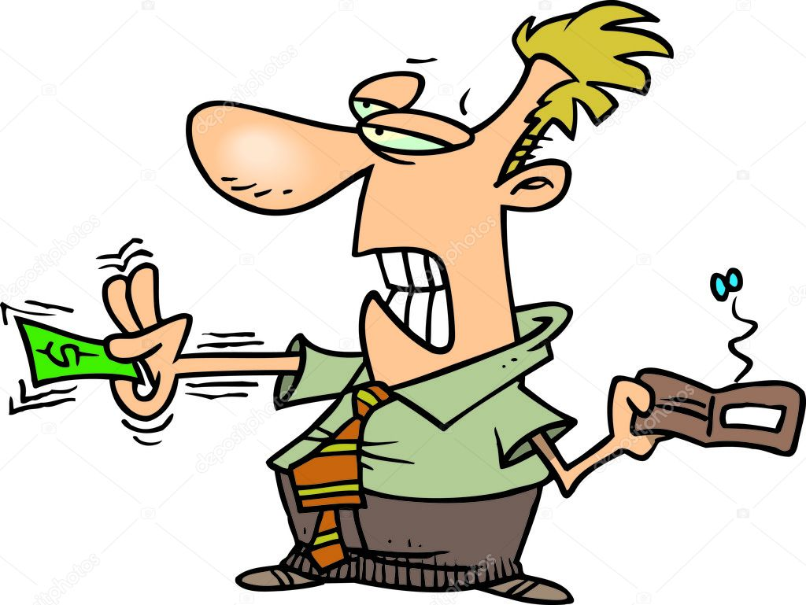
reluctantly: (adv.) unwilling, slowly.
Ahmad reluctantly agreed after a long time of discussion.

Slide 18
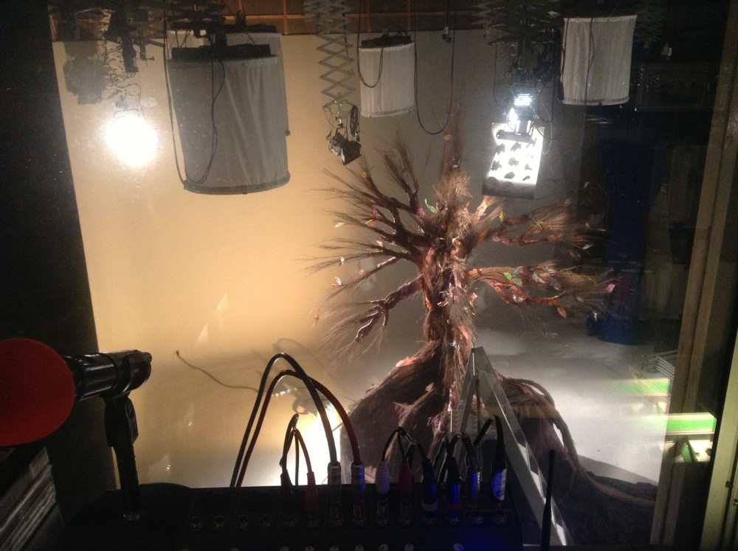
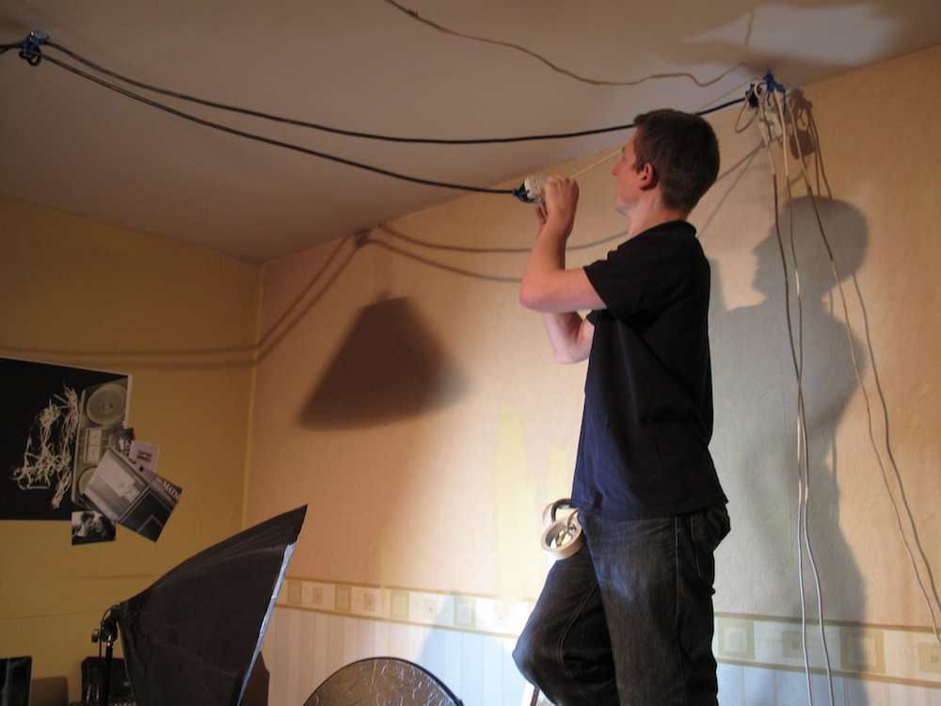
rigged: (v) put up temporarily.
The technician rigged up all the electric wires rapidly.

Slide 19
Page: 160 The Marble Champ
Listen and repeat
opponent
assign

Slide 20
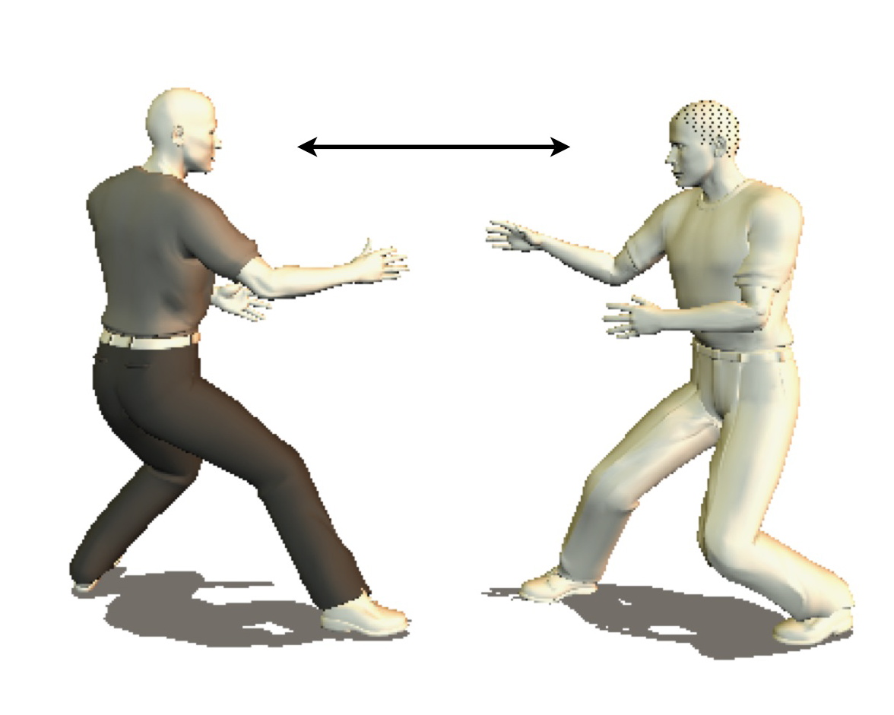
opponent: (n) person who tries to defeat someone else in a game.
Ali can beat his opponent easily in the match.

Slide 21

assign: (v) give.
The science teacher assigned a difficult task for the smart students.
assignment: (n)The smart students did the difficult assignment easily.

Slide 22
Page: 162 The Marble Champ
Listen and repeat
quiver
instinct
slivers
commotion

Slide 23
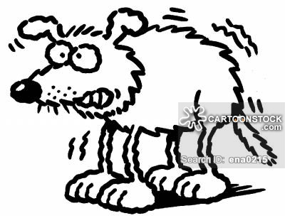
quiver: (v) tremble.
Rayan quivered when he heard the sudden noise.

Slide 24
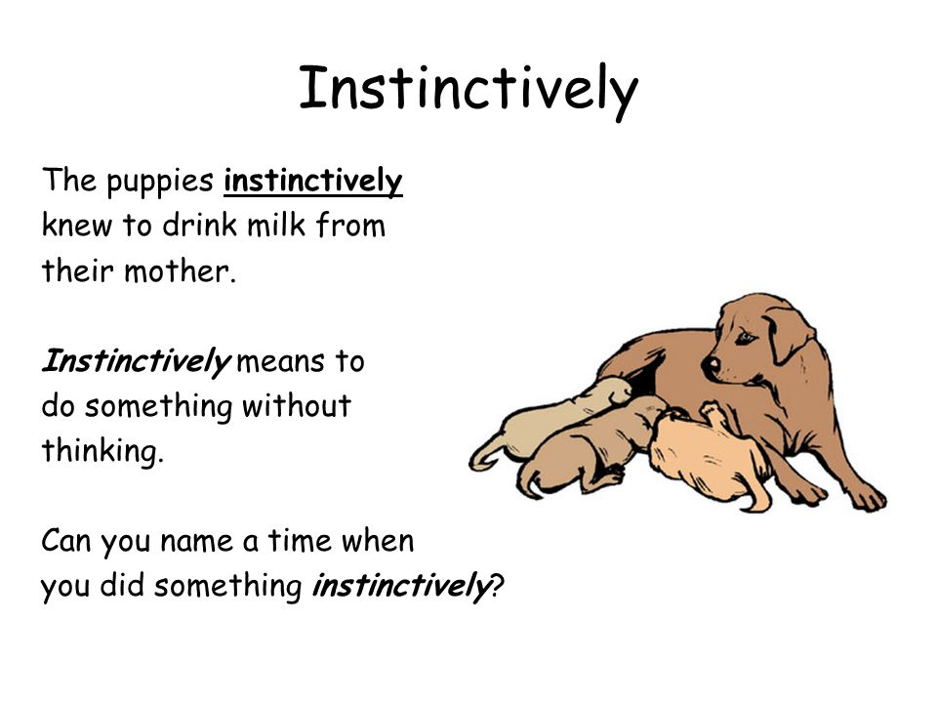
instinct: (adj) natural ability.
When Essam saw the fire, his first instinct told him to run away.

Slide 25

slivers: (n) small broken pieces.
Ayham is sweeping the slivers of the broken glass.

Slide 26
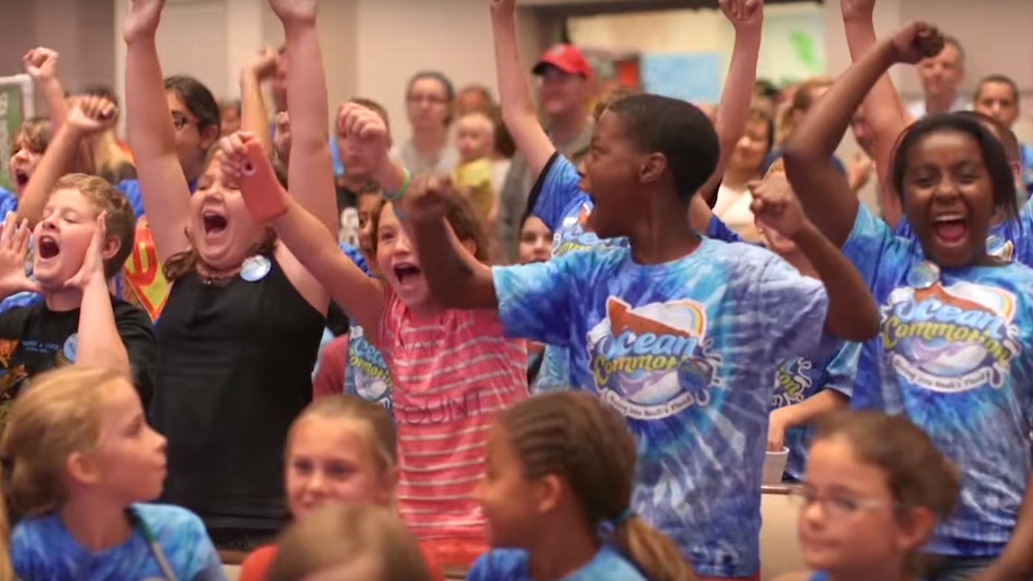
commotion: (n) sudden noisy activity.
The children are making a lot of commotion during the match.

Slide 27
Practice What Defines Success?
Fill in the spaces with the correct word from the list.
( assigned, commotion, fumed, rummaged, reluctantly)
The crowd waiting outside was causing a -----------------.
The boss ----------------- Thursday for our meeting.
My mom ------------------ let me go to my friend’s party.
Karam --------------- through his backpack to search for his pen.
The students ----------------- when they heard that the trip was cancelled.

Slide 28
Thank you for listening.
The End

