Slide 1

What Defines Success?
S. B. P. 153+154
Literary Words + Academic Words

Slide 2

What Defines Success?
Outcomes:
Students should be able to:
Discuss the big question
Define the meanings of the new words.
Use the new words in meaningful sentences.

Slide 3
What defines success?
Have you ever entered a competition such as a spelling bee, a race, a chess tournament, or a science fair?
Did you win first place?
If you didn’t, do you still think you were successful?
Why or why not?
Discuss.

Slide 4
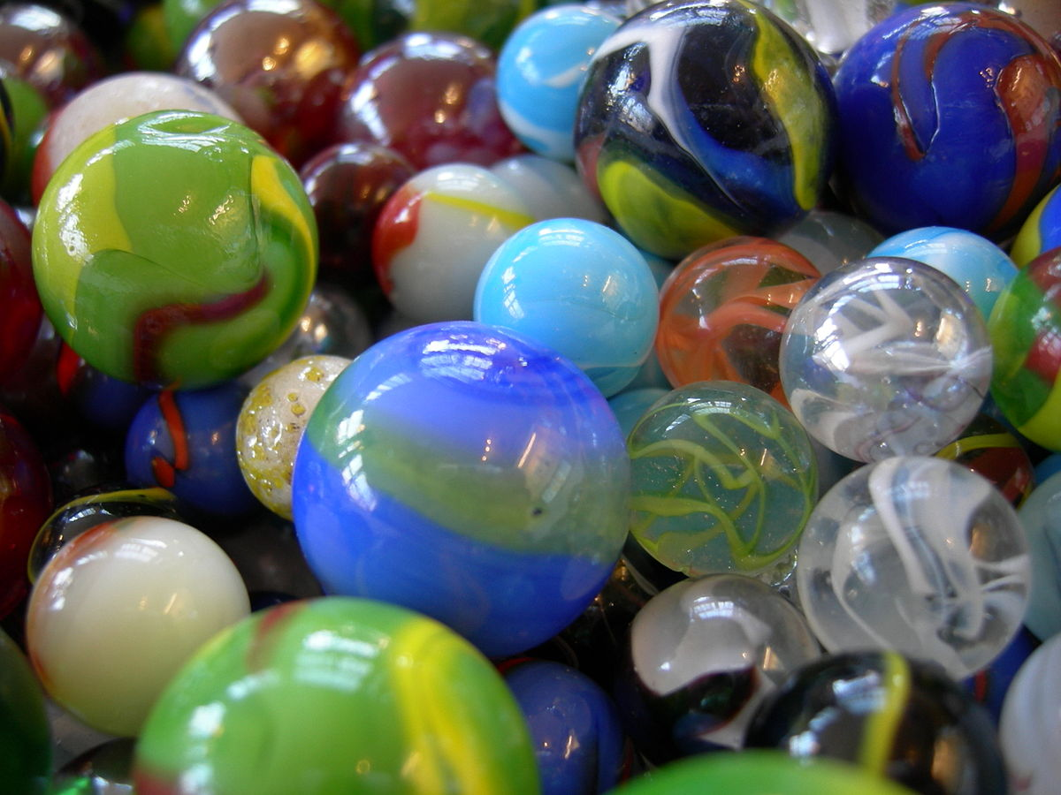
Build Background
“The Marble Champ.”
a short story
How much do you know about marbles?
Did you know that the game of marbles is more than 3,000 years old?

Slide 5
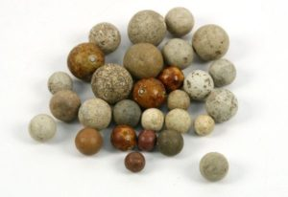
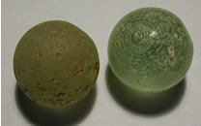
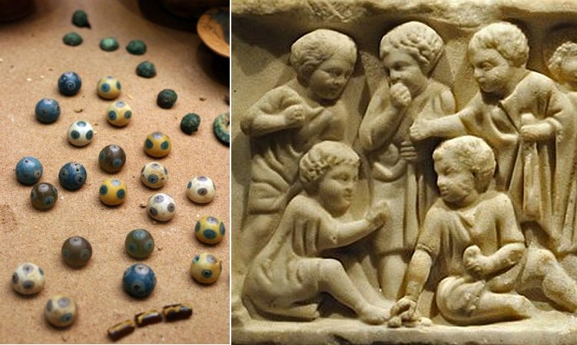
The history of Marbles
Archaeologists have found clay marbles in Egypt and Italy.
They have also found marbles in parts of Mexico and the United States dating back to 100 BCE. Marbles were made of clay, bone, polished nuts and stones, and, of course, marble (a hard white rock).
Now, most marbles are made of glass.

Slide 6
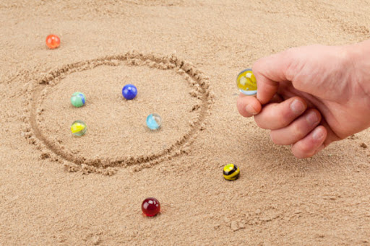
Ringer:
The most popular game of marbles is called Ringer.
One player draws a circle on the ground.
Then players take turns knocking other players’ marbles out of the circle with their own marbles.
This is done by “knuckling” the marble, which means that the marble is flicked by the thumb out of the hand.

Slide 7
Page: 153 Literary Words
Listen and repeat
Character motivation
suspense

Slide 8
Page: 153 Literary Words
Character motivation Suspense
These words are called literary words because in the discussion in literature, they have a unique meaning.

Slide 9
Watch the video well in order to get the meanings of the literary words
The Crow And The Pitcher.mp4

Slide 10
Now try to answer this question.
What made the crow drop the pebbles in to the pitcher?
The crow was thirsty, so he dropped pebbles in to the pitcher. The water then rose higher and higher, so the crow was able to drink water.
This reason is called a character motivation which explains why a character does something.

Slide 11
Read this paragraph well.
The polls had closed and the election was over. However, it was a very close race. A winner could not be predicted. The entire country waited anxiously.
Who would win the election?
Every ballot needed to be counted. When would the results be announced?

Slide 12
Do you know who is going to win the election?
Are you excited to know the winner of the election?
If you are excited or curious to know how events will turn out, this creates suspense in the story.
suspense: is a feeling of uncertainty , excitement, or curiosity about how events will turn out.
Writers often create suspense in a short story by hinting at what is going to happen. This keeps the readers wondering.

Slide 13
Academic Words
P. 154
Listen and repeat
considerable
objective
participate
previous

Slide 14
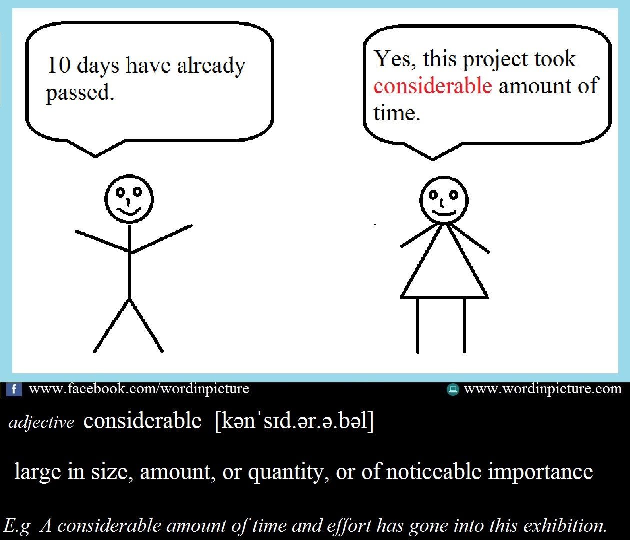

Slide 15
considerable: (adj) large enough to be noticed or have an effect.
Abdulla had a considerable success at school, He got As and Bs and won some writing contests.

Slide 16

objective: (adj) goal, something you are working hard to achieve.
Faris worked hard at playing chess. His objective was to win the chess match.

Slide 17
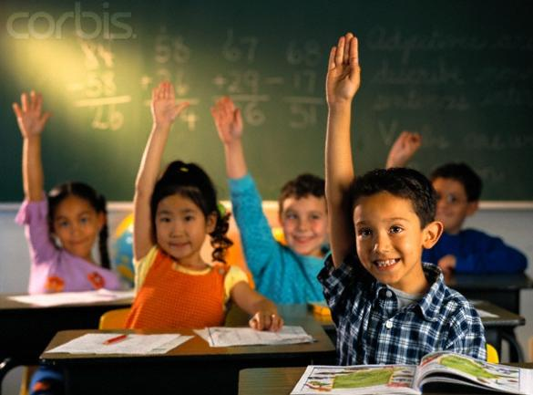
participate:(v) be involved in a particular activity.
My students like to participate in the Spelling Bee Competition.

Slide 18
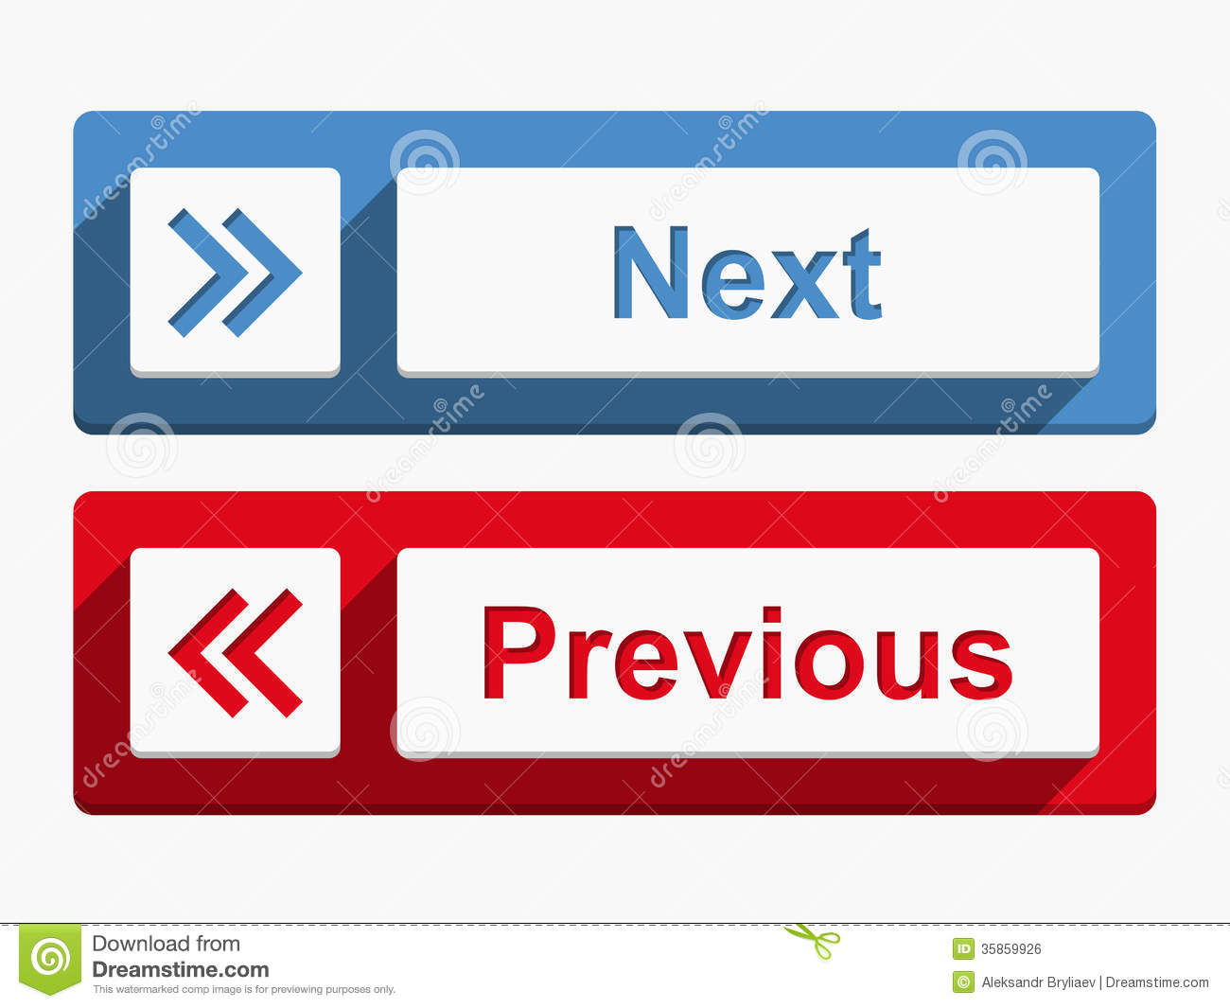

Slide 19
Previous: (adj) happening before something else.
Previous: (adj) The previous day of Saturday is Friday.

Slide 20
Practice : (S.B. P. 154) Answer the questions. Try to include the words in bold in your answer.
Who would you say has considerable athletic talent in your class?
What is your Math teacher’s objective?
Do you think it is important to participate in class discussion? Why or why not?
What did you do after school yesterday? What did you do the previous day?

Slide 21
Here are some suggested answers.
1. Mousa has considerable athletic talent because he won the Running Competition.
2. This week, my Math teacher’s objective is to teach us fraction.
3. It is important to participate in classroom discussions because my opinion matters.
4. After school yesterday I went to the library. The previous day I went to play soccer.

Slide 22
Thank you for listening.
The End

