Slide 1


Stone Soup pp.28 and 29
Unit: 1
Big Question: What are the pros and cons of sharing?
Genre: Folktale

Slide 2

Outcomes
By the end of this lesson, students are expected to
Genre
Literary Elements
Major Events
identify the genre and describe its special elements
explain the setting, main character, and conflict
summarize and retell the major events using past tense verbs

Slide 3
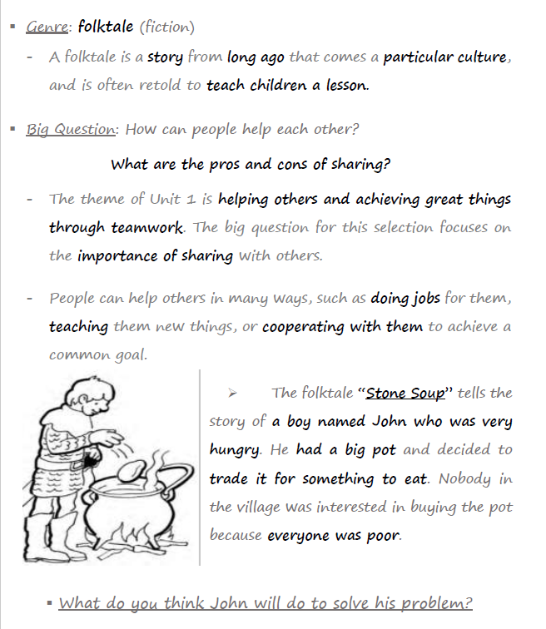
Introduction

Slide 4

IRS

Slide 5
IRS
What is a setting in a story?
1. the main problem
2. the place and time
3. the people in the story
4. the lesson the story teaches

Slide 6
IRS
What is a setting in a story?
1. the main problem = conflict
2. the place and time
3. the people in the story = characters
4. the lesson the story teaches = theme

Slide 7
IRS
Which of the following are features of folktales?
1. They happened a long time ago.
2. They have a happy ending.
3. They teach a moral.
4. all of the above

Slide 8
IRS
Which of the following are features of folktales?
1. They happened a long time ago.
2. They have a happy ending.
3. They teach a moral.
4. all of the above

Slide 9

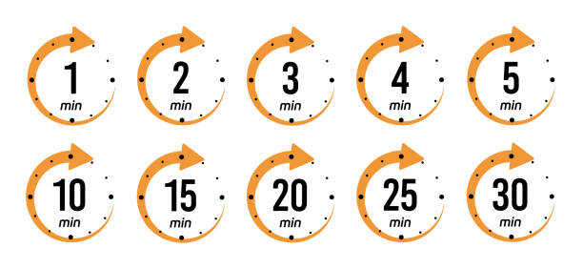
Warm-up Activity
Look at the illustrations: I’m going to show you some pictures from the story we are about to read.
Think about these questions:
Who do you think the characters are?
Where do you think the story takes place?
What do you think is going to happen?

Slide 10
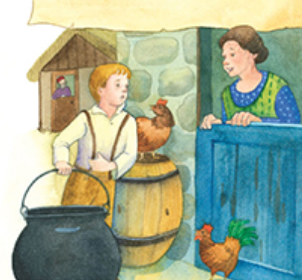
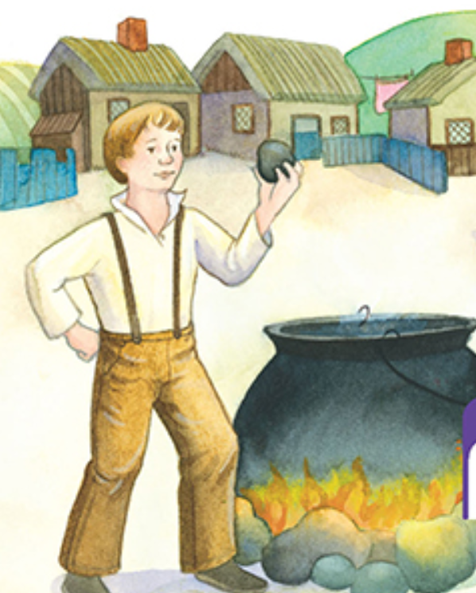
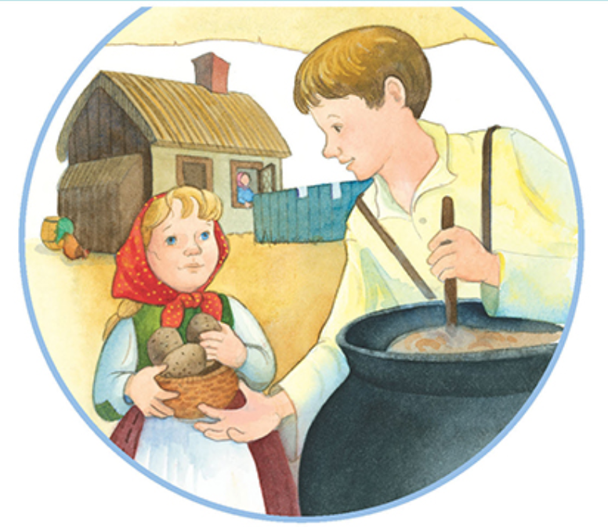
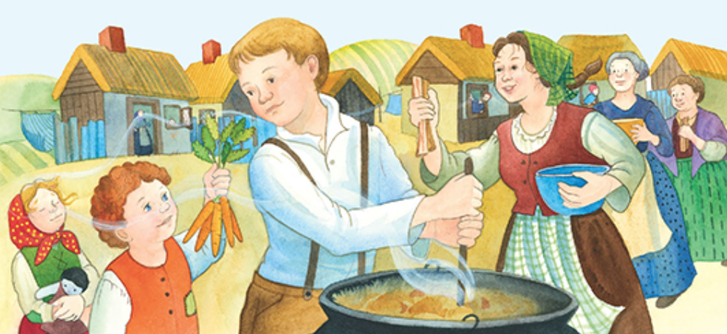
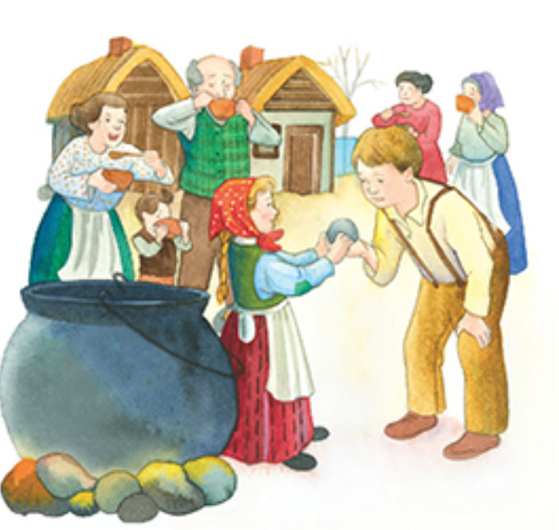

Slide 11
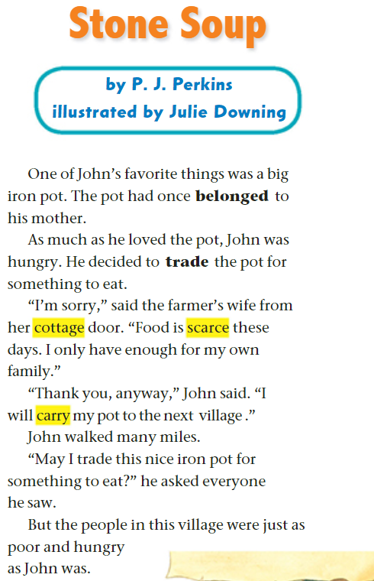


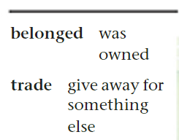
page 28

Slide 12

Discussion Questions on p.28
1. Who is the main character?
2. Who did the pot originally belong to?
3. Describe John’s pot.
4. What is John’s conflict?
5. How does John try to solve his problem?
6. Who does John ask for food first?
7. Why can't the farmer's wife give John food?

Slide 13
Feedback
1. Who is the main character?
2. Who did the pot originally belong to?
3. Describe John’s pot.
4. What is John’s conflict?
5. How does John try to solve his problem?
6. Who does John ask for food first?
7. Why can't the farmer's wife give John food?

Slide 14

Discussion Questions on p. 28
8. Where does John decide to carry his pot next?
9. Are the people in the next village able to help John?
Use the words belong and trade in complete and meaningful sentences of your own.

Slide 15
Feedback
8. Where does John decide to carry his pot next?
9. Are the people in the next village able to help John?
No
Use the words belong and trade in complete and meaningful sentences of your own.
belong: This book belongs to me; I bought it last week.
trade: I traded my bicycle for a scooter.

Slide 16
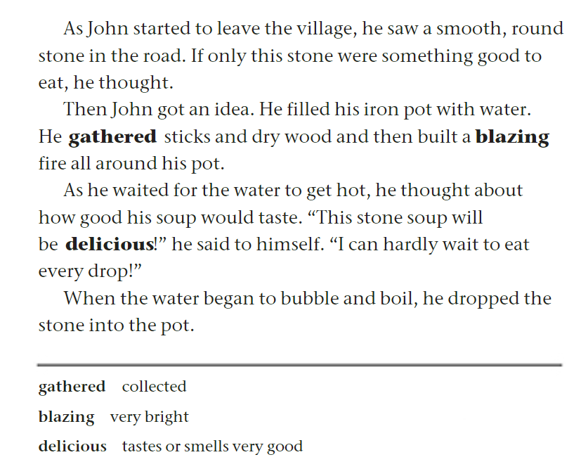
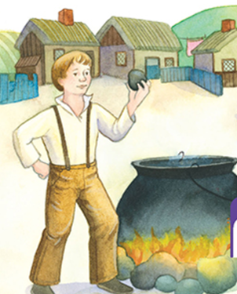
page 29

Slide 17
Discussion Questions on page 29
1. What did John see in the road as he started to leave the village?
2. What materials did John gather to build a fire?
3. What did John think about the stone soup he was making?
4. What did John do when the water began to boil?
5. What is the major event that occurs in this part of the story?
6. Find examples of past regular verbs, and past irregular verbs.

Slide 18
Feedback
1. What did John see in the road as he started to leave the village?
2. What materials did John gather to build a fire?
3. What did John think about the stone soup he was making?
4. What did John do when the water began to boil?
5. What is the major event that occurs in this part of the story? John built a fire, and he put the stone into a pot of boiling water.
6. Find examples of past regular verbs, and past irregular verbs.
6. regular: started, filled, gathered, waited, dropped
irregular: saw, thought, got, built, would, said, began

Slide 19

Linking to Life
Have you ever felt like you needed help but didn’t get it?
How did that make you feel?

Slide 20


Buzz in!
Critical Thinking:
Imagine you are one of the hungry villagers. Would you give food to John or keep it? Why?

Slide 21
IRS

Slide 22
IRS
The genre of “Stone Soup” is ___.
1. a fable
2. an informational text
3. a folktale
4. a fairy tale

Slide 23
IRS
The genre of “Stone Soup” is ___.
1. a fable
2. an informational text
3. a folktale
4. a fairy tale

Slide 24
IRS
The setting of “Stone Soup” is ___.
1. long ago, in a forest
2. in summer, at the beach
3. in the future, in a big city
4. long ago, in a village

Slide 25
IRS
The setting of “Stone Soup” is ___.
1. long ago, in a forest
2. in summer, at the beach
3. in the future, in a big city
4. long ago, in a village

Slide 26
IRS
What is John’s main conflict at the beginning of the story?
1. He wants to cook, but he has no fire.
2. He has too much food and doesn’t know how to share it.
3. He loves his pot, but he is very hungry.
4. He’s bored and looking for friends to play with.

Slide 27
IRS
What is John’s main conflict at the beginning of the story?
1. He wants to cook, but he has no fire.
2. He has too much food and doesn’t know how to share it.
3. He loves his pot, but he is very hungry.
4. He’s bored and looking for friends to play with.

Slide 28


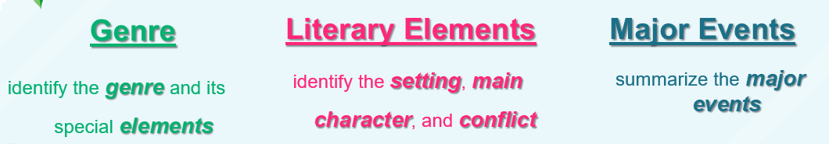
Please indicate your understanding of today’s learning outcomes by showing a thumbs up or thumbs down.

