Slide 1
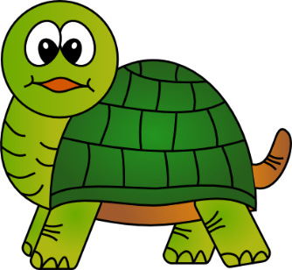
7Db:Adaptations
(Pg.60+61)

Slide 2
Choose the correct answer
1._________ Are places where organisms live in.
a. ecosystem
b. habitat
c. Humans

Slide 3







WRONG

Slide 4
Choose the correct answer
2. Plants are ______.
a. organisms
b. Living things
c. Both of them are correct

Slide 5
WRONG

Slide 6
Choose the correct answer
3. __________means non-living, like:
a. The physical
b. animals
c. Plants

Slide 7
WRONG

Slide 8
Choose the correct answer
4. __________means the conditions in a habitat.
a.Environment
b. Ecosystem
c. Both of them

Slide 9
WRONG

Slide 10

YOU ARE
AWESOME

