Slide 1
Unit: Ecosystem
Lesson: Adaptions
Grade: Seven

Slide 2

ISLAMIC EDUCATIONAL COLLEGE DATE: / / 2024 :
SUBJECT: Science
GRADE: 7
UNIT: Ecosystem
Lesson: Adaptions
LESSON
OBJECTIVES
01:00 minute
Objectives:
* Define Adaptation.
* Explain some adaptations in different organisms.
WARM UP
PREASSESSMENT
PRESENTATION
FORMATIVE ASSESSMENT
FEEDBACK
DIFFERENTIATION
REAL LIFE APPLICATION
CRITICAL THINKING
EXIT TICKET

Slide 3
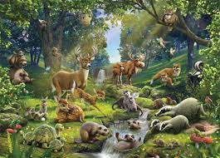
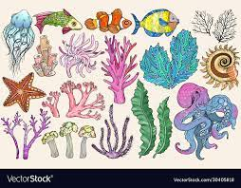
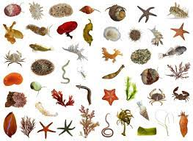
ISLAMIC EDUCATIONAL COLLEGE DATE: / / 2024 :
SUBJECT: Science
GRADE: 7
UNIT: Ecosystem
Lesson: Adaptions
LESSON
OBJECTIVES
The Organisms
01:00 minute
WARM UP
PREASSESSMENT
PRESENTATION
FORMATIVE ASSESSMENT
FEEDBACK
DIFFERENTIATION
Living things
REAL LIFE APPLICATION
CRITICAL THINKING
EXIT TICKET

Slide 4
ISLAMIC EDUCATIONAL COLLEGE DATE: / / 2024 :
SUBJECT: Science
GRADE: 7
UNIT: Ecosystem
Lesson: Adaptions
LESSON
OBJECTIVES
Ecosystem
Environment
01:00 minute
WARM UP
PREASSESSMENT
PRESENTATION
Physical
Environmental
Factors
FORMATIVE ASSESSMENT
Habitat
Community
FEEDBACK
DIFFERENTIATION
REAL LIFE APPLICATION
CRITICAL THINKING
EXIT TICKET

Slide 5
ISLAMIC EDUCATIONAL COLLEGE DATE: / / 2024 :
Activity:
How animals live in their habitat?
SUBJECT: Science
GRADE: 7
UNIT: Ecosystem
Lesson: Adaptions
LESSON
OBJECTIVES
01:00 minute
WARM UP
PREASSESSMENT
PRESENTATION
FORMATIVE ASSESSMENT
FEEDBACK
DIFFERENTIATION
REAL LIFE APPLICATION
CRITICAL THINKING
EXIT TICKET

Slide 6
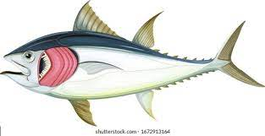
ISLAMIC EDUCATIONAL COLLEGE DATE: / / 2024 :
SUBJECT: Science
GRADE: 7
UNIT: Ecosystem
Lesson: Adaptions
LESSON
OBJECTIVES
01:00 minute
WARM UP
PREASSESSMENT
PRESENTATION
FORMATIVE ASSESSMENT
FEEDBACK
How Fish Adapt in the water?
DIFFERENTIATION
REAL LIFE APPLICATION
CRITICAL THINKING
EXIT TICKET

Slide 7
ISLAMIC EDUCATIONAL COLLEGE DATE: / / 2024 :
SUBJECT: Science
GRADE: 7
UNIT: Ecosystem
Lesson: Adaptions
LESSON
OBJECTIVES
01:00 minute
WARM UP
Fins
PREASSESSMENT
PRESENTATION
FORMATIVE ASSESSMENT
FEEDBACK
Gills
DIFFERENTIATION
REAL LIFE APPLICATION
CRITICAL THINKING
EXIT TICKET

Slide 8
ISLAMIC EDUCATIONAL COLLEGE DATE: / / 2024 :
SUBJECT: Science
GRADE: 7
UNIT: Ecosystem
Lesson: Adaptions
LESSON
OBJECTIVES
01:00 minute
WARM UP
PREASSESSMENT
PRESENTATION
How Fish Adapt in the water?
FORMATIVE ASSESSMENT
FEEDBACK
The features of fish | The importance
fins | to swim
gills | To breathe
DIFFERENTIATION
REAL LIFE APPLICATION
CRITICAL THINKING
EXIT TICKET

Slide 9
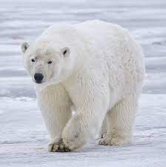
ISLAMIC EDUCATIONAL COLLEGE DATE: / / 2024 :
SUBJECT: Science
GRADE: 7
UNIT: Ecosystem
Lesson: Adaptions
LESSON
OBJECTIVES
01:00 minute
WARM UP
How Polar Bear Adapt
in the Arctic?
PREASSESSMENT
PRESENTATION
FORMATIVE ASSESSMENT
FEEDBACK
DIFFERENTIATION
REAL LIFE APPLICATION
CRITICAL THINKING
EXIT TICKET

Slide 10
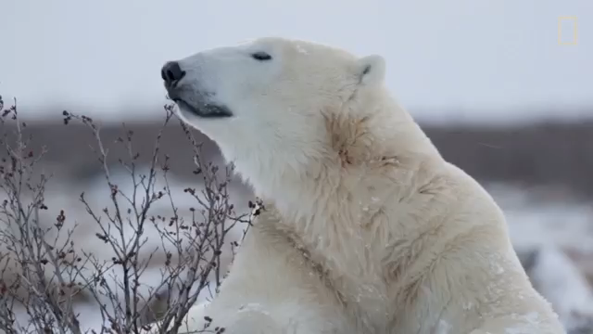
ISLAMIC EDUCATIONAL COLLEGE DATE: / / 2024 :
SUBJECT: Science
GRADE: 7
UNIT: Ecosystem
Lesson: Adaptions
LESSON
OBJECTIVES
01:00 minute
WARM UP
PREASSESSMENT
PRESENTATION
FORMATIVE ASSESSMENT
FEEDBACK
DIFFERENTIATION
REAL LIFE APPLICATION
CRITICAL THINKING
EXIT TICKET

Slide 11
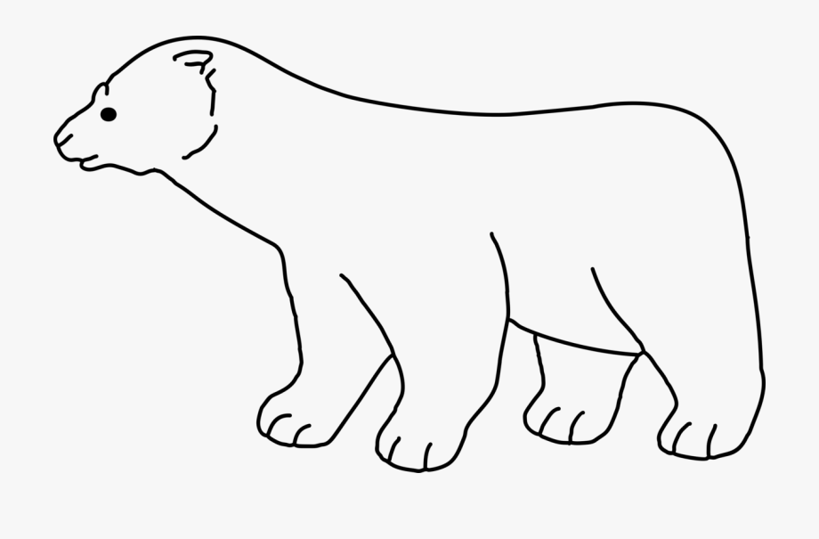
small ears
Thick and white fur
The feature of the polar bear. | Its function
Small ears | To stop it losing too much heat
Fur: White color | Camouflage( creeping up on seals without being seen)
Large feet | To spread out its weight . To stop it form sinking To swim
Rough soles | To grip the ice
Thick fur | - help keep it warm .
Large feet
Rough soles

Slide 12
ISLAMIC EDUCATIONAL COLLEGE DATE: / / 2024 :
SUBJECT: Science
GRADE: 7
UNIT: Ecosystem
Lesson: Adaptions
LESSON
OBJECTIVES
01:00 minute
WARM UP
How can the cactus adapt
in the desert ?
PREASSESSMENT
PRESENTATION
FORMATIVE ASSESSMENT
FEEDBACK
DIFFERENTIATION
REAL LIFE APPLICATION
CRITICAL THINKING
EXIT TICKET

Slide 13
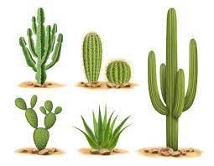
ISLAMIC EDUCATIONAL COLLEGE DATE: / / 2024 :
SUBJECT: Science
GRADE: 7
UNIT: Ecosystem
Lesson: Adaptions
LESSON
OBJECTIVES
What you can see in this picture? Name their habitat?
01:00 minute
WARM UP
PREASSESSMENT
PRESENTATION
FORMATIVE ASSESSMENT
FEEDBACK
DIFFERENTIATION
REAL LIFE APPLICATION
CRITICAL THINKING
EXIT TICKET

Slide 14
ISLAMIC EDUCATIONAL COLLEGE DATE: / / 2024 :
SUBJECT: Science
GRADE: 7
UNIT: Ecosystem
Lesson: Adaptions
LESSON
OBJECTIVES
1: These are called :
1: non-living things 2: organisms
2: They live in :
1: arctic 2: desert
01:00 minute
WARM UP
PREASSESSMENT
PRESENTATION
FORMATIVE ASSESSMENT
FEEDBACK
DIFFERENTIATION
REAL LIFE APPLICATION
IRS
CRITICAL THINKING
EXIT TICKET

Slide 15
ISLAMIC EDUCATIONAL COLLEGE DATE: / / 2024 :
SUBJECT: Science
GRADE: 7
UNIT: Ecosystem
Lesson: Adaptions
LESSON
OBJECTIVES
01:00 minute
WARM UP
videovideoplayback.mp4
PREASSESSMENT
PRESENTATION
FORMATIVE ASSESSMENT
FEEDBACK
DIFFERENTIATION
REAL LIFE APPLICATION
CRITICAL THINKING
EXIT TICKET

Slide 16
ISLAMIC EDUCATIONAL COLLEGE DATE: / / 2024 :
SUBJECT: Science
GRADE: 7
UNIT: Ecosystem
Lesson: Adaptions
LESSON
OBJECTIVES
01:00 minute
1: A cactus has:
1: thick stem 2: leaves
2: A cactus has thin and long____:
1: stem 2: roots
WARM UP
PREASSESSMENT
PRESENTATION
FORMATIVE ASSESSMENT
FEEDBACK
DIFFERENTIATION
REAL LIFE APPLICATION
R.P
CRITICAL THINKING
EXIT TICKET

Slide 17
ISLAMIC EDUCATIONAL COLLEGE DATE: / / 2024 :
SUBJECT: Science
GRADE: 7
UNIT: Ecosystem
Lesson: Adaptions
LESSON
OBJECTIVES
01:00 minute
Spines
WARM UP
No Leaves
PREASSESSMENT
PRESENTATION
FORMATIVE ASSESSMENT
Roots
Stem
FEEDBACK
DIFFERENTIATION
REAL LIFE APPLICATION
CRITICAL THINKING
EXIT TICKET

Slide 18
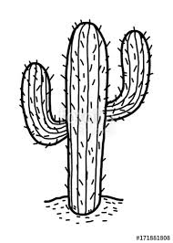
DIFFERENTIATION:
2+4
Thin and Long roots

Slide 19
DIFFERENTIATION
3+1
The feature | Its function
The feature | Its function
The feature | Its function
The feature | Its function

Slide 20
The feature of an cactus | Its function
No leaves | To lose less water
spines | To protect it from animals
Thick stem | To store water
Thin and long roots | To absorb as much water as possible when it rains.

Slide 21

ISLAMIC EDUCATIONAL COLLEGE DATE: / / 2024 :
SUBJECT: Science
GRADE: 7
UNIT: Ecosystem
Lesson: Adaptions
LESSON
OBJECTIVES
01:00 minute
WARM UP
Answer the following task?
PREASSESSMENT
PRESENTATION
FORMATIVE ASSESSMENT
FEEDBACK
DIFFERENTIATION
REAL LIFE APPLICATION
CRITICAL THINKING
EXIT TICKET

Slide 22
ISLAMIC EDUCATIONAL COLLEGE DATE: / / 2024 :
SUBJECT: Science
GRADE: 7
UNIT: Ecosystem
Lesson: Adaptions
LESSON
OBJECTIVES
01:00 minute
Adaptation
The features that something has to enable it do a certain job or survive in a particular place.
WARM UP
PREASSESSMENT
PRESENTATION
FORMATIVE ASSESSMENT
FEEDBACK
DIFFERENTIATION
REAL LIFE APPLICATION
CRITICAL THINKING
EXIT TICKET

Slide 23
ISLAMIC EDUCATIONAL COLLEGE DATE: / / 2024 :
SUBJECT: Science
GRADE: 7
UNIT: Ecosystem
Lesson: Adaptions
LESSON
OBJECTIVES
01:00 minute
What will happen if the cactus has wide and big leaves?
WARM UP
PREASSESSMENT
PRESENTATION
FORMATIVE ASSESSMENT
FEEDBACK
DIFFERENTIATION
REAL LIFE APPLICATION
CRITICAL THINKING
Buzz in
EXIT TICKET

Slide 24
ISLAMIC EDUCATIONAL COLLEGE DATE: / / 2024 :
SUBJECT: Science
GRADE: 7
UNIT: Ecosystem
Lesson: Adaptions
LESSON
OBJECTIVES
01:00 minute
WARM UP
How the cactus Adapt in
its Habitat?
PREASSESSMENT
PRESENTATION
FORMATIVE ASSESSMENT
FEEDBACK
DIFFERENTIATION
REAL LIFE APPLICATION
CRITICAL THINKING
EXIT TICKET

Slide 25
ISLAMIC EDUCATIONAL COLLEGE DATE: / / 2024 :
SUBJECT: Science
GRADE: 7
UNIT: Ecosystem
Lesson: Adaptions
LESSON
OBJECTIVES
01:00 minute
WARM UP
How the jack rabbit Adapt in
its Habitat?
PREASSESSMENT
PRESENTATION
FORMATIVE ASSESSMENT
FEEDBACK
DIFFERENTIATION
REAL LIFE APPLICATION
CRITICAL THINKING
EXIT TICKET

Slide 26
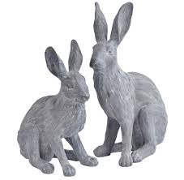
ISLAMIC EDUCATIONAL COLLEGE DATE: / / 2024 :
SUBJECT: Science
GRADE: 7
UNIT: Ecosystem
Lesson: Adaptions
LESSON
OBJECTIVES
01:00 minute
What can you see?
WARM UP
PREASSESSMENT
PRESENTATION
FORMATIVE ASSESSMENT
FEEDBACK
DIFFERENTIATION
REAL LIFE APPLICATION
CRITICAL THINKING
EXIT TICKET

Slide 27
ISLAMIC EDUCATIONAL COLLEGE DATE: / / 2024 :
SUBJECT: Science
GRADE: 7
UNIT: Ecosystem
Lesson: Adaptions
LESSON
OBJECTIVES
01:00 minute
1: these are called :
1: non-living things 2: organisms
2: they live in :
1: arctic 2: desert
WARM UP
PREASSESSMENT
PRESENTATION
FORMATIVE ASSESSMENT
FEEDBACK
DIFFERENTIATION
REAL LIFE APPLICATION
CRITICAL THINKING
EXIT TICKET

Slide 28
ISLAMIC EDUCATIONAL COLLEGE DATE: / / 2024 :
SUBJECT: Science
GRADE: 7
UNIT: Ecosystem
Lesson: Adaptions
LESSON
OBJECTIVES
02:00 minute
video
WARM UP
PREASSESSMENT
PRESENTATION
FORMATIVE ASSESSMENT
FEEDBACK
DIFFERENTIATION
REAL LIFE APPLICATION
CRITICAL THINKING
EXIT TICKET

Slide 29
ISLAMIC EDUCATIONAL COLLEGE DATE: / / 2024 :
SUBJECT: Science
GRADE: 7
UNIT: Ecosystem
Lesson: Adaptions
LESSON
OBJECTIVES
02:00 minute
1: jack rabbit has :
1: short legs 2: large hind legs
2: jack rabbit can get water by:
1: drinking water direct 2: eating food
WARM UP
PREASSESSMENT
PRESENTATION
FORMATIVE ASSESSMENT
FEEDBACK
DIFFERENTIATION
REAL LIFE APPLICATION
CRITICAL THINKING
EXIT TICKET

Slide 30
ISLAMIC EDUCATIONAL COLLEGE DATE: / / 2024 :
SUBJECT: Science
GRADE: 7
UNIT: Ecosystem
Lesson: Adaptions
LESSON
OBJECTIVES
Answer the following task:
02:00 minute
WARM UP
PREASSESSMENT
PRESENTATION
FORMATIVE ASSESSMENT
FEEDBACK
DIFFERENTIATION
REAL LIFE APPLICATION
CRITICAL THINKING
EXIT TICKET

Slide 31
ISLAMIC EDUCATIONAL COLLEGE DATE: / / 2024 :
SUBJECT: Science
GRADE: 7
UNIT: Ecosystem
Lesson: Adaptions
LESSON
OBJECTIVES
What will happen if a jack rabbit live in cold place?
02:00 minute
WARM UP
PREASSESSMENT
PRESENTATION
FORMATIVE ASSESSMENT
FEEDBACK
DIFFERENTIATION
REAL LIFE APPLICATION
CRITICAL THINKING
EXIT TICKET

Slide 32
ISLAMIC EDUCATIONAL COLLEGE DATE: / / 2024 :
SUBJECT: Science
GRADE: 7
UNIT: Ecosystem
Lesson: Adaptions
LESSON
OBJECTIVES
How can a jack rabbit live in its habitat?
02:00 minute
WARM UP
PREASSESSMENT
PRESENTATION
FORMATIVE ASSESSMENT
FEEDBACK
DIFFERENTIATION
REAL LIFE APPLICATION
CRITICAL THINKING
EXIT TICKET

Slide 33
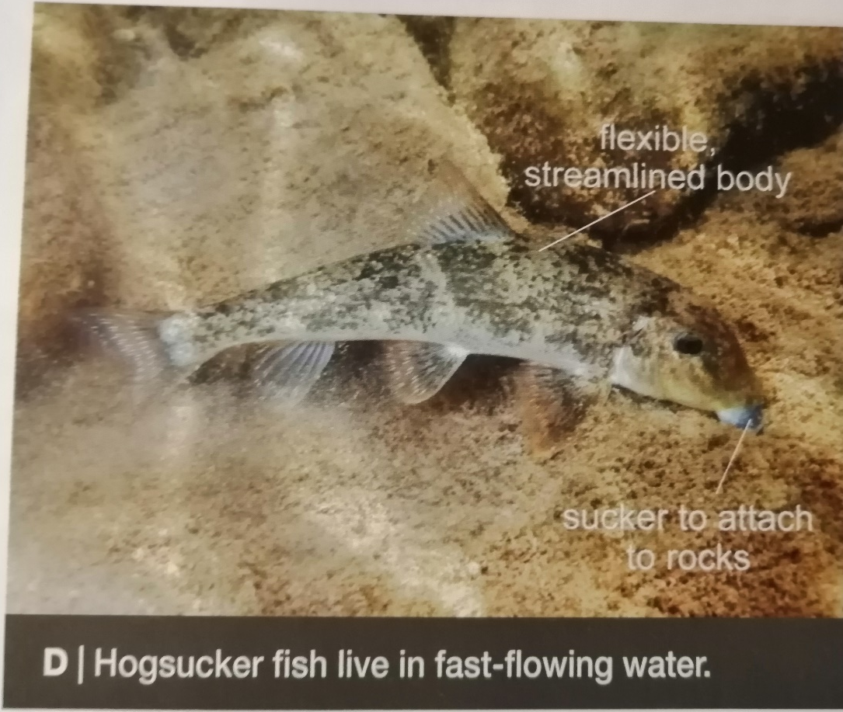
ISLAMIC EDUCATIONAL COLLEGE DATE: / / 2024 :
SUBJECT: Science
GRADE: 7
UNIT: Ecosystem
Lesson: Adaptions
LESSON
OBJECTIVES
01:00 minute
WARM UP
PREASSESSMENT
PRESENTATION
FORMATIVE ASSESSMENT
FEEDBACK
DIFFERENTIATION
REAL LIFE APPLICATION
CRITICAL THINKING
EXIT TICKET

Slide 34
ISLAMIC EDUCATIONAL COLLEGE DATE: / / 2024 :
SUBJECT: Science
GRADE: 7
UNIT: Ecosystem
Lesson: Adaptions
LESSON
OBJECTIVES
01:00 minute
WARM UP
PREASSESSMENT
How the Hogsucker adapt
in the fast-flowing water?
PRESENTATION
FORMATIVE ASSESSMENT
FEEDBACK
DIFFERENTIATION
REAL LIFE APPLICATION
CRITICAL THINKING
EXIT TICKET

Slide 35
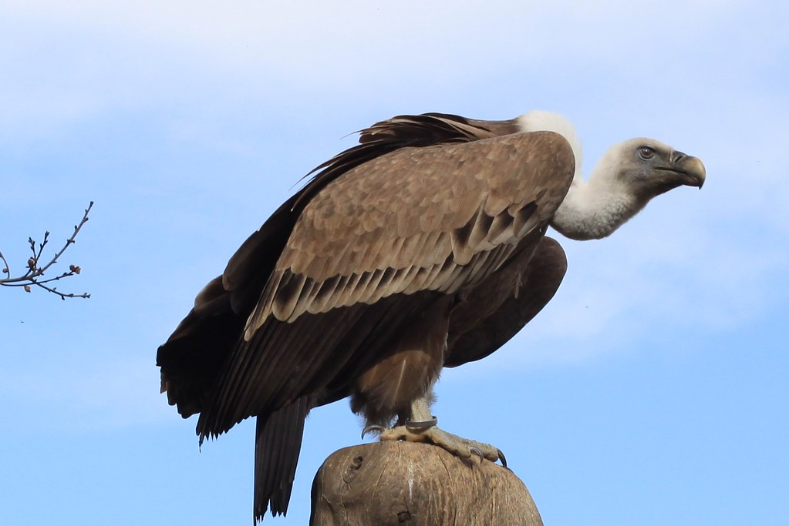
ISLAMIC EDUCATIONAL COLLEGE DATE: / / 2024 :
SUBJECT: Science
GRADE: 7
UNIT: Ecosystem
Lesson: Adaptions
LESSON
OBJECTIVES
FACT:
Many organisms are adapted to their habitats by both their features and their behavior (what they do).
Example:
Vultures in dessert urinate on their legs!
The urine evaporates, which cools the birds down.
01:00 minute
WARM UP
PREASSESSMENT
PRESENTATION
FORMATIVE ASSESSMENT
FEEDBACK
DIFFERENTIATION
REAL LIFE APPLICATION
CRITICAL THINKING
EXIT TICKET

Slide 36
ISLAMIC EDUCATIONAL COLLEGE DATE: / / 2024 :
SUBJECT: Science
GRADE: 7
UNIT: Ecosystem
Lesson: Adaptions
LESSON
OBJECTIVES
01:00 minute
WARM UP
Give an example about an animal
And its adaptation
PREASSESSMENT
PRESENTATION
FORMATIVE ASSESSMENT
FEEDBACK
DIFFERENTIATION
REAL LIFE APPLICATION
CRITICAL THINKING
EXIT TICKET

Slide 37
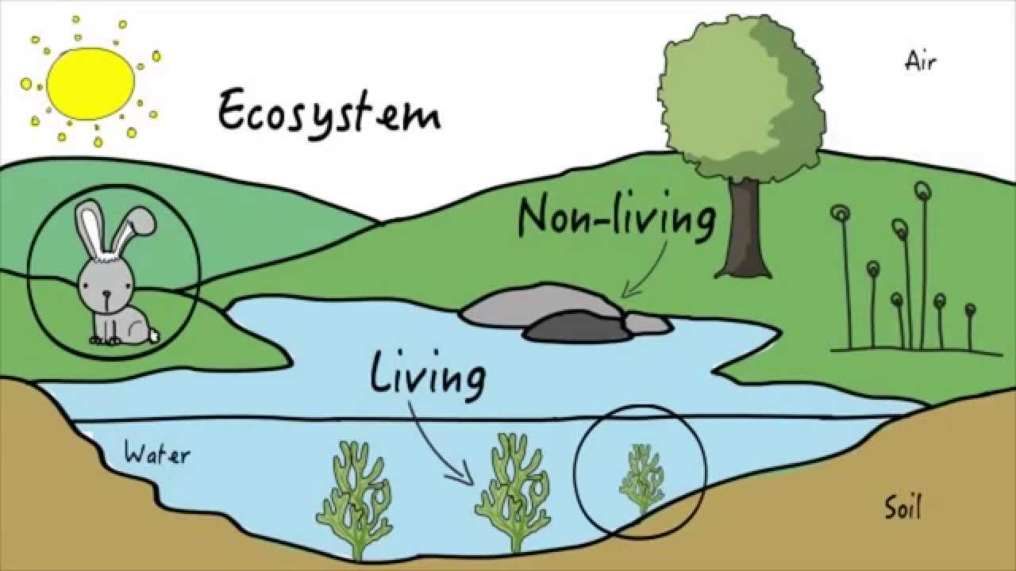
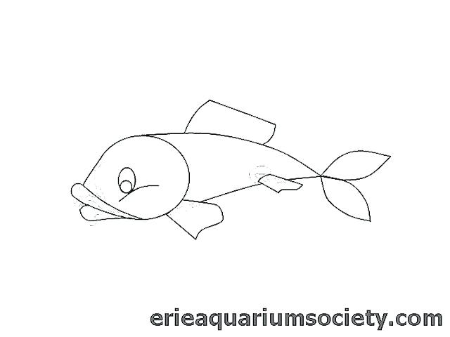
FINS
GILLS
The features of fish | The importance
fins | to swim
gills | To breathe
Organisms: Are living things( plants, animals, humans)
Environment: The conditions in a habitat caused by physical environmental factors.
Habitat: A place where organisms live in.
The physical environmental factors: The physical: means non-living, like:( air, water, light, temperature, wind) ,
Environmental: conditions hot, cool, cold, ice, wet, dry, light dark, sunny, windy, …Factors: thing
Ecosystem: is formed from the community of organisms and all the physical environment factors in a habitat.
Community: all the animals and plants live in a habitat .
Adaptation the features that something has to enable it do a certain job or survive in a particular place .
in a particular place .
Living things or organisms | Non living things
Rabbit | Sunlight
Tree | Air
Grass | Soil and rock
Sea plant | Water

Slide 38
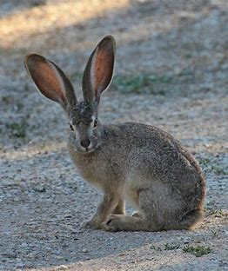
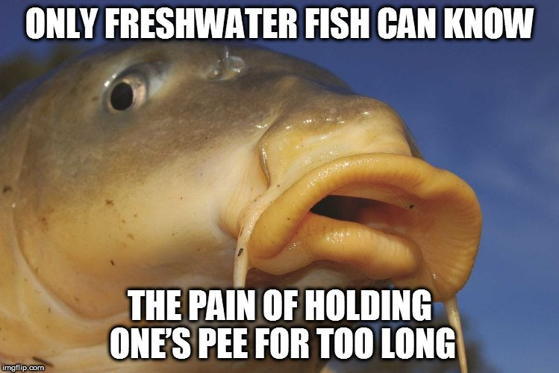
How can hogsucker fish live in fast flowing water.
Have suckers to allow them attach to rocks and stop them being swept away
small ears
Thick and white fur
No leaves
spines
Large feet
Thick stem
Thin and Long roots
Rough soles
The feature of an jack rabbit | Its function
Large ears | 1.To allow heat to escape 2:to improve hearing
mouth | Does not drink direct it gets water from eating food
Large hind legs | To run away quickly from animals ( its speed = up to70% km/h)
The feature of the polar bear. | Its function
Small ears | To stop it losing too much heat
Fur: White color | Camouflage( creeping up on seals without being seen)
Large feet | To spread out its weight . To stop it form sinking To swim
Rough soles | To grip the ice
Thick fur | - help keep it warm .
The feature of an cactus | Its function
No leaves | To lose less water
spines | To protect it from animals
Thick stem | To store water
Thin and long roots | To absorb as much water as possible when it rains.
Camouflage means hide from enemy or their pray.
The saguaro cactus can absorb a tonne of water a day after a storm.

