Slide 1
Unit: Ecosystem
Lesson: Adaptations ( pg.60+61)
Grade: Seven

Slide 2

ISLAMIC EDUCATIONAL COLLEGE DATE: / / 2024 :
SUBJECT: Science
GRADE: 7
UNIT: Ecosystem
Lesson:Adaptations
LESSON
OBJECTIVES
01:00 minute
Objectives:
* Define the scientific terms: habitat, environment, physical environmental factors, Community, Ecosystem.
WARM UP
PREASSESSMENT
PRESENTATION
FORMATIVE ASSESSMENT
FEEDBACK
DIFFERENTIATION
REAL LIFE APPLICATION
CRITICAL THINKING
EXIT TICKET

Slide 3
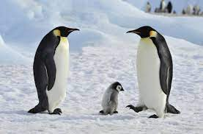
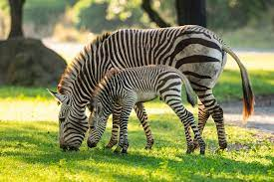
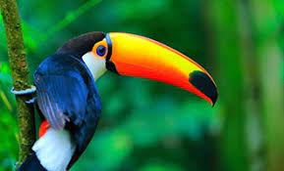
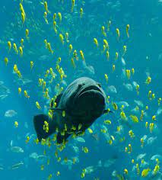
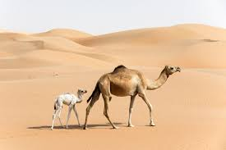
ISLAMIC EDUCATIONAL COLLEGE DATE: / / 2024 :
SUBJECT: Science
GRADE: 7
UNIT: Ecosystem
Lesson: Adaptions
LESSON
OBJECTIVES
01:00 minute
WARM UP
PREASSESSMENT
PRESENTATION
FORMATIVE ASSESSMENT
FEEDBACK
DIFFERENTIATION
REAL LIFE APPLICATION
CRITICAL THINKING
EXIT TICKET

Slide 4

ISLAMIC EDUCATIONAL COLLEGE DATE: / / 2024 :
SUBJECT: Science
GRADE: 7
UNIT: Ecosystem
Lesson: Adaptions
LESSON
OBJECTIVES
02:00 minute
WARM UP
PREASSESSMENT
1. The place where we live is called _____ .
a. habitat b. soil c. water
2. The organisms mean_______ .
a. living things b. non-living things c. only plants
PRESENTATION
FORMATIVE ASSESSMENT
FEEDBACK
DIFFERENTIATION
REAL LIFE APPLICATION
CRITICAL THINKING
IRS
EXIT TICKET

Slide 5
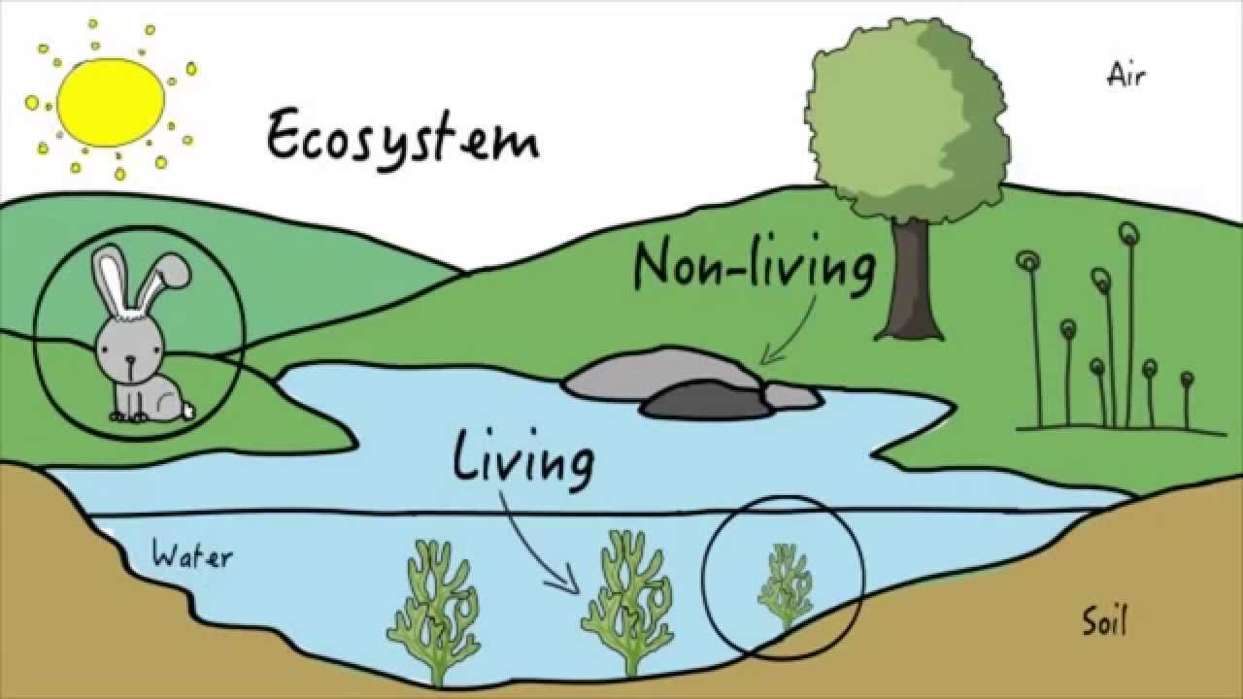
ISLAMIC EDUCATIONAL COLLEGE DATE: / / 2024 :
SUBJECT: Science
GRADE: 7
UNIT: Ecosystem
Lesson: Adaptions
LESSON
OBJECTIVES
01:00 minute
WARM UP
PREASSESSMENT
PRESENTATION
FORMATIVE ASSESSMENT
FEEDBACK
DIFFERENTIATION
community
REAL LIFE APPLICATION
Is formed from the group of organisms and non living things in same place
CRITICAL THINKING
Organisms like:
Non living things like:
habitat like:
EXIT TICKET

Slide 6
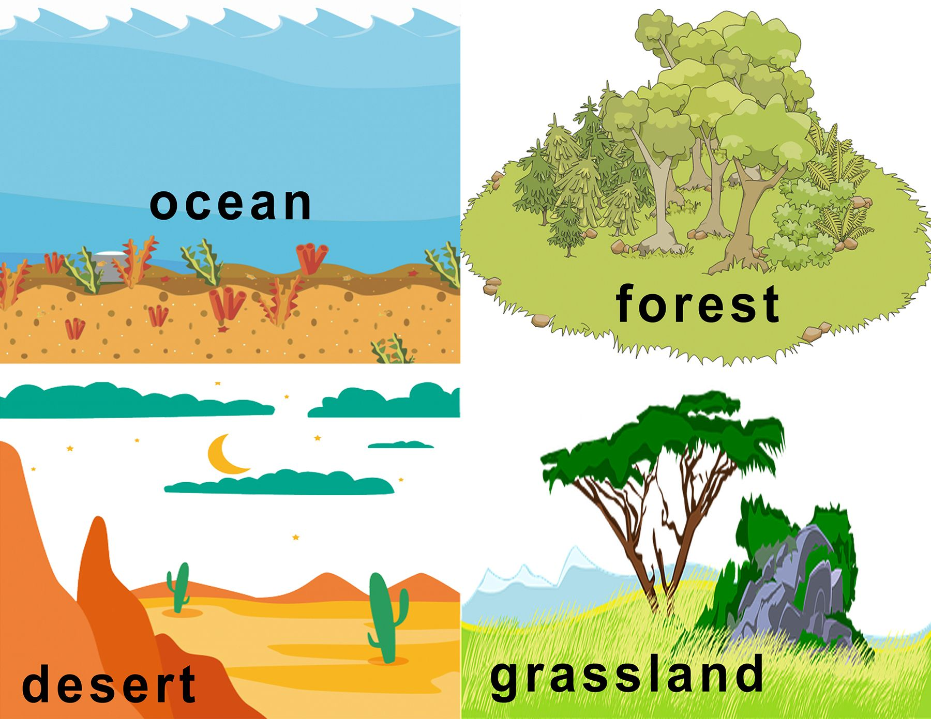

ISLAMIC EDUCATIONAL COLLEGE DATE: / / 2024 :
SUBJECT: Science
GRADE: 7
UNIT: Ecosystem
Lesson: Adaptions
LESSON
OBJECTIVES
01:00 minute
WARM UP
PREASSESSMENT
PRESENTATION
FORMATIVE ASSESSMENT
FEEDBACK
DIFFERENTIATION
Habitat
REAL LIFE APPLICATION
CRITICAL THINKING
EXIT TICKET

Slide 7
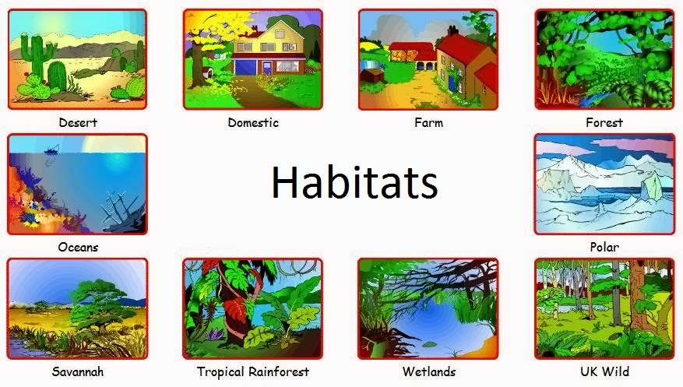
ISLAMIC EDUCATIONAL COLLEGE DATE: / / 2024 :
SUBJECT: Science
GRADE: 7
UNIT: Ecosystem
Lesson: Adaptions
LESSON
OBJECTIVES
01:00 minute
WARM UP
PREASSESSMENT
PRESENTATION
FORMATIVE ASSESSMENT
FEEDBACK
DIFFERENTIATION
REAL LIFE APPLICATION
CRITICAL THINKING
EXIT TICKET

Slide 8
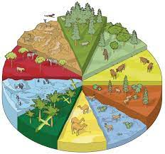
ISLAMIC EDUCATIONAL COLLEGE DATE: / / 2024 :
SUBJECT: Science
GRADE: 7
UNIT: Ecosystem
Lesson: Adaptions
LESSON
OBJECTIVES
The Five Major Habitat:
01:00 minute
WARM UP
PREASSESSMENT
Forests
Grasslands
Deserts
Polar regions
Aquatic habitat.
PRESENTATION
FORMATIVE ASSESSMENT
FEEDBACK
DIFFERENTIATION
REAL LIFE APPLICATION
CRITICAL THINKING
EXIT TICKET

Slide 9

ISLAMIC EDUCATIONAL COLLEGE DATE: / / 2024 :
SUBJECT: Science
GRADE: 7
UNIT: Ecosystem
Lesson: Adaptions
LESSON
OBJECTIVES
01:00 minute
WARM UP
Define Habitat
PREASSESSMENT
PRESENTATION
FORMATIVE ASSESSMENT
FEEDBACK
DIFFERENTIATION
REAL LIFE APPLICATION
CRITICAL THINKING
EXIT TICKET

Slide 10
ISLAMIC EDUCATIONAL COLLEGE DATE: / / 2024 :
SUBJECT: Science
GRADE: 7
UNIT: Ecosystem
Lesson: Adaptions
LESSON
OBJECTIVES
01:00 minute
WARM UP
PREASSESSMENT
The place where living things live is
PRESENTATION
FORMATIVE ASSESSMENT
FEEDBACK
DIFFERENTIATION
REAL LIFE APPLICATION
CRITICAL THINKING
EXIT TICKET

Slide 11
ISLAMIC EDUCATIONAL COLLEGE DATE: / / 2024 :
SUBJECT: Science
GRADE: 7
UNIT: Ecosystem
Lesson: Adaptions
LESSON
OBJECTIVES
01:00 minute
WARM UP
PREASSESSMENT
PRESENTATION
FORMATIVE ASSESSMENT
FEEDBACK
DIFFERENTIATION
REAL LIFE APPLICATION
CRITICAL THINKING
EXIT TICKET

Slide 12
ISLAMIC EDUCATIONAL COLLEGE DATE: / / 2024 :
SUBJECT: Science
GRADE: 7
UNIT: Ecosystem
Lesson: Adaptions
LESSON
OBJECTIVES
Ecosystem
Environment
01:00 minute
WARM UP
PREASSESSMENT
PRESENTATION
Physical
Environmental
Factors
FORMATIVE ASSESSMENT
Habitat
Community
FEEDBACK
DIFFERENTIATION
REAL LIFE APPLICATION
CRITICAL THINKING
EXIT TICKET

Slide 13
ISLAMIC EDUCATIONAL COLLEGE DATE: / / 2024 :
SUBJECT: Science
GRADE: 7
UNIT: Ecosystem
Lesson: Adaptions
LESSON
OBJECTIVES
What is Environment?
01:00 minute
WARM UP
PREASSESSMENT
What is Physical Environmental
Factors?
PRESENTATION
FORMATIVE ASSESSMENT
FEEDBACK
DIFFERENTIATION
REAL LIFE APPLICATION
CRITICAL THINKING
EXIT TICKET

Slide 14
ISLAMIC EDUCATIONAL COLLEGE DATE: / / 2024 :
SUBJECT: Science
GRADE: 7
UNIT: Ecosystem
Lesson: Adaptions
LESSON
OBJECTIVES
01:00 minute
WARM UP
The condition in a habitat are its Environment these conditions caused by Physical Environmental Factors
PREASSESSMENT
PRESENTATION
FORMATIVE ASSESSMENT
FEEDBACK
DIFFERENTIATION
REAL LIFE APPLICATION
CRITICAL THINKING
EXIT TICKET

Slide 15
ISLAMIC EDUCATIONAL COLLEGE DATE: / / 2024 :
SUBJECT: Science
GRADE: 7
UNIT: Ecosystem
Lesson: Adaptions
LESSON
OBJECTIVES
What is Community?
01:00 minute
WARM UP
PREASSESSMENT
PRESENTATION
FORMATIVE ASSESSMENT
FEEDBACK
DIFFERENTIATION
REAL LIFE APPLICATION
CRITICAL THINKING
EXIT TICKET

Slide 16
ISLAMIC EDUCATIONAL COLLEGE DATE: / / 2024 :
SUBJECT: Science
GRADE: 7
UNIT: Ecosystem
Lesson: Adaptions
LESSON
OBJECTIVES
01:00 minute
WARM UP
PREASSESSMENT
PRESENTATION
FORMATIVE ASSESSMENT
All the animal and plant that live in a habitat make up a Community
FEEDBACK
DIFFERENTIATION
REAL LIFE APPLICATION
CRITICAL THINKING
EXIT TICKET

Slide 17
ISLAMIC EDUCATIONAL COLLEGE DATE: / / 2024 :
SUBJECT: Science
GRADE: 7
UNIT: Ecosystem
Lesson: Adaptions
LESSON
OBJECTIVES
01:00 minute
WARM UP
PREASSESSMENT
PRESENTATION
FORMATIVE ASSESSMENT
FEEDBACK
DIFFERENTIATION
REAL LIFE APPLICATION
From this Picture try to conclude
What is the Ecosystem?
CRITICAL THINKING
EXIT TICKET

Slide 18
ISLAMIC EDUCATIONAL COLLEGE DATE: / / 2024 :
SUBJECT: Science
GRADE: 7
UNIT: Ecosystem
Lesson: Adaptions
LESSON
OBJECTIVES
01:00 minute
WARM UP
The community of organisms and all the physical environmental factors in a habitat form an Ecosystem
PREASSESSMENT
PRESENTATION
FORMATIVE ASSESSMENT
FEEDBACK
DIFFERENTIATION
REAL LIFE APPLICATION
CRITICAL THINKING
EXIT TICKET

Slide 19
ISLAMIC EDUCATIONAL COLLEGE DATE: / / 2024 :
SUBJECT: Science
GRADE: 7
UNIT: Ecosystem
Lesson: Adaptions
LESSON
OBJECTIVES
01:00 minute
WARM UP
PREASSESSMENT
What are the new concepts
that we learned today??
PRESENTATION
FORMATIVE ASSESSMENT
FEEDBACK
DIFFERENTIATION
REAL LIFE APPLICATION
CRITICAL THINKING
EXIT TICKET

Slide 20
Student 3
Student 3
Living things or organisms | Non living things
Living things or organisms | Non living things

Slide 21
Organisms: Are living things( plants, animals, humans)
Environment: The conditions in a habitat caused by physical environmental factors.
Habitat: A place where organisms live in.
The physical environmental factors: The physical: means non-living, like:( air, water, light, temperature, wind) ,
Environmental: conditions hot, cool, cold, ice, wet, dry, light dark, sunny, windy, …Factors: thing
Ecosystem: is formed from the community of organisms and all the physical environment factors in a habitat.
Community: all the animals and plants live in a habitat .
Adaptation the features that something has to enable it do a certain job or survive in a particular place .

