Slide 1


Relative clauses

Slide 2
Objectives :
By the end of this lesson, students will be able to:
Identify relative pronouns (who, whom, whose, which, that) and relative adverbs (where, when, why).
Understand what relative clauses are and their function in a sentence.

Slide 3
Watch the video and take notes while watching. .

Slide 4

Think of : 1- A person who always makes you laugh --------- 2- A thing that you use every single day --------- 3- A day when you felt proud of yourself --------- 4- A place where you like to spend time with friends --------- 5- A reason why people should eat healthy food ---------

Slide 5

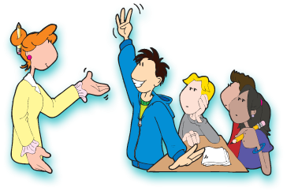

SUBJECT
GRADE
UNIT
LESSON
PRESENTATION
07:00 minutes
Instructions for Students
Take your Bingo sheet. Each box has a sentence (e.g., Find someone who has a pet, Find someone who can play football).
Stand up and move around the indoor playground. Talk to your classmates and ask them questions to match the sentences. Example: If the box says Find someone who likes pizza, ask: “Do you like pizza?”
If the answer is YES:
Write your classmate’s name in that box.
You can only write each person’s name once.
If the answer is NO:
Say thank you and go ask another classmate.
Your goal:
Fill in as many boxes as you can by finding different classmates.
Winning:
When you complete a full row (across, up-and-down, or diagonal), shout “BINGO!”
Keep playing until time is up to see who can fill the most boxes.
Important Rules:
Speak in English.
Be polite when asking and answering.
Keep moving, don’t stay with the same partner too long.

Slide 6
Relative pronouns :
who | subject pronoun for people only. E.g. The teacher who explained the lesson is very kind. teacher who explained the lesson is very kind
whom | Object pronoun for people only. The girl whom we invited came late
which | subject and object pronoun used for things only. E.g. The cake which she made was delicious.
whose | used for possessions. E.g. The girl whose father is a doctor is very smart.
where | used for places. The city where I was born is very beautiful.
when | used for times. The moment when they arrived was happy.

Slide 7
-Identify the relative clause in the following sentence :
The museum that Jordan built attracts many tourists every year.

Slide 8
What is a relative clause or Adjective Clause :
Subject | Relative clause | the verb of the sentence | The complement of the sentence
The man | who helped me | Is | a doctor
The table | which I bought yesterday | Matches | the furniture
The girl | whose dog died | Is | sad

Slide 9


Islamic Educational College
English
Unit 1
Grade 9
Why is it called an adjective clause?
What is the function of the adjective clause ?
The young girl laughed.
The girl who wore a red dress laughed
Because the adjective clause( relative clause) modifies (describes) the noun that comes before just like adjectives.

Slide 10
* The musician is Canadian. He wrote this song. The musician who wrote this song is ( subject/ person) Canadian. * The teacher who explained the lesson is ( subject/ person) smart .
People

Slide 11
My previous house was in Coventry. My previous house was quite small. 1-My previous house, which was quite small, was in Coventry. 2- I did well in chemistry, which was always my favorite subject. 3- The car which I like to own is very expensive .
Things

Slide 12

1. The relative pronoun that is used to modify people is ________________ 2. The relative pronoun that is used to modify things is ______________ 3. The expression which starts with a relative pronoun is called _________ 4. relative clauses are called _______
Formative assessment

Slide 13
1. The little girl whose doll was lost is sad. 2. The woman whose car is a BMW is coming tonight. 3. The teacher whose car was broken lives in my neighborhood .
Which girl is sad ?
What does the girl have ?
Am I modifying the girl by saying that she did something or that she has something ?

Slide 14
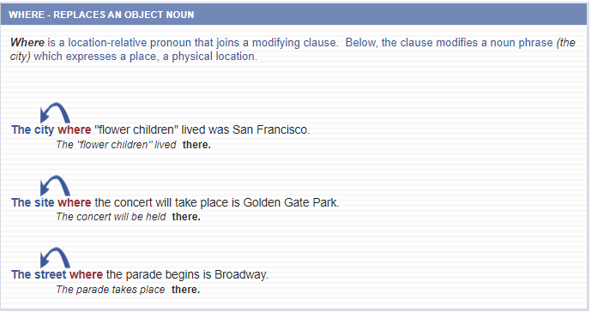
Where :
Where

Slide 15
Which VS Where
1- This is the hospital where I was born .
2- This is the hospital which we read about .
-where → means “in that hospital”. -You are saying what happened there (you were born).
-which → refers to the hospital as a thing in a book or article. •You are giving extra information about it (you read about it, not that something happened inside it).
1- This is the restaurant where I met my best friend .
2- This is the restaurant which is always busy .
-where = in that restaurant → an action happened there (you met your friend).
-which = the restaurant as a thing, and you describe it → “it is always busy.”
1- This is the street where I lost my keys .
2- This is the street which I hate the most .
-where = on that street → an event happened there (you lost your keys).
-which = the street as a thing, and you give your opinion about it.

Slide 16
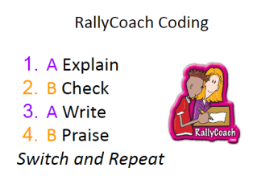
Task: Choose the correct relative pronoun (where / which /whose)
This is the café ________________ we had lunch yesterday.
2. The park _________________ is near my house is very big.
3. Do you know the boy _______________ bicycle was stolen?
4. That's the school ______________ my father studied many years ago.
5. The hotel ______________ we stayed last summer was very comfortable.
6. The city _______________ has many old buildings is famous with tourists.
7. The woman ______________ son is in my class is a doctor.
8. I'll never forget the place _________________ I first saw the sea.
2 minutes

Slide 17
1. The author, whom I met at the book signing, is dead. Subject+ verb 2. Do you know someone whom I can talk about global warming. Subject + verb 3. Morality is simply the attitude we adopt towards people whom we dislike. Subject+ verb
Whom

Slide 18
The man whom I met was a doctor . The girl whom my mom helped is kind

Slide 19
1- There are many reasons why I love teaching . 2- It is the reason why I hate arguing .
Why

Slide 20
When
1- The fourth of July when the US gained independence, is my favorite holiday.
2- The summer when I graduated from university was long and hot.
.

Slide 21
Joining 2 sentences with a relative pronoun

Slide 22
How to combine sentences using a relative pronoun: Step 1: Read both sentences carefully. Step 2: Find the noun in the first sentence that is repeated in the second sentence. Step 3: Choose the correct relative pronoun (who, whom, which, that, whose, where, when, why) and replace the repeated noun in the second sentence. Step 4: Start the second sentence with the relative pronoun. Step 5: Draw a bubble or highlight the noun in the first sentence that the relative pronoun refers to.

Slide 23
Example
Step 1: Find the two words that refer to the same thing/person.
The woman is in my class. She likes tennis.
Step 2: Replace the second word with a relative pronoun (we'll use a subject relative pronoun - that/which/who)
The woman is in my class. SheWHO likes tennis.
Step 3: Move the whole {adjective clause} behind the noun it modifies. These two sentences are both correct:
The woman {who likes tennis} is in my class.

Slide 24
Sentences with "whom":
I know a girl. You met her at the party.
Combined: I know a girl whom you met at the party.
The man is my uncle. You saw him yesterday.
Combined: The man whom you saw yesterday is my uncle.
They hired a consultant. I recommended him to them.
Combined: They hired a consultant whom I recommended to them.
She trusts the friend. I introduced her to her.
Combined: She trusts the friend whom I introduced to her.
The artist is famous. We invited the artist to our event.
Combined: The artist whom we invited to our event is famous.

Slide 25
Example: Sentence 1: I talked to a man. Sentence 2: His wife had died the year before. Step 1: Identify the owner → the man Step 2: Identify what belongs to him → his wife Step 3: Replace his with whose and put it at the beginning of the second sentence → whose wife had died the year before Step 4: Combine the sentences → Result: I talked to a man whose wife had died the year before.

Slide 26
Sentences with "whose":
The boy is in my class. His father is a doctor.
Combined: The boy whose father is a doctor is in my class.
This is the man. The man’s car was stolen.
Combined: This is the man whose car was stolen.
I met a woman. Her brother works at the bank.
Combined: I met a woman whose brother works at the bank.
The student is very intelligent. His answers were all correct.
Combined: The student whose answers were all correct is very intelligent.
She’s the person. Her idea won the competition.
Combined: She’s the person whose idea won the competition.

Slide 27
Sentences with "where":
This is the city. I grew up there.
Combined: This is the city where I grew up.
That’s the school. I studied there.
Combined: That’s the school where I studied.
We visited the country. My grandparents were born in that country.
Combined: We visited the country where my grandparents were born.
This is the place. We first met here.
Combined: This is the place where we first met.
The house is beautiful. I spent my childhood in that house.
Combined: The house where I spent my childhood is beautiful.

Slide 28
Sentences with "when":
I remember the day. We went to the beach that day.
Combined: I remember the day when we went to the beach.
2001 was the year. I moved to this city then.
Combined: 2001 was the year when I moved to this city.
That was the moment. She talked to me at that moment.
Combined: That was the moment when she talked to me
There was a time. People wrote letters by hand at that time.
Combined: There was a time when people wrote letters by hand.
I remember the summer. We traveled to France during that summer.
Combined: I remember the summer when we traveled to France.

Slide 29
The summer was long and hot. I graduated from university in the summer.
→ The summer when I graduated from university was long and hot.

Slide 30
The dog is over there. The dog's / its owner lives next door.
→ The dog whose owner lives next door is over there.
The little girl is sad. The little girl's / her doll was lost.
→ The little girl whose doll was lost is sad.
The woman is coming tonight. Her car is a BMW.
→ The woman whose car is a BMW is coming tonight.
The house belongs to me. Its roof is very old.
→ The house whose roof is old belongs to me.

Slide 31
Defining and non-defining
relative clauses

Slide 32

What is the meaning of Defining and non-defining
Use your phone and google it.

Slide 33

Take notes while watching.

Slide 34
Defining Relative Clauses (essential information, no commas)
-The man who is talking to the teacher is my uncle.(If we remove the clause, we don’t know which man.)
-The book that has a blue cover is mine.(Without the clause, we don’t know which book.)
-The girl whose phone is ringing is my cousin.(The clause tells us which girl.)
Non-Defining Relative Clauses (extra information, commas)
-My uncle, who is talking to the teacher, is very kind.(The clause is just extra information; we still know my uncle.)
-This book, which has a blue cover, is my favorite.(Even if we remove it: “This book is my favorite.” Still clear.)
-Sara, whose phone is ringing, forgot to put it on silent.(We already know Sara; the clause just adds detail.)

Slide 35
Rally Coach Instructions Work with a partner. Sit side by side. One person is the “Coach,” the other is the “Player.” The Player solves the first question on the worksheet. The Coach watches carefully, helps if needed, and checks the answer. Coaching rules: The Coach should guide, not give answers. Say things like: “Check that again,” “Try a different word,” or “Good job!” Switch roles after each question. Now the Coach becomes the Player, and the Player becomes the Coach. Continue until you finish all the worksheet questions. At the end, compare your answers together and be ready to share with the class.

