Slide 1
Letter Mm

Slide 2
Warm up
https://www.youtube.com/watch?v=6tlydXoNC2Q

Slide 3
Outcomes
01
Identify the sound of letter m.
02
Write the letter correctly between the lines.
03
Read words with letter m and use them in senteces.

Slide 4

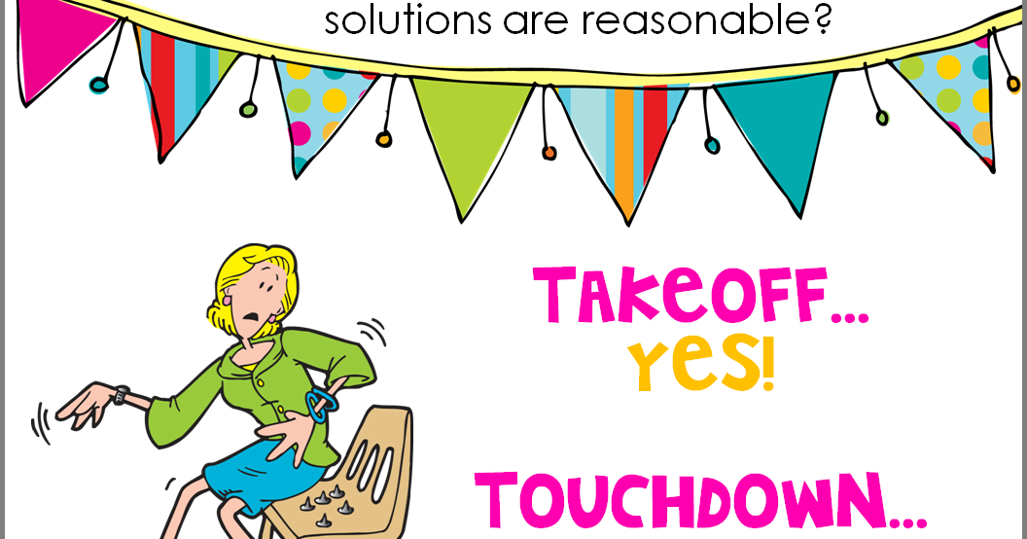
Pre-assessment
Take off or touch down if you know this letter?

Slide 5

What is the name of this letter?
What is the sound of this letter?
/m/

Slide 6
Let’s listen to a song
https://www.youtube.com/watch?v=0O0xmga_mXw

Slide 7

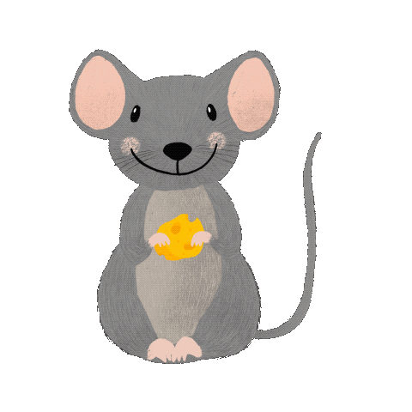


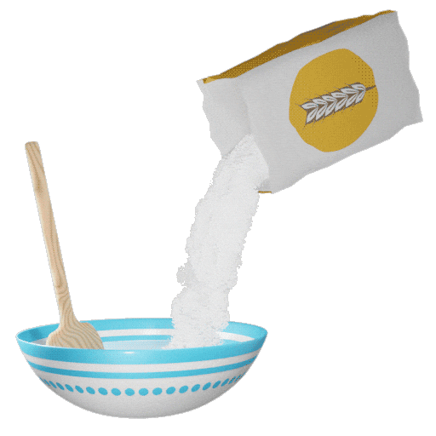

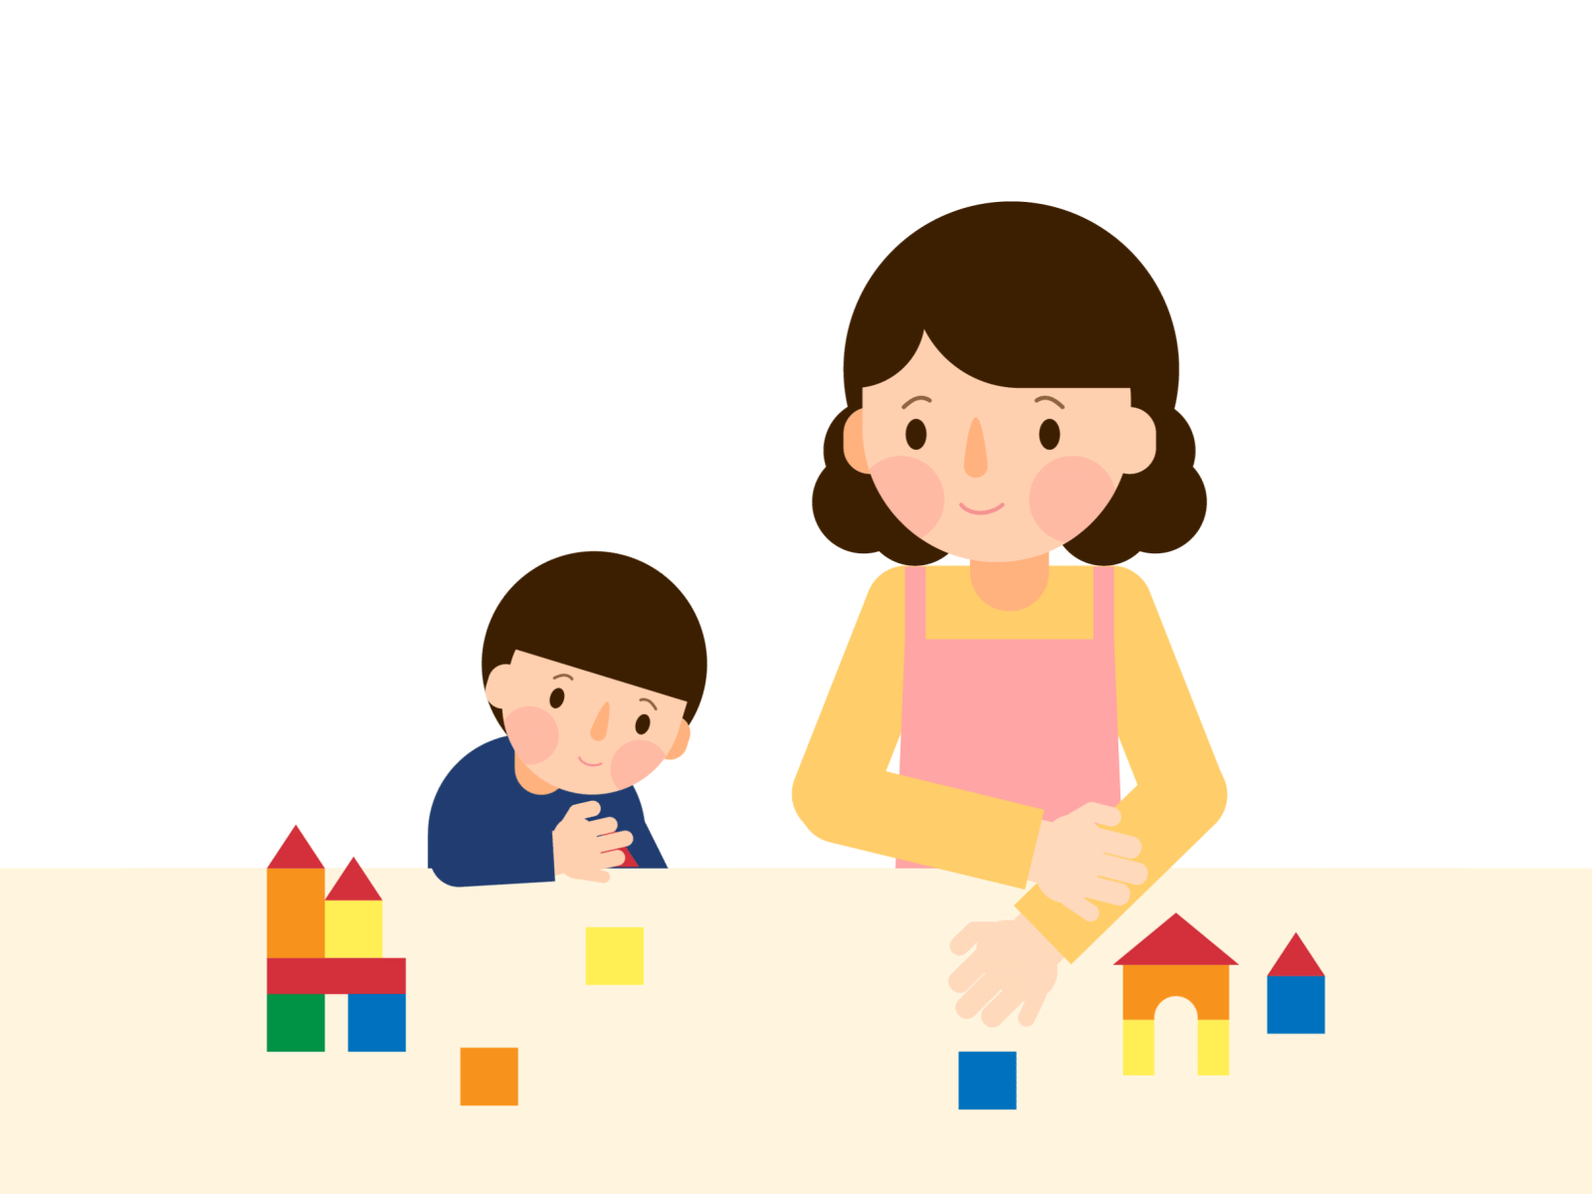
monkey
2:00 min
Random pick
mouse
jam
gum
mom
swim
mix

Slide 8


Real lifr application
Can you think of more words with letter m?
Random pick

Slide 9

How to write small m (lower case m)?
1
2
3

Slide 10

How to write capital M (upper case M)?
1
2
3

Slide 11
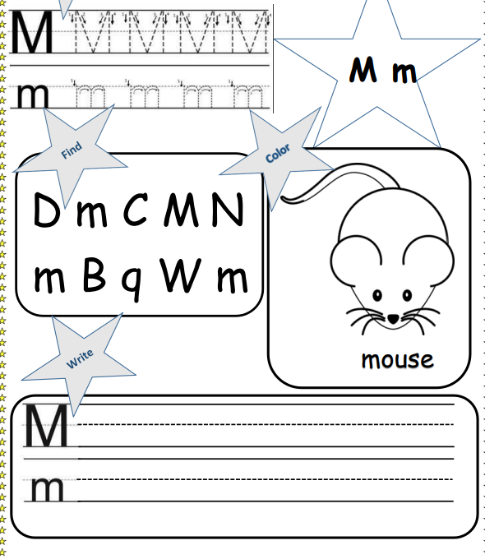

Slide 12
Group work
Unscramble the letters to form words.

Slide 13
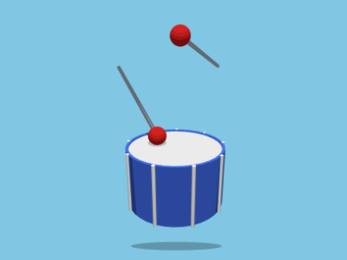
I am a word that ends with m. I make a nice sound. I can be small, or I can be big. Some people find me nice, and others find me noisy. What am I?
Critical thinking
Buzz in

Slide 14
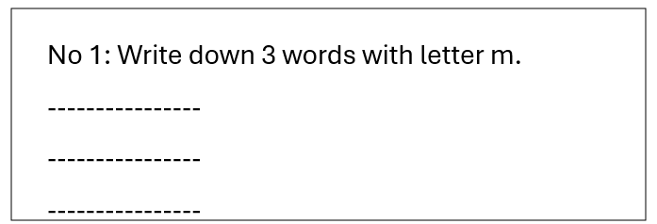
Differentiation
Random pick

Slide 15
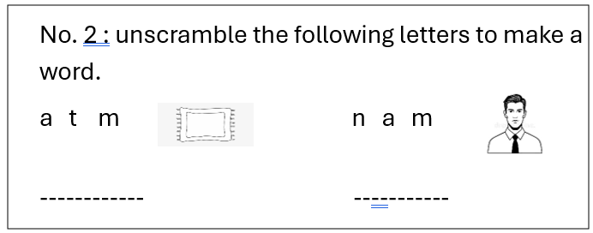
Differentiation
Random pick

Slide 16
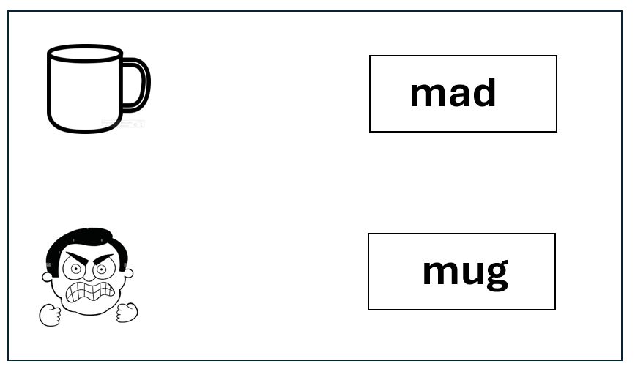
Differentiation
Random pick
No. 3: Match each word with the correct picture..

Slide 17
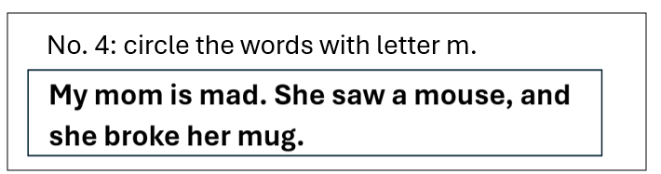
Differentiation
Random pick
No.4 : Circle the words with the letter m.

Slide 18
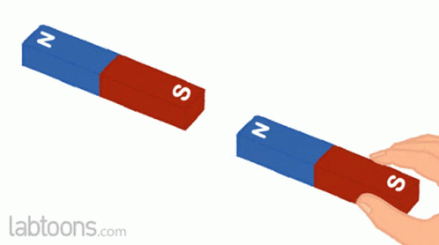

Summative assessment/IRS
Which picture has the /m/ sound in it?
1.
2.

Slide 19
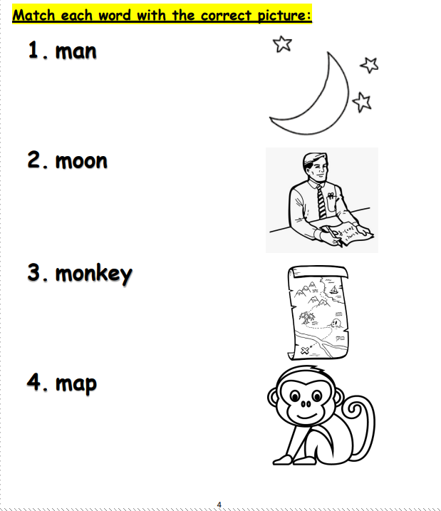

Slide 20
Let’s play a game
https://wordwall.net/resource/30494792/letter-m
5:00 min

