Slide 1

Unit: 1
Lesson: Grammar
Subject: Derivation
Grade: 10

Slide 2


ISLAMIC EDUCATIONAL COLLEGE DATE: :
SUBJECT: derivation
GRADE: 10
UNIT: 1
Lesson: 1
LESSON
OBJECTIVES
OBJECTIVES:
1. to identify the different usages of nouns .
2. to identify the use of verbs .
3. to use the correct forms of nouns and verbs .
01:00 minute
WARM UP
PREASSESSMENT
PRESENTATION
FORMATIVE ASSESSMENT
FEEDBACK
DIFFERENTIATION
REAL LIFE APPLICATION
CRITICAL THINKING
EXIT TICKET

Slide 3
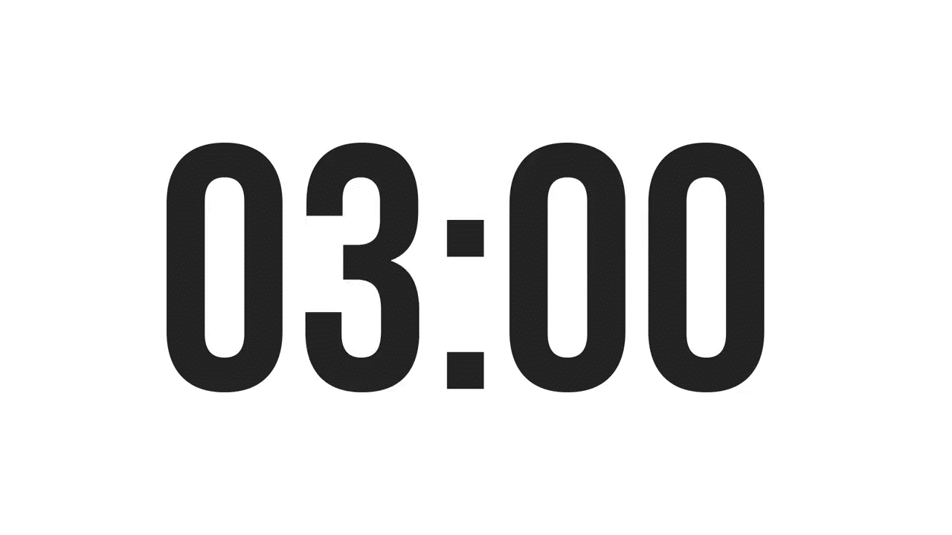
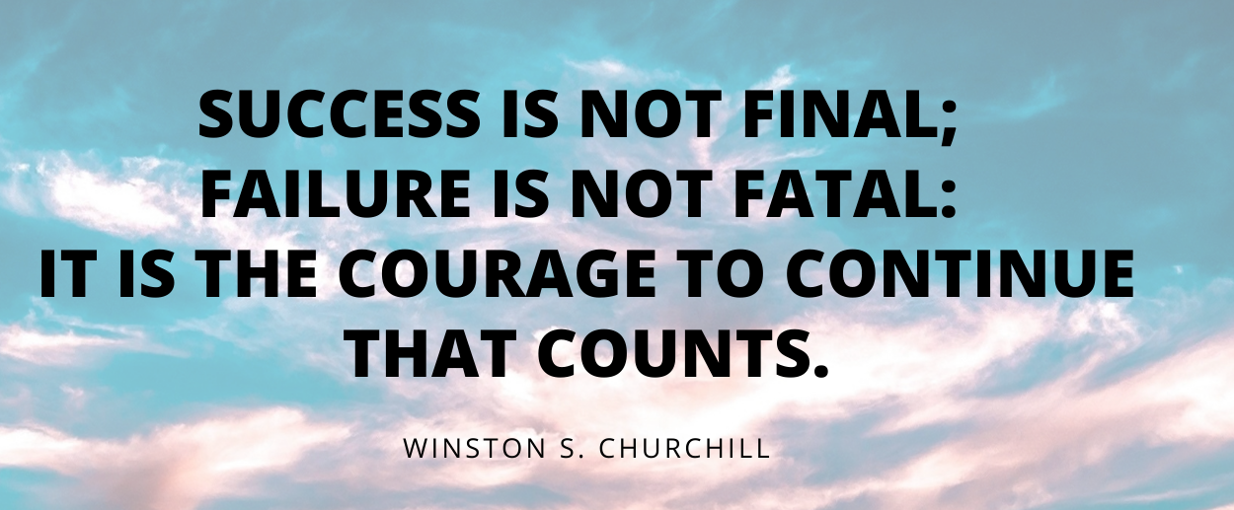


ISLAMIC EDUCATIONAL COLLEGE DATE:
SUBJECT:
GRADE: 10
UNIT: 1
LESSON:1
OUTCOMES
03:00 minutes
WARM UP
Comment on the following quotation:
PREASSESSMENT
PRESENTATION
FORMATIVE ASSESSMENT
FEEDBACK
DIFFERENTIATION
REAL LIFE APPLICATION
CRITICAL THINKING
EXIT TICKET

Slide 4
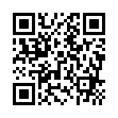
ISLAMIC EDUCATIONAL COLLEGE DATE:
SUBJECT:
GRADE: 10
UNIT: 1
LESSON:1
OUTCOMES
03:00 minutes
WARM UP
PREASSESSMENT :
PREASSESSMENT
https://wordwall.net/resource/13214866
PRESENTATION
FORMATIVE ASSESSMENT
FEEDBACK
DIFFERENTIATION
REAL LIFE APPLICATION
CRITICAL THINKING
EXIT TICKET

Slide 5
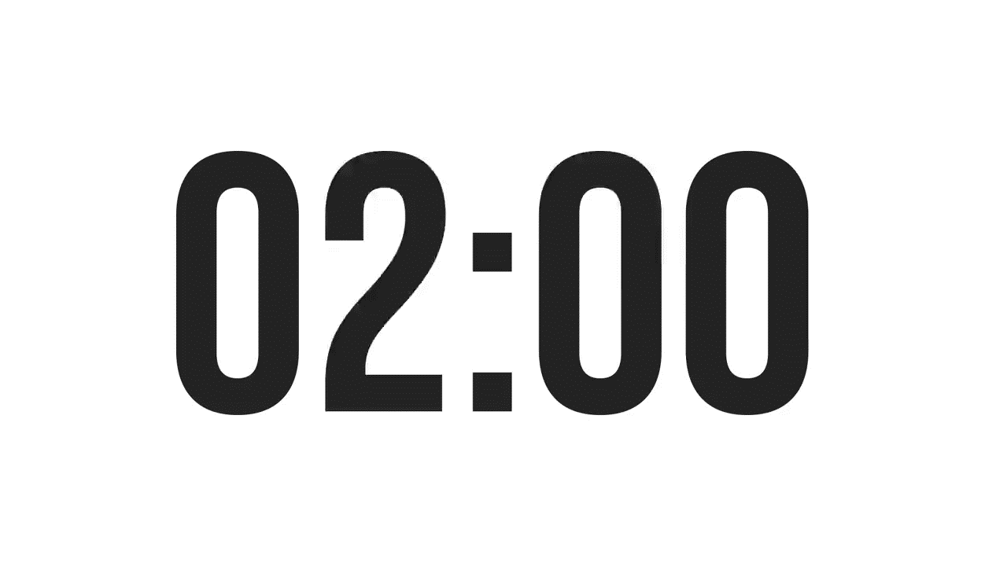

ISLAMIC EDUCATIONAL COLLEGE DATE:
SUBJECT: derivation
GRADE: 10
UNIT: 1
LESSON: 1
OUTCOMES
Searching Time :
What is Word Derivation?
What are Prefixes?
What are Suffixes ?
02:00 minutes
WARM UP
PREASSESSMENT
PRESENTATION
FORMATIVE ASSESSMENT
FEEDBACK
DIFFERENTIATION
REAL LIFE APPLICATION
CRITICAL THINKING
EXIT TICKET
BUZZ IN

Slide 6

ISLAMIC EDUCATIONAL COLLEGE DATE:
SUBJECT: derivation
GRADE: 10
UNIT: 1
LESSON: 1
OUTCOMES
PREASSESSMENT:
What is Word Derivation?
Definition: Word derivation is the process of creating new words from existing ones.
Example: "Happy" becomes "Happiness" (adding the suffix "-ness").
Prefixes
Definition: Prefixes are added to the beginning of a word to change its meaning.
Examples:
Prefix: "re-" (again) and "un-" (not)
Words: redo, retell, rewrite / unhappy, unkind, unknown
Suffixes
Definition: Suffixes are added to the end of a word to change its part of speech or meaning.
Examples:
Suffix: "-ness" (state of being)
Words: happiness, sadness, kindness
Suffix: "-ful" (full of) / Words: helpful, beautiful, joyful
02:00 minutes
WARM UP
PREASSESSMENT
PRESENTATION
FORMATIVE ASSESSMENT
FEEDBACK
DIFFERENTIATION
REAL LIFE APPLICATION
CRITICAL THINKING
EXIT TICKET
BUZZ IN

Slide 7

ISLAMIC EDUCATIONAL COLLEGE : =
SUBJECT derivations
GRADE: 10
UNIT: 1
LESSON: 1
OUTCOMES
05:00 minutes
PRESENTATION: look at the rules of using nouns
1. After – the /a/an
The development of language skills needs more immersion in real situations. (develop)
2. After the pronouns (my , our , your, his , her , their , its)
-The police protects our investment. (investing)
-You should enclose your C.V. with your application. (applicable)
3. After demonstratives (this, that, these, those)
-We can’t adopt this decision. (decide)
4. After quantifiers (any, many, much, little, few, only, other, another, no)
-Little encouragement is always needed. (encourage)
-I have no hesitation in recommending Mr. Ahmad for the job. (hesitate)
WARM UP
PREASSESSMENT
PRESENTATION
FORMATIVE ASSESSMENT
FEEDBACK
DIFFERENTIATION
REAL LIFE APPLICATION
CRITICAL THINKING
EXIT TICKET

Slide 8
ISLAMIC EDUCATIONAL COLLEGE DATE:
SUBJECT:
GRADE: 10
UNIT: 1
LESSON: 1
OUTCOMES
05:00 minutes
WARM UP
5. Before or after prepositions such as:
( of , for , on , in ,with, by from , without…….. )
-A great deal of wisdom comes from the old. (wise)
6. After (more , most) which are not preceded with (am /is /are / was / were )
-More motivation is needed these days. (motivated)
-Most intelligence comes from parents. (intelligent )
7. After possessive ('S) (S')
-My father’s generosity is endless. (generous)
-The boys' dedication is never forgotten. (dedicate)
8. At the beginning of the sentence provided that there is no noun after the gap:
- Pollution is a global issue. (pollute)
9. After ordinal and cardinal numbers Such as (one , two , three / first, second, third
-We have three suggestions for the new law. (suggest)
-The first edition of my book, was widely spread. (edit)
PREASSESSMENT
PRESENTATION
FORMATIVE ASSESSMENT
FEEDBACK
DIFFERENTIATION
REAL LIFE APPLICATION
CRITICAL THINKING
EXIT TICKET

Slide 9
ISLAMIC EDUCATIONAL COLLEGE DATE: :
SUBJECT:
GRADE: 10
UNIT: 1
LESSON: 1
OUTCOMES
05:00 minutes
WARM UP
Noun suffixes
PREASSESSMENT
PRESENTATION
Noun Suffixes | Examples
-tion -sion | alteration, demonstration expansion, inclusion, admission
-er - or | advertiser, driver ,computer, silencer actor , advisor , philosopher
-ment | development, punishment, unemployment
-ant | assistant, consultant ,
-age | breakage, wastage, package
--ence | preference, dependence, interference
-ance | attendance, acceptance, endurance
FORMATIVE ASSESSMENT
FEEDBACK
DIFFERENTIATION
REAL LIFE APPLICATION
CRITICAL THINKING
EXIT TICKET

Slide 10
ISLAMIC EDUCATIONAL COLLEGE DATE: :
SUBJECT:
GRADE: 10
UNIT: 1
LESSON: 1
OUTCOMES
05:00 minutes
WARM UP
PREASSESSMENT
-ery/-ry | bribery, robbery,bakery
-ism | criticism , idealism
ship | friendship, citizenship, leadership
-age | baggage, plumage
-ity | ability, similarity, responsibility, curiosity
ness | darkness, preparedness, consciousness
-cy | urgency, efficiency, frequency
PRESENTATION
FORMATIVE ASSESSMENT
FEEDBACK
DIFFERENTIATION
REAL LIFE APPLICATION
CRITICAL THINKING
EXIT TICKET

Slide 11
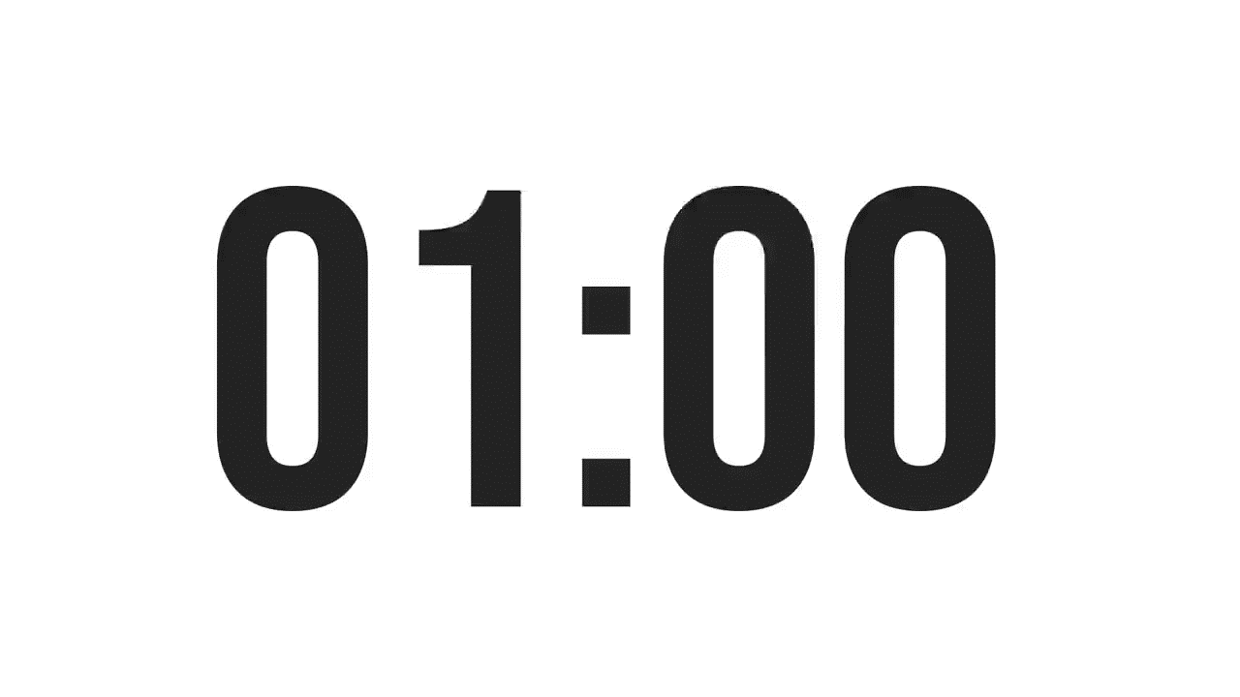
.
ISLAMIC EDUCATIONAL COLLEGE DATE: :
SUBJECT:
GRADE: 10
UNIT: 1
LESSON: 1
DIFFERENTIATION: Based on your number, do the task assigned to you
Student 1 and 3
Choose 5 complex derived nouns (you can provide a list or let them research), such as creation, movement, kindness, curiosity, decision.
Break each word into:
Root/base word (e.g., create)
Suffix used (e.g., -ion)
Explain:
How the suffix changes the word class to a noun.
Student 2 and 4
Choose 5 base words (verbs or adjectives), like teach, happy, move, kind, run.
Add common noun suffixes to make new nouns: -er, -ness, -ion, -ment, -ity.
E.g., teach → teacher, happy → happiness
For each word, write a short sentence using the new noun
OUTCOMES
01:00 minute
WARM UP
PREASSESSMENT
PRESENTATION
1
FORMATIVE ASSESSMENT
2
FEEDBACK
3
DIFFERENTIATION
REAL LIFE APPLICATION
4
CRITICAL THINKING
EXIT TICKET

Slide 12

ISLAMIC EDUCATIONAL COLLEGE DATE: :
SUBJECT:
GRADE: 10
UNIT: 1
LESSON: 1
OUTCOMES
Task :
Read the following statement and write the correct derivation of the word in bracket:
The ______________(difficult) of getting the driving license has obliged me to ignore the idea totally.
01:00 minute
WARM UP
PREASSESSMENT
PRESENTATION
FORMATIVE ASSESSMENT
FEEDBACK
DIFFERENTIATION
REAL LIFE APPLICATION
CRITICAL THINKING
EXIT TICKET
BUZZ IN

Slide 13
ISLAMIC EDUCATIONAL COLLEGE DATE: :
SUBJECT:
GRADE: 10
UNIT: 1
LESSON: 1
OUTCOMES
01:00 minute
Critical Thinking Question:
"Many words are made by adding prefixes or suffixes, like
'unhappy' (un- + happy) or 'teacher' (teach + -er). How does adding a prefix or
suffix change the meaning of a word? Can you give an example of a word that
changed a lot when a prefix or suffix was added?"
WARM UP
PREASSESSMENT
PRESENTATION
FORMATIVE ASSESSMENT
FEEDBACK
DIFFERENTIATION
REAL LIFE APPLICATION
CRITICAL THINKING
EXIT TICKET
BUZZ IN

Slide 14
ISLAMIC EDUCATIONAL COLLEGE DATE: :
SUBJECT:
GRADE: 10
UNIT: 1
LESSON: 1
OUTCOMES
01:00 minute
WARM UP
Real-Life Application Question:
"When you come across a new or unfamiliar word—like in
a news article, a job application, or at the doctor’s office—how
can knowing the root, prefix, or suffix help you figure out what it means?
Can you think of a time when understanding part of a word helped you
understand the whole word in real life?"
PREASSESSMENT
PRESENTATION
FORMATIVE ASSESSMENT
FEEDBACK
DIFFERENTIATION
REAL LIFE APPLICATION
CRITICAL THINKING
EXIT TICKET
BUZZ IN

Slide 15
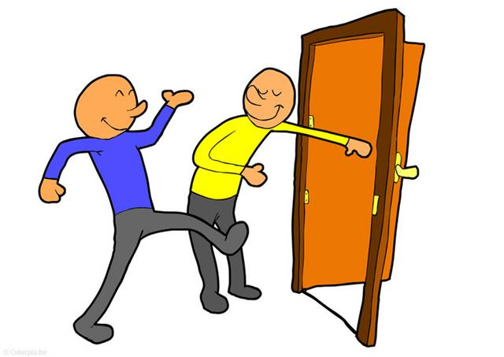

ISLAMIC EDUCATIONAL COLLEGE DATE: :
SUBJECT:
GRADE: 10
UNIT: 1
LESSON: 1
OUTCOMES
EXIT TICKET:
Write three sentences that have nouns.
02:00 minutes
WARM UP
PREASSESSMENT
PRESENTATION
FORMATIVE ASSESSMENT
FEEDBACK
DIFFERENTIATION
REAL LIFE APPLICATION
CRITICAL THINKING
EXIT TICKET
BUZZ IN

