Slide 1




Writing a Descriptive Essay about an Event or an Experience Grade 8

Slide 2


Outcomes
01
use a graphic organizer to plan and organize ideas
to vividly convey the event by using descriptive language that engages the reader's senses and emotions.
02
03
to organize the essay in a logical and clear structure following the outline a catchy introduction , body paragraph, and a reflective conclusion

Slide 3
You’re Painting a Picture with Words.
You should make the reader feel they were there by using details about the five senses (sight, sound, smell, touch, taste)

Slide 4
1. Brainstorming
Choose the Event/Experience
Think of an exciting event you participated in or attended.
first day of school or moving to a new school
a school trip
a family celebration or gathering (wedding, holiday, picnic…)
birthday celebration or surprise party
performing on stage
a special holiday celebration (Eid, New Year,…)
winning or losing a sports game
a moment of achievement
a school bazaar or fair (buying, selling, games, food stalls, music,…)

Slide 5
2. Planning
the event: _______________________
Who? ___________________________________________________
Where? _________________________________________________
When? __________________________________________________
Main Events:
First, ____________________________________________________
Then, ____________________________________________________
Next, ____________________________________________________
After that, ______________________________________________
Finally, ________________________________________________________________
Sensory Details (at least three senses)
What I saw: ________________________________________________________________________________
What I heard: _____________________________________________________________________________
What I smelled: ___________________________________________________________________________
What I felt: ________________________________________________________________________________
What I tasted: _____________________________________________________________________________

Slide 6
3. Drafting the Introduction
catchy beginning (hook): _____________________________________________________________________________________________
brief summary of the event: (what, where, when, and who)
_________________________________________________________________________________________________________________________________________________________________________________________
What makes this event / experience special:
Example: “It was the day I overcame my fear of public speaking.”
________________________________________________________________________________________________________________________________________________________________________________________________

Slide 7
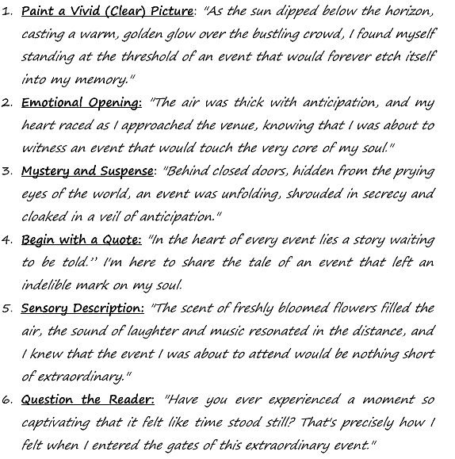
How to Begin my Essay
The opening of your descriptive essay should grab the reader's attention.
It should create a strong first impression and make the reader eager to explore the event through your words.
Here are some ways to begin your essay.

Slide 8


Slide 9
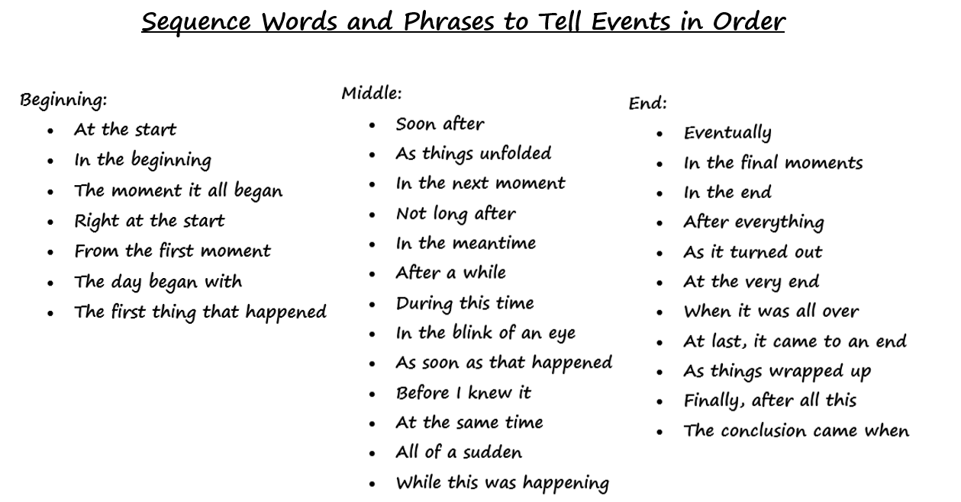
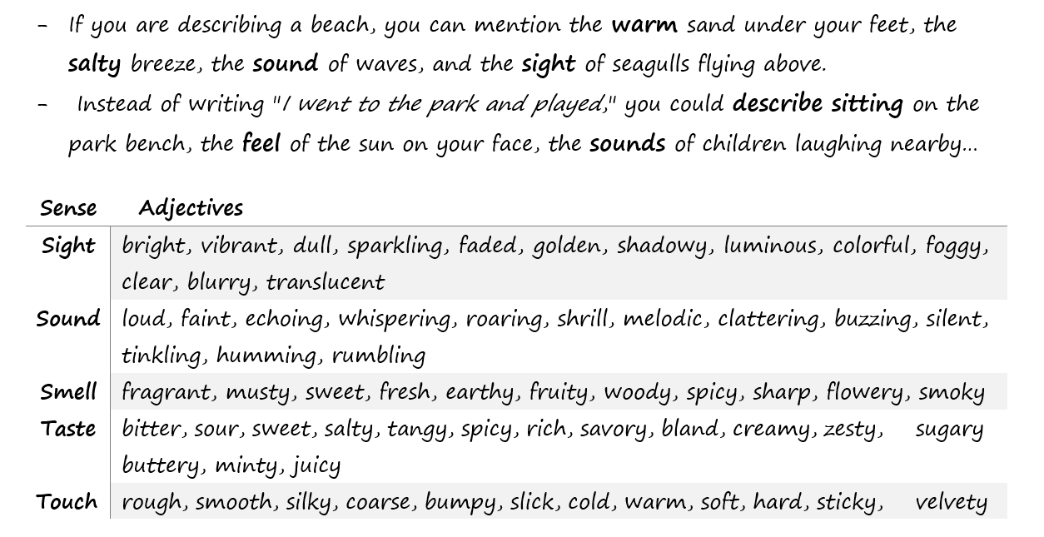
3. Drafting the First Body Paragraph
What happened? Describe the events in order. Use sequential words and sensory details.

Slide 10
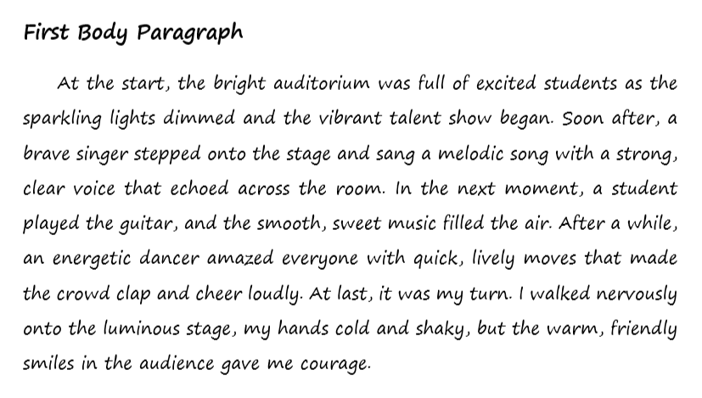

Slide 11
3. Drafting the Second Body Paragraph
The Most Important Moment
What was the most exciting or meaningful part of the event?
How did you feel during the event?
Why was it important to you?

Slide 12
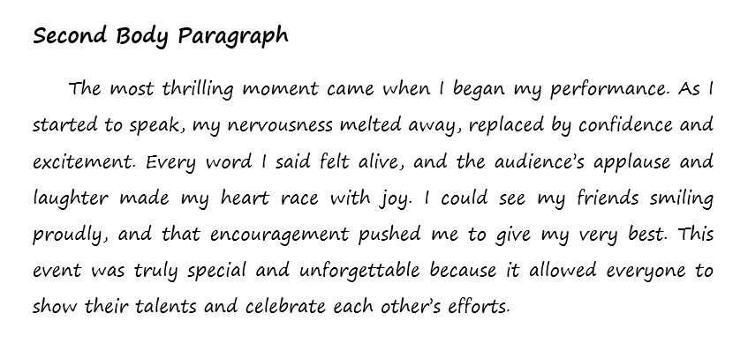

Slide 13

4. Drafting the Conclusion
(feelings and reflection)
What you learned or realized
➢ In the conclusion, you can use phrases that reflect the significance and lasting impressions of the event.
- Here are some examples:

Slide 14


Slide 15
Rubric
Success Criteria | Content & Ideas (3) | Lay out & Organization (1) | Structure (grammar) (2) | Spelling (1) | Punctuation (1) | Diction (Vocabulary) (2) | Total (8)

