Slide 1

Vocabulary: charge, identify, major, and occur
📘 Subject: English
🎓 Grade: 5
📆 Unit: 1 – First Semester (2025-2026)

Slide 2

By the end of this lesson, students are expected to:
recognize and define the words
charge, identify, major, and occur
use the new words in complete and meaningful sentences
connect the new vocabulary to real-life experiences

Slide 3

Pre-Assessment

Slide 4
What does the word charge mean?
1) to walk slowly 2) to hide 3) to run quickly towards someone or something 4) to take something that is not yours

Slide 5

What does the word charge mean?
3) to run quickly towards someone or something

Slide 6
2. What does it mean to identify something?
1) to forget it 2) to break it 3) to hide it 4) to know and name it

Slide 7

2. What does it mean to identify something?
4) to know and name it

Slide 8
3. What does the word occur mean?
1) to happen 2) to disappear 3) to study hard 4) to finish quickly

Slide 9

3. What does the word occur mean?
1) to happen

Slide 10
4. Which of these shows the word major?
1) a small mistake 2) a very important test 3) a small scratch on your pencil 4) a quiet walk in the park

Slide 11

4. Which of these shows the word major?
2) a very important test

Slide 12

Link to Life – Discuss with a Partner
Have you ever charged quickly towards something?
When was the last time you had to identify something correctly?
3. What is a major event that occurred in your life?

Slide 13


Critical Thinking
Buzz in
Imagine a major storm will occur tomorrow. You must identify the most important things to pack quickly. What would you take before you charge out the door?

Slide 14
Group Work Rubric
1. Participation: Each member participates and shares ideas with the group.
2. Task Completion: The task is divided fairly and is completed on time.
3. Collaboration: Group members listen to each other, respect ideas, and use only English to communicate.
4. Noise Level: Members work quietly and keep noise level appropriate.

Slide 15

Differentiation
Student’s Number | Task
1+4 | Match each word with its meaning. Fill in each blank with the correct word.
2+3 | Write a short story using all four words and present it to the class.

Slide 16
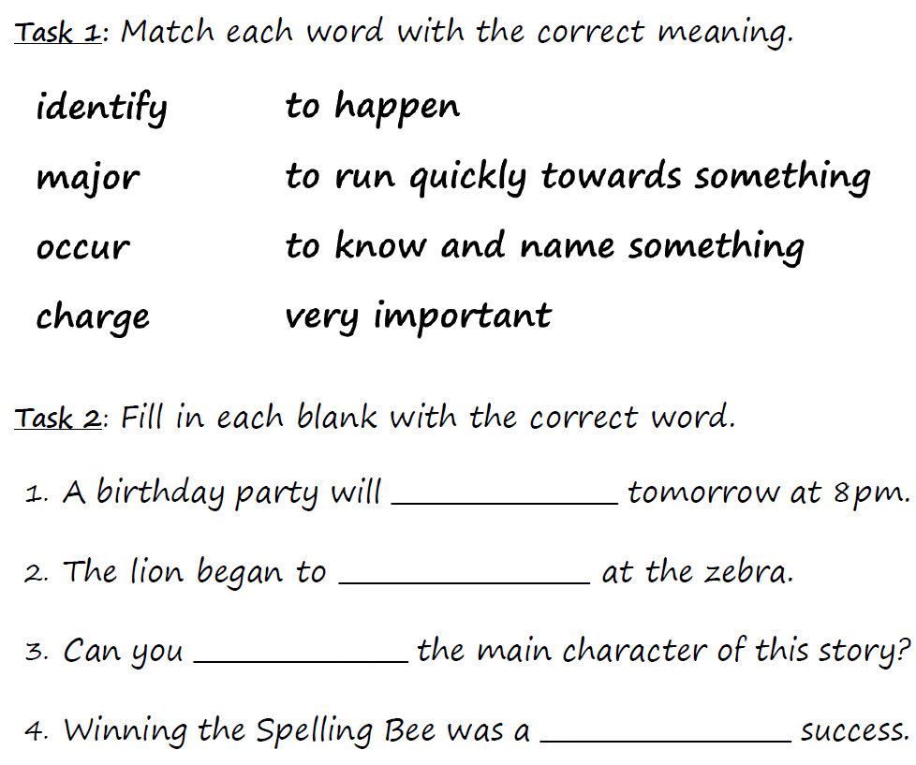
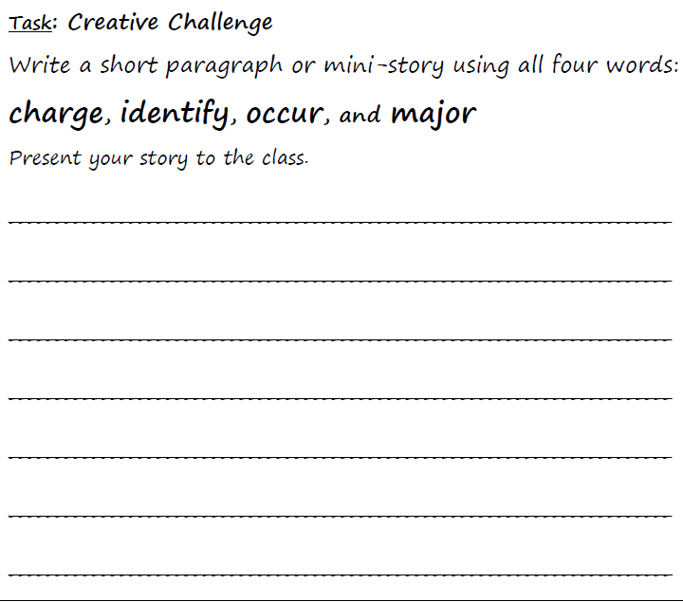

Slide 17
2+3
1+4

Slide 18
During the school’s science fair, something funny occurred. Our robot suddenly began to charge toward the students! We quickly tried to identify the problem and saw that a major button had been pressed by mistake. Everyone laughed at the robot’s mistake.
occur
charge
identify
major

Slide 19

identify – occurred – major – charge
One day, during a (1)_______________ school event, a horse began to (2) ________________towards the playground. The teachers had to (3)________________the safest place for the students. Luckily, nothing bad (4)_________________, and everyone laughed about the exciting day later.

Slide 20
identify – occurred – major – charge
One day, during a (1) major school event, a horse began to (2) charge towards the playground. The teachers had to (3) identify the safest place for the students. Luckily, nothing bad (4) occurred, and everyone laughed about the exciting day later.

Slide 21
Homework Use the words charge, identify, major, and occur in complete and meaningful sentences.

