Slide 1
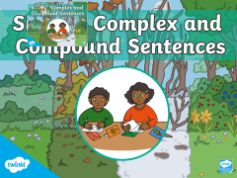


Slide 2
Sentence vs phrase
Instructions
Read each expression carefully.
Decide if it is a sentence or a phrase.
Switch your paper with your partner and check for each other .
1:30

Slide 3
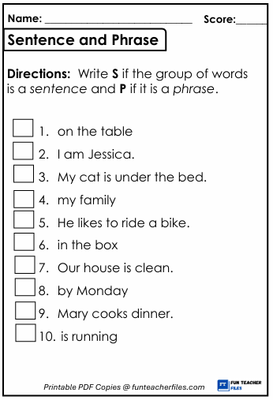
A sentence has a subject and a verb and expresses a complete thought.
P
S
A phrase is a group of words that work together but do not contain both a subject and a verb, so they do not express a complete thought..
S
P
S
P
S
P
S
P

Slide 4
Pre Assessment
1. The subject of a sentence is:
a) A describing word
b) The action in the sentence
c) The person or thing carrying out the main action
d) The punctuation at the end of a sentence

Slide 5
2. Which of the following is the subject in the sentence: “The dog barked loudly”?
a) loudly
b) dog
c) barked
d) the

Slide 6
3.Verbs can describe all of the following except:
a) Action
b) Emotion
c) opinion
d) Place

Slide 7
4. A clause must contain:
a) Only a verb
b) Only a subject
c) A subject and a verb
d) A subject, verb, and adjective

Slide 8

The subject of a sentence is the person or thing that is carrying out the main action of that sentence.
Verbs can describe an action (e.g. sing, climb), emotion (e.g. loves, hates), thought (e.g. thinks), opinion (e.g. believes)
A clause is a group of words that contains a verb and a subject.

Slide 9


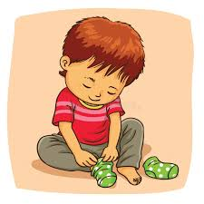


Independent vs Dependent
What do dependent and independent mean ?
Independent
Independent
Independent

Slide 10
Types of clauses
There are two types of clauses, main and subordinate.:
A main clause : (independent clause)
👉 That means it has a subject + a verb and expresses a complete thought.
A subordinate clause (dependent clause) Needs the main clause to make sense.
Often begins with words like because, although, when, if, since, who, which.

Slide 11
✅ Main Clause (Independent Clause)
(subject + verb, complete thought)
She likes pizza.
The dog barked loudly.
I finished my homework.
We went to the park.
The sun is shining.

Slide 12
✅ Subordinate Clause (Dependent Clause)
(needs a main clause to make sense; often begins with subordinating words)
Because she likes pizza
Although the dog barked loudly
When I finished my homework
If we go to the park
Since the sun is shining

Slide 13
✅ Combined Examples (Main + Subordinate)
She likes pizza because it tastes great.
2.Although the dog barked loudly, the baby kept sleeping.
Main ( independent)
subordinate (dependent)
subordinate (dependent)
Main ( independent)

Slide 14

Feedback
An independent clause has a subject and a verb which conveys a thought.
An independent clause is called a main clause .
A dependent clause needs another independent clause to convey a thought .
A dependent clause is called a subordinate clause .

Slide 15


Slide 16

Simple Sentences
A simple sentence has just one main clause. That means it has a subject + a verb and expresses a complete thought.
For example:
Bluebells are protected flowers.

Slide 17
Compound Sentences
A compound sentence will include two main clauses (they will both make sense on their own and have equal importance in the sentence).
The main clauses will be linked together by a type of word called a ‘co-ordinating conjunction’: and; so; but; or; for; yet; nor.
for → I stayed home, for it was raining.
and → She plays the piano, and she sings beautifully.
nor → He doesn’t like milk, nor does he drink juice.
but → I wanted to go outside, but it was too cold.
or → We can go to the park, or we can stay home.
yet → He is very young, yet he is very wise.
so → She was tired, so she went to bed early.

Slide 18
Compound Sentence
Main clause or an independent clause
coordinating conjunction
Main clause or an independent clause
Fan boys

Slide 19
Rally Robin: From Simple to Compound
Work with your partner.
Student 1 says a simple sentence.
Student 2 takes that sentence and turns it into a compound sentence by adding another independent clause with a coordinating conjunction (and, but, so, or, yet, for, nor).
S1 (Simple): She studied hard.
S2 (Compound): She studied hard, so she passed the test.
1 minute

Slide 20
Complex Sentences
What is a Complex Sentence?
👉 A complex sentence has:
One main clause (independent clause = complete thought).
One subordinate clause (dependent clause = cannot stand alone).
The subordinate clause usually begins with a subordinating conjunction (because, although, when, if, since, after, while, etc.) or a relative pronoun (who, which, that).

Slide 21
A Complex sentence
Independent clause
Subordinate conjunction
dependent clause
We stayed home because it was raining.
Subordinate conjunction
dependent clause
,
Independent clause
Because it was raining, we stayed home.

Slide 22
2. Although
Dep → Ind: Although she was tired, she finished her homework.
Ind → Dep: She finished her homework although she was tired.
3. When
Dep → Ind: When the bell rang, the students left the class.
Ind → Dep: The students left the class when the bell rang.
4. If
Dep → Ind: If you study hard, you will pass the exam.
Ind → Dep: You will pass the exam if you study hard.
5. Since
Dep → Ind: Since it was late, I took a taxi.
Ind → Dep: I took a taxi since it was late.
6. After
Dep → Ind: After he finished his meal, he washed the dishes.
Ind → Dep: He washed the dishes after he finished his meal.
7. While
Dep → Ind: While I was reading, the phone rang.
Ind → Dep: The phone rang while I was reading.

Slide 23
Formative Assessment
Differentiation
Students 1 + 2 :
Classify the following sentences into simple , compound and complex sentences.
Students 3+4:
Classify the following sentences into simple , compound and complex sentences.

Slide 24
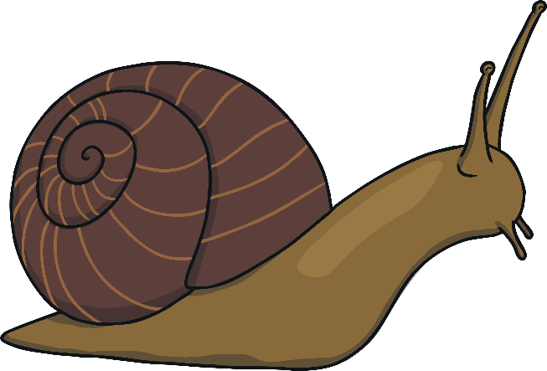
Exit Ticket
Why should we learn types of sentence ?

Slide 25
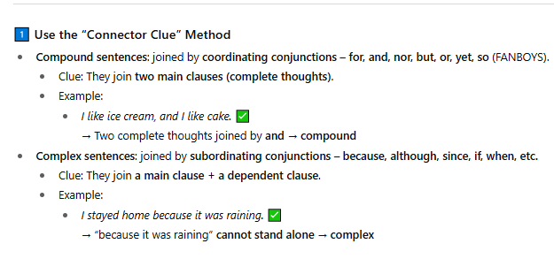

Slide 26
