Slide 1

1- To recognize different types of questions in English .
2- Identify helping verbs and their functions .

Slide 2

Take- off Touch Down
Take off if you know more than one type of questions in English.
Touch down if you know their functions.

Slide 3

01
Yes No Questions
02
Wh- Questions
Question Tags
03
What types of questions are you familiar with?
To confirm or deny information.
To gather more detailed information or clarify something.
To confirm or seek agreement.

Slide 4
Feedback
👍 Thumbs Up / 👎 Thumbs Down : 1. I know three types of questions and their functions.
2. Yes/No questions → to confirm or deny
3. Wh- questions → to ask for detailed answers.
4. Question tags → to confirm or seek agreement.

Slide 5
Verb to be
Verb to do
Is , am , are , was , were
Do , does , did
Verb to have
Modal Verbs
have , has , had
can , could , will ,would ,shall, should ,must

Slide 6
01
Pre assessment

Slide 7
Which of the following sentences contains a helping verb?
A) She writes every day. B) They are playing in the garden. C) He reads a book. D) I like chocolate.

Slide 8
2. “She is reading a book”. The function of the helping verb is:
A) To help the main verb . B) To form a question. C) To make the sentence negative.

Slide 9
3. He does not like spicy food .
The function of the helping verb is:
A) To help the main verb . B) To form a question. C) To make the sentence negative.

Slide 10
4. I am studying for the exam.
The function of the helping verb is : A) to help the main verb. B) To Form a question. C) To make the sentence negative.

Slide 11
1- To form a question : What is your name? 2- To form the negative form: she isn’t happy. 3- The main verb in a sentence : she is happy . 4- To support another verb: she is laughing.

Slide 12

*Structure question tags correctly with helping verbs.

Slide 13

Formative Assessment
https://www.educaplay.com/learning-resources/25365988-helping_verbs_mastery.html

Slide 14

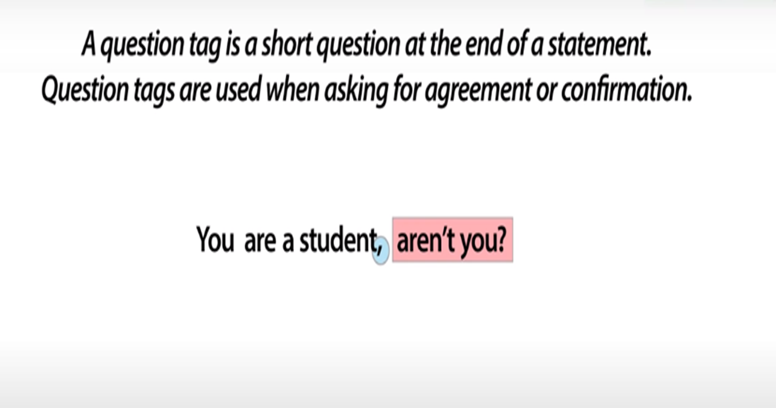




Slide 15
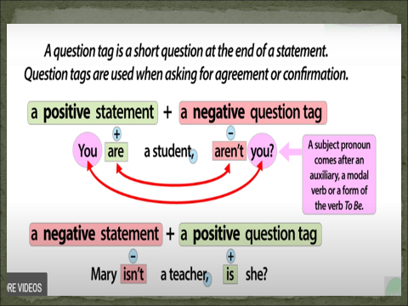

Slide 16
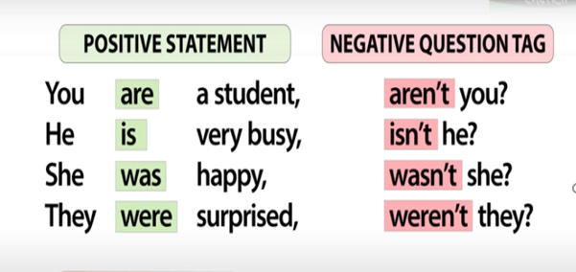

Slide 17
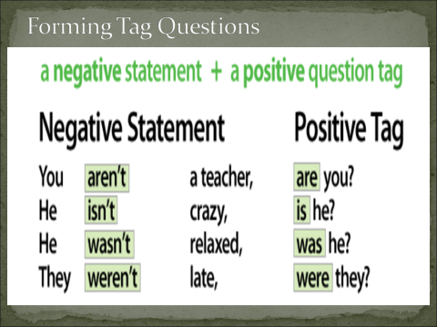

Slide 18
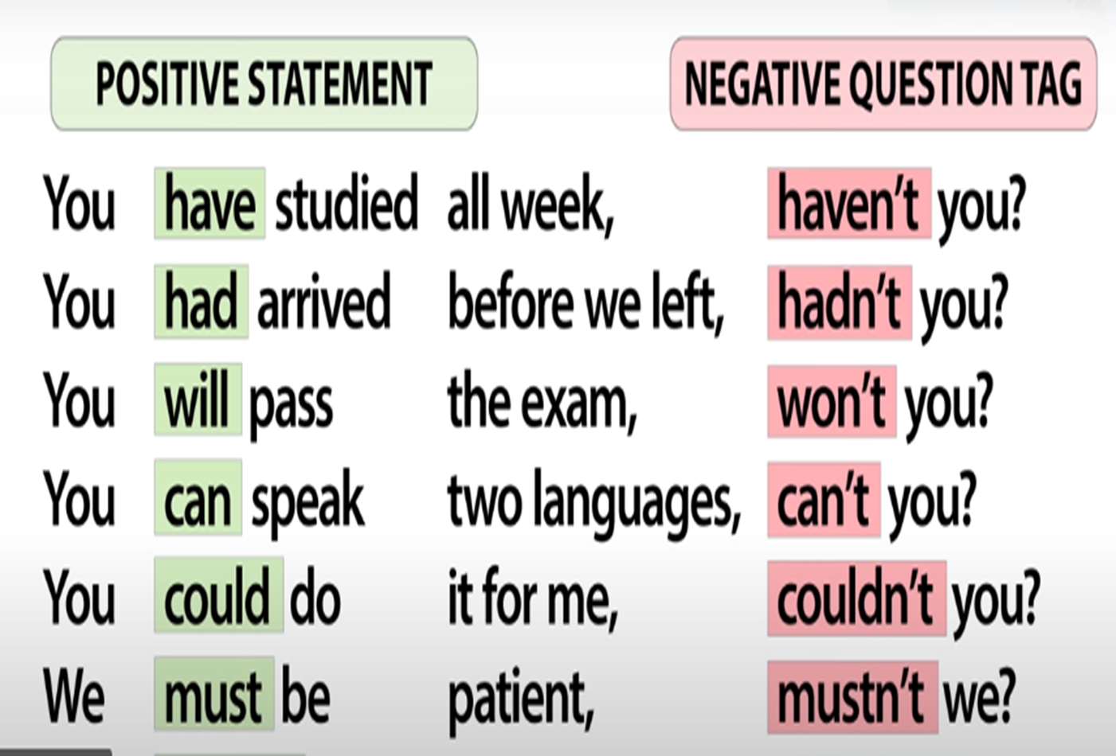

Slide 19
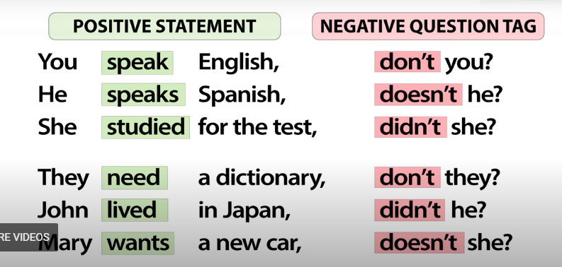
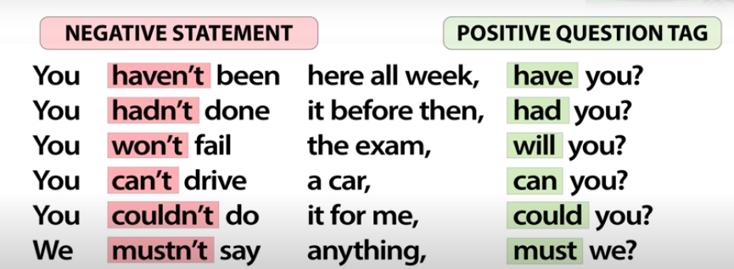

Slide 21
✅ Examples of Question Tags with Action Verbs
You play football, don’t you?
Main verb = play (action verb)
Explanation: Use don’t /doesn’t in the tag when the main verb is an action verb in the present simple.
She studies hard, doesn’t she?
Main verb = studies (action verb)
Explanation: In the present simple with he/she/it, use doesn’t in the tag.
They went to the park, didn’t they?
Main verb = went (past action)
Explanation: In the past simple, use didn’t in the tag.
We worked yesterday, didn’t we?
Main verb = worked (action verb)
Explanation: Past simple action → use didn’t .
He will help you, won’t he?
Main verb = help (future action)
Explanation: With will, repeat it in the tag (negative form).

Slide 22

Rally Coach
Drag the correct answer and drop it next to its statement.

Slide 23

🔹 Using HAS / HAVE / HAD in Question Tags
1️⃣ When HAS / HAVE / HAD = Action Verbs
👉 Meaning: to own, possess, experience, eat, etc.
We use do/does/did in the tag.
Examples:
She has a car, doesn’t she?
They have lunch at 2, don’t they?
He had a bike, didn’t he?
2️⃣ When HAS / HAVE / HAD = Auxiliary Verbs
👉 Meaning: part of perfect tenses.
We repeat has / have / had in the tag.
Examples:
She has finished her homework, hasn’t she?
They have visited London, haven’t they?
He had left before 9, hadn’t he?

Slide 24
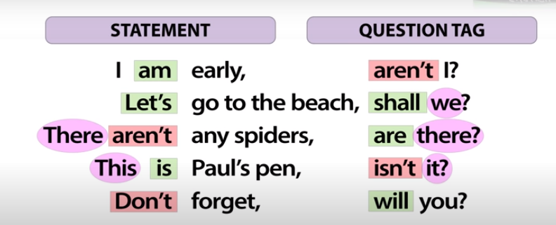

Exceptional Cases
Very important
Lunch was delicious, ?
Spring break is next week, _________?
Class finished quickly, _________?
wasn’t it
isn’t it

